Slide 1
Trapezoidal Maps – Assignment 3 Test file: jpc4394.txt
Jacob Cozzarin
and
William Carver

Slide 2
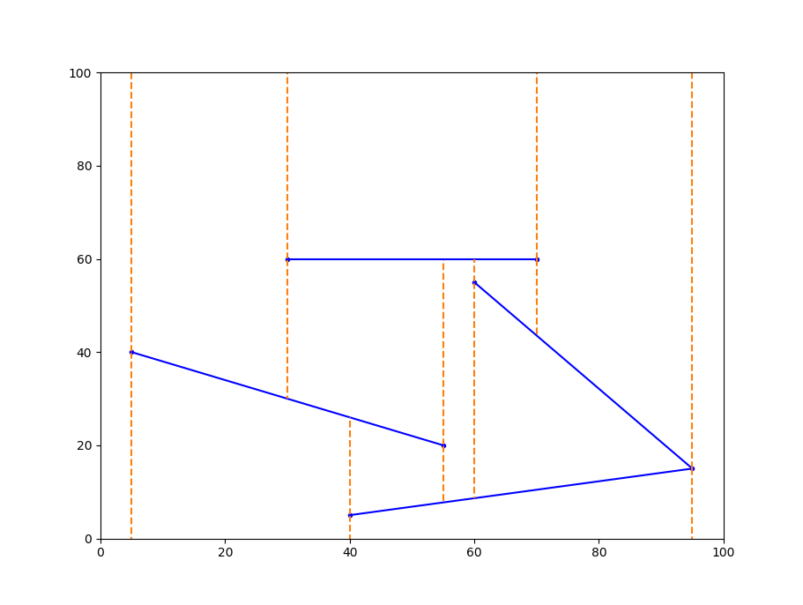
Trapezoidal Map

Slide 3
Rooted Directed Acyclic Graph
P1
Q2
Q3
T1
Q1
S2
S3
T12
S1
T3
P3
T11
S4
P2
P4
S4
S3
T10
T7
T2
S2
T5
S4
T8
T7
T9
S4
T3
T4
T6
T7
T10
T7

Slide 4
 | P1 | P2 | P3 | P4 | Q1 | Q2 | Q3 | S1 | S2 | S3 | S4 | T1 | T2 | T3 | T4 | T5 | T6 | T7 | T8 | T9 | T10 | T11 | T12 | Sum
P1 | 0 | 0 | 0 | 0 | 0 | 0 | 0 | 0 | 0 | 0 | 0 | 0 | 0 | 0 | 0 | 0 | 0 | 0 | 0 | 0 | 0 | 0 | 0 | 0
P2 | 0 | 0 | 0 | 0 | 0 | 0 | 0 | 1 | 0 | 0 | 0 | 0 | 0 | 0 | 0 | 0 | 0 | 0 | 0 | 0 | 0 | 0 | 0 | 1
P3 | 0 | 0 | 0 | 0 | 0 | 0 | 0 | 0 | 1 | 0 | 0 | 0 | 0 | 0 | 0 | 0 | 0 | 0 | 0 | 0 | 0 | 0 | 0 | 1
P4 | 0 | 0 | 0 | 0 | 0 | 0 | 0 | 1 | 0 | 0 | 0 | 0 | 0 | 0 | 0 | 0 | 0 | 0 | 0 | 0 | 0 | 0 | 0 | 1
Q1 | 1 | 0 | 0 | 0 | 0 | 0 | 0 | 0 | 0 | 0 | 0 | 0 | 0 | 0 | 0 | 0 | 0 | 0 | 0 | 0 | 0 | 0 | 0 | 1
Q2 | 0 | 0 | 0 | 0 | 1 | 0 | 0 | 0 | 0 | 0 | 0 | 0 | 0 | 0 | 0 | 0 | 0 | 0 | 0 | 0 | 0 | 0 | 0 | 1
Q3 | 0 | 0 | 0 | 0 | 0 | 1 | 0 | 0 | 0 | 0 | 0 | 0 | 0 | 0 | 0 | 0 | 0 | 0 | 0 | 0 | 0 | 0 | 0 | 1
S1 | 0 | 0 | 0 | 0 | 1 | 0 | 0 | 0 | 0 | 0 | 0 | 0 | 0 | 0 | 0 | 0 | 0 | 0 | 0 | 0 | 0 | 0 | 0 | 1
S2 | 0 | 1 | 0 | 0 | 0 | 1 | 0 | 0 | 0 | 0 | 0 | 0 | 0 | 0 | 0 | 0 | 0 | 0 | 0 | 0 | 0 | 0 | 0 | 2
S3 | 0 | 0 | 1 | 0 | 0 | 0 | 1 | 0 | 0 | 0 | 0 | 0 | 0 | 0 | 0 | 0 | 0 | 0 | 0 | 0 | 0 | 0 | 0 | 2
S4 | 0 | 0 | 1 | 1 | 0 | 0 | 0 | 0 | 0 | 1 | 0 | 0 | 0 | 0 | 0 | 0 | 0 | 0 | 0 | 0 | 0 | 0 | 0 | 3
T1 | 1 | 0 | 0 | 0 | 0 | 0 | 0 | 0 | 0 | 0 | 0 | 0 | 0 | 0 | 0 | 0 | 0 | 0 | 0 | 0 | 0 | 0 | 0 | 1
T2 | 0 | 1 | 0 | 0 | 0 | 0 | 0 | 0 | 0 | 0 | 0 | 0 | 0 | 0 | 0 | 0 | 0 | 0 | 0 | 0 | 0 | 0 | 0 | 1
T3 | 0 | 0 | 0 | 0 | 0 | 0 | 0 | 0 | 1 | 0 | 0 | 0 | 0 | 0 | 0 | 0 | 0 | 0 | 0 | 0 | 0 | 0 | 0 | 1
T4 | 0 | 0 | 0 | 0 | 0 | 0 | 0 | 0 | 1 | 0 | 0 | 0 | 0 | 0 | 0 | 0 | 0 | 0 | 0 | 0 | 0 | 0 | 0 | 1
T5 | 0 | 0 | 0 | 1 | 0 | 0 | 0 | 0 | 0 | 0 | 0 | 0 | 0 | 0 | 0 | 0 | 0 | 0 | 0 | 0 | 0 | 0 | 0 | 1
T6 | 0 | 0 | 0 | 0 | 0 | 0 | 0 | 0 | 0 | 0 | 1 | 0 | 0 | 0 | 0 | 0 | 0 | 0 | 0 | 0 | 0 | 0 | 0 | 1
T7 | 0 | 0 | 0 | 0 | 0 | 0 | 0 | 0 | 0 | 0 | 1 | 0 | 0 | 0 | 0 | 0 | 0 | 0 | 0 | 0 | 0 | 0 | 0 | 1
T8 | 0 | 0 | 0 | 0 | 0 | 0 | 0 | 0 | 0 | 0 | 1 | 0 | 0 | 0 | 0 | 0 | 0 | 0 | 0 | 0 | 0 | 0 | 0 | 1
T9 | 0 | 0 | 0 | 0 | 0 | 0 | 0 | 0 | 0 | 1 | 0 | 0 | 0 | 0 | 0 | 0 | 0 | 0 | 0 | 0 | 0 | 0 | 0 | 1
T10 | 0 | 0 | 0 | 0 | 0 | 0 | 0 | 0 | 0 | 0 | 1 | 0 | 0 | 0 | 0 | 0 | 0 | 0 | 0 | 0 | 0 | 0 | 0 | 1
T11 | 0 | 0 | 0 | 0 | 0 | 0 | 0 | 0 | 0 | 1 | 0 | 0 | 0 | 0 | 0 | 0 | 0 | 0 | 0 | 0 | 0 | 0 | 0 | 1
T12 | 0 | 0 | 0 | 0 | 0 | 0 | 1 | 0 | 0 | 0 | 0 | 0 | 0 | 0 | 0 | 0 | 0 | 0 | 0 | 0 | 0 | 0 | 0 | 1
Sum | 2 | 2 | 2 | 2 | 2 | 2 | 2 | 2 | 3 | 3 | 4 | 0 | 0 | 0 | 0 | 0 | 0 | 0 | 0 | 0 | 0 | 0 | 0
Adjacency Matrix

