Slide 1
Surveillance Camera using Raspberry Kit
Report week No.3

Slide 2
I ) Send Message via GSM II) Hair Detection III) Power Supply Circuit IV) Alarm Circuit V) Write Report VI) Meeting Minutes and Team Meeting VII) Plan for Next Week

Slide 3
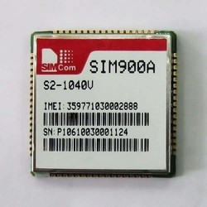

I ) Send Message
Send Message from GSM to Phone
Haven’t received message yet.
Write instruction
SMS

Slide 4

II) Hair Detection
Study how to detect hair with Open CV
Demo Hair Detection
Writing Instructions.

Slide 5
III) Power Supply Circuit
Refer exist circuits to choose ICs
Design Schematics

Slide 6
IV) Alarm Circuit
Refer exist circuits
Design Schematic

Slide 7
V) Meeting Minutes and Team Meeting
Meeting Minutes with Supervisor:
07:45 am on Saturday
Meeting Team:
17:45 pm on Wednesday and Friday

Slide 8
VI) Plan for Next Week
Receive Message via GSM
Write Report 3 (Important)
Make alarm board
Maintain Detection Algorithm
Meeting

Slide 9
Q&A

