Slide 1
Surveillance Camera using Raspberry Kit
Report week No.1

Slide 2
I ) Verify project scope II) Create plan III) Hardware Configuration IV) Camera Capturing V) Report Writing VI) Meeting Minutes and Team Meeting VII) Ubuntu and Open CV Installing VIII) Image Detection Studying

Slide 3
I ) Verify Project Scope
Write a program in C++, python or …to capture, transfer, display the image.
Use the OpenCV libraries to perform image recognition and estimate the object size.
Design and build electrical circuit for power supply + alarm system.
Send to users an alarm messages and intruder images

Slide 4
II) Create Plan
Total: 12 weeks
_ Human detection: 4 weeks
_ Alarm system + power supply circuit + others: 4 weeks
_ Integration: 1 weeks
_ Documentation: 3 weeks
Role:
_ Supervisor: Mr. Bui Dai Tri
_ Hardware manager: Nghianc
_ Software manager: Trinhda
_ Document manager: Holl
_ Integration manager: Lamnh
_ Process manager: Trinhda

Slide 5
III) Hardware Configuration
Buying hardware: Raspberry, Camera, GSM…
Installing Raspbian OS.
Interfacing Camera with Raspberry.
Interfacing GSM with Raspberry.
Writing Instructions.

Slide 6
IV) Camera Capturing
Writing source code for capturing by time setting.
Writing instructions.

Slide 7
V) Report Writing
Writing the first report for CMS submitting.
F:\Working\Capstone_Project\Documents\Reports\Report_1.docx

Slide 8
VI) Meeting Minutes and Team Meeting
Meeting Minutes with Supervisor:
17:15 pm on Wednesday
07:45 am on Saturday
Meeting Team:
17:45 pm on Tuesday and Friday

Slide 9
VII) Ubuntu and Open CV Installing
Installing Ubuntu on Laptop.
Installing Open CV Library and demo.
Writing instructions.

Slide 10
VIII) Image Detection Studying
Researching documents of image detecting.
Writing source code for image detecting and video detecting.
Trying Open CV.
Running as a demo on Ubuntu.
Writing instructions.

Slide 11
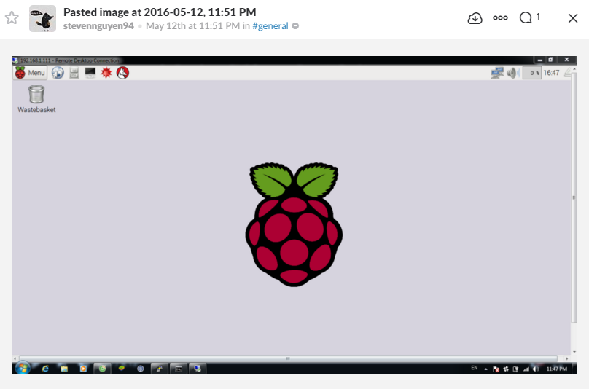


Slide 12
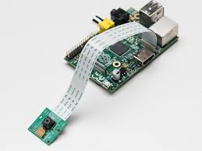
14/05/2016

Slide 13
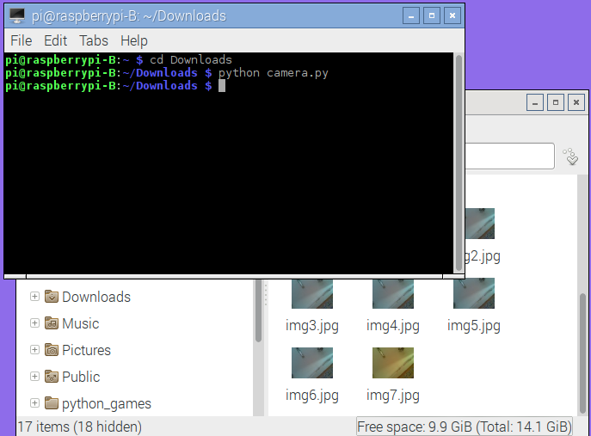

16/05/2016

Slide 14
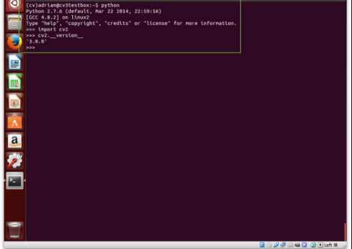

15/5/2016

Slide 15
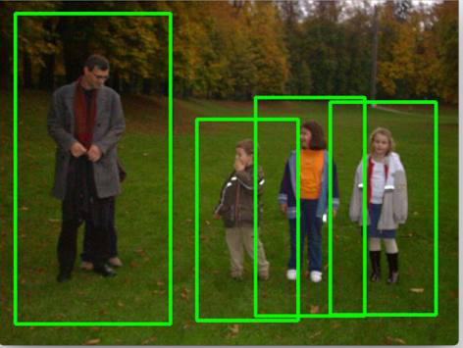
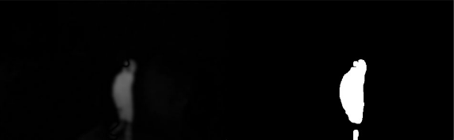
15/05/2015

Slide 16
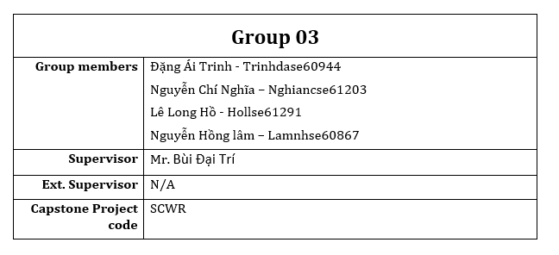


Slide 17




Slide 18
Plan
GSM
Report 2
Distance sensor
Mathlab
Detection
Start alarm system

Slide 19
Q&A

