Slide 1
WP4: Compute Node Software
Report (Stephan Kindermann, Carsten Ehbrecht)
CP4CDS Workshop – 5 Dec 2019

Slide 2
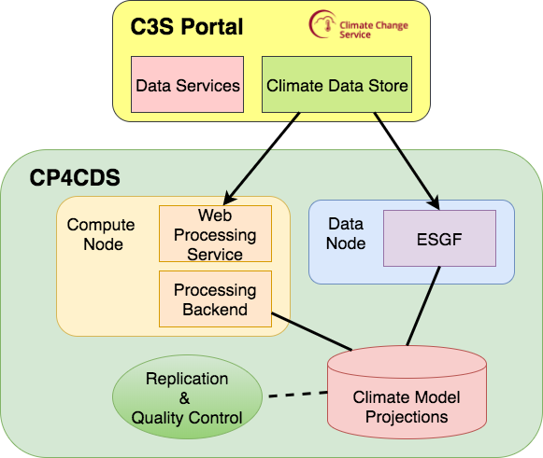
Status: CP4CDS compute node used by Climate Data Store
Compute Node provides Web Processing Service interface to processing backend on climate model data (CMIP5, CORDEX, …)
Possible processing backends: MAGIC Toolbox by Lot2, Subsetting/Regridding, etc.

Slide 3
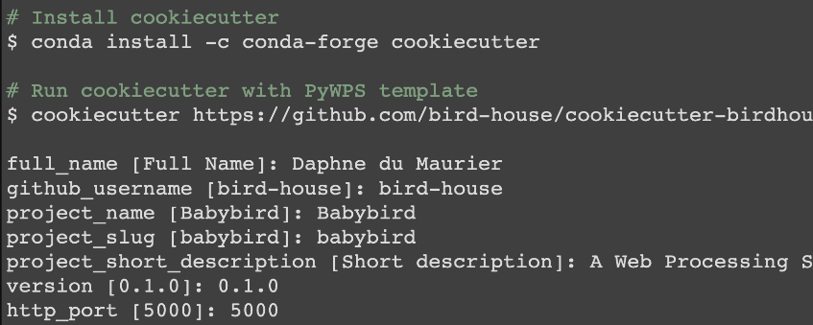


Status: Cookiecutter Template for PyWPS
A cookiecutter template to generate a new PyWPS project with custom settings.
Generated PyWPS project works out of the box.

Slide 4
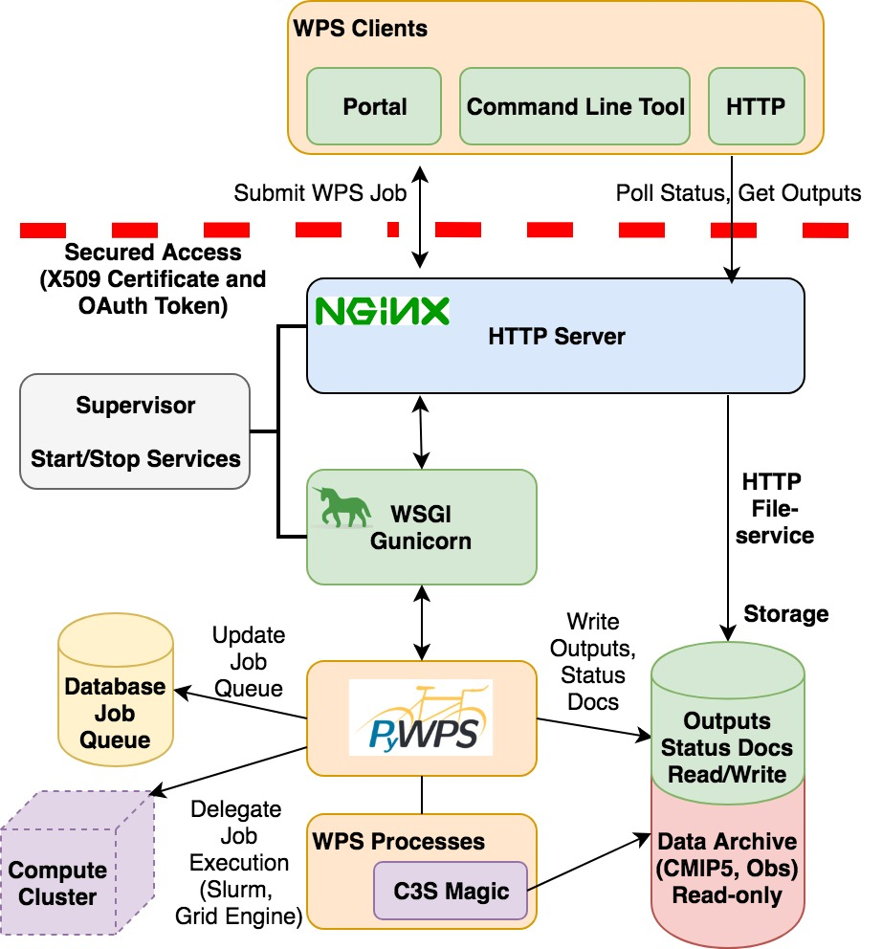
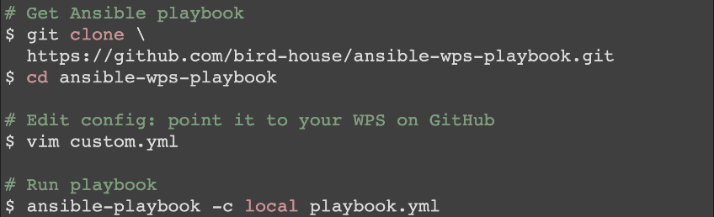

Status: Full-Stack Deployment with Ansible
Full-stack deployment of PyWPS needs several components like Nginx, Postgres.
We have developed an Ansible playbook to run this automatically with customizations.

Slide 5
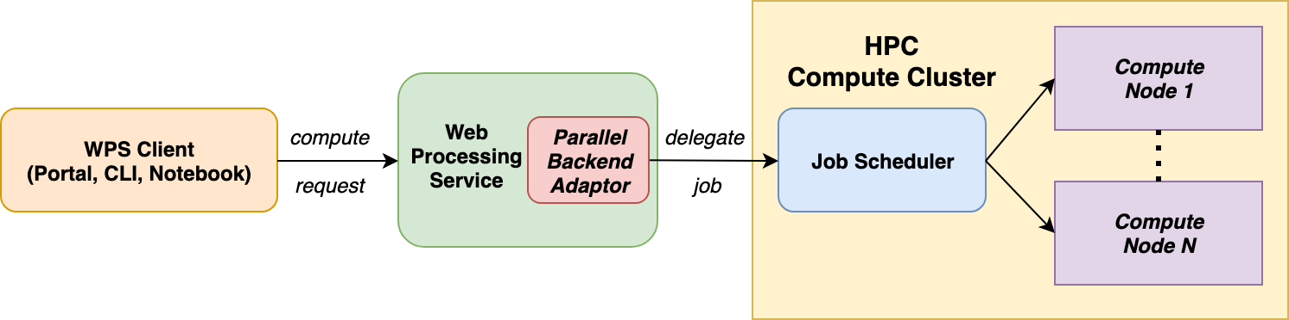
Status: PyWPS Scheduler Extension
We have developed a scheduler extension for PyWPS.
This extension delegates the processing job to a scheduler (Slurm) on a HPC compute cluster.

Slide 6
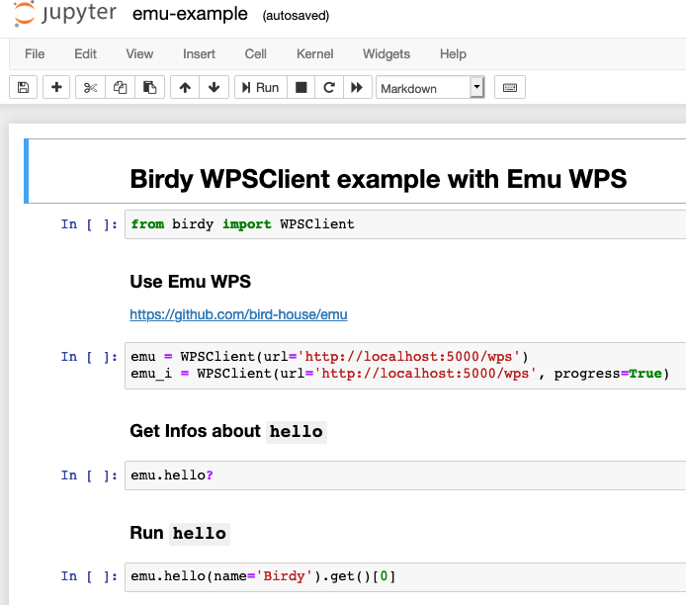
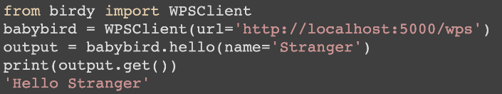
Status: Birdy WPS Client
A Python library based on OWSLib to interact with WPS.
WPS functions calls feel like normal Python functions.
Suitable to be used in Jupyter notebooks.

Slide 7
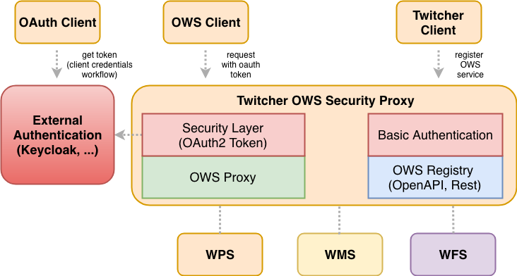
Status: Twitcher Security Proxy
Twitcher security proxy protects the process execution of a Web Processing Service.
The access control can both use X.509 certificates and OAuth access tokens.

Slide 8


Future: Improvements of the Compute Node Solution
The cookiecutter template and the Ansible playbook need to be adapted to project needs. We need a separate Ansible playbook for Twitcher security proxy. We need Ansible support for automatic Slurm cluster set-up.
Docker based deployment needs to be improved to support Kubernetes.
The Birdy client and OWSLib need to be adapted to the latest WPS developments (WPS rest-based, …). Need to full-fill CDS requirements.
The ESGF team is in the process of establishing a security solution based on OAuth for user authentication and service access using Keycloak. The Twitcher security proxy will be extended to work with OAuth tokens created by an external service like Keycloak.

Slide 9
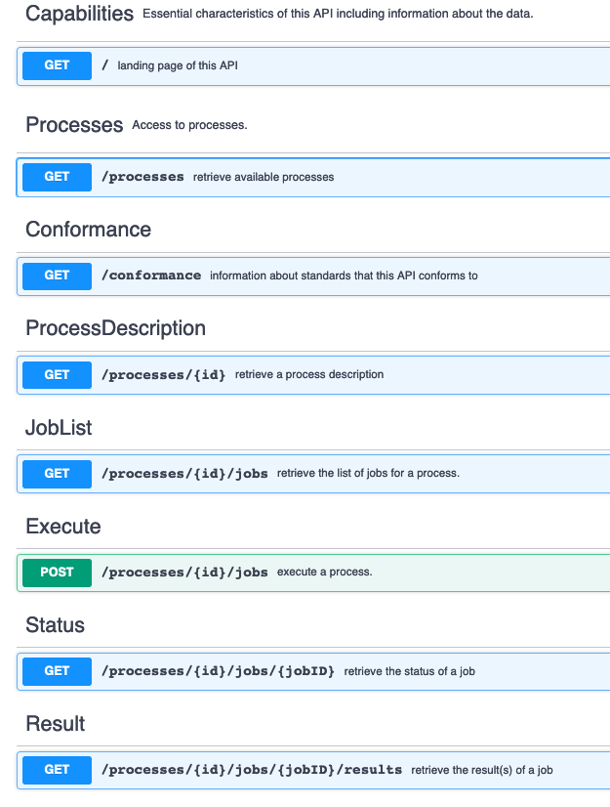
Future: PyWPS development
Bug-fixes, stability.
Improved job queue
Improving scheduler extension (direct Slurm connector).
Support upcoming rest based WPS interface using OpenAPI.
https://github.com/opengeospatial/wps-rest-binding

Slide 10
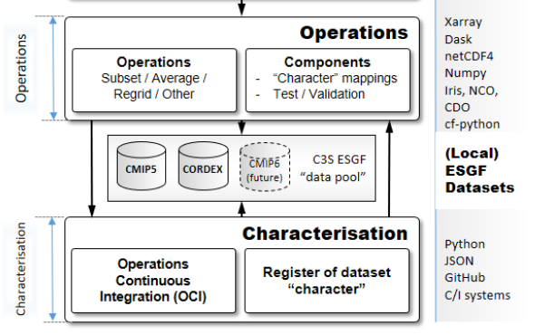
Future: Subsetting/Regridding Toolbox
Develop a new toolbox for subsetting and regridding.
Capable of handling diversity in CMIP5/CMIP6/CORDEX climate model data.
Provided as Web Processing Service to the Copernicus Climate Data Store.

Slide 12
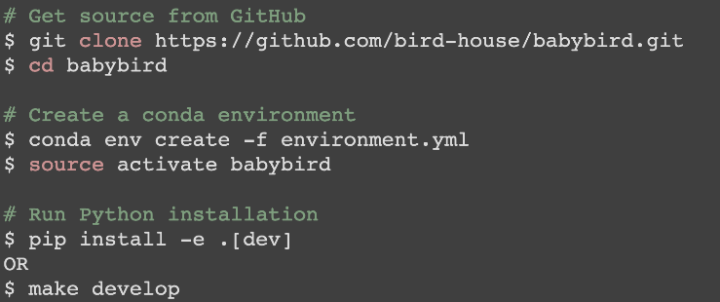
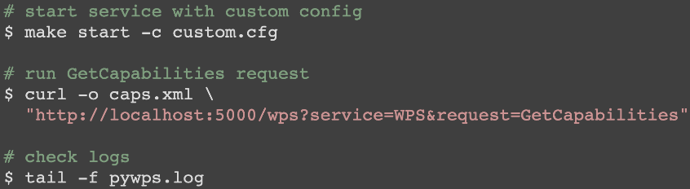

Status: PyWPS installation for Development
PyWPS project can be installed as normal Python package.
Library dependencies are managed by a Conda.
No additional installation steps to start service (using Werkzeug library).
This installation is recommend for development and demo.

Slide 13
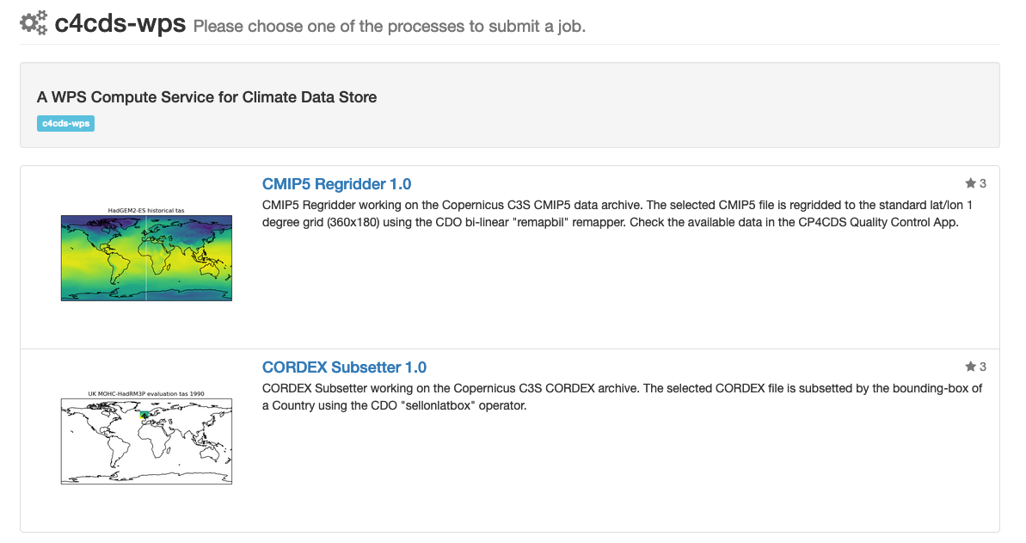
Usage: C4CDS WPS
A demonstrator WPS for subsetting and regridding for CMIP5 and CORDEX climate data.

Slide 14
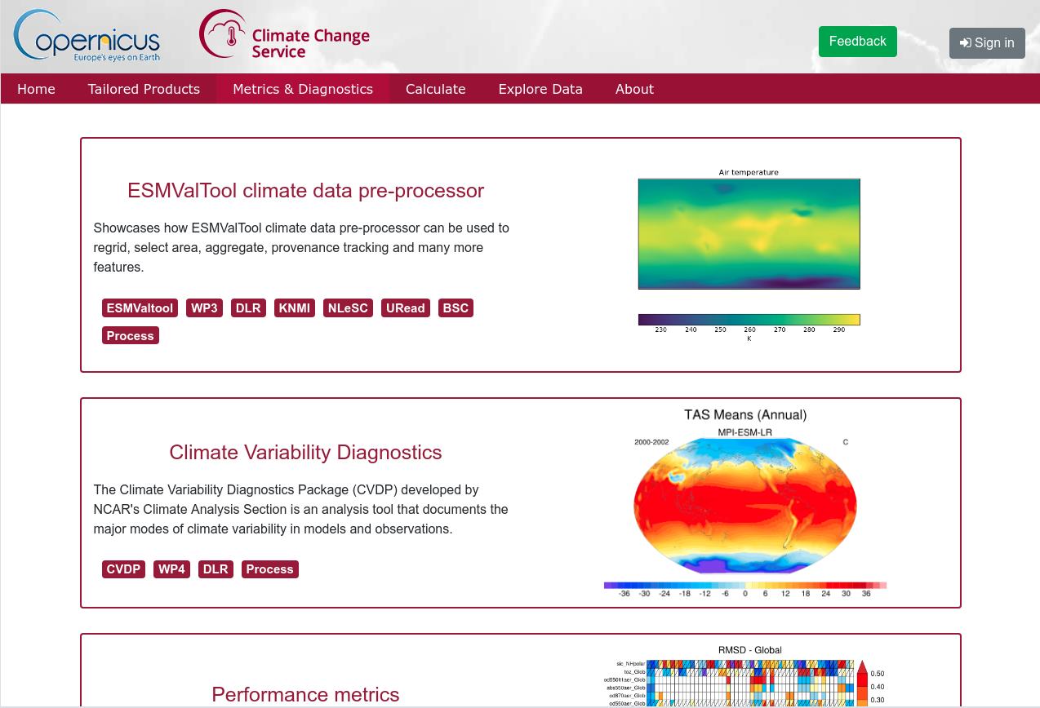
Usage: MAGIC WPS (by LOT 2)
Diagnostics based on ESMValTool

Slide 15
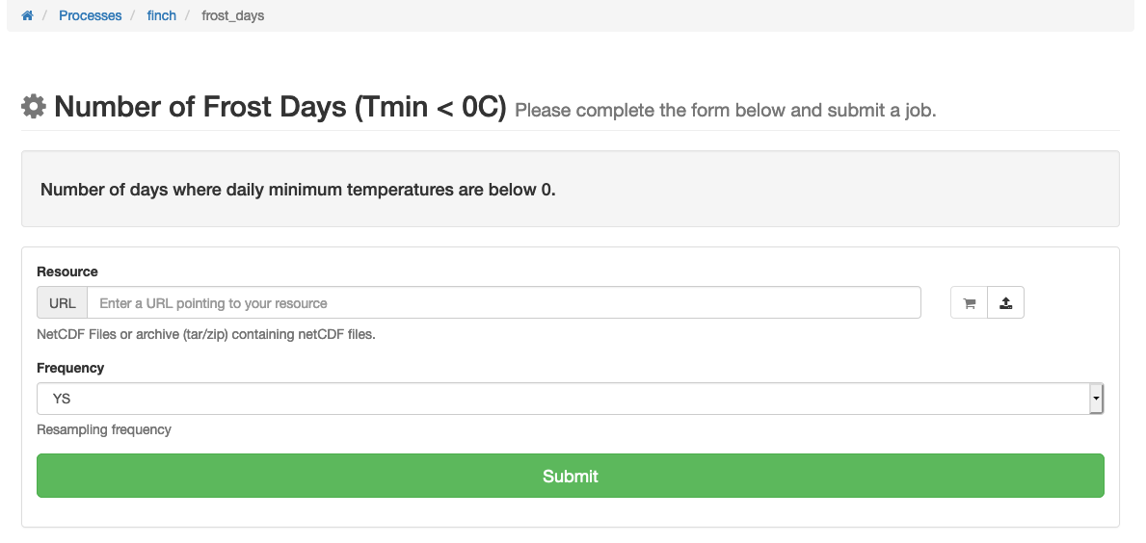
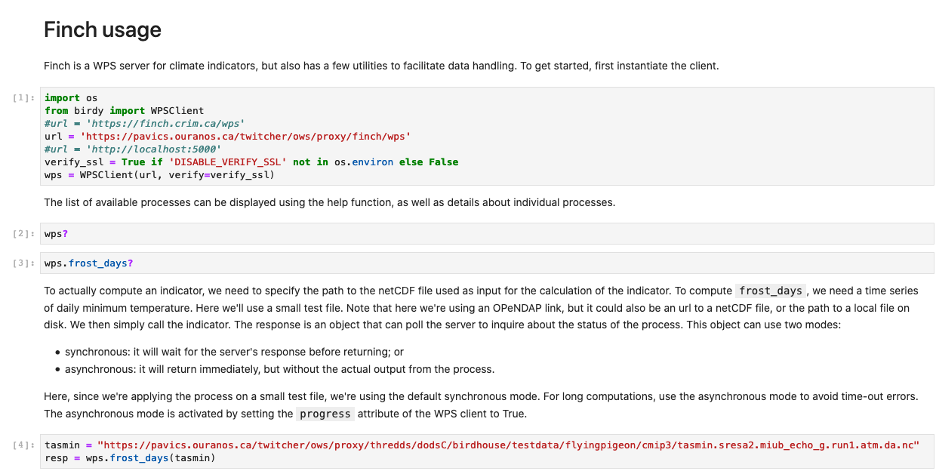
Usage: Finch WPS
WPS for Climate Indices.
Using xarray and dask.
Called by WPS clients, like a portal or Jupyter notebook.
Developed by Ouranos, Canada

