Slide 1
WP5: Interfaces and Tools
Report (Ag Stephens)
CP4CDS Final Meeting – 5th December 2019

Slide 2
Tasks
Task 5.1:
ESGF Search Client (esgf-pyclient)
Task 5.2:
Data Replication Tool (synda)
Task 5.3:
Common SDDS
Software Dependency Deployment Solution
Task 5.4
Declaring data requirements in code
Task 5.5
End-to-end testing
With IPSL Climate Model Assessment Framework (CliMAF)

Slide 3
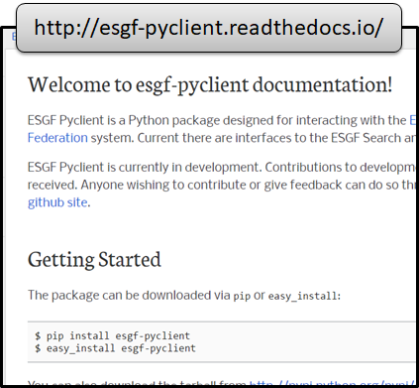
Task 5.1: ESGF Search Client (esgf-pyclient)
ESGF-pyclient:
Python client library to interrogate federated ESGF search "database".
To be used by applications that need to query the CP4CDS holdings.

Slide 4
Task 5.1: ESGF Search Client (esgf-pyclient)
Report:
Codebase has been updated to support Python 3 (v0.2.1).
Test suite updated to support use of Pytest.
Integrated with update of dependency: MyProxyClient.
Used in WP2 to query the CMIP5 holdings in order to identify available data.
Version supported on “conda-forge” channel.
New example Jupyter notebooks provided in repository.
Tested with published CP4CDS data sets.
Tested with CMIP6.
Tool continues to be used to by ESGF users.

Slide 5
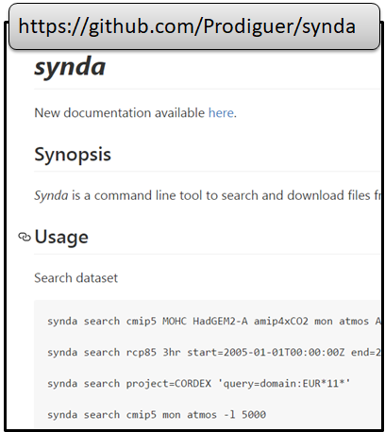
Task 5.2: Data Replication Tool (synda)
Synda:
Command-line tool to download or replicate ESGF data sets.
Can be connected to post-processing workflows.
Enabled for HTTP/GridFTP/Globus.

Slide 6
Task 5.2: Data Replication Tool (synda)
Report:
Synda has been developed to support production use in C3S 34x projects.
Bug fixes and ongoing maintenance during project.
Used within the ESGF federation for all major replications between continents.
Improvements made to post-processing integrations – allow integration with workflows.
Deployable using Conda packaging.
Supports all ESGF projects, including: CMIP5, CORDEX and CMIP6.

Slide 7
Task 5.3: Common SDDS (Software Dependency Deployment Solution)
SDDS concept:
A way of packaging a software environment used by an application – typically WPS.
Built on Conda because community makes significant use of it as packaging tool.
Using “conda-forge” channel – supported by earth sciences community.

Slide 8
Task 5.3: Common SDDS (Software Dependency Deployment Solution)
Report:
Deployed within the Compute Node (WP4).
Able to be deployed consistently in single-server, batch or container modes.
Fully described set of dependencies - enables reproducibility and records provenance.
Recipe uses Conda description of packages - made available through online repositories.

Slide 9
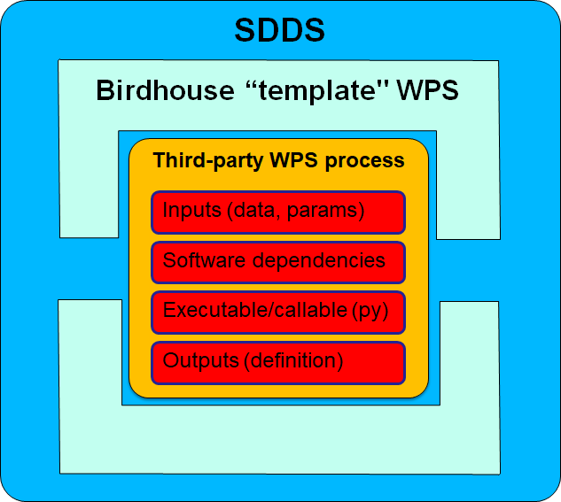
Task 5.3: Common SDDS (Software Dependency Deployment Solution)
Report:
Worked with WP4 to encapsulate SDDS in a conda environment within the Compute Node.
Developed a procedure for adding a new WPS to the CP4CDS Compute Node.

Slide 10







Development process a “MyApp” WPS for CP4CDS
CP4CDS Compute Nodes
Deploy
Review, test and configure for production
CP4CDS WPS Template
MyApp WPS
v1.0
CP4CDS
Create
Fork
Fork
example
<env>
MyApp1.0
<env>
Create
Request
review
CP4CDS WPS Template
MyApp WPS v1.0
MyApp
Rename/ modify

Slide 11
Task 5.4: Declaring data requirements in code
Initial focus:
Extending the Data Reference Syntax (DRS) to describe data required by the WPS in the Compute Node.
Change of focus:
Through meetings with WP4 and Lot 2 we agreed that a key aspect of is the need to describe dynamic inputs to a processing service:
Inputs that are dependent on selections already made.

Slide 12
Task 5.4: Declaring data requirements in code
Report:
Defined the concept of a “Meta-WPS”:
Complements the main WPS
WPS Describe Process document uses XML tags to indicate the availability of the Meta-WPS
WPS Client calls the Meta-WPS in order to dynamically discover the input options
Advantages:
Allows dynamic interactions between the WPS client (which could be a web-form) and the “Meta-WPS” in order to resolve complex relationships between inputs.
Uses the WPS standard to expose these relationships.

Slide 13
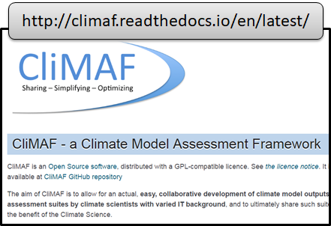
Task 5.5: End-to-end testing with CliMAF
Deploying the SDDS at remote sites.
Deploying the CliMAF/SDDS package into the Compute Node.

Slide 14
Task 5.5: End-to-end testing with CliMAF
Report:
Selected a subset of the CliMAF functionality to demonstrate end-to-end capability:
Select a CMIP5 model, experiment and variable.
Select a time range within that selection.
Calculate a time series of global averages.
Plot the resulting array on a line graph of variable vs time.
Output the plot to a PNG file.

Slide 15
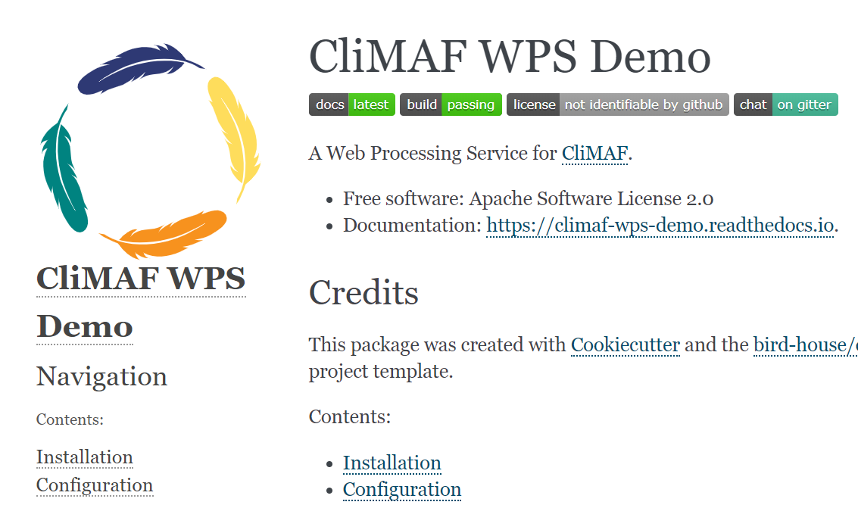
Task 5.5: End-to-end testing with CliMAF
Report:
Tested deployment at DKRZ and CEDA.
https://climaf-wps-demo.readthedocs.io/

Slide 16
WP5: Conclusions
Support for core software tools has been essential to the project, and has fed back into ESGF.
Relationship between the SDDS and the Compute Node is a solid foundation for the C3S 34e project.
Work on “declaring data requirements in code” has progressed understanding and will directly impact design of API in 34e project.
Interactions with Lot 2 and CliMAF have demonstrated the Compute Node and identified where work is needed to provide a common and robust solution.

