Slide 1
Test Automation in Python: Tools and Techniques 222ECS011 SOFTWARE TESTING
Presented By,
Ajitha C P,
NSS24CSCE01.

Slide 2
Test Automation in Python
Test automation is the process of using software to execute tests automatically, reducing manual effort and improving software reliability.
Python offers a simple syntax, a rich ecosystem of testing libraries, and seamless integration with DevOps tools.

Slide 3
Python Tools for Test Automation
Pytest
Popular and powerful testing framework in python.
Simple and readable syntax.
Unit test
Comes with Python(no extra installation required).
Selenium
Web automation framework.
Follows class-based structure.
Automates browser actions(click,input,navigation).
Works with different programming languages (Python,Java,C#).

Slide 4
Pytest
Python testing framework.
Easily integrates with API, UI, and mobile testing tools.
It involves parameterized testing, and automatic test discovery.

Slide 5
Pytest Workflow
Specify Test Files (if there are multiple files) on running.
Run pytest command (pytest
–v)
Auto Discovers test files(test_*.py, *_test.py)
Executes Test Cases
- Uses Fixtures
- Parameterized Tests
Generates Reports (Pass/Fail Summary)

Slide 6
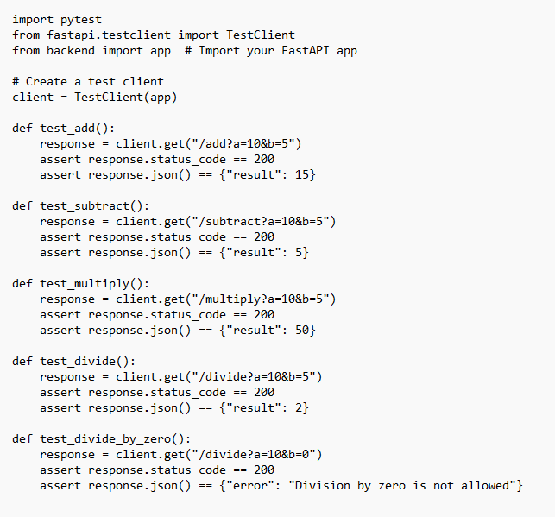
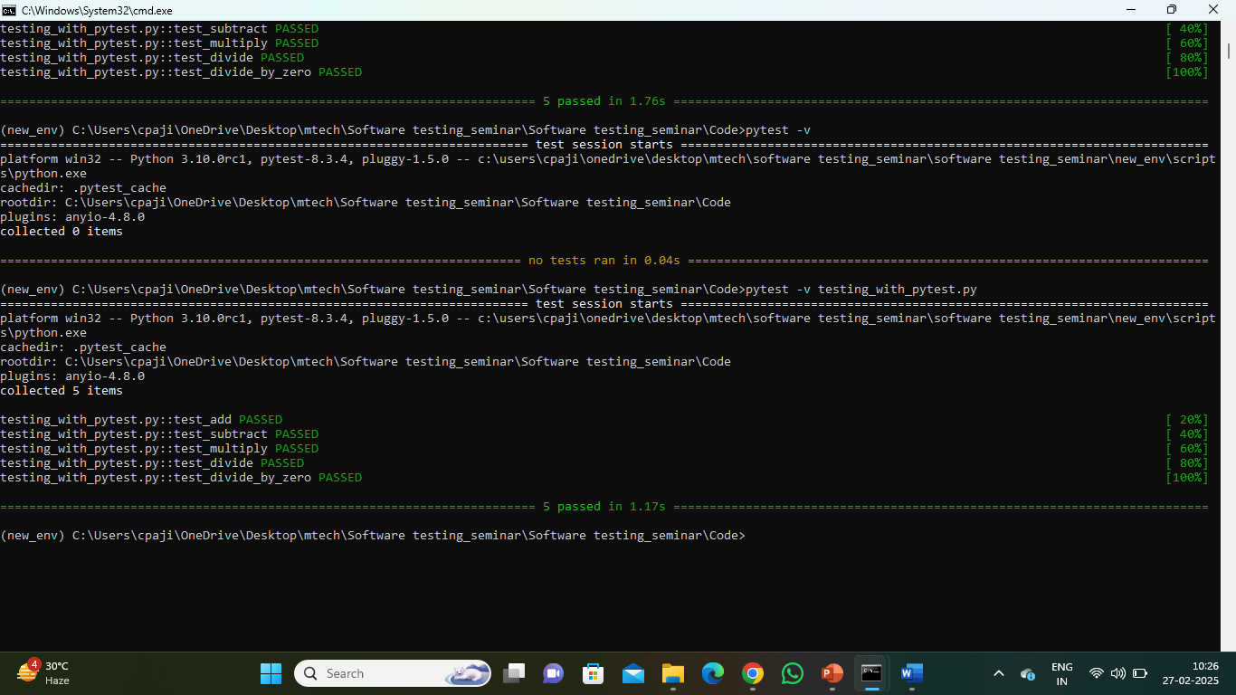
Pytest for Calculator Project

Slide 7
Unit test
Python's built-in framework, structured.
But it requires more boilerplate code.

Slide 8
Unit test Workflow
Test Runner (unittest.main())
Test Case Class (unittest.TestCase)
Test Methods (eg:
test_addition, test_subtraction)
Assertions (self.assertEqual)

Slide 9
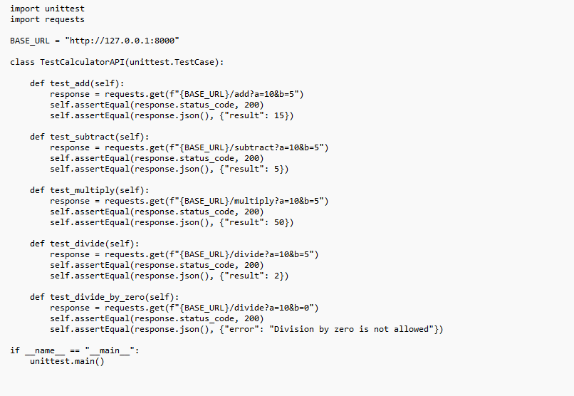
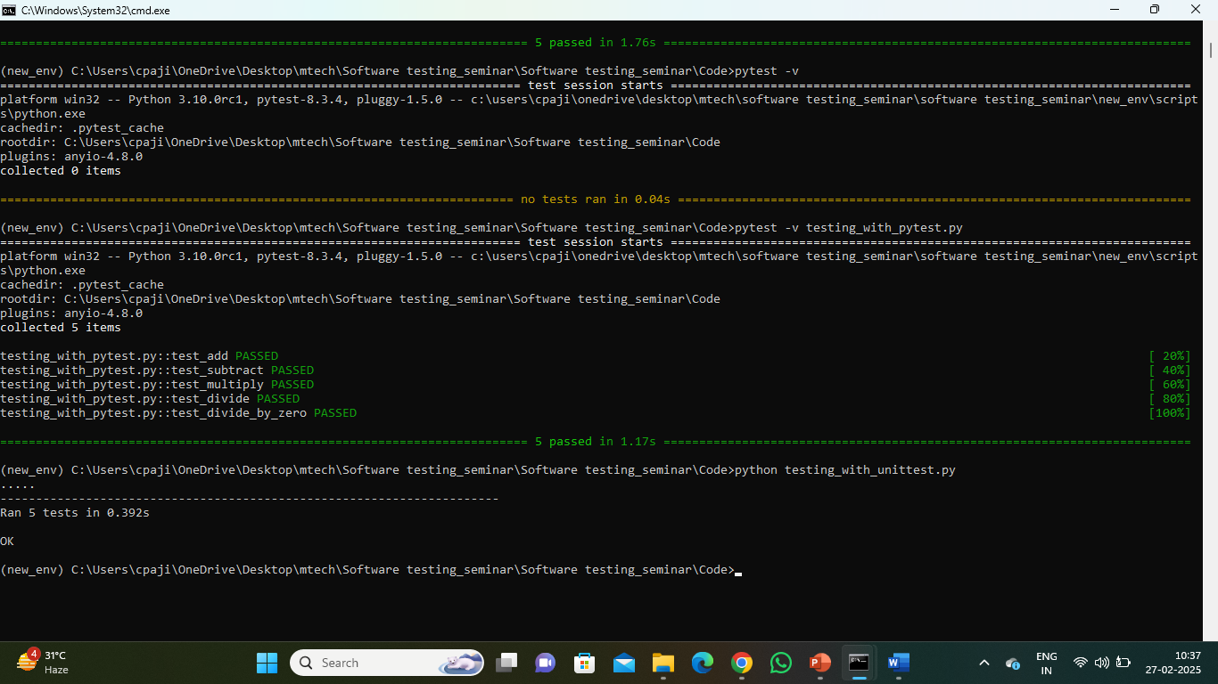
Unit test for Calculator Project

Slide 10
Selenium
Web Automation Framework.
Supports multiple browsers (Chrome, Firefox, Edge, Safari).
Supports explicit & implicit waits for element handling.
Used for functional, regression, and UI testing.
Integrates with Pytest,Unit test for test execution.
Supports headless browser execution for faster testing.

Slide 11
Selenium Workflow
Selenium Script (Python, Java, C#)
Selenium WebDriver
Browser Drivers (Chrome, Firefox, Edge, Safari)
Web Application

Slide 12
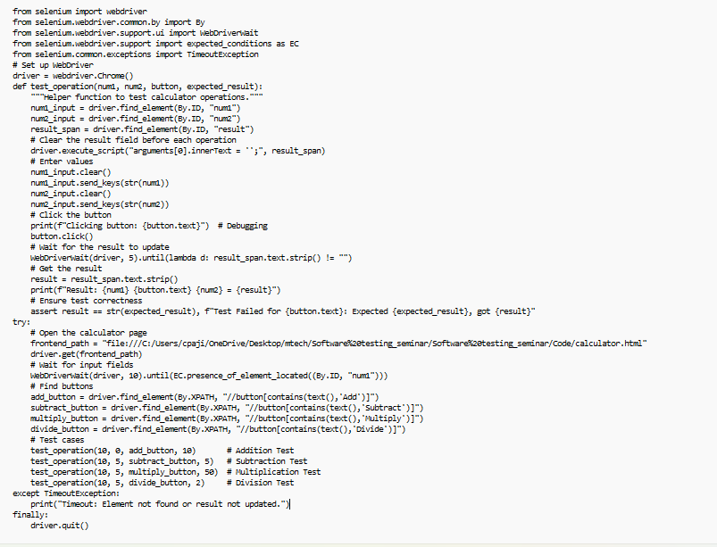
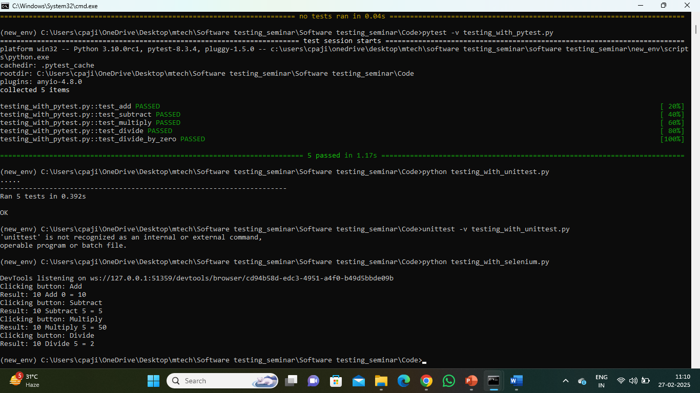
Selenium for Calculator Project

Slide 13
Pytest vs Unit test vs Selenium
Feature | Pytest | Unittest | Selenium
Ease of Use | Easy | Moderate | Moderate
Test Discovery | Automatic | Manual | Web based
Fixtures | Advanced Fixture Support | Basic Fixture Support | No Support
Parameterized Tests | Yes | No | No
Web Automation | No | No | Yes
Parallel Execution | Yes | No | Supports Parallel Execution through grid.

Slide 14
CI/CD Integration
CI/CD (Continuous Integration and Continuous Deployment/Delivery) integration is used to automate the software development lifecycle, improving efficiency, reducing errors, and ensuring reliable and fast deployment.
CI is the practice of frequently merging code changes from multiple developers into a shared memory(eg:GitHub,GitLab).
Continous Deployment:Every change that passes automated testing is automatically deployed to production without manual intervention.
Continous Delivery:The code is automatically tested and prepared for deployment but requires manual approval before going live.

Slide 15
Advantages of CI/CD
Automating Build and Testing (CI) – Ensures that code changes are automatically tested and integrated into the main branch without breaking the application.
Ensuring Code Quality – Helps in running linting, security checks, and unit tests before merging code.
Fast and Reliable Deployment (CD) – Automates the process of deploying applications to different environments, reducing manual effort and human errors.
Version control and rollbacks– Enables tracking of deployments, allowing easy rollback in case of failures.
Efficient Team Collaboration – Multiple developers can work on the project simultaneously without conflicts.

Slide 16
Advantages of CI CD separation
Separation of Concerns
CI.yml: Focuses on building, testing, and validating code before merging.
CD.yml: Handles deployment after the CI pipeline has successfully passed.
Parallel Execution – Keeping CI and CD separate allows them to run independently, reducing deployment delays and improving efficiency.
Flexibility and Customization – Different environments may require different deployment strategies. CI can remain generic, while CD can have multiple workflows based on environments (e.g., staging, production)

Slide 17
Advantages of CI and CD separation
Security Considerations – Deployment requires access to sensitive credentials (e.g., AWS, Azure, or Kubernetes keys). Keeping CI separate from CD minimizes security risks.
Better Debugging and Maintenance – If a failure occurs, it is easier to identify whether it’s a CI issue (e.g., failing tests) or a CD issue (e.g., deployment failure).

Slide 18

THANK YOU!

