Slide 1
Packetized Energy Management
Connor

Slide 2
Outline
Problem
Solution
Modeling
Results

Slide 3
Problem

Slide 4
Grid Failure Modes
Extreme oversupply (surge, spike)
Oversupply
Undersupply (brownout)
Extreme Undersupply (blackout)
Each causes different problems/damage

Slide 5
The Brownout Problem
Unexpectedly, transient, demand spikes
  Sports game
  Bad weather
Expected but rapidly changing demand
  Morning & evening routines
  Large events

Slide 6
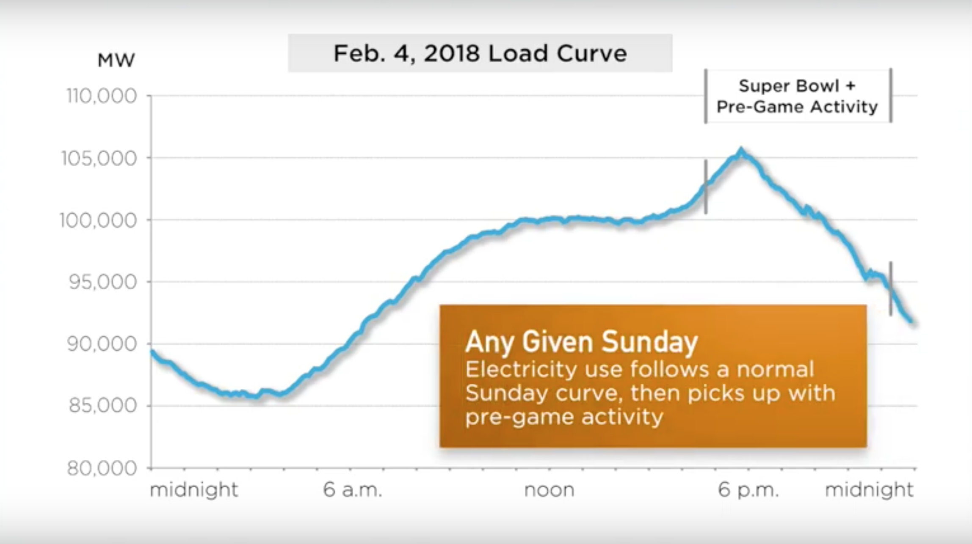
Unexpected Demand
“PJM serves all or parts of Delaware, Illinois, Indiana, Kentucky, Maryland,
Michigan, New Jersey, North Carolina, Ohio, Pennsylvania, Tennessee,
Virginia, West Virginia and the District of Columbia.”
https://www.youtube.com/watch?v=nx1Viry2xdM

Slide 7
Rapidly Changing Demand
2011 Grid Data for all of Great Britain provided by the University of Glasgow.
http://www.physics.gla.ac.uk/~shild/grid2025challenge/

Slide 8
A Solution

Slide 9
Packetized Energy Management
Grid load is split into two categories:
  Baseline load
  Flexible load
Flexible load energy is “packetized”
Appliances request a packet
Distributors allow packet consumption stochastically and according to supply

Slide 10
What is “flexible load”?
Things with “natural” energy reservoirs:
Heaters
Air Coolers
Boilers
Car chargers
Refrigerators
NOT things for instant or continuous use:
Lights
Plug in appliances
Hair Dryer
Cooking appliances

Slide 11
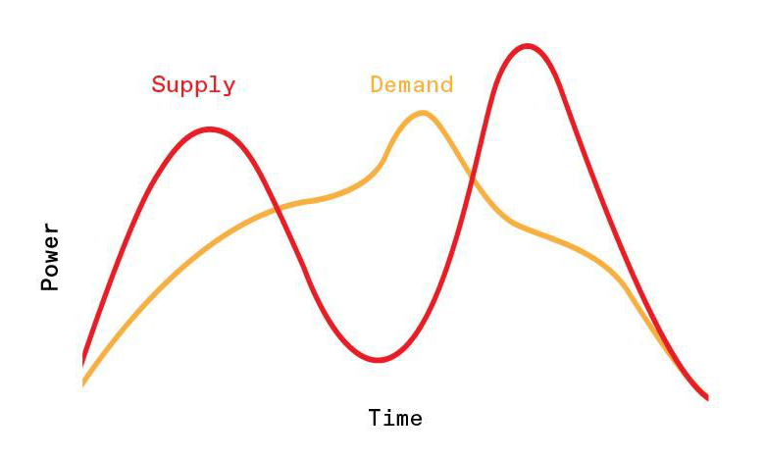
Before Packetization
https://spectrum.ieee.org/packetized-power-grid

Slide 12
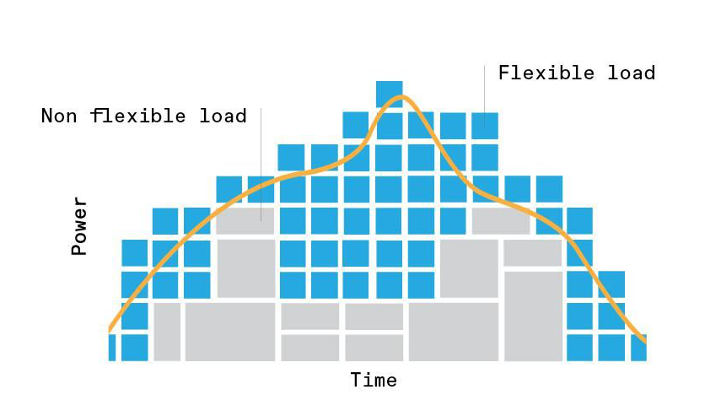
Packetized Load
https://spectrum.ieee.org/packetized-power-grid

Slide 13
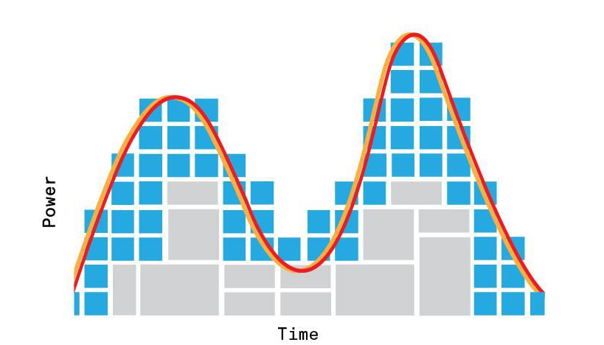
Managed Load
https://spectrum.ieee.org/packetized-power-grid

Slide 14
Summary
One central manager stochastically allows/denys requests according to available supply
Many appliances requesting energy packets
Communication over internet or dedicated infrastructure

Slide 15
Modeling

Slide 16
Simulation Parameters
Entities:
Sinusoid-like energy supply
Manager
Electric water heaters
Complications:
Thermal decay
charge decay
Stochastic use
Management disregard threshhold

Slide 17
Additional Parameters
1 packet ∝ N Watts
1 epoch ∝ N seconds

Slide 18
Rapidly Changing Demand
2011 Grid Data for all of Great Britain provided by the University of Glasgow.
http://www.physics.gla.ac.uk/~shild/grid2025challenge/

Slide 19
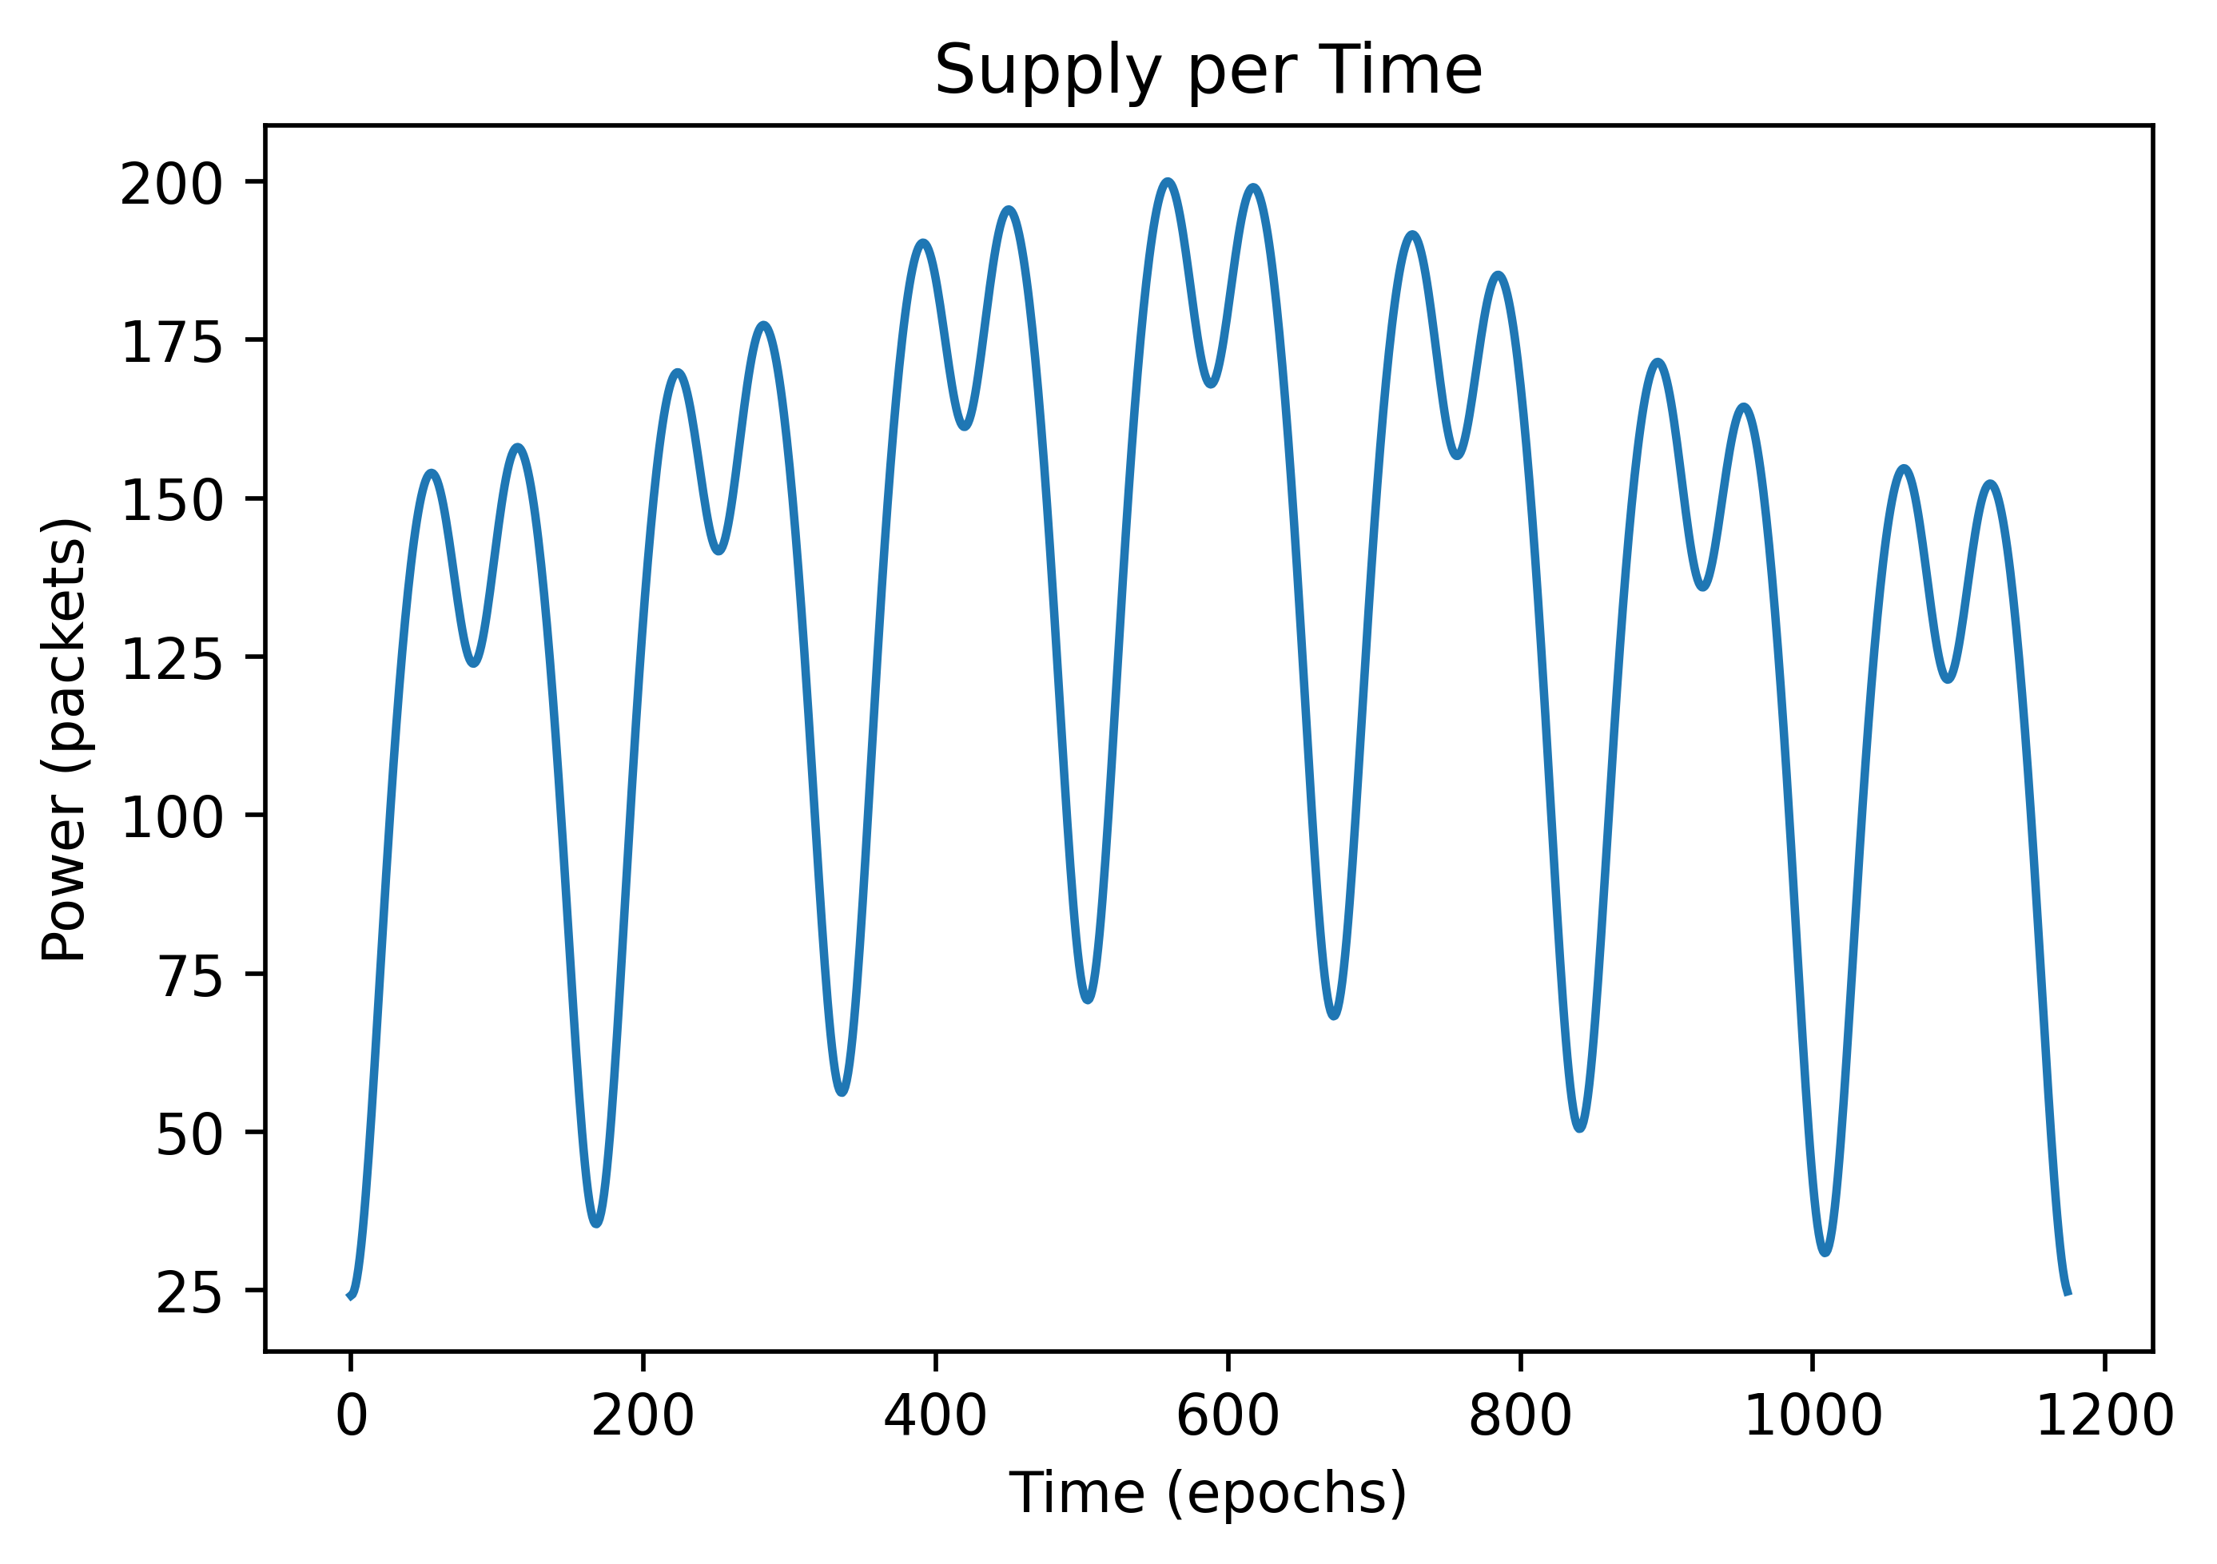
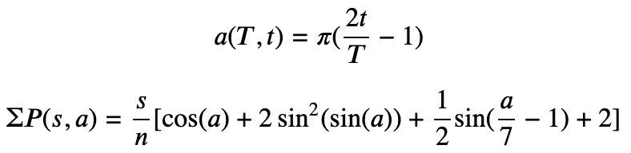
Total Grid Power Supply
n = 4.16333941 (normalization; experimentally determined)

Slide 20
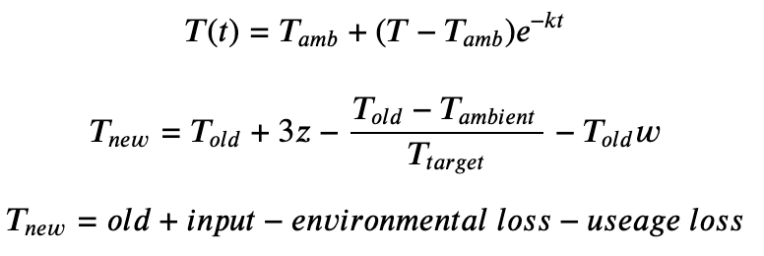
Electric Water Heater State

Slide 21
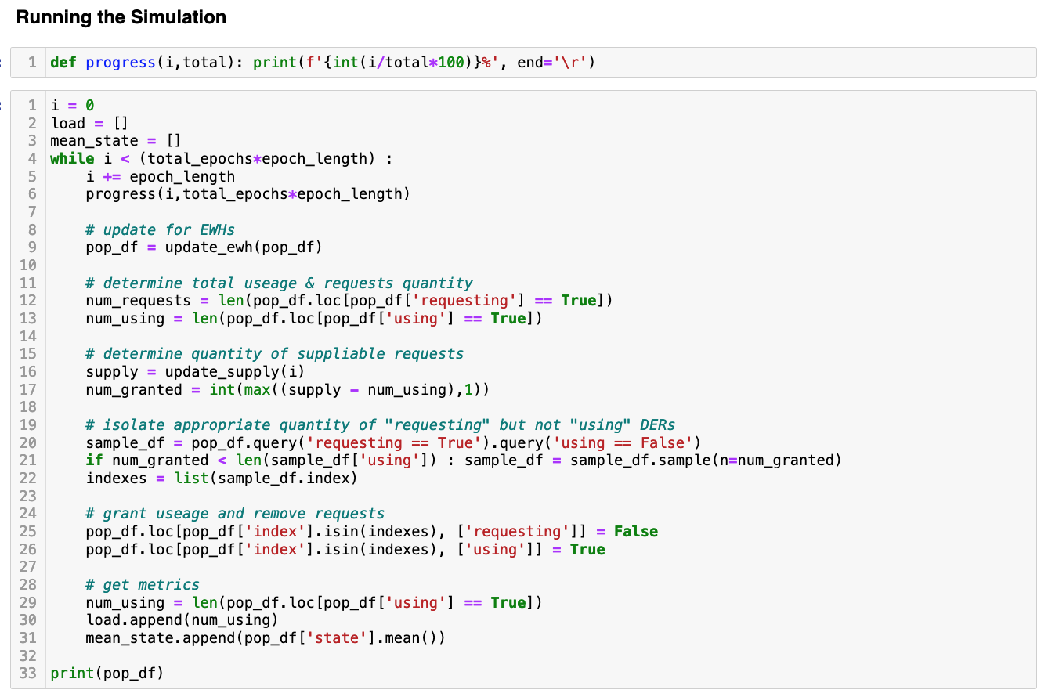
Code Sample

Slide 22
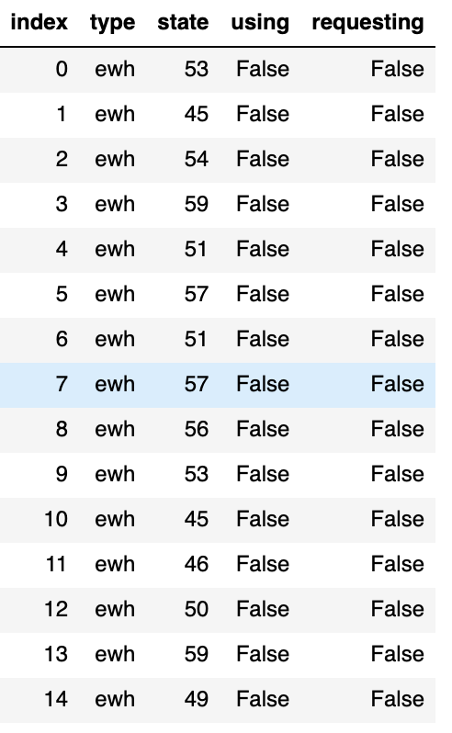
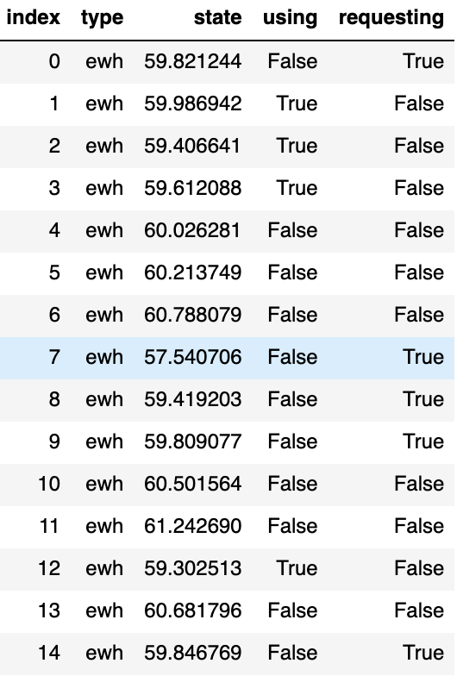
Data Table
Initial states
Steady States

Slide 23
Results

Slide 24
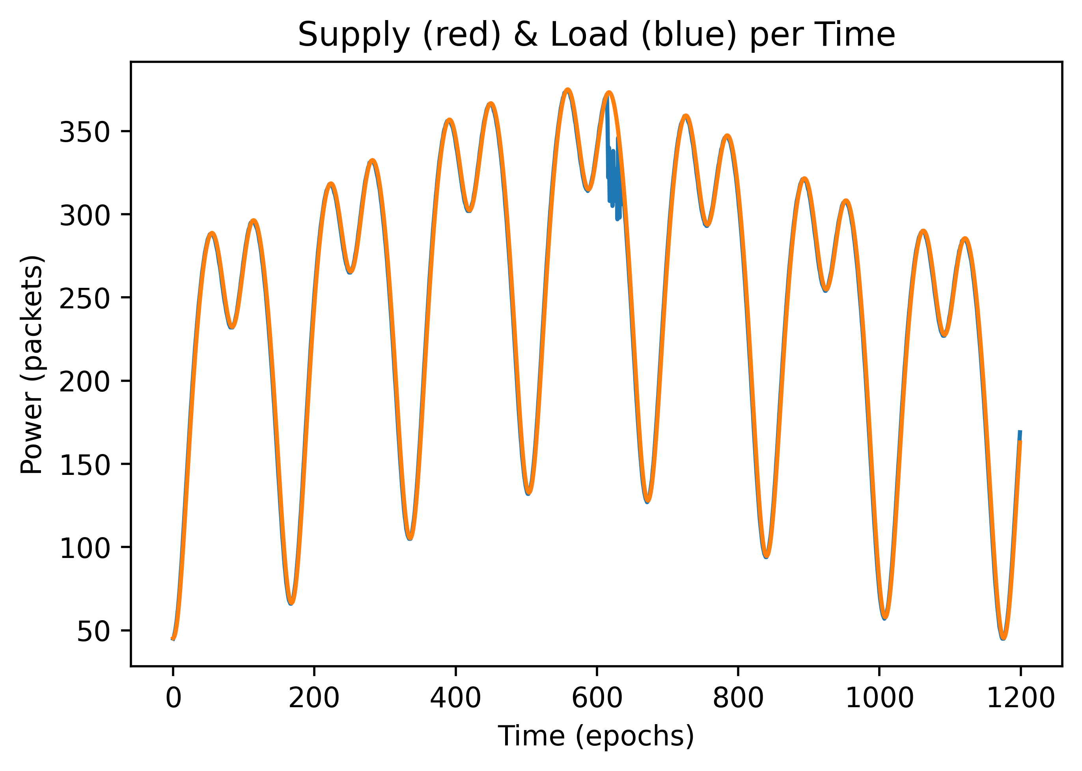
Matching Demand to Supply
It works!!

Slide 25
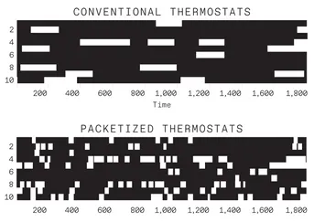
On/Off For Individual Devices

Slide 26
For the most part...

Slide 27
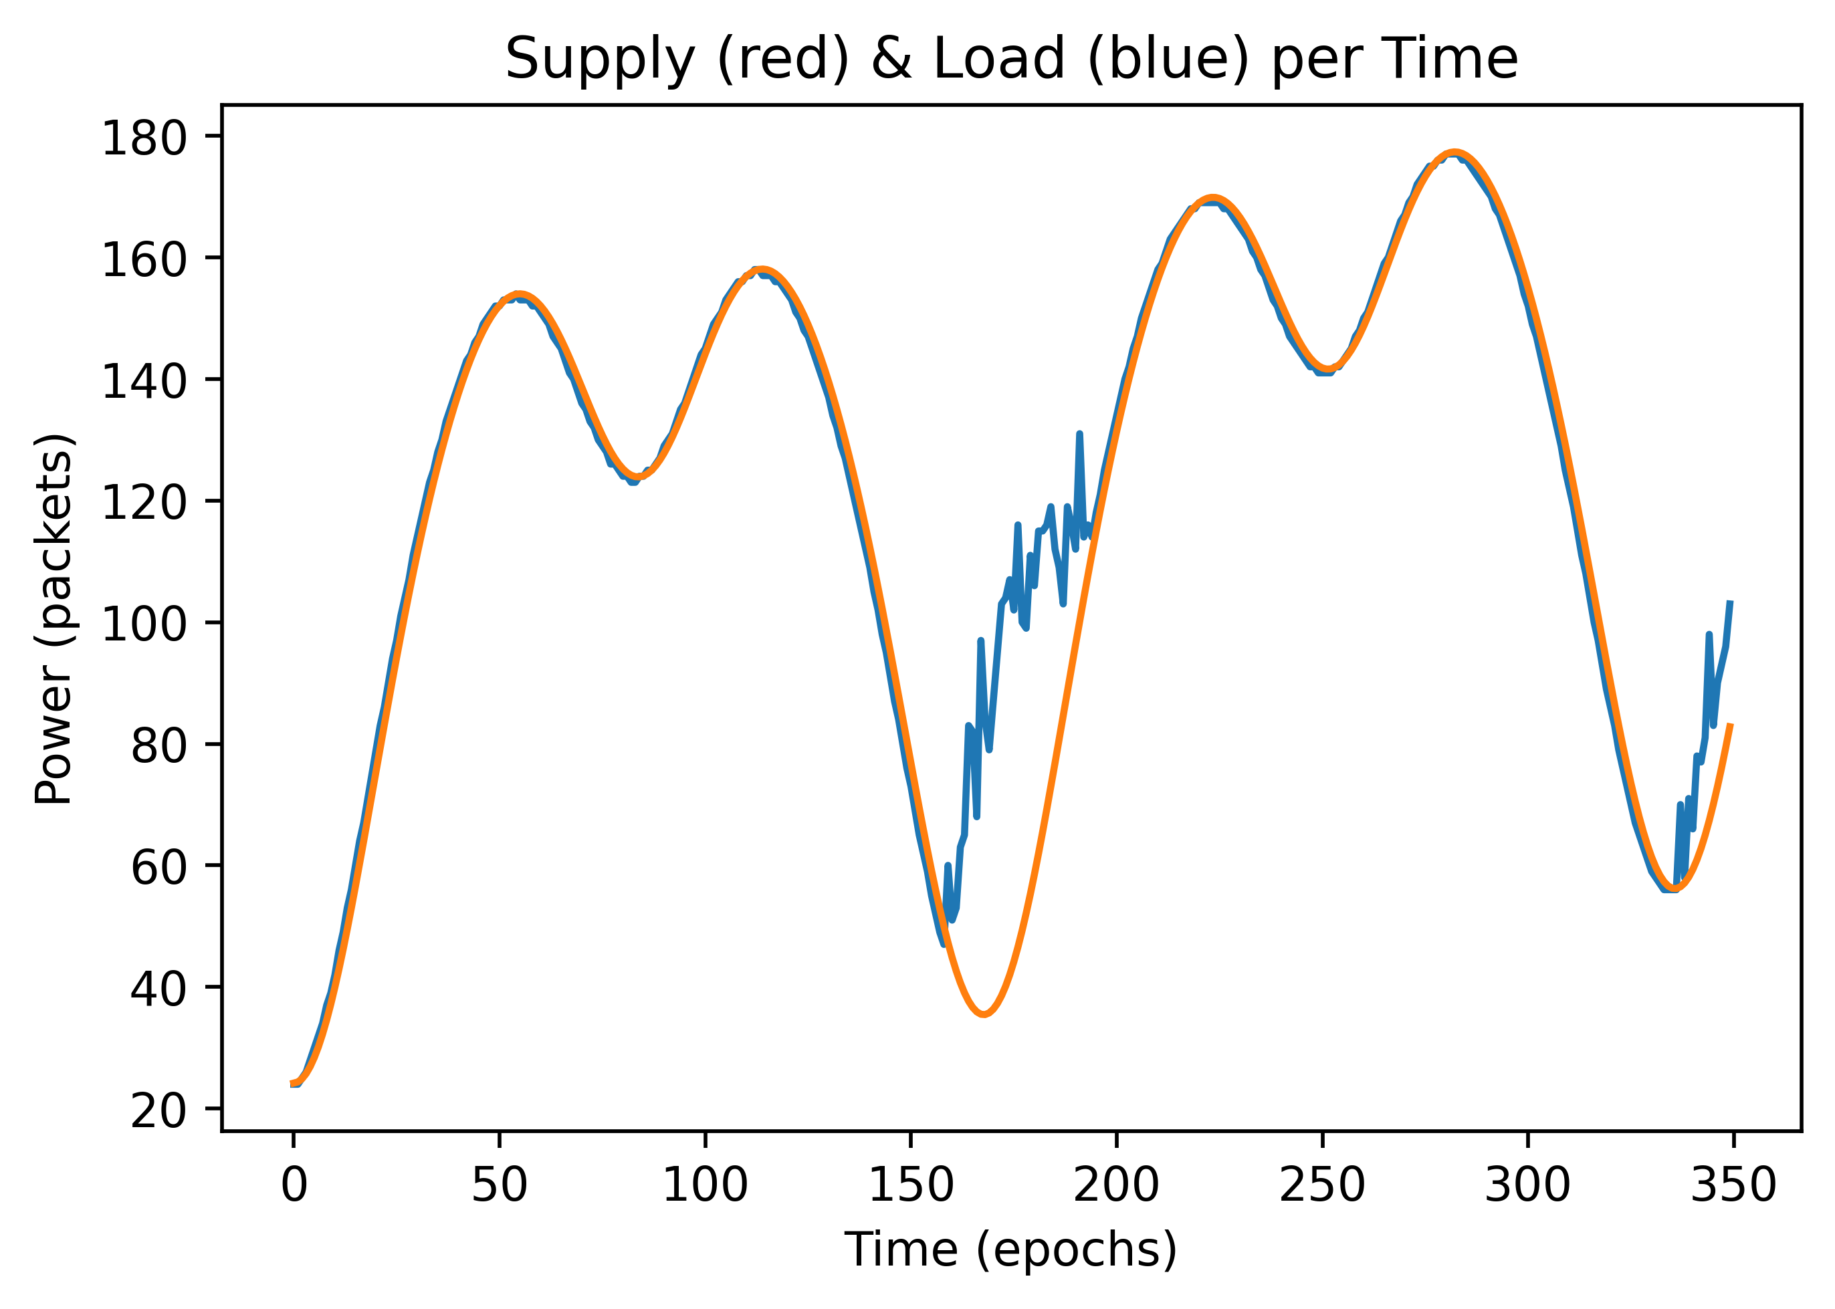
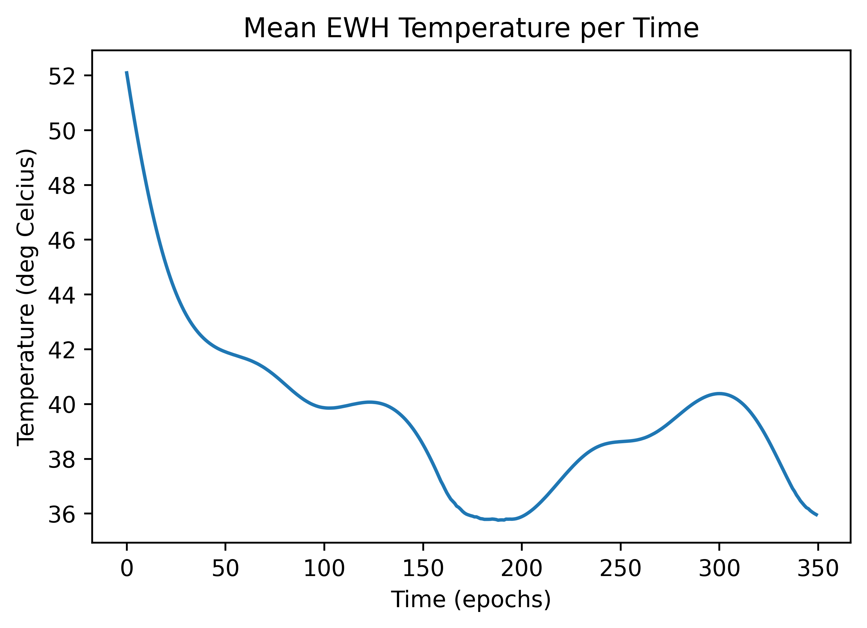
Undersupply & Recovery
There exists a domain in which packetized management is useful

Slide 28
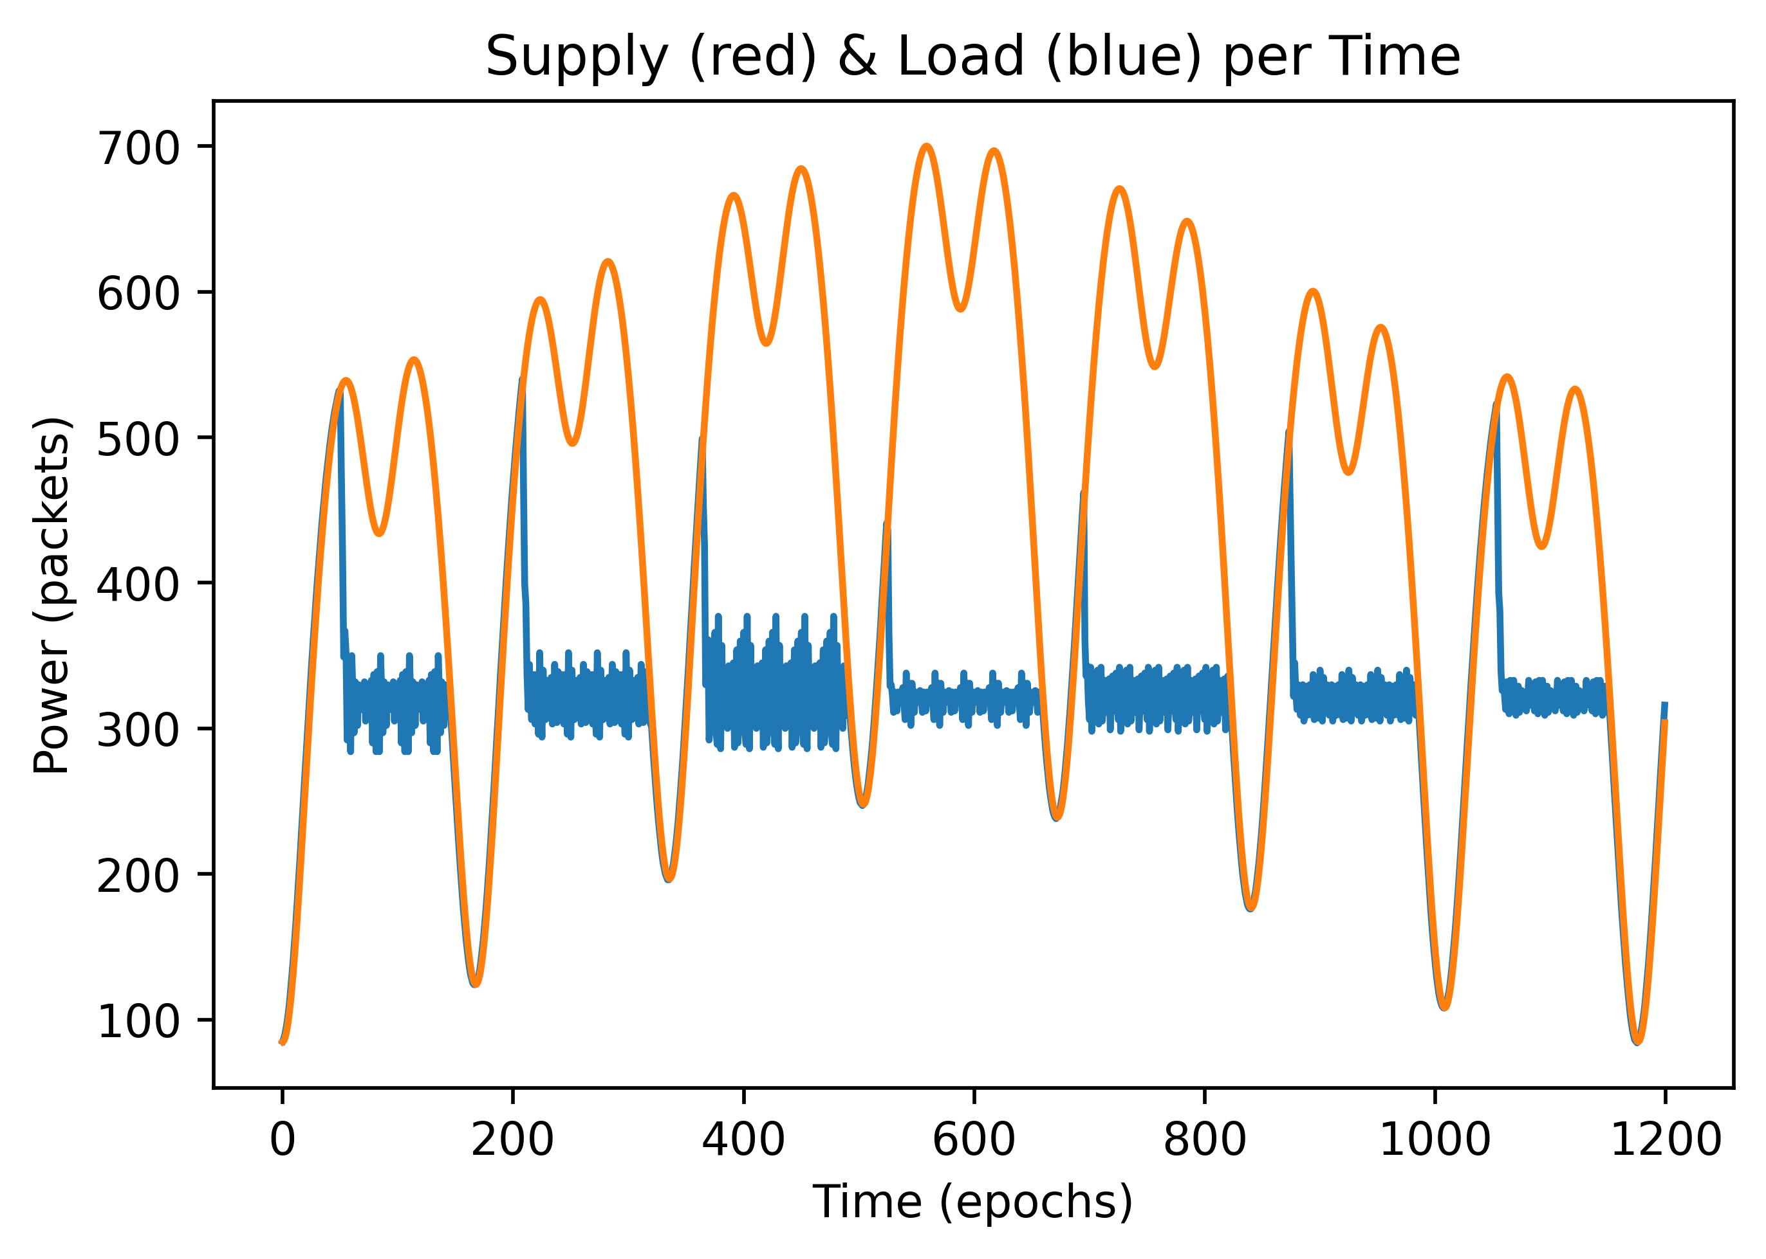
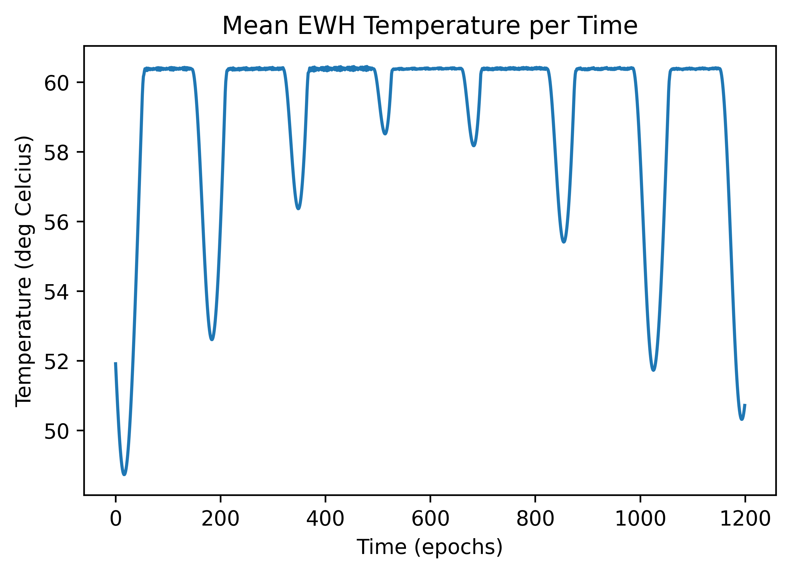
Oversupply & Recovery Spike
Keeps demand from surpassing supply
Creates predictable “return to baseline” spikes

Slide 29
Conclusion
Grid size electrical loads can be reasonably managed
Undersupply followed by oversupply leads to demand spike and steady state behavior
Undersupply leads to grid failure

Slide 30
References
Almassalkhi, M., Frolik, J., & Hines, P. (2022, February 15). How to prevent blackouts by packetizing the power grid. IEEE Spectrum. Retrieved April 18, 2022, from https://spectrum.ieee.org/packetized-power-grid
Espinosa, L. A., Almassalkhi, M., Hines, P., & Frolik, J. (2018). Aggregate modeling and coordination of diverse energy resources under Packetized Energy Management. 2017 IEEE 56th Annual Conference on Decision and Control (CDC). https://doi.org/10.1109/cdc.2017.8263849
Espinosa, L. A., Khurram, A., & Almassalkhi, M. (2021). Reference-tracking control policies for packetized coordination of heterogeneous der populations. IEEE Transactions on Control Systems Technology, 29(6), 2427–2443. https://doi.org/10.1109/tcst.2020.3039492
Frolik, J., & Hines, P. (2021, November 9). Systems and Methods for Random-Access Power Management.
Frolik, J., Hines, P., & Almassalkhi, M. (2021, October 19). Packetized Energy Management Control Systems and Methods of Using the Same.
Graber, G., Calderaro, V., Mancarella, P., & Galdi, V. (2019). Two-stage stochastic sizing and packetized energy scheduling of BEV charging stations with quality of service constraints. Applied Energy, 260, 114262. https://doi.org/10.1016/j.apenergy.2019.114262
Nardelli, P. H., Alves, H., Pinomaa, A., Wahid, S., Tome, M. D., Kosonen, A., Kuhnlenz, F., Pouttu, A., & Carrillo, D. (2019). Energy internet via packetized management: Enabling Technologies and deployment challenges. IEEE Access, 7, 16909–16924. https://doi.org/10.1109/access.2019.2896281
Rezaei, P., Frolik, J., & Hines, P. D. (2014). Packetized plug-in Electric Vehicle Charge Management. IEEE Transactions on Smart Grid, 5(2), 642–650. https://doi.org/10.1109/tsg.2013.2291384
Zhang, B., & Baillieul, J. (2013). A packetized direct load control mechanism for demand side management. 2012 IEEE 51st IEEE Conference on Decision and Control (CDC). https://doi.org/10.1109/cdc.2012.6427392

