Slide 1
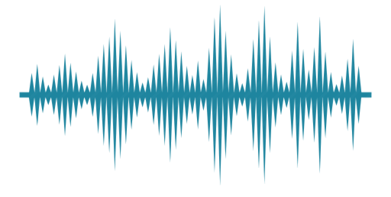
Harmony search for feature selection In aser
Pankaj Chauhan (18)
Gaurang Date (21)
Neha Nagarkoti (66)
Guided by: Kevin D’souza

Slide 2
Problem Statement
Speech emotion recognition is a particularly valuable for many real time applications. High dimensional data sets create problems even for automated systems.
In this project, our approach is to select a small subset out of the thousands of speech Data which is important for accurate classification of speech emotion recognition using Harmony Search Algorithm.

Slide 3
Speech Emotion Recognition System

Slide 4
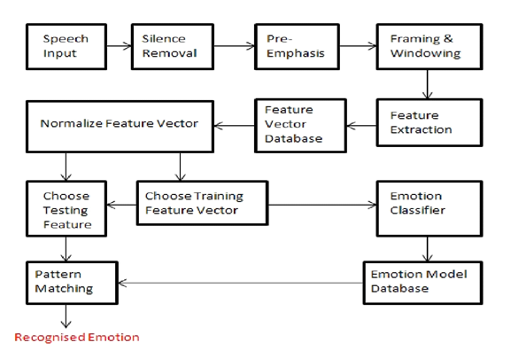
Fig. 2: Block diagram of Speech recognition

Slide 5
Features
MFCC
Mel-frequency cepstral coefficients (MFCCs) are coefficients that collectively make up an MFC.
The mel-frequency cepstrum (MFC) is a representation of the short-term power spectrum of a sound, based on a linear cosine transform of a log power spectrum on a nonlinear mel scale of frequency.
Pitch
Pitch is the perceived fundamental frequency of a speech signal, pitch is dependent on the tension created on the vocal fields due to the non-linear air flow during speech generation. It can be extracted using autocorrelation, cepstrum.

Slide 6
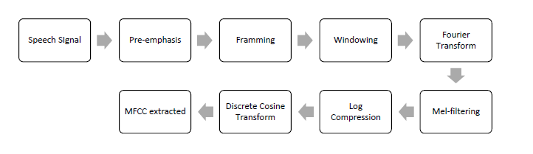
Extraction of MFCC Features
The Mel-frequency cepstrum (MFC) is a representation of the short-term power spectrum of a sound, based on a linear cosine transform of a log power spectrum on a non linear mel scale of frequency.
Fig. 3: Block diagram

Slide 7
FEATURE CLASSIFICATION

Slide 8
Linear Separators
Binary classification can be viewed as the task of separating classes in feature space:
wx + b = 0
wx + b > 0
wx + b < 0
f(x) = sign(wx + b)
Fig. 4

Slide 9
Linear Separators
Which of the linear separators is optimal?
Fig. 5

Slide 10
What is SVM?
It is a supervised machine learning algorithm which can be used for both classification or regression challenges. However, it is mostly used in classification problems.
What does it do?
In this algorithm, we plot each data item as a point in n-dimensional space with the value of each feature being the value of a particular coordinate.
Then, we perform classification by finding the hyper-plane that differentiate the two classes very well.

Slide 11
Why SVM?
The benefit is that one can capture much more complex relationships between your data-points without having to perform difficult transformations on our own.

Slide 12
Binary SVM: Classification Margin
Distance from example x_{i} to the separator is
Examples closest to the hyperplane are support vectors.
Margin ρ of the separator is the distance between support vectors.
ρ
r
Support Vectors are those datapoints that the margin pushes up against
Fig. 6.1

Slide 13
Maximum Margin Classification
Maximizing the margin is good according to intuition and PAC theory.
Implies that only support vectors matter; other training examples are ignorable.
Fig. 6.2

Slide 14
Problems with linear SVM
=-1
=+1
Fig. 7
What if the decision function is nonlinear?

Slide 15
Non-linear SVMs
General idea: the original feature space can always be mapped to some higher-dimensional feature space where the training set is separable:
Φ: x → φ(x)
Fig. 8

Slide 16
Doing multi-class classification
SVMs can only handle two-class outputs (i.e. a categorical output variable with arity 2).
How to handle multiple classes
Answer: one-vs-all, learn N SVM’s
SVM 1 learns “Output==1” vs “Output != 1”
SVM 2 learns “Output==2” vs “Output != 2”
:
SVM N learns “Output==N” vs “Output != N”

Slide 17
One-vs-All
vs the other classes: angry(S)
-1
+1
Fig. 9.1

Slide 18
One-vs-All
vs the other classes: angry(S)
vs the other classes: sad(S)
+1
-1
Fig. 9.2

Slide 19
One-vs-All
vs the other classes: angry(S)
vs the other classes: sad(S)
vs the other classes: happy(S)
-1
+1
Fig. 9.3

Slide 20
One-vs-All
Given a test sound S; how to decide its emotion ?
Assign S to the emotion function with the largest score

Slide 21
EMODB (535)
TRAINING (339)
TEST (196)
Anger | Boredom | Disgust | Fear | Happiness | Sadness | Neural | Total
127 | 81 | 46 | 69 | 71 | 62 | 79 | 535

Slide 22
INPUT
SILENCE REMOVAL

Slide 23
PRE EMPHASIS

Slide 24
FEATURE EXTRACTION
RESULT
MFCC extraction done ( for EMODB database)
MFCC features | 13
MFCC+𝛥MFCC+ 𝛥𝛥MFCC | 13 x 3 = 39
Mean, Standard deviation, Variance, Kurtosis | 39 x 4 = 156

Slide 25
Results when considering all features
SVM () |  | ONE vs ALL |  | MFCC (39)(Δ +ΔΔ)
 | 'Fear' | 'Disgust' | 'Neutral' | 'Anger' | 'Happiness' | 'Boredom' | 'Sadness'
'Fear' | 18.51% | 7.40% | 11.11% | 55.56% | 7.40% | 0 | 0
'Disgust' | 0 | 54.17% | 8.33% | 4.17% | 0 | 33.33% | 0
'Neutral' | 0 | 0 | 82.60% | 4.34% | 0 | 8.69% | 4.34%
Anger' | 0 | 0 | 0 | 90.69% | 9.30% | 0 | 0
'Happiness' | 0 | 0 | 0 | 68% | 32% | 0 | 0
'Boredom' | 0 | 12.90% | 9.67% | 0 | 0 | 61.29% | 16.12%
'Sadness' | 0 | 8.69% | 0 | 0 | 0 | 8.69% | 82.60%

Slide 26
Results when considering all features
SVM (Linear) |  | ONE VS ONE |  | MFCC (39)(Δ +ΔΔ)
 | 'Fear' | 'Disgust' | 'Neutral' | 'Anger' | 'Happiness' | 'Boredom' | 'Sadness'
'Fear' | 40.74 | 0 | 25.93 | 7.41 | 22.22 | 3.70 | 0
'Disgust' | 0 | 29.17 | 12.5 | 0 | 0 | 58.33 | 0
'Neutral' | 0 | 0 | 65.22 | 0 | 4.35 | 30.43 | 0
Anger' | 16.28 | 4.65 | 6.98 | 55.81 | 16.28 | 0 | 0
'Happiness' | 8 | 4 | 8 | 56 | 24 | 0 | 0
'Boredom' | 0 | 9.68 | 9.68 | 0 | 3.23 | 77.42 | 0
'Sadness' | 0 | 21.74 | 4.35 | 0 | 0 | 73.91 | 0

Slide 27
FEATURE EXTRACTION
MFCC extraction done ( for EMODB database)
MFCC features | 13
MFCC+𝛥MFCC+ 𝛥𝛥MFCC | 13 x 3 = 39
Mean, Standard deviation, Variance, Kurtosis | 39 x 4 = 156

Slide 28
FEATURE SELECTION
What is Feature selection
In Feature Selection , we simply mute / remove the features irrelevant to us without changing them.
Why is it needed
Speech emotion recognition is a particularly valuable for many real time applications.
High dimensional data sets create problems even for automated systems.
Feature Selection reduces number of features making calculations more fast due to comparative less data.

Slide 29
Feature Selection vs Dimensionality Reduction
In Feature Selection , we simply mute / remove the features irrelevant to us without changing them.
In Dimensionality Reduction (such as PCA) , the number of features are reduced by making combinations of our existing features .

Slide 30
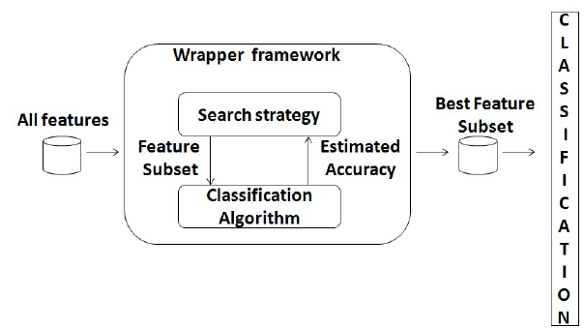
There are two main approaches for feature selection namely:
Wrapper method
It is method in which the features are selected using the classifier.
It is mainly used as post process method.
i.e. works on features after classification is done to optimize it.

Slide 31
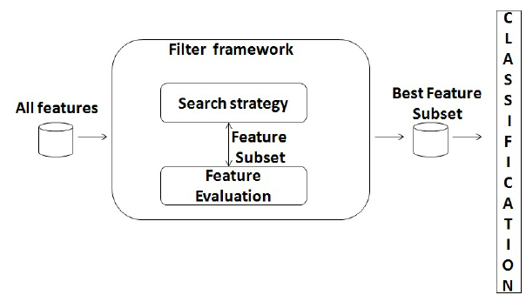
Filter method
It is method in which the selection of features is independent of the classifier used.
They are mainly used as a pre-process method.

Slide 32
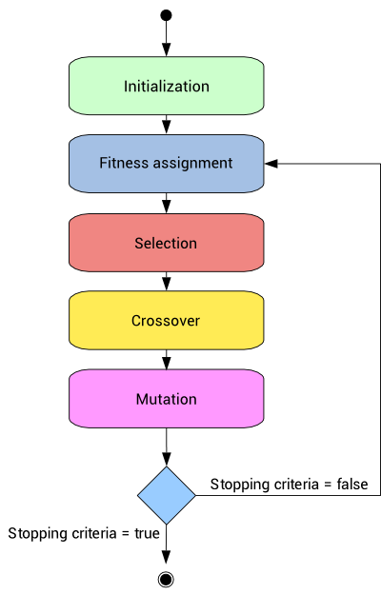
Genetic Algorithm
In nature, the genes of organisms tend to evolve over successive generations to better adapt to the environment.
The Genetic Algorithm is an heuristic optimization method inspired by that procedures of natural evolution.

Slide 33
COMPARISION
For Bangla text recognition SVM classifiers were used and to optimize Fuzzy feature data set HS, GA and PSO algorithm were tested.
Having an average accuracy of 89% with all features and higher computation time was reduced drastically.
Also improvisation in accuracy was observed with reduced computation time.
Optimization Algorithm | Optimization Feature Subset | Classification Accuracy (%) | Execution time (sec)
Genetic Algorithm | 45 | 84.65 | 1509.25
Particle Swarm Optimization | 40 | 85.19 | 1248.89
Harmony Search Algorithm | 48 | 90.29 | 944.75

Slide 34
Advantage of HS
Over Genetic Algorithm
Harmony Search algorithm is more fast.
Randomization is considered in Harmony search.
Better accuracies are provided for same table.
HS optimization is more easier than GA
Over Particle Swarm Optimization
Individual features are considered.
This helps to give better accuracy than PSO.

Slide 35
WHY HARMONIC SEARCH
Existing Nature inspired Algorithms:
Genetic Algorithm (GA)
Evolutionary Algorithm (Evolution)
Diversification
Intensification
relatively easier
versatile to combine HS with other meta-heuristic algorithms
Parallelism possible → Higher efficiency

Slide 36
HARMONY SEARCH
Harmony search is a music-based metaheuristic optimization algorithm. It was inspired by the observation that the aim of music is to search for a perfect state of harmony.
When a musician is improvising, he or she has three possible choices:
(1) playing any famous tune exactly from his or her memory
(2) playing something similar to the aforementioned tune (thus adjusting the pitch slightly)
(3) composing new or random notes

Slide 37
Harmonic Memory
It ensures that good harmonies are considered as elements of new solution vectors.
r_{accept} ∈[0,1]
harmony memory considering rate (HMCR)
r_{accept} =0.7 ~ 0.95
WHY??
rate low → only few elite harmonies are selected and it may converge too slowly
rate extremely high (near 1)→ Pitches in the Harmony memory are mostly used other ones are not explored well

Slide 38
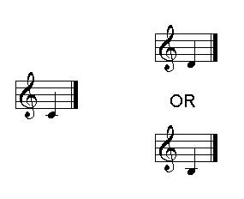
Pitch Adjusting
changing the frequency, it means generating a slightly different value in the HS algorithm.
x_{new} = x_{old} + ε × b_{range}
This action produces a new pitch by adding small random amount to the existing pitch .
ε is a random number from uniform distribution with the range of [-1, 1].
PAR =Pitch Adjusting rate

Slide 39
Randomization
To increase the diversity of the solutions.
Although the pitch adjustment has a similar role, it is limited to certain area and thus corresponds to a local search.
The use of randomization can drive the system further to explore various diverse solutions so as to attain the global optimality.

Slide 40
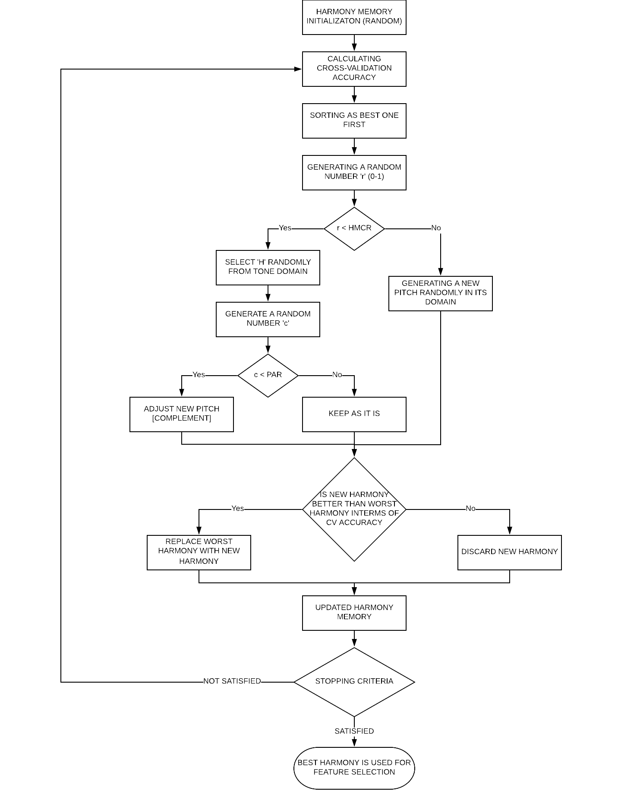
PARAMETER INITIALIZAITON
HMCR = 0.9
PAR = 0.4
MAX. ITERATION = 100
HARMONY MEMORY = 100

Slide 41
In this method ,we initialize HM randomly with 0 and 1. It represents selecting corresponding position’s value for number 1, 0 denotes no selection.
No of Musicians = No. of features
Tone domain for each musician will be same i.e. { 0,1 }.
 | p¹ | p² | p³ | p⁴ | . | . | p³⁸ | p³⁹ | Represented Subset
H¹
H²
H³
H⁴
H⁵
H⁶
H⁷
.
.
H¹⁰⁰

Slide 42
Binary Valued Initialization
All values are randomly generated
 | p¹ | p² | p³ | p⁴ | . | . | p³⁸ | p³⁹ | Represented Subset
H¹ | 0 | 1 | 0 | 1 | . | . | 0 | 1 | {f₂, f₄, …, f₃₉}
H² | 1 | 1 | 0 | 0 | . | . | 1 | 1 | {f₁, f₂, …, f₃₈, f₃₉}
H³ | 1 | 0 | 1 | 0 | . | . | 1 | 0 | {f₁, f₃, …, f₃₈}
H⁴ | 1 | 1 | 1 | 0 | . | . | 0 | 0 | {f₁, f₂, f₃, …}
H⁵ | 0 | 0 | 0 | 1 | . | . | 1 | 1 | {f₄, …, f₃₈, f₃₉}
H⁶ | 1 | 0 | 1 | 0 | . | . | 0 | 1 | {f₁, f₃, …, f₃₉}
H⁷ | 0 | 1 | 1 | 0 | . | . | 0 | 0 | {f₂, f₃, …}
. | . | . | . | . | . | . | . | . | .
. | . | . | . | . | . | . | . | . | .
H¹⁰⁰ | 0 | 1 | 0 | 1 | . | . | 0 | 1 | {f₁, f₂, f₃, f₄, …, f₃₈, f₃₉}

Slide 44
Cross Validation Accuracy
The purpose of using cross-validation is to make one more confident to the model trained on the training set.
Cross-validation is a technique to evaluate predictive models by partitioning the original sample into a training set to train the model, and a test set to evaluate it.
Training Set
(k parts)
Train data
(k-1 parts)
Test data
(1 part)
Cross-validation divides training data into k parts
Of these k-1 parts are used as training set and last part is used as test set.
This process is repeated for all possible combinations.
The cross validation accuracy is mean of all these values

Slide 45
Cross validation accuracies are calculated
 | p¹ | p² | p³ | p⁴ | . | . | p³⁸ | p³⁹ | Cross Validation Accuracy
H¹ | 0 | 1 | 0 | 1 | . | . | 0 | 1 | 32.83
H² | 1 | 1 | 0 | 0 | . | . | 1 | 1 | 37.82
H³ | 1 | 0 | 1 | 0 | . | . | 1 | 0 | 43.18
H⁴ | 1 | 1 | 1 | 0 | . | . | 0 | 0 | 36.92
H⁵ | 0 | 0 | 0 | 1 | . | . | 1 | 1 | 51.28
H⁶ | 1 | 0 | 1 | 0 | . | . | 0 | 1 | 44.88
H⁷ | 0 | 1 | 1 | 0 | . | . | 0 | 0 | 40.09
. | . | . | . | . | . | . | . | . | .
. | . | . | . | . | . | . | . | . | .
H¹⁰⁰ | 0 | 1 | 0 | 1 | . | . | 0 | 1 | 42.01

Slide 47
Sorting is done depending on cross-validation accuracies
 | p¹ | p² | p³ | p⁴ | . | . | p³⁸ | p³⁹ | Cross Validation Accuracy
H¹ | 1 | 0 | 1 | 1 | . | . | 1 | 1 | 57.36
H² | 1 | 1 | 0 | 0 | . | . | 1 | 1 | 53.28
H³ | 0 | 0 | 0 | 1 | . | . | 1 | 1 | 51.28
H⁴ | 1 | 1 | 0 | 0 | . | . | 0 | 0 | 49.99
H⁵ | 0 | 0 | 0 | 0 | . | . | 1 | 1 | 49.13
H⁶ | 1 | 0 | 1 | 0 | . | . | 0 | 1 | 44.88
H⁷ | 0 | 1 | 1 | 0 | . | . | 0 | 0 | 40.09
. | . | . | . | . | . | . | . | . | .
. | . | . | . | . | . | . | . | . | .
H¹⁰⁰ | 0 | 0 | 0 | 0 | . | . | 0 | 1 | 12.01
Best
Worst

Slide 48
0.09
0.49
0.25
0.76
0.99
0.79
0.19
0.16
r = 0.64
r = 0.7
r = 0.29
r =

Slide 49
HMCR = 0.9

Slide 52
PAR = 0.4

Slide 56
HMCR = 0.9
PAR = 0.4

Slide 57
HMCR = 0.9
PAR = 0.4

Slide 63
After all calculations for new Harmony, suppose we obtain
After this procedure again sorting is done according to cross-validation accuracies and until halting criteria is met the procedure continues
H^{NEW} |  |  |  |  | . | .
1
0
1
0
1 |  |  | 0 | 1
 | 29.02
HMCR = 0.9
PAR = 0.4
 | p¹ | p² | p³ | p⁴ | . | . | p³⁸ | p³⁹ | Cross Validation Accuracy
H¹ | 1 | 0 | 1 | 1 | . | . | 1 | 1 | 57.36
H² | 1 | 1 | 0 | 0 | . | . | 1 | 1 | 53.28
H³ | 0 | 0 | 0 | 1 | . | . | 1 | 1 | 51.28
H⁴ | 1 | 1 | 0 | 0 | . | . | 0 | 0 | 49.99
H⁵ | 0 | 0 | 0 | 0 | . | . | 1 | 1 | 49.13
H⁶ | 1 | 0 | 1 | 0 | . | . | 0 | 1 | 44.88
H⁷ | 0 | 1 | 1 | 0 | . | . | 0 | 0 | 40.09
. | . | . | . | . | . | . | . | . | .
. | . | . | . | . | . | . | . | . | .
H¹⁰⁰
r = 0.7
r = 0.96
r = 0.79
Best
r > HMCR
r < HMCR
r < HMCR
random number (0/1) =0
c = 0.62
c > PAR
c = 0.19
No change in ‘H’
New H=0
c < PAR
Modify ‘H’
New ‘H’=0
Worst
1 | 0 | 0 | 1 | . | . | 0 | 1 | 29.02
0 | 0 | 0 | 0 | . | . | 0 | 1 | 12.01
The Cross Validation accuracy is obtiained.
Compare new harmony accuracy with worst one
Since better replace worst with new.

Slide 65
HMCR = 0.9
PAR = 0.4

Slide 70
 | EMODB
 | Accuracy(%) |  |  | Dimension
 | US | S | V | US | S | R(%)
MFCC | 70.5 | 72.86 | +2.36 | 156 | 80 | 48.7

Slide 71
Difficulties faced in used method
This method considers common features for all emotions.
The issue here is while considering common features, few important but uncommon features are ignored and this highly affects the accuracies.

Slide 72
Solutions
To over come there were two options
Model of one vs all for each emotion
One vs one
Each of them have a flaw of giving almost equal accuracies.
To over come this also
In first comparison in confidence can be done.
In second cross accuracy of each other could be checked.

Slide 73
One vs All cross validation
Emotion | Features reduced from 156 to | Accuracies ( % )
Angry | 77 | 93.81
Boredom | 75 | 93.22
Disgust | 79 | 96.46
Fear | 84 | 93.81
Sad | 85 | 97.64
Neutral | 69 | 88.20
Happy | 73 | 89.38

Slide 74
One vs all gave good results in training set.
But on test set the accuracies worsened
So we shifted to one vs one model

Slide 75
One vs One samples
 | ‘Anger' | 'Boredom' | 'Disgust' | 'Fear' | 'Happiness' | 'Neutral' | 'Sadness'
‘Anger' | * | 81 | 83 | 69 | 78 | 65 | 86
'Boredom' | - | * | 81 | 80 | 79 | 88 | 76
'Disgust' | - | - | * | 85 | 93 | 80 | 74
'Fear' | - | - | - | * | 75 | 73 | 75
'Happiness' | - | - | - | - | * | 87 | 80
'Neutral' | - | - | - | - | - | * | 68
'Sadness' | - | - | - | - | - | - | *

Slide 76
Cross validation accuracies
 | ‘Anger' | 'Boredom' | 'Disgust' | 'Fear' | 'Happiness' | 'Neutral' | 'Sadness'
‘Anger' | * | 100 | 98.11 | 96.83 | 88.46 | 100 | 100
'Boredom' | - | * | 95.83 | 98.9 | 98.96 | 91.51 | 93.86
'Disgust' | - | - | * | 92.06 | 95.59 | 93.59 | 100
'Fear' | - | - | - | * | 88.01 | 92.78 | 100
'Happiness' | - | - | - | - | * | 97.06 | 100
'Neutral' | - | - | - | - | - | * | 98.91
'Sadness' | - | - | - | - | - | - | *

Slide 77
Results
Selected featurers | ‘Anger' | 'Boredom' | 'Disgust' | 'Fear' | 'Happiness' | 'Neutral' | 'Sadness'
‘Anger' | 76.74 | 0 | 2.32 | 20.9 | 0 | 0 | 0
'Boredom' | 3.22 | 70.96 | 19.35 | 0 | 0 | 6.45 | 0
'Disgust' | 4.1 | 25 | 66.67 | 0 | 0 | 4.1 | 0
'Fear' | 29.63 | 0 | 7 | 55.6 | 3.7 | 3.7 | 0
'Happiness' | 80 | 0 | 8 | 8 | 0 | 4 | 0
'Neutral' | 0 | 34.78 | 13.04 | 0 | 4.3 | 45.8 | 0
'Sadness' | 0 | 30.43 | 39.13 | 0 | 0 | 26.08 | 4.34

Slide 78
Unselected features | ‘Anger' | 'Boredom' | 'Disgust' | 'Fear' | 'Happiness' | 'Neutral' | 'Sadness'
‘Anger' | 55.81 | 0 | 4.65 | 16.28 | 16.28 | 6.98 | 0
'Boredom' | 0 | 77.42 | 9.68 | 0 | 3.23 | 9.68 | 0
'Disgust' | 0 | 58.33 | 12.5 | 0 | 0 | 12.5 | 0
'Fear' | 7.41 | 3.70 | 0 | 40.74 | 22.22 | 25.93 | 0
'Happiness' | 56 | 0 | 4 | 8 | 24 | 8 | 0
'Neutral' | 0 | 30.43 | 0 | 0 | 4.35 | 65.22 | 0
'Sadness' | 0 | 73.91 | 21.74 | 0 | 0 | 4.35 | 0

Slide 79
Conclusion
This project focused on selecting subset from dataset. We extracted MFCC feature set on corpus EMODB and IITKGP-SEHSC. Then, selecting features with HS algorithm and verified the effectiveness of HS with 10-fold cross validation on linear SVM.
The feature set was reduced to 50.64% than original with a 2.36% increment in 10-fold cross-validation accuracy and a 6.35% improvement in test accuracy of EMODB database.
The feature set was reduced to 55.77% than original with a 3.5% decrement in cross-validation accuracy and a reduction of 5.1% in test accuracy of IITKGP_SEHSC database.
able notes, and allowing the stochastic mechanisms of HS to be exploited more thoroughly.

Slide 80
Future Work
Need of better speech features is realized which contains emotional information.
Also reoccurring HS means selected features may can be fed again to HS for more reduced feature set.
Although simple in concept, the use of binary-valued note domain limits the efficiency and explorative potential of HS.
To better address these problems, an integer-valued HSFS algorithm has to be deployed on speech emotion recognition, providing more freedom for the choice of playable notes, and allowing the stochastic mechanisms of HS to be exploited more thoroughly.

Slide 81
Refrences
[1] El Ayadi, Moataz, Mohamed S. Kamel, and Fakhri Karray. "Survey on speech emotion recognition: Features, classification schemes, and databases." Pattern Recognition 44.3 (2011): 572-587.
[2] Tao, Yongsen, et al. "Harmony search for feature selection in speech emotion recognition." Affective Computing and Intelligent Interaction (ACII), 2015 International Conference on. IEEE, 2015.
[3] Gupta, S., Jaafar, J., Ahmad, W.F.W. and Bansal, A., 2013. Feature extraction using MFCC. Signal & Image Processing, 4(4), p.101
[4] Hsu, C.W., Chang, C.C. and Lin, C.J., 2003. A practical guide to support vector classification.
[5] Geem, Z.W. ed., 2009. Music-inspired harmony search algorithm: theory and applications (Vol. 191). Springer.
[6] Abdel-Raouf, O. and Metwally, M.A.B., 2013. A survey of harmony search algorithm. International Journal of Computer Applications, 70(28).

Slide 82
[7] Manjarres, D., Landa-Torres, I., Gil-Lopez, S., Del Ser, J., Bilbao,
M.N., Salcedo-Sanz, S. and Geem, Z.W., 2013. A survey on applications
of the harmony search algorithm. Engineering Applications of Artificial Intelligence, 26(8), pp.1818-1831.
[8] V. Radisic, Y. Qian, and T. Itoh, “Novel architectures for high-efficiency amplifiers for wireless applications,” IEEE Transactions on Microwave Theory and Techniques, vol. 46, no. 11, pp. 1901–1909, Nov. 1998.
[9] Kadambe, S. and Boudreaux-Bartels, G.F., 1992. Application of the wavelet transform for pitch detection of speech signals. IEEE transactions on Information Theory, 38(2), pp.917-924.
[10] Rabiner, L., 1977. On the use of autocorrelation analysis for pitch detection. IEEE transactions on acoustics, speech, and signal processing
[11] Madzarov, G., Gjorgjevikj, D. and Chorbev, I., 2009. A multi-class SVM classifier utilizing binary decision tree. Informatica, 33(2).
[12] B. Schuller, G. Rigoll, M. Lang, Speech emotion recognition combining acousticfeatures and linguistic information in a hybrid support vector machine-belief networkarchitecture, in: Proceedings of the ICASSP 2004, vol. 1, 2004, pp. 577–580.

