Slide 1
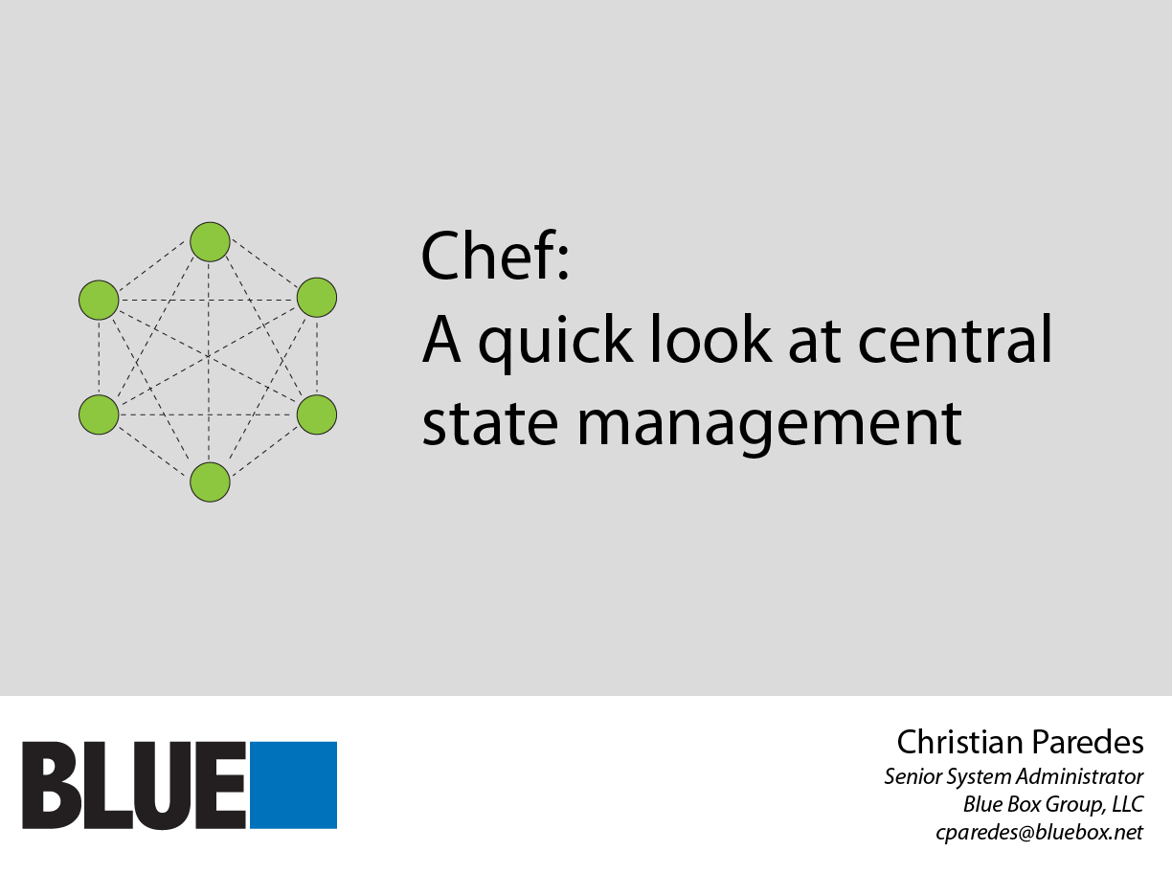
Notes:
Hey guys, welcome.
Now I know that some of you guys like naming your machines cute names, like Simon Belmont or Dr. Who. But we all know that a saner way of dealing with hundreds or thousands of machines is by having some sort of naming scheme that maps onto the machine's function and which part of the network segment it might be in, something like “app01.prod.example.com.” I think there's a better way to deal with machines than that, one that doesn't necessarily rely on naming conventions or whatever, but rather, you can simply inspect a machine, check out the software, and say, "oh, okay. This is probably a production app server.” I’ll have to thank R. I. Pienaar for that bit of insight, he’s the principal developer of mcollective and he showed me the way after a set of Twitter message exchanges on the question of using hostnames as a quick description of a system.
Before I go any further, I just want to talk about who I am and why I think this idea might be a better way forward.

Slide 2
The Problem:

Slide 3
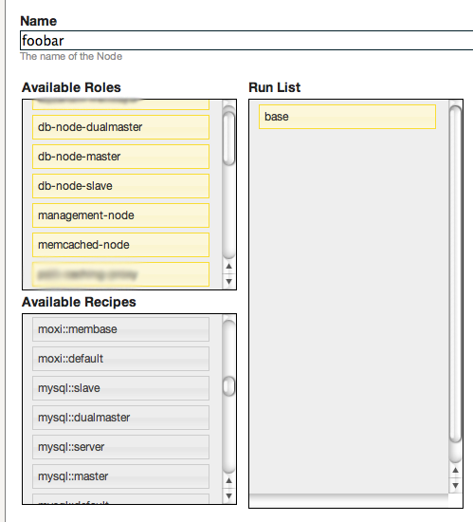
Problem description
Customer wants some kind of interface to quickly deploy machines.
Notes:
Here’s the set of problems we want to address with whatever system we adopt. We want an interface to deploy machines, either via a web UI or some sort of language we can use to express our thoughts. This means, we want to avoid touching the systems themselves and avoid configuring them by hand as much as possible. Examples here are from Chef.

Slide 4
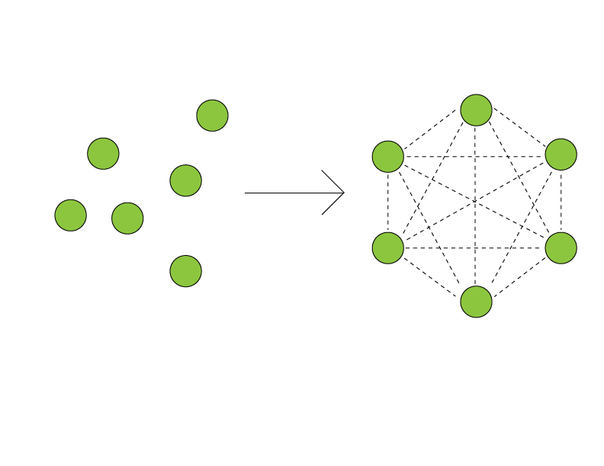
Problem description
Customer wants to deploy services automatically – that is, customer not only wants to deploy machines, they also want to have them hook into each other automatically.
Notes:
The customer also wants a way to automatically setup services. We not only want to have hands off deployments of managed servers, we also want to be hands off when it comes to configuring every aspect of the cluster so that they hook into each other. MySQL replication, for instance, should be automatic.

Slide 5
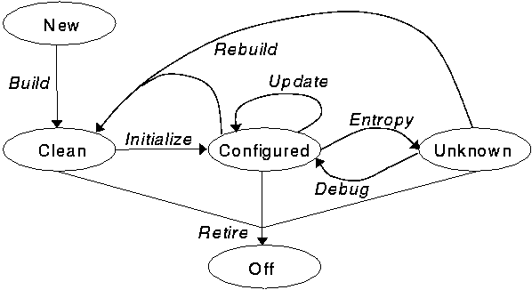
Problem description
Customer wants to manage machines throughout its lifecycle.
(image from
http://verticalsysadmin.com/cfengine3 [Aleksey Tsalolikhin], who got it from Rémy Evard’s LISA 1997 “An Analysis of UNIX System Configuration”)

Slide 6
Solution?
Use a configuration management system, like Puppet, cfengine, or Chef.
This fulfills at least (1) and (3) of our problem description (nice interface, lifecycle management.)
What about (2)?

Slide 7
Use Chef.
Ruby-based
Ordered execution of code
chef-server has built-in support for presenting node information for other nodes to use.
Notes:
So, Chef _does_ have a DSL. You can definitely program wholly within that DSL style, though it’s not a hard and fast rule like in other configuration management languages. What I’ve seen in various cookbook repositories is having a variable being assigned an entire Chef DSL code block, then sometime later in the recipe, have them execute a function that’s defined within some sort of class that defines the code block. T dot run_action “create”, for instance.

Slide 8
So, what kind of information can we use?
recipes: actual code that describes what you want to configure that can be applied directly to a node
roles: logical grouping of cookbooks and other roles that can be applied to a node
attributes: set of hashes that can be thrown into the “metadata” of the node (we can, for instance, have a “cluster” attribute that distinguishes nodes in cluster A from cluster B.)

Slide 9
Secret sauce for deploying multi-tiered services
chef search (powered by Solr)
Search against roles, attributes, recipes, kitchen sink

Slide 10
Example of searching against roles within a recipe
# Execute on MySQL DB servers in its cluster; grant privileges to
# a specific database for each app server in the same cluster as
# the DB.
app-servers = search(:node, “roles:app* AND cluster:#{node[:cluster]}”)
app-servers.each do |app-server|
query = “grant all privileges on foobar.* to \
#{app-server[:app][:user]}@#{app-server[:ipaddress]} \
identified by ‘#{app-server[:app][:password]}’;”
ruby_block do
block do
system “mysql -e ‘#{query}’”
end
not_if “mysql -e ‘show grants for #{app-server[:app][:user]}\
@#{app-server[:ipaddress]};’ | grep #{app-server[:ipaddress]}”
action :create
end
end
Notes:
Here’s a better example, and yes, there’s a lot going on here: since we’re good sysadmins, we only want to grant permission to access a database from specific IP addresses. Which IP addresses? App server IP addresses. But also, say we have a single chef-server but many different web applications managed by this single server, with each web app having their own set of app servers and DB servers. We can fence them from each other by introducing another attribute, let’s say “cluster”, and have a logical AND that ensures that we only want app servers belonging to the same cluster as the DB server. Anyway, we execute this code on each DB server, search for app servers belonging in the same cluster as the DB server we’re executing this code on, and then do a “grant all privileges” for a specific database, to a specific user and IP address as reported by that particular app server, and set a password that’s also reported by that particular app server.
We make sure we don’t execute this code if “show grants” shows up with anything with the same IP address.

Slide 11
knife
CRUD client for Chef.
# bootstrap CentOS 5 machine with role “app-server”
$ knife bootstrap <fqdn> “role[app-server]” -d \
centos5-gems
# search for nodes with role “app-server”
$ knife search node “roles:app-server”
# upload app-server.rb role file to chef-server.
$ knife role from file app-server.rb
# upload httpd cookbook to chef-server.
$ knife cookbook upload httpd
Notes:
A lot of your interaction with chef-server will be made through knife, which is a CRUD client for chef (create, read, update, delete.) You can bootstrap machines, do your searches, upload Chef-specific data, etc.

Slide 12
knife reporting (with chef search!)
# search for nodes that have a degraded 3ware RAID array
$ knife ssh -m “ `knife exec -E “search(:nodes, ‘*:*’).each \
{ |host| puts host[:hostname] }” | xargs`” ‘status=$(tw_cli \
/c0 show | grep -i “degrade”) ; if [ $status ] ; then \
echo “* DEGRADED” ; else echo “* OK” ; fi’
foobar.example.com * DEGRADED
barfoo.example.com * OK
(slightly modified from http://blog.loftninjas.org/2010/12/29/knife-one-liners/)
Notes:
One particular example which I modified from the link below is generating a report. Say I want to know which machines has a degraded 3ware RAID array – and yes, I know this is messy, but you can look at that link below to see how you can execute knife commands from a separate file. You can have knife create SSH connections and execute “tw_cli /c0 show” on nodes that match a certain search criteria (in this example, we search for EVERY managed node), then echo OK or DEGRADED based on whether tw_cli showed up with anything degraded or not. Perhaps you can then pipe all of this info to `mail` and have it mail you a report if anything’s degraded.

Slide 13
From piles of servers to services
I have a bunch of machines, I have my Chef recipes and roles, then I apply them to these sets of machines.
Chef search collects each machine that has specific roles, and does something with them (like creating grants on MySQL DB’s or creating config files so that app servers know where to find these DB’s.)
Notes:
Anyway, we go from having a pile of servers, to bootstrapped servers, to linked servers that form a service. We accomplish this mostly through chef’s search capabilities. Search is both a function in the DSL and a subcommand in knife.

Slide 14
So, what’s the upshot?
Notes:
Yeah, so what’s the point with fooling around with this anyway?

Slide 15
I don’t have to care about individual servers – I just know that I have N of them and that they behave according to what role or recipes I’ve assigned to them.
Notes:
I don’t have to worry about naming servers in any particular convention nor keep tabs on particular servers – all I care about now is that I have, say, 20 app servers, and 5 database master/slave pairs, and that they’re serving some sort of application with whatever piece of code. This is a bit of a philosophical shift in thinking – if we have our own hardware, we still _do_ have to worry about hardware failures and whatnot, but what if we already had a decent inventory system that told us which rack and slot each machine was in? Then we mostly only have to worry about machine specs!

Slide 16
What else could we do?
(disclaimer: I haven’t tried these ideas yet.)
- With custom ohai plugins, could measure load average, IOPs, or even disk and RAID array types, and stuff them into node attributes. (Then could pull them out with knife and generate a report, or automatically provision/destroy machines based on what we measured.)
Notes:
If I had a ton of time on my hands, I would do something like this: measure things with sar and uptime, or even check out /proc and grab interesting information and throw them into attributes (via ohai, which is similar to facter), then use recipes that act upon that information (or maybe grab them with knife exec for a report… or even have some intelligence that acts upon that information to provision new machines. One can dream.)

Slide 17
What else could we do?
Automatically setup replication between database machines (this I have done before*)
* https://github.com/blueboxgroup/bbg_cookbooks/tree/master/mysql - coauthored cookbook with Lee Huffman.
Notes:
You can also automatically setup MySQL replication. I actually had this coded up for a customer, and we’ve open sourced the cookbooks that I’ve coded up in the link below.

Slide 18
Quick tips
Use RVM (Ruby Version Manager), it’ll make your life much easier.
Use monit, just in case chef-client decides to gobble all of the memory on your nodes.
Use Ruby Enterprise Edition! (tuned better for server performance than vanilla Ruby.)
Setup a CI server like Hudson to deploy Chef code after passing tests
Notes:
Here’s a few quick tips for those who want to use Chef. USE RVM ON YOUR MACHINE! It’ll make your life way easier. I’d probably go as far as to say that you should use it on your servers, too (that’s what we do at Blue Box Group, and it works out great.)
I’d use something like monit in order to monitor memory usage on chef-client. Yes, since Chef is in Ruby, it’ll eat up a lot of memory. Be safe, make sure Chef doesn’t eat your memory alive.
Use Ruby Enterprise Edition. It has a way better garbage collector and allows you to tweak GC settings.

Slide 19
Further reading
Knife one liners: http://blog.loftninjas.org/2010/12/29/knife-one-liners/
Orchestration Panel, Cloud Connect 2010: http://www.slideshare.net/dev2ops/orchestration-panel-at-cloud-connect-2010
“My Chef Workflow”: http://ardell.posterous.com/a-chef-developers-workflow (developer oriented, but helps if you want a guide on how to quickly setup your machine for Chef.)
“Chef as a system integration tool” (self-plug): http://www.redbluemagenta.com/2010/12/02/chef-as-a-system-integration-tool/
Notes:
Here’s some links that you can check out.

Slide 20
Thanks! Any questions? (you can also contact me at cparedes@bluebox.net.)
Acknowledgements:
R. I. Pienaar, for showing me why hostnames suck
Stephen Balukoff and Elise Worthy, for encouraging me to get off my ass and write up a talk
Opscode, for writing an awesome piece of software and putting up with me
Sara Gemma, for being incredibly supportive while I was working on this project
Notes:
Thanks guys! Anyone have any questions?
You can also contact me at that email address if you feel shy.

