Slide 1
Fowler Flap Angle Study and Animation
By Cameron Parvini

Slide 2
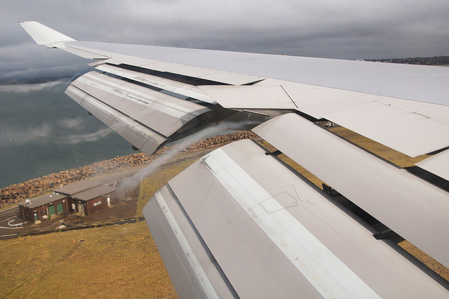
Fowler Flap History
Theorized in 1924 by Harlan D. Fowler
Tested in 1927 by Fowler & Crewfoot
Approved by NACA several years later
Figure 1: Extended Fowler Flap
http://www.decodedscience.com/wing-flaps-for-lift-augmentation-in-aircraft/11831/2
Notes:
Still in use today:
Boeing 707, 737, 747
Lockheed Martin C-130
Northrop-Grumman E-2C
Etc.

Slide 3
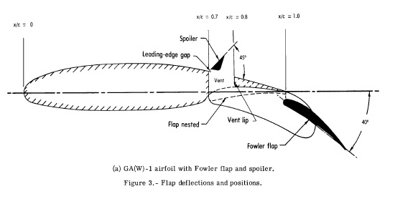
Geometry
Figure 2: Fowler Flap Geometry
Paulson, John W. Jr., *"Wind-Tunnel Investigation of a Fowler Flap and Spoiler for an Advanced General Aviation Wing,"* Langley Research Center, Hampton, VA 23665. June 1976. NASA TN D-8236.

Slide 4
Changes to Legacy Code
Several functions were altered to accept two foils
Two new functions added:
init( ); Initialization function for the animation
animate( ); Script for plotting each frame of the animation
Notes:
build_rhs( ); additional index for our second Kutta Condition
build_matrix( ); reformatted to complete all the math without the use of as many functions.
get_tangential_velocity( ); additional argument for A_{ij}^{t}

Slide 5
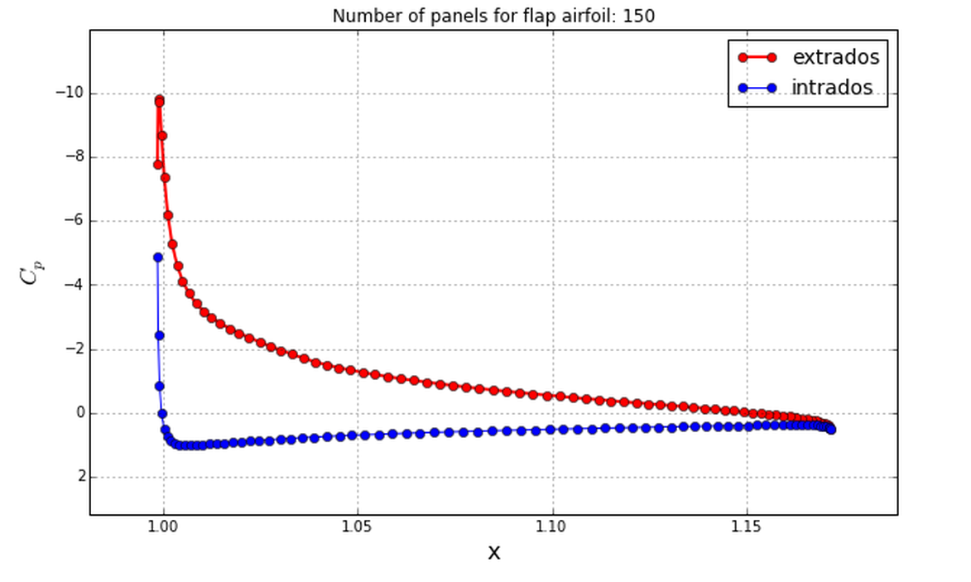
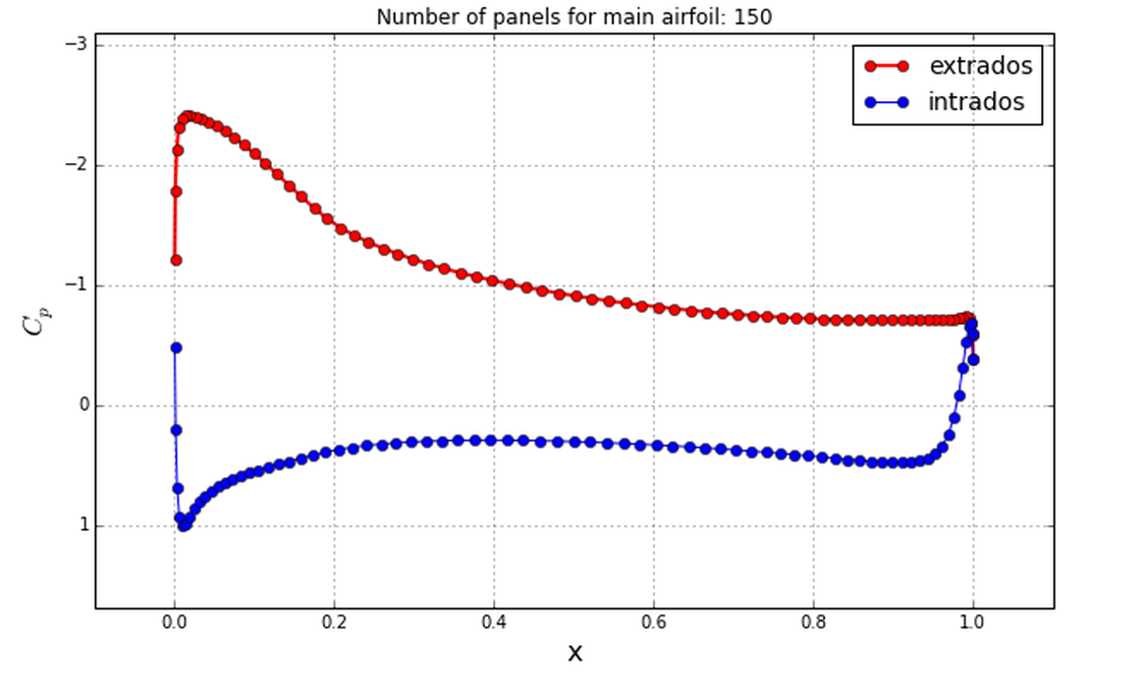
Results
C_{P} appears within reason for the first several steps
Lift and Accuracy calculations are reasonable
Animation functions were slow, but the video is clean
Notes:
Cp Breaks down at higher flap angles, as expected
Action required to both slide and rotate the flap proved “choppy” and imprecise – scrapped instead to focus on flap angle.
Animation: Could improve by increasing steps and decreasing the change in flap angle.
Issues mainly with the time to render all of the steps.

Slide 6
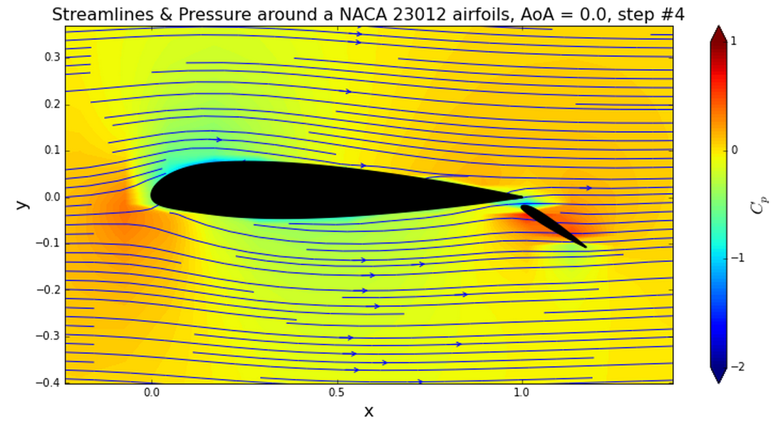
Results
Streamlines and C_{P}:
Notes:
Cp Breaks down at higher flap angles, as expected
Action required to both slide and rotate the flap proved “choppy” and imprecise – scrapped instead to focus on flap angle.
Animation: Could improve by increasing steps and decreasing the change in flap angle.
Issues mainly with the time to render all of the steps.

Slide 7
Moving Forward
Could add functionality to slide flap out into position
Time required to render all the steps is terrible, and should be improved
Animating the intrados/extrados plots based on step
Extension could be made to 3-body flow
Notes:
Code looks clean, but doesn’t operate quickly.
Could be a great spot for GPU processing and/or parallel computing with PyCUDA or Numba due to the similarity of each calculation set.

