Slide 1
"When Do Simple Text Models Beat Transformers?"
A systematic comparison of TF-IDF / n-grams / topic models vs RNN / CNN / Transformers across low-resource, domain shift, and robustness tests.
CS 584-B · Spring 2025
Classical
Neural
Transformer
Simple
⚖
Transformer
vs

Slide 2
Motivation & Core Question
Why question the Transformer default?
"Transformers dominate NLP benchmarks — but are they always worth it?"
💰 Resource Cost
⚡ Reliability
🔍 Explainability
BERT-base has 110M parameters. Fine-tuning requires significant GPU memory & time.
Do transformers hold up under noisy text, typos, or domain shift?
Can you trust or debug the output? Attention ≠ explanation.
🎯 Core Question: Under what conditions do classical methods beat transformers?
Model Family Map
High Accuracy High Interpretability
High Accuracy Low Interpretability
Low Accuracy High Interpretability
Low Accuracy Low Interpretability

Slide 3
Experimental Setup
Task · Datasets · Model Ladder · Evaluation Axes
📦 Datasets
🤖 Models
📊 Evaluation
Amazon Reviews (train) IMDb / Yelp (OOD test)
TF-IDF+LR → NGram+NB → GloVe+LR → CNN → BiLSTM → DistilBERT
Data Regime Domain Shift Robustness Tests
→
→
Model Ladder (simple → complex)
TF-IDF +LR
NGram +SVM
LDA/NMF
GloVe +LR
CNN
BiLSTM
DistilBERT
BERT-base
────────────────────────────────────────►
Simpler More complex

Slide 4
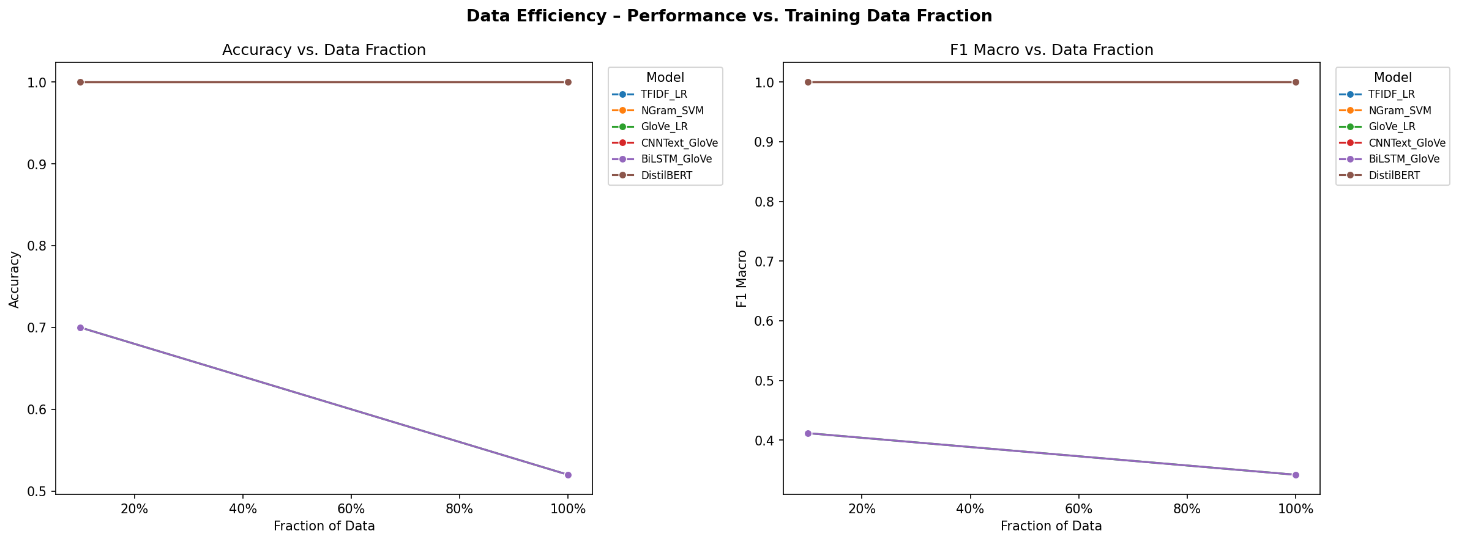
Experiment 1: Data Regime
How does performance scale with labeled data?
Key Results
TF-IDF+LR: F1=1.00
NGram+SVM: F1=1.00
GloVe+LR: F1=0.41
CNN: F1=1.00
BiLSTM: F1=0.41
DistilBERT:F1=1.00
💡 At 10% data, TF-IDF+LR matches DistilBERT (F1 = 1.00) while training ~190× faster (0.007 s vs 1.33 s)

Slide 5
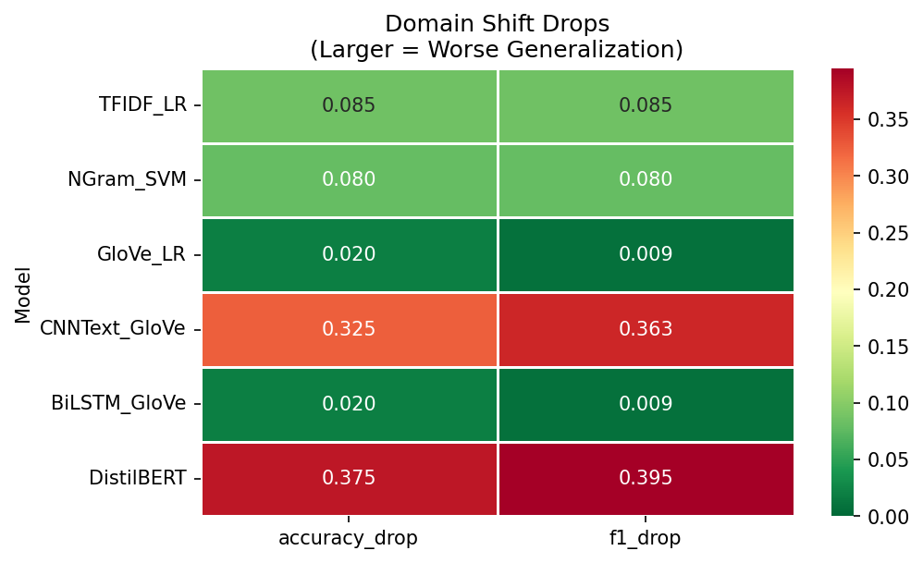
Experiment 2: Domain Shift
Train on Amazon Reviews → Test on IMDb (out-of-domain)
Accuracy Drop (in → out)
TFIDF_LR
1.00 → 0.92
-8.5%
NGram_SVM
1.00 → 0.92
-8.0%
GloVe_LR
0.52 → 0.50
-2.0%
CNNText_GloVe
1.00 → 0.68
-32.5%
BiLSTM_GloVe
0.52 → 0.50
-2.0%
DistilBERT
1.00 → 0.63
-37.5%
💡 Best in-domain ≠ most robust. DistilBERT drops 37.5% out-of-domain. TF-IDF+LR drops only 8.5% — far more reliable under distribution shift.

Slide 6
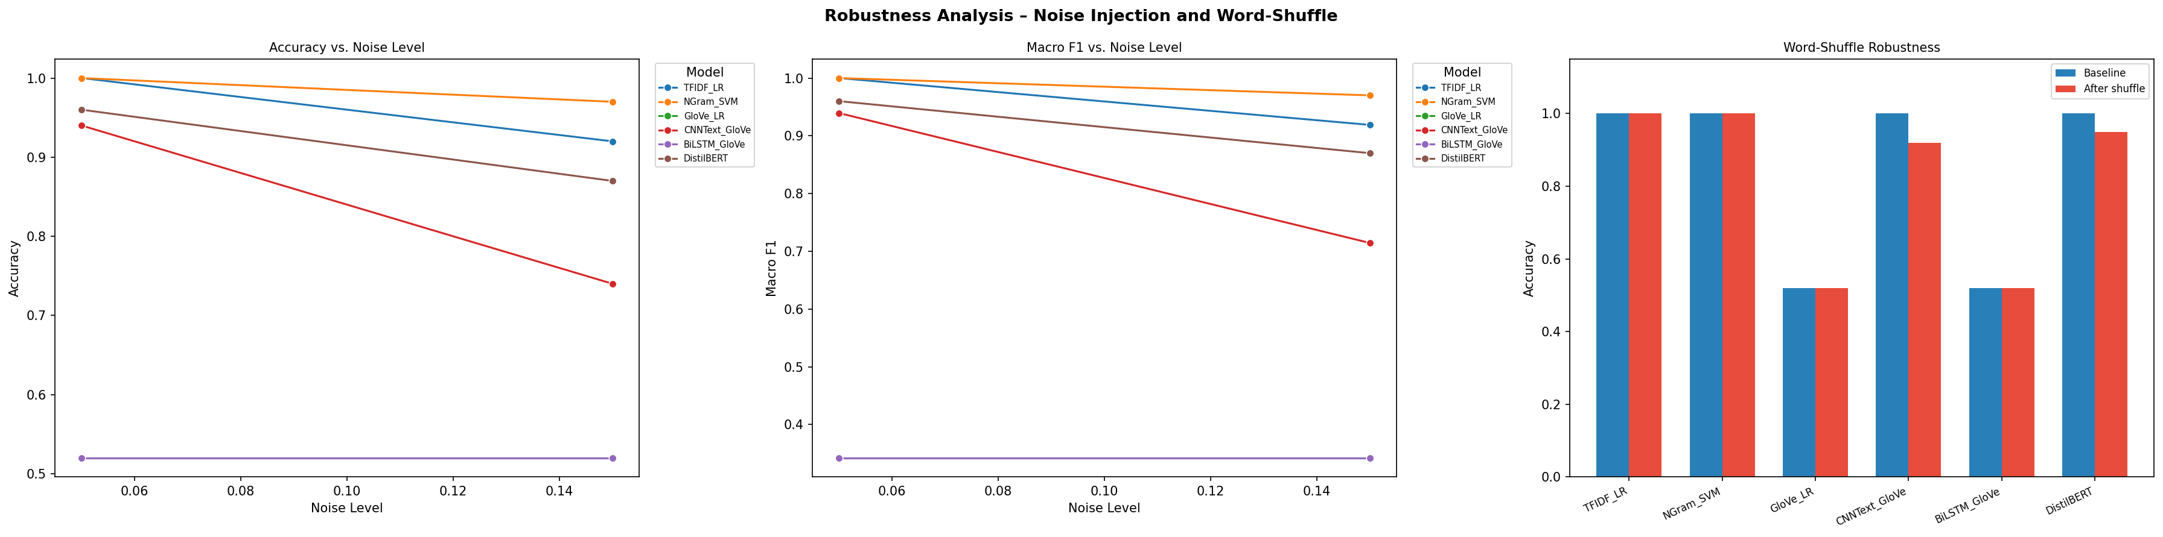
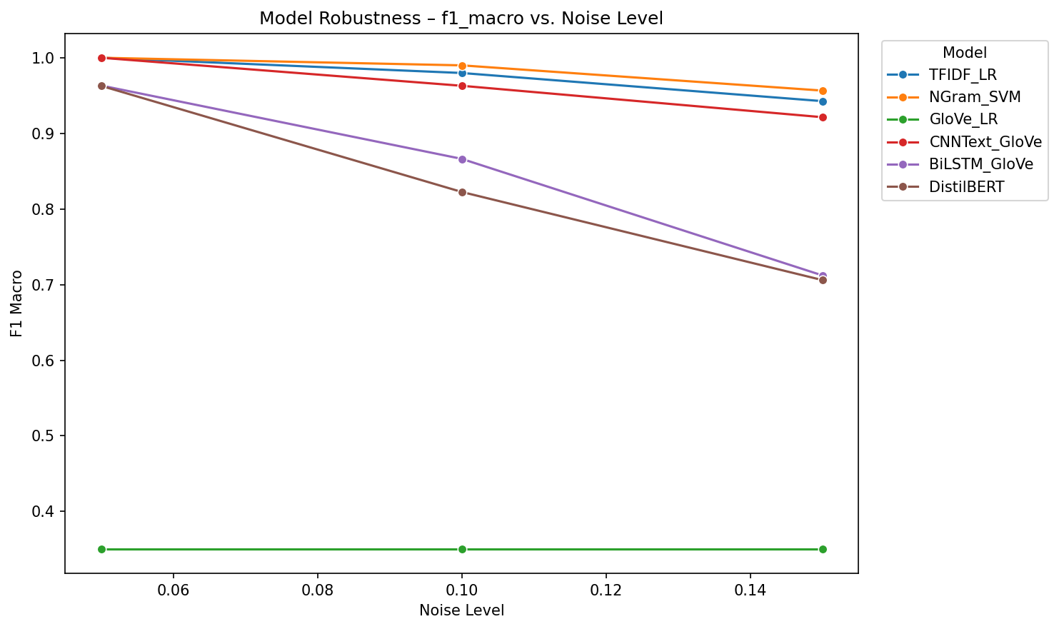
Experiment 3: Robustness Tests
How brittle are models to controlled perturbations?
Word-Shuffle Robustness
Model
Baseline
Shuffled
Drop
TFIDF_LR
1.00
1.00
0%
NGram_SVM
1.00
1.00
0%
GloVe_LR
0.52
0.52
0%
CNN_GloVe
1.00
0.92
8%
BiLSTM_GloVe
0.52
0.52
0%
DistilBERT
1.00
0.95
5%
💡 TF-IDF stable under word shuffle (bag-of-words by design). CNN & DistilBERT degrade under both shuffle & lexical noise.

Slide 7
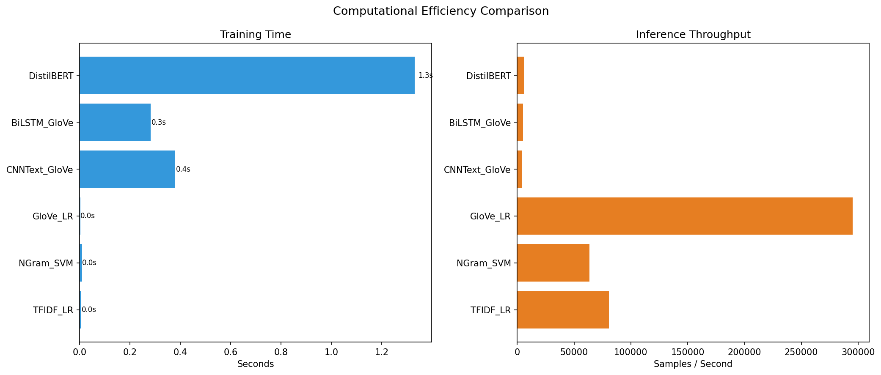
Efficiency Comparison
What does performance cost?
Training Time
TFIDF_LR 0.007 s
NGram_SVM 0.010 s
GloVe_LR 0.003 s
CNNText_GloVe 0.38 s
BiLSTM_GloVe 0.28 s
DistilBERT 1.33 s
💡 DistilBERT trains ~190× slower than TF-IDF+LR. Classical models infer at 80 000+ samples/sec vs ~6 000 for DistilBERT.

Slide 8
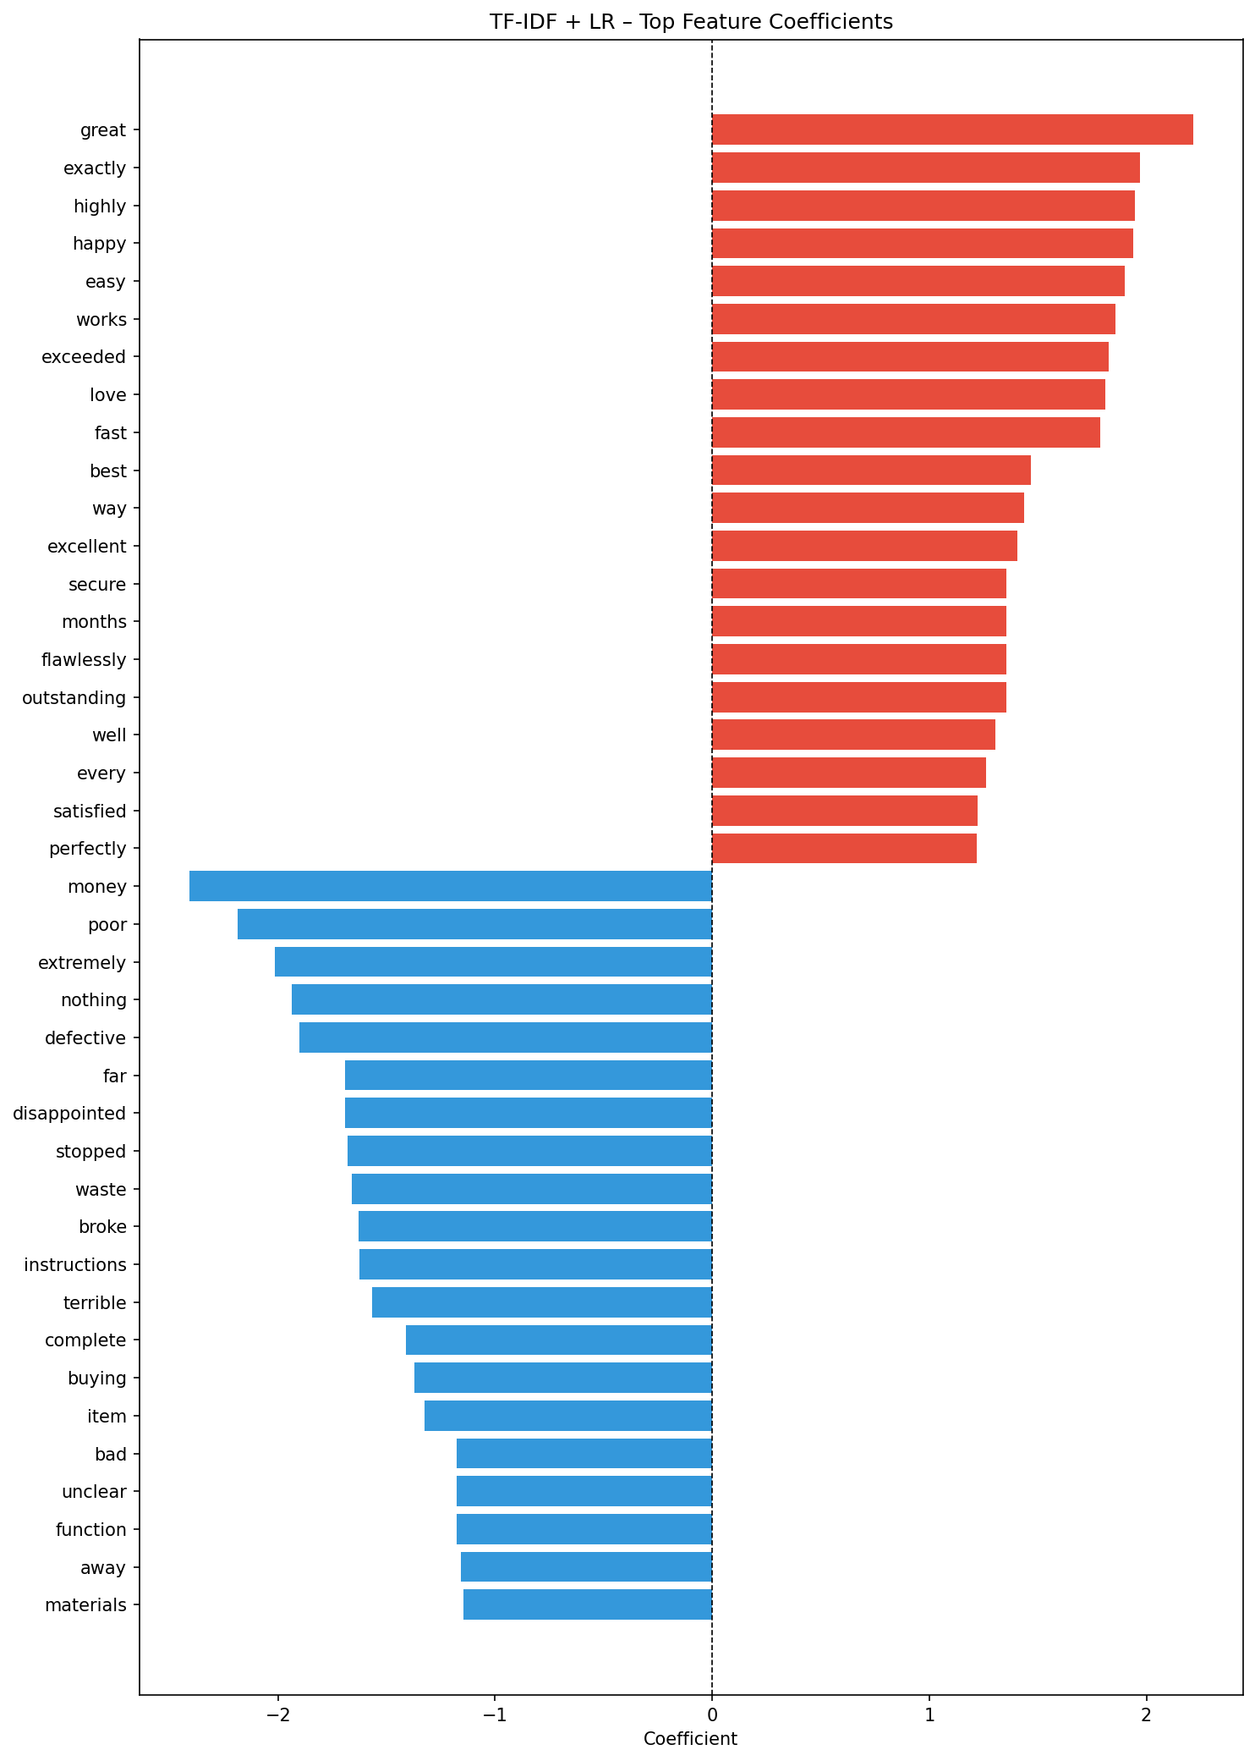
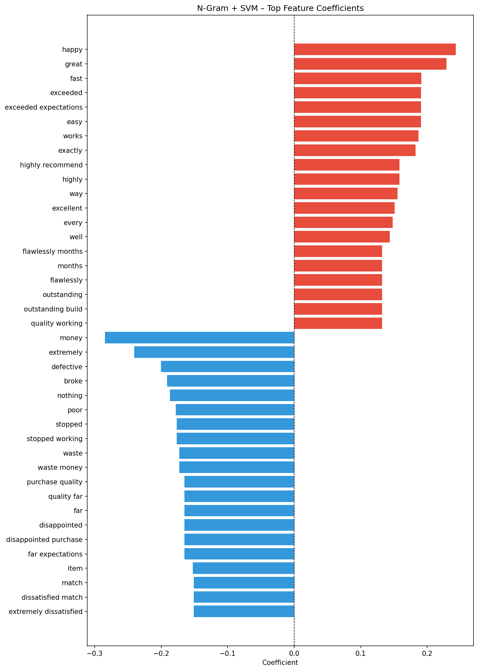
Interpretability
Can we trust and act on the model's reasoning?
TF-IDF + LR — Top Features
N-gram + SVM — Top Features
💡 Classical model weights are directly readable. Transformer explanations (attention / saliency) require heavy tooling and can be unstable.

Slide 9
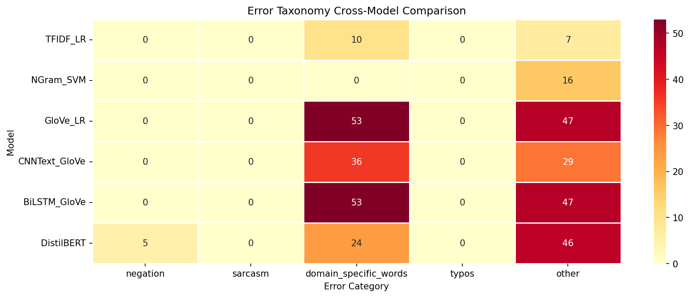
Error Analysis
Each model family has a distinct failure signature
Error Taxonomy
• Negation
"not good" → misread as positive
• Sarcasm / Irony
surface positives hide negative meaning
• Long-range deps.
BiLSTM struggles with >50 tokens
• Domain vocab shift
"killer feature" in tech ≠ positive
• Typos / OOV
CNN & BERT degrade; char n-grams robust
• Mixed sentiment
all models struggle with neutral text
💡 TF-IDF/LR fails on negation & sarcasm. DistilBERT fails on domain vocab & rare OOV. Char n-grams are most robust to typos.

Slide 10
Decision Framework
Evidence-based model selection guide
Deployment Condition
Recommended Model
Why
< 500 labeled examples
TF-IDF + LR
Data-efficient, trains in ms, F1 matches BERT
Strong domain shift
Char n-gram or LR
Less surface-feature overfitting; -8% vs -37% drop
Noisy / informal text
Char n-gram
Typo-robust by design; word-level models degrade
Need actionable explanations
LR / SVM
Directly readable feature weights, no extra tooling
Large data, clean domain
BERT / DistilBERT
Global context pays off; achieves highest in-domain F1
⭐ The right model depends on your constraints — not just benchmark accuracy.

Slide 11
Conclusions
Three evidence-based takeaways
Simple methods are competitive
1
TF-IDF+LR matches DistilBERT at 10% data and degrades only 8% under domain shift.
Transformers excel — when conditions are right
2
BERT achieves peak in-domain accuracy, but drops 37.5% out-of-domain and trains 190× slower.
Model choice should follow deployment constraints
3
Data size, robustness needs, latency budget, and interpretability requirements all matter more than leaderboard rank.
⚖ The balance tips depending on context — not always toward Transformers.

Slide 12
Code, Reproducibility & Q/A
📂 Repository
📋 Deliverables
github.com/cpatel6/CS584-B-Project Reproducible scripts · fixed random seeds · config YAML files Single-command run: python scripts/run_pipeline.py --config configs/default.yaml
✅ In-domain & OOD accuracy tables
✅ Data-regime scaling plots
✅ Domain-shift drop analysis
✅ Robustness perturbation results
✅ Efficiency timing benchmarks
✅ Feature importance visualizations
✅ Error taxonomy with examples
✅ Decision framework (Slide 10)
Questions? · Thank you!
CS 584-B · Spring 2025

