Slide 1
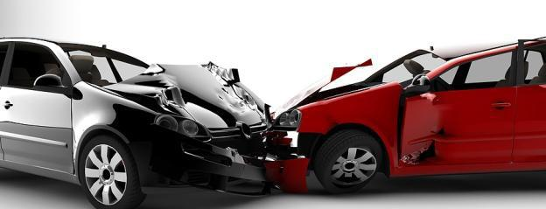
Factors Affecting Major Injuries
Team 3:
Chakradhar Pathi
Mrunali Kadam
Ravali Musty

Slide 2
Introduction
On average, there are 5,808,272 car crashes in the United States annually.
In 2014 alone, there were 32,675 deaths as a direct result of motor vehicle accidents.
In 2010, the total cost of societal harm from motor vehicle crashes in the United States was approximately $836 billion.

Slide 3
What is the need to analyze car crashes
To provide
Insights on what factors influence the injury during a crash.
Recommendations on how to prevent an accident.
To Reduce
Number of accidents and save people from getting injured
Damage caused to the property during the crash.

Slide 4
Purpose
Identify
The factors affecting the injure severity
Models to predict the outcome of Injury severity
Evaluate
The correctness of the model and draw insights
Build

Slide 5
Agenda
Data Description and Sources
Software Used
Analysis Method
Observations
Results

Slide 6


Data Sources
National Highway Transportation Safety Administration (NHTSA)
National Automotive Sampling System (NASS) General Estimates System (GES)

Slide 7
Software Used and Analysis Method
KNIME Tool
Microsoft Excel
CRISP-DM (Analysis Method)

Slide 8
CRISP-DM
The CRISP-DM method has 6 steps in it-
Business Understanding
Data Understanding
Data Preparation
Model Building
Model Evaluation
Model Deployment

Slide 9
Business Understanding
Thousands of crashes occur every year resulting in loss of people’s lives and Properties.
Additionally, thousands of people are injured.
Nationally representative probability sample is collected from information provided by 5 million police men.
Our objective is to identify the factors causing the loss and mitigate the damage.

Slide 10

Business Questions?
How to identify the factors that affect ‘Major’ Injury ?
What recommendations should be given to prevent the damage to property and people?

Slide 11
Data Understanding
There are four datasets provided by NASS GES dataset
Accidents
Vehicles
Person
Distract
The dataset has 135900 records and 195 columns in it

Slide 12
Data Pre-Processing
Data Consolidation
Data Aggregation
Data Reduction
Data Transformation

Slide 13
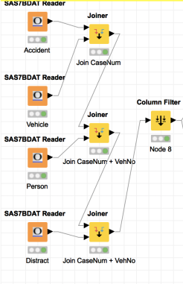
Data Consolidation
Data is consolidated in KNIME tool using a Joiner Node
Accident, vehicle, Person and Distract tables are joined using a inner join
Final data points -135900
195 columns

Slide 14
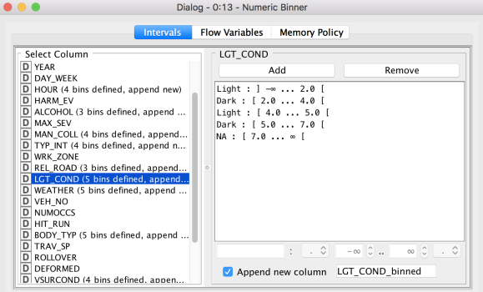
Data Aggregation
Columns Binned
Hour
Light Condition
Weather
Body Type
Month
Alcohol_IM
Surface Condition
Seat Position
Airbags
Injure Severity
Type of Intersection
Relation to road
Manner of collision
Rollover
Sex_IM
Age_IM
Deformed

Slide 15
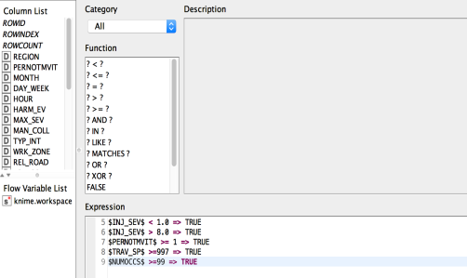
Data Reduction (Rows)
Rule Based Row Filter
Erroneous values are removed
Total Rows : 18260

Slide 16
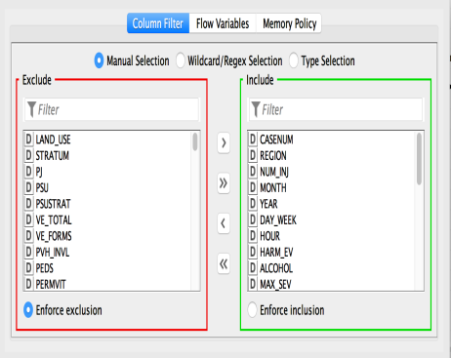
Data Reduction (Columns)
Column Filter
Relevant columns are included after manual research and feature selection
Total Columns : 21

Slide 17
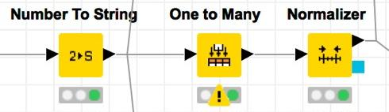
Data Transformation
Conversion of number to string
Creation of Dummy Variables
Normalization of the dummy variables

Slide 18
Relevant variables to our study
Accident | Vehicle | Person
Month Day of week Hour of day Alcohol_IM Light condition Weather Number of vehicles involved Manner of Collision Type of intersection Relation to traffic way Type of Intersection Work Zone | Body Type Travel Speed Surface Condition Number of Occupants Rollover | Age_IM Sex_IM Seat Position Air Bag

Slide 19
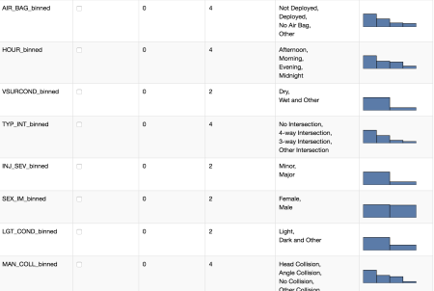
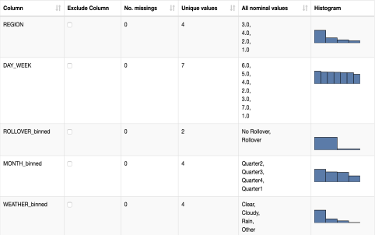
Descriptive Statistics

Slide 20
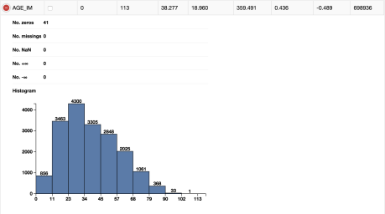
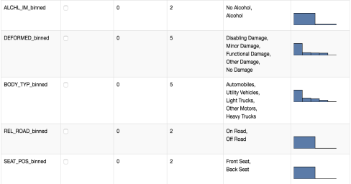
Descriptive Statistics

Slide 21
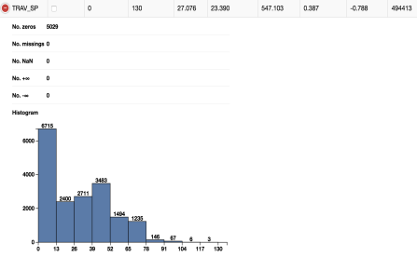
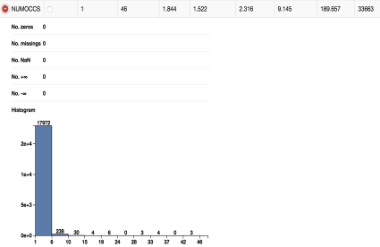
Descriptive Statistics

Slide 22
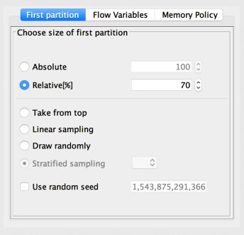
Data Partitioning
Input Data
Training Data - 12782
Test Data – 5478
70%
30%

Slide 23
Model Building
Artificial Neural Network
01
Decision Tree
02
Random Forest
03

Slide 24
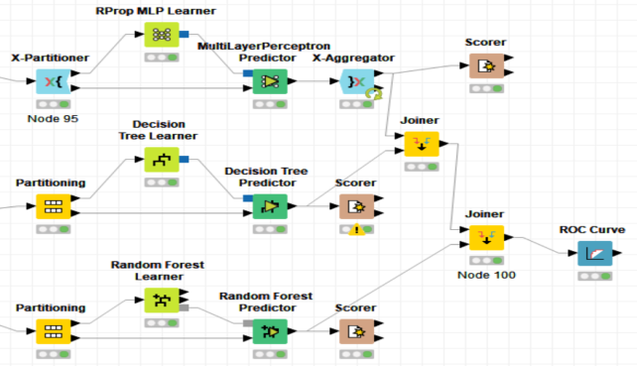
Model Building (Unbalanced)

Slide 25
Model Evaluation (Unbalanced)
Measure | Artificial Neural Network | Decision Tree | Random Forest
Accuracy | 80.8% | 77.4% | 82.3%
Sensitivity | 14.8% | 33.9% | 16.5%
Specificity | 96.3% | 87.6% | 97.8%
Precision | 48.5% | 38.9% | 63.5%
Model

Slide 26
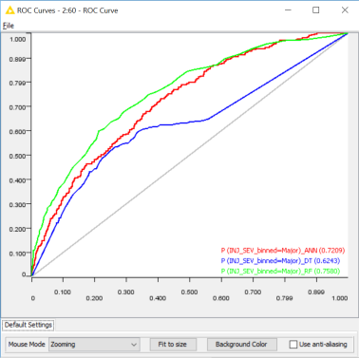
Model Evaluation:
ROC Curve (Unbalanced)

Slide 27
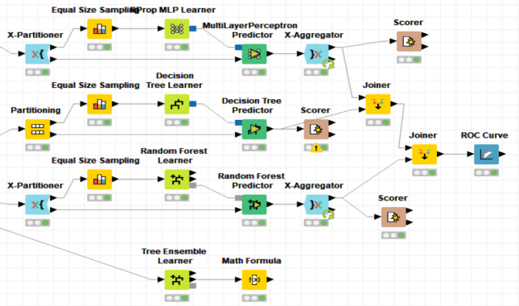
Model Building (balanced)

Slide 28
Model Evaluation (balanced)
Measure | Artificial Neural Network | Decision Tree | Random Forest
Accuracy | 65.1% | 64.2% | 71.0%
Sensitivity | 69.9% | 62.2% | 68.6%
Specificity | 64.0% | 64.6% | 71.6%
Precision | 31.4% | 29.3% | 36.2%
Model

Slide 29
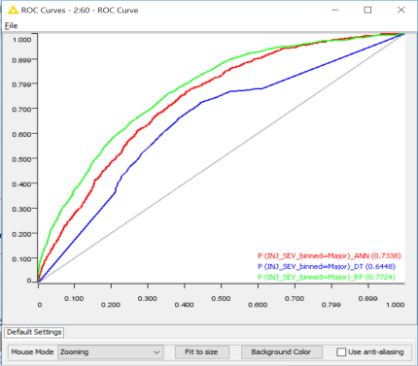
Model Evaluation:
ROC Curve (balanced)

Slide 30
Analysis Results
The best model out of all 3 models is Random Forest with highest accuracy of 71%.
According to our model factors leading to ‘Major’ Injury severity are:
Deformation
Airbags
Travel Speed
Body Type of vehicle

Slide 31
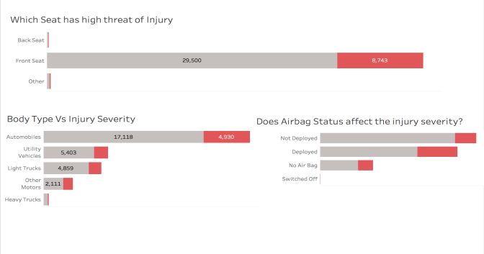
Insights from Tableau Visualization

Slide 32
Recommendations
Seat Belt must be worn at all times while in the car
Airbags must be installed and kept on all the times.
Maintain the speed limit when on road.

Slide 33
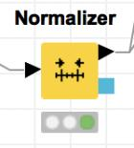

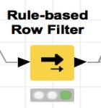
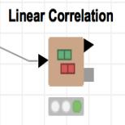
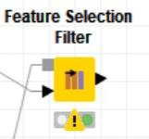
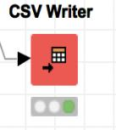
Useful Nodes

Slide 34
THANK YOU

