Slide 1
TCE Tour: Screencast
These are accompanying slides for a set of TCE screencast clips available at
http://tce.cs.tut.fi/index.php/home/screencasts
The set of videos goes through the most important tools in TCE by means of a simple CRC example application
Starts from C, ends with a TTA+program running on an FPGA board

Slide 2
Intro and Exploration (about 7 minutes)
Start with the application code in C
minimal.adf is shipped in TCE:
  a minimal set of resources in TTAs supported by the tcecc compiler
reflect.vhdl is a VHDL implementation of a custom operation which will be added later to the design

Slide 3
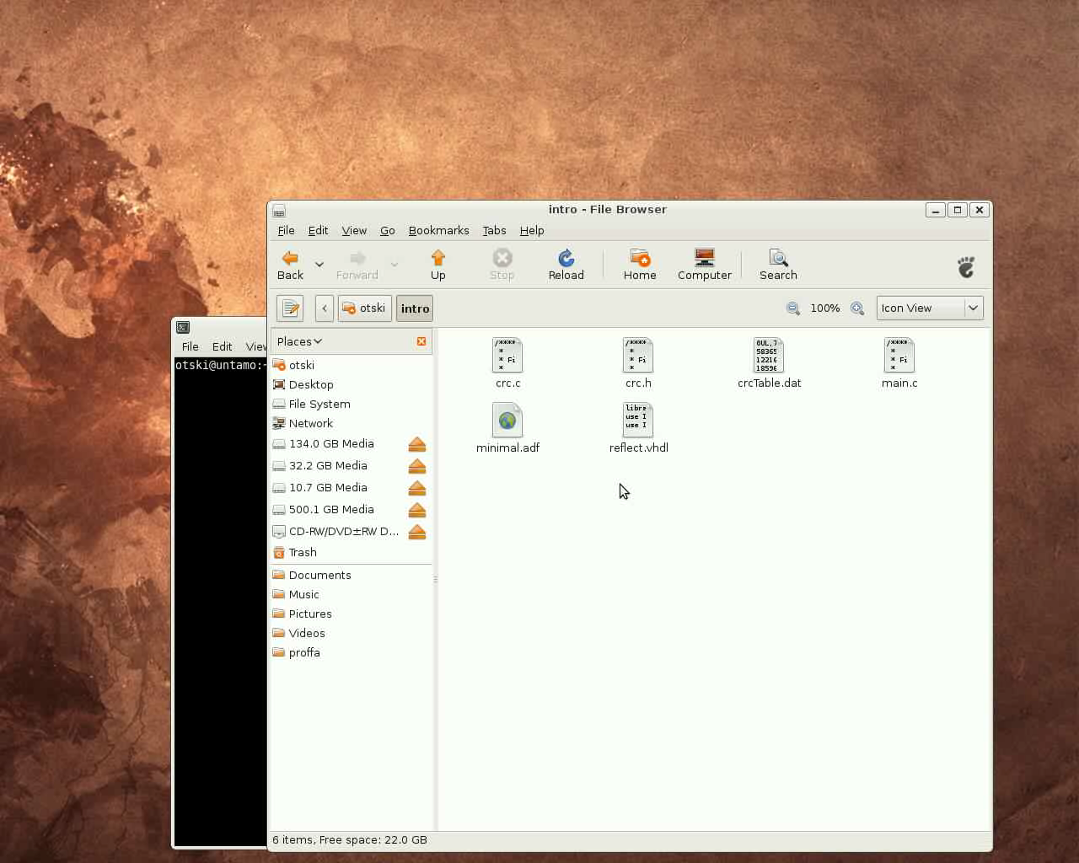
Intro and Exploration

Slide 4
Intro and Exploration
Open the minimal.adf to the Processor Design GUI
  “prode minimal.adf &”

Slide 5
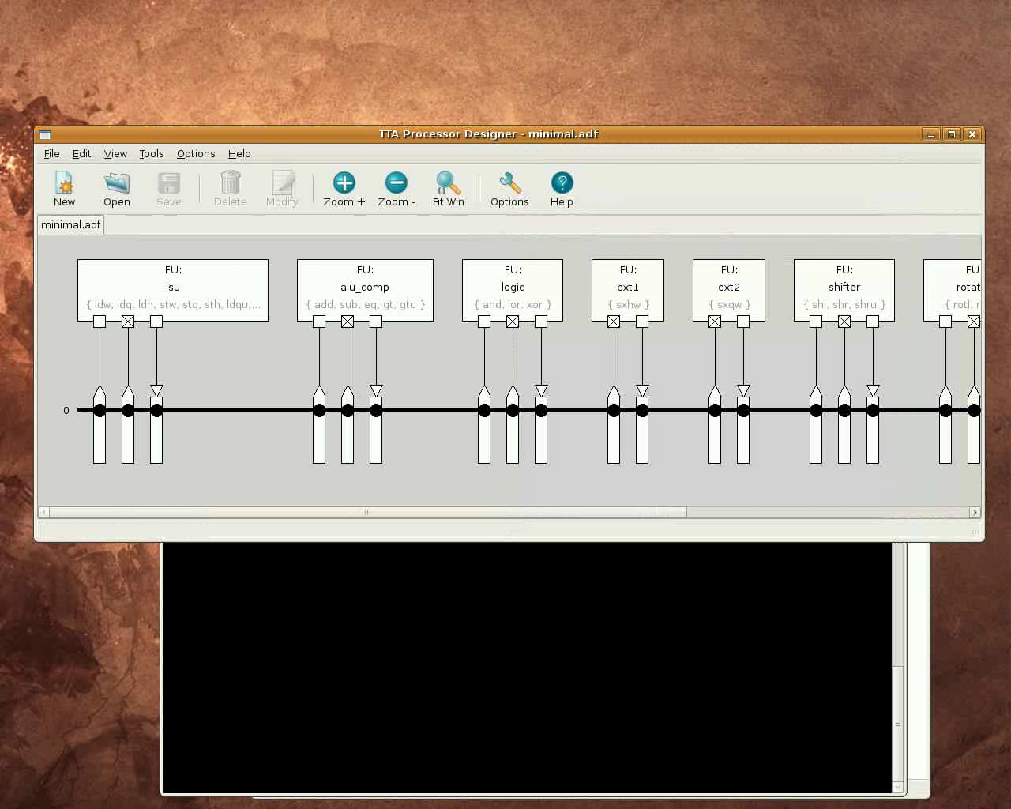

Slide 6
Intro and Exploration
The main.c has a simple string “TCE rocks!” for which we are going to compute the CRC

Slide 7
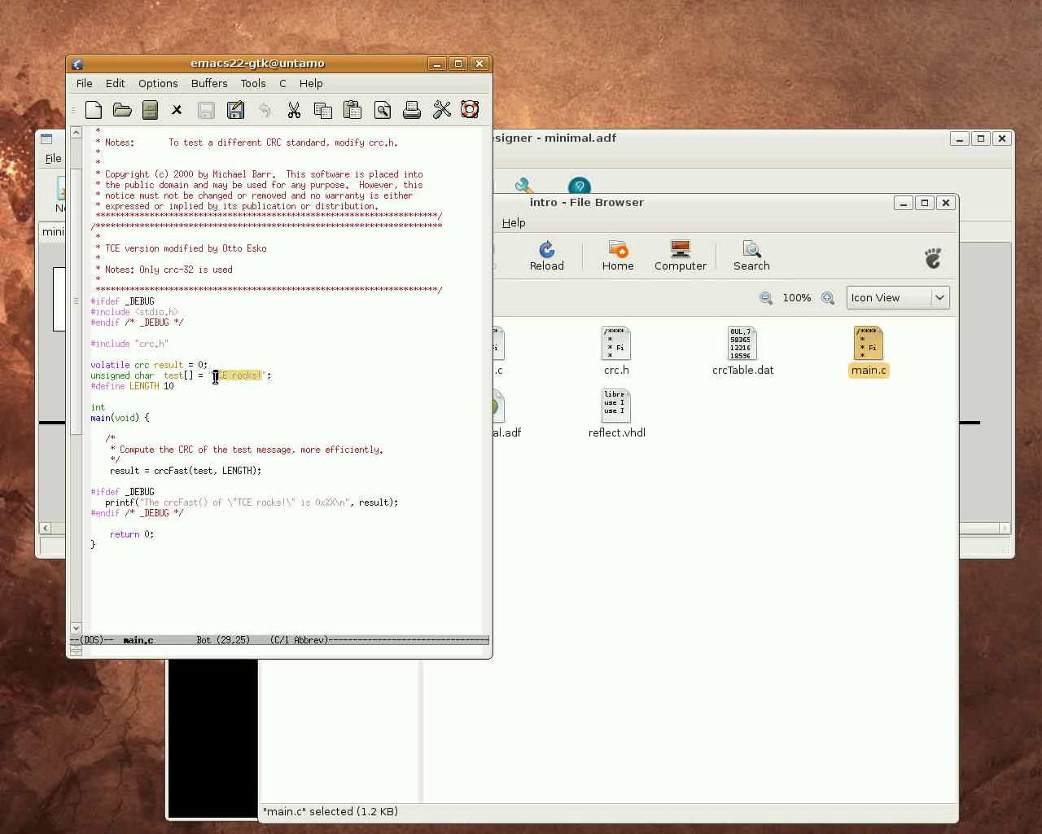

Slide 8
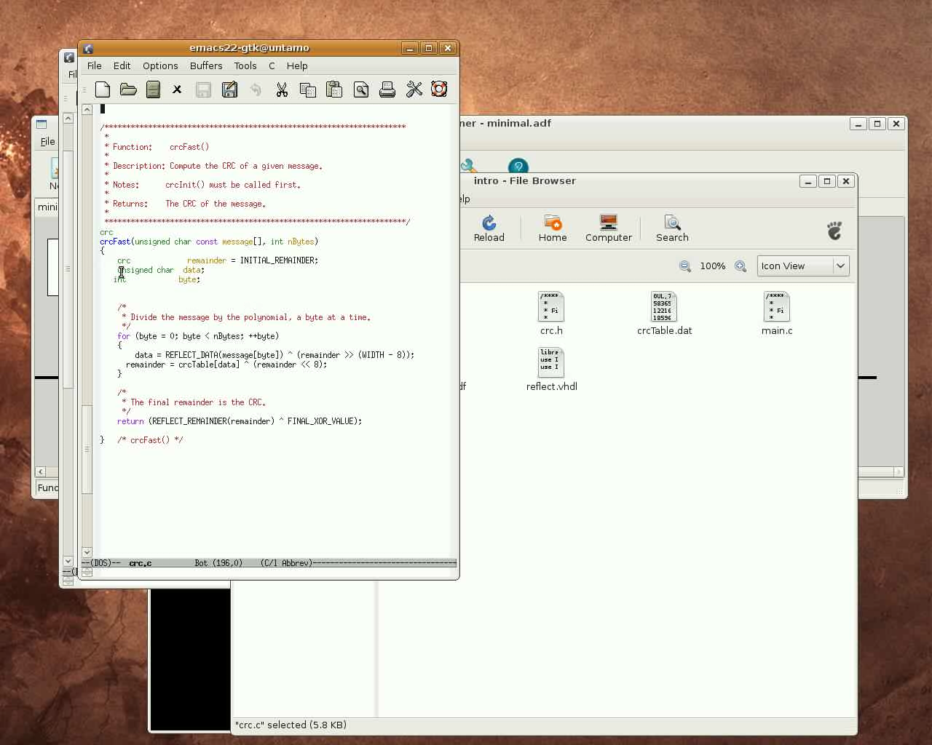

Slide 9
Intro and Exploration
Let's see how well the CRC code runs with the smallest supported TTA
  Compile the code to the TTA with the retargetable tcecc compiler
  Load the processor architecture description and the compiled program to the Processor Simulator GUI (Proxim)

Slide 10
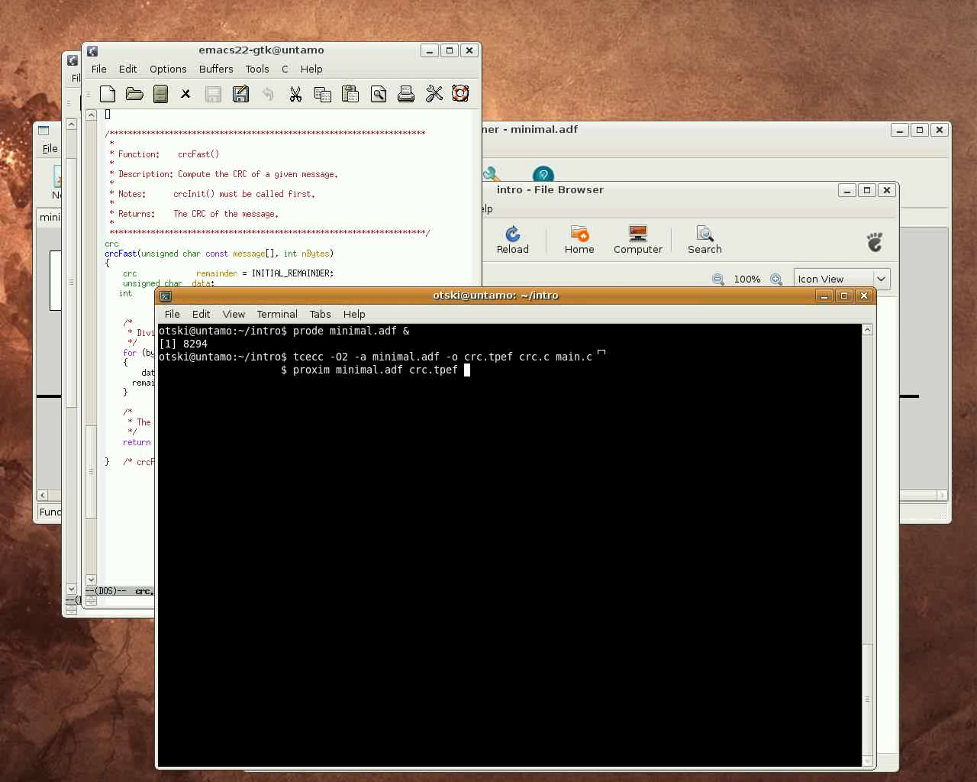

Slide 11
Intro and Exploration
Proxim's main window displays the disassembly of the TTA program
The minimal.adf has only one bus, thus the moves cannot be parallelized

Slide 12
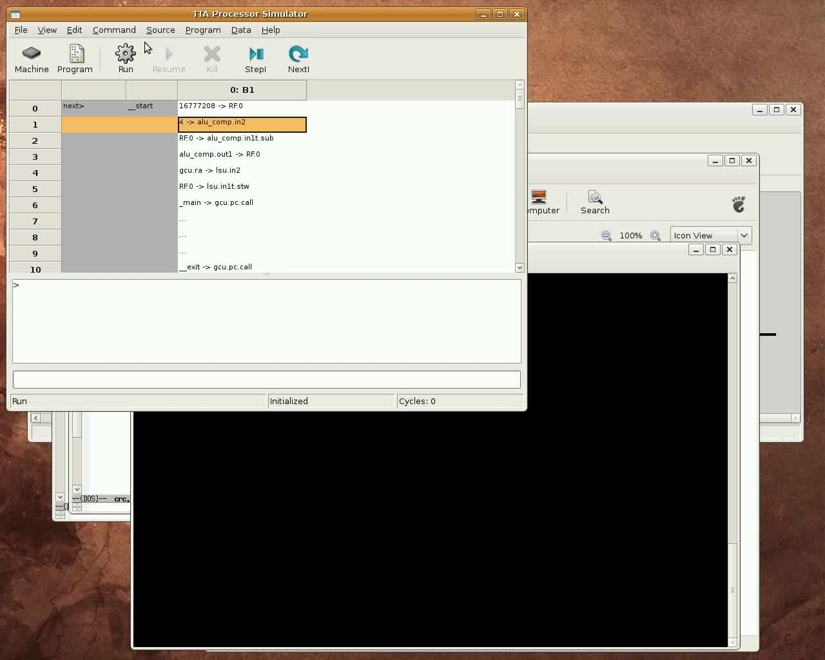

Slide 13
Intro and Exploration
Proxim's machine window:
  Visualizes the TTA processor when running the given program
  Single stepping the assembly code highlights the transport paths in the processor accessed by the moves in the current instruction
  Allows inspecting the values in programmer-visible registers of the TTA such as FU ports, the utilization of the components (color coding), etc.
  Most importantly for this case, the simulator displays the total cycle count 6109 (number of TTA instructions executed)
  Also statistics for the different operations executed, registers used etc. can be produced to guide manual exploration of the architecture
    “info proc stats”

Slide 14
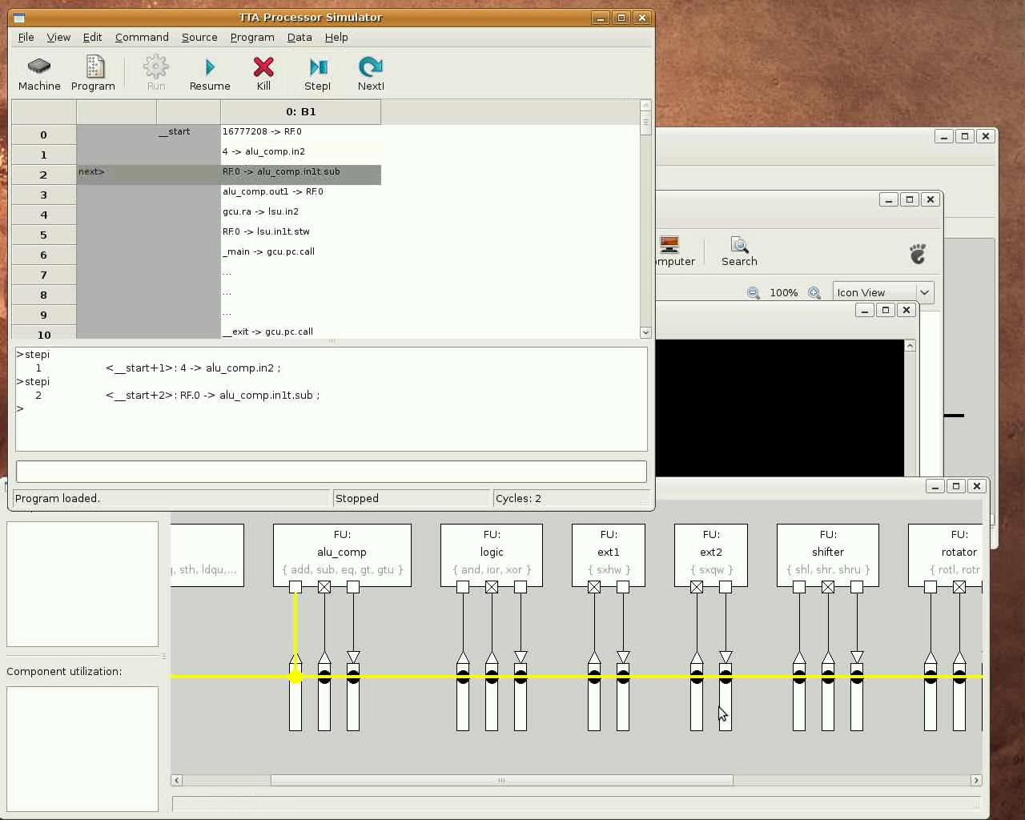

Slide 15
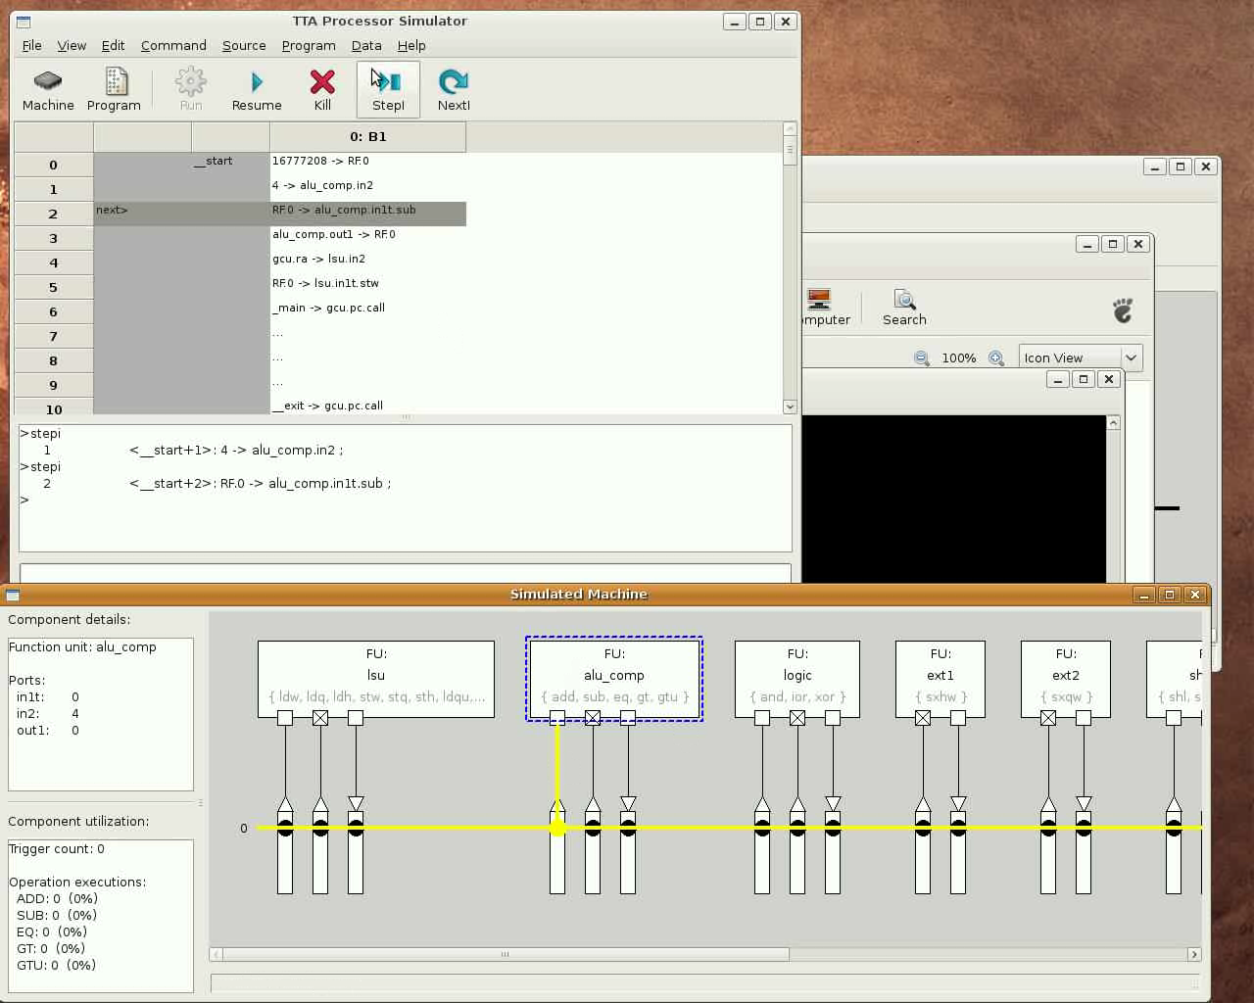

Slide 16
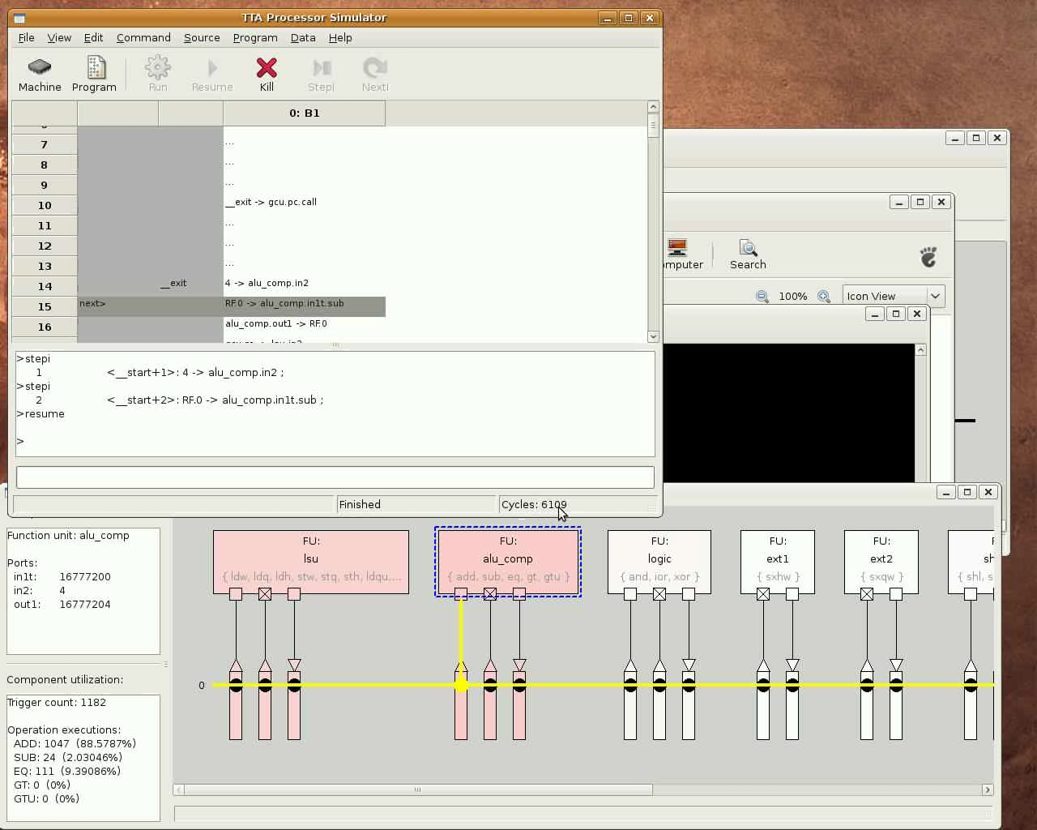

Slide 17
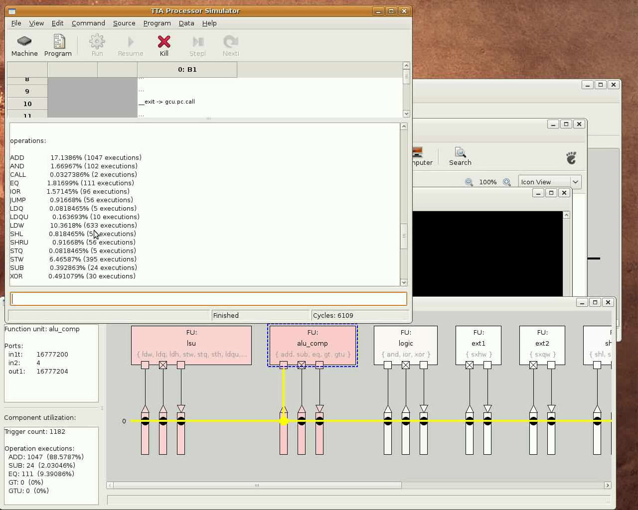

Slide 18
Intro and Exploration
The minimal.adf has only 5 registers, the CRC algorithm can use more as we saw from the stats
Let's add some more registers using the Processor Designer (ProDe)
  In this case we double the number to 10 registers
Recompile the program for the new architecture with 10 registers using tcecc
This time we'll load the processor+program to the command line interface of the simulator (ttasim)
  “info proc cycles” works here also and produces the cycle count 3116 which is almost halved from the one we got using a machine with only 5 registers

Slide 19
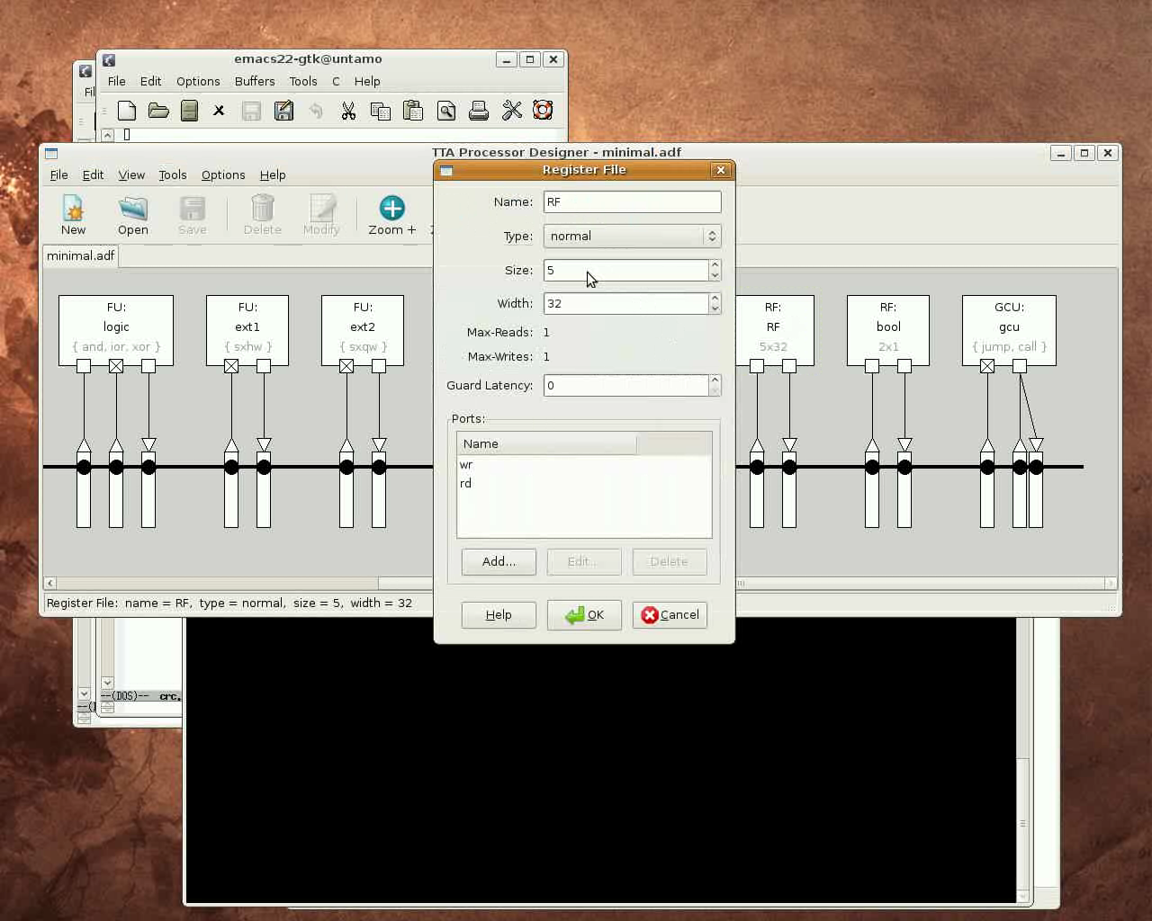

Slide 20
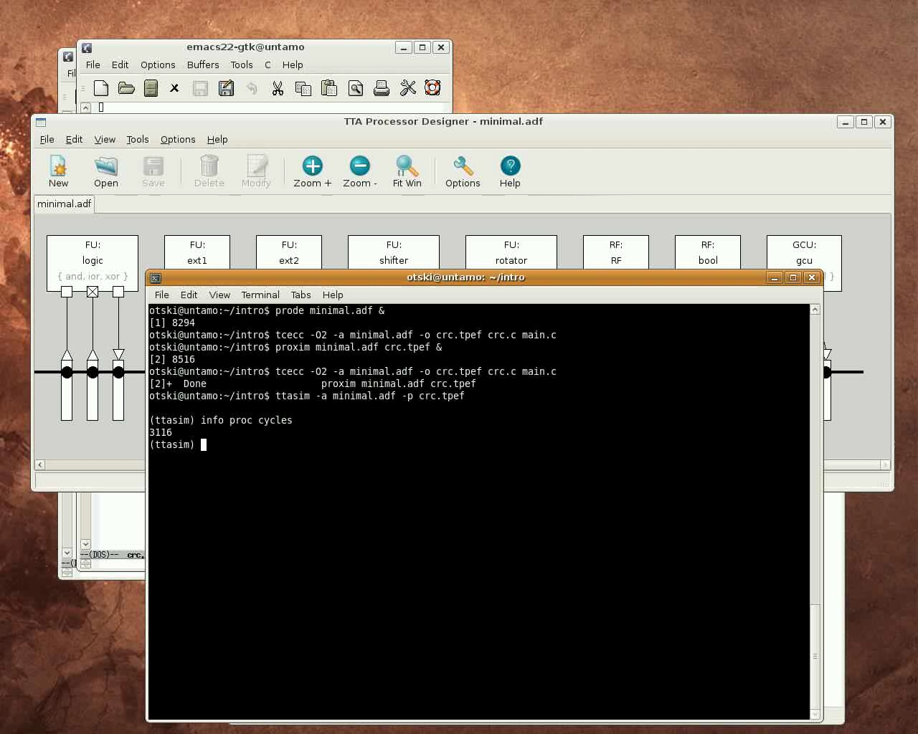

Slide 21
Intro and Exploration
Next we'll try the Design Space Explorer tool
The tool is used to launch “explorer plugins” which perform modifications to the target and measure their effect to
  cycle count
  area estimate
  energy estimate
  longest path delay estimate
The plugins can be fully automated or semi-automated
  Can implement a loop that explores multiple points in the design space or just generate one new design space point (processor configuration)
“explore -g” prints a list of available exploration plugins
  In this example we use the GrowMachine plugin which adds basic resources to the machine until the cycle count does not drop anymore significantly

Slide 22
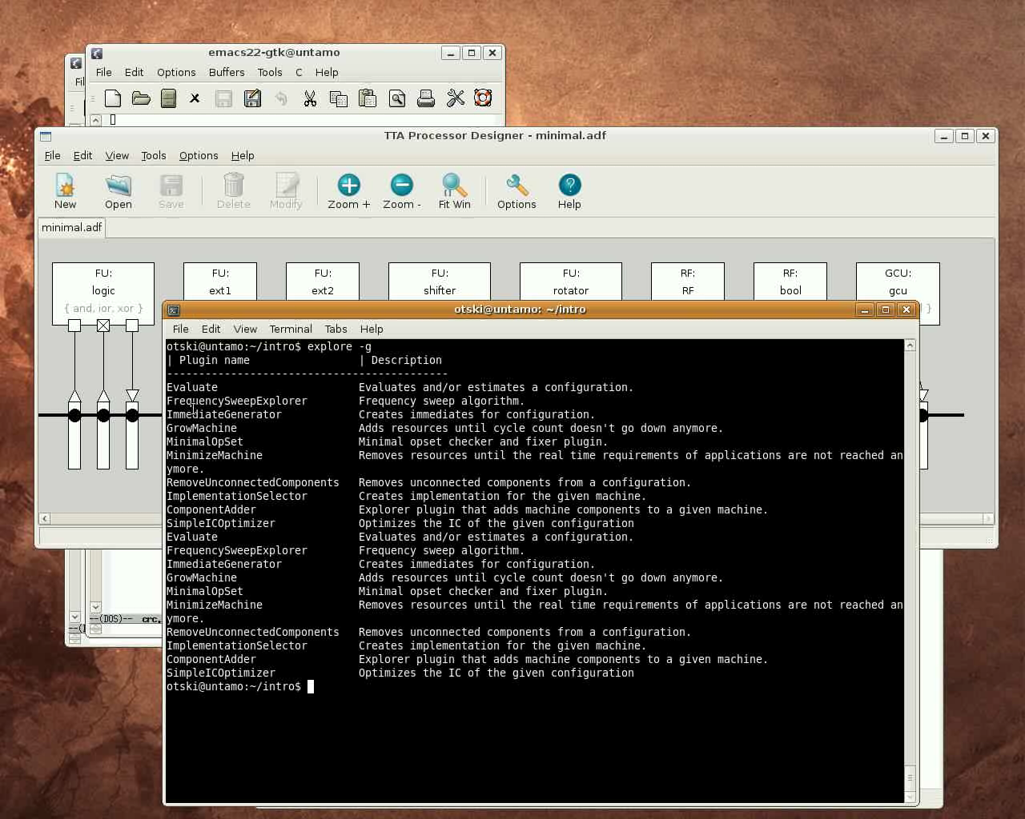
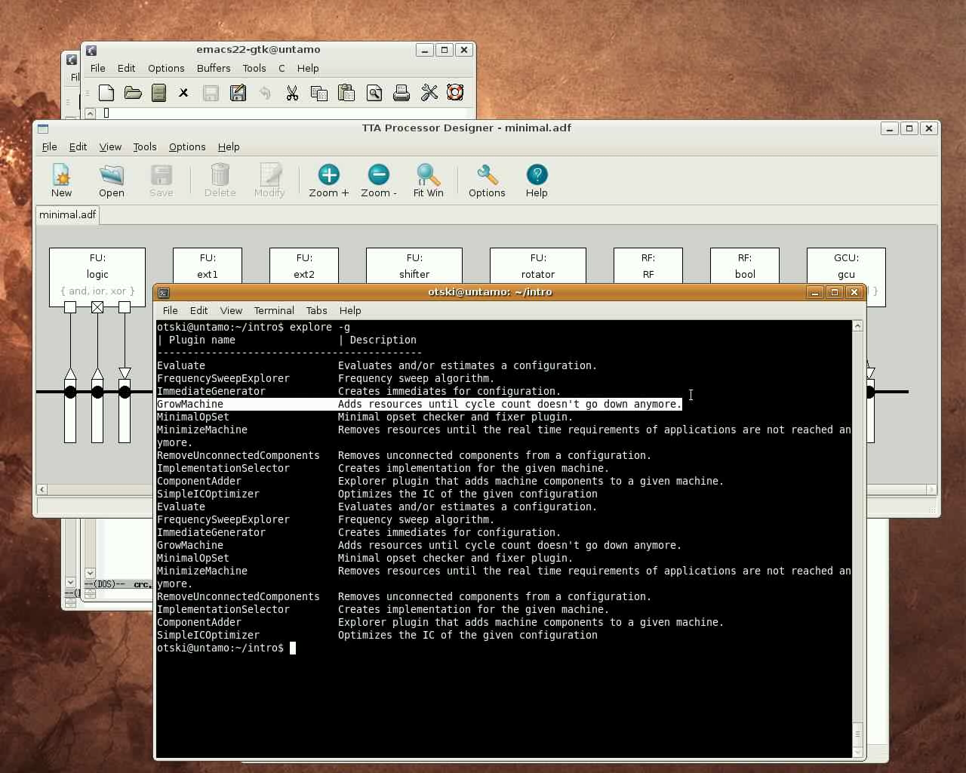

Slide 23
Intro and Exploration
The explorer is used by first adding the software of the application to a Design Space Database (dsdb)
Then we launch the explorer plugin which produces one or more new “configurations” to the DSDB along with their characteristics data (at least cycle counts)
  Plugins usually have parameters which can also be configured through explorer
In this case 2 new configurations were produced after starting the GrowMachine from our minimal.adf starting point
The best cycle count we got using this explorer plugin is 690
Let's see with ProDe how the generated best architecture looks like

Slide 24
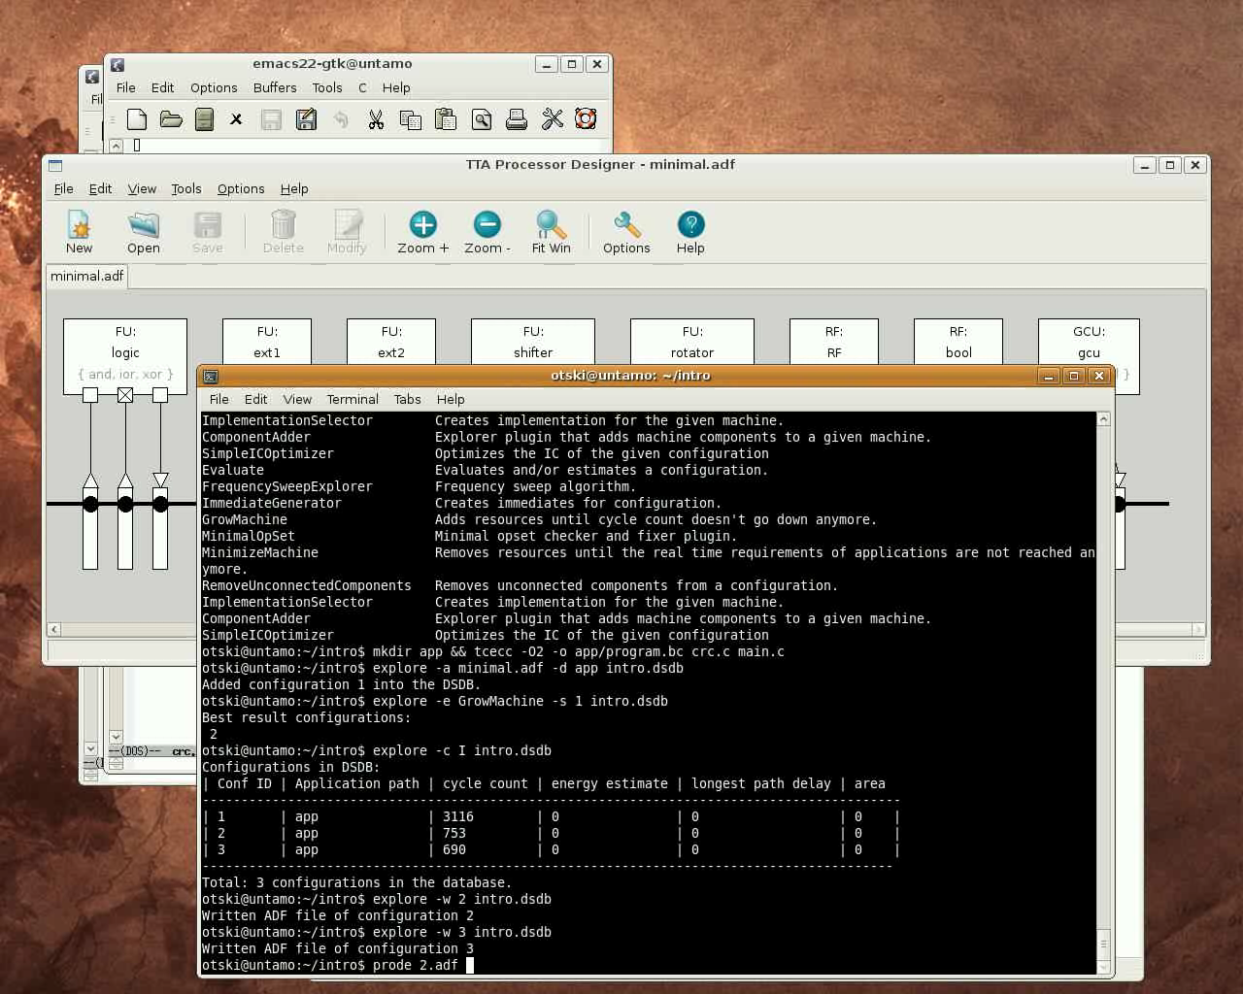

Slide 25
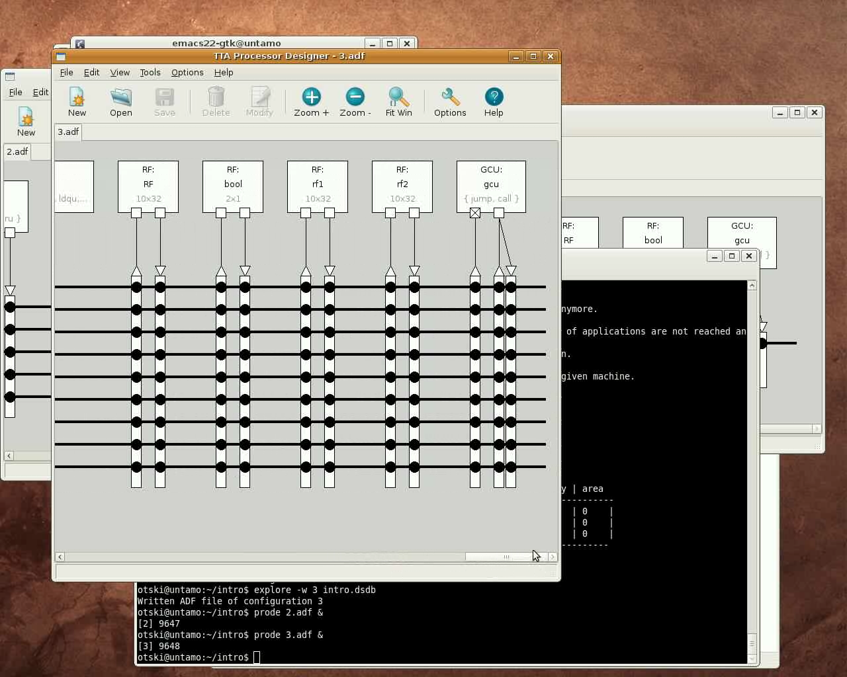

Slide 26
Intro and Exploration
As we can see, the GrowMachine plugin has added more buses and FUs to the machine
  Currently a brute-force approach of incrementing the current resource set with a constant factor is used
For example, the machine has 9 buses (instead of 1), many more function units and additional two register files

Slide 27
Profiling and Using a Custom Operation
(about 4 minutes)
The GrowMachine plugin managed to squeeze the cycle count down to 690 by just duplicating resources
We are not happy with this number yet as we know it can get much lower when some custom hardware is used
This video shows how to profile the application and use a custom operation (special function unit) to accelerate a “hot spot” in the CRC program

Slide 28
Profiling and Using a Custom Operation
First we'll compile the program with procedure inlining disabled so we get a proper function profile of the program

Slide 29
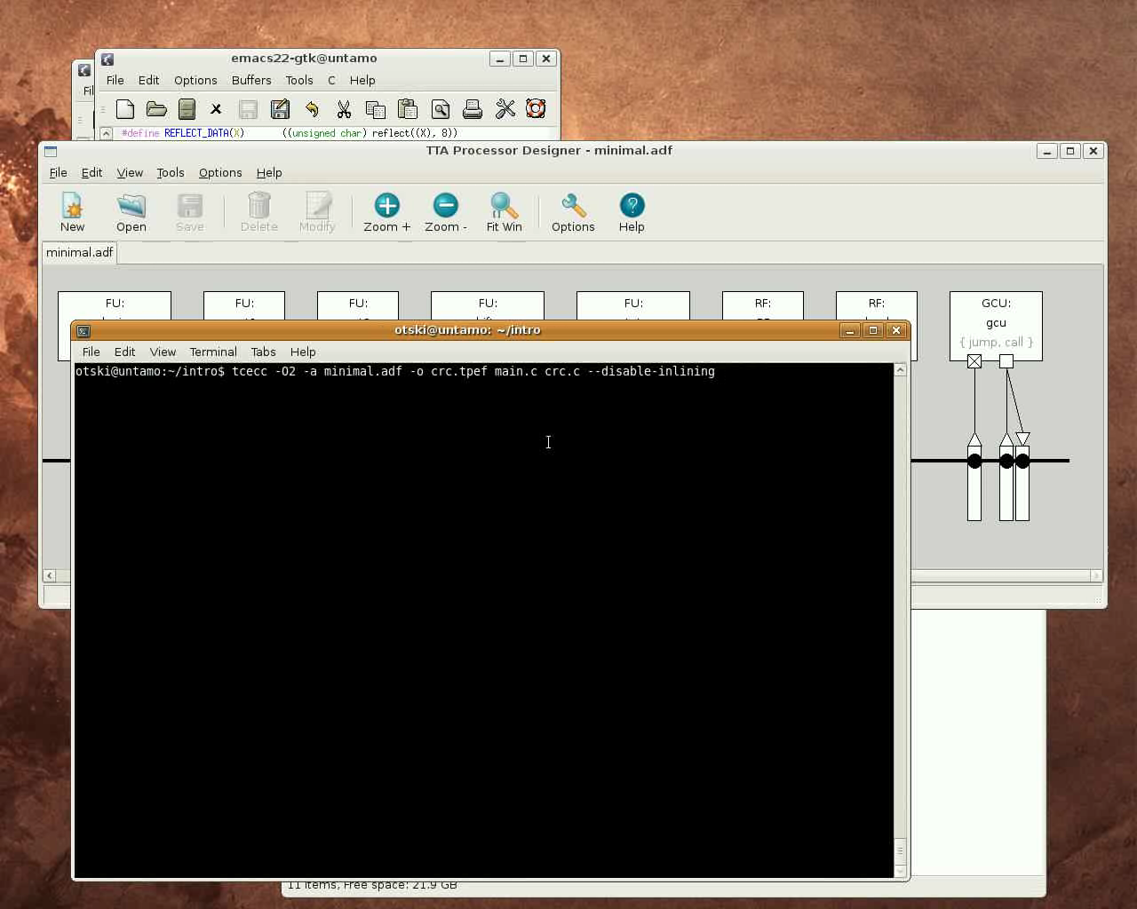

Slide 30
Profiling and Using a Custom Operation
Simulate the program:
  Note that the cycle count has increased due to the disabled inlining to 4917
  Verify the program by dumping the computed CRC number from memory

Slide 31
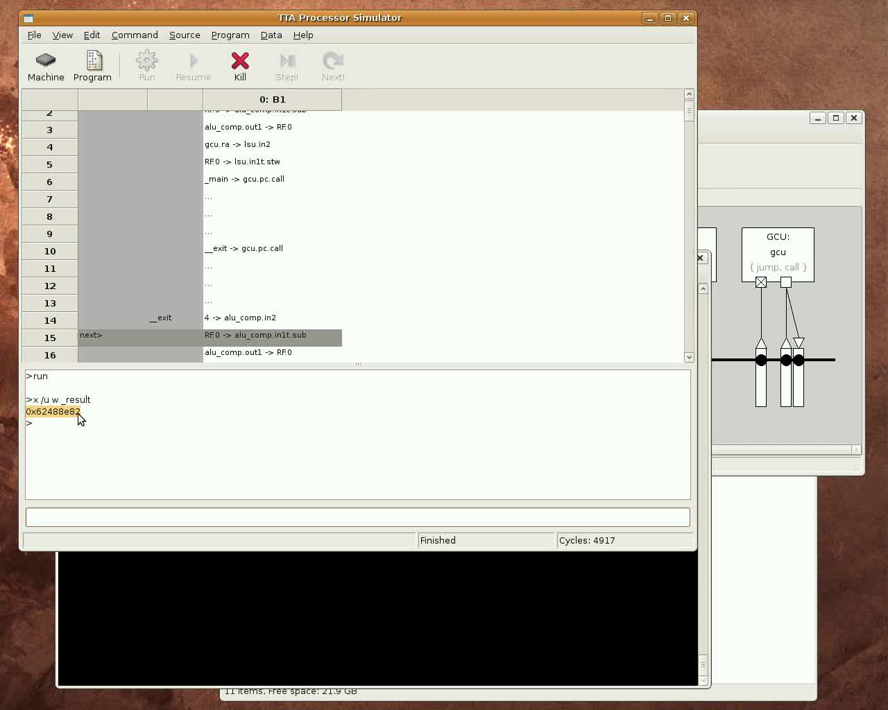

Slide 32
Profiling and Using a Custom Operation
Program profile:
  To find out the “hot spot” in the program, we highlight the top executed instructions
  We find out the instructions in the _reflect() function are executed very frequently, thus it's a potential candidate for acceleration with a custom operation (special function unit)

Slide 33
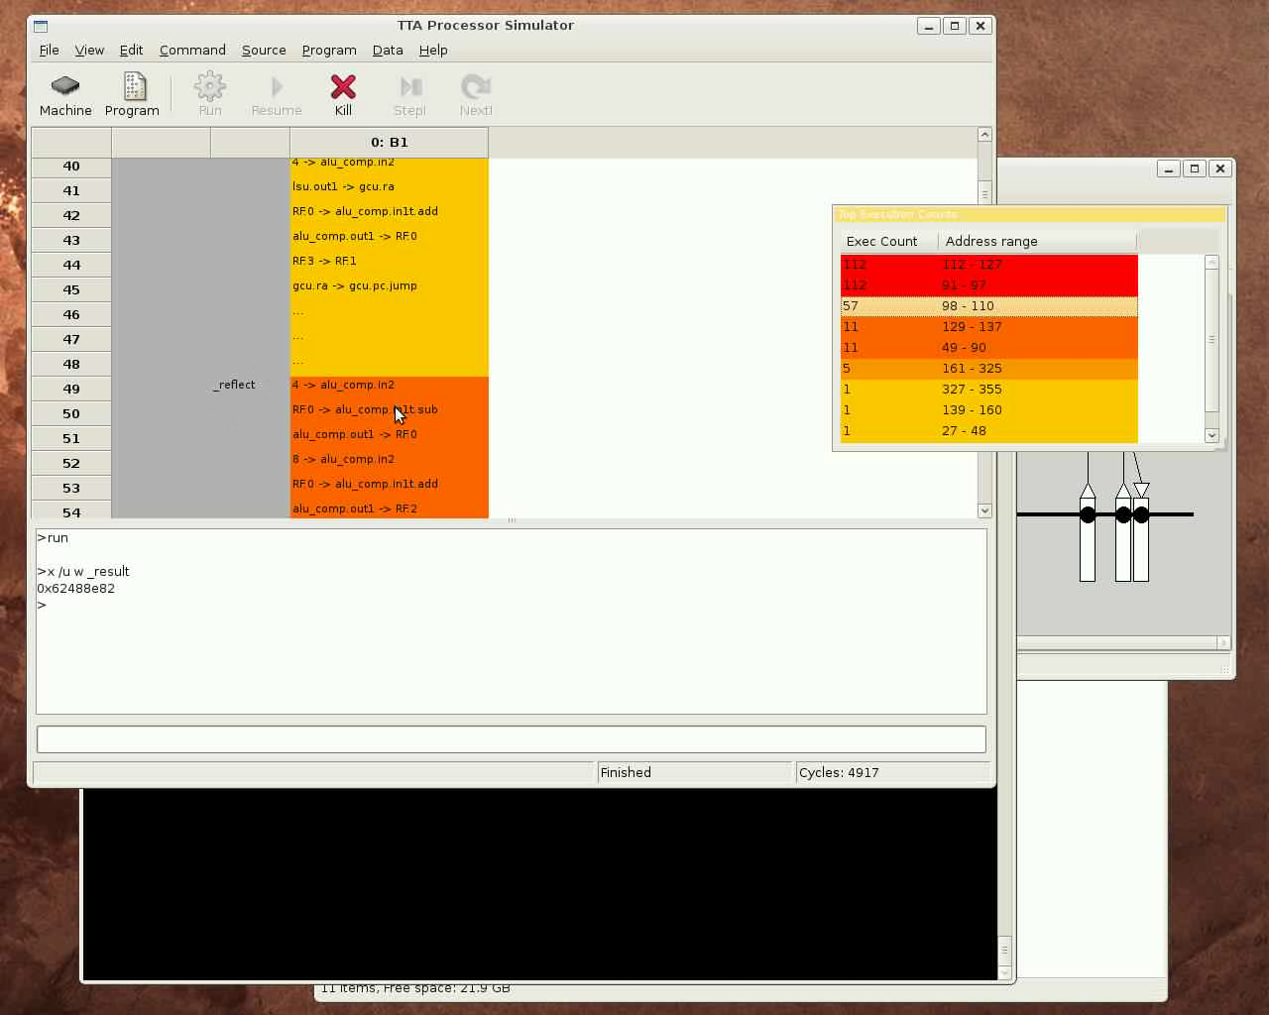

Slide 34
Profiling and Using a Custom Operation
We find out that the reflect function is called through macros REFLECT_DATA and REFLECT_REMAINDER in the core loop of the C code
The reflect() computes a “bit reflection”
  Reverses bits like a mirror was placed in the middle of the word)
  We see from the macros that it's done only for word sizes 8 and 32 bits

Slide 35
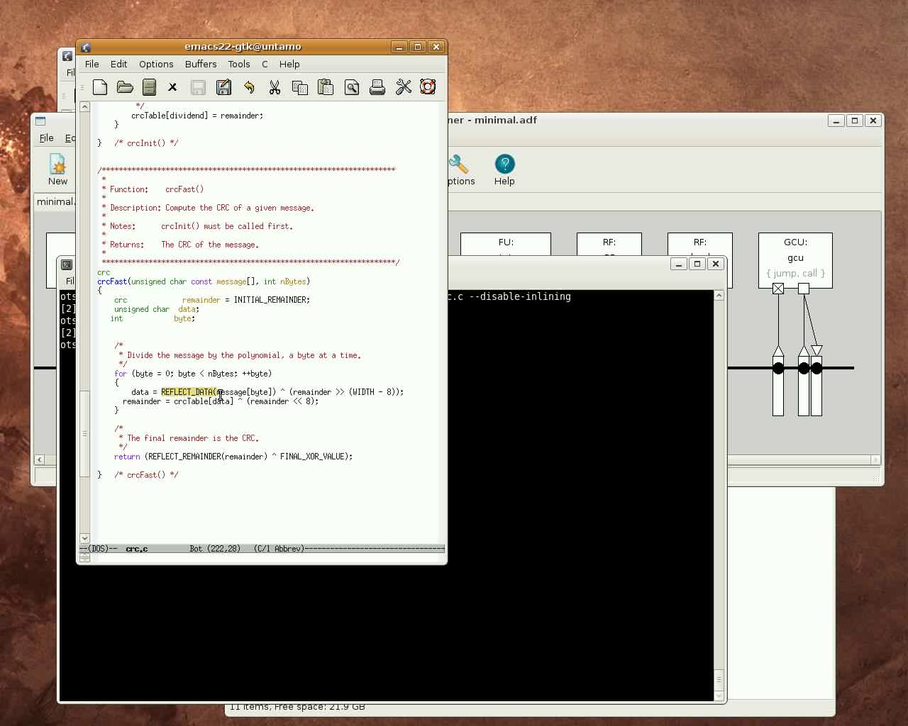

Slide 36


Slide 37


Slide 38
Profiling and Using a Custom Operation
The reflect() function is extremely simple and efficient to implement in hardware (just wiring and shifting if necessary), but looks like a heavy loop when implemented in C code
Let's create a custom operation for the REFLECT
  Custom operations added to TCE using a tool called Operation Set Editor (OSEd)
First we add general “static” information about the operation like its name and the number and type of inputs and outputs

Slide 39
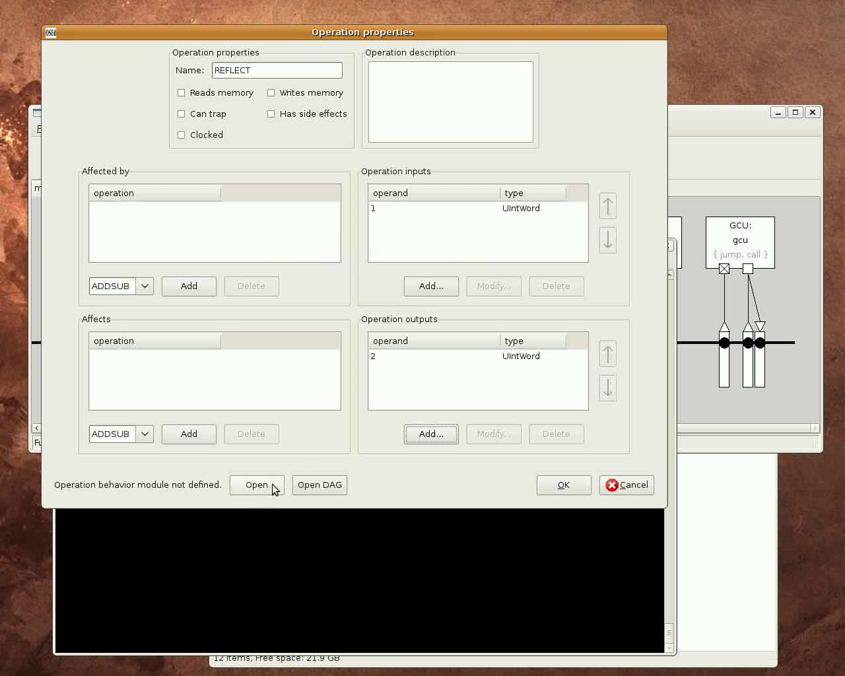

Slide 40
Profiling and Using a Custom Operation
The let's add a simulation behavior description for the operation
We can copy the original C code to the simulation behavior definition, just define:
  Reads from operation inputs (UINT(1), UINT(2)) to variables in the C code
  Write result to the operation output (IO(3))
The simulation behavior is loaded runtime to the processor simulator
  It's a “plugin” module which needs to be compiled
  Build it with OSEd
  Test that the simulation behavior definition works using the operation behavior simulator

Slide 41
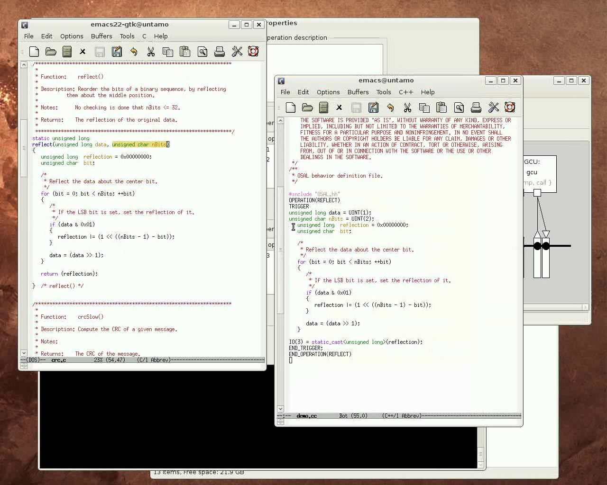

Slide 42
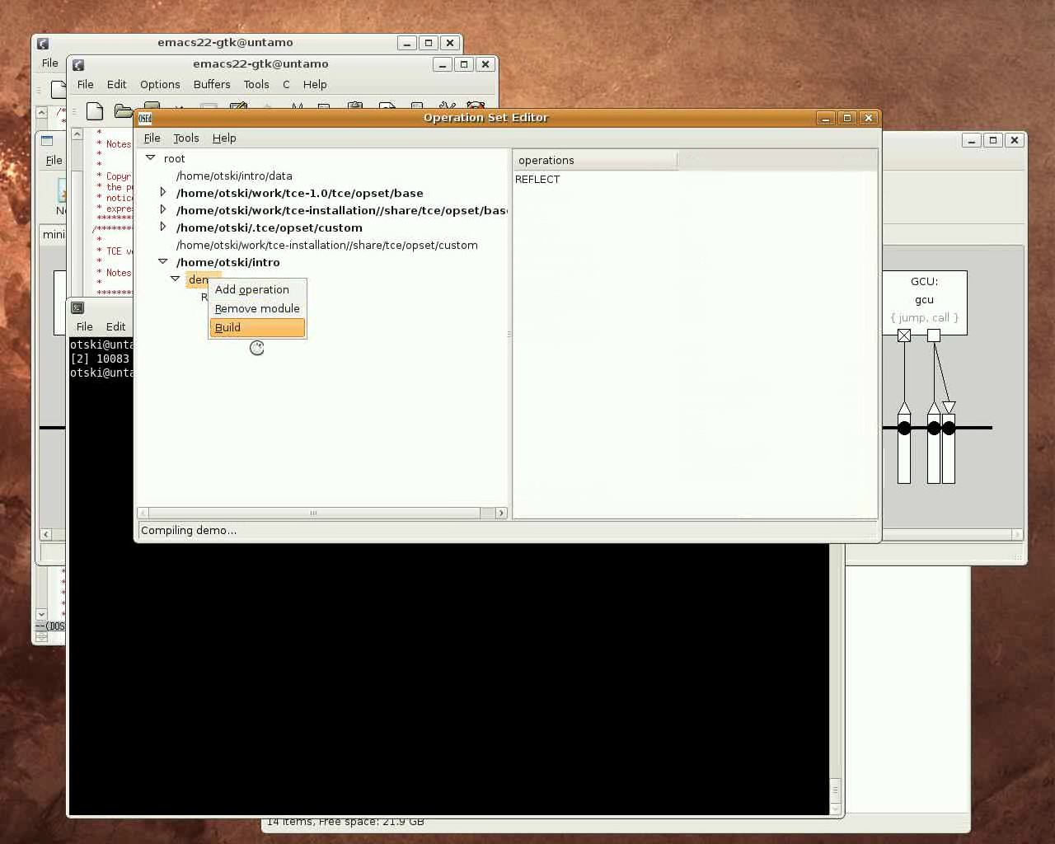

Slide 43


Slide 44
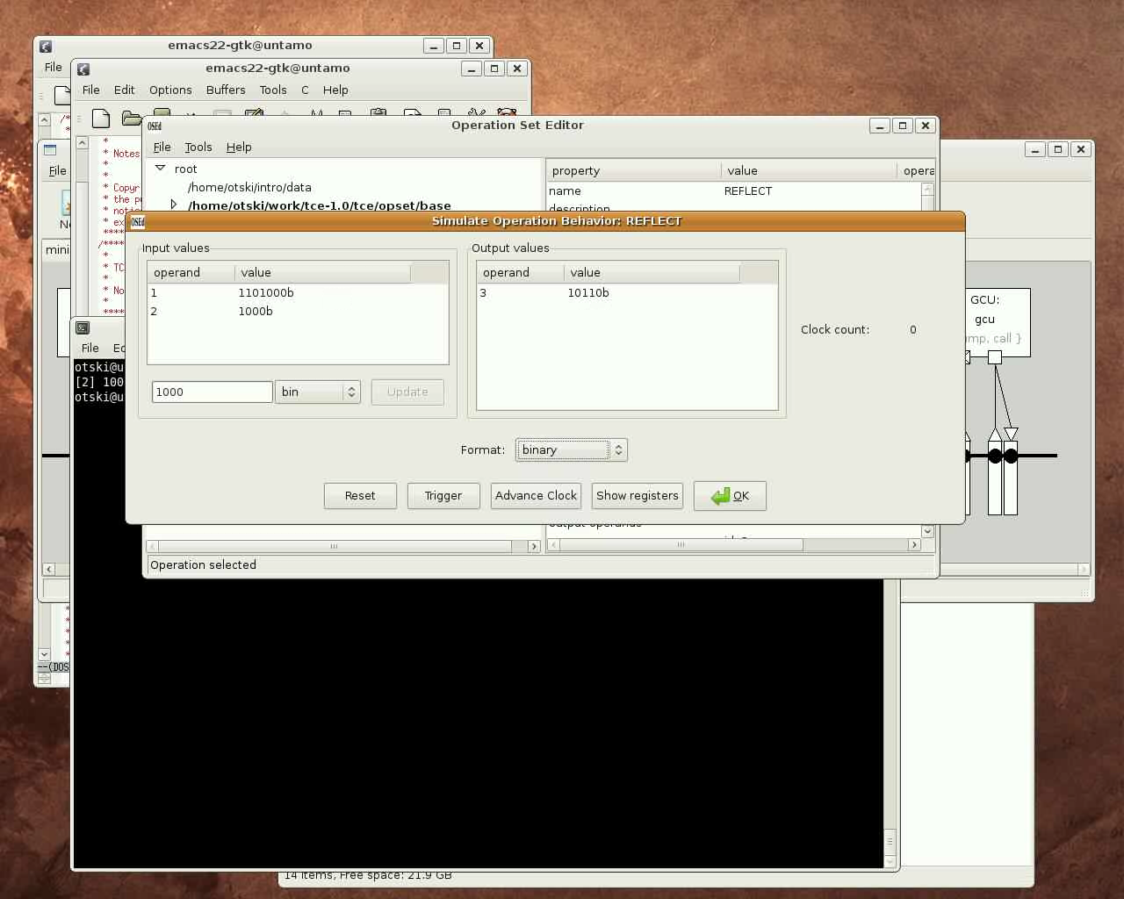

Slide 45
Adding SFU to the Machine and Using it in C Code (1.5 minutes)
Now that we have defined a new custom operation to the TCE, we can use it in our TTA in a special function unit and execute it from our C code
Add the custom operation to a new function unit in the TTA with the Processor Designer tool
  Add a function unit
  Add ports to the function unit
  Add the operation to the function unit
  Edit the operations port bindings, pipeline resource usage, and latency
In this case we are certain that the REFLECT operation can be done in 2 cycles in hardware
  Probably 1 cycle would be enough due to the operation's simplicity, but we “play it safe”

Slide 46
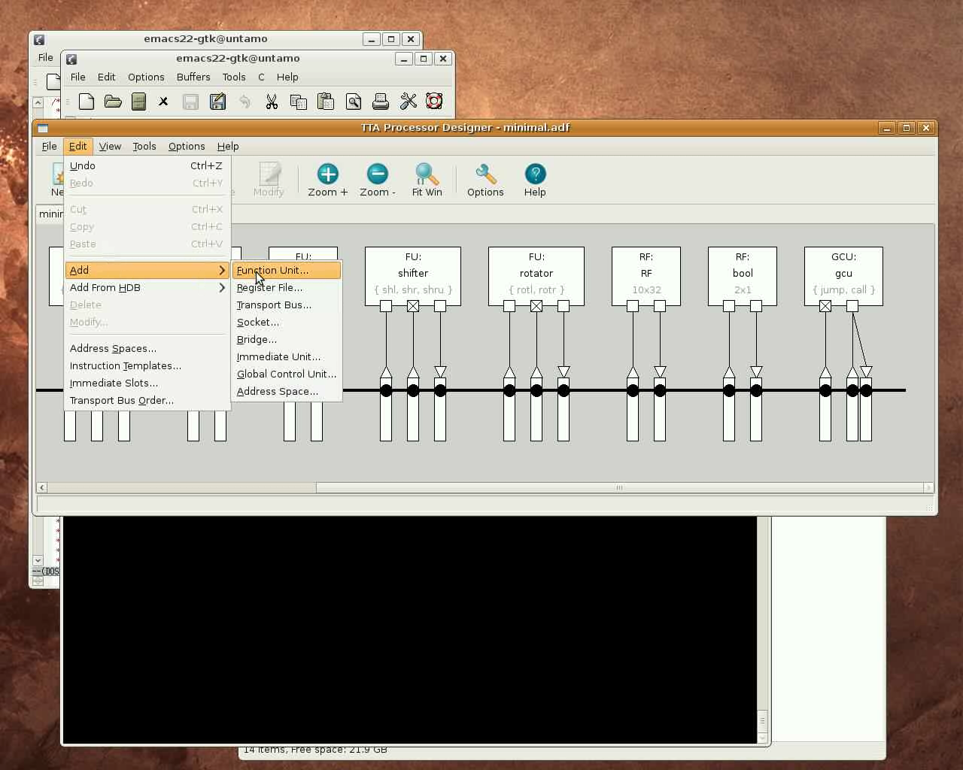

Slide 47
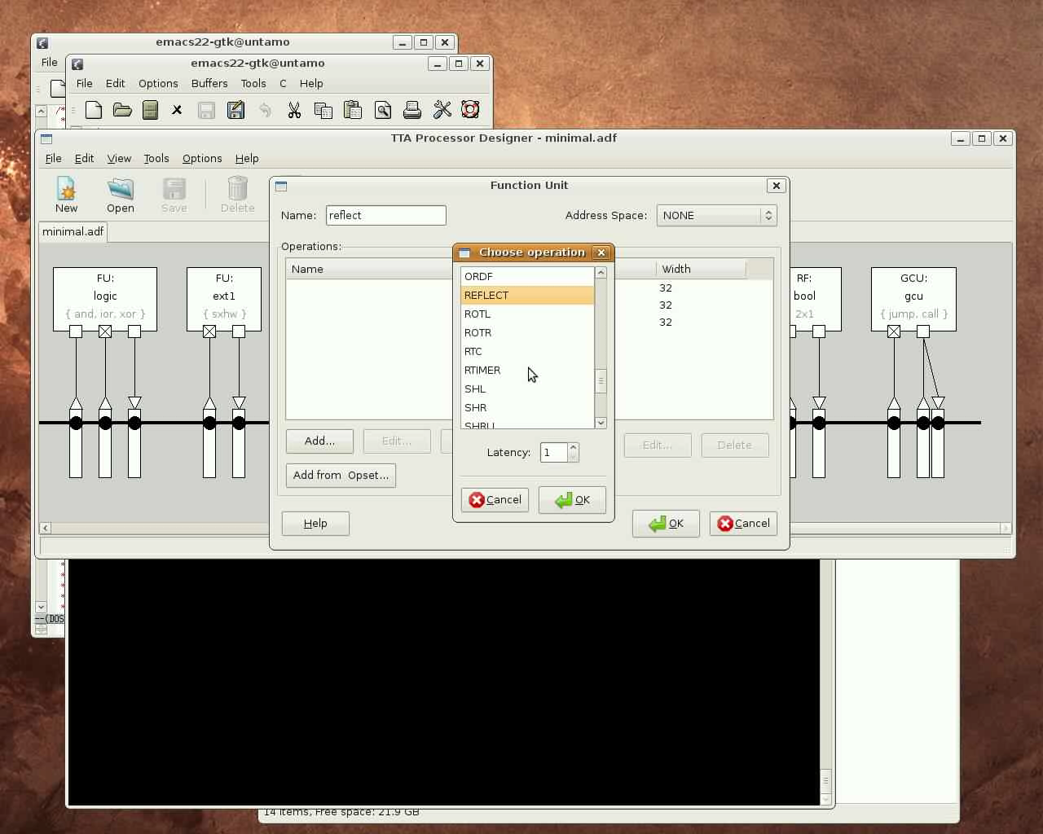

Slide 48
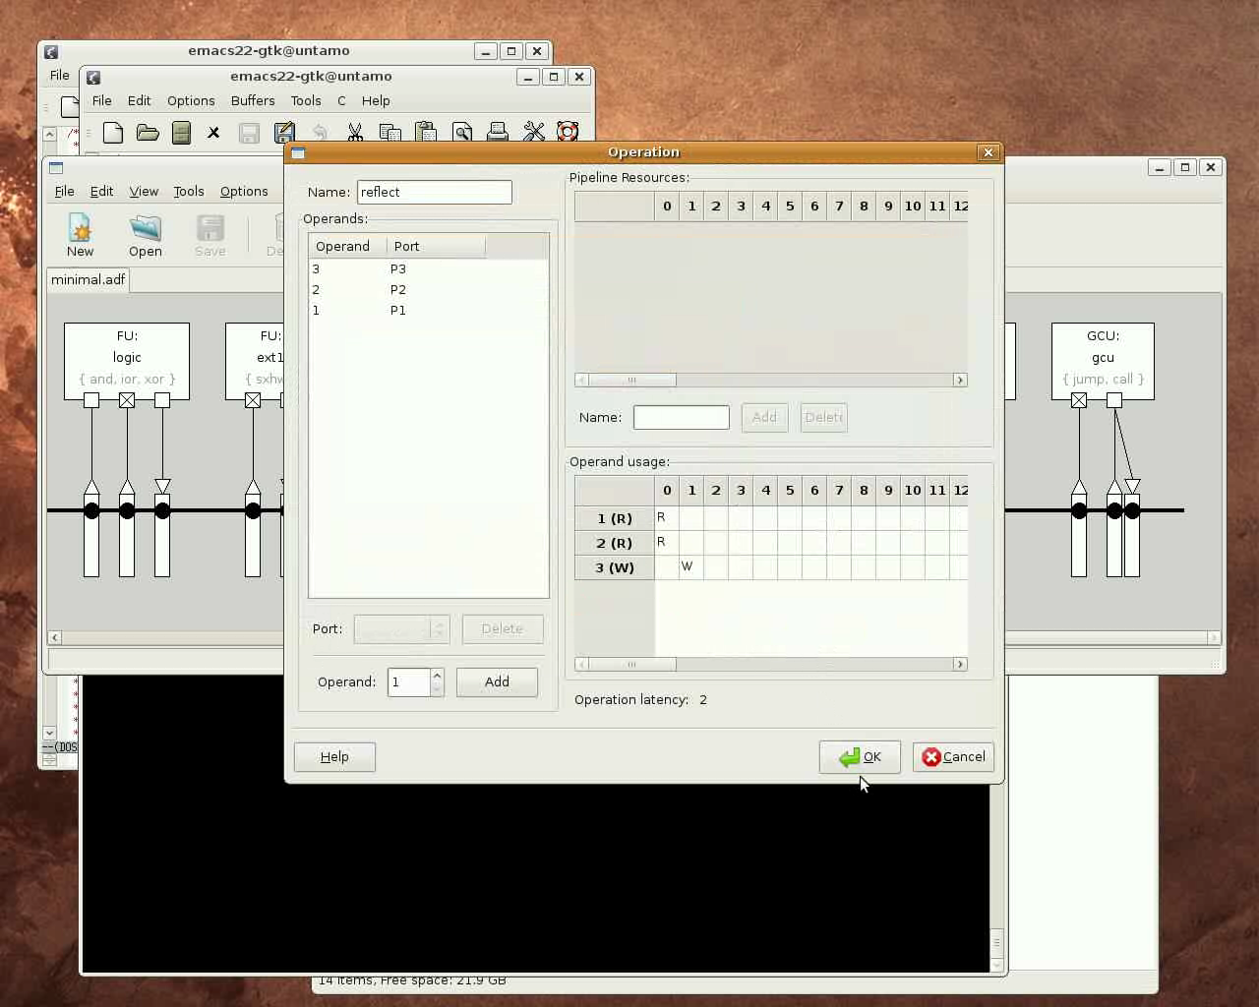

Slide 49
Adding SFU to the Machine and Using it in C Code (1.5 minutes)
Now the architecture supports the REFLECT custom operation with the added function unit
Let's now use the REFLECT operation from our C code to accelerate the algorithm
First add:
  #include “tceops.h”
  This brings in the macros that are used to invoke TTA operations manually
Then call the REFLECT operation through a TCE operation macro:
  _TCE_REFLECT(...);

Slide 50
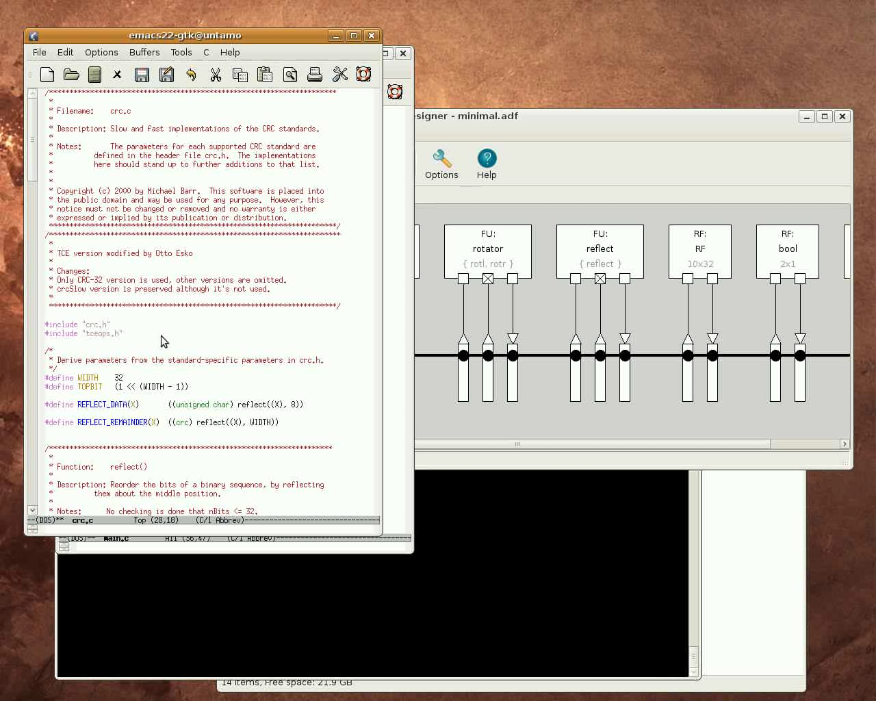

Slide 51


Slide 52
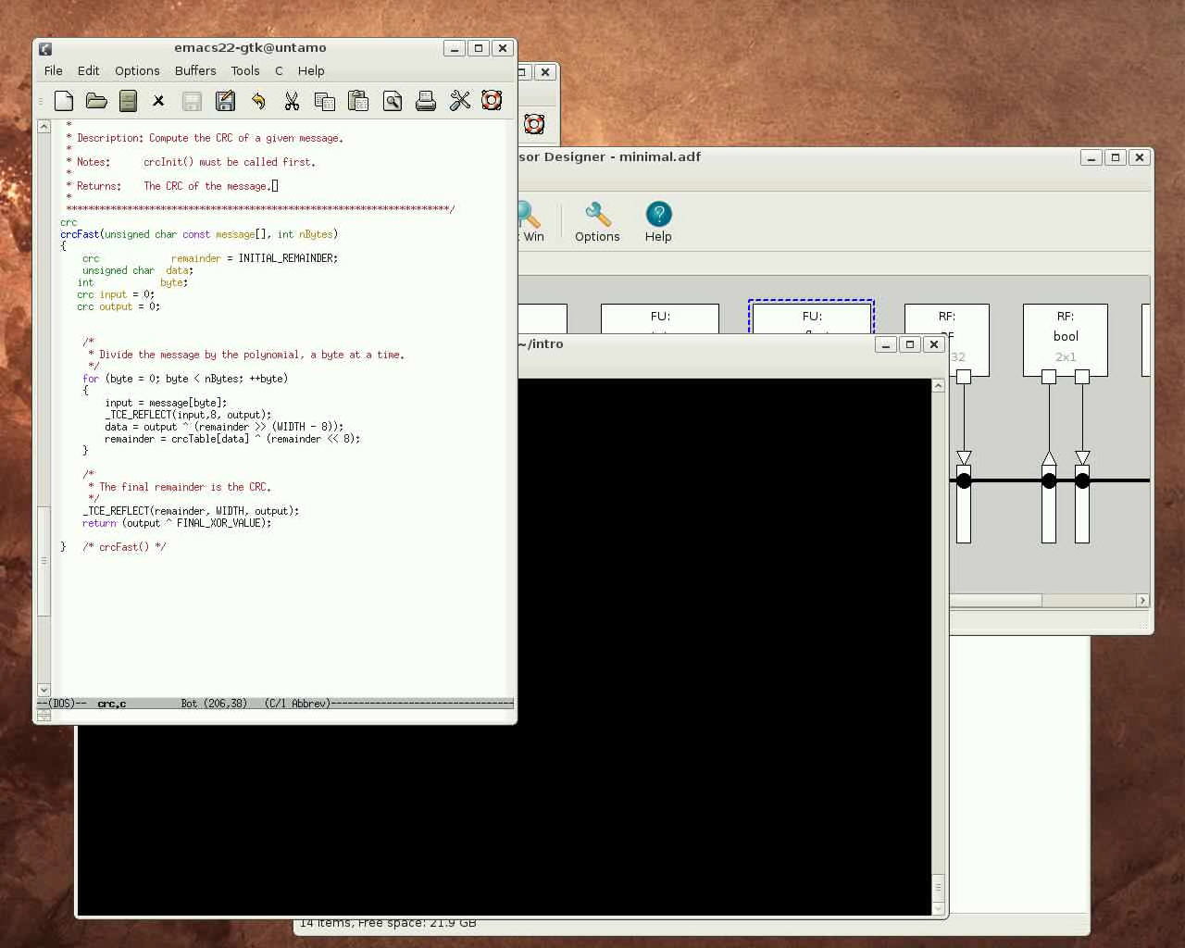

Slide 53
Adding SFU to the Machine and Using it in C Code (1.5 minutes)
Finally, recompile the code which now uses the custom operation, verify that the program still works correctly, and see its effect to the cycle count using the simulator
  Cycle count now dropped to 403
  By using custom operation we reached a lower cycle count with much less hardware
Now we could use explorer to increase the performance
  Current architecture has only one bus
  By increasing concurrency we would reach lower cycle count

Slide 54
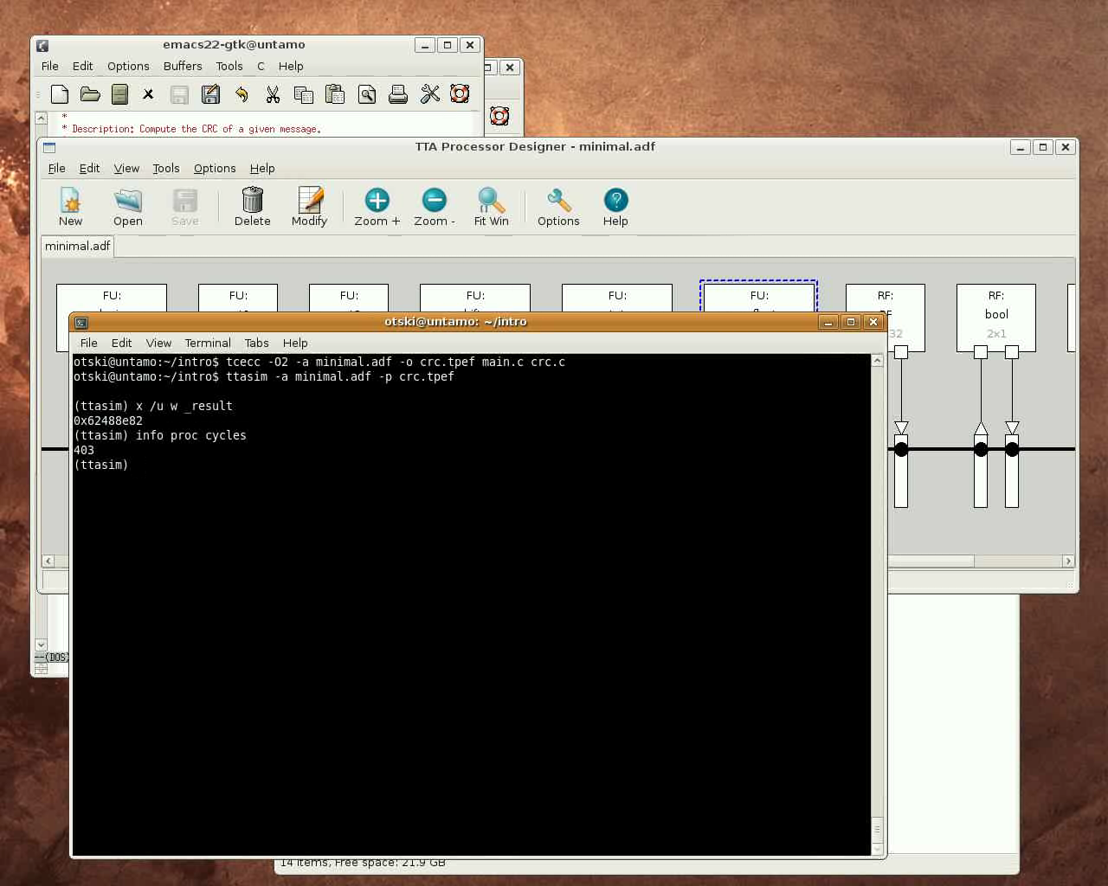

Slide 55
Adding Implementation of the SFU to the Hardware Database (50 sec)
Now we have found a good custom operation to accelerate our algorithm and used it in our architecture and C code
In order to generate VHDL for the processor, we still need to add an implementation of the SFU to a Hardware Database (HDB)
Of course, implementing the SFU might take a bit longer than the 50 sec, thus we use a previously implemented VHDL block for demonstration purposes :)
HDBEditor is a GUI for editing HDBs, we use it to add the implementation to an HDB along with the data needed to generate a processor
  The names of the input/output ports and the entity name in the VHDL, etc..

Slide 56
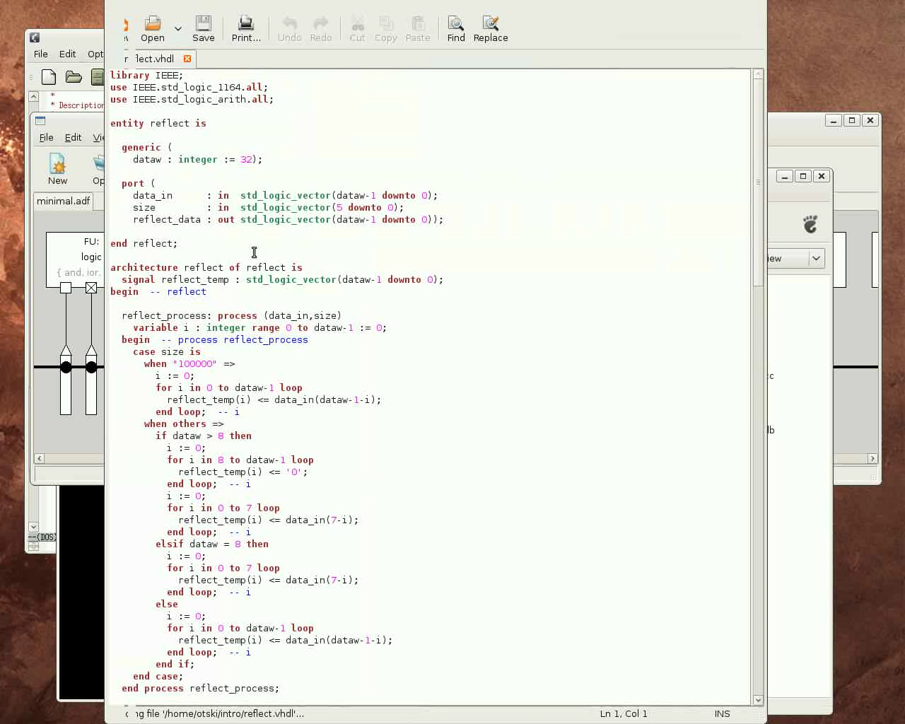

Slide 57
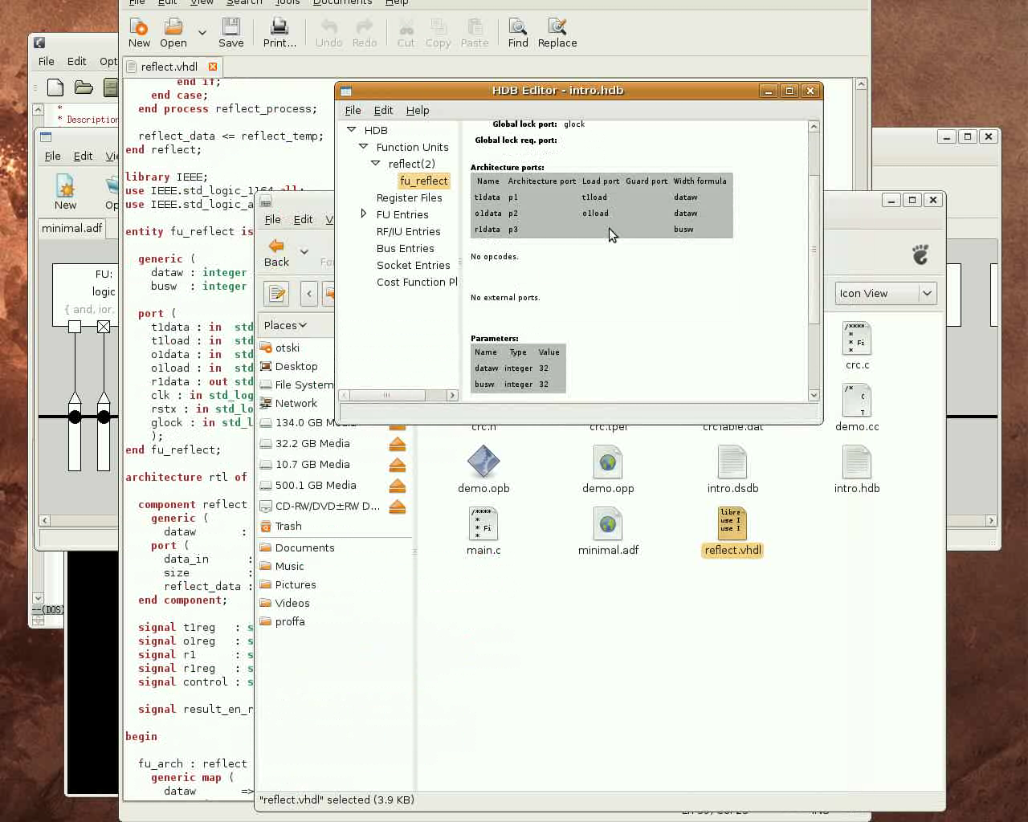

Slide 58
Adding Implementation of the SFU to the Hardware Database (50 sec)
Now we have added an implementation of the REFLECT SFU to a HDB
Finally we need to connect the architecture of the FU in our TTA architecture file to this implementation
  Use automated exploration plugin for this
In TCE, architecture of the processor components and the actual implementation are separated
  Architecture components (in ADF files edited with ProDe) are connected to HDB implementations through an Implementation Definition File (IDF)
  Architecture definition file (ADF), implementation definition file (IDF) and one or more Hardware Databases (HDB) form a “processor configuration” that can be outputted as a VHDL implementation

Slide 59
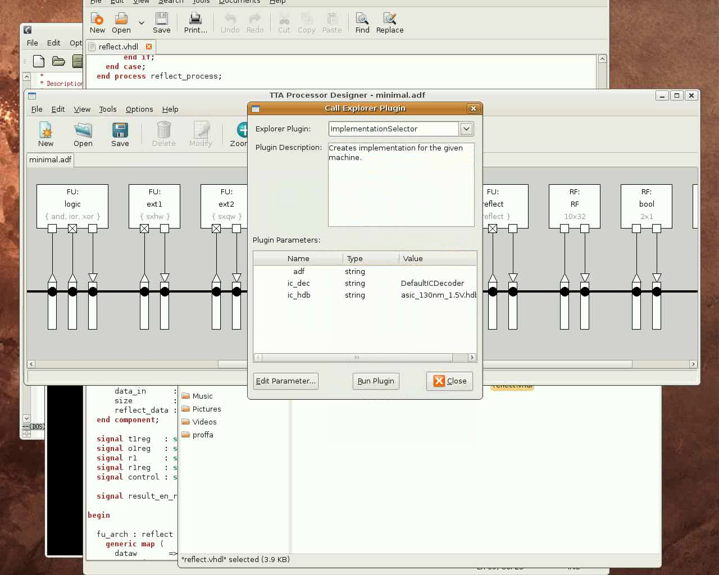

Slide 60
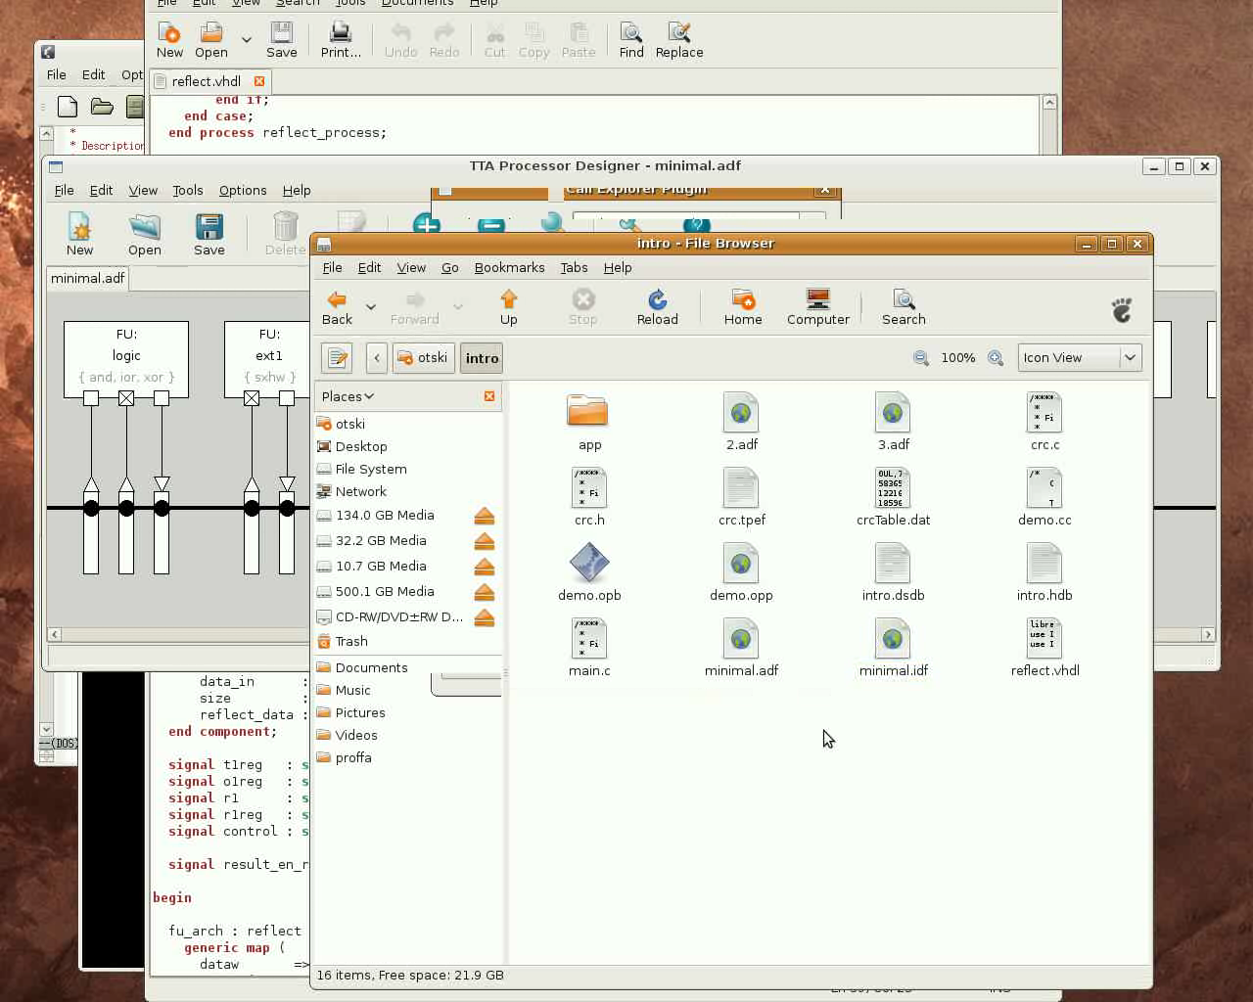

Slide 61
Generating the Processor (32 sec)
Now we have all we need to generate the processor implementation in VHDL
For this we use the Processor Generator (ProGe) tool which can be invoked from the command line or from the ProDe GUI

Slide 62
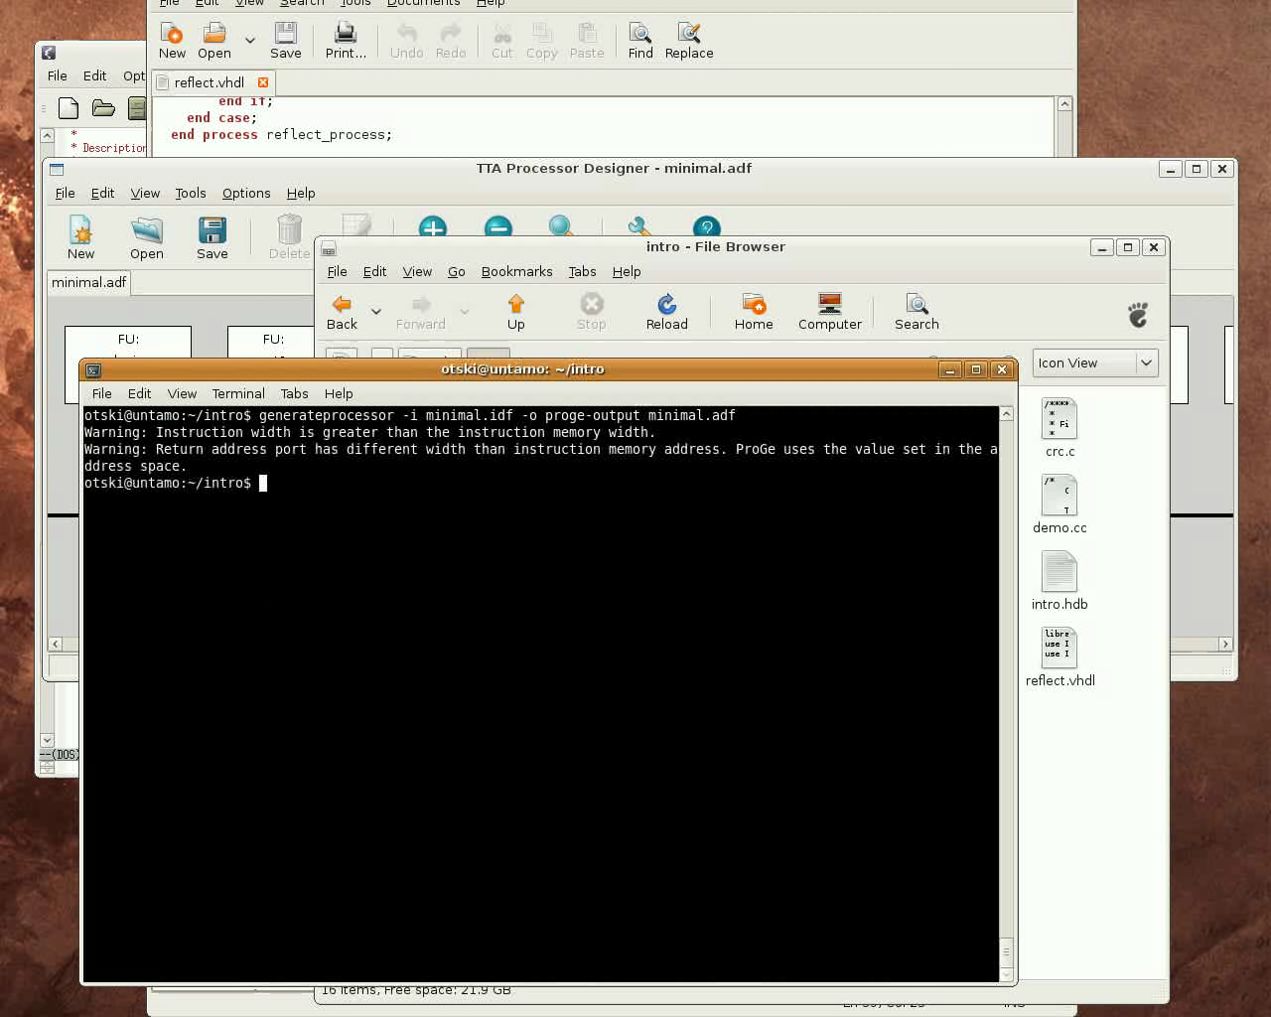

Slide 63
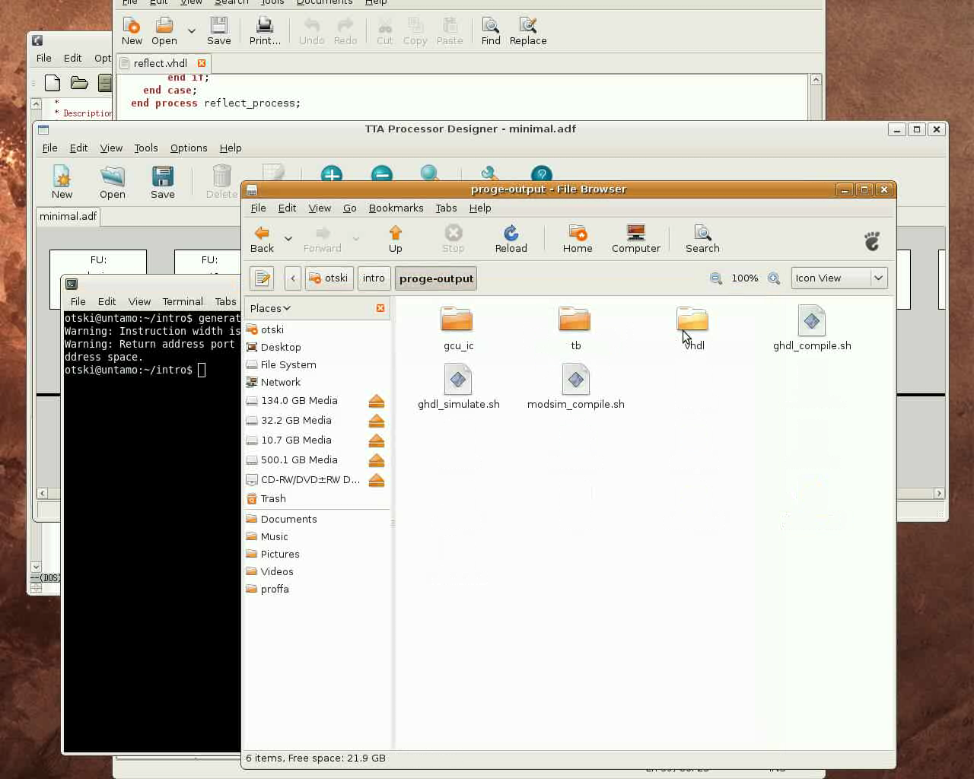

Slide 64
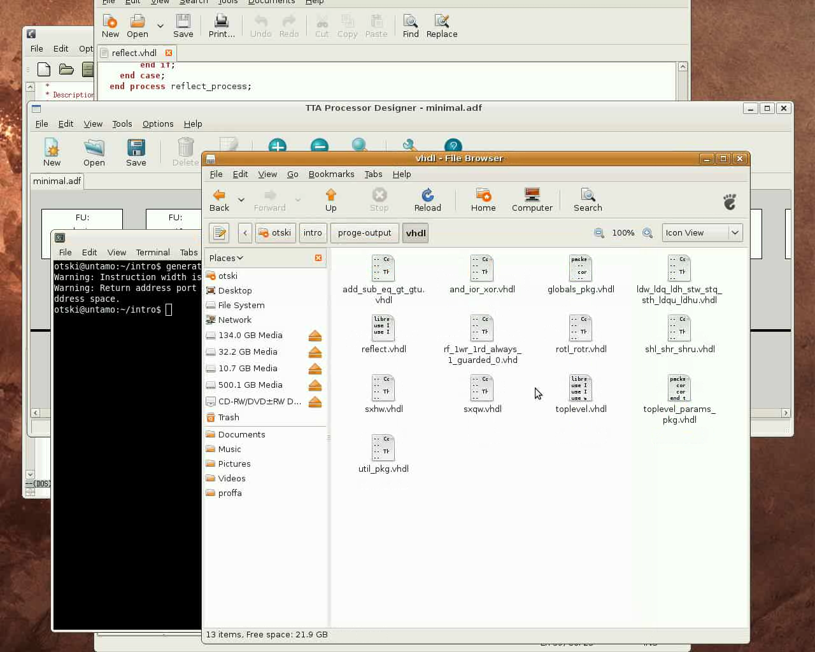

Slide 65
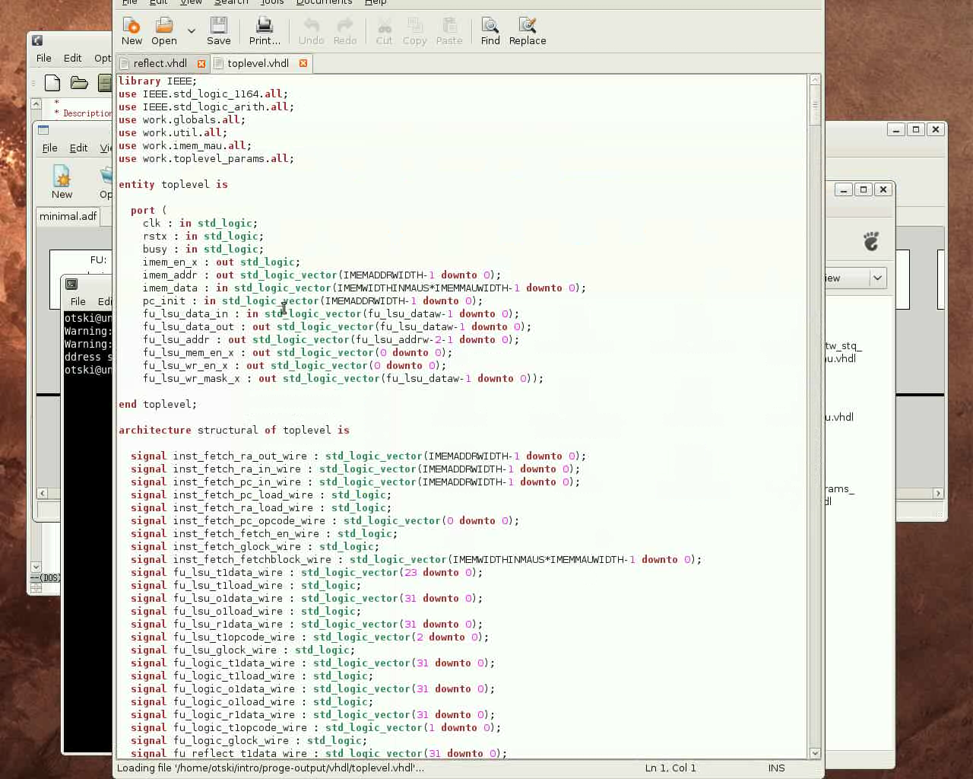

Slide 66
Change Load-store Unit to an Avalon Bus Load/store Unit (36 secs)
Next we'll use an FPGA board to test the processor
For this we need to change the load-store unit function unit implementation to one that supports Altera's Avalon interface
  We'll use the Altera Memory Mapped Interface
  TTA acts as a master on the bus
  This way we can use Altera's IP-components
This can be done quickly with the Processor Designer tool

Slide 67
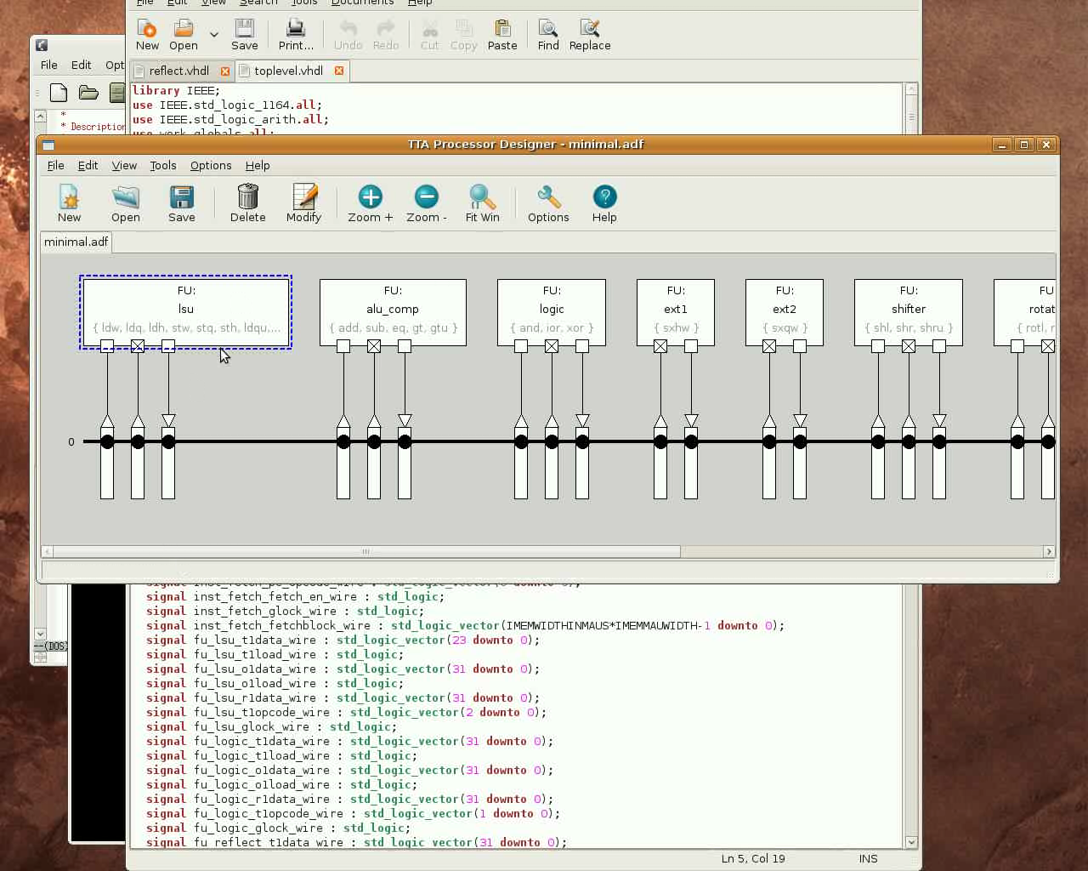

Slide 68
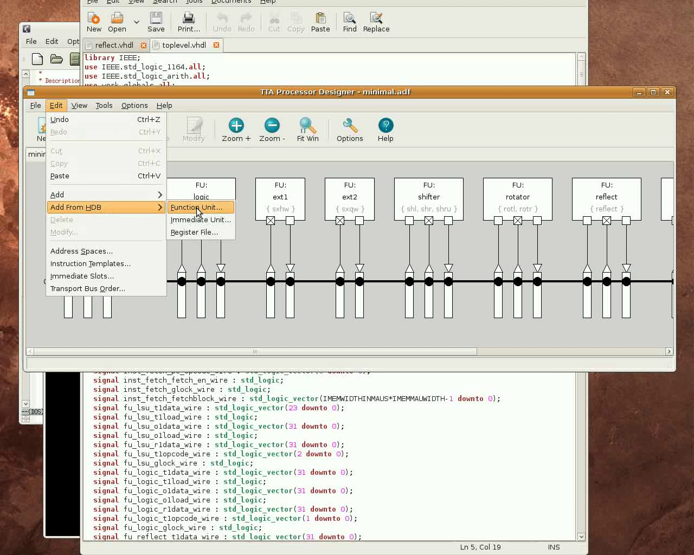

Slide 69
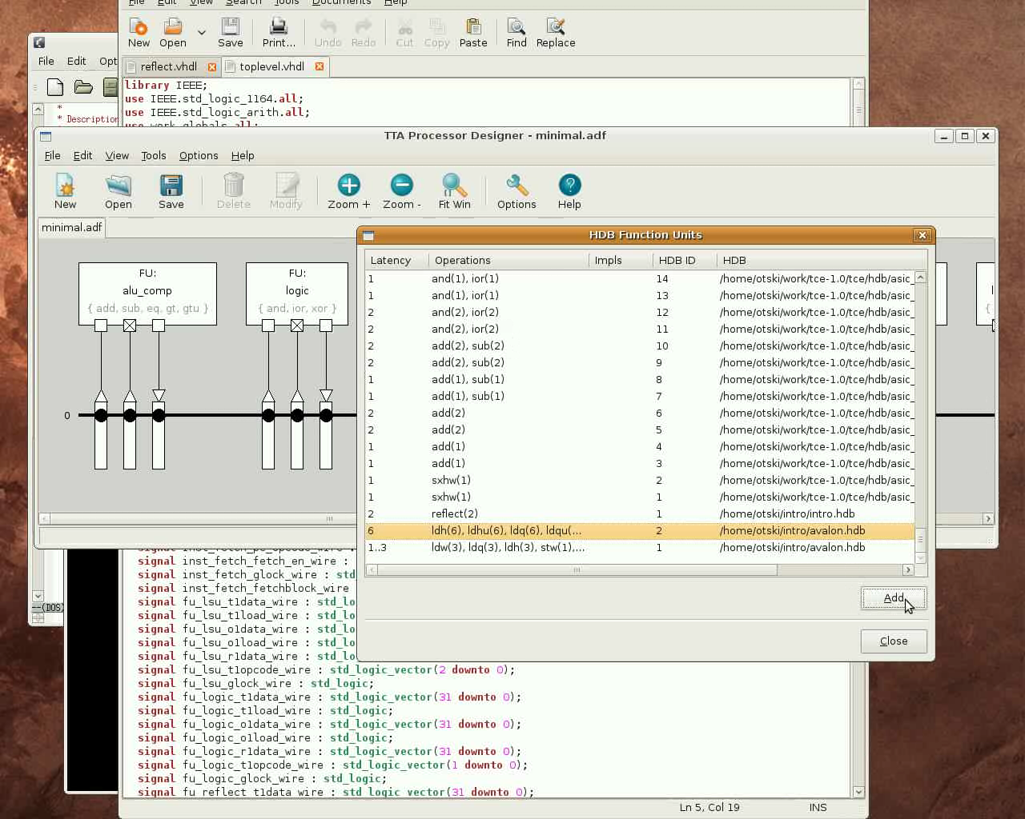

Slide 70
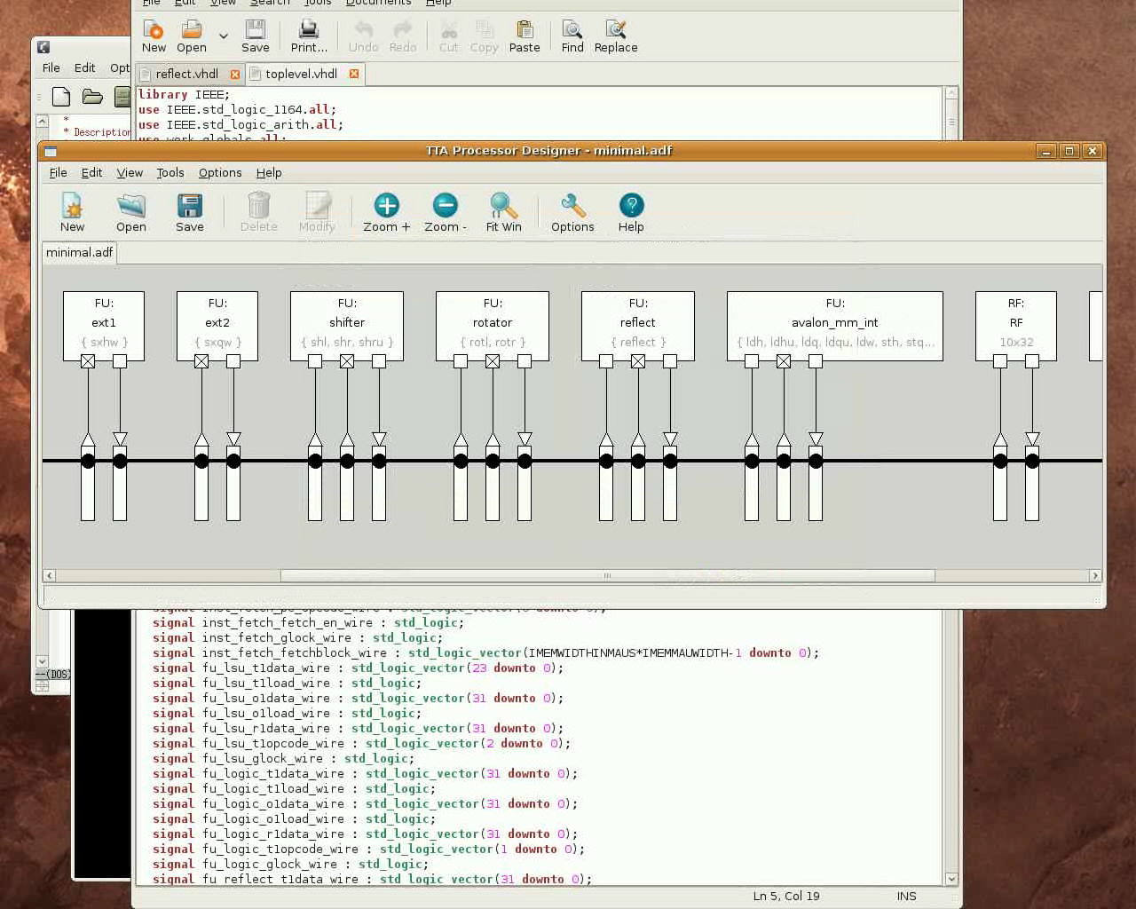

Slide 71
Using Avalon LCD for Output (21 secs)
Now the TTA can interface with the memory (and other I/O) in the FPGA board using the Avalon bus
Finally, we need a device to produce some output from our CRC computation to verify it actually works
For this we use an LCD screen connected through the Avalon bus
  We use the LCD controller from SOPC Builder's IP component library
The LCD controller is connected to the Avalon Memory Mapped bus interface so we can define a putchar() function (which is used by printf()) that writes characters to the controller's memory mapped registers

Slide 72
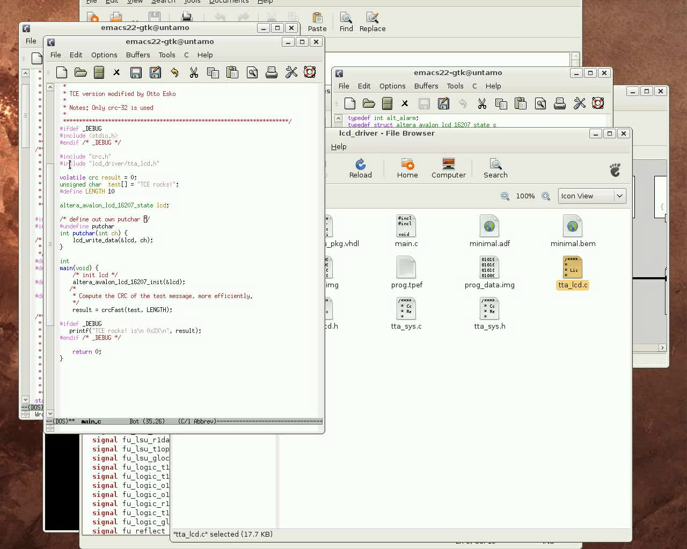

Slide 73
Generate the Bit Image of the Program Memory and Synthesize the Design
(2 minutes)
Finally, to get the TTA running on the FPGA we need to generate a bit image of the program memory
  Use command line tool generatebits

Slide 74
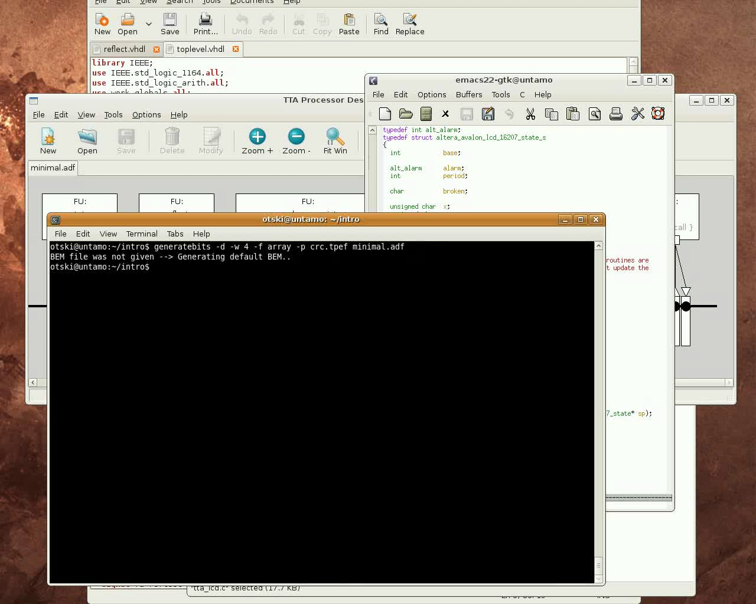

Slide 75
Generate the Bit Image of the Program Memory and Synthesize the Design
Load the VHDL files of the generated TTA processor to the Altera's Quartus II tool to synthesize the design to the FPGA
  We add a layer on top of the ProGe generated toplevel.vhdl (not displayed in the video)
    In this case the instruction memory is very small so we implement as “logic”
    Synthesize tools optimizes it into a small space of internal memory banks and logic
  The external interface of the new layer is the external buses of the load-store unit we added, and control signals (clk, reset)
    The LSU interface is actually the Avalon interface
  Then in Altera's SOPC builder we export TTA as a component to the design along with the onchip memory and the LCD component and connect them all to the Avalon bus
    TTA is the Avalon Master and the memory and LCD controller are slaves
  Synthesize the design to the FPGA and note how many of the logic elements were consumed of the FPGA by our TTA
  Finally, upload the design to the FPGA board

Slide 76
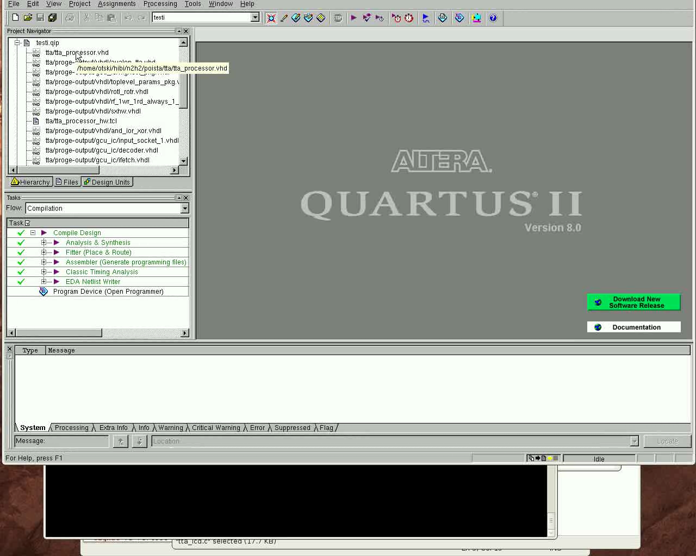

Slide 77
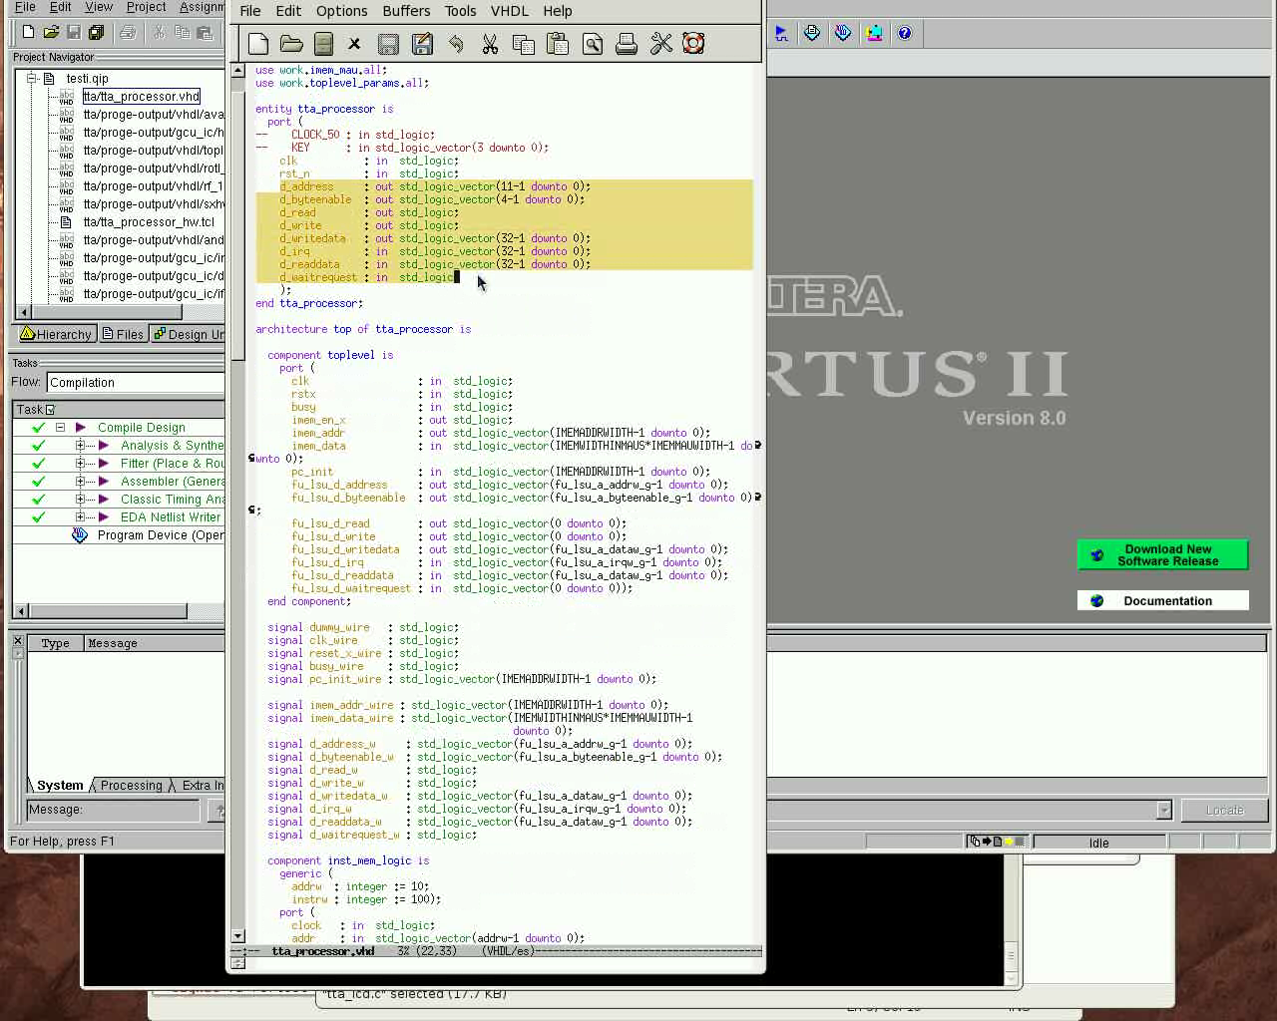

Slide 78
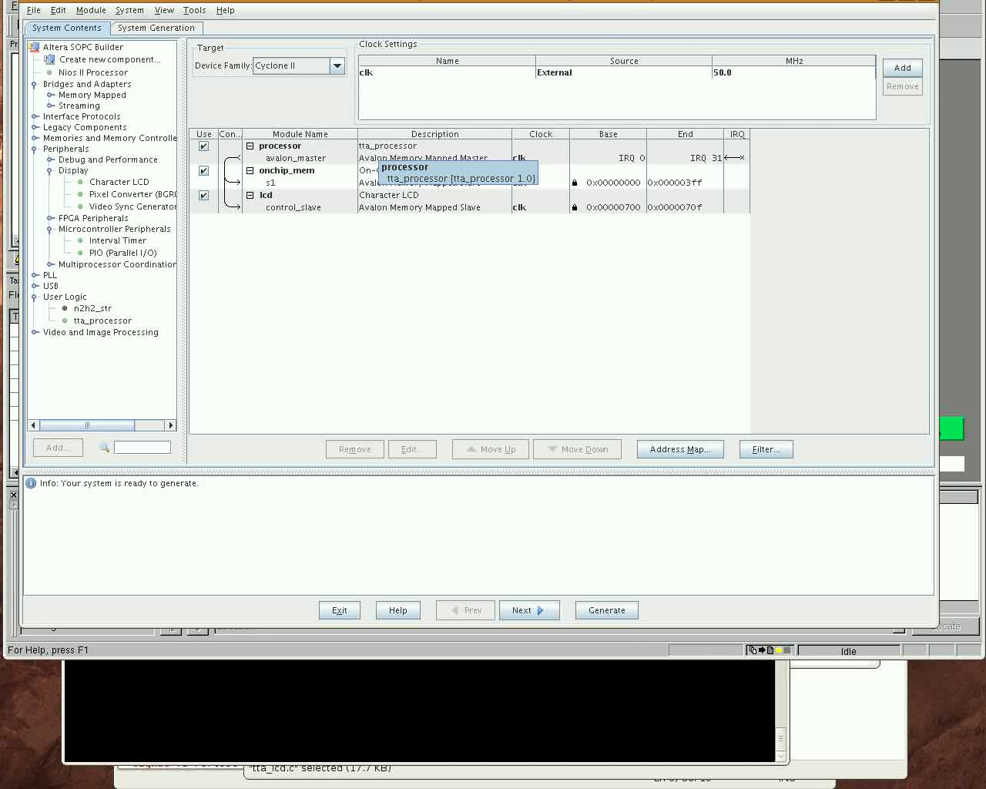

Slide 79
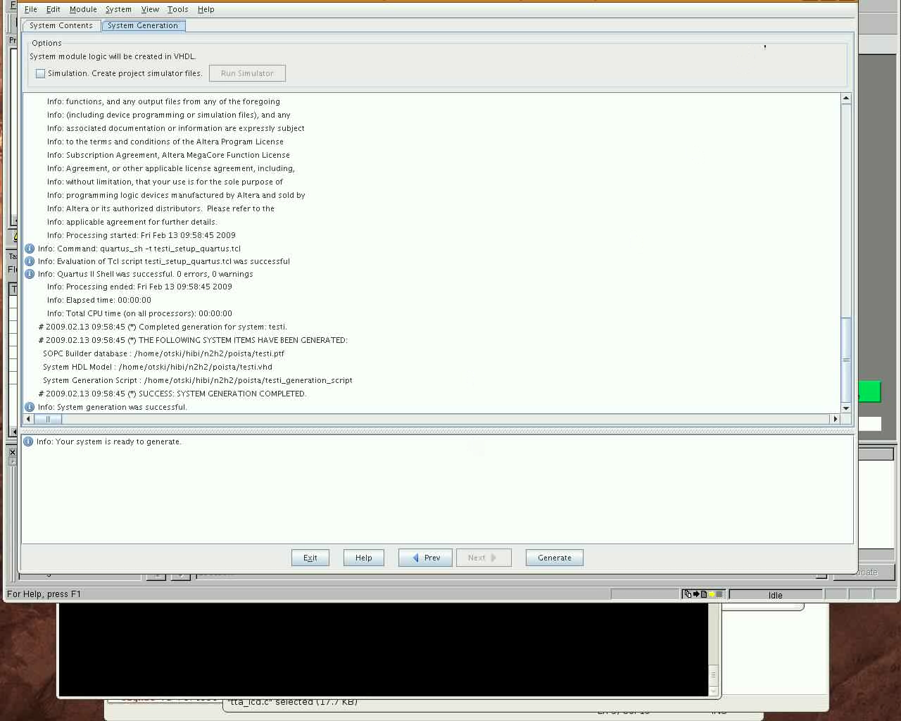

Slide 80
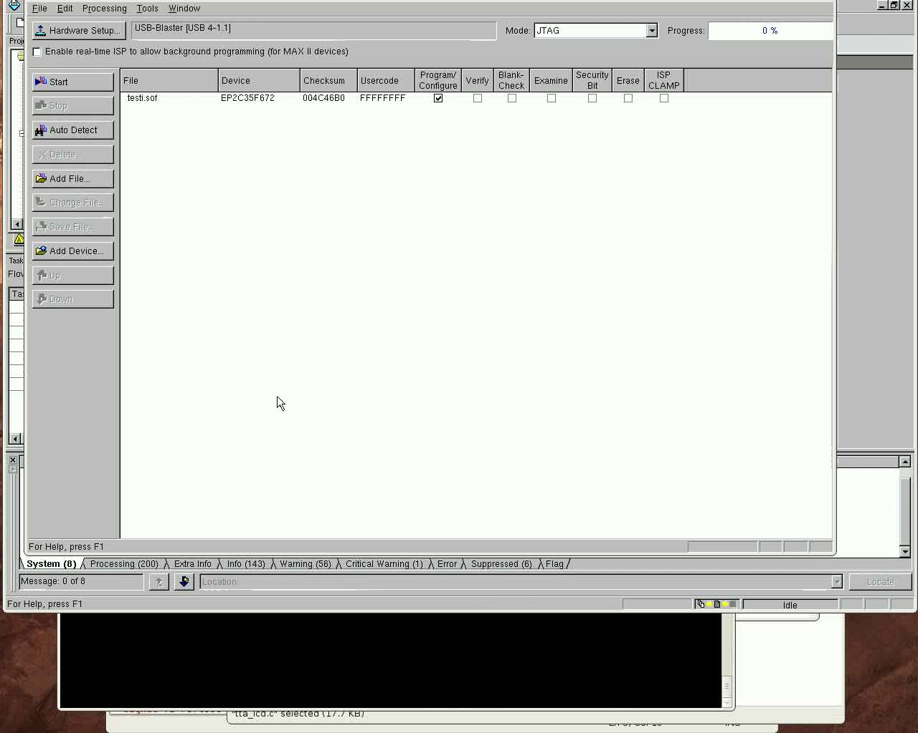

Slide 81
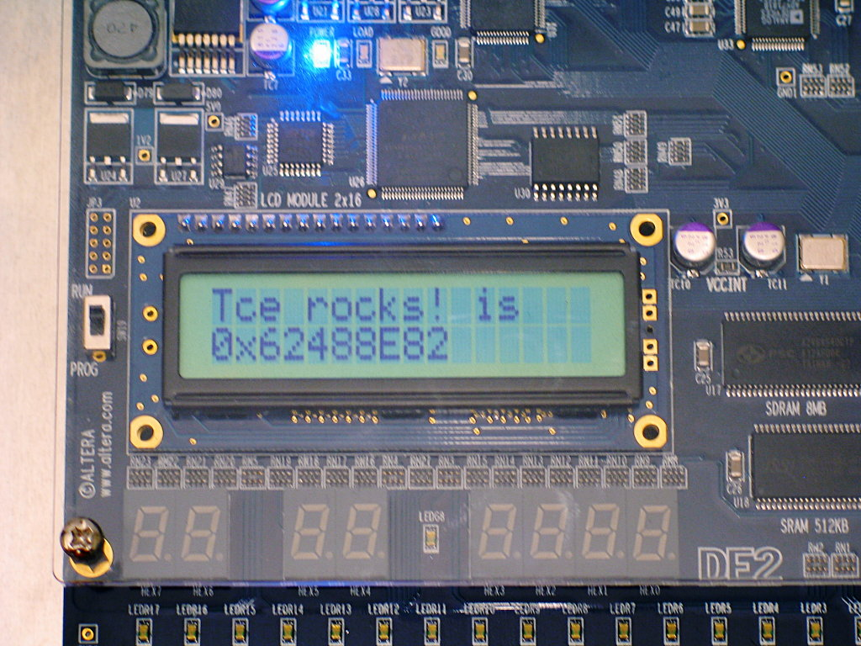
The End – Thanks for Your Attention!

