Slide 1
TTA-Based Co-design Environment (TCE)‏
Tutorial
v.1.1
authors: Otto Esko
Pekka Jääskeläinen
This work is licensed under the Creative Commons Attribution 3.0 Unported License: http://creativecommons.org/licenses/by/3.0/

Slide 2
Outline
TCE design flow overview
TCE design flow tutorial
  TCE Tour:
  From C code to an Application Specific Processor RTL
Summary

Slide 3
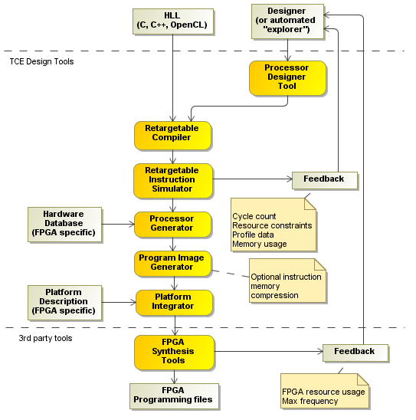
TCE ASIP Design Flow

Slide 4
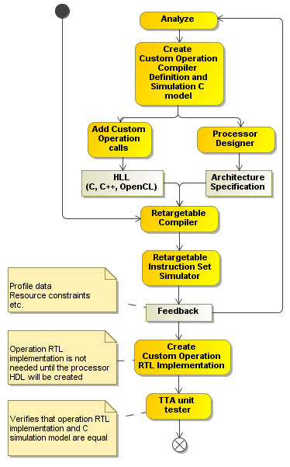
TCE Custom Operation Flow

Slide 5
Application
Tutorial application is CRC-32
  Cyclic Redundancy Check
Application will be analyzed and accelerated
We will create ASIP RTL from the application
  C to VHDL
Download tutorial files from http://tce.cs.tut.fi/tutorial_files/tce_tutorials.tar.gz
Unpack with: tar -xzf tce_tutorials.tar.gz

Slide 6
TCE ASIP Design Flow

Slide 7
Compile the application
Copy the starting point architecture to tutorial folder:
cp /usr/local/share/tce/data/mach/minimal.adf start.adf
Open the architecture in Processor Designer tool:
  prode start.adf
    Adjust address spaces
Compile the source code for starting point architecture
  tcecc -O3 -a start.adf -o crc.tpef -k result main.c crc.c

Slide 8
TCE ASIP Design Flow

Slide 9
Simulate using Proxim GUI
Start proxim:
  proxim start.adf crc.tpef &
Execution can be followed from machine window:
  Select View -> Machine Window
  Try stepping the execution
Click Run or Resume to finish execution

Slide 10
Proxim cont.
Result can be checked from the result variable
  x /u w _result
  Correct result is 0x62488e82
Cycle count is at bottom right
  Command “info proc cycles” also shows them
  Write down the cycle count for comparison
Resource usage statistics can be seen
  info proc stats

Slide 11
TCE Custom Operation Flow

Slide 12
Analyze the application
Open file crc.c in a text editor
  crcFast function calls reflect function using REFLECT_DATA macro
  Then performs bitwise xor-operation
  Reflect is also called at the end of the function with REFLECT_REMAINDER macro
Reflect function reflects the input bit pattern
  Iterative on software
  Can be done concurrently on hardware
    Good custom operation candidate

Slide 13
Reflect operation: SW vs. HW
On software: On hardware:
for (bit = 0; bit < nBits; bit++) {
if (data & 0x01) {
reflection I=
(1 << ((nBits-1) – bit));
}
data = (data >> 1);
}
INPUT DATA
7 6 5 4 3 2 1 0
Registers
0 1 2 3 4 5 6 7
OUTPUT DATA

Slide 14
Further analyzation
Reflect is performed for 8-bit and 32-bit data
  Can be done on same hardware
    32-bit crosswiring
    Need to add multiplexers before registers for 8-bit reflections
Not much logic needed
  Can be done in one clock cycle
  -> operation latency is 1 cycle

Slide 15
TCE Custom Operation Flow

Slide 16
Add custom operation definitions
Operation definition tells the semantics of the operation to compiler
Open operation set editor
  osed &
Add new module
  Right click /home/tce/.tce/opset -> Add module
  Name it as “tutorial”
Add operation
  Name the operation REFLECT8
  Add 1 UIntWord input port
  Add 1 UIntWord output port
  Click OK
Repeat for operation REFLECT32

Slide 17
Add custom operation simulation model
C++ simulation model is needed to simulate the operation
We can use the original reflect function as the simulation model.
  It needs some small changes
Right click REFLECT8 and select Modify Behavior
Copy-paste the operation behavior from the user manual or from file custom_operation_behavior.cc
Save the file
Compile the behavior by right clicking “tutorial” and select build

Slide 18
TCE Custom Operation Flow

Slide 19
Add SFU to architecture
We need to add a Function Unit that supports the custom operations into our architecture
First copy the current architecture
  cp start.adf custom.adf
Open the copy in ProDe
  prode custom.adf &
Select Edit -> Add -> Function Unit...
  Name the function unit as REFLECTER (capital letters!)‏
  Add port:
    name it input1
    check the “Triggers” box
  Add another port
    name it output1

Slide 20
Add SFU cont.
Add operations by clicking Add from opset...
  Select REFLECT8
  Check that latency is 1
Repeat for operation REFLECT32
Close the dialog with OK
Connect the function unit
  Select Tools -> Fully Connect IC
Save the architecture
Now the processor architecture supports REFLECT8 and REFLECT32 operations

Slide 21
TCE Custom Operation Flow

Slide 22
Add custom operation calls
Copy crc.c
  cp crc.c crc_with_custom_op.c
Open crc_with_custom_op.c in text editor
Add #include “tceops.h” to the top
Locate crcFast function
Add 2 new variables to the beginning of crcFast function
crc input = 0;
crc output = 0;
Modify the for-loop:
input = message[byte];
_TCE_REFLECT8(input, output);
data = output ^ (remainder >> (WIDTH - 8));
remainder = crcTable[data] ^ (remainder << 8);

Slide 23
Add custom operation calls cont.
Modify the return value
  Replace line
return (REFLECT_REMAINDER(remainder) ^ FINAL_XOR_VALUE);
  With lines:
_TCE_REFLECT32(remainder, output);
return (output ^ FINAL_XOR_VALUE);
Now the code uses reflect custom operations instead of the original reflect-function

Slide 24
TCE Custom Operation Flow

Slide 25
Compile and simulate with custom operation
Compile the new code
tcecc -O3 -a custom.adf -o crc_with_custom_op.tpef -k result main.c crc_with_custom_op.c
This time we will use the command line simulator ttasim and produce bus trace for RTL verification
Launch ttasim:
  ttasim
Enable bus trace setting:
  setting bus_trace 1

Slide 26
Simulate cont.
Load architecture and program and execute program
  mach custom.adf
  prog crc_with_custom_op.tpef
  run
Verify result (should be 0x62488e82)‏
  x /u w _result
Check cycle count
  info proc cycles
  WOW!
Simulator produced the bus trace in file crc_with_custom_op.tpef.bustrace

Slide 27
TCE Custom Operation Flow

Slide 28
Add SFU implementation to HDB
In order to create processor VHDL we need to add HW implementation for the new Special Function Unit
Implementation is in file tour_vhdl/reflect.vhdl
  Open it in text editor
Next step is add the implementation to Hardware Database (HDB)‏
  Map HW ports to architecture ports in HDB
  Add generic values to HDB
  Add HW implementation files to HDB

Slide 29
Add SFU cont.
To speed up things we’ll use the given tour_example.hdb
Open hardware database editor to take a look at the hdb:
  hdbeditor tour_example.hdb &

Slide 30
TCE ASIP Design Flow

Slide 31
Generate processor RTL implementation
Open the architecture in ProDe
  prode custom.adf &
  select Tools -> Processor Implementation
Next step is to select implementations for the function units
  But we will skip this and use the given implementation description file
Click Load IDF... and select file custom_operations.idf

Slide 32
Generate processor cont
In Binary Encoding Map dialog
  Select Generate new
Target directory dialog
  Click Browse...
  Create new folder: proge-output
  Select it
Click OK to generate processor
  Processor RTL implementation is now in folder proge-output

Slide 33
TCE ASIP Design Flow

Slide 34
Generate program binary images
Now we need the program images for the processor
  generatebits -d -w 4 -p crc_with_custom_op.tpef
-x proge-output custom.adf
Command creates
  Instruction memory image crc_with_custom_op.img
  Data memory image crc_with_custom_op_data.img

Slide 35
VHDL simulation
Go to proge-output folder
  cp proge-output
Copy images for the testbench
  cp ../crc_with_custom_op.img tb/imem_init.img
  cp ../crc_with_custom_op_data.img tb/dmem_init.img
Compile testbench
  ./ghdl_compile.sh
Simulate testbench
  ./ghdl_simulate.sh
    This will take some time

Slide 36
Verification
We can compare the bus traces to verify RTL simulation
Cut RTL simulation bus trace to match the ttasim bus trace
  head -n (cycle count) bus.dump > sim.dump
Compare bus traces
  diff -u sim.dump ../crc_with_custom_op.tpef.bustrace
  If there is no output traces were equal

Slide 37
Summary
TTA is a customizable processor architecture template
We have covered the basics of the TCE design flow
  You now know how to
    Modify a processor architecture
    Create and add custom operations
    Create RTL implementation of the processor and binary images of the program
    Verify the implementation
Simple custom operation increased the performance significantly
Performance can be also increased by adding more resources to the processor
  You can try it on your own

