Slide 1
Weekly Challenge Tutorial: Arbitrage
Presented by Alex

Slide 2
Problem statement review
Given a set of currencies and trading rates between them, determine if there is a way to profit only by making trades.
https://open.kattis.com/problems/arbitrage

Slide 3
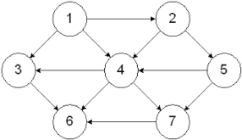
Problem statement rewording
We are dealing with a graph theory problem. The nodes are currency, and the trading rates are directed edges
We want to find out if there are
cycles where the value decreases.

Slide 4
How can we find a negative cycle?
To find a negative cycle: find the minimum distance from a node to itself.
Minimum distance is (very) common
(If you don’t know any way to find it, you should definitely learn something!)

Slide 5
Problems with min distance
What node do we start with?
Some minimum distance algorithms don’t work unless you are guaranteed non-negative edge weights (In particular, dijkstra's algorithm).
Constraints are small, so we will can use a simple algorithm: Floyd Warshall.

Slide 6
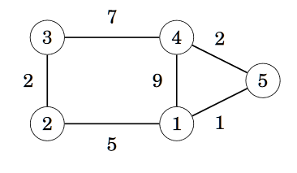
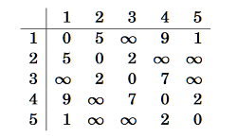
Example on a (undirected) graph without cycles:
Represent edges as a adjacency matrix

Slide 7
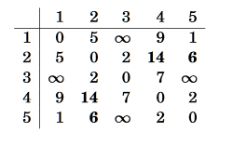
Fix node 1 and find all shorter paths through it.

Slide 8
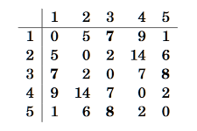
Fix node 2 and find all shorter paths through it.

Slide 9
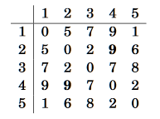
Fix node 3 and find all shorter paths through it.

Slide 10
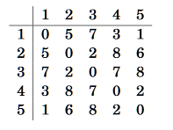
...and so on until you get through all 5 nodes.
Q: How many times do we need to repeat this process to guarantee we find all the shortest paths?

Slide 11
Q: In the general case, how many times do we need to repeat this process to guarantee we find all the shortest paths?
A: NONE!
Proof (by induction):
https://wcipeg.com/wiki/Floyd%E2%80%93Warshall_algorithm#Proof_of_correctness

Slide 12
Extra things to consider
The amount of arbitrage can be huge in the worst case!

Slide 13
Extra things to consider
We are going to need use floating-point numbers, so we must consider accuracy.

Slide 14
Implementing
https://github.com/OSUACM/Weekly_Events/blob/master/2018-09-24/Arbitrage.java
for (int i = 0; i < edgeMatrix.length; i++) {
for (int j = 0; j < edgeMatrix.length; j++) {
for (int k = 0; k < edgeMatrix.length; k++) {
//check if there is bigger gain j->i->k
if (edgeMatrix[j][k] < edgeMatrix[j][i] + edgeMatrix[i][k]) {
edgeMatrix[j][k] = edgeMatrix[j][i] + edgeMatrix[i][k];
}
}
}
boolean arbitrage = false;
for (int i = 0; i < edgeMatrix.length; i++) {
if (edgeMatrix[i][i] > 1e-7) {
arbitrage = true;
}
}

Slide 15
Yaay
It’s so nice

