Slide 1
Weekly Challenge 1
Leaps and Bounds

Slide 2
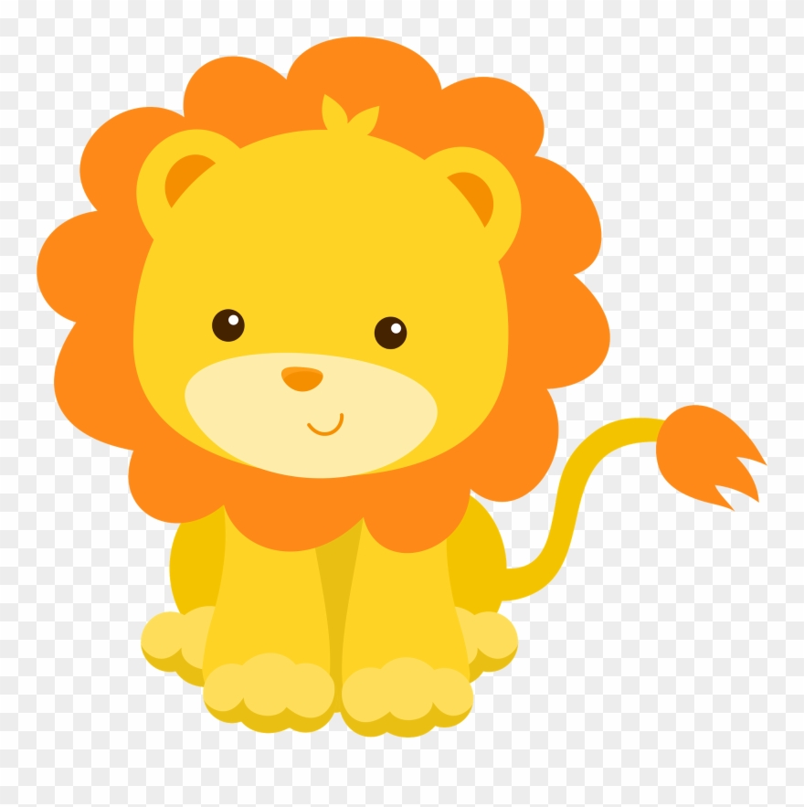
Statement
N lions are standing on the number line playing leapfrog.
They want to have a lion standing on each of N spots on the number line.
Is it possible for this to occur?

Slide 3
Answer
If, for any k, the kth lion is in front of k spots, it’s impossible because lions can’t go backwards.
Otherwise, it is always possible, as we can move the front lion just 1 spot at a time until all spots are covered.
We can implement this check by sorting the array of lions and spots, then ensuring that the kth number in the lions array is greater than the kth spot.

Slide 4
Answer to Bonus
To generate an optimal solution, we use the following strategy:
Always move the furthest back lion that is not on a empty spot.
Intuition: If you have a bunch of lions in a line, moving one furthest back makes the most progress. Moving the one furthest back will cause the lions to group up into a line and make fast progress.

Slide 5
More Convincing Proof
Suppose we move a lion (at index i) that isn’t the furthest back. There are 2 cases:
No other lion will ever reach index i. In this case, the ‘furthest back’ strategy will eventually move this lion anyways.
Another lion will later reach index i. If we don’t move that lion further, it makes no difference, but if we wanted to move the new lion to index i+1, and we hadn’t moved the old lion, we would have saved a move, as the new lion would have jumped over the old lion.

