Slide 1
Little Language
Design Pattern

Slide 2
Building a Dice Roll Expression Language
I want to create a little language that will allow my users to express a dice roll.
Here are some examples of the types of dice rolls that I want my users to be able to express
1d20 + 5: roll one twenty-sided die and add five to the result.
2d4 - 1: roll two four-sided dice and subtract one from the result.
My little language will be exposed as a Java library with the following basic interface:
int result = Dice.roll(“1d20 + 5”);

Slide 3
Building a Dice Roll Expression Language
I could use code generation tools like Lex and Yacc for C, or Antlr for Java, but for a language this simple, it would be easier to code a parser by hand.
Creating a simple parser by hand gives me the following benefits:
better control over the structure and behavior of the resulting code.
makes it easier to maintain the code.
knowledge of how to create parsers in languages for which there are no parser generators (e.g. JavaScript)
Knowing how to create a simple parser by hand also makes it easier to understand and customize the behavior of parser generators, which is useful for when you want to tackle a more complex DSL.

Slide 4
Grammar in Backus-Naur Form (BNF)
A grammar defines the rules (a.k.a. productions) of the language syntax in terms of terminal and non-terminal symbols. Operator precedence is NOT, AND, OR.
expression -> add
add -> mult + add | mult – add | mult
mult -> paren * mult | paren / mult | paren
paren -> ( add ) | unary
unary -> - num | d num | D num | terminal
terminal -> dice | num
dice -> num d num | num D num
num -> [0-9]+
Example: (1 + 3d4) * ((12 - 2d6) / -3) + d8

Slide 5
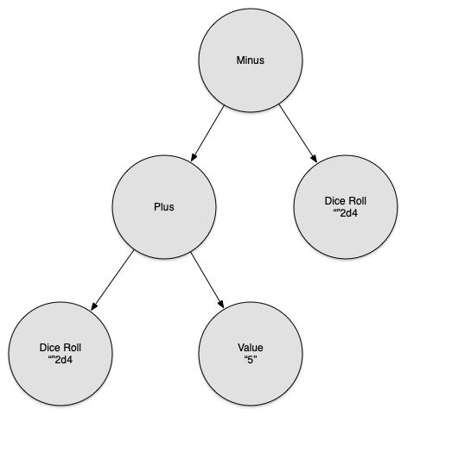
Syntax Trees
1d20 + 5 - 1d4

Slide 6
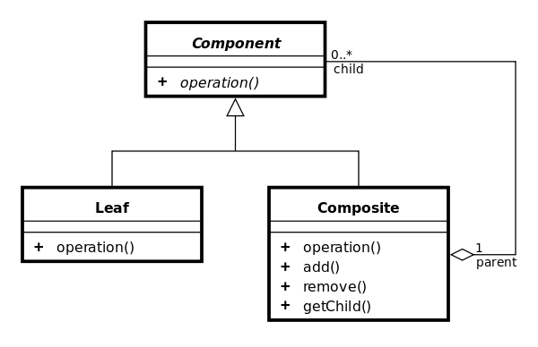
Object Model: Composite Pattern

Slide 7
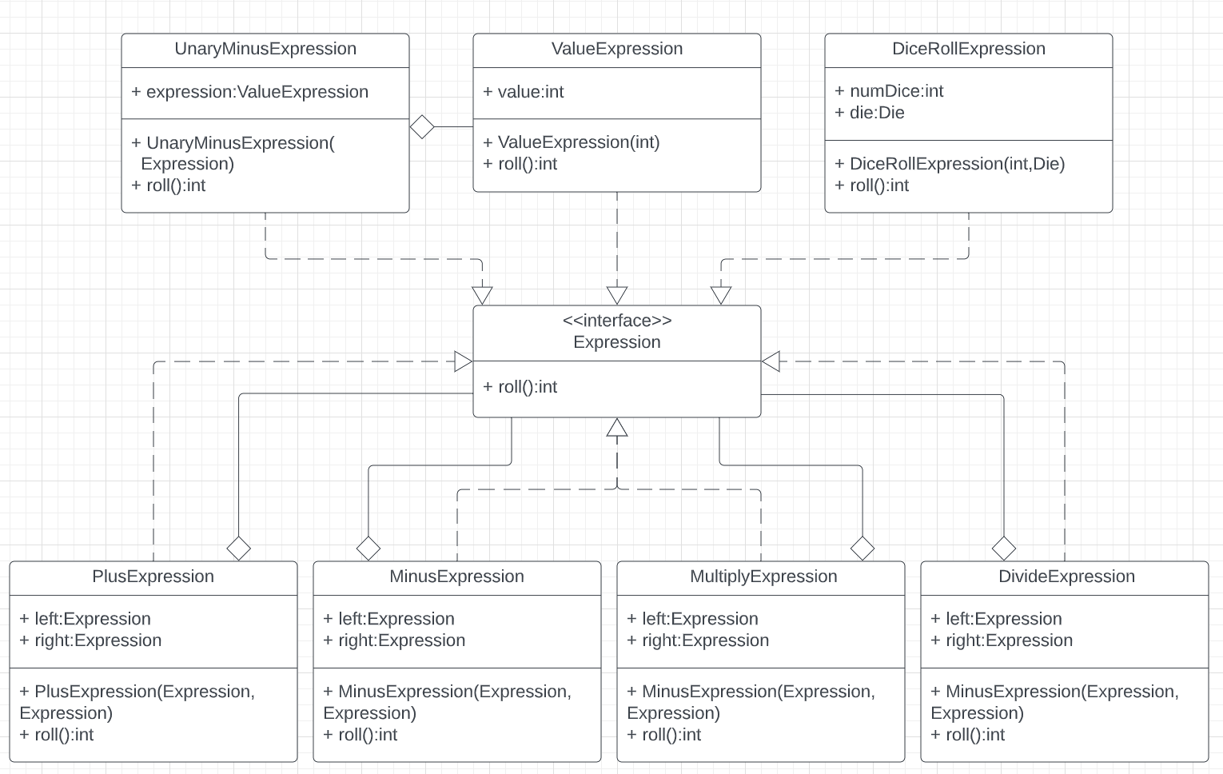
Object Model: Composite Pattern

Slide 8
Object Model: Composite Pattern
1d20 + 5 – 1d4
Expression e = new MinusExpression(
new PlusExpression(
new DiceRollExpression(1, Die.D20),
new ValueExpression(5)
),
new DiceRollExpression(1, Die.D4)
);
int result = e.roll();
System.out.println(result);

Slide 9
Building a Little Language Parser
The goal of our parser is to convert a string representing an expression such as “1d20 + 5 – 1d4” into a composite object like the one we created programmatically in the previous slide.
The little language parser will be subdivided into two separate processes:
Lexical Analyzer: converts a sequence of characters into a sequence of language-specific terminal symbols (i.e. tokens), trimming out all whitespace.
Parser: converts a sequence of tokens into a composite object.

Slide 10
Lexical Analyzer
Accepts a sequence of characters and converts them into a sequence of terminal symbols (a.k.a. tokens).
Each token has a type which can be expressed as a regular expression and a lexeme, which is the string that matched the regular expression for the token in question.
Token Types: PLUS, MINUS, MULTIPLY, DIVIDE, LEFT_PAREN, RIGHT_PAREN, DIE, NUMBER, EOS
For an expression such as: “1d20 + 5 – 1d4”, the sequence of tokens produced by consecutive calls to lexer.nextToken() are:
Token {type=NUMBER, lexeme=“1”}
Token {type=DIE, lexeme=“d”}
Token {type=NUMBER, lexeme=“20”}
Token {type=PLUS, lexeme=“+”}
Token {type=NUMBER, lexeme=“5”}
Token {type=MINUS, lexeme=“-”}
Token {type=NUMBER, lexeme=“1”}
Token {type=DIE, lexeme=“d”}
Token {type=NUMBER, lexeme=“4”}
Token {type=EOS, lexeme=null}

Slide 11
Parser
Uses a LexicalAnalyzer and top-down recursive descent to convert the tokens into a composite object based on the syntax rules defined for the grammar.

