Slide 1

Ben.README [wip]

Slide 2
Ben.README
This is a new document and still a work in progress. It’s meant to be documentation on me.
Two reasons for this to exist
The creation has helped me identify and refine my thoughts and values.
Hopefully this will help you understand me better and help us work together.
Important: NOT meant as a replacement for actually getting to know each other.

Slide 3
My Job[s]
Plus Merchant Experience Group | Enable Amazing Work
Work with partners in Product and UX to create high level vision for products in this area. Responsible for the long term health of all products in this area. Represent this product domain to the rest of the organization. Manage cross project priorities and ensure we have the right skills on each. | Set up teams for success and autonomy Collect and share context from across the broader Shopify. Attract, retain and grow high performing individuals and teams. Foster a culture of passion, innovation and collaboration leading to a track record for building quality products.
Important: If you feel I’m not meeting any of these responsibilities you’d be doing me a huge favour by letting me know as soon as possible

Slide 4
My Availability
TLDR; Very few things are more important than talking to you if you want to talk to me. If you need to talk, let’s talk.
Heard a rumour? Need clarification on something? Blocked? I’d love to hear as soon as possible. Come by my desk, stop me in the hall, shoot me a Slack message, we don’t need to wait for our next scheduled 1:1.
Feel free to put something in my calendar, don’t feel like you need to ask first.
Is my calendar full? Send me a message and I’ll very likely be able to move something around.

Slide 5
My Assumptions
You’re very good at your job. You wouldn’t be here if you weren’t. If it feels like I’m questioning you it’s because I’m either: a) Trying to gather context. Or b) Trying to be a sounding board and rubber duck.
I’m not good at your job. You know best. I’ll work to provide necessary context and ask questions to help you vet your ideas but I won’t override you.
You’ll let me know if you can’t do your job. One of my main responsibilities is ensuring that you’re set up for success. Occasionally things slip through the cracks and I won’t know I’m letting you down.
You feel safe debating with me. I find that ideas improve by being examined from all angles. If it sounds like I’m disagreeing I’m most likely just playing devil’s advocate. This does rely on us being able to have a safe debate.

Slide 6
How can I help you
Provide context. Most of my day is spent collecting, filtering and sharing context/information from across other projects, domains, and product lines. I’ll try to push information to you as much as I can but feel free to ask about anything else.
Provide an outside(ish) perspective. I won’t be working on your project day to day but will be close enough to have informed thoughts.
Cheer. “I will celebrate your successes. If you're not a person who self-promotes, please let me do it for you. Tell me when things go well, share the things which make you proud, and I'll cheer/share appropriately.“ - Del
Firefight. “If my favourite opening line is "I could use a hand with...", my second favourite is "I screwed up: ...". A mistake, if shared, becomes a challenge; if hidden, becomes a failure.” - Del
Other. Please let me know how else I can help.

Slide 7
How can you can help me
Do amazing work. This is the expectation. Let me know if there is something preventing you from accomplishing this.
Disagree with me. The best solutions comes from a healthy level of debate. We need to be able to separate our ideas from our egos . I’ll challenge your ideas with the goal of coming to the best possible solution, I hope you’ll challenge mine.
Tell me when I screw up. This is very important. I screw up and sometimes don’t notice. I need to know or I’ll likely do it again.
Communicate. One of my jobs is to provide context. Are you missing some? Let me know and I’ll fill you in or go find out.
Bring your friends. We’re growing the team and you know who you want to work with.

Slide 8
Your development
“No one hands you personal growth here; but it's there for the taking. It's being able to try hard things; that you might not succeed at every time. It's seeing the practices of the talented people around you; practices that you're free to steal. Or it's the advice that others will give to you; advice that you didn't always ask for but is usually a good idea to take.”
- Steven Noble
Your career is yours. You know best how you’d like to grow and in what areas. I can provide feedback and an outside perspective.
I’ll do my best to provide growth and learning opportunities, it’ll be up to you to seize them. Let’s work together on this.
At the end of the day, it is your career. You set your goals. You set your priorities. Let me know how I can help you achieve them.

Slide 9
Feedback
Feedback is critical to both of our successes at Shopify. Three dimensions are required for people to continue to give you feedback:
Safety - Unlikelihood of being punished for giving feedback. Should be high
Effort - The amount of work in order to give feedback. Should be low
Benefit - How likely is it that giving you feedback will materially impact your behavior? Should be high
Let me know if I don't do well on any of these three dimensions.

Slide 10
Feedback cont.
When/how?
I don’t believe in storing feedback and then scheduling a time to provide it. If I have feedback to give you I’ll work to provide it as soon as possible, in the moment if I can. It’s unlikely it’ll start with “I have some feedback to give you”.
More specific?
If you’d like specific feedback on something let me know! I’m happy to provide an outside perspective.
What should you do with feedback?
Consider it. Acting on it is not required. You’ll receive a lot of feedback at Shopify. Most of it will be good, some of it won’t be. Like everything else, please think about each piece critically and decide whether to act on it or not.

Slide 11
One on Ones
There’s a lot of variety in frequency, length and format of one on ones with my direct reports. From thirty minutes bi-weekly to an hour per week. Coffee in the cafe, private meeting room, head out for a walk, let me know what works best.
Length, frequency, format and content is up to you. We’ll start with 45 minutes bi-weekly and then adjust from there.
The best 1:1s I’ve had have focused beyond the moment: Your career development, team strategy and opportunity, the greater Shopify, etc. Feel free to come with a topic you’d like to discuss. I’d love it if you spent a few minutes beforehand preparing so that we can get the most of our time.

Slide 12
Default to Open [WIP]
“Default to Open” is a core value of Shopify. All of our tools and processes are defaulted in this direction. Infrequently those defaults are overridden and there are things that I won’t be able to share before a certain date. These events are rare and always thoughtfully considered.
You can ask me anything. The vast majority of the time I’ll answer. Very infrequently, I won’t be able to. But I’m committed to never lying to you.
Note: Default to Open means that the information is there if you look for it. Shopify is too large at this point for it to be possible for one person to know everything so not all information will be pushed.

Slide 13
What I value
Merchant focus. We’re all here to create the best product that we possibly can. That starts with a laser focus on our merchants and their customers.
Critical thinking. Nothing is sacred and we don’t do anything “because we’ve always done it that way”. No cargo culting.
Self reflection. Self reflection is an important part of growth. You’ll miss opportunities without it.
Intentionality. We have too much to do for any of it to be random. Intentionality is important to make sure we get the results we want.
Empathy. Connecting with your customer’s emotions is incredible important to building the best product that we can. Having empathy for your co-workers will help us to build strong teams.

Slide 14
end
This document is new and still a wip. I’d love your feedback.
Did you find the time you spent reading this valuable?
Was something critical missing?
Were there slides included that you didn’t find useful
If you see me not living up to anything included please let me know. It’s possible that I’ve changed my mind (👍). More likely I’m dropping the ball (👎). Either way I’d like to know.

Slide 15
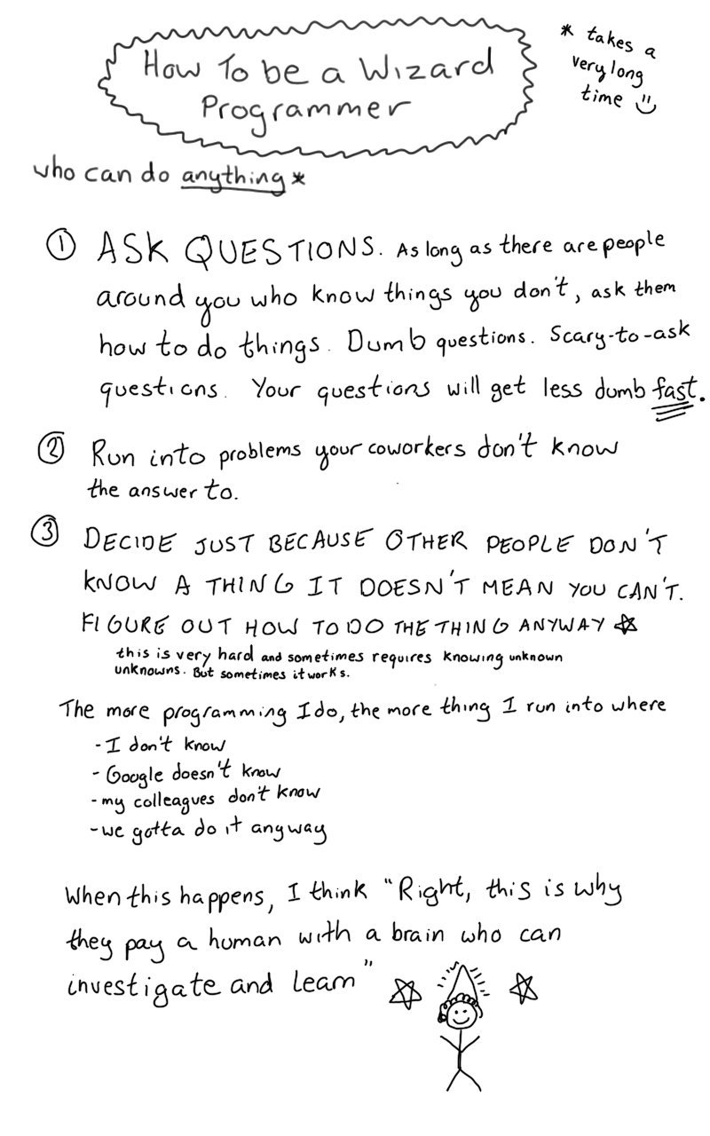
This is from Julia Evans: https://drawings.jvns.ca/wizard-programmer/

Slide 16
Sound good?
We’re hiring! Shopify is hiring a for number of roles across all offices. Check out our Careers page for more information: https://www.shopify.ca/careers
Interested? Sound like something you could be interested in? I’d love to chat and answer any questions you have, feel free to get in touch: ben.morris@shopify.com or @bnmrrs

