Slide 1
DATA / MSAI / MSML 641 · GROUP 6 · FINAL PROJECT · AUGUST 19, 2026
AdInsight
Shows you how an ad is trying to persuade you — in plain language, with the evidence to check it.
DETECTS SEVEN PERSUASION TACTICS
Urgency
Scarcity
FOMO
Fear appeals
Authority
Social proof
Exaggerated claims
THE TEAM
Chris Pedretti
Shashank Ashoka
Ciara Cameron
Jonathan Kim
Engineering · Classifier · App & Extension
Architecture · ASR/VLM · VLM Extraction
Data & Annotation · Hyperopt Tuning
Data Pipeline · Baseline Model
Notes:
Hi everyone — we're Group 6, and this is AdInsight. It's a tool that shows you how an ad is trying to persuade you — in plain language, with the evidence to check it. It detects these seven persuasion tactics, and I'll show it working live in about two minutes. Our roles are on screen; I'll be presenting for the team. [Target: 0:30]

Slide 2
AREA 1 · PROBLEM AND USERS
Persuasion you can't see, aimed at the people who pay most for it
WHO IT'S FOR
Adults 60 and older — heavily targeted by health, supplement, insurance, and financial ads on Facebook, Instagram, YouTube, and news sites.
WHAT ADINSIGHT DOES INSTEAD
Names the tactic — urgency, fake scarcity, authority framing — at the moment the user sees the ad.
$2.4B
4×
Explains in plain language, quoting the ad's own words back as evidence.
FTC-reported fraud losses, ages 60+, 2024
growth since 2020 (~$600M) — highest median loss of any age group
Educational, not judgmental — no "scam / not scam", no legal claims. It gives a reason to slow down.
WHAT THEY DID BEFORE ADINSIGHT
Our interviews: ignore it, click through and judge the landing page, Google it, check Amazon or Reddit, ask family. Older users verify socially or buy first and judge after. Manual, inconsistent, and often too late.
Positioning: the concern is rarely a false statement — it's the framing. "Only 3 left." "Doctor recommended." "Offer ends tonight."
THE TACTICS WE NAME
Urgency
Scarcity
FOMO
Fear appeals
Authority
Social proof
Exaggerated claims
Notes:
We built this for adults sixty and older. They're the most heavily targeted group for health, supplement, insurance, and financial ads — and the FTC numbers show why it matters: reported fraud losses for people over sixty hit 2.4 billion dollars in 2024, roughly four times what they were in 2020, with the highest median loss of any age group.
Before AdInsight, what people did about a suspicious ad was improvised: ignore it, click through and judge the landing page, Google it, check Amazon or Reddit, ask family. Our interviews found older users verify socially — or buy first and judge after. The key design decision: AdInsight doesn't say "scam" or "not scam." The concern usually isn't a false statement — it's the framing. "Only 3 left." "Doctor recommended." So we name the tactic, explain it in plain language, and let the person decide. [Target: 1:45]

Slide 3
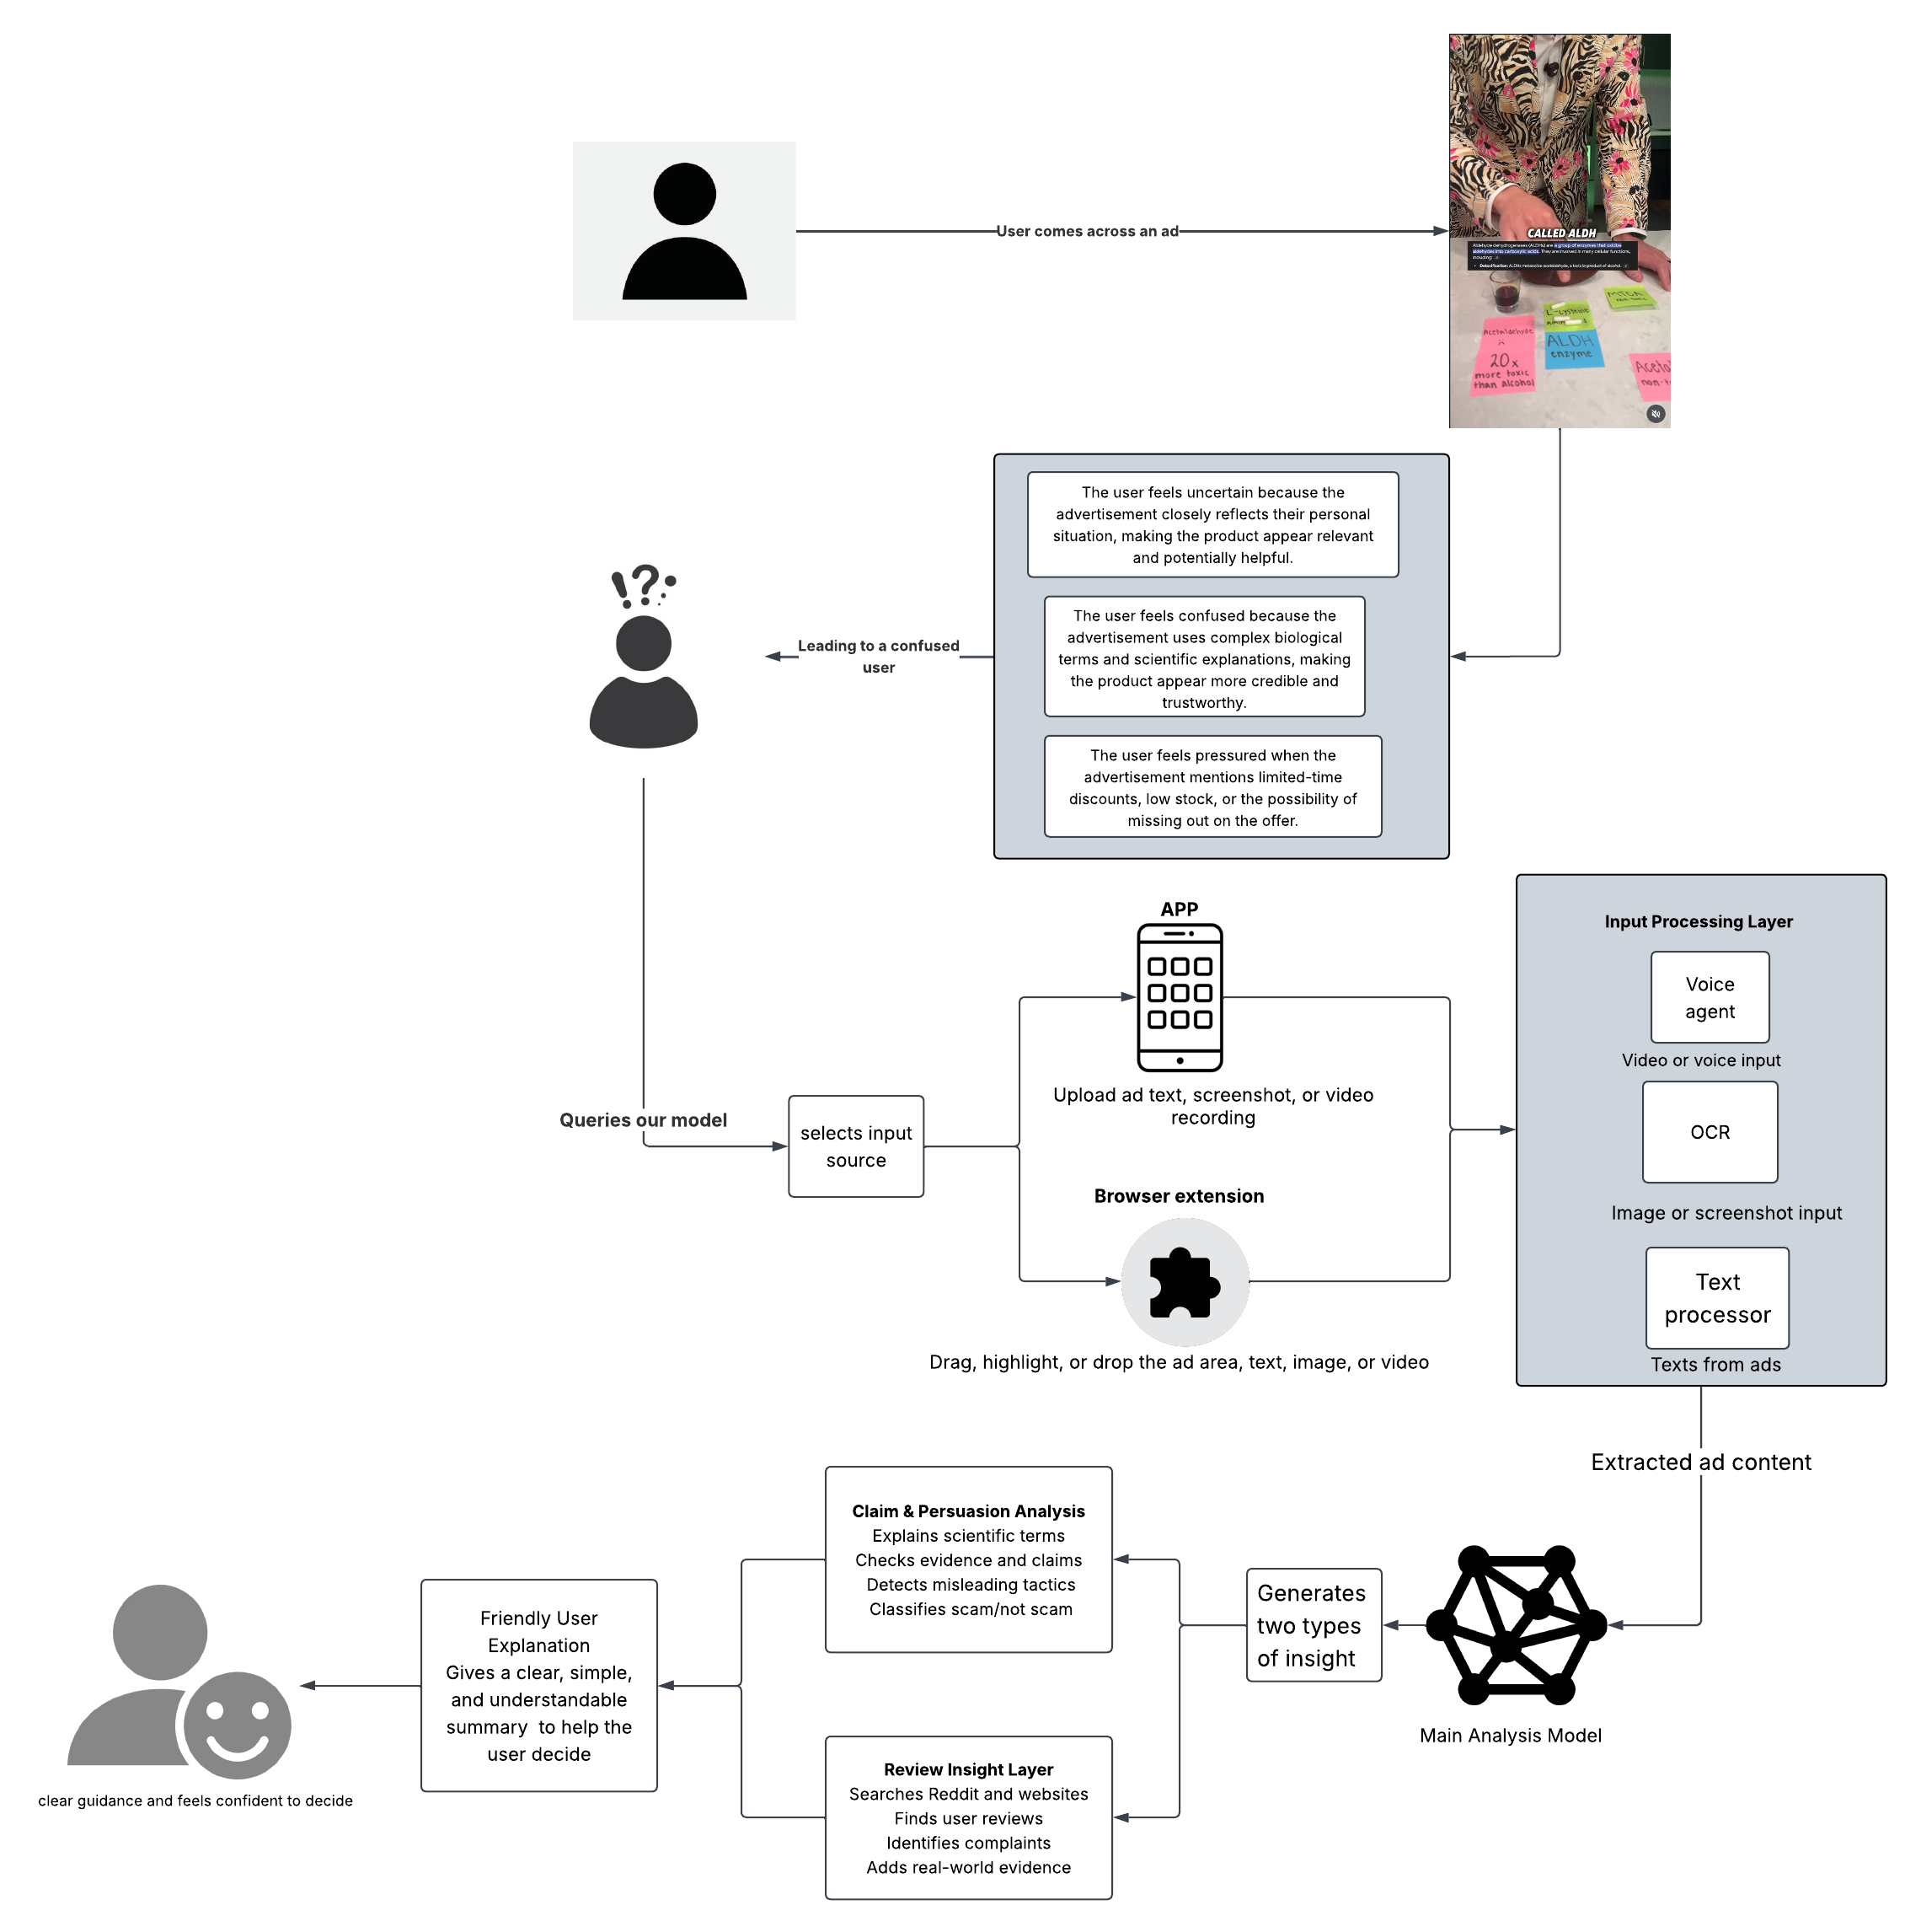
AREA 2 · PRODUCT
One analysis engine, three ways in
Three surfaces, one backend. Web app, desktop window, and a Chrome extension all POST to the same Flask /api/analyze.
Read. Image ads: VLM transcription (transcription-only prompt — it may not name tactics or judge) with local RapidOCR + spacing repair as offline fallback. The extension shoots 3-frame bursts to catch rotating creatives.
Classify. Fine-tuned DistilBERT, 8 classes; long ads scored in sliding windows so a tactic at the end still counts.
Explain. Every finding is badged with its evidence: model pick (with confidence) or phrase found (traceable to our labeling guidelines). Below 60% confidence with no phrase, it says "not sure" instead of guessing.
Check. A review-insight layer (independent-source web search) was prototyped, but its retrieval was not reliable enough to ship — it was removed from the final build.
Engineering: 186 automated tests (130 Python + 56 JS) · model ships as 134 MB float16.
System architecture — ad in, plain-language explanation out
Notes:
Here's the system end to end — the diagram on the right. Three front ends — a web app, a desktop app, and a Chrome extension — all talk to one Flask endpoint.
The pipeline has four steps. Read: for image ads, a vision-language model transcribes the ad — and it's restricted by prompt to transcription only, it may not name tactics or judge — with fully local OCR as the offline fallback. Classify: a fine-tuned DistilBERT, eight classes, with sliding windows so long ads still get scored end to end. Explain: every finding is badged with its evidence — either "model pick" with a confidence, or "phrase found," a trigger phrase from our labeling guidelines literally present in the ad. And below sixty percent confidence with no phrase, the system says "not sure" instead of guessing. Check: we prototyped a review layer that searched independent sources, but its retrieval was not reliable enough to ship, so we removed it from the final build. The whole thing is held together by 186 automated tests. [Target: 3:00]

Slide 4
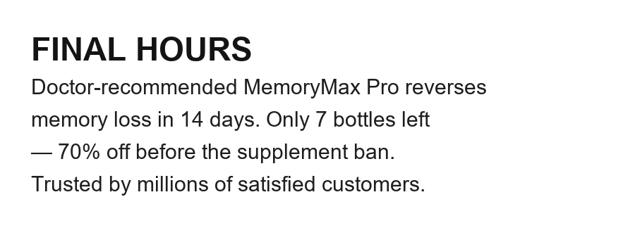
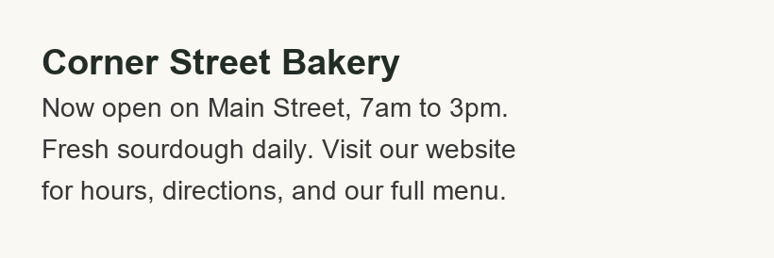
AREA 2 · PRODUCT — LIVE DEMO
Watch it work
1
Paste a loaded ad. "FINAL HOURS: Doctor-recommended MemoryMax Pro… only 7 bottles left" → five tactics, each quoting the ad, plus the banner: "Take your time. Nothing requires a decision today."
2
Upload a screenshot. The supplement ad image → "What we read from your image" (OCR ~98% confidence, spacing repaired) → six tactics. A bad scan is visible, never silent.
The loaded ad — six tactics
3
Try to fool it. A clean bakery ad → Neutral — no false alarm. (It used to cry "Social Proof, 75.8%" before we fixed the dataset.)
4
Meet it where ads live. The Chrome extension overlays a real page: hover an ad, or screenshot-capture a video ad in place.
The clean ad — Neutral, no false alarm
Backup: recorded run in reports/final/demo.mp4
Notes:
Let me show you, rather than describe it. (Switch to the app.)
First, a loaded ad — I'll paste this: "FINAL HOURS: doctor-recommended MemoryMax Pro, only 7 bottles left." AdInsight finds five tactics, each one quoting the ad's own words back, and the banner says: take your time — nothing requires a decision today.
Second, an image. I upload this screenshot — notice it shows "what we read from your image" first, at 98 percent OCR confidence, so a bad scan is visible, never silent — and then six tactics.
Third — let's try to fool it. A clean bakery ad. It comes back Neutral. No false alarm. It didn't always — that fix is a story you'll hear in a minute.
And fourth, the extension: same analysis overlaid on a real page, including screenshot capture for video ads. (Back to slides.) [Target: 5:00]

Slide 5
AREA 3 · NLP METHOD AND EVALUATION — DATA
4,374 ads, 8 classes — rebuilt after we caught our model cheating
The shortcut we found: in the original 7-class corpus (3,230 ads), "limited stock" appeared in 435 of 449 Scarcity examples (96.9%). The model could pass the test by memorizing one phrase.
CLASS DISTRIBUTION (FINAL CORPUS)
Urgency
959
Exagg. claims
905
The fix: merged 857 real e-commerce rows from the Mathur et al. dark-patterns corpus (Scarcity, Urgency, Social Proof) and added 287 Neutral examples so "no tactic" became a possible answer.
Scarcity
798
Social proof
510
Effect: top-phrase coverage fell — Scarcity 97.3%→73.4%, Urgency 91.6%→74.0% — forcing the model to learn broader patterns.
Authority
389
Fear appeals
304
Neutral
287
Protocol: stratified 70/15/15 train/val/test (657 held-out test ads, untouched during tuning); class-weighted cross-entropy for the 4.3× imbalance.
FOMO
222
Neutral (amber) is new — added with the dark-patterns merge
Notes:
Now the NLP. Our task is eight-way persuasion-tactic classification on 4,374 ads — and the number to remember from this slide is 435 out of 449. In our original corpus, that's how many Scarcity examples contained the exact phrase "limited stock." Nearly 97 percent. A model can ace that test by memorizing one phrase.
So we rebuilt the data: 857 real e-commerce rows merged in from the Mathur et al. dark-patterns corpus, plus 287 Neutral examples so "no tactic" became a possible answer. Top-phrase coverage dropped by over twenty points, forcing the model to learn broader patterns. Protocol: stratified 70/15/15 split, 657 test ads never touched during tuning, class-weighted loss for the four-times imbalance. [Target: 6:15]

Slide 6
AREA 3 · NLP METHOD AND EVALUATION — MODEL
Fine-tuned DistilBERT, tuned with Hyperopt, shipped small
MODEL
HYPERPARAMETER SEARCH
SHIPPING IT
distilbert-base-uncased, fine-tuned for 8-way classification.
128-token training window; longer ads scored in overlapping sliding windows with per-class max-pooling — a tactic in an ad's closing seconds still counts.
Metric: macro F1 — with a 4.3× class imbalance, accuracy would hide weak minority-class performance; macro F1 weights all 8 classes equally.
Hyperopt TPE over lr {1e-5…5e-5} × batch {8, 16} × epochs {2–4} × weight decay {0, 0.01, 0.05} — a 72-config space, 3 trials evaluated on validation macro F1.
Winner: lr 5e-5 · batch 16 · 3 epochs · wd 0.0
Best 0.886 vs worst trial 0.788 val macro F1, then retrained on the final corpus (val macro F1 0.928).
float32 → float16: 268 MB → 134 MB, with zero changed predictions on the held-out check.
Runs on CPU in ~1s per ad — no GPU anywhere in the demo.
Tokenizer and split logic shared between training and the app — what we evaluate is what we serve.
Reproducibility: the winning configuration and trial table are committed with the repo (best_parameters.txt · hyperopt_trials.csv), and the shipped checkpoint was re-evaluated end-to-end on the held-out split while preparing this talk — the reported numbers reproduced exactly.
Notes:
The classifier is fine-tuned DistilBERT. Our metric is macro F1 — with imbalanced classes, accuracy would hide weak minority-class performance. We tuned with Hyperopt's TPE, sampling three configurations from a 72-config space; the winner — learning rate 5e-5, batch 16, three epochs — was retrained on the final corpus. And we ship it small: float16 halves the model to 134 megabytes with zero changed predictions, so everything you just saw runs on a CPU in about a second per ad. [Target: 7:00]

Slide 7
AREA 3 · NLP METHOD AND EVALUATION — RESULTS
0.919 macro F1 on held-out data — read alongside its baselines
MACRO F1, SAME 657-AD TEST SPLIT
7-CLASS → 8-CLASS (AFTER THE DATA REBUILD)
Majority class
0.045
0.896→0.919
TF-IDF + LogReg
0.894
macro F1
0.909→0.929
0.77→0.88
DistilBERT (tuned)
0.919
accuracy
Social Proof F1
accuracy: 0.219 · 0.901 · 0.929 — identical stratified split, seed 42
Neutral scores a perfect 1.00 — we report that as a warning, not a result: synthetic Neutral rows are trivially separable from tactic ads.
The 657-ad test set stayed untouched through model selection and tuning.
Honest read: a classical baseline gets close. That is our shortcut story confirmed — formulaic ad phrasing rewards n-grams. DistilBERT's edge (+2.5 macro F1) comes exactly where phrasing varies, and it is the edge that survives on harder, less formulaic ads.
Notes:
On held-out data: 0.919 macro F1, 93 percent accuracy. But the honest comparison is against baselines on the same split: majority class gets 0.045; TF-IDF with logistic regression gets 0.894. That classical baseline being close is our shortcut story confirmed — formulaic ad phrasing rewards n-grams. DistilBERT's edge comes exactly where phrasing varies. The data rebuild also moved every headline number — macro F1 up from 0.896, and Social Proof, our weakest class, from 0.77 to 0.88. One caution we flag ourselves: Neutral scores a perfect 1.00 — that's a warning, not a result, because synthetic Neutral rows are trivially separable. [Target: 8:00]

Slide 8
AREA 3 · NLP METHOD AND EVALUATION — FAILURE ANALYSIS
The real world is not our test set
6 GENUINE ADS FROM X / INSTAGRAM / REELS — TEXT EXTRACTION (53 REQUIRED STRINGS)
…BUT CLASSIFICATION BARELY MOVED
1 / 6
0 / 6
0
RapidOCR raw
55%
correct with OCR text
correct with cleaner VLM text
trigger phrases fired in 18 runs
Our OCR + repair
64%
4 of 6 were income-claim ads — a genre absent from our training data. One scored "Urgency, 98%" with no deadline in the ad: a confident error.
VLM transcription
89%
The OCR bug that started it: an avatar covered "TH", RapidOCR read "ISWEEKONLY" — the Urgency trigger never fired and the ad passed as clean.
The 0.60 guard kept the system silent on 4 of 6 — for a 60+ audience, silence is the right failure mode; a false alarm teaches users to stop trusting the tool.
Sentence-level probing agrees: out-of-distribution fragments get confident nonsense ("take two capsules daily" → Fear, 99%).
Takeaway: better extraction didn't fix classification — the bottleneck is the training distribution, not the input pipeline. That finding sets our roadmap.
Notes:
And here's where it fails, because this matters more than the last slide. We took six genuine ads from X, Instagram, and reels. On text extraction, the VLM crushed OCR — 89 percent of required strings versus 55. But classification barely moved: one of six correct with OCR text, zero of six with cleaner VLM text, and zero trigger phrases fired in eighteen runs. Four of the six were income-claim ads — a genre absent from our training data — and one produced a confident error: "Urgency, 98 percent" with no deadline anywhere in the ad. The saving grace: our confidence guard kept the system silent on four of six, and for this audience silence is the right failure mode. The takeaway sets our roadmap: the bottleneck is the training distribution, not the input pipeline. [Target: 9:15]

Slide 9
AREA 4 · USER EVIDENCE
Six users, ages 60–74, four tasks each
5/6
4/6
6/6
5/6
completed the text-ad task without assistance
completed the image-ad task independently
identified the main persuasion tactic shown
rated the plain-language explanation as useful
WHAT IT CHANGED IN THE PRODUCT
Kept the extracted-text read-back front and center — seeing "what the system read" was the most-praised feature; it stays a first-class UI element.
EARLIER FIELD RESEARCH SHAPED THE DATA, TOO
Week-8 outreach in ad comment sections: repeated phrases are what raise suspicion —
Simplifying "model pick" wording — jargon was the main stumbling block, not the workflow.
"As soon as I hear or see 'limited stock', I just scroll away."
Rewriting low-confidence copy so "no strong prediction" can't be read as "verified safe."
That finding drove which trigger phrases and tactics our dataset curated first.
Scope, honestly stated: a six-person, single-session study shows the workflow is learnable and the output understandable — it cannot measure long-term trust or behavior change. A larger, more digitally diverse 60+ cohort is the next validation step.
Notes:
We put AdInsight in front of six users in our target group, ages sixty to seventy-four, and had each one do four tasks: analyze a pasted text ad, analyze a screenshot, identify the main tactic, and explain the result in their own words. Five of six completed the text task without help, four of six the image task, all six identified the tactic, and five of six rated the explanation useful.
What users did changed the product: the extracted-text read-back stays front and center because seeing "what the system read" was the most-praised feature; the jargon — "model pick" — was the main stumbling block, so we're simplifying it; and we're rewriting the low-confidence message so "no strong prediction" can't be read as "verified safe." We're honest about scope: a small single-session study shows the workflow is learnable — it can't measure long-term trust. [Target: 10:15]

Slide 10
AREA 5 · ETHICS AND LIMITATIONS
Built to inform, not to judge
DATA RIGHTS
BIAS
Training data: our collected public ad texts plus the published Mathur et al. dark-patterns research corpus, credited. Labels are educational annotations — never "scam," never a legal claim.
The training distribution under-represents whole genres (income-claim ads went 0-for-4). Strong held-out scores are not evidence the model works on every ad — we say so, on stage and in the report.
PRIVACY
WHEN THE MODEL IS WRONG
Screenshots can contain more than the ad. The RapidOCR path runs fully on-device; the VLM path leaves the device only when an API key is configured — and that boundary must be disclosed to users. Nothing is retained.
High-confidence errors happen ("Urgency, 98%", no deadline). Mitigations: the <60% guard prefers silence to false alarms; every finding carries checkable evidence the user can verify against the ad itself. AdInsight supports judgment — it never replaces it.
"AdInsight gives users a reason to slow down — the decision stays with them."
Notes:
Four commitments. Data rights: our training data is collected public ad text plus the published dark-patterns research corpus, credited — and labels are educational, never legal claims. Privacy: screenshots can contain more than the ad; the OCR path runs fully on-device, and anything that leaves the device requires configured API keys — a boundary that must be disclosed. Bias: the training distribution under-represents whole genres — we showed you income ads going zero for four — so strong test scores are not a promise. And when the model is wrong — it will be — every finding carries checkable evidence, and the tool prefers silence to false alarms. AdInsight supports judgment; it never replaces it. [Target: 11:00]

Slide 11
WHAT WE LEARNED
Three lessons we'd defend
1 · Held-out ≠ real world
2 · Explanations need evidence
3 · For 60+, silence beats a false alarm
0.92 macro F1 in the lab, 1-of-6 on genuine ads. We found it, measured it, and can name the cause: training-distribution coverage.
Users trusted the tool because it quotes the ad, shows what it read, and badges every claim with its source — model pick or phrase found.
One wrong "this is a pressure tactic" teaches a user to ignore the tool. The confidence guard is a design choice, not a limitation.
IF WE KEPT GOING
Multi-label classification head · real-ad training data for uncovered genres (income claims) · a larger usability cohort · rebuilding the review-insight layer with retrieval reliable enough to ship.
Thank you — questions?
github.com/cpedrett-umd/Group-6-Final-Project · Chris Pedretti · Shashank Ashoka · Ciara Cameron · Jonathan Kim
Notes:
Three lessons we'd defend. Held-out is not the real world — we measured that gap ourselves. Explanations need evidence — users trusted the tool because it quotes the ad and shows its sources. And for this audience, silence beats a false alarm — that guard is a design choice. Thank you — happy to take questions. [Target: 11:30, then 2 min Q&A]

