Slide 1
AdInsight
Helping Users Understand the Persuasion Behind Every Advertisement
An AI tool that analyzes advertisement text, identifies persuasive tactics, and explains how they're used to influence consumers.
What AdInsight Detects
Urgency
Scarcity
FOMO
Fear appeals
Authority
Social proof
Exaggerated claims
THE TEAM
Chris Pedretti
Jonathan Kim
Ciara Cameron
Shashank Ashoka
Engineering · Data & Eval
Data Collection, Preprocessing and
Annotation
Data Quality, Annotation & Evaluation
App · Browser Extension
Notes:
30 seconds. We're Group 6, building the Persuasion-Aware Ad Explainer: an NLP system that tells you, in plain language, which persuasion tactics an ad is using and what real customers say about the product. One presenter today; everyone's role is on screen.

Slide 2
The Problem: Persuasion You Can't See
Many users recognize the offer, but not the persuasive tactics behind it.
WHO
Older adults and everyday internet users who regularly encounter online advertisements.
Current User Behavior
from our user conversations
THE PROBLEM
Ignore the ad
Users recognize the offer, but not the persuasion tactic.
Emotional language can encourage impulsive decisions.
There is no simple way to explain how an advertisement is trying to influence the user.
Click through and judge the website
Google the company
Read reviews
Search Reddit
THE SOLUTION
Ask friends or family
AdInsight analyzes advertisement text, identifies persuasive tactics, and explains them in plain language so users can make more informed decisions before clicking or purchasing.
No single tool explains why an ad is persuasive.
Notes:
90 seconds. Anchor the user: adults 60+, heavily targeted by health and money ads. The pain isn't just that ads persuade — it's that today's coping strategies (right side, straight from our user conversations) are all manual and inconsistent. No one has a reliable method.

Slide 3
What we've built: the data engine
The MVP so far is a multi-modal collection pipeline — three input types funneling into one labeled dataset.
T
Text ads
I
Image ads
Scripted collection of ad copy using regex-based extraction, cleaned and written straight to the dataset CSV.
OCR pulls on-screen ad text from screenshots; its output was just merged into the unified dataset.
7,768
2
8
ad texts in the unified dataset
input modalities piloted — text & image
annotation labels — 7 tactics + neutral — with written guidelines
Notes:
2 minutes. Show, don't tell: open ads_dataset_full.csv or run the collection script live if time allows. Three pipelines are real code today — regex text scraper, faster-whisper/WASAPI audio capture, OCR for screenshots — and they converge into one 7,768-row labeled CSV. Be upfront about the audio chunking bug and that the fix is in progress.

Slide 4
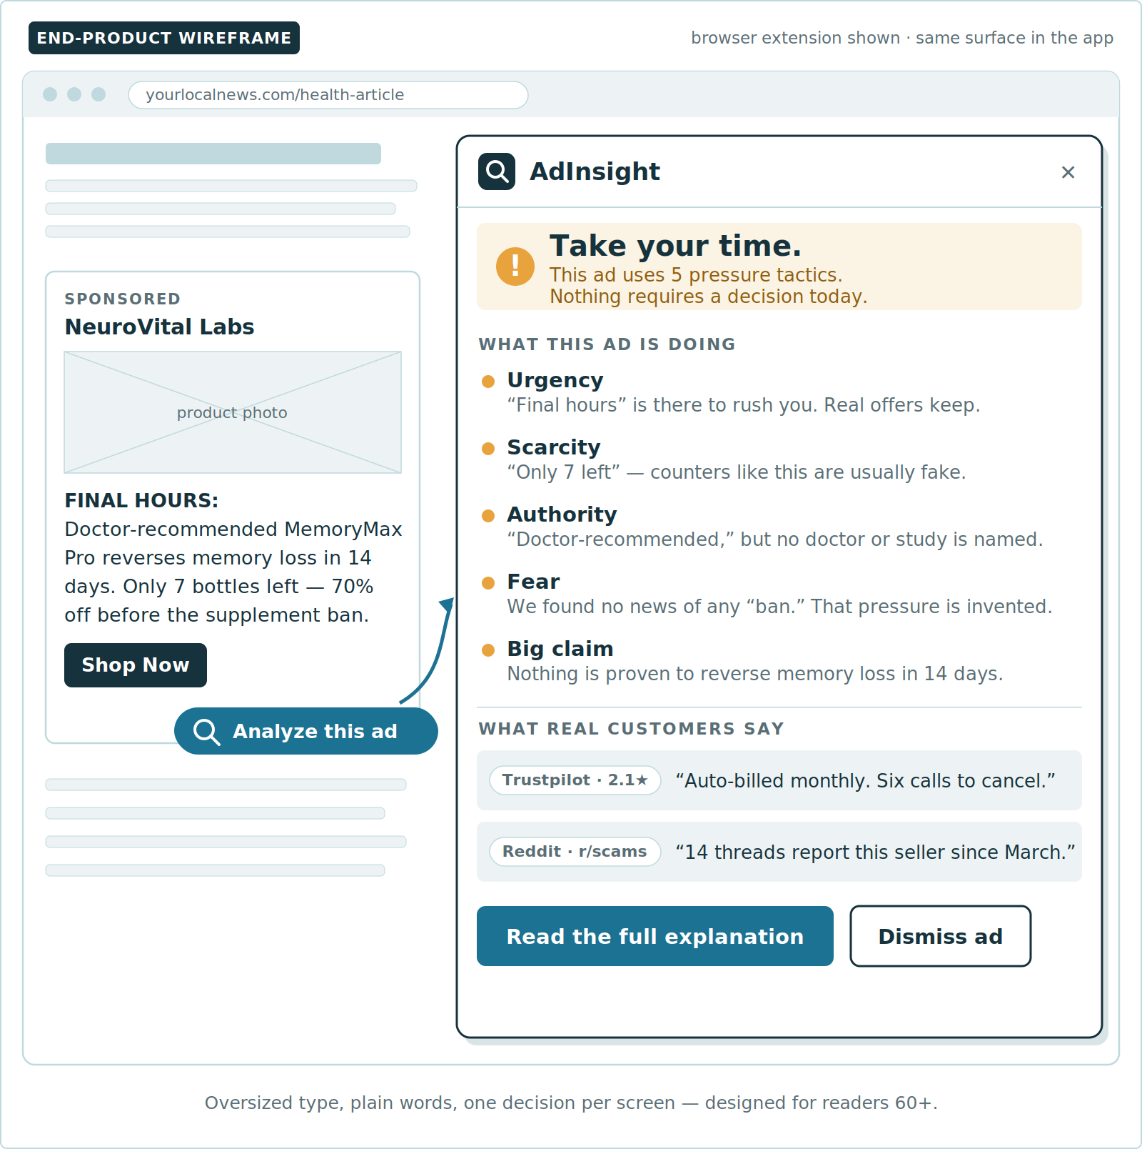
Where it's headed: the end product
A concrete blueprint — from ad encounter to plain-language verdict in four stages.
1
Capture
Upload or highlight any ad — text, or screenshot— in the app or the browser extension.
2
Extract
OCR, and text processing normalize every ad into clean text.
3
Analyze
The model flags persuasion tactics and checks claims, while the review layer pulls real user experiences from Reddit and review sites.
4
Explain
One friendly, plain-language explanation that helps the user decide with confidence.
Notes:
90 seconds. The professor asked for a concrete picture of the end product — this is our working system blueprint. Walk the four stages left to right on the diagram: user hits a confusing ad, submits it via app or extension, input processing normalizes it, the analysis model produces tactic/claim analysis plus review evidence, and the user gets one friendly explanation.

Slide 5
User insight: what the evidence tells us
Published data backs our core assumptions - and what we still need to test ourselves.
WHAT WE DID
We reviewed published consumer research — FTC Consumer Sentinel data, AARP fraud surveys, BrightLocal's 2026 review survey, YouGov, and academic literature — on how people handle suspicious or too-good-to-be-true ads today.
THE GAP
The MVP itself has not been in front of real users yet.
WHAT WE LEARNED
Everyone has a workaround; nobody has a method. 79% say they know buying from social media ads is risky — yet more than 1 in 5 fraud losses started with a social media ad, post, or message. Coping is ad-hoc: check reviews (69%), Google the seller (51%), ask family — and it varies person to person, ad to ad. (AARP; YouGov)
— and neither have our assumptions, beyond desk research. That is the headline goal for the second half: moderated sessions with adults 60+ and a short poll of our own, measuring whether our explanations actually change how people judge an ad.
People already hunt for third-party evidence. 95% of consumers read reviews before a purchase decision, and 74% check at least two review sites. Even the FTC's advice is to search a seller's name plus "scam" or "complaint" before buying — the exact search our review-insight layer automates. (BrightLocal; FTC)
Suspicion often arrives too late. 63% say the old tells — poor grammar, cheap design — no longer feel reliable, and more than 40% of social-media scam losses began with ordering from an ad, with most people discovering the fraud only when goods never arrived. The tool must meet users at the ad itself. (Chain Store Age; FTC)
Notes:
2 minutes — the professor said this is what they most want to see. Lead with what real users told us and what it changed: it validated the review-insight layer and told us to catch users at the ad, not after the click. Then own the gap honestly: the tool itself hasn't been user-tested yet, and that's the top priority for the second half.

Slide 6
Persevere
Dropped Audio Data Modality
Combined plurality of datasets
Preprocessing towards class balance
Audio data collection proved inconsistent and difficult to standardize. To improve data quality, audio modality was removed and efforts redirected to remaining text and image modalities
Combined multiple publicly available advertising datasets comprising real ad data, synthetically generated text data samples, and OCR web-scraped image data
Implemented preprocessing techniques including text cleaning, duplicate removal, quality filtering and heuristic labeling to prepare a more balanced dataset
North-Star Metric: F1 Score across the 7 persuasion class labels
ROAD TO DEMO DAY
1
2
3
4
5
Merge & annotate the multi-modal dataset
Train & evaluate the tactic classifier (CLIP baseline)
Build the explanation & review-insight layers
Ship the app & browser-extension MVP
Usability tests with 60+ users → demo day
Notes:
90 seconds, then leave 2 minutes for questions. Decision: persevere. The problem and the appetite for third-party evidence are validated, the data engine works, and nothing yet argues against the concept — the open question is usability, which is exactly what the second half attacks: finish the dataset, train the classifier, build the explanation and review layers, ship the MVP surface, and put it in front of 60+ users before demo day.

