Slide 1
Lecture 11 – Class Diagrams
Learning Goals
Create a basic class diagram with attributes and operations
Convert a class diagram to code
Describe the three types of class relationships
Draw associations between classes, complete with multiplicities and roles
Describe the difference between aggregation and composition, and the impliciations when writing code
Define an interface and contrast with a base class
Given a system, draw a class diagram to describe all the relationships
©Paul Davies, C. Antonio Sanchez. Not to be copied, used, or revised without explicit written permission from the copyright owner.

Slide 2
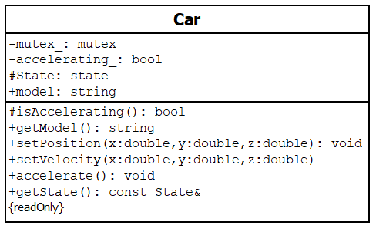
Class Diagrams
Give an overview of the classes that need to be created, including important member variables and functions, and the relationships between classes.
Class Name
Attributes (display optional)
Accessibility Indicator: ‘+’ means public ‘-’ means private
‘#’ means protected
Operations (display optional)
Properties
Function parameters and types
Return type

Slide 3
Class Diagram: Attributes
Attribute Syntax:
visibility name: type multiplicity = default {properties}
Attributes
visibility: public (+), protected (#), or private (-)
name: attribute name
type: type or class of the attribute
multiplicity: number of elements (e.g. size of an array)
default: default value if isn’t specified in constructor
properties: any additional properties
Each attribute will correspond to a member variable in code
Only the name is necessary
Types can be explicit classes (language-specific) or more generic names (i.e. “number”) as long as the intention is clear
Include attributes only if they are important and you want to explicitly specify their names

Slide 4
Class Diagram: Operations
Operation Syntax:
visibility name (parameters) : return-type {properties}
visibility: public (+), protected (#), or private (-)
name: attribute name
parameters: method arguments
direction name: type = default
direction: in, out, or inout
return-type: return type or class of the operation
properties: any additional properties
Operations
Each operation will correspond to a member function in code
Include operations only if they are important for interaction with other classes
No need to specify getters/setters, they are implicit unless you want to clarify them (e.g. the return value is read-only)

Slide 5
Class Relationships
UML defines three class relationships: association, encapsulation, and generalization.
Association: describes a makes-use-of or calls-upon relationship, implies that one class contains a reference to and can send messages to another.
Encapsulation: captures the part-of or belongs-to relationship. It implies that one class owns or controls another. There are two ‘types’: aggregation and composition.
Generalization: describes the kind-of relationship, whether a class can be substituted for or inherits from another.

Slide 6
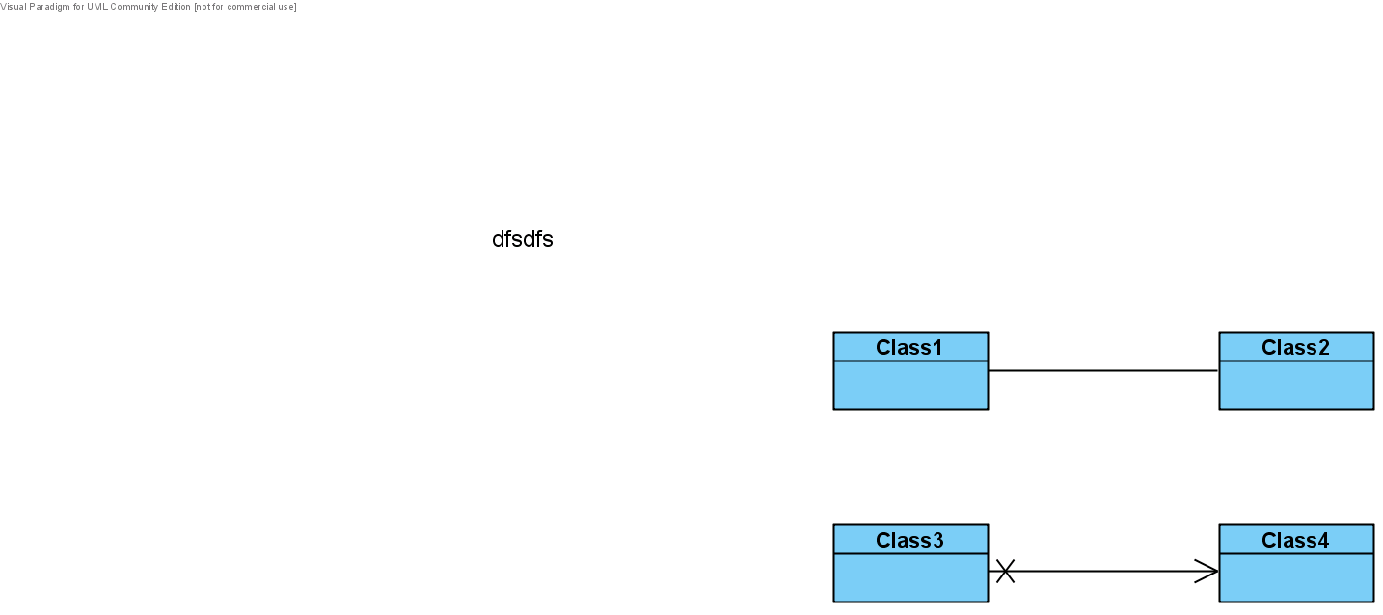
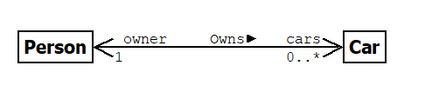
Class Associations
Bidirectional:
optional
Unidirectional:
Associations imply that one class has the ability to send messages to another. This may be through a member variable, or through a member function.
role (attribute name)
label
multiplicity

Slide 7
Association: Multiplicity
Number of unique associates. May need to check for prior existence when adding new association. If variable multiplicity, may need to check existence before usage internally.
0..1 | Could be 0 or 1 objects (caution: could be 0).
0..* | Could be 0 or more objects (caution: could be 0).
* | Unknown many (caution: could be 0).
1 | Guaranteed always to be exactly 1 object.
n | Guaranteed always to be exactly ‘n’ objects (e.g. 5).
1..* | Unknown many but at least 1 and maybe more objects.

Slide 8
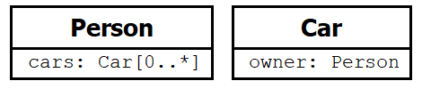
Association: Roles
The role identifies the attribute name in the association. They can use full attribute syntax (visibility, type, etc.). The above implies:
In fact, the two diagrams are equivalent.
Associations with roles can emphasize the interaction.
Internal attributes are often used for primitives or classes not visible in the diagram. Associations are are used to visually map out class relationships.

Slide 9
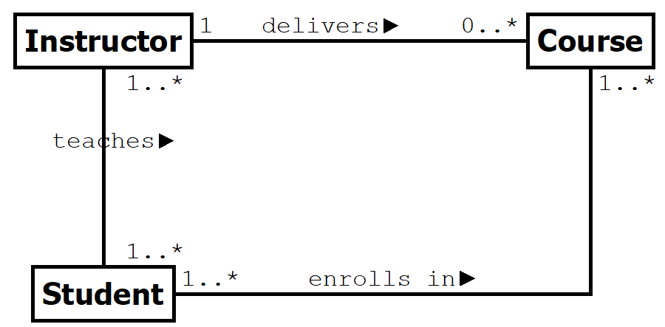
Association: Labels
The label or name aids in readability. It is usually a verb phrase to describe the relationship. It has no impact on code, only in improving clarity of the model.

Slide 10
Class Encapsulation
Used when an association is so strong that an association does not capture the the essense of the relationship.
A CPU is part of a Computer
The Gearbox and Engine are part of a Car
A Room is part of a Building
A Student ID belongs to a Student
Encapsulation often has implications when it comes to memory management. The “owner” of an object is often tasked with creating and destroying it.

Slide 11
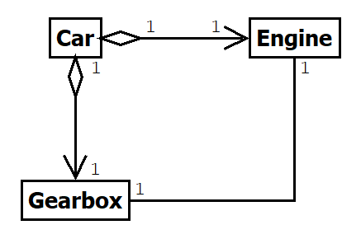
Encapsulation: Aggregation
Aggregation implies that ownership is transitory – i.e. the object is being “borrowed”. The object can be detached from the owner and given to another one at run-time.
The lifetime of the owner and object are not necessarily tied together. Usually means class has add/remove methods for borrowed objects.

Slide 12
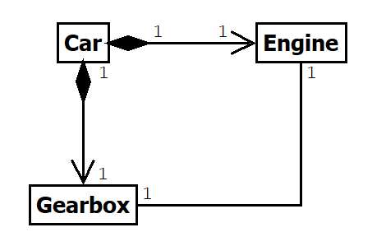
Encapsulation: Composition
Composition implies a stronger ownership than aggregation: the owner and parts have the same lifetime, implying the owner is responsible for creation/deletion of resource.
Implies parts cannot be detached from owner, and ownership cannot be shared (i.e. multiplicity at owner size is 1).

Slide 13
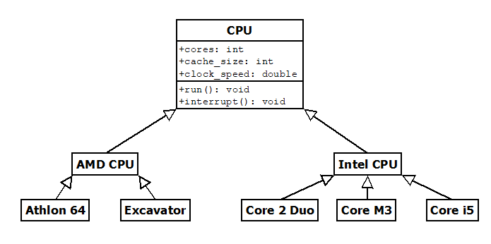
Class Generalization
Describe the kind-of or substitutes-for relationship. This implies two things:
Inheritance: derived class inherits all attributes/operations of the base
Substitutability: anywhere the base is used, the derived class can also be used
Usually implies class inheritance in C++
// Inheritance
class IntelCPU : public CPU {
// ...
};

Slide 14
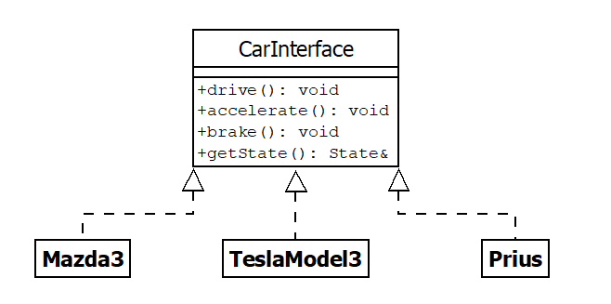
Class Generalization: Interfaces
An interface describes the contract a class must abide by, but has no explicit inheritance of attributes or operations. An implementation class implements the interface.
// Pure Abstract Class // Only pure virtual member functions class CarInterface { public: virtual void drive() = 0; virtual void accelerate() = 0; virtual void brake() = 0; virtual State& getState() = 0; };
In C++ an implementation may inherit from the interface, but in modern C++ with template program, often does not. All that is required is that the interface methods exist.

Slide 15
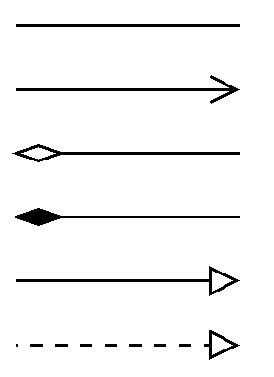
Class Diagrams Summary

