Slide 1
Lecture 13 – Sequence Diagrams
Learning Goals
Describe the purpose of sequence diagrams
Identify the components of a sequence diagram
Discuss differences between sequence diagrams used during the analysis phase vs design phase
Draw a sequence diagram for a given use case scenario
Include loops and conditionals in a sequence diagram
Convert a sequence diagram into a class diagram
©Paul Davies, C. Antonio Sanchez. Not to be copied, used, or revised without explicit written permission from the copyright owner.

Slide 2
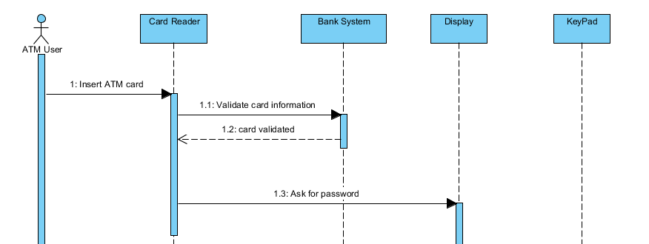
Sequence Diagrams
Sequence diagrams capture the step-by-step sequence of events in a single use-case scenario. They should capture the essense of user-interaction and document the response for interesting scenarios, involve only major objects/actors.
Participants (objects, actors, roles)
Initiating Actor
Lifeline
Message
Time
Return
Activation

Slide 3
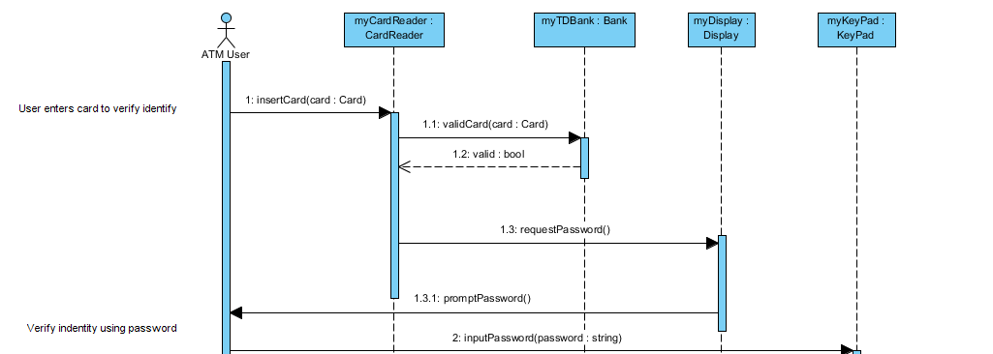
Sequence Diagrams
Participants are usually objects, can be labelled using name : class syntax.
Messages can either be descriptive, or methods using the name (arguments) syntax

Slide 4
Sequence Diagrams: Analysis vs Design
Sequence diagrams are often drawn at two different times during the software-development cycle: during the analysis phase, and the design phase.
During analysis phase, useful for communication with the customer, minimal technical/implementation details. Helps to ensure understanding of the process. Often describes an existing (perhaps manual) system.
During design phase, includes more implementation specifics. Can be translated into software objects/class diagrams.

Slide 5
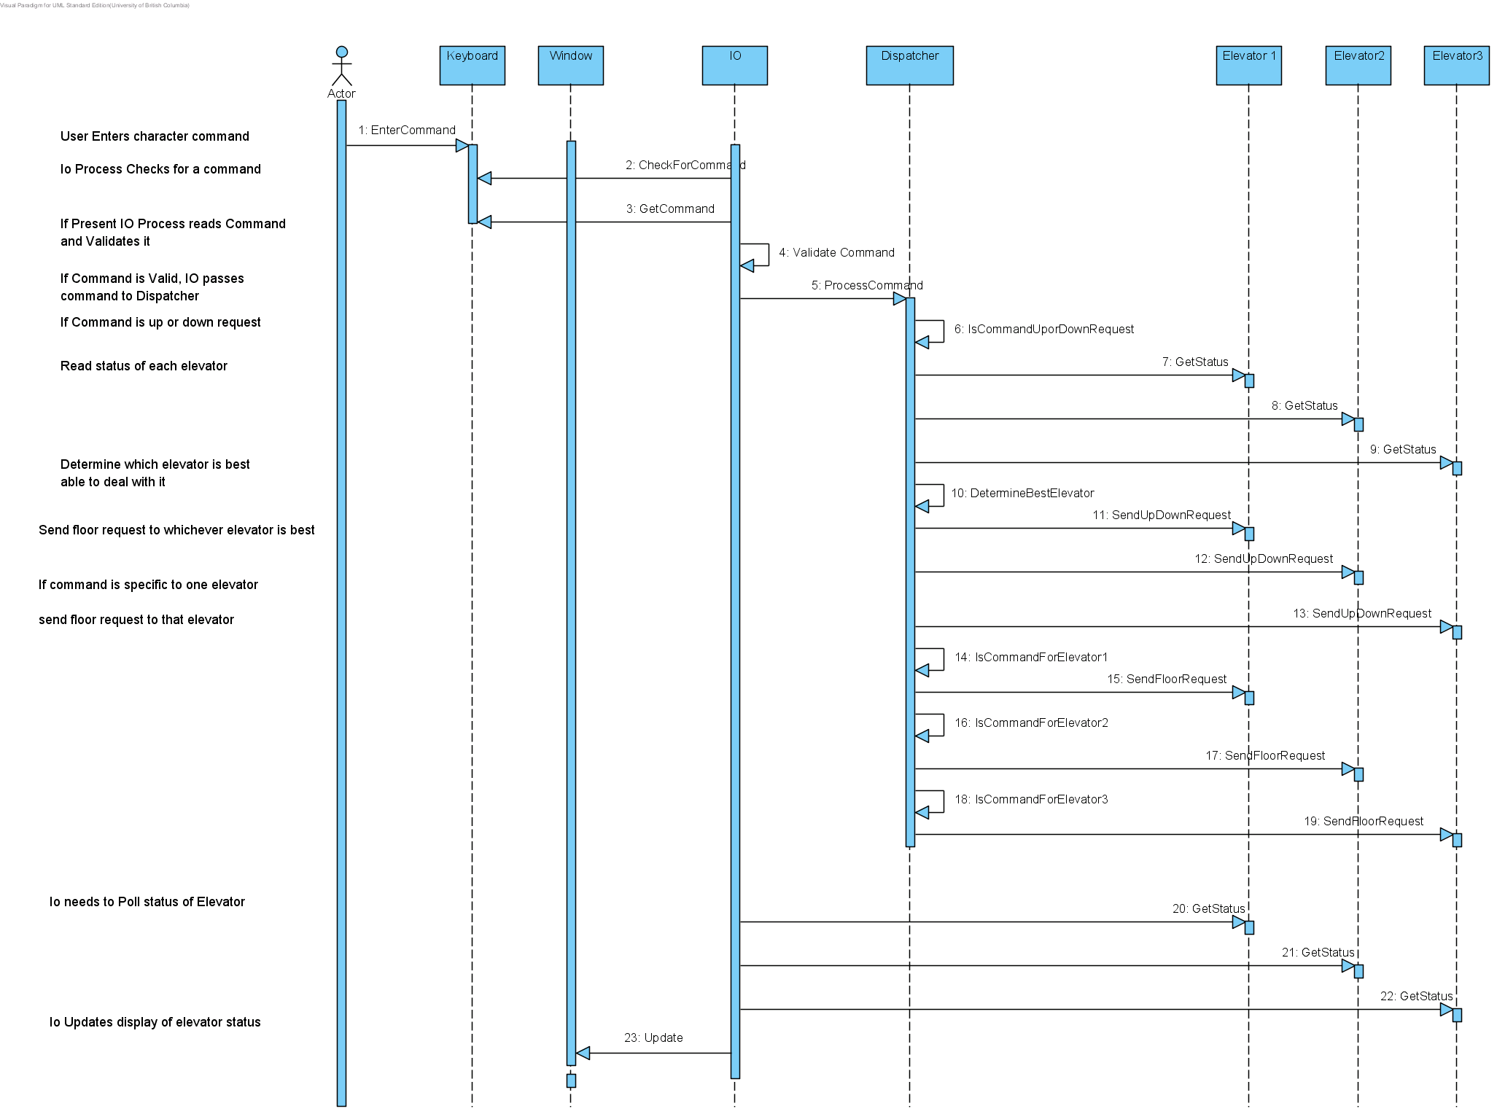
Example: Analysis Model for Elevator
Optional comments:

Slide 6
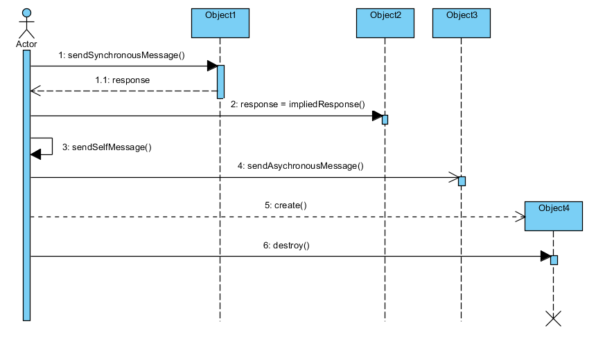
Sequence Diagrams: Message Types
End of Life

Slide 7
Class Example: Withdraw Cash
Create a Sequence Diagram for the following use-case scenario
Use Case Withdraw cash
The user inserts their bank card into the card reader of the ATM
The system reads the chip to identify user & account.
The system contacts the bank to request the PIN number for the card and account details.
The system prompts the user to enter their PIN.
The user enters their PIN.
The system prompts for the amount of the cash withdrawal.
The user enters the amount of the cash withdrawal.
The system checks with the banks central computer to ensure sufficient funds
The cash is dispensed and the customer’s account at the bank is debited
The card is returned to the user
End

Slide 8
Sequence Diagrams: Decisions/Iterations
Sequence diagrams are not flowcharts. They are more useful when looking at sequences of events and timings.
When loops/decisions are important, we can include them combination fragments.
Opt | Optional fragment that executes if (Condition) is true.
Alt | Alternative fragment for mutually exclusive logic based on if-else type decision.
Loop | Loop fragment: A sequence of messages that repeats while some Condition is true. (Note: Can also be written as loop(n) to indicate looping n times)
Par | Two or more sequences that execute in parallel.
Region | Critical region. A sequence of statements that can only be executed by one thread at a time, the implication is that the designer will have to implement some form of mutual exclusion (i.e. a mutex with wait and signal) to protect the code.

Slide 9
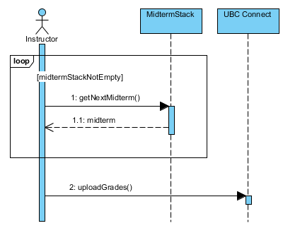
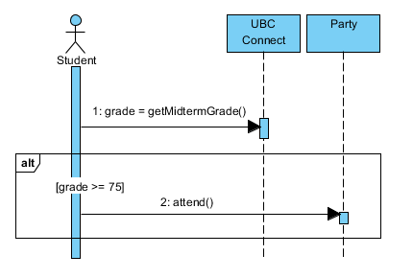
Sequence Diagrams: Decisions/Iterations

Slide 10
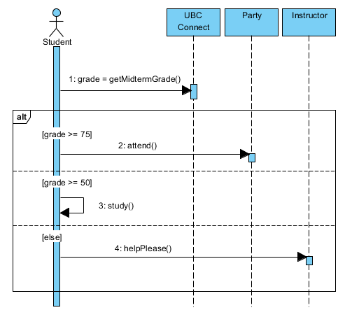
Sequence Diagrams: Decisions/Iterations

Slide 11
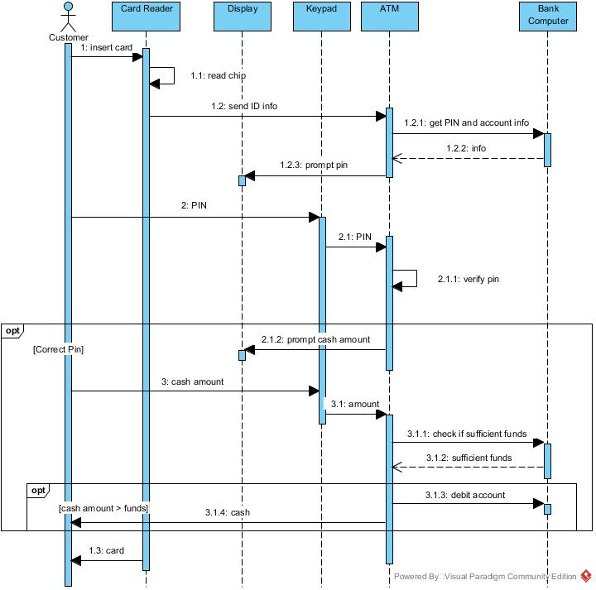
Class Example: Withdraw Cash

Slide 12
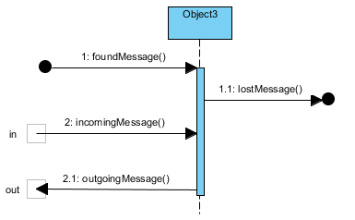
Sequence Diagrams: Incoming/Outgoing
Lost and found messages are for when the other participant is unknown, or we don’t care for the purposes of this diagram.
Gates
Gates usually connect to other sequence diagrams which have corresponding games with the same names.

Slide 13
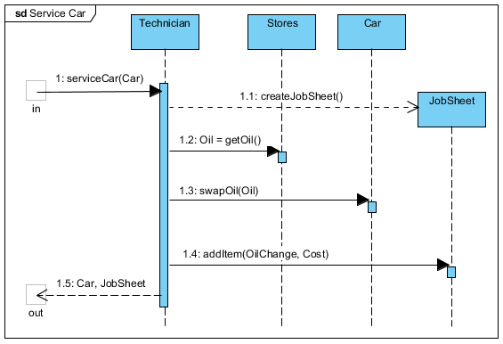
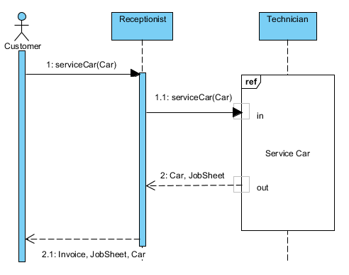
Sequence Diagrams: Hierarchies
https://knowhow.visual-paradigm.com/uml/sequence-diagram-gate/

Slide 14
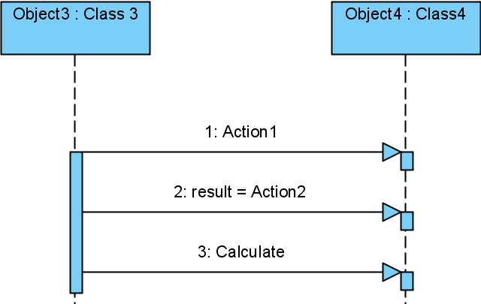
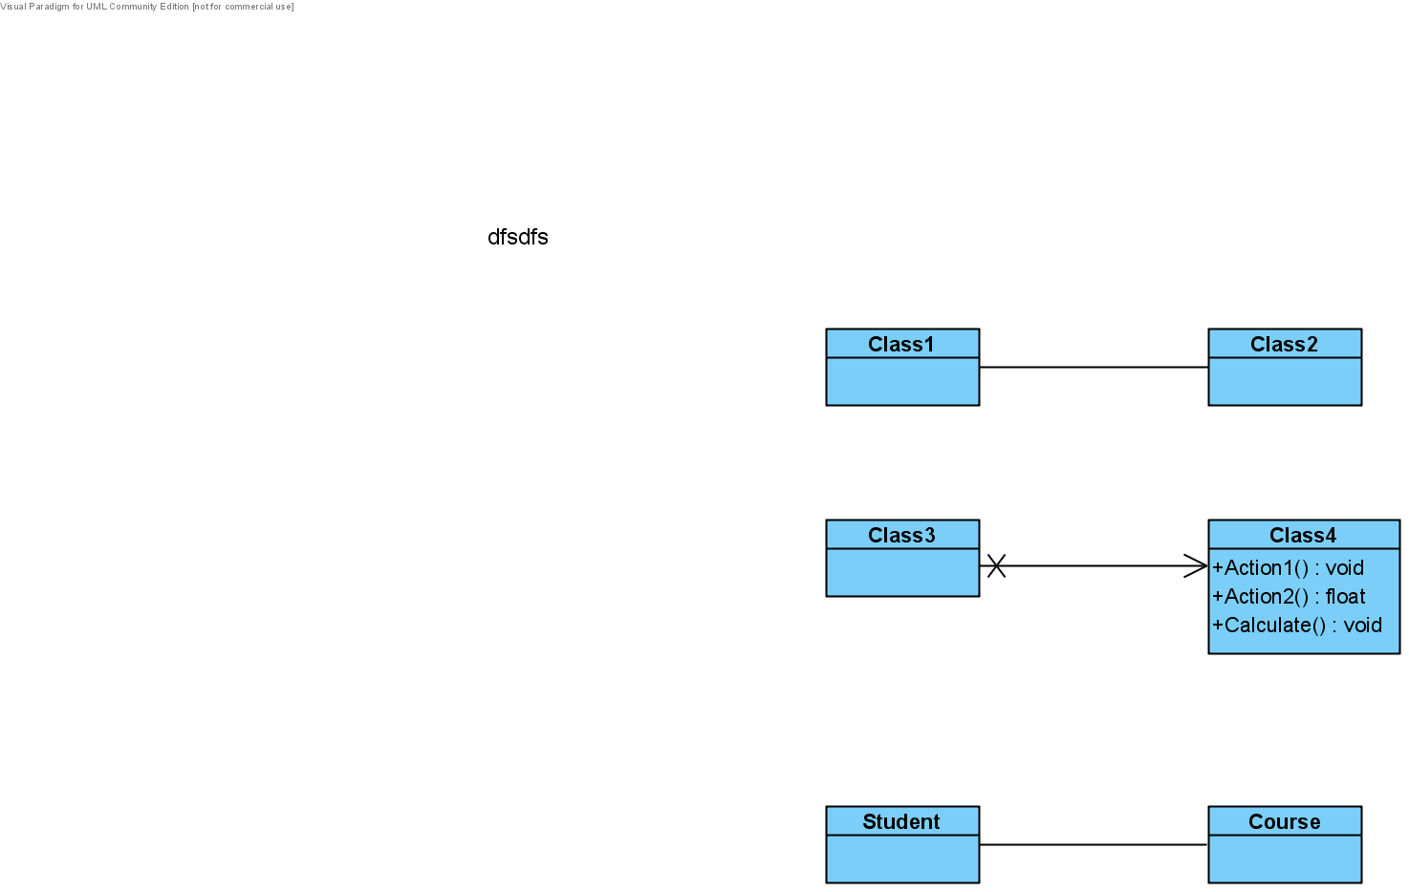
Sequence Diagrams to Class Diagrams
Section from a Sequence Diagram
Class Diagram
Sequence diagrams and Class Diagrams must be consistent. Messages usually correspond to operations, direction of arrows corresponds to direction of association.

Slide 15
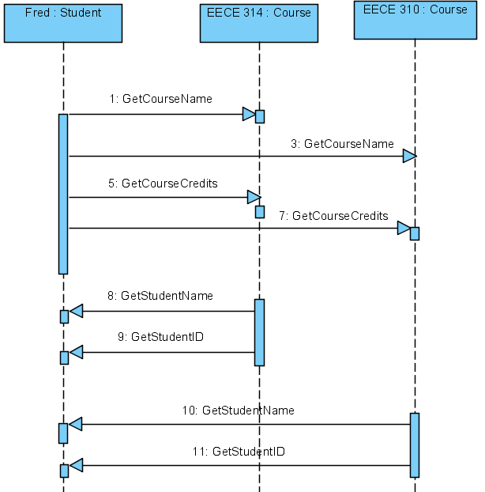
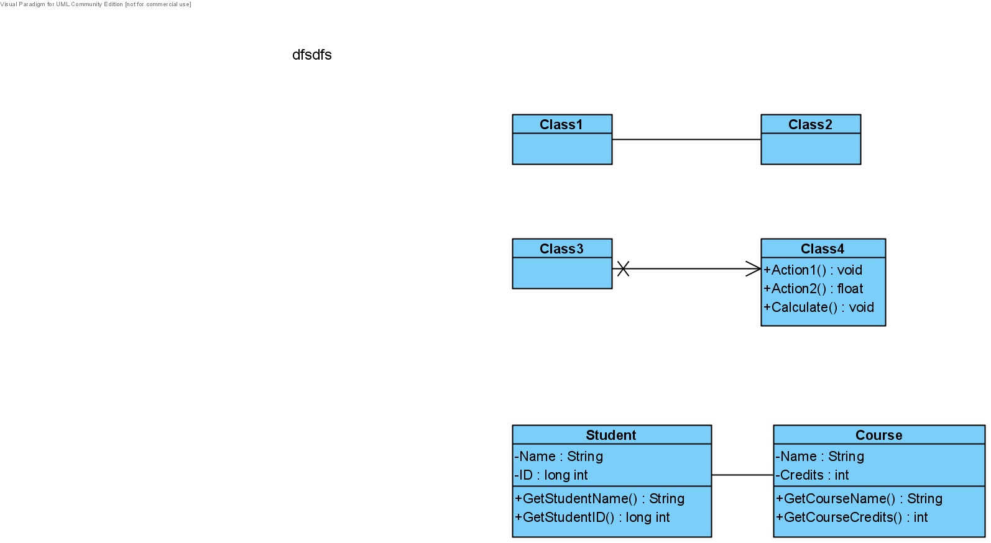
Sequence Diagram to Class Diagram
Section from a Sequence Diagram
Maps to this Class Diagram
2
class Student {
Course *course1 ; // points at runtime to EECE314
Course *course2 ; // points at runtime to EECE310
. . .
} ;
class Course {
Student *theStudent ; // points to ‘fred’ at runtime
. . .
} ;

