Slide 1
Lecture 14 – Condition Variables
Learning Goals
Distinguish between events and conditions
Describe the function of a condition variable and how it can be used to implement events and conditions
Describe the issue of spurious wakeups, and how we can deal with them for events and conditions
Use condition variables to solve a synchronization task, both within a single process and between multiple processes
©Paul Davies, C. Antonio Sanchez. Not to be copied, used, or revised without explicit written permission from the copyright owner.

Slide 2
Interthread/process Synchronization
In concurrent systems, if two threads/processes are dependent, we often need to wait until some task is complete before we can continue.
So far we have seen:
thread/process joining – wait for each thread/process to finish
mutex – wait until a single resource or critical section becomes free
semaphores – wait until one of a countable number of resources is free
Conditions: wait until a condition is set by some other thread/process

Slide 3
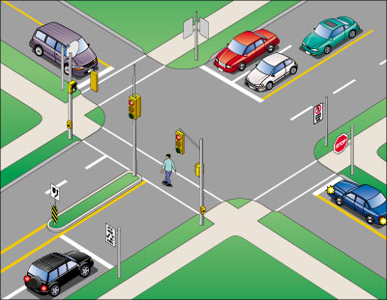
Traffic Light Control System
Pedestrians wait for walk light
Cars wait for traffic light
How would you do it?

Slide 4
Events and Conditions
Used to wait until something happens to trigger threads to continue.
Event: an instantaneously pulsed occurrence. When triggered, causes one or all waiting threads to wake up and continue. Future threads attempting to wait will block until the next trigger.
Think: start gun of a race.
Condition: an occurrence with a persisted state. When triggered, causes all waiting threads to wake up and continue. Future threads attempting to wait will continue without blocking until the condition is manually reset.
Think: doorway or gate

Slide 5
Traffic Light Control System
Cars wait until light turns green, future cars continue if still green
Pedestrian light waits until button pressed,
future light changes will wait until button pressed again.
Pedestrains wait until walk sign turns on,
future pedestrians continue if still on

Slide 6
Condition Variable
Condition variables allow us to implement both events and conditions.
They rely on data shared between threads, and consist of:
A synchronization primitive that supports wait(), notify_one() and notify_all()
An optional predicate to determine if the thread should continue (thread will wait until predicate evaluates to true)
When waiting on a condition variable, the current thread will block.
When the condition variable is notified, either one or all waiting threads are awoken, ready to check any shared data to see if the thread should continue waiting.

Slide 7
Condition Variable
N
Condition Variable
wait()
notify_all()
notify_one()
A
B
C
D

Slide 8
Condition Variable with Predicate
Condition Variable
N
predicate(): false
wait()
true
notify_all()
notify_one()
A
Predicate still false, so will again block
Still waiting to be notified of predicate change
B
C
D

Slide 9
Condition Variable
When should we use a condition variable?
In general, when we are interested in non-counting synchronization, letting one or all waiting threads/processes through.
Events:
Let through a group at a time
Any stragglers must wait for the next event
Condition:
Let through a group at a time
Any stragglers will still be allowed through until we close the gate

Slide 10
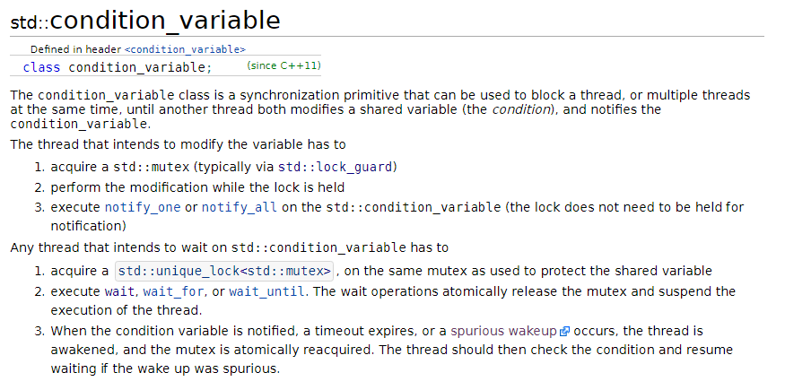
C++11 Condition Variables
http://en.cppreference.com/w/cpp/thread/condition_variable

Slide 11
C++11 Condition Variables
std::mutex mutex; std::condition_variable cv; bool ready = false;
Event
Condition
{ // wait for condition notification std::unique_lock<decltype(mutex)> lock(mutex);
// only wait if condition not set while (!ready) {
cv.wait(lock); } }
{ // wait for event notification std::unique_lock<decltype(mutex)> lock(mutex); cv.wait(lock); }
wait
{ // modify condition state
std::lock_guard<decltype(mutex)> guard(mutex); ready = true; } // notify waiting threads of change cv.notify_all();
notify
// wake up all waiting threads cv.notify_all();

Slide 12
C++11 Condition Variables
// wait for condition notification
{ std::unique_lock<decltype(mutex)> lock{mutex}; // lock is acquired, all shared data is protected // in critical section // check on shared data while (!ready) { // internally releases lock and goes to sleep cv.wait(lock); // lock re-acquired } }
// lock released
Must use same mutex
Must use unique_lock
Lock is re-acquired after wait
one awoken thread exits at a time

Slide 13
C++11 Condition Variables
The while() loop pattern is so common that in C++ they built it in to the condition variable allowing you to specify a “predicate” function:
{ std::unique_lock<decltype(mutex)> lock{mutex}; while (!ready) { cv.wait(lock); } }
{ std::unique_lock<decltype(mutex)> lock{mutex}; cv.wait(lock, [&](){ return ready; } ); }
Predicates are anything that can be evaluated as a boolean expression: bool predicate(). They are most often implemented using in-line lambdas:
auto predicate = [&](){ return ready; }
capture (& by reference)
arguments
expression

Slide 14
Condition Variables: Typical Usage
CVs are usually used as “conditions” that depend on shared data. The typical usage-pattern is as follows.
Notifying Thread:
lock mutex
modify shared data
unlock mutex
notify CV (one or all)
Waiting Thread:
lock mutex
loop until shared data satisfies predicate
wait
unlock mutex

Slide 15
Condition Variable
When should we use a condition variable?
In general, when we are interested in non-counting synchronization, letting one or all waiting threads/processes through.
Events:
Let through a group at a time
Any stragglers must wait for the next event
Condition:
Let through a group at a time
Any stragglers will still be allowed through until we close the gate

Slide 16
Spurious Wakeups
Sometimes threads are woken by the OS without having received a proper notification from the condition variable. E.g. after your process receives an interrupt signal.
We call these spurious wake-ups, and are considered to be rare events. However, it breaks the standard “event” implementation.
{ std::unique_lock<decltype(mutex)> lock(mutex); cv.wait(lock); // could wake up “spuriously”
}
Q: Why don’t spurious wakeups affect the “condition” implementation?

Slide 17
Spurious Wakeups
Sometimes these rare spurious wake-ups can be harmless. E.g. triggering a pedestrian crossing. Other times we may need to fix them.
Observation:
Events are like Conditions, except they get “reset” immediately after threads awoken
Failed Attempt #1:
{ std::unique_lock<decltype(mutex)> lock{mutex}; while (!ready) { cv.wait(lock); }
ready = false; // reset condition state }
{ // modify condition state
std::lock_guard<decltype(mutex)> guard(mutex); ready = true; } // notify waiting threads of change cv.notify_all();

Slide 18
Spurious Wakeups
{ std::unique_lock<decltype(mutex)> lock{mutex}; while (!ready) { cv.wait(lock); }
ready = false; // reset condition state }
Condition Variable
N
ready: false
wait()
true
notify_all()
notify_one()
A
B
C
C & D wake up but see ready as false, so go back to sleep
D

Slide 19
Spurious Wakeups
We need to wait until all desired threads (one or all) have passed condition barrier before resetting condition.
void release_one() { { // wait for condition notification std::lock_guard<std::mutex> lock(mutex); release = 1; // release one } cv.notify_one(); } void release_all() { { // wait for condition notification std::lock_guard<std::mutex> lock(mutex); release = waiting; // release all } cv.notify_all(); }
Failed Attempt #2:
void wait() { std::unique_lock<std::mutex> lock(mutex); ++waiting; // track # threads waiting // wait until release while (release == 0) { cv.wait(lock); } --release; // one thread was released --waiting; // one less thread waiting }

Slide 20
Spurious Wakeups
void wait() { std::unique_lock<std::mutex> lock(mutex); ++waiting; // track # threads waiting while (release == 0) { cv.wait(lock); } --release; // one thread was released --waiting; // one less thread waiting }
N
release one
Condition Variable
release all
waiting: 0
release: 0
2
1
3
wait()
notify_all()
2
notify_one()
1
A
B
C woke up but left waiting because D took his spot
C
D

Slide 21
Spurious Wakeups
Issues when trying to release all waiting threads and a new thread comes along and calls wait() between the start of the release operation and the time the last originally waiting thread resets release to zero.
This is a race condition, could lead to issues if some important threads are left waiting forever.
Solution:
Stop new threads from calling wait() (requires an additional semaphore)
Let new threads through – they are essentially arriving near the same time as the release call anyways (requires a boolean)

Slide 22
Spurious Wakeups
Attempt #3:
void wait() { std::unique_lock<std::mutex> lock(mutex); ++waiting; // track # threads waiting // arrived while still releasing all if (all) { ++release; // release me too } // wait until notification signals some to release while (release == 0) { cv.wait(lock); } --release; // one thread was released if (release == 0) { // cause future threads will wait all = false; } --waiting; // one less thread waiting }
void release_one() { { // wait for condition notification std::lock_guard<std::mutex> lock(mutex); release = 1; // release one } cv.notify_one(); } void release_all() { { // wait for condition notification std::lock_guard<std::mutex> lock(mutex); release = waiting; // release all all = true; // releasing all } cv.notify_all(); }

Slide 23
Spurious Wakeups
void wait() { std::unique_lock<std::mutex> lock(mutex); ++waiting;
if (all) { ++release; } cv.wait(lock, [&](){return release != 0;}); --release;
if (release == 0) { all = false; } --waiting; }
Condition Variable
N
release one
waiting: 0
all: false
release: 0
release all
2
1
3
true
wait()
notify_all()
2
notify_one()
1
3
A
B
C
D

Slide 24
Spurious Wakeups
We solved the spurious wake-up problem by “holding the door open” until the last waiting thread has passed through.
This should work well in most cases, since the time taken to release all threads is typically very short. If a new thread arrives at the event during this time, we are essentially pretending it has arrived a few milliseconds earlier and assuming this precise timing is of no importance.
This is not a true event behaviour, however. To truly fix this, we need to introduce a second condition variable to block new threads while the other condition is open. This doubles the synchronization overhead.

Slide 25
Interprocess Condition Variables
The standard C++11 std::condition_variable only works between threads within a single process. To create a condition variable for interpress synchronization, we can use the CPEN333 course library.
class condition_variable : public virtual named_resource { public: condition_variable(const std::string &name); // constructor
void wait(std::unique_lock<cpen333::process::mutex>& lock); // waits to be notified
// continues to wait until the predicate is true and cv is notified
template<typename Predicate> void wait(std::unique_lock<cpen333::process::mutex>& lock, Predicate pred); void notify_one(); // awakes one waiting thread
void notify_all(); // awakes all waiting threads
bool unlink(); // unlinks name from condition variable (POSIX) };
Unlike std::condition_variable, these do not suffer from spurious wakes.

Slide 26
Car
int main() { cpen333::process::mutex mutex("traffic_mutex"); cpen333::process::condition_variable cv("traffic_cv"); cpen333::process::shared_object<TrafficLightInfo>
light("traffic_light"); // wait for green light std::unique_lock<decltype(mutex)> lock(mutex); cv.wait(lock, [&](){ return light->green; }); std::cout << "Driving through" << std::endl; return 0; }
Traffic Light Controller
int main() { cpen333::process::mutex mutex("traffic_mutex"); cpen333::process::condition_variable cv("traffic_cv"); cpen333::process::shared_object<TrafficLightInfo>
light("traffic_light"); // initialize to green light std::unique_lock<decltype(mutex)> lock(mutex); light->green = true; light->walk = false; lock.unlock(); while(true) { // flip lights lock.lock(); light->green = !light->green; light->walk = !light->walk; lock.unlock(); cv.notify_all(); // notify threads of change std::this_thread::sleep_for(std::chrono::seconds(60)); } return 0; }
Pedestrian
int main() { // start with traffic light off cpen333::process::mutex mutex("traffic_mutex"); cpen333::process::condition_variable cv("traffic_cv"); cpen333::process::shared_object<TrafficLightInfo>
light("traffic_light"); // wait for walk light std::unique_lock<decltype(mutex)> lock(mutex); cv.wait(lock, [&](){ return light->walk; }); std::cout << "Walking through" << std::endl; return 0; }

Slide 27

Homework
Go through the tutorial on Sequence Diagrams in Visual Paradigm
https://www.youtube.com/watch?v=18_kVlQMavE
Go through the course library examples in:
examples/q9_condition
examples/q10_condition_variable
examples/q11_event
examples/q12_rendezvous
Quiz 5 next week on UML

