Slide 1
Lecture 15 – Communication Diagrams
Learning Goals
Describe the difference between a sequence diagram and communication diagram
Given a use-case scenario, sketch out an object interaction diagram
Given a systems problem description, sketch out a system overview diagram
©Paul Davies, C. Antonio Sanchez. Not to be copied, used, or revised without explicit written permission from the copyright owner.

Slide 2
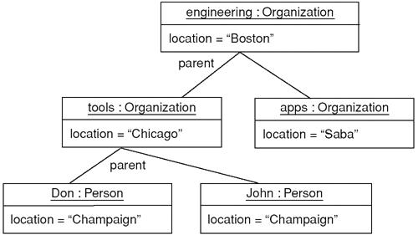
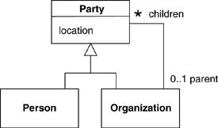
Object Diagram
Like a class diagram, but shows instances of classes (i.e. objects).
Underline the name : class type to show it is an instance, shows any known values within the instance.
Class Diagram
Object Diagram
Source: Fowler, Martin. UML distilled: a brief guide to the standard object modeling language. Addison-Wesley Professional, 2004.

Slide 3
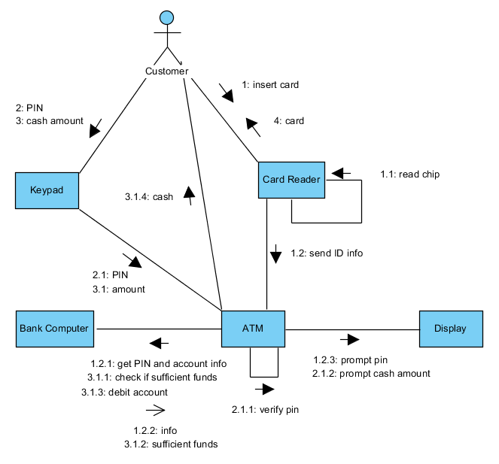
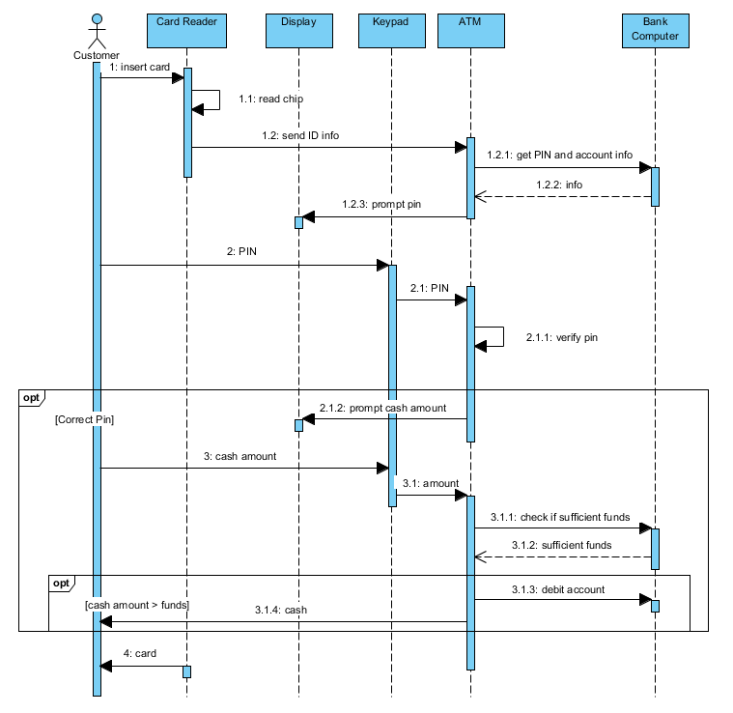
Communication Diagram
Similar to the object diagram, pictoral version of a sequence diagram.
Numbered messages go on the interaction arrows.

Slide 4
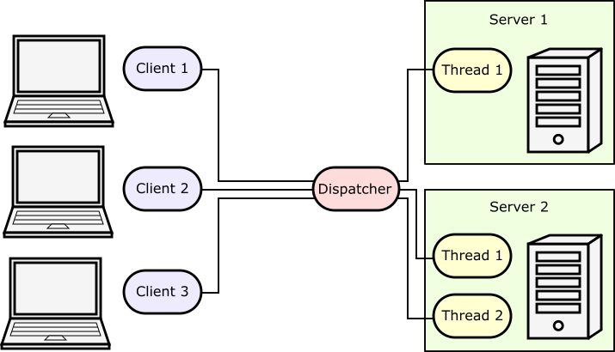
Object Interaction Diagram
Not official UML!! ➔ Anything goes!!!
Usually similar to a communication diagram, with messages removed. Use anything you like that helps make it clear what’s going on.
Customer 1
Server 1
Customer 2
Server 2
Customer 3
Chef 1
Order Queue
Chef 2
Serve Queue
...
Chef 3
...

Slide 5
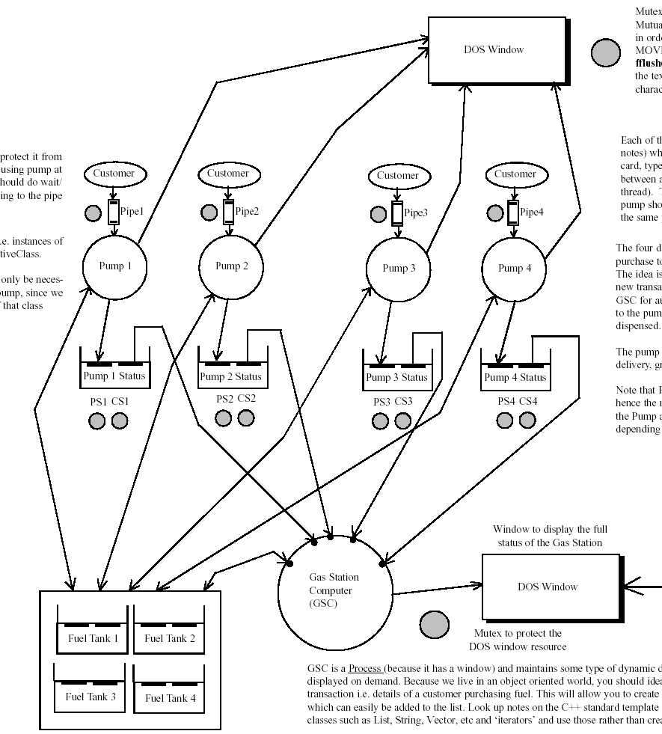
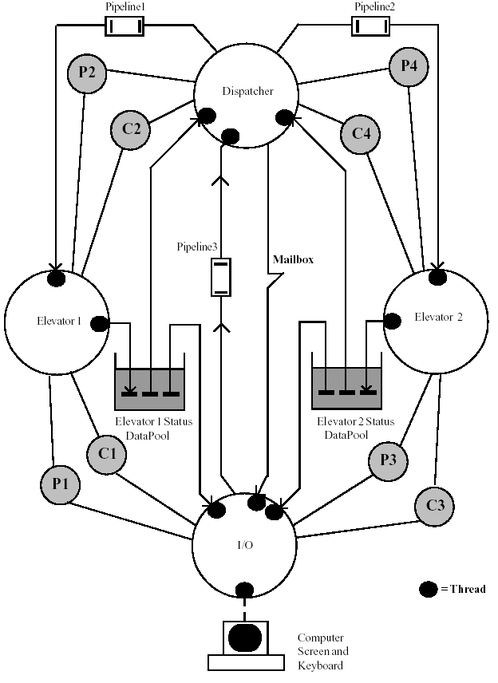
Gas Station
Elevator Control System
Gas Station Simulation

Slide 6
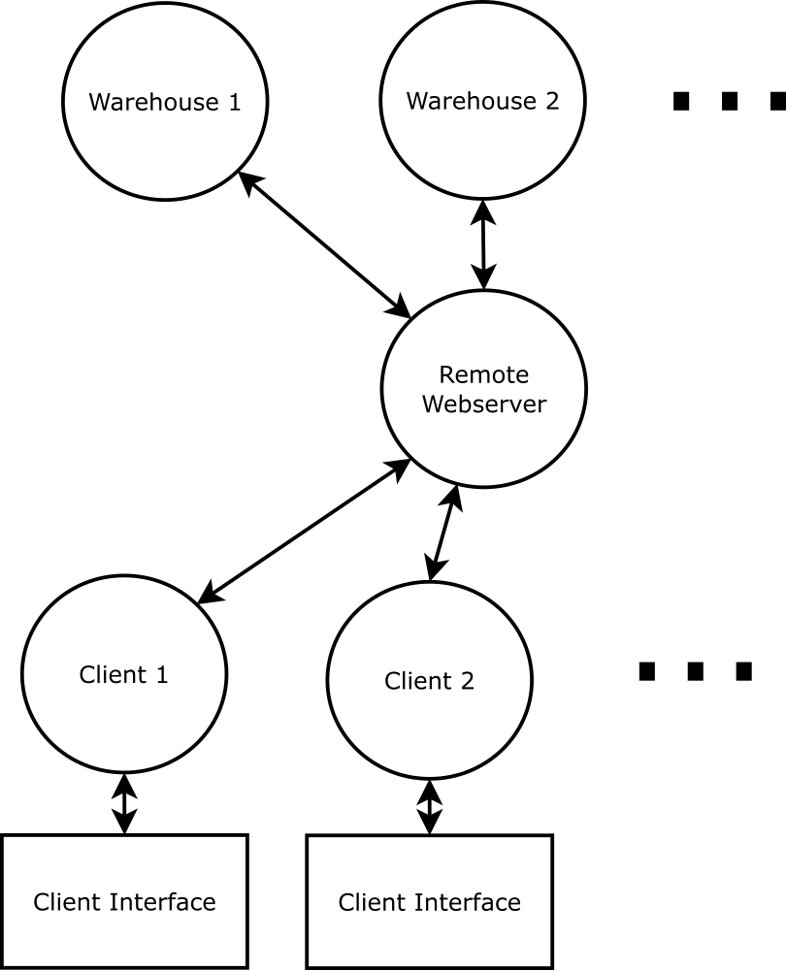
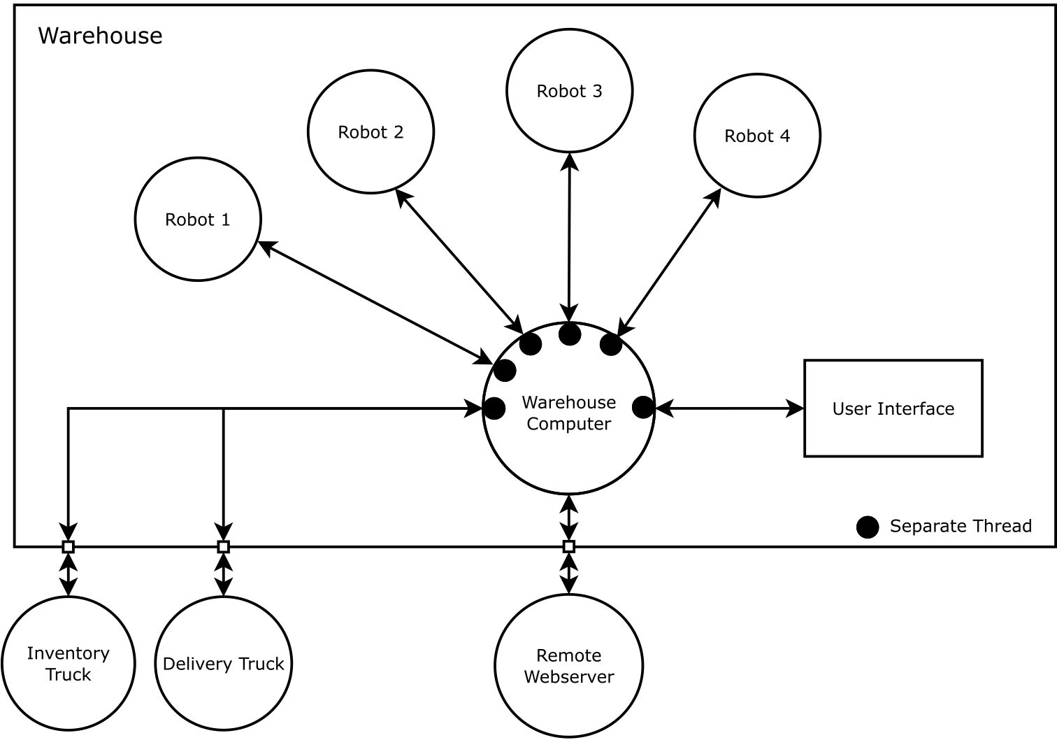
Amazoom Automated Warehouse

Slide 7
Object Interaction Diagram
Provide an overview of the interaction, give a strong-enough indication of what needs to communicate with what.
Can be used to document each use-case, or use-case scenario.
Can also be used to provide a high-level overview of the system components. If the diagram shows the overall system design, we sometimes call it a System Overview Diagram.

Slide 8
UML Summary
Use-Case Diagram: shows all use-cases, initiated by actors
Class Diagram: structure of class hierarchies, associations between classes
Sequence Diagram: documents sequence/timings of events for each use-case scenario
Communication Diagram: pictoral version of sequence diagram, can be used to replace a sequence diagram in a given use-case scenario
Non UML
Object Interaction Diagram: communication diagram without messages, plus extras to improve clarity of interactions
System Overview Diagram: high-level interaction of major system components

