Slide 1
Lecture 18 – Agile Development
Learning Goals
Describe the waterfall development approach, identify drawbacks
Provide and overview of agile development
Define User Stories, Tasks, Sprints
List drawbacks of agile development
Give examples when Agile is appropriate and not appropriate for a development project
©Paul Davies, C. Antonio Sanchez. Not to be copied, used, or revised without explicit written permission from the copyright owner.

Slide 2
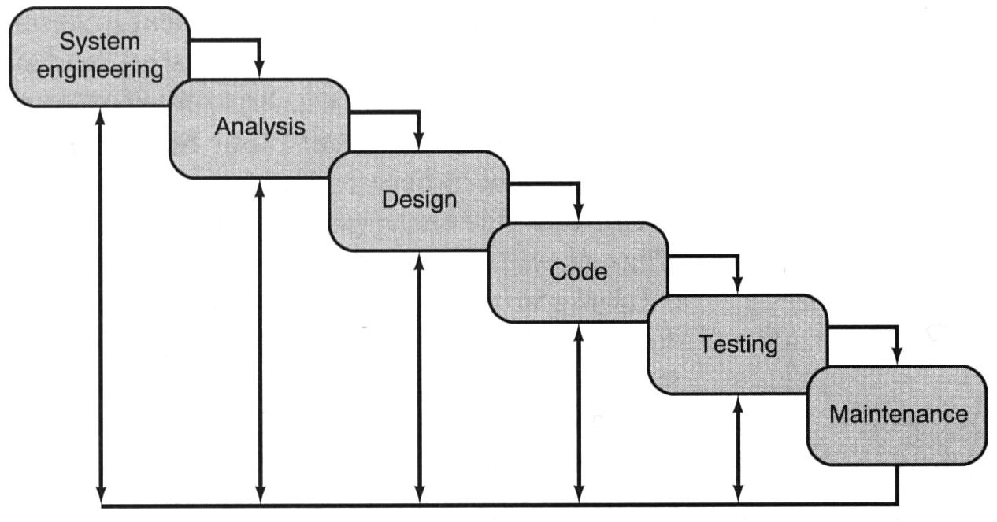
Waterfall Development
Software Life Cycle or Waterfall model of software development
This software life-cycle paradigm implies a sequential approach to software, beginning at the system level, and progressing through stages until the final product is delivered. In reality, stages get revisisted, usually leading to several iterations.

Slide 3
Waterfall Development
Many large-scale projects have failed while following this approach. The waterfall model assumes a once-only delivery in one single software release.
It does not address the element of risk: it assumes that all requirements are equally important and are tackled in the same way.
High risk activities such as interfacing the system to an unknown database, using unknown tools, hiring staff that are not familiar with them, miss-perception of user requirements, or flaws in the initial design may not be discovered until much later in the process. This can lead to massive delays and cost-overruns towards.
Finally unless multiple projects are on-going, it leads to poor staff utilisation, analysts are only employed at the beginning of a project and testers only at the end.

Slide 4
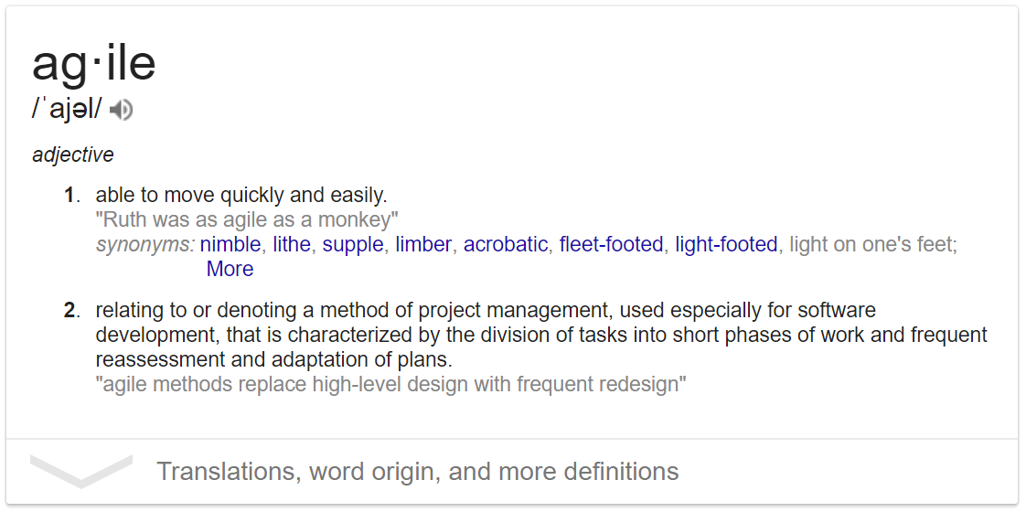
Agile Development
Not really a single methodology.
Attempts to adjust development practice to be more flexible:
Shorter cycles to reduce risk
Ability to adjust quickly to changing requirements
Iterative Development: software is delivered to customer regularly, with each new significant functionality developed and tested. Starts with a minimum working version.
Short life-cycles with specific targets
Immediate feedback with each feature
Paid throughout development for each release
Better staff utilization

Slide 5
Waterfall vs Agile
Waterfall Method: predictive
Carefully documents requirements, implements, tests up front
Suitable for large engineering projects where cost to change is prohibitive (e.g. building bridges, car manufacturing, etc.)
Agile Method: adaptive
Iterative process that adapts to requirements change, or as realities are better understood
Collaborative, customer-centric
Cheap to change (more suitable in software engineering)

Slide 6
The Agile Manifesto
2001: a group of software developers organized to express dissatisfaction with being forced to use the waterfall model. Strong emphasis on documentation before design, contract negotiation, lack of flexibility. Formed the Agile Alliance, wrote the Agile Manifesto.
We are uncovering better ways of developing software by doing it and helping others do it. Through this work we have come to value:
Individuals and interactions over processes and tools
Working software over comprehensive documentation
Customer collaboration over contract negotiation
Responding to change over following a plan
While there is value in the things on the right, we value the things on the left more
Beck, Kent, et al, "Manifesto for Agile Software Development". Agile Alliance, 2001

Slide 7
User Stories
Agile approaches seek to uncover the functionality required of a system through a process of exploring user stories.
User stories: short, simple narrative descriptions of a feature told from the perspective of the person who desires it: As a <my role>, I want to be able to <some goal> so that <some reason>.
Often written on index cards or sticky notes, stored in a shoe box, or arranged on walls or tables to facilitate planning and discussion. As such, they strongly shift the focus from writing about features to discussing them. In fact, these discussions are more important than whatever text is written.

Slide 8
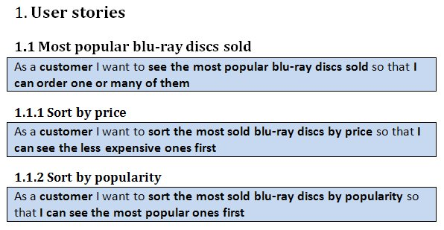
User Stories
Product Backlog: set of goals/features that the system must meet. This is the what, not the how. Usually divided into a set of small sub-features that represent manageable chunks of work.

Slide 9

Sprints
Development divided into sprints, each lasting 1-3 weeks
Within each sprint you design, implement, and test a version of your product
Each version gets progressively closer to your release version.
Important: the result of each sprint is something you can demonstrate (not just a bunch of code and functions).
So consider the development of say a “PAC Man game”,
The 1st sprint might focus on developing the maze and displaying the screen.
The 2nd sprint might implement the single player game strategy etc.
The 3rd sprint might allow for multiple players and customization.

Slide 10
Sprints
Sprints are then broken down into smaller tasks
Each task involves writing, testing, and integrating a piece of code
Each task takes no more than a few hours/days. If it does then break it down into smaller task as it’s probably too complex for 1 task
So for example, for Sprint 1 of our Pac Man game:
There may be 10’s of tasks per sprint. Tasks are often dependent on other tasks.
Task 1: draw maze on the screen
Task 2: draw player on the screen
Task 3: Read player input
Task 4: Update player’s location based on input

Slide 11
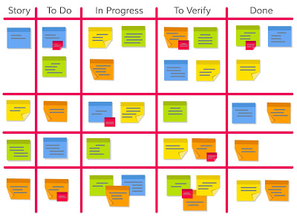
The Agile Board
Tasks are written on post-its, placed in the “To-Do” or Product Backlog column sorted by priority.
Rather than managers pushing work, developers pull work from the To-Do column, place in the “In Progress” column
When task is ready to be tested, it moves to the next column…
Can add as many columns as necessary
http://www.techno-pm.com/2017/05/scrum-board-example.html

Slide 12
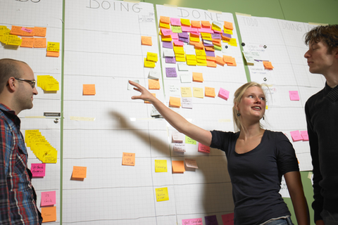
Scrum Meetings
In many companies, scrums (or daily stand-up meetings) are short meetings (5 - 15min) typically held at the start of each day.
Usually, everyone stands to keep it short.
A “scrum master” runs the meeting.
Each group member summarises:
What has been done since the last scrum
What he or she intends to do
before the next scrum.
Any obstacles preventing progress.

Slide 13
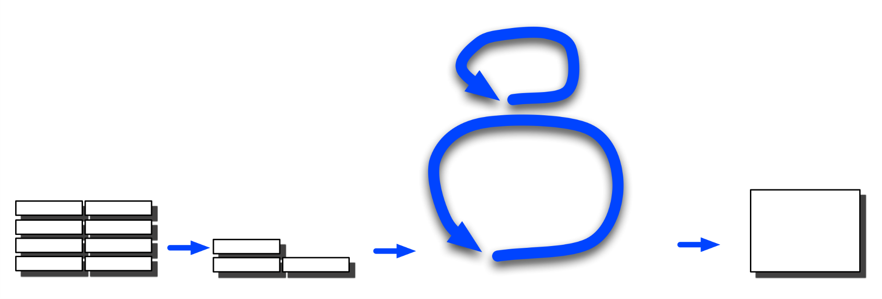
User Story: Proposed by Stake holders, customers etc. Written in the form of
“As a (my role) I want the system to be able to do (task) so that (benefit)”
Scrum Illustration
Daily scrum: What have I done? What am I doing?
What is holding me up?
List of product features (User Stories) yet to be implemented
1 day
1-3 Week Sprint (retrospective meeting)
Product
backlog
Release
backlog
Sprint: Design, test and release next version/iteration
“Shippable”
Product
Increment with latest features
Prioritised list of features, broken down into tasks and estimates of time

Slide 14
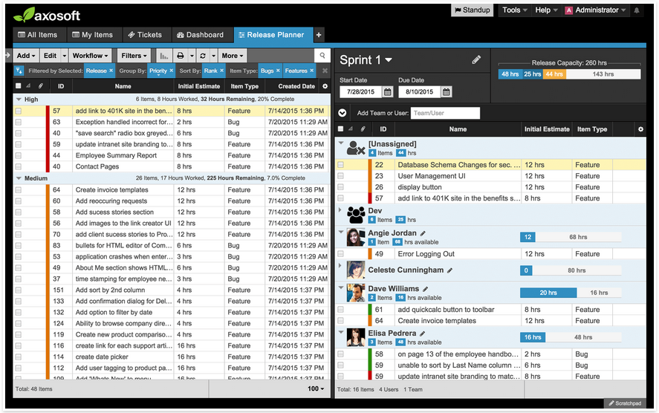
Agile Software – axosoft

Slide 15
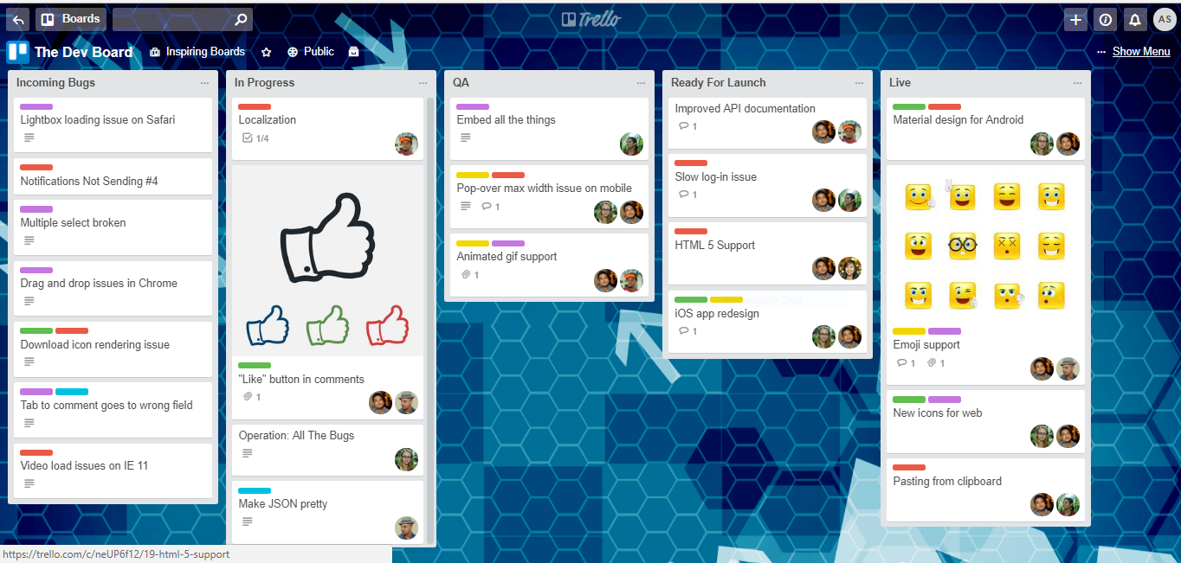
Agile Software – Trello

Slide 16
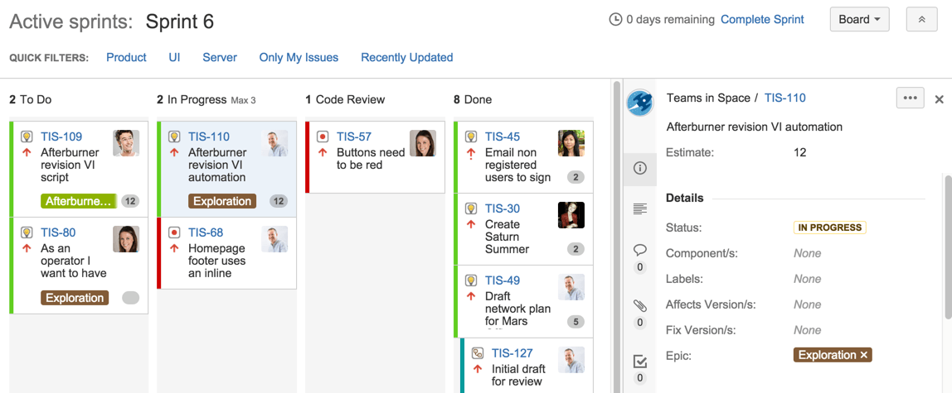
Agile Software – JIRA

Slide 17
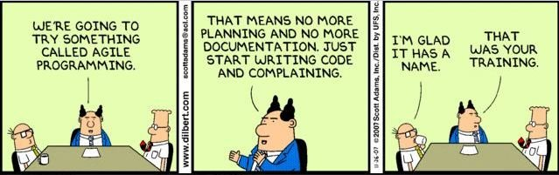
Drawbacks of Agile
Agile development works well for some projects especially when requirements, technology are not well understood or are changing.
It’s main criticism is that project management is often non-existent, and that the only documentation is the Source code itself.
It is also dependent on the idea that : “the software will be ready when it’s ready”.

Slide 18
No One-Size-Fits-All Approach
Agile can present problems when:
The Software is large/complex and developed over years not weeks i.e. relies on the designs being on paper, not in the head of a developer
Software that has a deadline so that marketing, training, budgets etc can be coordinated.
Software is safety critical e.g. fly by wire aircraft where certification may be necessary.
Agile has it’s sceptics, but it’s currently the favoured approach for many small software development projects in certain fields e.g. web/app type stuff.
Many companies will have their own versions of agile development. Sprints can be 3 months, weekly stand-ups, etc… usually develop according to company culture.

Slide 19
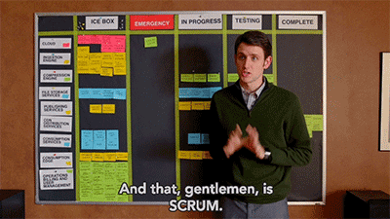
https://i2.wp.com/media.giphy.com/media/xT1XGOGdyDrL2BTfxK/giphy.gif?resize=400%2C225&ssl=1
Silicon Valley, S01E05

