Slide 1
Lecture 19 – Scheduling
Learning Goals
Describe how priorities affect thread execution
Describe and give an example of priority inversion
Discuss the factors involved in real-time scheduling
Given a set of tasks, determine if it is possible to schedule them so that all deadlines are met using a time-line graph
Apply the conditions of Liu and Layland to determine analytically if real-time scheduling is possible
Describe rate-monotonic sequencing, and use it to schedule a given set of tasks
©Paul Davies, C. Antonio Sanchez. Not to be copied, used, or revised without explicit written permission from the copyright owner.

Slide 2
Process Priority
All operating systems assign a numerical priority to each thread/process.
This indicates the thread’s relative importance. High priority threads are always scheduled to be run in preference to lower priority threads whenever they are not blocked.
A high-priority process/thread should be able to pre-empt (i.e. displace) a low priority one. That is, it even if a low priority thread has started, it can be interrupted by the high priority thread.

Slide 3
Priority Inversion
This thread pre-emption can introduce an issue known as priority inversion.
Imagine a low priority task that has acquired some non-sharable resource (i.e. has acquired a mutex lock)
A high priority task comes along and tries to wait for the resource to become free (it is blocked, and can’t steal the resource from the low-priority task)
A medium priority task comes along and pre-empts the low priority task.
mutex
low priority
pre-empt
Medium priority task is indirectly blocking execution of higher priority, even though their actions are independent (no shared resources)
med priority
pre-empt
high priority
wait

Slide 4

Priority Inversion
Priority inversion: when a lower-priority indirectly pre-empts a higher-priority task even though they are independent (no shared resources).
Usually harmless, only serving to delay higher-priority task.
Lead to problems with the Mars Pathfinder Mission in 1997:
Higher priority process could never finish on time, triggered a watchdog timer on the lander to reset the system multiple times, jeopardizing the mission.

Slide 5
Priority Inversion
The most common solution to priority inversion is priority inheritance: when a lower-priority task blocks a higher priority task due to a shared resource, the priority of the lower task is temporarily raised by the OS to that of the waiting task. When the resource is released, the priority is returned.
mutex
unlock
low priority
med priority
pre-empt
raise priority
high priority
wait

Slide 6
Real-Time Scheduling
Many real-time systems can be broken-down into a set of regularly scheduled tasks, each with either fixed or bounded worst-case compute times.
C triggered for the 1st time
C triggered for the 2nd time
C triggered for the 3rd time
c1
c2
c3
0
10
20
30
40
50
60
70
80
90
100
110
120
Time ms
A Periodic Task ‘C’ being triggered every 50 ms
e.g. Cruise control: monitors car’s speed every 500 ms and outputs correction to throttle (max time: 10 ms)

Slide 7
Real-Time Scheduling
Period: time between successive triggering of the task
Deadline: maximum time available to complete execution (i.e. produce a response)
Compute time: (maximum) CPU time required to generate the response
Compute time of C = 5ms
Deadline of ‘C’ = 40ms
Deadline of ‘C’ = 40ms
c1
c2
c3
compute time <= deadline
deadline <= period (usually)
Period of ‘C’ = 50ms
Period of ‘C’ = 50ms
0
10
20
30
40
50
60
70
80
90
100
110
120
Time ms
A Periodic Task ‘C’ being triggered 3 times, once every 50 ms each with a deadline time of 40ms and compute time of 5ms

Slide 8
Real-Time Scheduling
Soft Deadlines: if missing the occasional deadline is acceptable (e.g. a car’s cruise control generates at 600 ms instead of 500 ms once or twice)
Hard Deadlines: deadline must be met each and every time or else system fails (e.g. pacemaker, Therac 25)
Given two processes,
A:
period = 500ms soft deadline = 500ms
compute time = 200ms
B:
period = 1000ms hard deadline = 1000ms
compute time = 200ms
Is it possible to schedule them on a single CPU?
A
A
A
A
A
B
B
B
0
500
1000
1500
2000
2500

Slide 9
Real-Time Scheduling
A:
period = 500ms soft deadline = 500ms
compute time = 200ms
B:
period = 1000ms hard deadline = 600ms
compute time = 600ms
100% CPU Usage
A
A
A
A
B
B
B
0
500
1000
1500
2000
2500
A:
period = 500ms hard deadline = 500ms
compute time = 200ms
B:
period = 1000ms hard deadline = 600ms
compute time = 600ms

Slide 10
Real-Time Scheduling
Is it possible to analyze a given set of N periodic tasks and guarantee with 100% certainty that each can be scheduled to meet it’s deadline each time it is triggered?
If so, how do we make it happen? i.e. force the OS to schedule the tasks so that no deadlines are missed.
Example:
Antonio gives you a lab and says it’s due in two weeks
Another prof gives you an assignment and says it’s due Friday
Which do you prioritize?
Possible Approach:
Prioritize and schedule work based on shortest deadline = highest priority

Slide 11
Real-Time Scheduling
It is necessary for tasks to be able to pre-empt each other, based on priority.
Rate-Monotonic Scheduling (RMS): a static priority is assigned at compile time according to activation period of the job (shorter period → higher priority)
An assignment that takes 1 day to complete every 5 days.
An assignment that takes 1.5 days to complete every 4 days.
An assignment that takes 1 day to complete every 3 days.
Can you figure out how to prioritize your time, when exactly you will be working and when you would be idle?
Note: Assume that you have to decide how to prioritise these tasks at the start of term and cannot change your priorities later. Plot a graph showing when you would be working on each assignment.

Slide 12
Real-Time Scheduling
Periods and ”Computation times”:
. . .
A1
A2
B1
B2
B3
C1
C2
C3
C4
0
2
4
6
8
10
A takes 1/5 = 20% your life cycle
B takes 3/8 = 37.5% your life cycle
C takes 1/3 = 33% your life cycle
Total: 90.83% life usage
. . .
C1
B1
A1
C2
B2
C3
A2
B3
C4
0
2
4
6
8
10

Slide 13
Real-Time Scheduling
Two ways to analyze a set of periodic tasks to guarantee with 100% accuracy that they will or will not always meet their individual deadlines:
Draw a time line graph to show how you would perform the tasks. Draw the graph until the pattern repeats (lowest-common multiple of periods)
Analyze the set of tasks to show mathematically that they always met their deadline
Approach 2 is the most desirable since it is quick, but unfortunately does not always give a definitive answer. Approach 1 is time consuming, but always gives an answer.

Slide 14
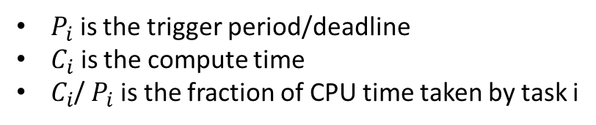
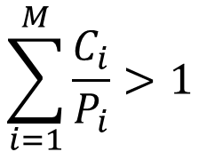
Real-Time Scheduling
Liu and Layland (1973) show that a set of M tasks will definitely not meet their deadlines if
$$\sum_{i=1}^{M}{\frac{C_{i}}{P_{i}}}>1$$
If the CPU utilisation is > 100%, tasks will not meet their deadline i.e. they will fail at some time
$P_{i}$ is the trigger period/deadline
$C_{i}$ is the compute time
$C_{i}$/ $P_{i}$ is the fraction of CPU time taken by task i
The above expression does not guarantee they will succeed if <= 1. In that case we have to analyse the task set further to determine if they will meet their deadlines in practice.

Slide 15
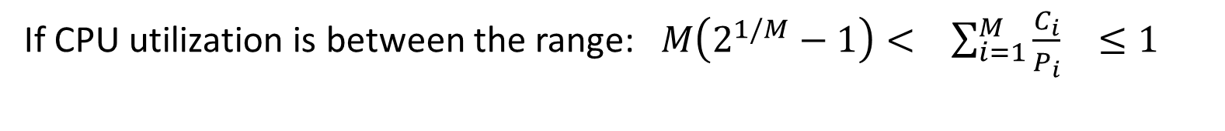
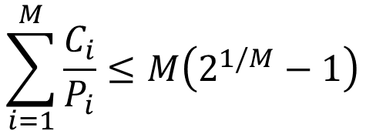
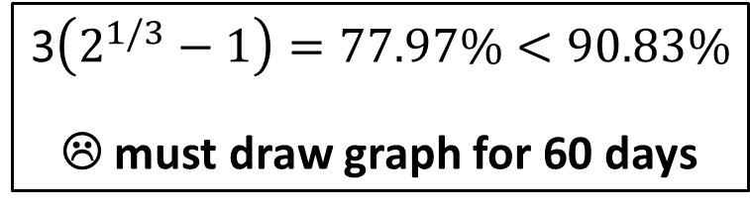
Real-Time Scheduling
An assignment that takes 1 day to complete every 5 days.
An assignment that takes 1.5 days to complete every 4 days.
An assignment that takes 1 day to complete every 3 days.
1/5 + 3/8 + 1/3 = 90.83%
Possibility of success
Liu and Layland wend further: if the tasks are scheduled on the basis of shorter deadline first, then it IS guaranteed that tasks will meet their deadlines if
$$\sum_{i=1}^{M}{\frac{C_{i}}{P_{i}}}≤M\left(2^{1/M}−1\right)$$
3$\left(2^{1/3}−1\right)=77.97\%<90.83\%$
☹ must draw graph for 60 days
If CPU utilization is between the range: $M\left(2^{1/M}−1\right)< \sum_{i=1}^{M}{\frac{C_{i}}{P_{i}}} ≤1$
then we must draw a time-line graph.

Slide 16
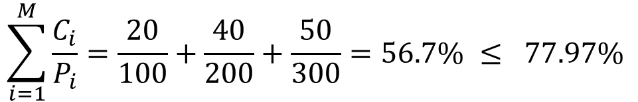
Real-Time Scheduling
Task A with period 100 ms, compute time 20 ms
Task B with period 200 ms, compute time 40 ms
Task C with period 300 ms, compute time 50 ms
$$\sum_{i=1}^{M}{\frac{C_{i}}{P_{i}}}=\frac{20}{100}+\frac{40}{200}+\frac{50}{300}=56.7\% ≤ 77.97\%$$
☺

Slide 17
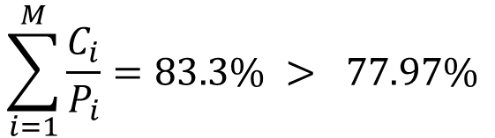
Real-Time Scheduling
Task A with compute time 5 ms, period 20 ms
Task B with compute time 10 ms, period 30 ms
Task C with compute time 10 ms, period 40 ms
$$\sum_{i=1}^{M}{\frac{C_{i}}{P_{i}}}=83.3\% > 77.97\%$$
☹
Try scheduling tasks as shortest deadline = highest priority and pre-emptive scheduling
When task A wants to run, it can pre-empt either task B or C
B can pre-empt C but not A.
Assume all tasks released at the same time (the worst case scenario), but A, having the highest priority, runs first.

Slide 18

Real-Time Scheduling
Task A with compute time 5 ms, period 20 ms
Task B with compute time 10 ms, period 30 ms
Task C with compute time 10 ms, period 40 ms
$83.3\%$ CPU Utilization
A
A1
A2
A3
A4
A5
A6
B
B1
B2
B3
B4
C
C1
C2
C3
RMS
A1
B1
C1
A2
C1
B2
A3
C2
A4
B3
A5
C3
B4
A6
C3
0
20
40
60
80
100
120

Slide 19
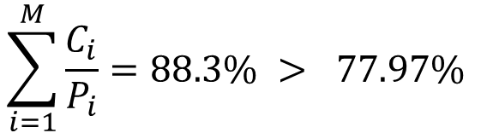
Real-Time Scheduling
Task A with compute time 6 ms, period 20 ms
Task B with compute time 10 ms, period 30 ms
Task C with compute time 10 ms, period 40 ms
$$\sum_{i=1}^{M}{\frac{C_{i}}{P_{i}}}=88.3\% > 77.97\%$$
☹
A
A1
A2
A3
A4
A5
A6
B
B1
B2
B3
B4
C
C1
C2
C3
RMS
C1
A1
B1
C1
A2
C1
B2
A3
4ms
4ms
0
20
40
60
80
100
120
C1 missed its deadline by 2 ms ☹

Slide 20
Rate-Monotonic Scheduling
Rate-Monotonic Scheduling, Liu and Layland (1973), is a real-time operating system scheduling algorithm for pre-emptable periodic processes with static (fixed) priorities.
Assumes:
Tasks are periodic and have hard deadlines
Tasks are independent (i.e. none blocks for any other due to mutex)
Each task is deterministic (we can calculate the exact worst-case compute time)
Task swapping occurs in zero time
Implementation:
Sort tasks by increasing deadline, assign decreasing priorities
i.e. higher the rate, higher the priority (rate-monotic scheduling)

Slide 21
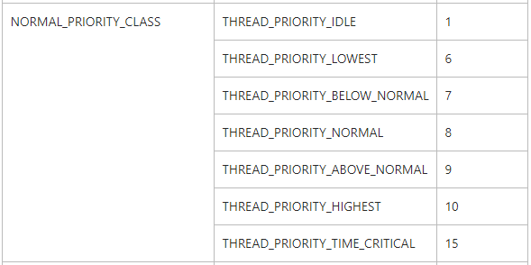
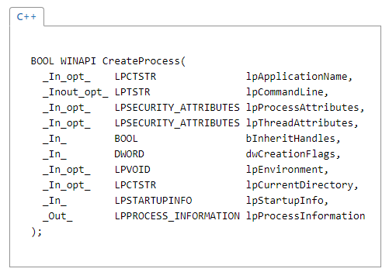
Process/Thread Priorities (Windows)
Priorities range from 1 to 31, determined by a
Priority Class for the process
Priority Level for the thread
BOOL SetThreadPriority( HANDLE hThread, int nPriority );
BOOL SetPriorityClass( HANDLE hProcess, DWORD dwPriorityClass );
https://msdn.microsoft.com/en-us/library/windows/desktop/ms685100(v=vs.85).aspx

Slide 22
Process/Thread Priorities (POSIX)
Process/thread priorities work differently depending on a schedule policy: SCHED_FIFO, SCHED_RR, or SCHED_OTHER
By default, true priority value depends on a process’s nice value, and a thread’s assigned priority (SCHED_OTHER). SCHED_FIFO and SCHED_RR ignore the nice value, allow direct setting of thread priorities, typically in range [1, 99]
int setpriority(int which, id_t who, int value); // modifies the “nice” value
pthread_setschedparam(pthread_t thread, int policy, struct sched_param *param);
https://linux.die.net/man/3/pthread_setschedparam
https://developer.apple.com/library/content/documentation/Darwin/Conceptual/KernelProgramming/scheduler/scheduler.html

