Slide 1
Lecture 20 – Readers and Writers
Learning Goals
Describe the readers-writers problem, and the concept of a shared lock
Give a real-world example where shared locks should be applied
Develop pseudo-code for a shared lock implementation and argue how and why it works
Differentiate between read-priority, write-priority, and fair-priority shared locks, and list the advantages and disadvantages/pitfalls of each
Describe the Read-Copy-Update pattern, and how it differs from shared locks
Give a real-world example where RCU should be applied
Outline pseudo-code for implementing RCU for a given application
©Paul Davies, C. Antonio Sanchez. Not to be copied, used, or revised without explicit written permission from the copyright owner.

Slide 2
Mutual Exclusion
Until now, we’ve been insistent on the following rules for mutual exclusion:
If a shared variable is NEVER modified, no need for mutex
If a shared variable is EVER modified, yes need for mutex
readers need to acquire mutex before reading
writers need to acquire mutex before writing
How many readers can access the resource at a time?
1
How many writers can access the resource at a time?
1

Slide 3
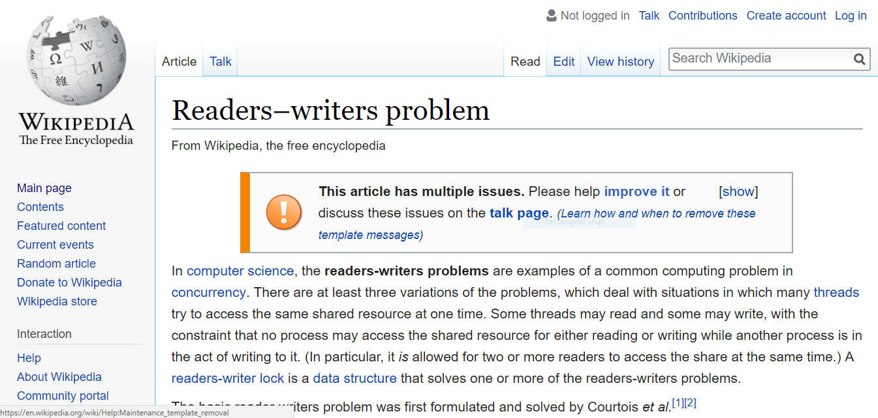
Mutual Exclusion
Imagine if Wikipedia worked this way…

Slide 4
Mutual Exclusion
In cases where reading is much more frequent than writing, this can lead to inefficient use of the resource.
Q1: Can any harm come from having multiple threads only reading a variable concurrently (i.e. no writers)?
Q2: Can any harm come from having multiple threads only writing a variable concurrently (i.e. no readers)?

Slide 5
Mutual Exclusion
If one process/thread is reading from a resource, then we must prevent any other process/thread from writing to it at the same time.
If one process/thread is writing, we must prevent all other processes/threads (both reading and writing) from accessing the resource at the same time.
However, if all the processes/threads are simply reading (i.e. they will not attempt to update or write to the resource during that access), then we can have an unlimited number to be simultaneously active without problems.
Ordinary mutexes do not differentiate between reading and writing operations.
This is a significant drawback, since in the field of concurrent programming, reading from a resource is performed, in general, far more frequently than writing to it.

Slide 6

Example: Airline Reservation System
Thousands of vacationers/agents checking prices simultaneously, hoping for that deal-of-a-lifetime price drop. Imagine if everyone had to wait their turn…
An agent needing to change/update the information in the database, such as making a reservation, needs to wait for exclusive access.
Create a solution that would allow unlimited numbers of reader processes/threads to be simultaneously active, but enforce full mutual exclusion when a writer is using the resource.

Slide 7
Readers-Writers Problem
A new kind of mutex is required with separate Wait/Signal interfaces for Reader and Writer processes.
Set of Mutex Interface Functions for a Reader
Reader Process or Thread
waitToRead()
When multiple process/thread share access, we say the mutex is locked in read or shared mode
When a single process requires exclusive access, we say the mutex is locked in write or exclusive mode
doneReading()
Resource
Readers/Writers Mutex
Writer Process or Thread
waitToWrite()
doneWriting()
Set of Mutex Interface Functions for a Writer

Slide 8
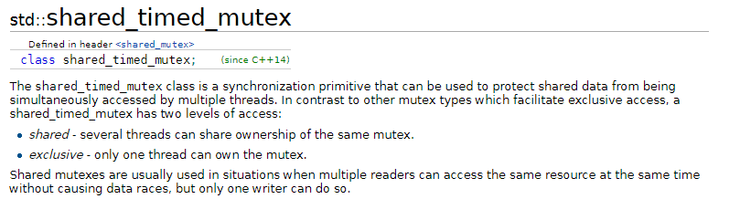
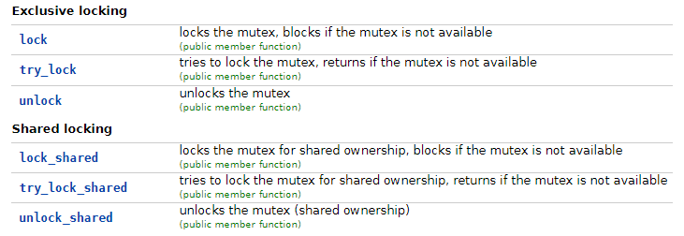
Shared Locks
In C++14, the standard introduced shared_timed_mutex
In C++17, the standard introduced shared_mutex
http://en.cppreference.com/w/cpp/thread/shared_mutex

Slide 9
Shared Locks
#include <shared_mutex>
std::shared_mutex:
allows shared access via lock_shared()/unlock_shared()
allows exclusive access via lock()/unlock()
std::shared_timed_mutex:
allows shared access via lock_shared()/unlock_shared()
allows exclusive access via lock()/unlock()
also has timed versions
std::shared_lock<SharedMutexType>:
similar to unique_lock, but locks the underlying mutex in shared mode

Slide 10
Shared Locks
std::shared_mutex mutex; // reader { std::shared_lock<decltype(mutex)> lock(mutex); // locked in "shared" mode (internally calls lock_shared() ) } // writer { std::unique_lock<decltype(mutex)> lock(mutex); // locked in "exclusive" mode (internally calls lock() ) }

Slide 11
Reader Performs S.lock_shared() to Gain Entry
No Writers Present: Reader Permitted to Enter
E
E
B
B
A
A
Reader Blocked by Writer
Reader Process Performs S.unlock_shared() to Leave
Resource
Resource
E
B
A
Reading
Shared Mutex ‘S’ Protecting Resource
Writer Process Performs S.unlock() to Leave
C
Writing
D
Writer Process Executes S.lock() to Gain Entry
C
C
D
D
Blocked by Reader
Writer Blocked by other Writer
Writer gains Entry
Writer gains Entry because no more Readers accessing resource
Resource is BUSY to Writer Threads but Open to Reader Threads
Resource is BUSY to Reader and Writer Threads
Resource is FREE to Both Readers and Writers

Slide 12
Exercise: Shared Locks
To gain access in shared mode, must wait until no other thread holds exclusive lock
To gain access in exclusive mode, must wait until no other thread holds exclusive or shared lock
How would you implement it?
How many synchronization primitives do you need?
What kind of primitives should they be?

Slide 13
Implementation
Read:
mutex.lock();
++readers;
if (readers == 1) {
resource.wait();
}
mutex.unlock();
// do read
mutex.lock();
--readers;
if (readers == 0) {
resource.notify();
}
mutex.unlock();
Ingredients:
One “global” binary semaphore for exclusive access: resource
One “local” mutex for read counts: mutex
A counter to store the number of readers: readers
Methods:
Write:
resource.wait();
// do write
resource.notify();

Slide 14
Implementation
Read:
mutex.lock();
++readers;
if (readers == 1) {
resource.wait();
}
mutex.unlock();
// do read
mutex.lock();
--readers;
if (readers == 0) {
resource.notify();
}
mutex.unlock();
First reader will wait until resource is available and acquire it
Future readers will go through without waiting
Next writer will wait until final reader notifies resource
1, 2
Write:
resource.wait();
// do write
resource.notify();
3

Slide 15
Shared Locks: Priority
Given that a resource is already locked in shared mode, should a new “reader” that comes along automatically be given the rights to lock in shared mode?
This is known as a read-priority or read-preferring lock
Imagine readers constantly coming along, then trying to lock in write mode. An exclusive lock can only be acquired once all readers have left. A constant stream of readers may cause write-starvation.
To counter this, we can make a writer to block out any new incoming readers.
This is known as a write-priority or write-preferring lock
A constant stream of writers may cause read-starvation.

Slide 16
Exercise: Write-Preferring Shared Lock
When a writer (exclusive access) attempts to acquire a lock, it waits until all existing readers complete and release the resource
If there is any writer, it takes precedence over all future readers (shared access)
How would you implement it?
How many synchronization primitives do you need?
What kind of primitives should they be?

Slide 17
Exercise: Write-Preferring Shared Lock
Approach: track # of readers accessing, readers
# writers waiting, writers
Read:
Wait until no writers waiting
increment # readers,
if # readers == 1, acquire resource
… read …
decrement # readers
if # readers == 0, release resource
Write:
increment # writers waiting
acquire resource
decrement # writers waiting
… write …
release resource
wmutex
cv
wmutex
sem
rmutex
wmutex
cv
sem
rmutex
sem
sem

Slide 18
Implementation
Read:
wmutex.lock();
cv.wait(wmutex, writers == 0);
rmutex.lock();
++readers;
if (readers == 1) {
sem.wait();
}
rmutex.unlock();
wmutex.unlock();
// do read
rmutex.lock();
--readers;
if (readers == 0) {
sem.notify();
}
rmutex.unlock();
Future writers blocked at wmutex
Write:
wmutex.lock();
++writers;
wmutex.unlock();
sem.wait();
// do write
sem.notify();
wmutex.lock();
--writers;
wmutex.unlock();
cv.notify();
writers > 0
Guaranteed not to block
Release resource
wake readers

Slide 19
Fair Priority
Both read-preferred and write-preferred locks can lead to starvation.
A fair priority lock alternates between letting readers through and writers through.
If we could guarantee that when waiting on semaphores/CVs that threads are awoken in the same order that they call the wait() function, then we can use this to let readers/writers pass in order of arrival. However, in general, we cannot make this assumption.
This leaves two options:
Manually maintain and manage a FIFO queue of waiting threads
Find some other way…

Slide 20
Fair Priority: Batches
current_batch
next_batch
A common solution is to alternate:
Let one writer through
Let a batch of readers through
If a reader arrives with no writers present, it adds one to the current batch of readers executing (current_batch++).
If a reader arrives with one or more writers present (waiting or executing), it adds one to the next batch of readers to execute (next_batch++).
After the current batch of readers finishes executing (current_batch == 0), it signals the next writer to go through
After a writer finishes executing, it signals the next batch of readers to go through (current_batch = next_batch, next_batch = 0)
write completion triggers swap

Slide 21
Fair Priority: Batches
NO!
Is this fair priority approach safe from starvation?
“Next writer” and “next reader” may not mean the next one that arrived, only next one to wake up. It is still possible that a reader or writer continuously gets left behind.
If all threads have the same priority, the chances of this are exceedingly rare (though may still be possible depending on the OS). If one thread has a lower priority, however, it can be quite likely.
The fix? Manually track order of arrival of threads in a FIFO queue.

Slide 22
Readers-Writers Mutex
The implementation in C++14/17 has fair priority, but only works between threads of a single process.
For other priorities, see
cpen333::thread::shared_mutex_exclusive (exclusive-access preferred) cpen333::thread::shared_mutex_shared (shared-access preferred) cpen333::thread::shared_mutex_fair (fair priority)
For inter-process use, see
cpen333::process::shared_mutex_exclusive (exclusive-access preferred) cpen333::process::shared_mutex_shared (shared-access preferred) cpen333::process::shared_mutex_fair (fair priority)

Slide 23
Shared Locks Summary
Shared locks allow multiple “readers” simultaneous access to a resource.
To gain exclusive access, we must wait until there are no other current accesses.
When both potential readers and writers are waiting for access, we can prefer to give priority to one class, or try to balance between the two:
read-preferred locks give priority to waiting readers
write-preferred locks give priority to waiting writers
fair locks try to balance the two
If a resource is locked with exclusive (write) access, this blocks out all others.

Slide 24
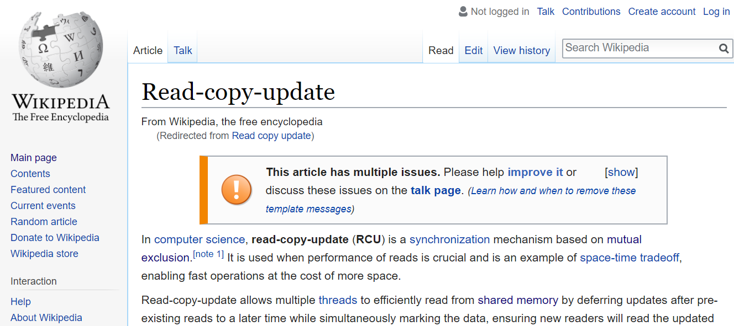
Shared Locks are great, but…
Imagine if Wikipedia worked this way…

Slide 25
Ready-Copy-Update
Rather than block out all readers while we are modifying a resource, we can instead make a copy of the resource, modify the copy, then atomically swap the old resource with the new. This pattern is called Read-Copy-Update (RCU).
This allows readers to still access the resource while the modification is taking place.
Requirements:
Pointer to resource for existing readers to keep access to original unmodified copy
Mutex for only allowing one writer at a time
Method of atomically switching pointer to updated resource (or mutex to enforce mutual exclusion)

Slide 26
Read-Copy-Update
ptr
ptr
ptr
Resource
W1
R2
R3
R1
R4
ptr
Copy
nptr
modify
nptr

Slide 27
Read-Copy-Update
Common:
Write:
static std::mutex rmutex; static std::mutex wmutex; Resource* resource_ptr = new Resource();
// lock out other writers { std::lock_guard<decltype(wmutex)> wlock(wmutex); // copy resource Resource* copy_ptr = new Resource(); *copy_ptr = *resource_ptr; // modify copy ... // safely replace original { std::lock_guard<decltype(rmutex)> rlock(rmutex); resource_ptr = copy_ptr; } }
Read:
// safely grab pointer to current resource Resource* local_resource_ptr = nullptr; { std::lock_guard<decltype(rmutex)> lock(rmutex); local_resource_ptr = resource_ptr; } // do what you want with local_resource_ptr

Slide 28
Read-Copy-Update
Ideal when writes are rare, want to ensure read access even when writing.
If we can guarantee atomic setting of pointers, read access requires no lock at all.
Read performance increased compared to shared locks, but at expense of space.
Memory-management issues: can only free old copies of resource once all readers accessing it have completed. Can be alleviated using std::shared_ptr.
Still typically only allows one writer at a time.
Possible to allow multiple writers, but then need method of merging results and dealing with conflicts, typically requires user intervention (e.g. Git, Wikipedia).

Slide 29
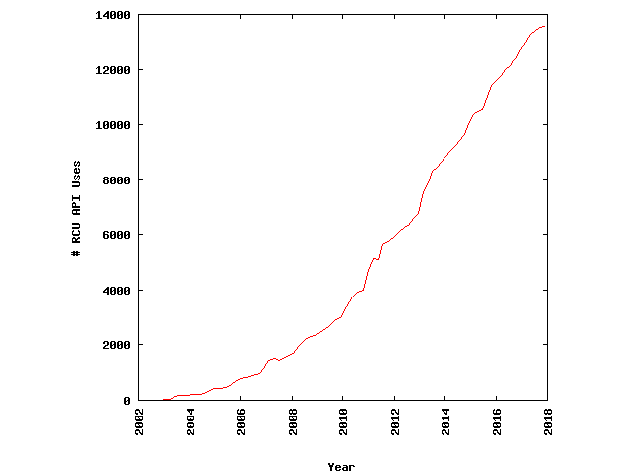
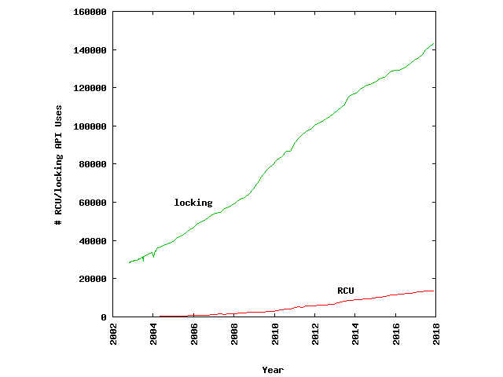
Read-Copy-Update
Usage in the Linux Kernel:
http://www.rdrop.com/users/paulmck/RCU/linuxusage.html

Slide 30

Homework
Work on those Project Design Documents, due Friday December 1st, 11:59 PM
Go through the course library examples in:
examples/q16_reader_writer
Quiz 7 next week on Deadlock, Scheduling

