Slide 1
Additional Topics
Learning Goals
Become exposed to certain topics so you’ve at least heard of them and can investigate further
Message Queues
Latches/Barriers
Promises/Futures
Thread Pools
Monitors
Active Classes
Remote Procedural Calls
CORBA
©Paul Davies, C. Antonio Sanchez. Not to be copied, used, or revised without explicit written permission from the copyright owner.

Slide 2
Inter-Process Communication
So far we’ve seen…
Shared memory: block of memory mapped to multiple processes so they can access it simultaneously
Pipes: queue of bytes that can be sent between processes
Sockets: queue of bytes that can be sent across a network
Now we briefly introduce:
Messages
Message queues

Slide 3
Windows Messages
Operation of the Windows OS is largely based on Events.
Every time a mouse button is pressed, an event is triggered
Every time a keyboard key is pressed, an event is triggered
Every time a count-down timer reaches zero, an event is triggered
Every time a new hardware device is plugged in, an event is triggered
With each event, a Message is broadcast by the system. Windows communicates with an application by sending these event messages to it. Applications can also send messages to each other, or to specific threads.
A process or thread can check for a message, and any data associated with it.
https://msdn.microsoft.com/en-us/library/windows/desktop/ms632590(v=vs.85).aspx

Slide 4
Windows Message Queues
Messages are stored in a queue, consist of a numeric identifier.
When reading messages, we can filter for IDs in a given range. The current thread can wait for the next message within the range, and remove it from the queue.
Reads are sequential, similar to a FIFO, except that the applied filter can be used to ignore or postpone reading of certain messages, allowing some message prioritization functionality.
Writing to message queues never blocks or suspends (i.e. the queue dynamically grows to accommodate the message)

Slide 5
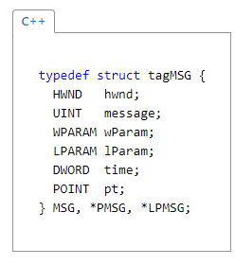
Windows Messages
BOOL PostMessage( HWND hWnd, UINT Msg, WPARAM wParam, LPARAM lParam):
posts a message to a specific window, or broadcast to all top-level windows in the system.
BOOL PostThreadMessage( DWORD idThread, UINT Msg, WPARAM wParam, LPARAM lParam)
posts a message to the specified thread
BOOL PeekMessage( LPMSG lpMsg, HWND hWnd, UINT wMsgFilterMin, UINT wMsgFilterMax, UINT wRemoveMsg)
reads the next message with ID in a given filter range if one exists, without removing it (unless explicitly requested)
BOOL GetMessage( LPMSG lpMsg, HWND hWnd, UINT wMsgFilterMin, UINT wMsgFilterMax)
waits for and reads the next message with ID in a given filter range, removing it from the queue.
BOOL WaitMessage()
waits until there is at least one message in the queue
Windows messages consist of

Slide 6
Windows Messages
The precise meaning of these numeric messages is up to the application, usually interpreted as a request or command.
The message 1000 could ask the recipient thread to turn ON a light bulb in the living room.
The message 1001 could mean turn OFF the light bulb.
The message values 1000-1009 could be interpreted by an elevator as a request to GO to any of the floors 0-9.
The message 4000 sent to a process/thread could mean ‘terminate yourself’.
The sender cannot force the receiver to read the message, only hope for a response.

Slide 7
POSIX Message Queues
Message queues in Linux/macOS and other POSIX systems work a bit differently than the Windows counterpart.
Queues are explicitly created, given a named path /dev/mqueue/…
Queues can be shared, unlinked, and closed
Messages consist of a string and an integer priority
Messages are delivered highest priority first, those with identical priorities are delivered in order of arrival
Can set up a callback function (signal event handler) to handle incoming messages
http://man7.org/linux/man-pages/man7/mq_overview.7.html

Slide 8
POSIX Message Queues
#include <mqueue.h>
mqd_t mq_open(const char *name, int oflag);
Creates or connects to an existing message queue, with creation flags
int mq_send(mqd_t mqdes, const char *msg_ptr, size_t msg_len, unsigned int msg_prio);
Sends a character string message with provided priority to the given queue
ssize_t mq_receive(mqd_t mqdes, char *msg_ptr, size_t msg_len, unsigned int *msg_prio);
Retrieves the next highest priority message, along with its priority, (by default) blocking until there is a message
int mq_notify(mqd_t mqdes, const struct sigevent *sevp);
Registers a signal-event handler to respond to incoming messages
int mq_close(mqd_t mqdes);
closes the queue
int mq_unlink(const char *name);
unlinks the name from the queue

Slide 9
Message Queue Summary
Useful for sending information between threads/processes.
Similar to pipes, except
multiple threads/processes can write to the same queue concurrently
some functionality for message priorities, by either filtering (Windows) or sorting (POSIX)
Messages need to be interpreted, often into commands
Beware of unbounded memory issues, since queue grows with each message

Slide 10
Synchronization
So far we’ve seen…
Mutex: basic primitive for providing mutual exclusion of critical section
Semaphore: counting primitive limiting the # of threads accessing a resource
Condition Variables: allow waiting until certain conditions are met
Shared Mutex: allow multiple concurrent shared accesses, or exclusive access
Now we briefly introduce:
Latches
Barriers
Promises/Futures

Slide 11
Latches
A countdown latch allows threads/processes to wait until the latch’s value reaches zero. Decrementing and waiting are often decoupled, allowing many threads to wait for a single signal. Latches are useful for synchronizing the start of several threads.
Usually supports the following operations:
decrement(): reduce the count of the latch
wait(): waits until the value of the latch reaches zero
decrement_and_wait(): reduce the count and wait until the latch reaches zero
Note the lack of increment() or reset(int). Latches are usually considered a one-time-use object, initialized to a particular value.

Slide 12
Latch Implementations
In C++20:
#include <experimental/latch>
std::experimental::latch
latch(size_t value): constructor with initial value
count_down(size_t n=1): reduces value
count_down_and_wait(): reduces value by one and waits until reaches zero
is_ready(): checks if value is zero
wait(): blocks until value is zero
Until then, see boost::thread::latch, or create your own:
Shared counter variable
Mutex to protect access
Condition variable for waiting until count is 0

Slide 13
Latch Example
Create and synchronize the start of multiple threads (2 different ways)
void thread_func(std::experimental::latch& latch) { latch.wait(); // ... synchronized action ... } void main() { // latch with value of 1 std::experimental::latch latch(1); const int nthreads = 100; for (int i=0; i<nthreads; ++i) { std::thread thread(thread_func, std::ref(latch)); thread.detach(); } // notify all threads to start at once latch.count_down();
return 0; }
void thread_func(std::experimental::latch& latch) { latch.count_down_and_wait(); // ... synchronized action ... } void main() { const int nthreads = 100; // latch with value of # threads std::experimental::latch latch(nthreads); for (int i=0; i<nthreads; ++i) { std::thread thread(thread_func, std::ref(latch)); thread.detach(); } return 0; }

Slide 14
Barriers
A barrier is a synchronization primitive used to wait until a given number of threads arrive before allowing any of them to continue. When all threads have been let through, it resets to provide another synchronization point. It is also sometimes called a rendezvous.
They support a wait() operation that is used to wait until a specified number of threads arrive.
It is essentially a counter (similar to a semaphore) that waits until the count becomes zero before allowing threads to continue. The count then resets, ready for the next set of waits.
Barriers are useful for coordinating a set of repeated parallel tasks.

Slide 15
Barrier Implementations
In C++20:
#include <experimental/barrier>
std::experimental::barrier
barrier(size_t num_threads): constructor with # threads
arrive_and_wait(): waits until all others arrive
arrive_and_drop(): removes thread from the set
Until then, see boost::thread::barrier, or cpen333::thread::rendezvous or can easily create your own:
Shared counter variable
Mutex to protect access
Condition variable for waiting until count is 0

Slide 16
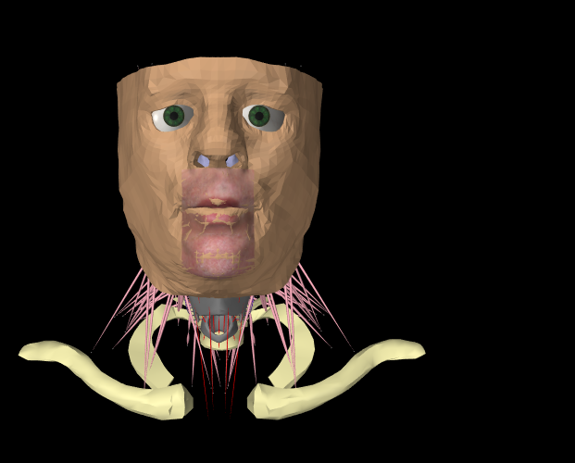
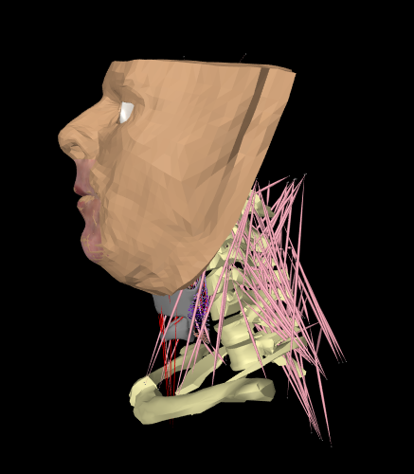
Barrier Example
In graphics, simulation, special effects, may have many different objects/geometries
Compute physics, updated positions and deformations, lighting effects, etc… using multiple threads
Need to synchronize completion before rendering frame
artisynth.org
We could create a new bunch of threads each update, do work, then join threads to synchronize, but leads to constant creation/deletion of threads.
Better to use separate threads executing in a loop with barrier to synchronize.

Slide 17
Promises and Futures
A promise sets up a contract that a value will be available in the future.
Allows a function to be launched asynchronously, returning a proxy for the result. We can query the status of the future, or wait for it to be ready.
Basic functionality:
future = promise.get_future();
// waits for promise
value = future.get();
// fulfills promise
promise.set( value );

Slide 18
Promises and Futures in C++11
std::promise<ValueType>: Associated with a future, manually sets future value or exception
std::future<ValueType> Waits for a value to be ready, there can only be one per promise/task
std::shared_future<ValueType> Waits for a value to be ready, can be many waiting in multiple threads
Futures can also be returned by functions, with no associated promise visible, allowing functions to be executed asynchronously
std::async(std::launch, Function&&, Args&&...)
Returns a future that can be used to obtain the result of the provided function call, potentially executed asynchronously, could be deferred.

Slide 19
Promises and Futures: Example
Launching an asynchronous or deferred function
long find_factor(long n) { // ... compute prime factors of n ... } int main() { // launches immediately std::future<long> async_result = std::async(std::launch::async, find_factor, 249234224); // launches when result requested std::future<long> deferred_result = std::async(std::launch::deferred, find_factor, 9887897182); long x = async_result.get(); long y = deferred_result.get(); return 0; }

Slide 20
Thread Pools
We’ve already seen the producer-consumer pattern for distributing work between several threads. Thread pools generalize this:
A common fixed-size pool of threads used for running generic tasks
A shared queue of tasks to run by the pool
Adding a task to the pool returns a future that can be used to wait on the result
thread_pool pool(4);
future = pool.execute(func, args);
result = future.get(); // waits for result

Slide 21
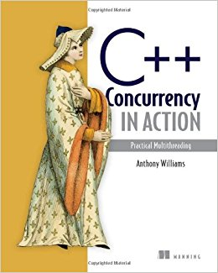
Thread Pools
Not part of C++ standard (yet). You can find many library implementations out there.
Create your own…
Provide interfaces with fixed parameter/return types
Manually wrap function calls with parameters, use promise/future to return results asynchronously
Template programming to auto-detect parameter/return types
Java has ThreadPoolExecutor, runs instances of Runnable
Anthony Williams

Slide 22
Thread Pools
Not part of C++ standard (yet). You can find many library implementations out there.
class thread_pool { public:
// initializes pool thread_pool(size_t nthreads);
// submits a task to run template<typename Func, typename...Args> auto submit(Func&& func, Args&&... args)
-> std::future<decltype(func(args...))>;
// run next task in calling thread
void run_pending_task();
// shuts down the pool
void shutdown(); };
Anthony Williams

Slide 23
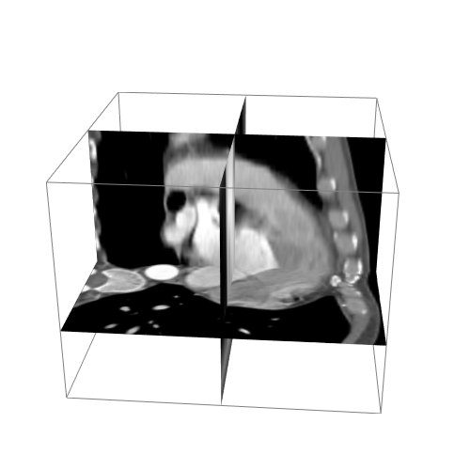
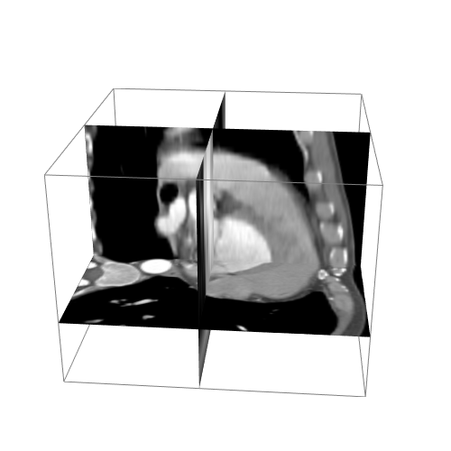
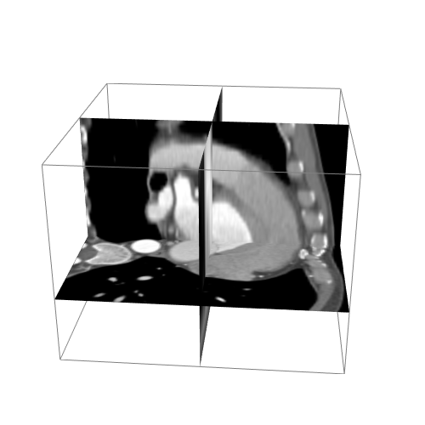
Thread Pools: Example
Dynamic MR of Heart Beating
256x256x64 3D volume
12 full volumes
Need to decode 64x12 2D slice images and assemble into a 3D+Time data structure
void load4DImage(Image4D image) {
vector<future<void>> futures;
for (int time=0; time<12; ++time) {
futures.push_back(pool.execute(load3DImage(image, time)));
}
// wait for completion
for (auto& f : futures) {
f.get();
}
}
void load3DImage(Image4D image, int time) {
vector<future<void>> futures;
for (int slice=0; slice<64; ++slice) {
futures.push_back(pool.execute(load2DImage(image, time, slice)));
}
// wait for completion
for (auto& f : futures) {
f.get();
}
}
Issues?

Slide 24
Thread Pools
CAUTION: If you have a set of inter-dependent tasks, beware of deadlock!
Pools have a fixed number of threads running. If one task is ever stuck waiting for something, that thread remains occupied. If all threads in the pool are waiting for an event triggered by a task still in the queue to be executed, will be deadlocked!
Can lead to some pretty hard-to-find race conditions that may even be machine-dependent if pool size is dependent on number of cores.
Thread pools are most effective for running a set of independent tasks. If advanced synchronization is required, usually best to manage threads manually.

Slide 25
Monitors
A monitor handles synchronization internally. All functionality that may lead to race conditions is encapsulated within interface functions.
Essentially, the details of the required synchronization are hidden from the programmer. It is the designer’s responsibility to ensure safe use of the resource rather than the user’s. The result is a thread-safe class.
Often provide the ability to wait for conditions to be met.
Recall: Thread-Safe Queue implementations for the Producer-Consumer pattern

Slide 26
Monitors: Example
/** * Add funds to bank account * @param amount amount to deposit */ void deposit (double amount) { std::lock_guard<std::mutex> lock(mutex_);
balance_ += amount; cv_.notify_all(); } /** * Retrieve bank balance * @return your current savings, treat with care */ double getBalance() { std::lock_guard<std::mutex> lock(mutex_);
return balance_; } // allows waiting until there is money in the account void waitForBalance(double b) { std::unique_lock<std::mutex> lock(mutex_); cv_.wait(lock, [&](){ return balance >= b ;}); } // constructor and destructor BankAccount () : balance_(0), mutex_(), cv_() { } };
class BankAccount { private: double balance_; // the data to be protected std::mutex mutex_; std::condition_variable cv_; public: /** * Safely withdraw funds if there is sufficient money * @param amount amount to withdraw * @return true if successful, false otherwise
*/ bool withdraw (double amount) { std::lock_guard<std::mutex> lock(mutex_); bool status = false; if (balance >= amount) { status = true; balance -= amount; cv_.notify_all(); } return status ; }

Slide 27
Monitors: Example
void child(BankAccount& forfun) { // I need money to spend std::cout << "Waiting for money to be put into account"
<< std::endl; forfun.waitForBalance(1000);
double balance = forfun.getBalance();
forfun.withdraw(balance); std::cout << " Spending all my extra money :), $"
<< balance << std::endl; } int main() { BankAccount forschool; // every week put 300 in for (int i=0; i<52; ++i) { std::thread bigspender(&child, std::ref(forschool)); std::cout << "Giving child $300 for school" << std::endl; forschool.deposit(300); bigspender.join(); // wait for child } std::cout << "Done." << std::endl; return 0; }
class BankAccount { public: bool withdraw (double amount);
void deposit (double amount); double getBalance(); void waitForBalance(double b); };

Slide 28
Active Objects
An active object is one in which the member functions are executed asynchronously, with all the work done on a private internal thread.
Allows us to encapsulate functionality, and interact with threads in an object-oriented manner. Like monitors, synchronization is handled internally.
The active object’s private thread runs all the work. Member functions can be invoked by callers, which enqueue messages/tasks on the internal thread, and returns immediately without blocking.
Messages are processed sequentially within the object, making them atomic with respect to each other. The object's private data is only accessed from the private thread, so there is no need for a mutex (apart from perhaps the thread-safe queue).

Slide 29
Active Objects
active_object::~active_object() { { std::lock_guard<decltype(mutex_)> lock(mutex_); queue_.push_back(POISON); } cv_.notify_one(); thread_.join(); }
void active_object::run() { std::unique_lock<decltype(mutex_)> lock(mutex_,
std::defer_lock); Message msg; do { lock.lock(); cv_.wait(lock, [&](){ return !queue_.empty(); } ); msg = queue_.front(); queue_.pop_front(); lock.unlock(); // do something with msg
} while (msg != POISON); }
Base class:
class active_object { private: std::thread* thread_; // worker thread
std::deque<Message> queue_; // queue
std::mutex_ mutex_; // protect queue
std::condition_variable cv_; // wait when idle const Message POISON; // poison pill void run(); public: // create object active_object() : thread_(nullptr), queue_(), mutex_(),
POISON() { thread_ = new std::thread(&active_object::run, this); } // terminate private thread ~active_object(); };

Slide 30
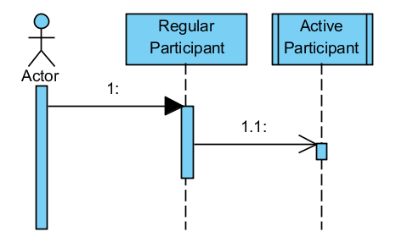
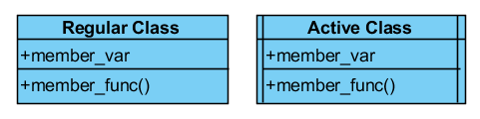
Active Objects
Active objects allow us to better reason about thread-safety, hide many of the low-level details.
So common that they have special notation in UML diagrams:

Slide 31
Distributed Applications
More and more applications are being developed based on a distributed architecture model, with multiple processes running on multiple computers connected remotely via a network, e.g. the internet, or some local private network.
The problem faced here is how to write an application that will allow a process on one computer to communicate with a process on another computer in a seamless fashion.

Slide 32
Remote Procedure Calls
Sockets can be used to implement remote procedure calls (RPC) in a distributed system. The client sends data representing a message to the server, asking it to carry out some action remotely on the server.
The server receives the message and data and invokes code within the server application to carry out the action, while passing back any results to the client.
Server
Command = 10 might mean insert into database, the other argument might be the data to insert, e.g. 20
Application: Port 100 interprets incoming data as Commands + Arguments and returns results
Client
Create Socket()
Connect(192.234.567.890, 100)
Write (10);
Write (20) ;
X = Read()
10, 20
Socket
Read() and Write()
Socket
Result of operation passed back, e.g. 1=OK, 0=Failed
Server IP Address 192.234.567.890

Slide 33
Remote Procedure Calls
Details of communication are hidden using encapsulation. To an observer, there is very little difference between local calls and remote calls except that:
Remote calls have higher latency
Remote calls may fail due to errors in communication
Communication layer typically involves a request-response message passing system.
There should exist some mechanism to handle/recover from a failed remote call.
Calls can by synchronous or asynchronous. For synchronous calls, the RPC interface waits until the response is received before giving control back to the calling thread.

Slide 34
Security Considerations with RPC
Since RPC involves sending messages over a network which trigger actions on a remote machine, there may be some important security considerations.
Data Encryption: if sending raw data via sockets, and if that data contains personal or private information, may want to encrypt it so that the contents cannot be observed in raw form.
Raw:
{ “username”: “antonio”, “password”: “snuffleupagus” }
vs
AES128:
9SkftAqi9ZIRcTc7lKmUhXPyGAVNdt/Vf9Lqd1xSzJfDJPTvti/Dub90r4pwD9zPckzilI3m4APqNKV4J9zK86pSw/p51rtO7XsGr8l8IL4=

Slide 35
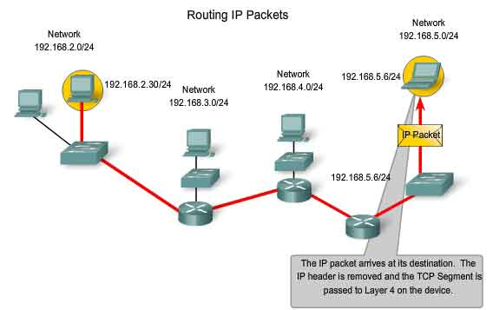
Security Considerations with RPC
Identify Verification: may wish to establish and verify the identity of the remote machine before accepting commands. Often accomplished through use of digital certificates that rely on public-key encryption (e.g. RSA).
Man-in-the-Middle Attack: an intermediate machine relays information to the destination, but may eavesdrop or alter messages as they pass through.
http://www.highteck.net/EN/Network/OSI_Network_Layer.html

Slide 36
Security Considerations with RPC
Open Systems Interconnection (OSI) model
Application Layer
Solution: use SSL/TLS in communication layer, handles identities, encryption, message integrity (e.g. OpenSSL).
SSL: secure sockets layer TLS: transport layer security
Application
Application Programming Interface (API)
Presentation Layer – Communication Protocol
Session Layer – Security (SSL/TLS)
Transport Layer –Socket Communication (TCP/UDP)
…
e.g. http://simplestcodings.blogspot.ca/2010/08/secure-server-client-using-openssl-in-c.html

Slide 37
Security Considerations with RPC
Malicious code: one of the main purposes of firewalls is to prevent remote users from accessing your computer through an open port and executing code to gain access or compromise the security of your machine.
NEVER BLINDLY EXECUTE ARBITRARY CODE YOU RECEIVE THROUGH A SOCKET!!
Many issues can be solved through processing of received data prior to executing.
Data validation: checks that input meets a set of criteria
Data sanitization: modifies the input to ensure validity

Slide 38

Security Considerations with RPC
SQL Injections: nefarious SQL statements are entered to trick the system into executing multiple commands. Easily prevented by escaping quotes and ensuring proper database permissions.
https://xkcd.com/327/
Buffer Overflow Exploits: similar, but involve overwriting machine code by triggering a write past the end of an array. Easily prevented by always checking array sizes.

Slide 39
Distributed Object Oriented Applications
RPC can simplify the interface of communication between remote machines, but still relies on careful design and machine/language-specific code.
it’s not very elegant, and the need for explicit IP addresses and port numbers, as well as reading/writing raw bytes is not particularly object oriented.
The Common Object Request Brokerage Architecture (CORBA) is an open standard defined by the Object Modelling Group (OMG). DCOM is Microsoft's own proprietary rival to CORBA.
Both CORBA and DCOM define a model for communication between objects in a distributed object architecture, that is, objects existing within different processes, either on the same machine or on different machines located anywhere in the world.

Slide 40
Distributed Object Oriented Applications
System Boundary
An Active Class
An Active Class
class MyClass1 : public ActiveClass { func1() { ….. } func2(int p1, int p2 ) {….. } func3() { ….. }
int main() { MyClass2 Object2 ; int x = Object2.func1(p1, p2); } };
class MyClass2 : public ActiveClass {
int func1(int p1, int p2) { ….. } void func2() { ….. } void func3() { ….. }
int main() { MyClass1 Object1 ; int x = Object1.func2( p1, p2); }
} ;
Direct method invocation
Traditional Object Oriented Approach Object within the same system communicating via direct method invocation

Slide 41
41
Object 1
Client machine in UK
Object 3
Server In Canada
MyActiveClass2
MyActiveClass1
int func1(int p1, int p2) { ….. }
void func2() { ….. }
void func3() { ….. }
int main()
{
. . .
}
func1() { ….. }
func2(int p1, int p2) { …..}
func3() { ….. }
int main()
{
int x = Object3.func1(p1, p2);
}
Proxy classes are designed to emulate the real object in another system. Objects on one system communicate with their (local) proxy whose job it is to marshal parameters and returned data between the real objects
The ORB allows objects to be located and to be registered for use in the world with a service provider (like yellow pages) where ORBS can go to register their objects and find objects of the type they want
int
Object 1 communicates with object 3 via the proxy
Object 3 communicates with object 1 via the proxy
p1,p2
Proxy for Object 3
Proxy for Object 1
int func1(int p1, int p2) { ….. }
void func2() { ….. }
void func3() { ….. }
Object Request Broker
func1() { ….. }
func2(int p1, int p2 ) { ….. }
func3() { ….. }
Locate
Object Locator
Register
method
ORB
p1,p2
ORB
internet
int

Slide 42
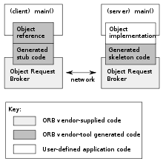
CORBA
CORBA builds higher level protocols on top of something like sockets/RPC.
Uses an interface definition language (IDL) to define the interfaces, component structure. IDL is translated to any number of implementation languages, like C++ or Java.
Client application communicates with the local proxy, which relays messages with an ORB to locate the remote object.
The remote procy carries out the actions and returns the response to the local one, which then passes it back up to the client.
DCOM: Distributed Component Object Model, Microsoft’s proprietary version
https://en.wikipedia.org/wiki/Common_Object_Request_Broker_Architecture

Slide 43
Additional Topics Summary
Message queues allow multiple threads/processes to post data into a thread-safe queue, with some control over priority
Barriers/Latches allow us to count down to trigger events
Promises/Futures allow us to execute functions asynchronously
Thread pools allow us to use a group of threads to execute a queue of tasks asynchronously
Monitors are used to encapsulate the synchronization details so the programmer doesn’t have to worry about it as much
Active objects act like thread objects that execute tasks asynchronously
We can use these along with a communication layer to perform remote procedure calls
CORBA abstracts RPC further, used to auto-generate interfaces

