Slide 1
CPEN333 – Course Review
Learning Goals
What is System Software Engineering?
Whirlwind tour through all material
Mutual exclusion
Inter-Process Communication
UML
Synchronization & Deadlock
Priority and Scheduling
Advanced Patterns (Producer-Consumer, Readers-Writers, RCU)
A few example problems
©Paul Davies, C. Antonio Sanchez. Not to be copied, used, or revised without explicit written permission from the copyright owner.

Slide 2
Lecture 1: Introduction to System Software Engineering
Learning Goals
Define a system, system software, and system software engineering
Distinguish between hard and soft time constraints
Distinguish between event-driven and time-driven systems, and give examples
Describe the difference between interrupts and polling for detecting and handling events
List advantages and disadvantages of both interrupts and polling
Discuss why testing real-time systems can be challenging

Slide 3

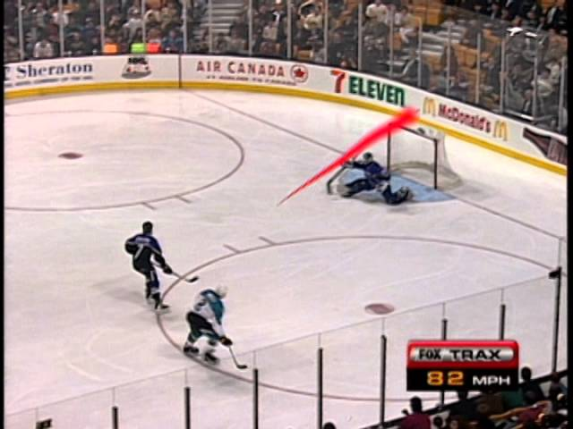
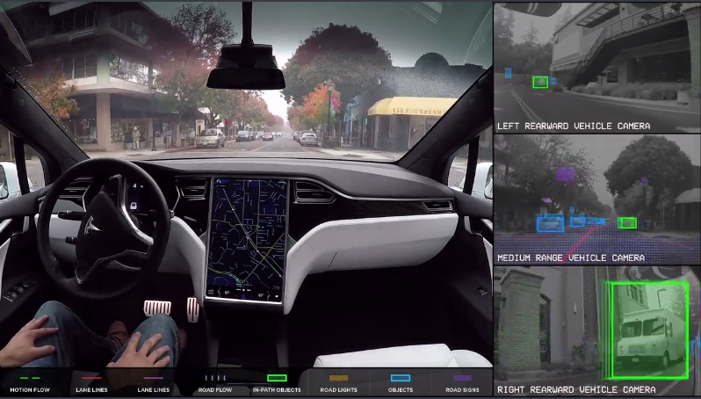
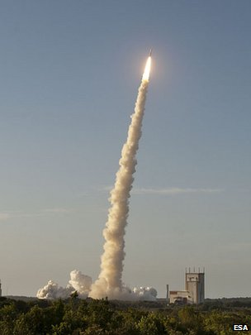
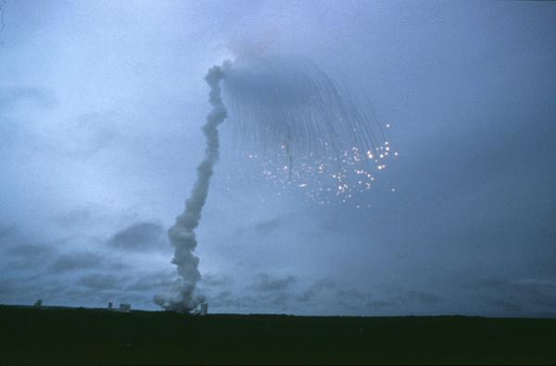
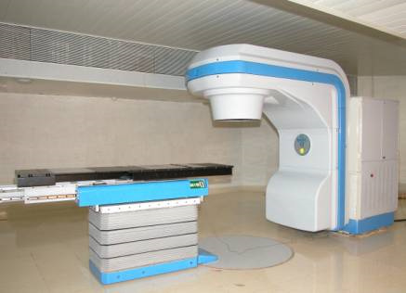
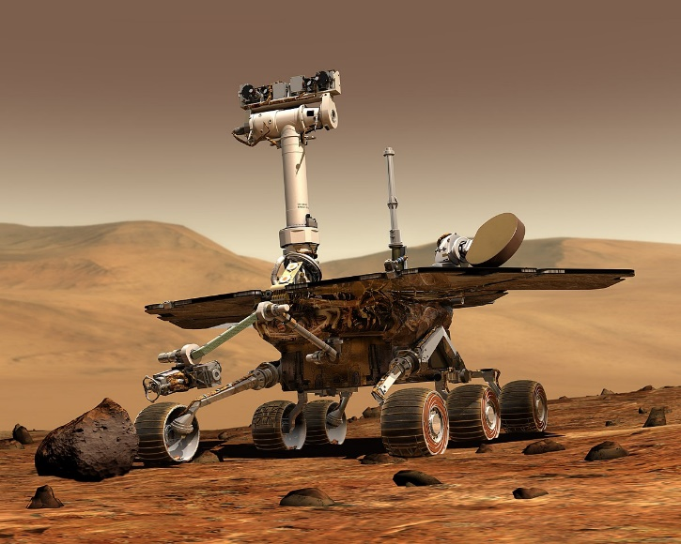
Examples of Systems

Slide 4
Lecture 2: Introduction to Concurrency
Learning Goals
Describe the differences between single-tasking and multi-tasking
Identify challenges introduced by adding concurrency
Describe an example of a multitasking system (perhaps with a diagram)
Identify whether or not a program will benefit from concurrency, either in terms of efficiency or scalability
Describe various methods of implementing multitasking, and list some advantages/disadvantages of each
Define and describe time-slicing and how it differs from pseudo-multitasking

Slide 5

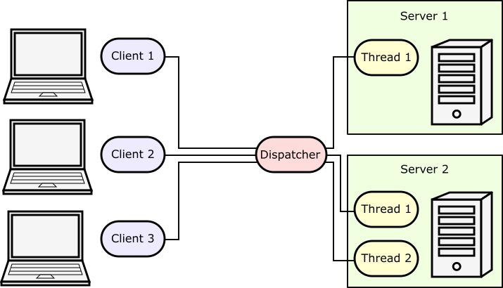

Multi-Tasking Example
60k searches per second
0.5 s to process each search

Slide 6
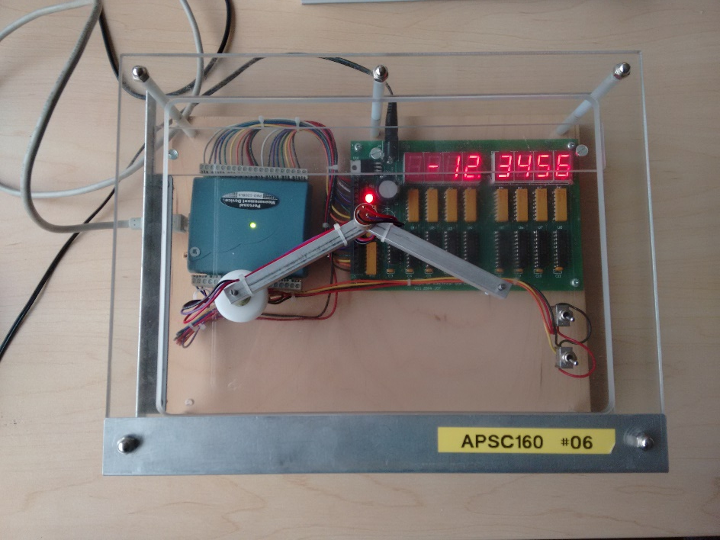
Pseudo Multitasking
Simply switch between a bunch of sequential tasks fast enough that it looks like they are running in parallel.
int main() {
// continuously cycle through set of monitors
// to give appearance of parallel operation
while ( deviceIsOn() ) {
monitorTemperature();
monitorHumidity();
monitorAtmosphericPressure();
updateDisplays();
}
return 0;
}

Slide 7
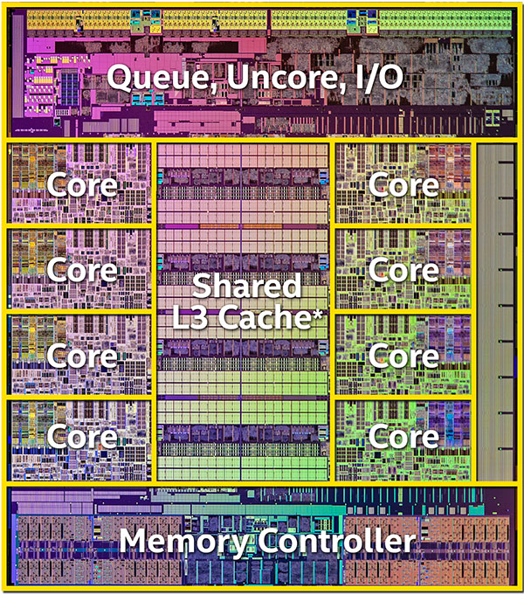
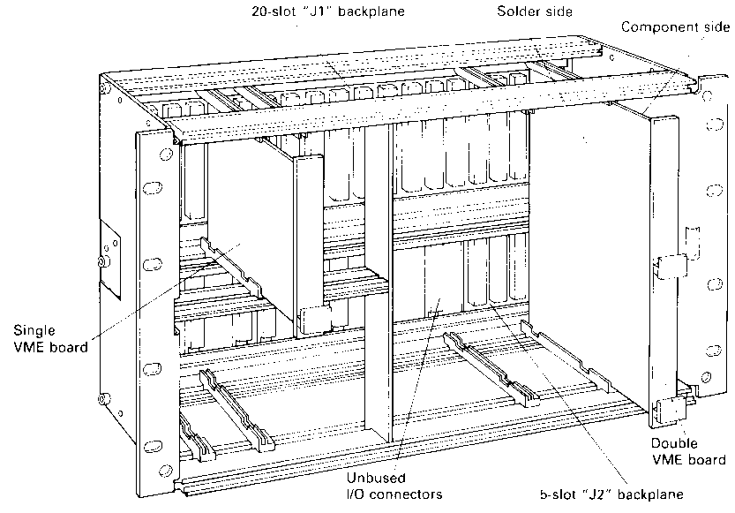
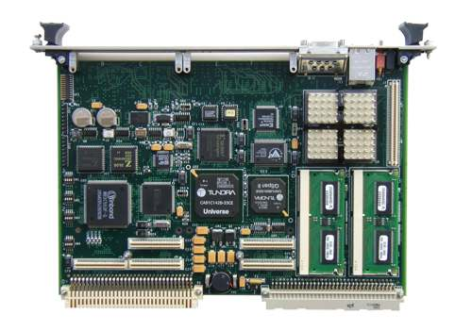
Multiple Dedicated Processors/Cores
Each processor/core is given one task to run on its own, synchronizes with others.
(2015) 8 Core I7 CPU with shared Cache and Memory controller
Custom server with shared backplane, communicate over a VMEbus

Slide 8
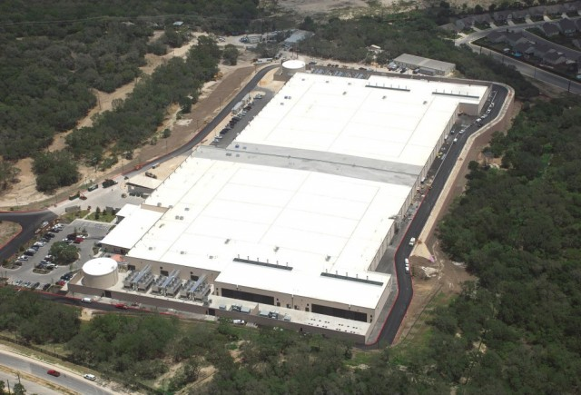
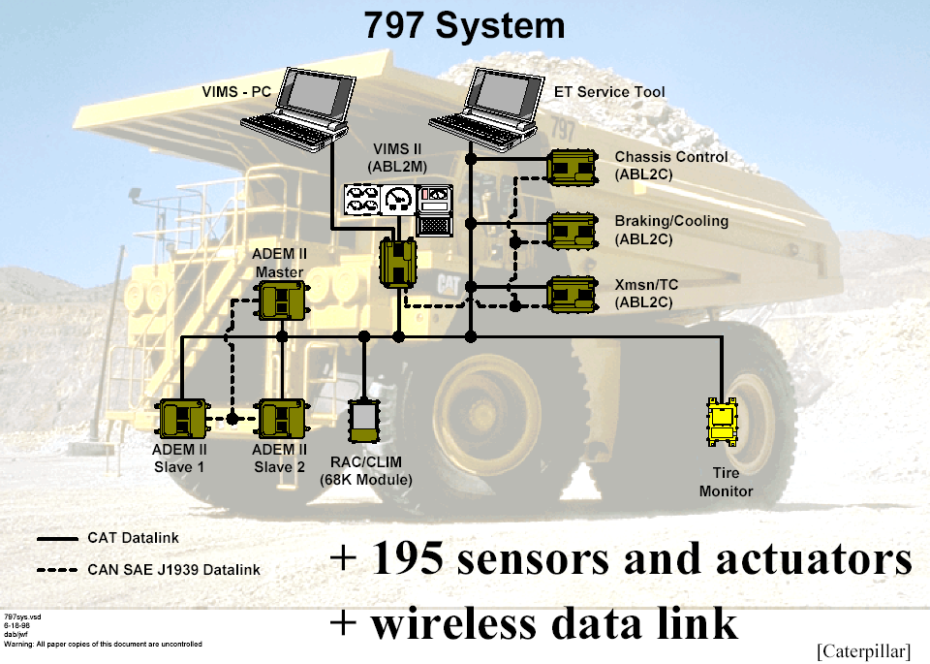
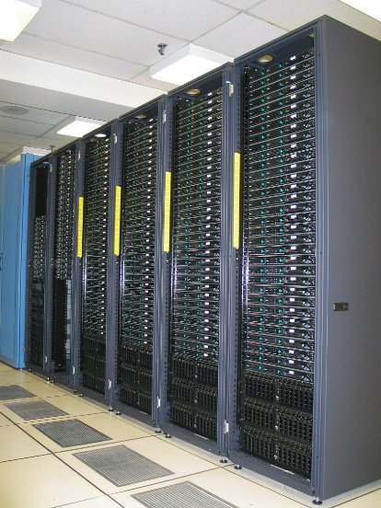
Distributed Systems
Microsoft’s data center in
San Antonio, Texas

Slide 9
Time-Slicing
OS Kernel called to deal with Interrupt
Operating System Kernel
Operating System Kernel
Save State of Current Task
Restore State of Next Task
Interrupt Cleared
Real Time Clock
Real Time Clock
10ms interrupt
CPU
Kernel directs CPU to swap/resume task
List of Tasks Descriptors (1 per Process)
1
2
3
4
5
Active Process Queue
Repeat Forever

Slide 10
Lecture 3: Threads
Learning Goals
Describe what a thread is in your own words
Describe the role of the Operating System kernel in thread creation
Create and use threads in C++ using the C++11 standard std::thread class
Describe two methods of thread communication and give a code example
Define a race condition and give an example
Given code that runs in parallel, identify all possible sequences and outputs
Given an application, identify where it might be useful to use separate threads
List potential drawbacks or limitations of multiple threads

Slide 11
Communication and Synchronization Problems
More threads more problems. Communication and synchronization issues grow exponentially, scattering data leads to more data dependencies, slowing the system down, leading to data management challenges.
11
Process/Thread
Thread
Process/Thread
Thread
Process/Thread
Thread
Communication Problems
Synchronisation Problems
Process/Thread
Process/Thread
Thread
Thread
Process/Thread
Thread

Slide 12
Lecture 4: Processes
Learning Goals
Describe what a process is in your own words
Describe the role of the Operating System kernel in process creation
Describe the differences between processes and threads, and list some advantages/disadvantages of each
Understand that there are differences in process creation between different operating systems (you don’t need to know how to create them on each platform)
Create a child process with the help of the course library

Slide 13
Application/Process/Thread Decomposition
Towards Crude, single tasking systems running on 1 CPU/Core
Monolithic System
Monolithic System
No Granularity
System broken down into processes
Multi-tasking systems
Process
Process
Process
Process
Process
Process
System broken down into processes: Coarse grained or Process Granularity
Processes broken down into smaller processes
Process
Process
Process
Process
Process
Process
Smaller Processes broken down into threads
Multi-threaded systems
Processes broken down into threads: Fine grained or Thread Granularity
Thread
Thread
Thread
Thread
Thread
Thread
Threads broken down into smaller threads
Thread
Thread
Thread
Tending towards highly parallel programming with increasing data dependencies
Thread
Thread
Thread
High Granularity

Slide 14
Lecture 5: Exceptions, Specifications, and Testing
Learning Goals
Understand what an exception is, and what they are useful for
Use exceptions in combination with a try—catch block
Create and use a custom exception class
Define and give examples of preconditions and postconditions
Write complete and correct method specifications
Partition inputs to design tests for a method that cover all expected behaviours
Write unit tests against a method

Slide 15
Specifications
Preconditions
// REQUIRES: data is a non-empty vector // EFFECTS: returns the index of the last occurrence // of val in data, or -1 if not found int find(std::vector<int>& data, int val);
Postconditions
int a0 = find({0, 1, 2, 3, 4, 5}, 2);
int a1 = find({0, 1, 2, 3, 4, 5}, 6);
int a2 = find({0, 1, 1, 1, 4, 5}, 1);
int a3 = find({}, 1);
// fails precondition, output indeterminate

Slide 16
Testing
Unit Testing: testing each method/class (i.e. a unit) in isolation. Each partition of inputs
is usually separated into a separate test so that a failed test will indicate exactly
what type of bug to search for.
Integration Testing: testing the system as a whole to ensure the various components of
the software function properly in combination. If all unit tests pass, then you
know the issue is somewhere in the interfacing or timings.
Regression Testing: testing the system to ensure it performs exactly as it did in a previous
functional version. Often important when adding new features or optimizing parts
of code, making sure you don’t break any part that works.

Slide 17
Lecture 6: Mutual Exclusion
Learning Goals
Define mutual exclusion and describe its use
Define and differentiate between an atomic operation and a critical section
Create your own mutual exclusion class from scratch using atomic operations
Create your own lock class that uses RAII principles to guarantee exception safety
Use a mutex and lock to prevent inter-thread race conditions in a code example
Use an inter-process mutex to prevent race conditions between multiple processes
Identify critical sections in a provided task or code

Slide 18
Race Conditions
CPU/Core P1
Actual ‘counter’
CPU/Core P2
Miscellaneous
Miscellaneous
Miscellaneous
0
Miscellaneous
Read value (0)
Data
0
Data
Read value (0)
Read value of a (0)
Read value of a (0)
Add 1 to value (1)
Add 1 to value (1)
Add 1 to value (1)
Add 1 to value (1)
Store back (1)
Data
1
Data
Store back (1)
Store back a (1)
Store back a (1)
Miscellaneous
Error: ‘a’ has only been incremented once instead of twice
Miscellaneous
Miscellaneous
Miscellaneous

Slide 19
Mutex: Exception Safety
Solution: use RAII principles, destructors guaranteed to be called!!
#include <mutex> class lock { std::mutex& mutex_; // reference to a mutex public: lock(std::mutex& mutex) : mutex_(mutex) { mutex_.lock(); // lock in constructor } ~lock() { mutex_.unlock(); // unlock in destructor } };
void threadinc(std::mutex& mutex, size_t& counter) { for (size_t i=0; i<5000000; ++i) { { lock mylock(mutex); // locks mutex counter += 1;
} // mutex guaranteed to be unlocked } }

Slide 20
Lecture 7: Inter-Process Communication Shared Memory
Learning Goals
Explain why processes cannot share local memory as easily as threads
Describe a possible mechanism of how processes can share blocks of memory
List and describe three levels of persistence of resources
Use the CPEN 333 library to create and apply named shared memory objects for inter-process communication
List some advantages and drawbacks of shared memory objects
Identify which accesses of shared memory need protection or synchronization via a mutex and which don’t, arguing your case

Slide 21

IPC: How would YOU do it?
Let’s say two processes on the same machine DO want to share memory. How would you do it?

Slide 22
struct Pool *my_ptr;
Process B maintains a pointer to the datapool
struct Pool {
int joe ;
char fred ;
char array[256] ;
float result ;
} ;
Structure Template mapping/overlaying data for Process B onto datapool
Data Pool Stored in
Memory
Shared
Memory
struct Pool {
int joe ;
char fred ;
char array[256] ;
float result ;
} ;
Structure Template mapping/overlaying data for Process A onto datapool
A Structure template used by each process can create a ‘plan’ or ‘blue print’ of the data which can be mapped or overlaid onto a blank block of memory that forms the datapool. Of course all processes must use the same template typically maintained within a header file
Process A maintains a pointer to the datapool
struct Pool *my_ptr;

Slide 23
Lecture 10 – Pipes and Sockets
Learning Goals
Understand the basic workings of a simple pipe using a circular buffer
Describe the properties of uni-directional pipes and relation to synchronization
Provide a brief overview of the client-server model
Set up a pipe_server for multiple simultaneous connections
Describe what sockets are used for, and how they connect
Set up a socket_server for multiple simultaneous connections
Describe why an explicit socket communication protocol is necessary
Create an example communication protocol and API for an application

Slide 24
Pipes
Pipes are usually implemented using circular buffers: the “beginning” of the buffer advances and wraps around as you read from the buffer. The end also wraps around.
Care must be taken not to write so much as to wrap around and overwrite unread data.
Buffer Top
The pipe implementation generally handles this synchronization internally, blocking writes while the pipe is full.
Pointer to Writing Position
Pointer to Reading Position
Buffer Bottom

Slide 25
Socket Server
The server opens the port, listens for incoming requests, accepts a client connection, and then communicates with the client using low-level read/write operations.
During and after the connection process, the original port is still free to listen for new clients.
Client
Server :52001
Client
Client

Slide 26
Socket Communication Protocol
There is a need to establish an explicit protocol for your application
Most web-based communication is text-based (e.g. HTML or JSON)
For raw numbers, byte order and size needs to be explicitly stated.
E.g. Messages are sent with a 2-byte message-type identifier, followed by a 4-byte little-endian integer indicating the remainder of the message size, followed by UTF-8 text-based content in JSON format that ends with a terminating zero.
0x6a 0x73 0x10 0x00 0x00 0x00 0x7b 0x22 0x6d 0x73 0x67 0x22 0x3a 0x22 0x68 0x65 0x6c 0x6c 0x6f 0x22 0x7d 0x00
type =
‘j’ ‘s’
size = 16
content = {“msg”:“hello”}

Slide 27
Application Program Interface (API)
{ "results" : [ { "formatted_address" : "1600 Amphitheatre Parkway, Mountain View, CA 94043, USA", "geometry" : { "location" : { "lat" : 37.4224764, "lng" : -122.0842499 }, "location_type" : "ROOFTOP", "viewport" : { "northeast" : { "lat" : 37.4238253802915, "lng" : -122.0829009197085 }, "southwest" : { "lat" : 37.4211274197085, "lng" : -122.0855988802915 } } }, "place_id" : "ChIJ2eUgeAK6j4ARbn5u_wAGqWA", "types" : [ "street_address" ] } ], "status" : "OK" }
e.g. Google Maps has an API for finding locations. HTTP requests are made of the form
https://maps.googleapis.com/maps/api/geocode/json?address=1600+Amphitheatre+Parkway,+Mountain+View,+CA&key=YOUR_API_KEY
Google will then respond to your request with a JSON-formatted string according to the API specification.
https://developers.google.com/maps/documentation/geocoding/start

Slide 28
Lecture 8: Introduction to UML
Learning Goals
Describe the purpose of the Unified Modelling Language (UML)
Argue why modelling is important in System Software Engineering
List several types of diagrams, and give a short description of their purpose
Outline instances where and how UML is used in practice

Slide 29
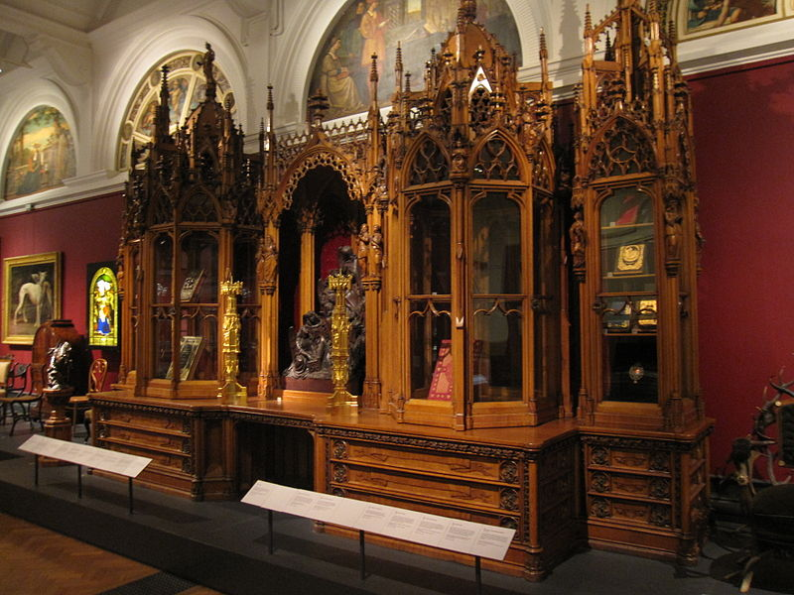
Why Model at All?
If you are hammering together a simple bookcase with a few pieces of wood and a handful of nails, you may not need to spend much time on design.
Imagine building this one without a plan.
The Leistler Bookcase took over a year to build, and was shown off at the Great Exhibition in London (1851) as a demonstration of the “wonders of industry”.
By Gryffindor (Own work) [CC BY-SA 3.0]

Slide 30
Lecture 9: Use Case Diagrams
Learning Goals
Define and distinguish between User Stories and Use Cases
Describe a set of use-cases and use-case scenarios given an application
Give examples of use-cases for a given system
Draw a Use Case Diagram for a system
Differentiate between include, generalize, and extend relationships

Slide 31
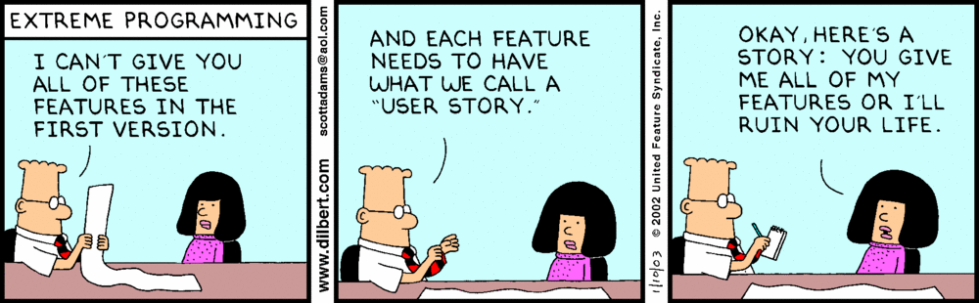
User Stories
User Story: “As a <role>, I want to be able to <some goal> so that <some reason>”
http://dilbert.com/
Often used in the planning stage, each “story” describing one feature of the software.

Slide 32
Use Cases: Library System
Library Use cases
Checking out a book for loan.
Checking in a returned book.
Checking if a book is in stock and where to find it.
Reserving a book that is currently out on loan.
Dealing with payment of overdue fines.
Adding new members to the library.
Deleting old members from the library.
Dealing with changes of members details e.g. name address etc.

Slide 33
Use Case Scenarios
Often documented using structured pseudo-code, but keep it simple, unambiguous and clear to others.
Start of Primary scenario/transaction
The user inserts their ID card into the system.
The system reads the magnetic strip from the card.
If the system cannot read the card then <<Scenario 1>>
The system contacts the banks central computer to request the PIN number for the card and their account details.
If bank central computer cannot access users account then <<Scenario 2>>
The system prompts the user for their PIN.
The user enters their PIN.
If PIN cannot be authenticated <<Scenario 3>>
The user is prompted for the amount of the withdrawal.
The user enters the amount of withdrawal.
The system checks with the banks central computer
If the user has insufficient funds <<Scenario 4>>
The cash is dispensed and the customer’s account at the Bank Central Computer is debited with the withdrawal amount.
The card is returned to the user and a receipt issued.
End-Of-Transaction
Scenario 1: The users card is returned. End-of-Transaction
Scenario 2: The users card is returned. End-of-Transaction
Scenario 3: The user is given two more attempts to enter a correct PIN. If this fails the card is kept and the transaction ends. Otherwise
resume primary scenario.
Scenario 4: The user is given the opportunity to enter a lesser amount or cancel the transaction. If cancel is chosen, the card is returned and
the transaction ends. If the lesser amount is acceptable then resume primary scenario.

Slide 34
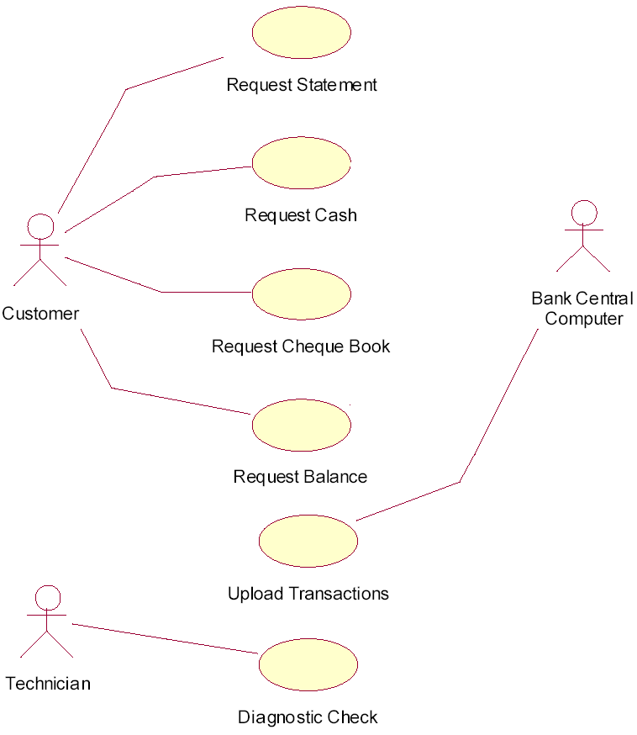
Use Case Diagrams
Withdraw Cash
There may be multiple primary actors in your system.
e.g. the Bank’s Central Computer requests all transactions be uploaded, or a technician runs a diagnostics check

Slide 35
Lecture 11 – Class Diagrams
Learning Goals
Create a basic class diagram with attributes and operations
Convert a class diagram to code
Describe the three types of class relationships
Draw associations between classes, complete with multiplicities and roles
Describe the difference between aggregation and composition, and the impliciations when writing code
Define an interface and contrast with a base class
Given a system, draw a class diagram to describe all the relationships

Slide 36
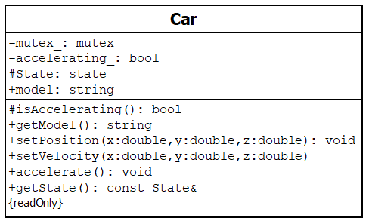
Class Diagrams
Give an overview of the classes that need to be created, including important member variables and functions, and the relationships between classes.
Class Name
Attributes (display optional)
Accessibility Indicator: ‘+’ means public ‘-’ means private
‘#’ means protected
Operations (display optional)
Properties
Function parameters and types
Return type

Slide 37
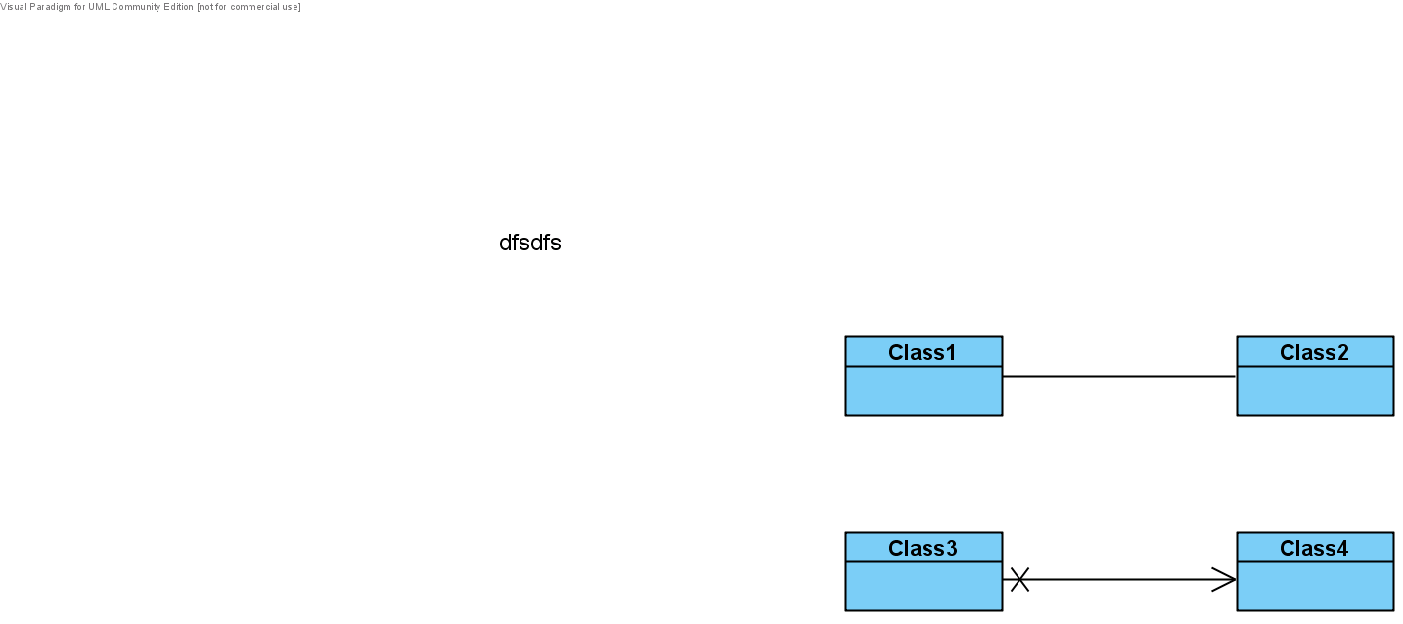
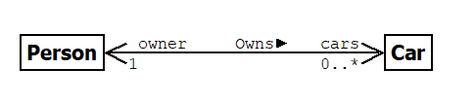
Class Associations
Bidirectional:
optional
Unidirectional:
Associations imply that one class has the ability to send messages to another. This may be through a member variable, or through a member function.
role (attribute name)
label
multiplicity

Slide 38
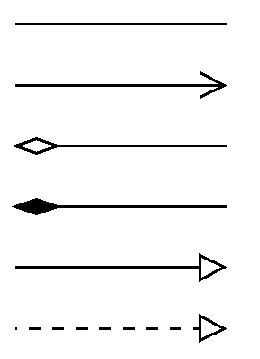
Class Diagrams Summary

Slide 39
Lecture 13 – Sequence Diagrams
Learning Goals
Describe the purpose of sequence diagrams
Identify the components of a sequence diagram
Discuss differences between sequence diagrams used during the analysis phase vs design phase
Draw a sequence diagram for a given use case scenario
Include loops and conditionals in a sequence diagram
Convert a sequence diagram into a class diagram

Slide 40
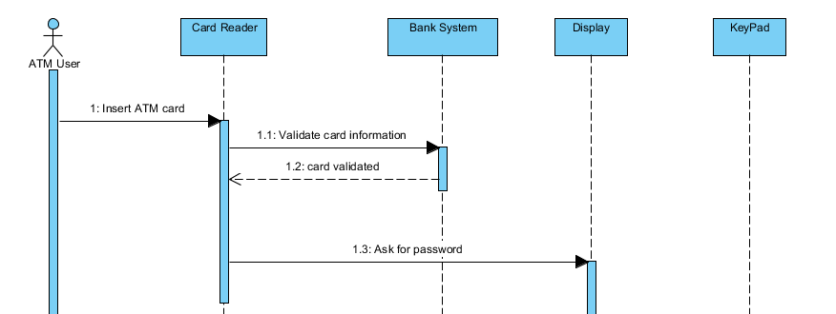
Sequence Diagrams
Sequence diagrams capture the step-by-step sequence of events in a single use-case scenario. They should capture the essense of user-interaction and document the response for interesting scenarios, involve only major objects/actors.
Participants (objects, actors, roles)
Initiating Actor
Lifeline
Message
Time
Return
Activation

Slide 41
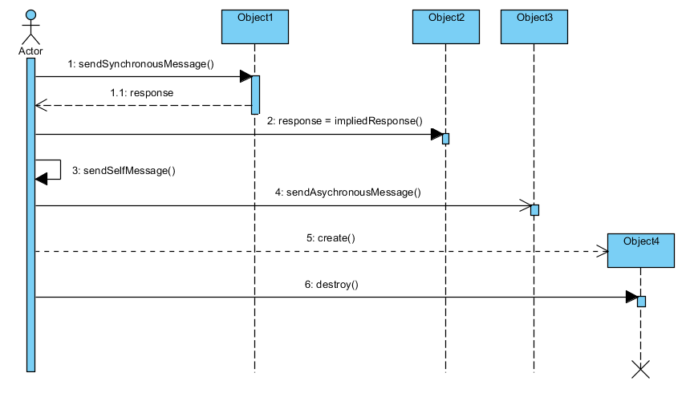
Sequence Diagrams: Message Types
End of Life

Slide 42
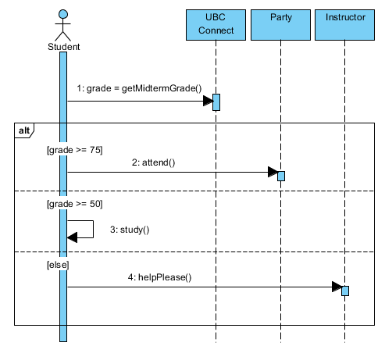
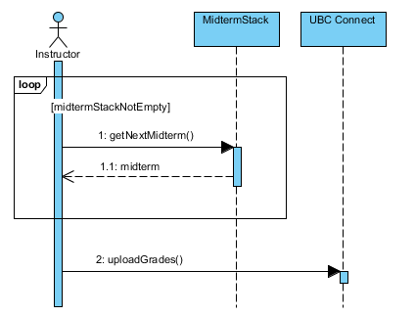
Sequence Diagrams: Decisions/Iterations

Slide 43
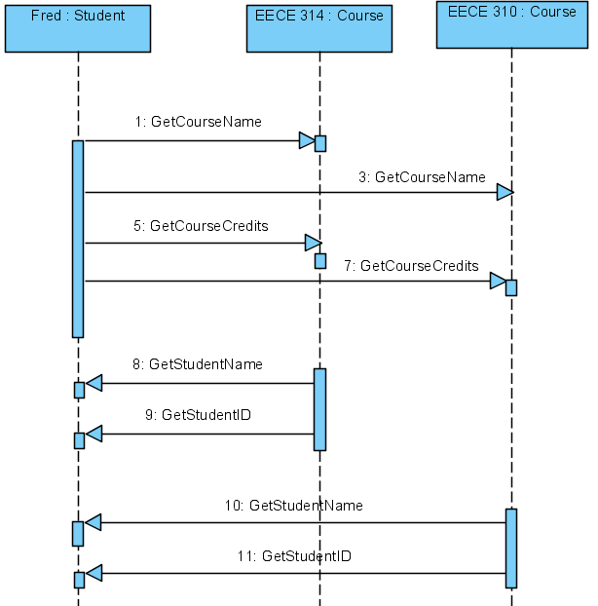
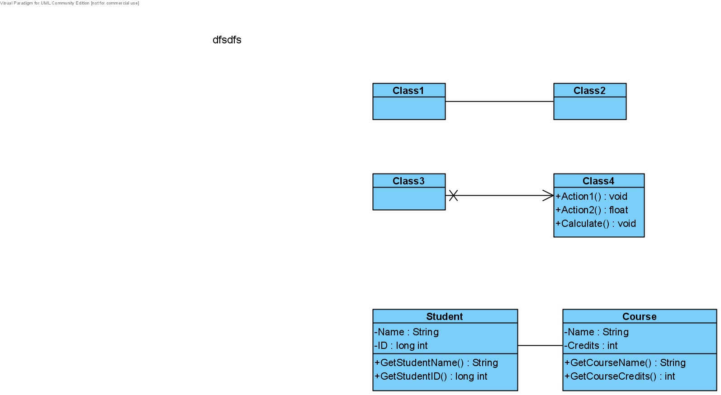
Sequence Diagram to Class Diagram
Section from a Sequence Diagram
Maps to this Class Diagram
2
class Student {
Course *course1 ; // points at runtime to EECE314
Course *course2 ; // points at runtime to EECE310
. . .
} ;
class Course {
Student *theStudent ; // points to ‘fred’ at runtime
. . .
} ;

Slide 44
Lecture 15 – Communication Diagrams
Learning Goals
Describe the difference between a sequence diagram and communication diagram
Given a use-case scenario, sketch out an object interaction diagram
Given a systems problem description, sketch out a system overview diagram

Slide 45
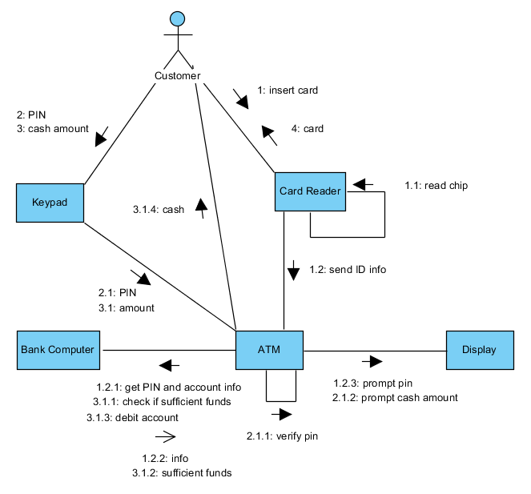
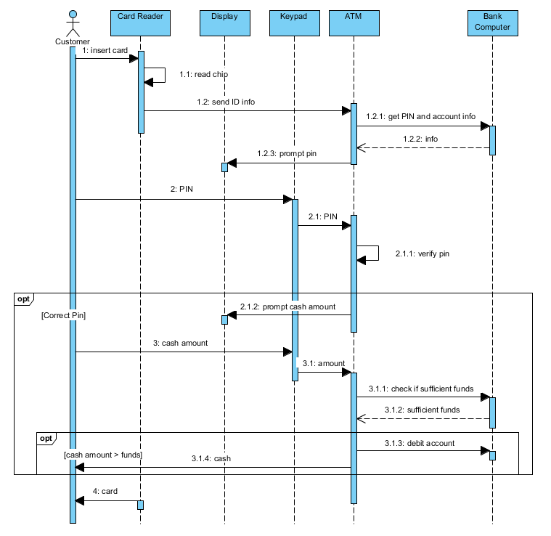
Communication Diagram
Similar to the object diagram, pictoral version of a sequence diagram.
Numbered messages go on the interaction arrows.

Slide 46
Object Interaction Diagram
Not official UML!! ➔ Anything goes!!!
Usually similar to a communication diagram, with messages removed. Use anything you like that helps make it clear what’s going on.
Customer 1
Server 1
Customer 2
Server 2
Customer 3
Chef 1
Order Queue
Chef 2
Serve Queue
...
Chef 3
...

Slide 47
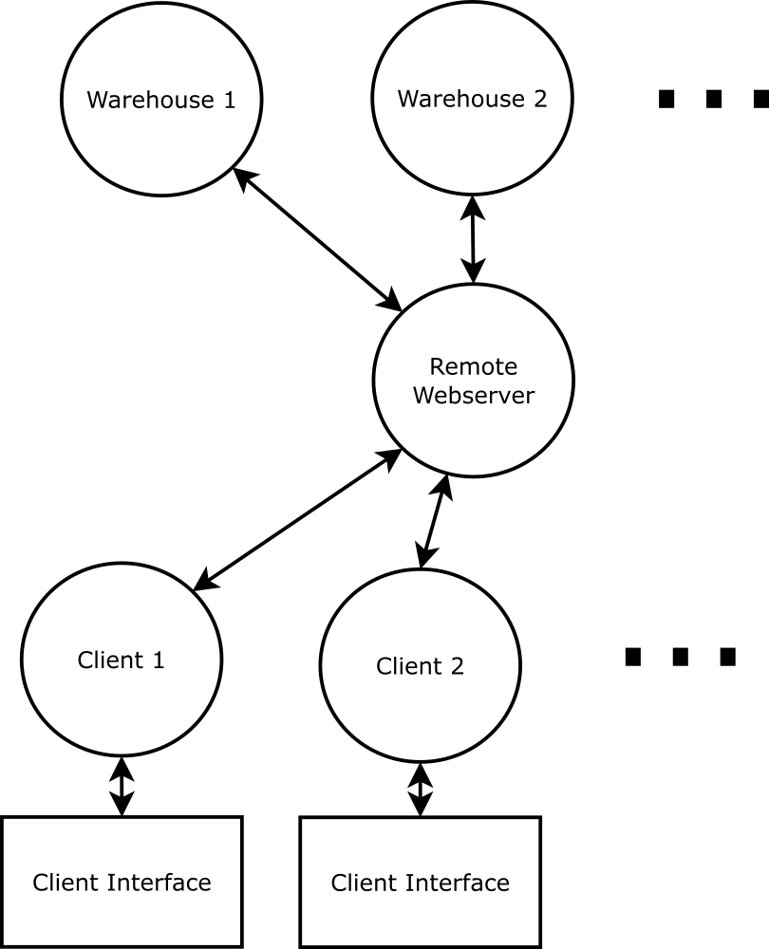
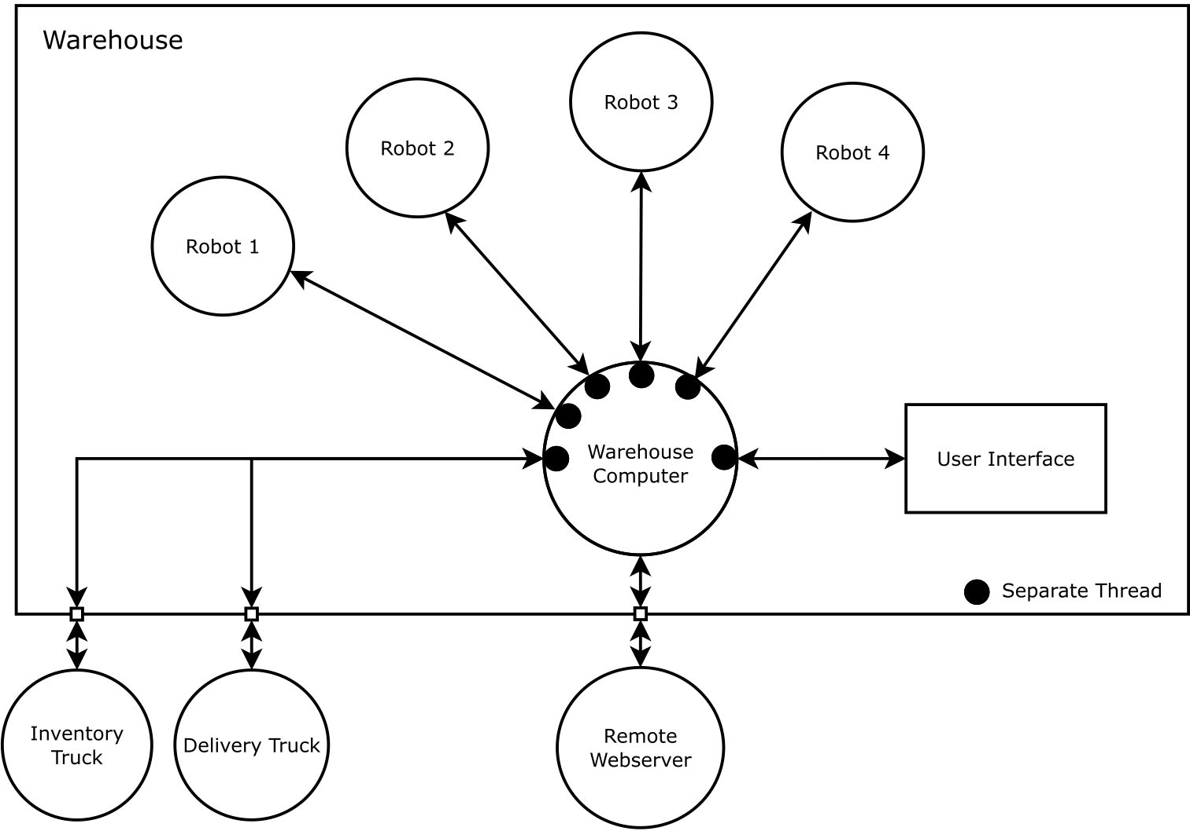
Amazoom Automated Warehouse

Slide 48
Lecture 18 – Agile Development
Learning Goals
Describe the waterfall development approach, identify drawbacks
Provide and overview of agile development
Define User Stories, Tasks, Sprints
List drawbacks of agile development
Give examples when Agile is appropriate and not appropriate for a development project

Slide 49
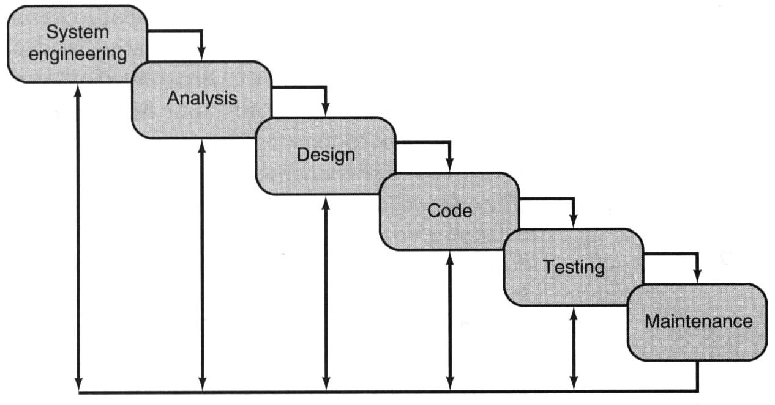
Waterfall Development
Software Life Cycle or Waterfall model of software development
This software life-cycle paradigm implies a sequential approach to software, beginning at the system level, and progressing through stages until the final product is delivered. In reality, stages get revisisted, usually leading to several iterations.

Slide 50
The Agile Manifesto
2001: a group of software developers organized to express dissatisfaction with being forced to use the waterfall model. Strong emphasis on documentation before design, contract negotiation, lack of flexibility. Formed the Agile Alliance, wrote the Agile Manifesto.
We are uncovering better ways of developing software by doing it and helping others do it. Through this work we have come to value:
Individuals and interactions over processes and tools
Working software over comprehensive documentation
Customer collaboration over contract negotiation
Responding to change over following a plan
While there is value in the things on the right, we value the things on the left more
Beck, Kent, et al, "Manifesto for Agile Software Development". Agile Alliance, 2001

Slide 51
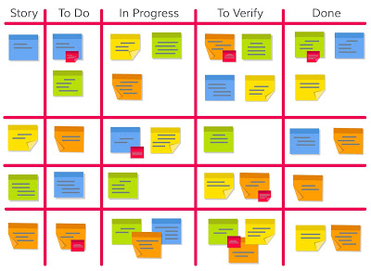
The Agile Board
Tasks are written on post-its, placed in the “To-Do” or Product Backlog column sorted by priority.
Rather than managers pushing work, developers pull work from the To-Do column, place in the “In Progress” column
When task is ready to be tested, it moves to the next column…
Can add as many columns as necessary
http://www.techno-pm.com/2017/05/scrum-board-example.html

Slide 52
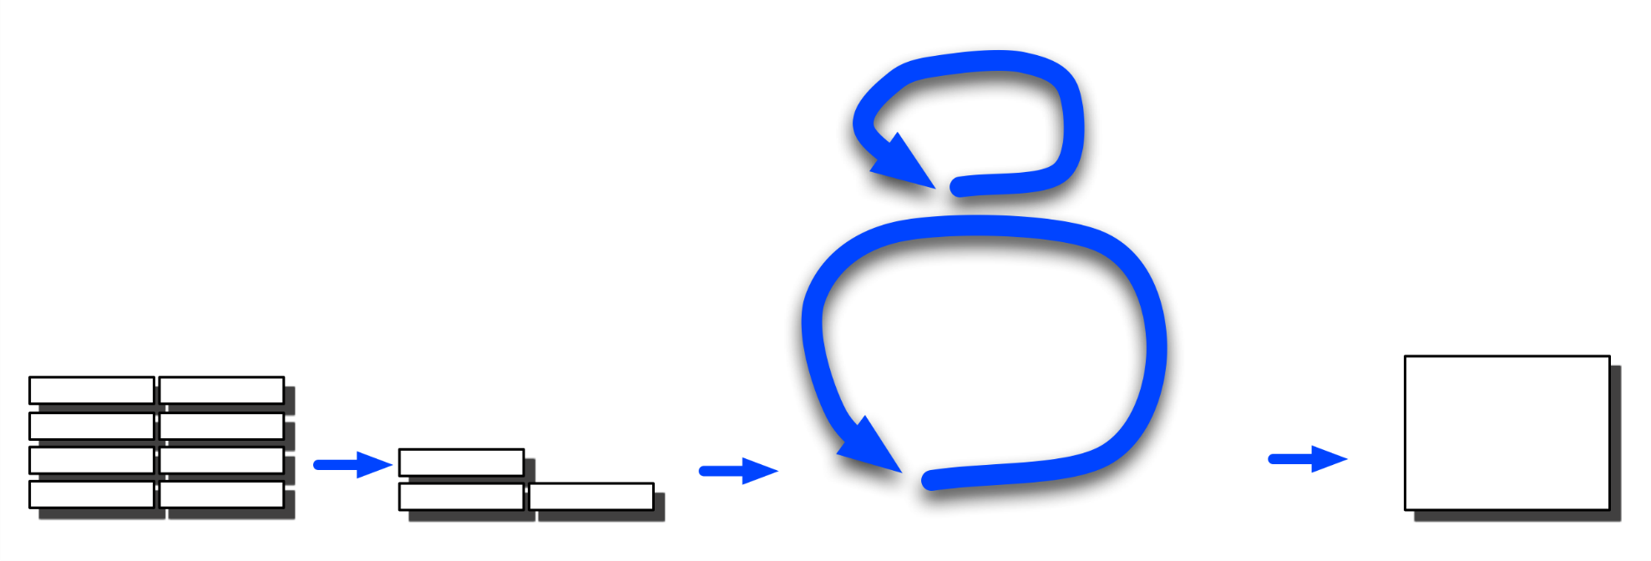
User Story: Proposed by Stake holders, customers etc. Written in the form of
“As a (my role) I want the system to be able to do (task) so that (benefit)”
Scrum Illustration
Daily scrum: What have I done? What am I doing?
What is holding me up?
List of product features (User Stories) yet to be implemented
1 day
1-3 Week Sprint (retrospective meeting)
Product
backlog
Release
backlog
Sprint: Design, test and release next version/iteration
“Shippable”
Product
Increment with latest features
Prioritised list of features, broken down into tasks and estimates of time

Slide 53
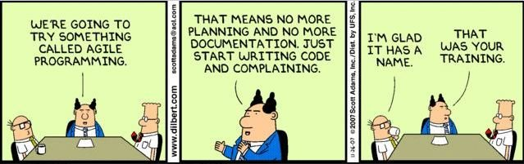
Drawbacks of Agile
Agile development works well for some projects especially when requirements, technology are not well understood or are changing.
It’s main criticism is that project management is often non-existent, and that the only documentation is the Source code itself.
It is also dependent on the idea that : “the software will be ready when it’s ready”.

Slide 54
Lecture 12 – Semaphores
Learning Goals
Describe a semaphore and distinguish from a mutex
Give examples of applications of semaphores
Use semaphores for process/thread synchronization with the help of the course library
Design and implement the solution to the roller coaster problem

Slide 55
Semaphores
S.Wait() To Gain Entry
A
D
C
C
B
B
D
A
Blocked
Resource
Resource
Semaphore ‘S’ Protecting Resource
Access
A
D
C
B
S.Notify () to Leave
S = 1: Resource is FREE
S = 0: Resource is BUSY
Note Resource Stays Busy (S=0) when a thread leaves and there was one waiting
Resource Becomes Free when a thread leaves and there are no more waiting outside

Slide 56

Roller Coaster
Decremented
Unchanged as Charlie is waiting
Incremented
Entry=2
Entry=1
Entry=0
Wait()
Exit=0
Charlie Blocked Trying to Get On
Charlie Blocked Trying to Get On
Wait()
Wait()
Charlie Blocked Trying to Get Off
Charlie Free to get off
Notify()
Wait()
Notify()
Notify()
Wait()
Notify()
x 2
Wait()
Empty=2
Decremented
Full=0
Empty=1
Notify()
Empty=0
Incremented
Coaster Free to Ride
Coaster Blocked trying to Ride
Unchanged as Coaster is waiting

Slide 57
Lecture 14 – Condition Variables
Learning Goals
Distinguish between events and conditions
Describe the function of a condition variable and how it can be used to implement events and conditions
Describe the issue of spurious wakeups, and how we can deal with them for events and conditions
Use condition variables to solve a synchronization task, both within a single process and between multiple processes

Slide 58
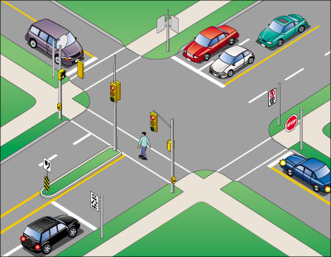
Traffic Light Control System
Cars wait until light turns green, future cars continue if still green
Pedestrian light waits until button pressed,
future light changes will wait until button pressed again.
Pedestrains wait until walk sign turns on,
future pedestrians continue if still on

Slide 59
C++11 Condition Variables
std::mutex mutex; std::condition_variable cv; bool ready = false;
Event
Condition
{ // wait for condition notification std::unique_lock<decltype(mutex)> lock(mutex);
// only wait if condition not set while (!ready) {
cv.wait(lock); } }
{ // wait for event notification std::unique_lock<decltype(mutex)> lock(mutex); cv.wait(lock); }
wait
{ // modify condition state
std::lock_guard<decltype(mutex)> guard(mutex); ready = true; } // notify waiting threads of change cv.notify_all();
notify
// wake up all waiting threads cv.notify_all();

Slide 60
Spurious Wakeups
void wait() { std::unique_lock<std::mutex> lock(mutex); ++waiting;
if (all) { ++release; } cv.wait(lock, [&](){return release != 0;}); --release;
if (release == 0) { all = false; } --waiting; }
Condition Variable
N
release one
waiting: 0
all: false
release: 0
release all
2
1
3
true
wait()
notify_all()
2
notify_one()
1
3
A
B
C
D

Slide 61
Lecture 16 – Producers and Consumers
Learning Goals
Describe the producer-consumer pattern for distributing work between threads
Solve the producer-consumer problem using semaphores and/or condition variables
Implement various types of thread-safe queues and identify when each should be applied
Describe the generator pattern and when it applies
Given a problem description, identify and justify the optimal approach for distributing work between threads/processes

Slide 62
Producer-Consumer Pattern
Producers: add work to a shared thread-safe queue
Consumers: remove work from a shared thread-safe queue
All synchronization is handled internally by the queue.
Queue supports two operations:
push(…) adds an item
pop(…) removes an item
Producer
Consumer
Queue
Producer
Consumer
Producer
...
Consumer

Slide 63
Producer-Consumer Problem
Solution #1: Semaphores
psem
1
0
wait()
notify()
Produce:
psem.wait()
push(data)
csem.notify()
Consume:
csem.wait()
data = pop()
psem.notify()
Producer
Empty
Consumer
data
Full
data
notify()
wait()
0
1
csem

Slide 64
Circular Buffer
Buffer Top
Materials:
index for read offset cidx(0)
index for write offset pidx(0)
mutex for read offset cmut
mutex for write offset pmut
semaphore for reading csem(0)
semaphore for writing psem(N)
Pointer to Writing Position
Pointer to Reading Position
Buffer Bottom
Methods:
Produce:
psem.wait() // wait for empty slot
pmut.lock() // grab index under lock
idx = pidx;
pidx = (pidx+1)%N
push(data) // produce
pmut.unlock()
csem.notify() // one more item avail.
Consume:
csem.wait() // wait for item
cmut.lock() // grab index under lock
idx = cidx;
cidx = (cidx+1)%N
data = pop() // consume
cmut.unlock()
psem.notify() // one more empty slot

Slide 65
Dynamic Producer-Consumer Queue
Internal dynamic queue, protected by mutual exclusion
One condition variable for consumers to wait while queue is empty
Produce:
mutex.lock()
queue.push(data)
mutex.unlock()
cv.notify_one()
Producer
Consumer
Queue
Producer
Consumer
Consume:
mutex.lock()
cv.wait( !queue.empty() )
data = queue.pop()
mutex.unlock()
Producer
...
Consumer

Slide 66
Generator Pattern
In cases where inputs are predictable (e.g. compute all prime numbers…), do we really need producer threads to populate a queue?
Instead, we can remove the producer side, and make the “queue” itself generate the next item.
Consumer
Generator
Consumer
generator.yield()
or next() or emit() or get() or pop()
...
Consumer

Slide 67
Lecture 17 – Deadlock and Starvation
Learning Goals
Define the terms deadlock, livelock and starvation
Give an example that causes deadlock
List the four conditions that are necessary for deadlock to occur
Given a problem description, draw a resource allocation graph
Given a resource allocation graph, determine if a system is in deadlock
Describe the four methods of dealing with deadlock
Describe the Banker’s Algorithm for avoiding deadlock with multiple shared resources
Identify whether a given state is safe or unsafe according to the Banker’s Algorithm

Slide 68
Resource Allocation Graph
We can try to detect when a deadlock is about to occur using a resource allocation graph:
R₁
R₃
Resources drawn as a box
Dots indicate number available
Circles represent processes
Arrow from process to resource indicates request
Arrow from resource dot to process indicates assignment
P₁
P₂
P₃
R₂
R₄

Slide 69
Dealing with Deadlocks
In general, there are four solutions:
Ignorance: ignore the problem altogether.
Avoidance: anticipate the deadlock and avoid it by carefully allocating the resources during program design.
Detection and Recovery: acknowledge that deadlocks can occur outside of your control. Detect when they happen and take action to recover.
Prevention: employ resource allocation algorithms at run-time to make sure that the system never gets into a situation where deadlock can arise.

Slide 70

The Dining Philosophers Problem
A group of 6 philosophers are sitting around a dining table containing 6 bowls of rice and 6 chopsticks.
Each philosopher alternates between eating and thinking. They have access to two chopsticks: one on their left, and one on their right.
To eat, the philosopher needs to pick up two chopsticks one-at-a-time. To think, they put down the chopsticks one-at-a-time.
How should they proceed?

Slide 71
Granted as this leaves $8k and requester A could ask for $4k more to complete loan then return it (i.e. a safe state)
Granted as this leaves $6k and requester B can ask for $3k more to complete loan and return it
Granted as this leaves $3k and requester C can ask for $1k more to complete loan and return it
Has
Max
Has
Max
Has
Max
Starting point, bank can lend each customer their full agreed amount
A | 0 | 6
B | 0 | 5
C | 0 | 4
D | 0 | 7
Request $2k
A | 2 | 6
B | 0 | 5
C | 0 | 4
D | 0 | 7
A | 2 | 6
B | 2 | 5
C | 0 | 4
D | 0 | 7
Request $2k
Request $3k
Free $10k
Free $8k
Free $6k
Has
Max
Has
Max
Has
Max
Has
Max
Has
Max
A | 2 | 6
B | 2 | 5
C | 3 | 4
D | 0 | 7
Request $3k
A | 2 | 6
B | 2 | 5
C | 3 | 4
D | 0 | 7
Request $2k
A | 4 | 6
B | 2 | 5
C | 3 | 4
D | 0 | 7
A | 4 | 6
B | 2 | 5
C | 4 | 4
D | 0 | 7
A | 4 | 6
B | 2 | 5
C | 0 | 4
D | 0 | 7
Request $1k
RELEASE $4k
Request $3k
Free $3k
Free $3k
Free $1k
Free $0k
Free $4k
Both temporarily refused (in any order) as this would not leave the bank with enough money to satify anyone’s order (i.e. it would be in an unsafe state).
Granted as still in safe state, e.g.:
C requests 1, releases 4
B requests 3, releases 5
A requests 2, releases 6
D requests 7, releases 7
Granted as C now has it’s full entitlement and could return it
Who would be allowed to borrow money now?

Slide 72
The Banker’s Algorithm
R₀
R₁
R₂
Has
Max
Has
Max
Has
Max
B borrows (1,1,0), pays back (2,2,0) – Free: (2,3,2)
A borrows (2,2,1), pays back (3,2,2) – Free: (3,3,3)
C borrows (1,1,2), pays back (2,2,2) – Free: (4,4,3)
D borrows (4,4,3), pays back (4,4,4) – Free: (4,4,4)
A | 1 | 3 | 0 | 2 | 1 | 2
B | 1 | 2 | 1 | 2 | 0 | 0
C | 1 | 2 | 1 | 2 | 0 | 2
D | 0 | 4 | 0 | 4 | 1 | 4
Free: 1
Free: 2
Free: 2
Is this a safe state?
Limitations of Banker’s Algorithm:
Requires a central authority granting resources. Being denied resources when they are available could lead to inefficiencies at the cost of only potential deadlock.

Slide 73
Lecture 19 – Scheduling
Learning Goals
Describe how priorities affect thread execution
Describe and give an example of priority inversion
Discuss the factors involved in real-time scheduling
Given a set of tasks, determine if it is possible to schedule them so that all deadlines are met using a time-line graph
Apply the conditions of Liu and Layland to determine analytically if real-time scheduling is possible
Describe rate-monotonic sequencing, and use it to schedule a given set of tasks

Slide 74
Priority Inversion
This thread pre-emption can introduce an issue known as priority inversion.
Imagine a low priority task that has acquired some non-sharable resource (i.e. has acquired a mutex lock)
A high priority task comes along and tries to wait for the resource to become free (it is blocked, and can’t steal the resource from the low-priority task)
A medium priority task comes along and pre-empts the low priority task.
mutex
low priority
pre-empt
Medium priority task is indirectly blocking execution of higher priority, even though their actions are independent (no shared resources)
med priority
pre-empt
high priority
wait

Slide 75
Real-Time Scheduling
Period: time between successive triggering of the task
Deadline: maximum time available to complete execution (i.e. produce a response)
Compute time: (maximum) CPU time required to generate the response
Compute time of C = 5ms
Deadline of ‘C’ = 40ms
Deadline of ‘C’ = 40ms
c1
c2
c3
compute time <= deadline
deadline <= period (usually)
Period of ‘C’ = 50ms
Period of ‘C’ = 50ms
0
10
20
30
40
50
60
70
80
90
100
110
120
Time ms
A Periodic Task ‘C’ being triggered 3 times, once every 50 ms each with a deadline time of 40ms and compute time of 5ms

Slide 76
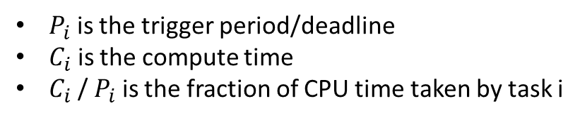
Real-Time Scheduling
Liu and Layland (1973) show that a set of M tasks will definitely not meet their deadlines if
$$\sum_{i=1}^{M}{\frac{C_{i}}{P_{i}}}>1$$
If the CPU utilisation is > 100%, tasks will not meet their deadline i.e. they will fail at some time
$P_{i}$ is the trigger period/deadline
$C_{i}$ is the compute time
$C_{i}$ / $P_{i}$ is the fraction of CPU time taken by task i
The above expression does not guarantee they will succeed if <= 1. In that case we have to analyse the task set further to determine if they will meet their deadlines in practice.

Slide 77
Real-Time Scheduling
An assignment that takes 1 day to complete every 5 days.
An assignment that takes 1.5 days to complete every 4 days.
An assignment that takes 1 day to complete every 3 days.
1/5 + 3/8 + 1/3 = 90.83%
Possibility of success
Liu and Layland wend further: if the tasks are scheduled on the basis of shorter deadline first, then it IS guaranteed that tasks will meet their deadlines if
$$\sum_{i=1}^{M}{\frac{C_{i}}{P_{i}}}≤M\left(2^{1/M}−1\right)$$
3$\left(2^{1/3}−1\right)=77.97\%<90.83\%$
☹ must draw graph for 60 days
If CPU utilization is between the range: $M\left(2^{1/M}−1\right)< \sum_{i=1}^{M}{\frac{C_{i}}{P_{i}}} ≤1$
then we must draw a time-line graph.

Slide 78
Real-Time Scheduling
Task A with compute time 5 ms, period 20 ms
Task B with compute time 10 ms, period 30 ms
Task C with compute time 10 ms, period 40 ms
$83.3\%$ CPU Utilization
A
A1
A2
A3
A4
A5
A6
B
B1
B2
B3
B4
C
C1
C2
C3
RMS
A1
B1
C1
A2
C1
B2
A3
C2
A4
B3
A5
C3
B4
A6
C3
0
20
40
60
80
100
120

Slide 79
Lecture 20 – Readers and Writers
Learning Goals
Describe the readers-writers problem, and the concept of a shared lock
Give a real-world example where shared locks should be applied
Develop pseudo-code for a shared lock implementation and argue how and why it works
Differentiate between read-priority, write-priority, and fair-priority shared locks, and list the advantages and disadvantages/pitfalls of each
Describe the Read-Copy-Update pattern, and how it differs from shared locks
Give a real-world example where RCU should be applied
Outline pseudo-code for implementing RCU for a given application

Slide 80
Reader Performs S.lock_shared() to Gain Entry
No Writers Present: Reader Permitted to Enter
E
E
B
B
A
A
Reader Blocked by Writer
Reader Process Performs S.unlock_shared() to Leave
Resource
Resource
E
B
A
Reading
Shared Mutex ‘S’ Protecting Resource
Writer Process Performs S.unlock() to Leave
C
Writing
D
Writer Process Executes S.lock() to Gain Entry
C
C
D
D
Blocked by Reader
Writer Blocked by other Writer
Writer gains Entry
Writer gains Entry because no more Readers accessing resource
Resource is BUSY to Writer Threads but Open to Reader Threads
Resource is BUSY to Reader and Writer Threads
Resource is FREE to Both Readers and Writers

Slide 81
Shared Locks Summary
Shared locks allow multiple “readers” simultaneous access to a resource.
To gain exclusive access, we must wait until there are no other current accesses.
When both potential readers and writers are waiting for access, we can prefer to give priority to one class, or try to balance between the two:
read-preferred locks give priority to waiting readers
write-preferred locks give priority to waiting writers
fair locks try to balance the two
If a resource is locked with exclusive (write) access, this blocks out all others.

Slide 82
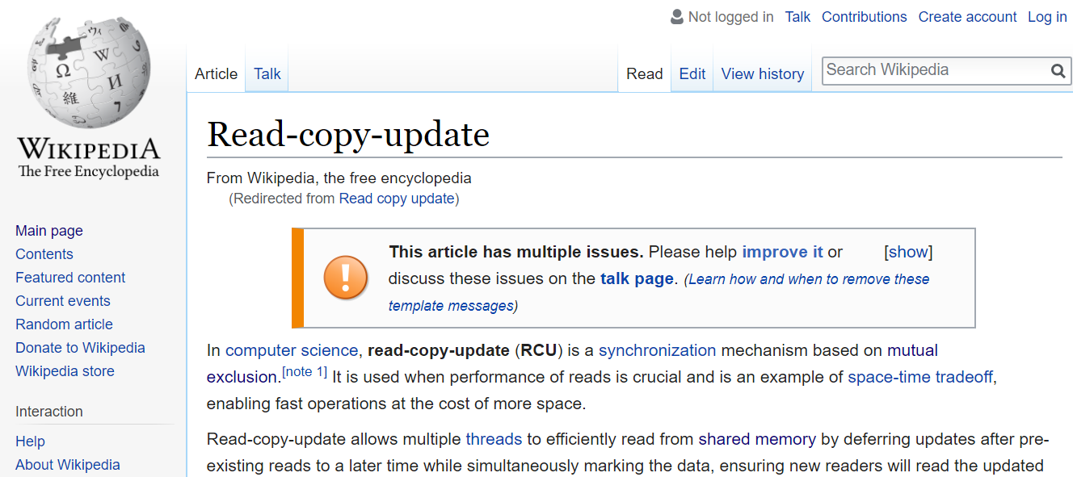
Shared Locks are great, but…
Imagine if Wikipedia worked this way…

Slide 83
Read-Copy-Update
ptr
ptr
ptr
Resource
W1
R2
R3
R1
R4
ptr
Copy
nptr
modify
nptr

Slide 84

Warner Bros.

