Slide 1
Lecture 2: Introduction to Concurrency
Learning Goals
Describe the differences between single-tasking and multi-tasking
Identify challenges introduced by adding concurrency
Describe an example of a multitasking system (perhaps with a diagram)
Identify whether or not a program will benefit from concurrency, either in terms of efficiency or scalability
Describe various methods of implementing multitasking, and list some advantages/disadvantages of each
Define and describe time-slicing and how it differs from pseudo-multitasking
©Paul Davies, C. Antonio Sanchez. Not to be copied, used, or revised without explicit written permission from the copyright owner.

Slide 2
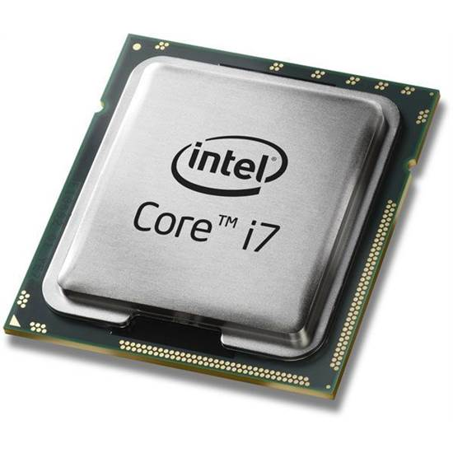
Single-Task vs Multi-Task
Single Tasking: a single program (thread) that runs sequentially
#include <iostream> int main() { for (int i=0; i<10; ++i) { std::cout << i << std::endl; } return 0; }
55 push %rbp
48 89 e5 mov %rsp,%rbp
48 83 ec 10 sub $0x10,%rsp
c7 45 fc 00 00 00 00 movl $0x0,-0x4(%rbp)
83 7d fc 09 cmpl $0x9,-0x4(%rbp)
7f 22 jg 40084d <main+0x37>
8b 45 fc mov -0x4(%rbp),%eax
89 c6 mov %eax,%esi
bf 60 10 60 00 mov $0x601060,%edi
e8 66 fe ff ff callq
be 00 07 40 00 mov $0x400700,%esi
48 89 c7 mov %rax,%rdi
e8 a9 fe ff ff callq 4006f0
83 45 fc 01 addl $0x1,-0x4(%rbp)
eb d8 jmp 400825 <main+0xf>
b8 00 00 00 00 mov $0x0,%eax
c9 leaveq
c3 retq
55
48
89
e5
48
83
ec
10
fc
45
c7

Slide 3
Single-Task vs Multi-Task
Multi Tasking: sections of code can be executed in parallel
#include <thread> #include <vector> #include <iostream> void thread_fn(int idx) { std::cout << "hello thread " << idx << std::endl; } int main() { std::vector<std::thread> threads; for (int i=0; i<4; ++i) { threads.push_back( std::thread(thread_fn, i) ); } // wait for all threads to finish for (auto& thread : threads) { thread.join(); } return 0; }
thread_fn(0)
thread_fn(1)
thread_fn(2)
thread_fn(3)

Slide 4
Multi-Tasking
Advantages:
greater flexibility – system can be distributed across several servers
greater scalability – a single program can be instantiated as many times as needed
Disadvantages:
challenges in decomposing system into appropriate concurrent units
challenges in communication between parallel units
challenges in synchronization between parallel units
challenges in debugging and testing

Slide 5

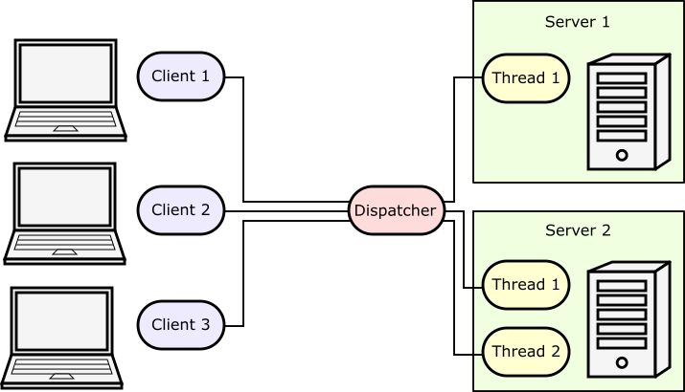

Multi-Tasking Example
60k searches per second
0.5 s to process each search

Slide 6
Multi-Tasking Woes
void increment() { int x = readMemoryValue(shared_memory_address); x = x + 1; writeMemoryValue(shared_memory_address, x); }
Thread 1:
Thread 2:
int x = readMemoryValue(shared_memory_address);
x = x + 1;
int x = readMemoryValue(shared_memory_address);
writeMemoryValue(shared_memory_address, x);
x = x + 1;
writeMemoryValue(shared_memory_address, x);

Slide 7
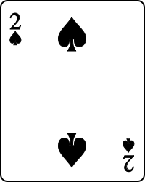
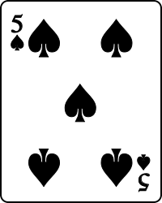
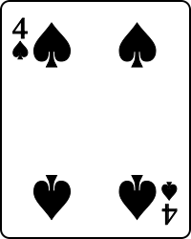
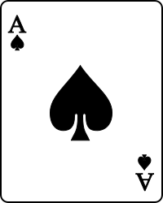
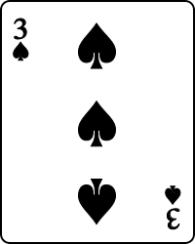
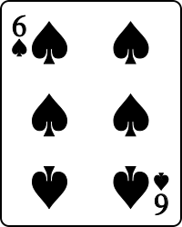
Parallel Programming
Multi-tasking has the potential to make your software faster
Parallel Programming: specialized area of concurrent programming that focuses on designing faster algorithms using concurrency.
e.g. parallel merge sort

Slide 8
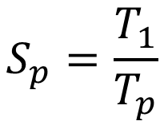
Parallel Programming
In general, speeding up code is hard.
Splitting system into parallel units introduces data dependencies
Some sections need to wait for other portions to be complete
Introduces need for synchronization, limits gains
$$S_{p}=\frac{T_{1}}{T_{p}}$$
Merge Sort: 10 s
Speed-up Factor:
Parallel Merge Sort (p=4): 7 s
Speedup: 1.4x

Slide 9
Multitasking Implementations
Pseudo-multitasking
Multiple dedicated processors/cores
Distributed systems
Time-sliced processors/cores

Slide 10
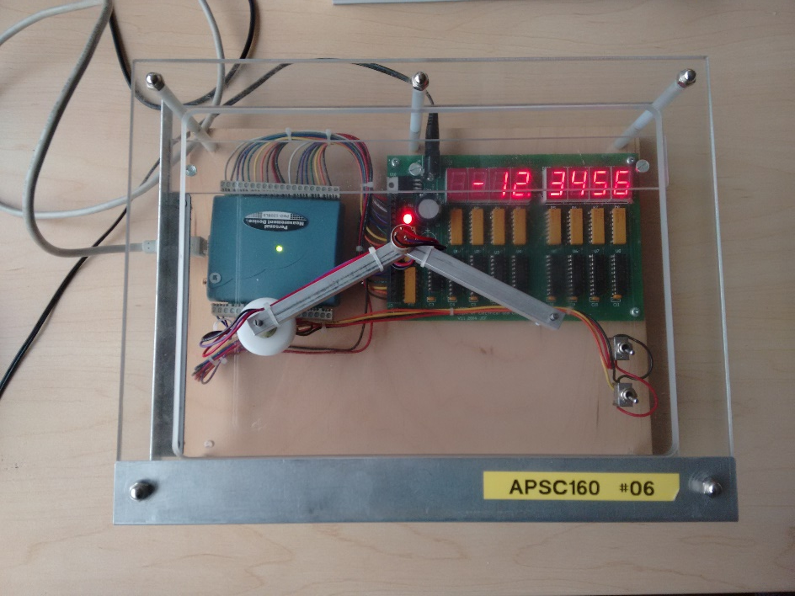
Pseudo Multitasking
Simply switch between a bunch of sequential tasks fast enough that it looks like they are running in parallel.
int main() {
// continuously cycle through set of monitors
// to give appearance of parallel operation
while ( deviceIsOn() ) {
monitorTemperature();
monitorHumidity();
monitorAtmosphericPressure();
updateDisplays();
}
return 0;
}

Slide 11
Pseudo Multitasking
Advantages:
simple to implement and debug
no knowledge of operating system required
communication and synchronization is trivial
Disadvantages:
tasks must be brief, preferably with guaranteed maximum execution times
tasks must never loop on a condition or wait for input
if a task crashes, brings down the entire system

Slide 12
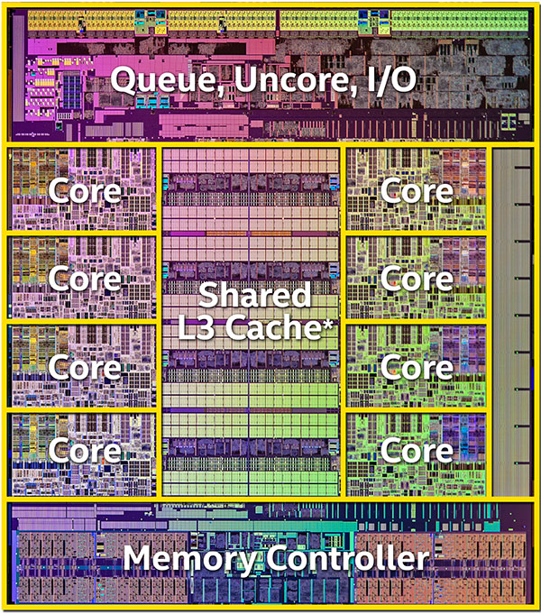
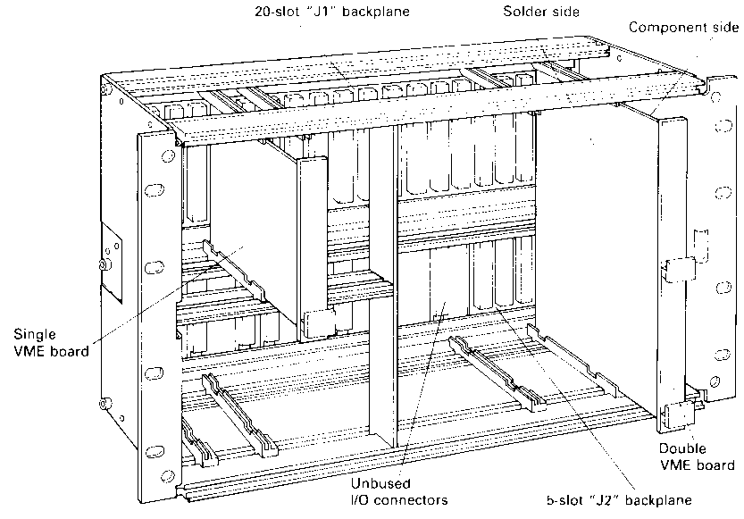
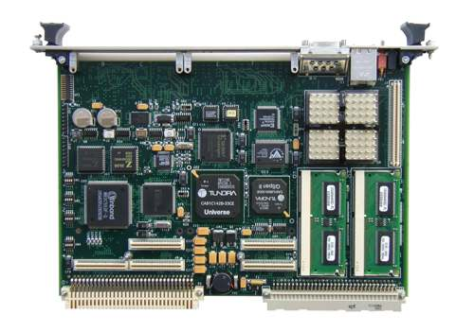
Multiple Dedicated Processors/Cores
Each processor/core is given one task to run on its own, synchronizes with others.
(2015) 8 Core I7 CPU with shared Cache and Memory controller
Custom server with shared backplane, communicate over a VMEbus

Slide 13
Multiple Dedicated Processors/Cores
Advantages:
customizable to the application
extremely high performance
Disadvantages:
highly expensive
requires complex hardware
inflexible, cannot accommodate dynamic process creation
difficult to debug

Slide 14
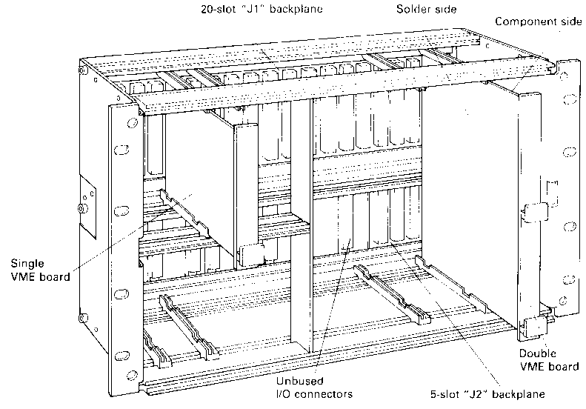
Distributed Systems
Each processor/core is given one task to run on its own, processors can be in different machines/locations and communicate over a network.
Network
Node A
Node B
Node C

Slide 15
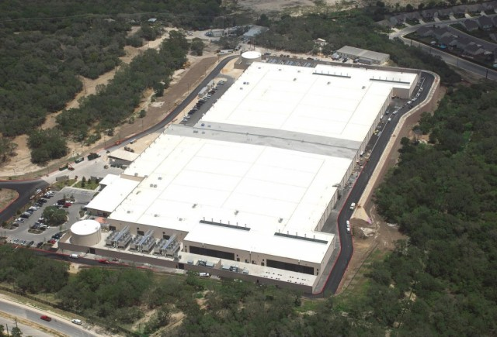
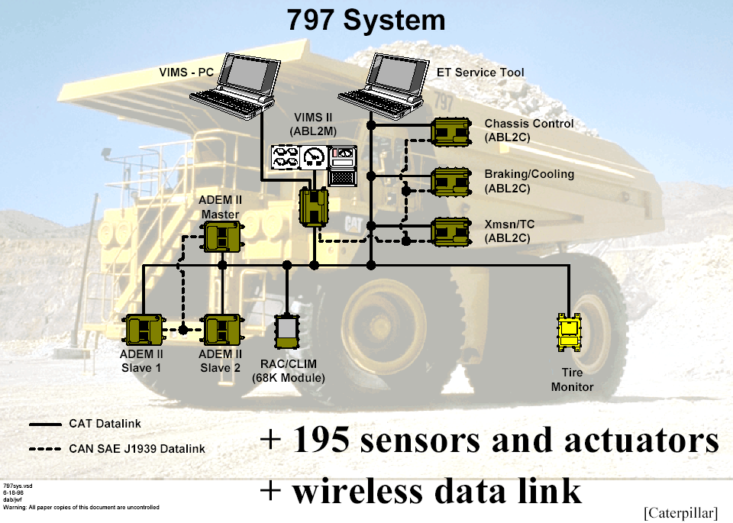
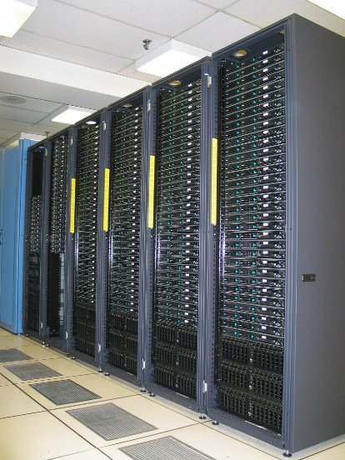
Distributed Systems
Microsoft’s data center in
San Antonio, Texas

Slide 16
Distributed Systems
Advantages:
flexibility in adding/removing resources
if one node goes down, the rest can continue and pick up the slack
Disadvantages:
network communication is slower and less reliable
complexity in design, requires redundancy in case of disconnection or errors

Slide 17
Time-Slicing
The more practical and cheaper approach, used in most systems today.
Relies on a Multi-Tasking Operating System (MTOS) in conjunction with a
time-sliced CPU/core.
processor’s computation time is divided into time-slices
OS assigns slices to programs/threads
processor swaps between programs/threads rapidly, executing one time slice after the other, sequentially

Slide 18
Time-Slicing
OS Kernel called to deal with Interrupt
Operating System Kernel
Operating System Kernel
Save State of Current Task
Restore State of Next Task
Interrupt Cleared
Real Time Clock
Real Time Clock
10ms interrupt
CPU
Kernel directs CPU to swap/resume task
List of Tasks Descriptors (1 per Process)
1
2
3
4
5
Active Process Queue
Repeat Forever

Slide 19
Time-Slicing
Advantages:
splitting of execution is handled automatically by the OS
sub-tasks no longer need to be short, can wait on conditions or for input
if one task goes down, others can still run
Disadvantages:
context switch (saving current task’s state and restoring next) adds overhead

Slide 20
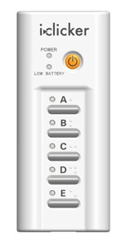
Homework:
Read Introduction to C++ lecture notes
Read Introduction to Git lecture notes
https://cpen333.github.io/
Bring or borrow an iClicker (or alternative?)
Create an ECE account for labs
https://help.ece.ubc.ca/How_To_Get_An_Account

