Slide 1
Lecture 4: Processes
Learning Goals
Describe what a process is in your own words
Describe the role of the Operating System kernel in process creation
Describe the differences between processes and threads, and list some advantages/disadvantages of each
Understand that there are differences in process creation between different operating systems (you don’t need to know how to create them on each platform)
Create a child process with the help of the course library
©Paul Davies, C. Antonio Sanchez. Not to be copied, used, or revised without explicit written permission from the copyright owner.

Slide 2
Process
A complete program, consisting of one or more threads of execution, and an environment.
Executable machine code
Allocated memory block of virtually addressable memory (stack and heap)
Operating-system-specific descriptors of resources (e.g. file descriptors, handles, data sources/sinks)
Security attributes (e.g. process owner and permissions)
A process can have child processes, which are spawned and run in parallel, each with its own environment.

Slide 3
Application/Process/Thread Decomposition
Towards Crude, single tasking systems running on 1 CPU/Core
Monolithic System
Monolithic System
No Granularity
System broken down into processes
Multi-tasking systems
Process
Process
Process
Process
Process
Process
System broken down into processes: Coarse grained or Process Granularity
Processes broken down into smaller processes
Process
Process
Process
Process
Process
Process
Smaller Processes broken down into threads
Multi-threaded systems
Processes broken down into threads: Fine grained or Thread Granularity
Thread
Thread
Thread
Thread
Thread
Thread
Threads broken down into smaller threads
Thread
Thread
Thread
Tending towards highly parallel programming with increasing data dependencies
Thread
Thread
Thread
High Granularity

Slide 4
Process Decomposition
requests
Scheduler
Scheduler
commands
Big Monolithic Single Tasking System
Big Monolithic Single Tasking System
Process Decomposition
main() { }
main() { }
main() { }
main() { }
requests
Process 1
Process 2
Process 3
Process 4
From: Single-Tasking System
To: Multi-Tasking System
What guidelines should the programmer consider when decomposing a system?
How many processes and threads should we create?

Slide 5
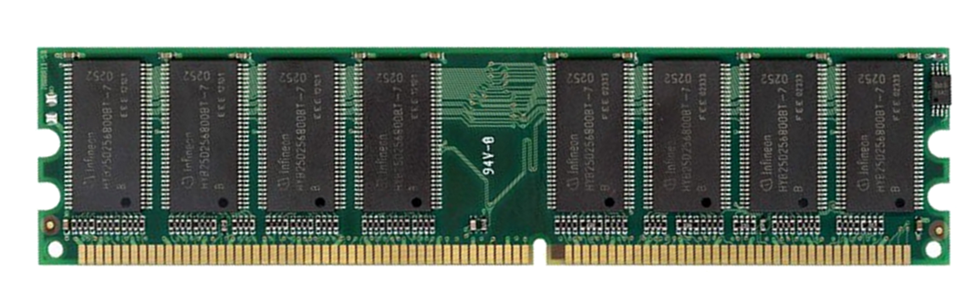
Challenges with Processes
Unlike threads within a single process, separate processes do not share address space.
Process 1 Memory:
Process 2 Memory:
0x10008000: FE 85 23 11 …
0x10008000: E5 64 32 F9 …

Slide 6
Challenges with Processes
Unlike threads within a single process, separate processes do not share address space.
Multi-tasking operating system kernel
Support for process creation
Mechanisms for inter-process communication, inter-process synchronization

Slide 7
Processes vs Threads
Advantages of Processes:
If one process fails, others continue
New process instances can be started manually, or outside of a main program
Processes can be run on separate machines
Disadvantages of Processes:
Less efficient than threads due to additional overhead (more memory, state info)
Communication/synchronization happens across process boundaries

Slide 8
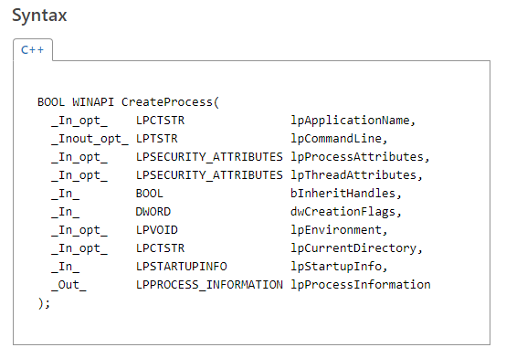
Creating Processes (Windows)
lpApplicationName needs to be full path to executable (or NULL)
lpCommandLine will search the system PATH environment variable
Needs to be non-const (is modified)

Slide 9
Creating Processes (Windows)
#include <windows.h> #include <iostream> int main() { STARTUPINFO si; PROCESS_INFORMATION pi; // initialize structures ZeroMemory( &si, sizeof(si) ); si.cb = sizeof(si); ZeroMemory( &pi, sizeof(pi) ); // create a variable string command-line const char cmd[] = "notepad.exe test.txt"; char vcmd[80]; strcpy(vcmd, cmd);
// Start the child process. CreateProcess( NULL, // No module name (use command line) vcmd, // Command line NULL, // Process handle not inheritable NULL, // Thread handle not inheritable FALSE, // Set handle inheritance to FALSE 0, // No creation flags NULL, // Use parent's environment block NULL, // Use parent's starting directory &si, // Pointer to STARTUPINFO structure &pi // Pointer to PROCESS_INFORMATION structure ); // Wait until child process exits. WaitForSingleObject( pi.hProcess, INFINITE ); // Close process and thread handles. CloseHandle( pi.hThread ); CloseHandle( pi.hProcess ); std::cout << "done" << std::endl; return 0; }

Slide 10

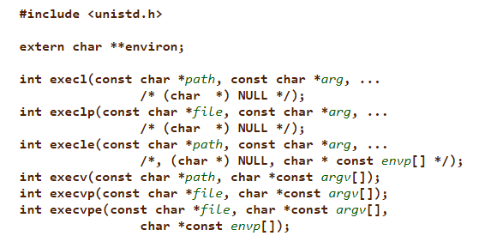
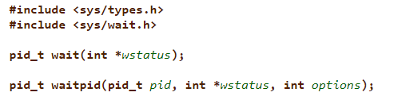
Creating Processes (OSX, Linux)
fork: creates a new process by duplicating the calling process
exec: replaces the current process with a new one
waitpid: waits for a child process to receive an event (like terminating)

Slide 11
Creating Processes (OSX, Linux)
#include <unistd.h> #include <sys/wait.h> #include <iostream> int main() { char* cmd[] = {"notepad.exe", "test.txt", NULL}; pid_t pid = fork(); if (pid == 0) { // child process execvp(cmd[0], cmd); // nothing beyond here gets executed } // wait for child process to complete int status; waitpid(pid, &status, 0); std::cout << "done" << std::endl; return 0; }

Slide 12
Creating Child Processes
Program begins here
int main() {
Statement A
Statement B
}
Scheduling
OS Kernel e.g. Windows,
Linux, OSX + Multi Core CPU
int main() {
CreateProcess( … ) ;
CreateProcess( … ) ;
CreateProcess( … ) ;
}
int main() {
Statement C
Statement D
}
Three calls to the OS Kernel requesting it to create and schedule 3 processes
int main() {
Statement E
Statement F
}

Slide 13
Library Abstractions
Calling OS kernel functions explicitly is undesirable. It ties our programs to a specific OS, making our code less portable.
Some of the details can be abstracted away, wrapped in a library that provides a consistent interface.
Child process creation, inter-process synchronization, inter-process communication is NOT part of any C++ standard.
For ease-of-use and cross-platform portability, a CPEN333-specific library is provided.
https://github.com/cpen333/library

Slide 14
Library Abstractions
Program begins here
int main() {
Statement A
Statement B
}
Scheduling
CPEN333
Library
OS Kernel e.g. Windows,
Linux, OSX + Multi Core CPU
int main() {
CreateProcess( … ) ;
CreateProcess( … ) ;
CreateProcess( … ) ;
}
int main() {
Statement C
Statement D
}
int main() {
Statement E
Statement F
}
Translation Layer

Slide 15
Creating Child Process (CPEN333 Library)
The course library introduces a subprocess class
class subprocess { public:
// Constructors
subprocess(const std::string &cmd, bool start = true, bool detached = false); subprocess(const std::vector<std::string> &exec, bool start = true, bool detached = false); bool start(); // start subprocess bool join(); // wait for subprocess to complete
bool terminate(); // force termination of process
};

Slide 16
Creating Child Process (CPEN333 Library)
#include <cpen333/process/subprocess.h> #include <iostream> int main() { cpen333::process::subprocess proc("notepad.exe test.txt"); proc.join(); std::cout << "done" << std::endl; }

Slide 17
Creating Child Process (CPEN333 Library)
#include <cpen333/process/subprocess.h> #include <vector> #include <string> #include <iostream> int main() { std::vector<std::string> exec = {"notepad.exe", "filename with spaces.txt"}; cpen333::process::subprocess proc2(exec); proc2.join(); std::cout << "done" << std::endl; }

Slide 18
Homework
Download the course library and read/compile/run the examples in:
examples/q0_basics
examples/q1_threads
examples/q2_processes
https://github.com/cpen333/library
Look up and learn about Resource acquisition is initialization (RAII)

