Slide 1
Lecture 6: Mutual Exclusion
Learning Goals
Define mutual exclusion and describe its use
Define and differentiate between an atomic operation and a critical section
Create your own mutual exclusion class from scratch using atomic operations
Create your own lock class that uses RAII principles to guarantee exception safety
Use a mutex and lock to prevent inter-thread race conditions in a code example
Use an inter-process mutex to prevent race conditions between multiple processes
Identify critical sections in a provided task or code
©Paul Davies, C. Antonio Sanchez. Not to be copied, used, or revised without explicit written permission from the copyright owner.

Slide 2
Mutual Exclusion
… neither can live while the other survives
~J.K. Rowling
Certain resources cannot be used simultaneously by two or more processes/threads without interfering with each other in a detrimental way
We require a way to limit access, so that if one process/thread is using a resource, all others are forced to wait until the resource becomes available.
Mutual Exclusion:
If any thread is accessing a resource, all others are excluded from doing so.

Slide 3
Mutual Exclusion
Hardware Resources Requiring Mutual Exclusion
Printers.
Memory
I/O devices such as
Graphics Displays
Disk Files
The OS takes care of the problem by using print spoolers, memory allocation algorithms and device drivers, windowing software (i.e. one window per process) built into the kernel to queue up accesses to the resource.
Q: How do we implement this in our own software?

Slide 4
Race Conditions
X 3
void threadinc(size_t& counter) { for (size_t i=0; i<5000000; ++i) { counter +=1; } }
Reads the current value of counter
Adds 1 to that value
Stores the new value back to counter

Slide 5
Race Conditions
CPU/Core P1
Actual ‘counter’
CPU/Core P2
Miscellaneous
Miscellaneous
Miscellaneous
0
Miscellaneous
Read value (0)
Data
0
Data
Read value (0)
Read value of a (0)
Read value of a (0)
Add 1 to value (1)
Add 1 to value (1)
Add 1 to value (1)
Add 1 to value (1)
Store back (1)
Data
1
Data
Store back (1)
Store back a (1)
Store back a (1)
Miscellaneous
Error: ‘a’ has only been incremented once instead of twice
Miscellaneous
Miscellaneous
Miscellaneous

Slide 6
Critical Section
void threadinc(size_t& counter) { for (size_t i=0; i<5000000; ++i) {
counter +=1;
} }
Critical Section: a section of code in which it is critical that the instructions not be interrupted by another thread or process.

Slide 7
Mutual Exclusion: How would you do it?
void threadinc(size_t& counter) { for (size_t i=0; i<5000000; ++i) {
... ? ...
counter += 1;
... ? ...
} }

Slide 8
Mutual Exclusion: How would you do it?
void threadinc(bool& usage_flag, size_t& counter) { // increment for (size_t i=0; i<5000000; ++i) {
// wait until not being used while (usage_flag == true) {} usage_flag = true;
counter += 1;
// let next thread use counter
usage_flag = false; } }
Protect operation with a flag?
Multiple steps:
two threads can concurrently see flag as false, then set to true

Slide 9
Mutual Exclusion: How would you do it?
CPU 1
e.g. 10nS
Think
e.g. 10nS
Address Bus
Read
Write
R/W Signal
1
0
Data In
0 (Free)
Data Out
1 (Busy)
CPU 2
e.g. 10nS
Think
e.g. 10nS
Address Bus
Read
Write
R/W Signal
1
0
Data In
0 (Free)
Data Out
1 (Busy)

Slide 10
Mutual Exclusion: How would you do it?
void threadinc(bool& usage_flag, size_t& counter) { // increment for (size_t i=0; i<5000000; ++i) {
// wait until not being used while (usage_flag == true) {} usage_flag = true;
counter += 1;
// let next thread use counter
usage_flag = false; } }
We want this to be captured in a single, uninterrupted operation

Slide 11

Atomic Operations
atomic: cannot be broken down into smaller parts
Q: Are the following atomic operations?
assigning a constant byte value
assigning a constant integer value
copying an integer value
incrementing an integer
char x = ‘x';
CC BY-SA 3.0, https://commons.wikimedia.org/w/index.php?curid=295612
int y = 10;
int z = y;
z += 1;

Slide 12
Atomic Operations in Assembly
pushq %rbp movq %rsp, %rbp movb $120, -9(%rbp) movl $10, -8(%rbp) movl -8(%rbp), %eax movl %eax, -4(%rbp)
addl $1, -4(%rbp)
nop popq %rbp ret
void is_this_atomic() {
%rbp: 64-bit stack “base” pointer
%rsp: 64-bit stack “top” pointer
%eax: 32-bit general purpose
%rax: 64-bit general purpose
%rbx: 64-bit general purpose
%rcx: 64-bit general purpose
%rdx: 64-bit general purpose
char x = 'x';
int y = 10;
int z = y;
z += 1;
}

Slide 13
Atomic Operations in Assembly
void threadinc(size_t& counter) {
pushq %rbp movq %rsp, %rbp movq %rdi, -24(%rbp)
movq $0, -8(%rbp)
.L36: cmpq $4999999, -8(%rbp) ja .L37
movq -24(%rbp), %rax movq (%rax), %rax leaq 1(%rax), %rdx movq -24(%rbp), %rax movq %rdx, (%rax)
addq $1, -8(%rbp) jmp .L36
.L37: nop popq %rbp ret
for (size_t i=0; i<5000000; ++i) {
counter += 1;
}
}

Slide 14
Atomic Operations in Assembly
.L37: movq -24(%rbp), %rax movzbl (%rax), %eax testb %al, %al je .L36 jmp .L37
.L36: movq -24(%rbp), %rax movb $1, (%rax)
while (usage_flag == true) {}
usage_flag = true;

Slide 15
Atomic Operations
atomic: cannot be broken down into smaller parts
An atomic operation is a single operation which cannot be interrupted by the real-time clock interrupt (time-slicing), or by another thread (e.g. when accessing shared memory).
CC BY-SA 3.0, https://commons.wikimedia.org/w/index.php?curid=295612
We want some way to check that our flag has been cleared and if so, simultaneously set it.

Slide 16
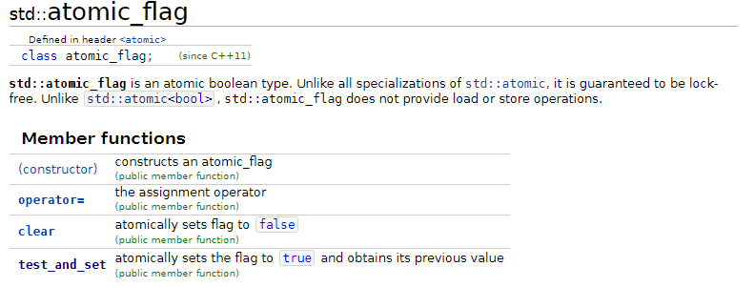
Atomic Flags in C++11
http://en.cppreference.com/w/cpp/atomic/atomic_flag

Slide 17
Atomic vs Critical Section
void threadinc(std::atomic_flag& usage_flag, size_t& counter) { // increment for (size_t i=0; i<5000000; ++i) { // wait until not being used while (usage_flag.test_and_set() == true) {}
counter += 1;
// clear to let others access counter usage_flag.clear(); } }
atomic
critical section

Slide 18
Mutual Exclusion: How would you do it?
void threadinc(std::atomic_flag& usage_flag, size_t& counter) { // increment for (size_t i=0; i<5000000; ++i) { // wait until not being used while (usage_flag.test_and_set() == true) {} counter += 1; // clear to let others access counter usage_flag.clear(); } }
lock:
unlock:

Slide 19
Spin-Lock
lock:
// wait until not being used while (usage_flag.test_and_set() == true) {} ... // clear to let others access counter usage_flag.clear();
unlock:
Notes:
Atomic flag initialization std::atomic_flag usage_flag = ATOMIC_FLAG_INIT;
Spin-wait should yield to other threads rather than loop indefinitely while (usage_flag.test_and_set() == true) { std::this_thread::yield(); }

Slide 20
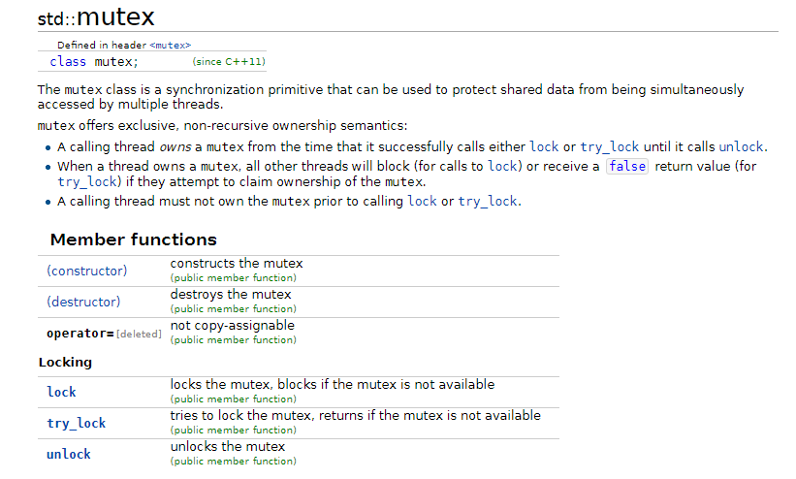
(Mut)ual (Ex)clusion
http://en.cppreference.com/w/cpp/thread/mutex

Slide 21
Mutex
void threadinc(std::mutex& mutex, size_t& counter) { // increment for (size_t i=0; i<5000000; ++i) { // wait until not being used mutex.lock() counter += 1; // clear to let others access counter mutex.unlock(); } }
lock:
unlock:

Slide 22
Mutex
Always remember to unlock, or you could lock everyone out of using a resource!!!
void threadinc(std::mutex& mutex, size_t& counter) { // increment for (size_t i=0; i<5000000; ++i) { // wait until not being used mutex.lock() counter += 1; } }
Only the thread who locks the mutex can unlock it!!!

Slide 23
Mutex: Exception Safety
#include <exception> struct TenMillionException :
public std::exception {
const char* what() const noexcept { return "ten million exception"; } };
// increments the counter by 1, throwing an
// exception at 10 million void increment(size_t& counter) { if (counter == 10000000) { throw TenMillionException(); } ++counter; }
// increments counter by 5 million in increments of 1 void threadinc(std::mutex& mutex, size_t& counter) { for (size_t i=0; i<5000000; ++i) { mutex.lock(); increment(counter); // might throw exception
mutex.unlock(); } } // catches any exception to prevent program termination void threadcatch(std::mutex& mutex, size_t& counter) { try { threadinc(mutex, counter); } catch (std::exception& ex) { std::cout << "An exception was thrown: "
<< ex.what() << std::endl; } }

Slide 24
Mutex: Exception Safety
Solution: use RAII principles, destructors guaranteed to be called!!
#include <mutex> class lock { std::mutex& mutex_; // reference to a mutex public: lock(std::mutex& mutex) : mutex_(mutex) { mutex_.lock(); // lock in constructor } ~lock() { mutex_.unlock(); // unlock in destructor } };
void threadinc(std::mutex& mutex, size_t& counter) { for (size_t i=0; i<5000000; ++i) { { lock mylock(mutex); // locks mutex counter += 1;
} // mutex guaranteed to be unlocked } }

Slide 25
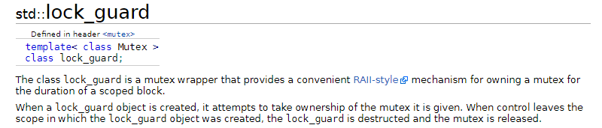
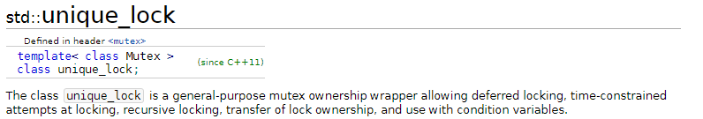
Locks

Slide 26
Locks
unique_lock:
lock_guard:
void threadinc(std::mutex& mutex, size_t& counter) { for (size_t i=0; i<2500000; ++i) { {
// locks mutex std::unique_lock<std::mutex> mylock(mutex); counter += 1;
mylock.unlock();
// ... do other stuff
mylock.lock();
counter += 1;
} // mutex guaranteed to be unlocked } }
void threadinc(std::mutex& mutex, size_t& counter) { for (size_t i=0; i<5000000; ++i) { {
// locks mutex std::lock_guard<std::mutex> mylock(mutex); counter += 1;
} // mutex guaranteed to be unlocked } }

Slide 27
Mutexes and Locks Between Processes
The current std::atomic_flag and std::mutex only work between threads in the same process.
To coordinate between separate processes, we need a mechanism to create a mutex that is accessible without needing to share the same virtual memory block.
Most operating systems provide a mutex implementation that is accessible using a name or path. If a mutex with the given name doesn’t exist, the OS kernel will create one. If a mutex with the name does exist, the OS kernel will return it so the process can share access to it.

Slide 28
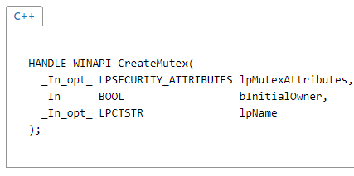
Mutexes and Locks Between Processes
Windows:
void threadinc(size_t& counter) { // connect to mutex named "windows_mutex" HANDLE mutex = CreateMutex(NULL, FALSE,
"windows_mutex"); for (int i=0; i<5000000; ++i) { WaitForSingleObject(mutex, INFINITE); // lock ++counter; ReleaseMutex(mutex); // unlock }
CloseHandle(mutex); }
https://msdn.microsoft.com/en-us/library/windows/desktop/ms682411(v=vs.85).aspx

Slide 29
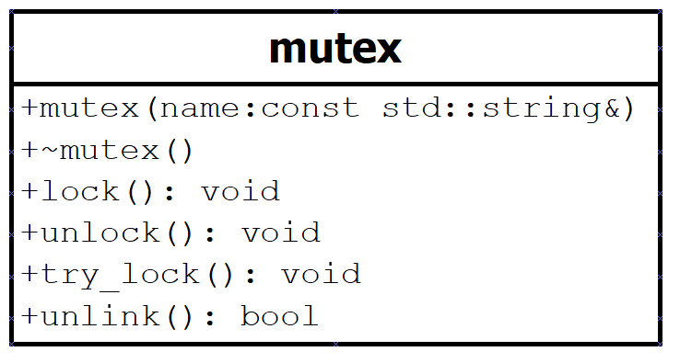
Mutexes and Locks Between Processes
CPEN333 Library:
#include <cpen333/process/mutex.h> void threadinc(size_t& counter) { // inter-process mutex cpen333::process::mutex mutex("process_mutex"); // increment for (size_t i=0; i<500000; ++i) { // locks
std::lock_guard<cpen333::process::mutex> lock(mutex);
counter += 1; } }

Slide 30
Mutexes and Locks Between Processes
Notes:
Windows mutexes have process persistence, which means they continue to exist as long as at least one process still has a reference to it
Linux/OSX mutexes have kernel persistence, which means they continue to exist until the system is rebooted.
A Linux/OSX named mutex can have the name unlinked from the mutex, meaning that future mutexes constructed using original name will create a new and unrelated mutex. This is useful for when a program terminates or crashes. On Windows, there is no concept of “unlinking” a resource name.

Slide 31
Mutexes and Locks Between Processes
In the CPEN 333 library, we provide an unlink() function to all inter-process resources, including mutexes. On Windows, this function does nothing. On Linux/OSX, it unlinks the name from the resource (e.g. mutex) so the next time the program is run, a new resource will be created.
For cross-platform portability, you should always make sure to unlink a resource when all processes are done with it, even if on Windows.
*NIX Kernel
cpen333::process::mutex mutex1("process_mutex");
cpen333::process::mutex mutex2("process_mutex");
mutex:
"process_mutex"
mutex1.unlink();
mutex:
"process_mutex"
cpen333::process::mutex mutex3("process_mutex");

Slide 32

Homework
Download the updated course library and read/compile/run the examples in:
examples/q7_mutex
https://github.com/cpen333/library
Read a tutorial on a unit testing framework (e.g. Google-Test, Catch) and try it out
Quiz 2 next week on threads, processes, mutexes

