Slide 1
Lecture 8: Introduction to UML
Learning Goals
Describe the purpose of the Unified Modelling Language (UML)
Argue why modelling is important in System Software Engineering
List several types of diagrams, and give a short description of their purpose
Outline instances where and how UML is used in practice
©Paul Davies, C. Antonio Sanchez. Not to be copied, used, or revised without explicit written permission from the copyright owner.

Slide 2
UML: Unified Modelling Language
UML is a general modelling language in software engineering to provide a standard way to visualize the design of a system.
Its main purpose is to help communicate and plan out
structure
behaviour
interactions
in a software system. This becomes essential when working on large projects, and when working in a team where everyone needs to be on the same page.

Slide 3
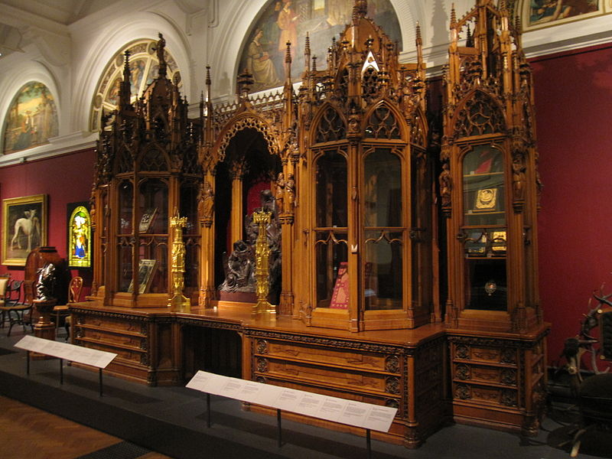
Why Model at All?
If you are hammering together a simple bookcase with a few pieces of wood and a handful of nails, you may not need to spend much time on design.
Imagine building this one without a plan.
The Leistler Bookcase took over a year to build, and was shown off at the Great Exhibition in London (1851) as a demonstration of the “wonders of industry”.
By Gryffindor (Own work) [CC BY-SA 3.0]

Slide 4
Why Model at All?
Software systems are becoming more and more complex. With the ubiquity of computers (smart phones, smart homes, smart clothing, automation), the desire for everything to be connected, and the incredible computing power available, more and more is being demanded of software engineers.
Have you ever been faced with a complex problem and had to draw something out?
How about when trying to explain something to a friend?
Diagrams allow us to decompose complex systems into simpler abstract components and visualize them. This can help us understand and better communicate the “big picture” ideas behind a system, and give us a road-map for development.

Slide 5
UML: Unified Modelling Language
Mathematicians use algebraic symbols to communicate, electrical engineers have circuit notation, software engineers have evolved their own notation for describing the architecture and behaviour of software systems.
UML, the Unified Modelling Language, is that standardized language. It has syntax and semantics to convey meaning, allowing two people fluent in that language to communicate and understand the intention of the other.
There are a set of 13 essentially graphical notations, supplemented by text, designed to capture requirements and design alternatives. You don’t always need all 13 diagrams; you choose the ones that capture important information about the system you are working on.

Slide 6
Types of Diagrams
Use-Case Diagrams: document high-level functional requirements, and relationships with users and other systems (actors). These outline every observerable function your system must perform.
Class Diagrams: outline the different entities in a system, and their relationships with each other. It shows the structural breakdown of the software.
Sequence Diagrams: show the detailed flow of execution of events, and relative timings between them. These model the behaviour, the interactions between collaborating objects.

Slide 7
Types of Diagrams
State Diagrams: outline the time-dependent changes in state and transitions of each major object or interaction in your system.
Activity Diagrams: model high-level activities and transitions between system states, shows concurrency of activities.
Deployment Diagrams: show where each of your software modules are deployed in the physical system and how they communicate.
http://www.agilemodeling.com/essays/umlDiagrams.htm

Slide 8
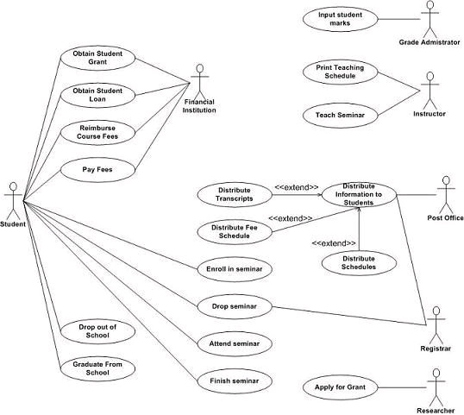
Use Case Diagram
Used for analyzing requirements, exploring user interactions.
Documents:
Who initiates an interaction
What information enters the system
What information comes out
Measurable benefits to the user
Requirements analysis uncovers functionality the system must provide to satisfy its users.
Example Use-case Diagram for a student database

Slide 9
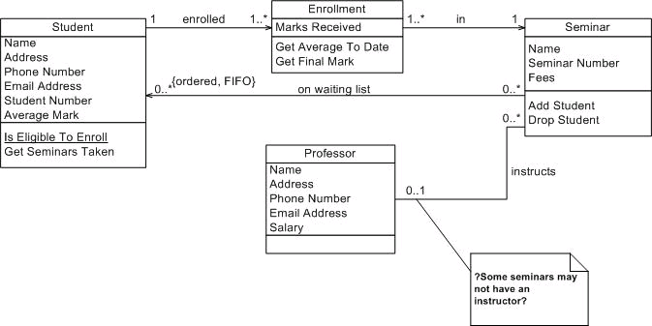
Class Diagram
Relationship between objects/classes.
Can be more abstract and design-centered, or specific and implementation-centered.
Explores software architecture, functionality and relationships between objects in our system (i.e. instances of classes).
Example Class Diagram

Slide 10
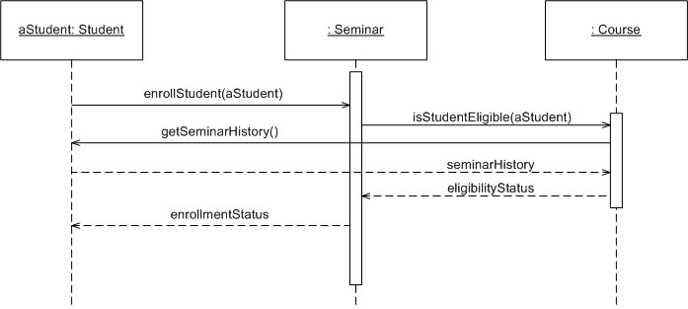
Sequence Diagram
Model the interaction of collaborating objects using message passing as they attempt to achieve the functionality expressed in one or more use cases.
This models the behaviour of the system in response to inputs from the external world.
Example Sequence Diagram

Slide 11
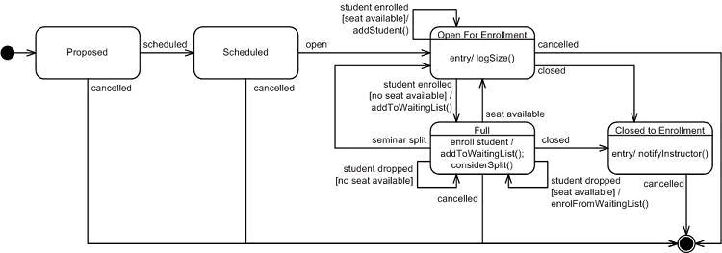
State Chart Diagram
State
State Transition following an event
Starting State
Terminating State
Model the time dependent behaviour of objects or systems in response to messages sent to it over a period of time.

Slide 12
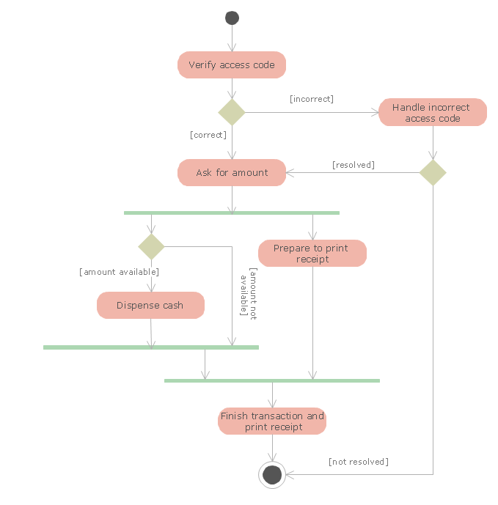
Activity Diagram
Show the procedural flow of control while processing an activity, modelling the logic in a use-case or use-case scenario.
Green bars indicate creation and joining of parallel sections.

Slide 13
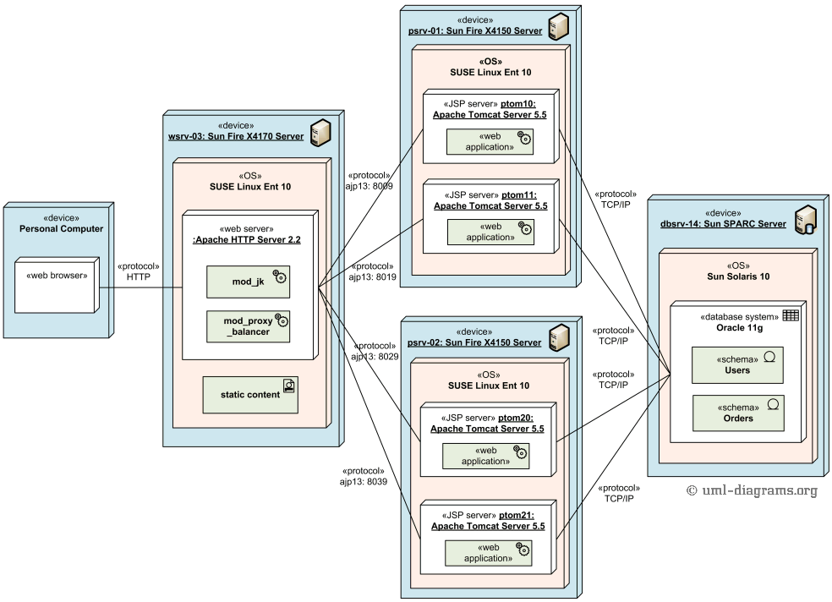
Deployment Diagram
Show how complex software will be deployed (installed) across a distribution of computers and networks.
Gives an indication of the kinds of
runtime resources are required

Slide 14
UML In Practice
Is UML and modelling actually used in practice?
It depends…
In military, security, and safety critical applications, a full detailed design with documentation is often required before you even start programming.
Some firms insist on a formal UML approach. This can be useful when you want to generate code automatically (or using interns) from a model. This is known as Model-Driven Development (MDD).
Some clients/customers may insist on full documentation with formal UML.
Many developers use UML informally, documenting enough ideas to allow the team to understand what and how things will work.

Slide 15

Homework
Download the updated course library and read/compile/run the examples in:
examples/q7_mutex
examples/q3_shared_memory
Read: The Value of Modelling
https://www.ibm.com/developerworks/rational/library/6007.html
Quiz 3 next week on mutexes, shared memory

