Slide 1
Lecture 9: Use Case Diagrams
Learning Goals
Define and distinguish between User Stories and Use Cases
Describe a set of use-cases and use-case scenarios given an application
Give examples of use-cases for a given system
Draw a Use Case Diagram for a system
Differentiate between include, generalize, and extend relationships
©Paul Davies, C. Antonio Sanchez. Not to be copied, used, or revised without explicit written permission from the copyright owner.

Slide 2
User Stories and Use Cases
Capture the functional requirements of a system
Describe interactions between actors and the system
Actor: a person or thing that has a “goal” in the system (e.g. User, Organization, Software System)
Not necessarily a single individual, so sometimes referred to as roles
Goal: a purpose, or something to be achieved through interaction
User Stories take the viewpoint of an actor and list it’s goals
Use Cases describe all the actors and their goals in detail

Slide 3
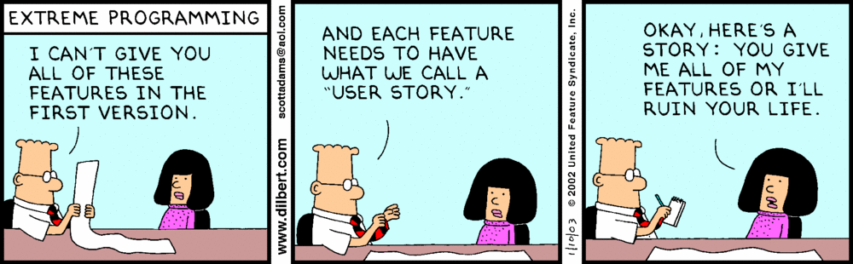
User Stories
User Story: “As a <role>, I want to be able to <some goal> so that <some reason>”
http://dilbert.com/
Often used in the planning stage, each “story” describing one feature of the software.

Slide 4
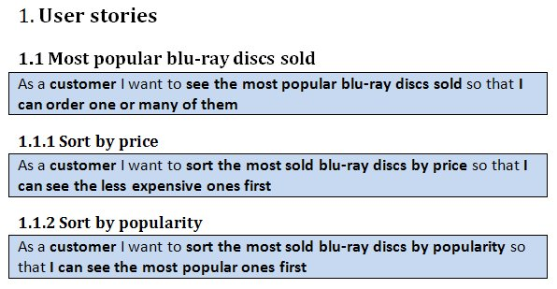
Example User Stories – Video Rental Library

Slide 5
Use Cases
Use Cases explore each User Story, analyze the requirements and how they can be achieved in terms of interactions between the actor and system.
What data goes in/out (the interaction)
What effect this has on the system
What the benefit to the user is (the objective)
Describes the sequence of interactions to accomplish a specified, identifiable task, from a high-level perspective, and is written in plain language.

Slide 6
Use Cases: Library System
Library Use cases
Checking out a book for loan.
Checking in a returned book.
Checking if a book is in stock and where to find it.
Reserving a book that is currently out on loan.
Dealing with payment of overdue fines.
Adding new members to the library.
Deleting old members from the library.
Dealing with changes of members details e.g. name address etc.

Slide 7
Use Cases: Library System
Checking out a book for loan.
What needs to take place for this to occur?
Member goes home with a book
Benefit:
Interaction:
Effects:
Member identifies him/herself with id, indicates which book
If user is allowed and book is available, lend book for a specified period
Update records of loan and availability
Member’s loan record updated to reflect loaned books
Library’s loan record updated to show book availability

Slide 8
Use Cases: Library System
Use-Case: Borrow Book
The member identifies him/herself to the librarian using membership identification card.
The member presents one or more books to the Librarian.
The Librarian checks the books to make sure they can be loaned.
The Librarian checks the membership card to make sure it is valid.
The Librarian looks up the member’s records and checks for any due fines and that the number of loaned books will be less than 6 (the maximum).
The Librarian refuses to loan books to members with overdue fines.
If acceptable, each book is stamped with the appropriate return date (2 weeks from today).
The Librarian updates the member’s loan details by entering it into the loan library.

Slide 9
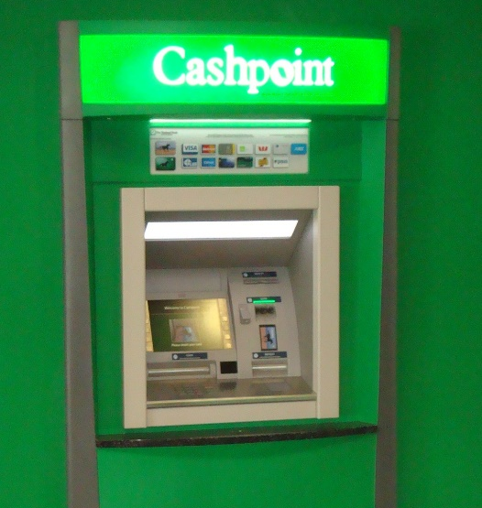
Use Cases: ATM
ATM Use cases
Withdraw Cash
Request Balance
Request Statement
Request Cheques
Withdraw Cash
Benefit: - User goes home with cash money
Interaction: - User identifies him/herself
- Requests amount
- System checks balance and limits
- If valid, dispenses cash, debits account
- Asks user if would like receipt
Effects: - User’s account balance updated
- ATM’s available cash updated
By Richard001 (Own work) [Public domain], via Wikimedia Commons

Slide 10
Use Cases: ATM
Use-Case: Withdraw Cash
The user inserts their ID card into the system.
The system reads the card’s chip to identify the user & account.
The system prompts the user to enter their PIN.
The user enters their PIN.
The system contacts the banks central computer to verify the PIN account details.
If PIN is authenticated the user is prompted for the amount of the withdrawal. If not, the card is returned to the user with an appropriate failed identification message.
The system prompts for the amount of the cash withdrawal.
The user enters the amount of the cash withdrawal.
The system checks with the banks central computer to ensure that the user has sufficient funds.
If there are sufficient funds, the cash is dispensed and the customer’s account at the Bank Central Computer is debited accordingly, otherwise an appropriate “insufficient funds” message is displayed
The card is returned to the user and a receipt is printed.

Slide 11
Use Cases
What to write and how much detail is necessary?
There are no explicit rules or syntax. It must capture everything the system should do, otherwise the feature may be missed.
Capture all the interactions you expect will be played out, the benefits to the user or actor, and the effect it has on the system.
Should focus on the “what’s”, not the “how’s”, i.e. should not go into the underlying details required to get the functionality to work.

Slide 12
Use Case Scenarios
Specific instance of a use case that is played out.
What could happen? What do we do in that case?
ATM:
What if the users PIN is incorrectly entered?
What if the user has insufficient funds in their account?
What if the cash dispenser cannot read the?
What if the cash dispenser is out of money?
What if the bank central computer is off-line?
Each scenario addresses one of path of interation, but are all part of the same Use Case. They are not errors, since they may reflect important logic or business operation.

Slide 13
Use Case Scenarios
Often documented using structured pseudo-code, but keep it simple, unambiguous and clear to others.
Start of Primary scenario/transaction
The user inserts their ID card into the system.
The system reads the magnetic strip from the card.
If the system cannot read the card then <<Scenario 1>>
The system contacts the banks central computer to request the PIN number for the card and their account details.
If bank central computer cannot access users account then <<Scenario 2>>
The system prompts the user for their PIN.
The user enters their PIN.
If PIN cannot be authenticated <<Scenario 3>>
The user is prompted for the amount of the withdrawal.
The user enters the amount of withdrawal.
The system checks with the banks central computer
If the user has insufficient funds <<Scenario 4>>
The cash is dispensed and the customer’s account at the Bank Central Computer is debited with the withdrawal amount.
The card is returned to the user and a receipt issued.
End-Of-Transaction
Scenario 1: The users card is returned. End-of-Transaction
Scenario 2: The users card is returned. End-of-Transaction
Scenario 3: The user is given two more attempts to enter a correct PIN. If this fails the card is kept and the transaction ends. Otherwise
resume primary scenario.
Scenario 4: The user is given the opportunity to enter a lesser amount or cancel the transaction. If cancel is chosen, the card is returned and
the transaction ends. If the lesser amount is acceptable then resume primary scenario.

Slide 14
Use Case Diagrams
Very simple diagram involving two symbols: “actors” and “use-cases”.
Withdraw Cash
ATM Use-Case Diagram

Slide 15
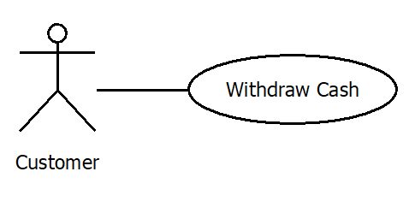
Use Case Diagrams
Each oval represents a unique use-case, with a high-level label. All use-cases must be initiated by an actor.
Use cases are documented elsewhere, with a detailed description of the interactions.
Use Case

Slide 16
Use Case Diagrams
An actor is an external entity we are modelling. They could be users, other systems, hardware, etc. They initiate one or more use-cases.
Not all people (or entities) involved in execution is an actor. Actors must initiate a use-case and gets some measureable benefit from the interaction, not just someone/something that happens to be involved.

Slide 17
Use Case Diagrams
We may show other actors that are involved if it is important to the use-case.
In UML, we refer to “actors” who do not initiate a use-case as a secondary actor. The initiator is the primary actor.
Withdraw Cash

Slide 18
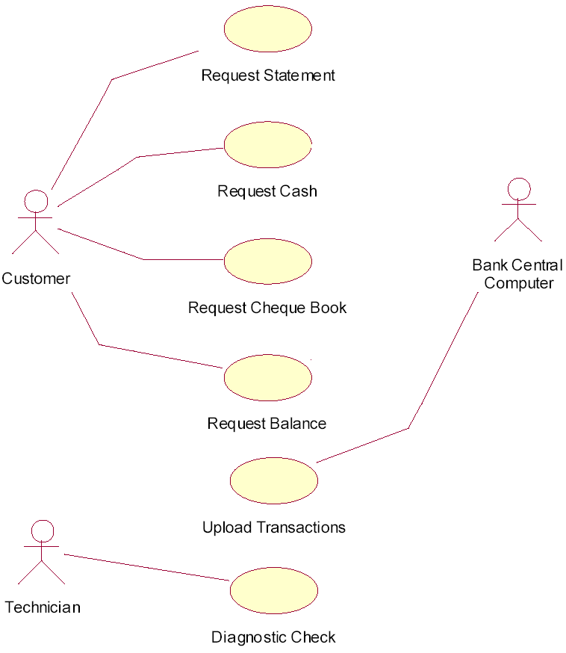
Use Case Diagrams
Withdraw Cash
There may be multiple primary actors in your system.
e.g. the Bank’s Central Computer requests all transactions be uploaded, or a technician runs a diagnostics check

Slide 19
Use Case Diagrams
Why bother with such simple diagrams?
They show the big-picture without getting bogged down by the details of design and implementation
Focuses on what needs to be done, useful for organizing tasks
Useful for communicating with customer, relating use-cases to major objectives
Helps reduce missed or misunderstood features or functionality during analysis
Developers can immediately asses required functionality, asses risks and identify any potential challenges

Slide 20
Use Case Diagrams: Includes
Sometimes commonality exists between steps, e.g. each operation at an ATM requires an identification step using a bank card and pin.
Rather than duplicate the common interaction within each use-case, we extract into a “mini use-case” which can be included in the others.
THIS IS NOT BREAKING DOWN INTO FUNCTIONS! The included mini use-case should still involve some interaction between actor and system, with benefits and effects.
Ask: is this important from a big-picture perspective, or only an implementation detail?

Slide 21
Use Case Diagrams: Includes
<<include>>
Verify User with Main Computer
NOT really Use-cases
<<include>>
Customer
<<include>>
Get Balance of Account
If a use-case does not contain any user-interaction OR, does not lead to any direct, measurable benefit for the user, then it is NOT a use-case, it is simply functionality.

Slide 22
Documenting Includes
Start of Primary scenario/transaction
Include Identify User (a prerequisite or precondition for the execution of this use-case)
If identification fails << Scenario 1>>
The system contacts the banks central computer to request the PIN number for the card and their account details.
If bank central computer cannot access users account <<Scenario 2>>
If PIN cannot be authenticated <<Scenario 3>>
The user is prompted for the amount of the withdrawal.
The user enters the amount of withdrawal.
The system checks the account balance with the banks central computer
If the user has insufficient funds <<Scenario 4>>
The cash is dispensed and the customer’s account at the Bank Central Computer is debited with the withdrawal amount.
The card is returned to the user and a receipt issued.
End-Of-Transaction
Scenario 1: The users card is returned. End of Transaction
Scenario 2: The users card is returned. End of Transaction
Scenario 3: The user is given two more attempts to enter a correct PIN. If this fails the card is kept and the transaction ends. Otherwise resume primary scenario.
Scenario 4: The user is given the opportunity to enter a lesser amount or cancel the transaction.
If cancel is chosen, the card is returned and the transaction ends.
If the lesser amount is acceptable then resume primary scenario.

Slide 23
Use Case Diagrams: Generalzation
When two or more use-cases achieve the same goal. e.g. Unlocking an iphone: passcode, OR fingerprint, OR face recognition.
The outcome/benefits are the same, but interaction is different.
‘Finger Print Scan’, ‘Retina Scan’ and ‘Card and Pin’ are all ‘kinds of’ use case that identify the user
Withdraw Cash

Slide 24
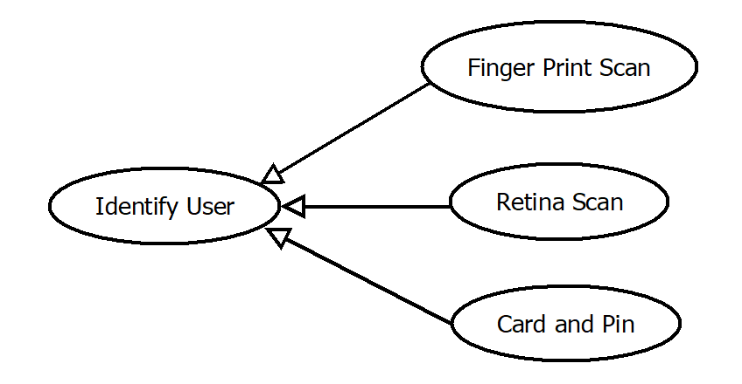
Use Case Diagrams: Generalization
The base (or root) use-case should be documented in very general terms.
“Identify the user”
obtain their account details from the bank central computer
Generization is about isolating common objectives and expressing that commonality in the use-base case.
base use-case
derived use-cases
The details are then described in the derived use-cases.

Slide 25
Use Case Diagrams: Extends
Allow for extensions of use-cases. Model optional behaviour involving user-or actor-interaction.
Use-Case Request Cash
. . .
. . .
If( users wants to chose type of $ notes)
Extend use case : Choose $$$ Notes
If user chooses to have a receipt
Extend use case : Print Receipt
. . .
. . .
The card is returned to the user and a receipt is issued.
End-Of-Transaction
<<extends>>
Receipt Needed?
Customer
Request Cash
<<extends>>
Choose $$$ Notes

Slide 26
Use Case Diagrams: Summary
User stories are used to develop and analyze the list of functional requirements
Use-Cases describe the details of the interactions, can include multiple scenarios leading to different interaction procedures. Descriptions do not have a specific syntax, but must capture requirements in a way that analysists and customers can understand.
Use-Cases can include other use-cases, can sometimes be generalized – having multiple derived use-cases, and can extend other use-cases adding optional interactions.
Note the arrow types in the diagrams!! Both the style and direction.

