Slide 1

CPEN333: System Software Engineering Quiz #6: UML Part 2

Slide 2
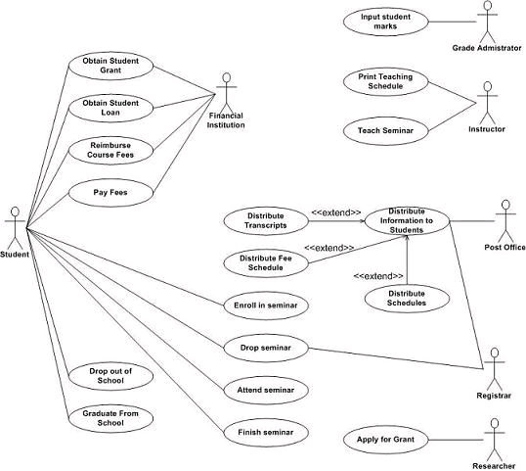
Q1: Diagrams
What kind of Diagram is this?
Use Case Diagram
Sequence Diagram
Class Diagram
System Overview Diagram

Slide 3
Q2: Use-Case Diagrams
Which of the following is NOT a Use-Case for an ATM, so should NOT appear in the Use-Case Diagram
Customer withdraws cash from an ATM
Technician requests lists of detected faults in ATM
ATM requests user’s account information from bank server
Bank server requests net amount of cash in machine

Slide 4
Q3: Use-Case Diagrams
Who are the primary actors in Withdraw Cash?
Customer
Customer, Bank Central Computer
Customer, Printer
Customer, Printer, BCC
Withdraw Cash

Slide 5
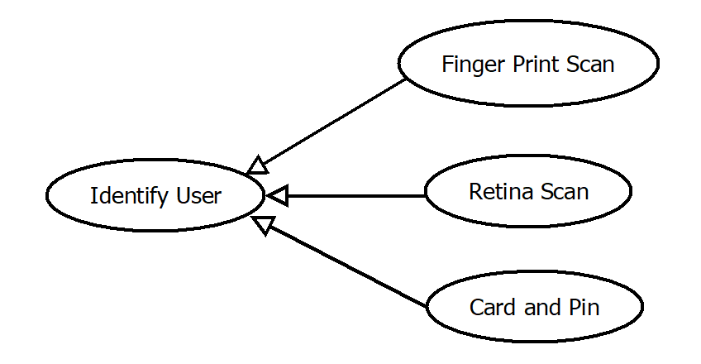
Q4: Use-Case Diagrams
What do the arrows indicate?
Includes
Association
Generalization
Extends

Slide 6
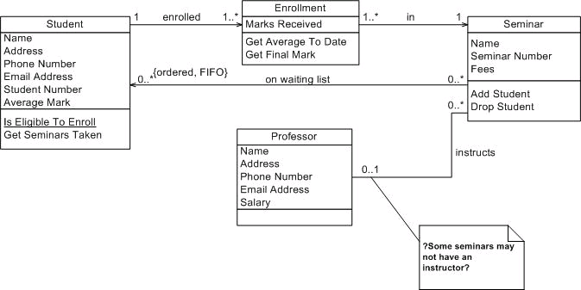
Q5: Diagrams
What kind of Diagram is this?
Use Case Diagram
Sequence Diagram
Class Diagram
System Overview Diagram

Slide 7
Q6: Class Diagrams
How many Enrollments can a Student have?
1
1 or more
0 or more
0 or 1

Slide 8
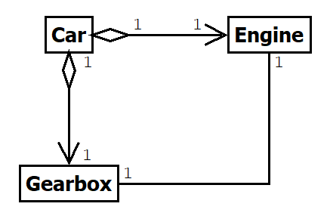
Q7: Class Diagrams
What does this say about the Car’s relationship to Engine and Gearbox
Car “owns” them (encapsulation)
Car “borrows” them (aggregation)
Engine and Gearbox own Car (encapulstion)
Engine and Gearbox borrow Car (aggregation)

Slide 9
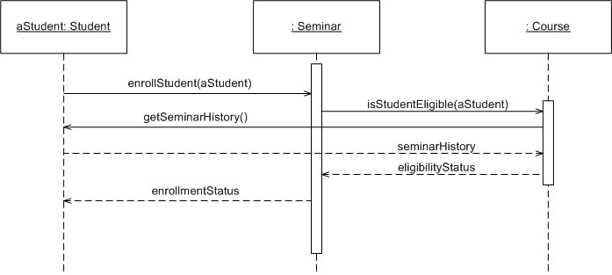
Q8: Diagrams
What type of Diagram is this?
Use Case Diagram
Sequence Diagram
Class Diagram
System Overview Diagram

Slide 10
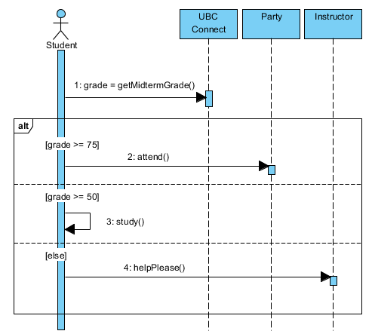
Q9: Sequence Diagrams
If a student scores 80% on the midterm,
what does he/she do?
Attend the party
Study
Attend the party and study
Attend the party, study, and ask for help

Slide 11
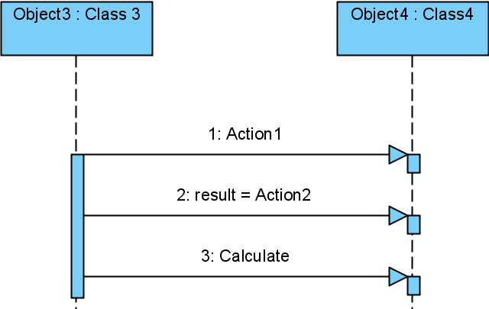
Q10: Sequence Diagrams
Which of the following statements is NOT correct
Object3 needs a pointer/reference to Object4
Object3 communicates synchronously with Object4
Object4 needs a pointer/reference to Object3
Object4 sends a message to Object3

Slide 12
Q11: Sequence Diagrams
Which of the following is NOT true about sequence diagrams?
They can be useful in the analysis phase for outlining general procedures
They can be useful in the design phase for outlining implementation details
Their primary purpose is to document use-case scenarios
They should be drawn for every possible sequence of events in your system

