Slide 1
Assembly Language for x86 Processors 7th Edition
Kip Irvine
Chapter 1: Basic Concepts
Slides prepared by the author
Revision date: 1/15/2014
(c) Pearson Education, 2015. All rights reserved. You may modify and copy this slide show for your personal use, or for use in the classroom, as long as this copyright statement, the author's name, and the title are not changed.

Slide 2
Welcome to Assembly Language
Some Good Questions to Ask
Assembly Language Applications
Irvine, Kip R. Assembly Language for Intel-Based Computers 7/e, 2015.

Slide 3
Questions to Ask
Why am I learning Assembly Language?
What background should I have?
What is an assembler?
What hardware/software do I need?
What types of programs will I create?
What do I get with this book?
What will I learn?
Irvine, Kip R. Assembly Language for Intel-Based Computers 7/e, 2015.

Slide 4
Welcome to Assembly Language (cont)
How does assembly language (AL) relate to machine language?
How do C++ and Java relate to AL?
Is AL portable?
Why learn AL?
Irvine, Kip R. Assembly Language for Intel-Based Computers 7/e, 2015.

Slide 5
Assembly Language Applications
Some representative types of applications:
  Business application for single platform
  Hardware device driver
  Business application for multiple platforms
  Embedded systems & computer games
(see next panel)
Irvine, Kip R. Assembly Language for Intel-Based Computers 7/e, 2015.

Slide 6
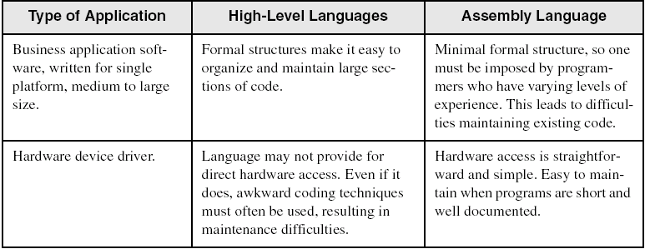
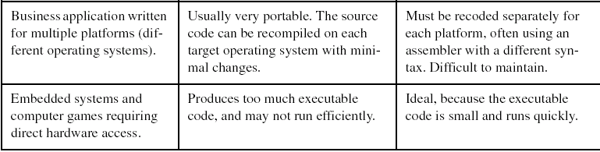
Comparing ASM to High-Level Languages
Irvine, Kip R. Assembly Language for Intel-Based Computers 7/e, 2015.

Slide 7
What's Next
Welcome to Assembly Language
Virtual Machine Concept
Data Representation
Boolean Operations
Irvine, Kip R. Assembly Language for Intel-Based Computers 7/e, 2015.

Slide 8
Virtual Machine Concept
Virtual Machines
Specific Machine Levels
Irvine, Kip R. Assembly Language for Intel-Based Computers 7/e, 2015.

Slide 9
Virtual Machines
Tanenbaum: Virtual machine concept
Programming Language analogy:
  Each computer has a native machine language (language L0) that runs directly on its hardware
  A more human-friendly language is usually constructed above machine language, called Language L1
Programs written in L1 can run two different ways:
  Interpretation – L0 program interprets and executes L1 instructions one by one
  Translation – L1 program is completely translated into an L0 program, which then runs on the computer hardware
Irvine, Kip R. Assembly Language for Intel-Based Computers 7/e, 2015.

Slide 10
Translating Languages
English: Display the sum of A times B plus C.
C++: cout << (A * B + C);
Assembly Language:
mov eax,A
mul B
add eax,C
call WriteInt
Intel Machine Language:
A1 00000000
F7 25 00000004
03 05 00000008
E8 00500000
Irvine, Kip R. Assembly Language for Intel-Based Computers 7/e, 2015.

Slide 11
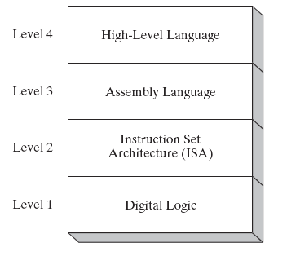
Specific Machine Levels
(descriptions of individual levels follow . . . )
Irvine, Kip R. Assembly Language for Intel-Based Computers 7/e, 2015.

Slide 12
High-Level Language
Level 4
Application-oriented languages
  C++, Java, Pascal, Visual Basic . . .
Programs compile into assembly language (Level 4)
Irvine, Kip R. Assembly Language for Intel-Based Computers 7/e, 2015.

Slide 13
Assembly Language
Level 3
Instruction mnemonics that have a one-to-one correspondence to machine language
Programs are translated into Instruction Set Architecture Level - machine language (Level 2)
Irvine, Kip R. Assembly Language for Intel-Based Computers 7/e, 2015.

Slide 14
Instruction Set Architecture (ISA)
Level 2
Also known as conventional machine language
Executed by Level 1 (Digital Logic)
Irvine, Kip R. Assembly Language for Intel-Based Computers 7/e, 2015.

Slide 15
Digital Logic
Level 1
CPU, constructed from digital logic gates
System bus
Memory
Implemented using bipolar transistors
next: Data Representation
Irvine, Kip R. Assembly Language for Intel-Based Computers 7/e, 2015.

Slide 16
Assembly Language for x86 Processors 7th Edition
Kip Irvine
Chapter 2: x86 Processor Architecture
Slides prepared by the author
Revision date: 1/15/2014
(c) Pearson Education, 2015. All rights reserved. You may modify and copy this slide show for your personal use, or for use in the classroom, as long as this copyright statement, the author's name, and the title are not changed.

Slide 17
Chapter Overview
General Concepts
IA-32 Processor Architecture
IA-32 Memory Management
64-bit Processors
Components of an IA-32 Microcomputer
Input-Output System
Irvine, Kip R. Assembly Language for x86 Processors 7/e, 2015.

Slide 18
General Concepts
Basic microcomputer design
Instruction execution cycle
Reading from memory
How programs run
Irvine, Kip R. Assembly Language for x86 Processors 7/e, 2015.

Slide 19
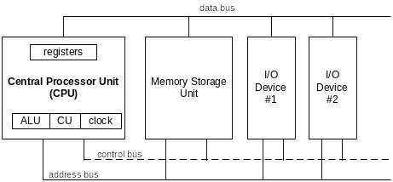
Basic Microcomputer Design
clock synchronizes CPU operations
control unit (CU) coordinates sequence of execution steps
ALU performs arithmetic and bitwise processing
Irvine, Kip R. Assembly Language for x86 Processors 7/e, 2015.

Slide 20
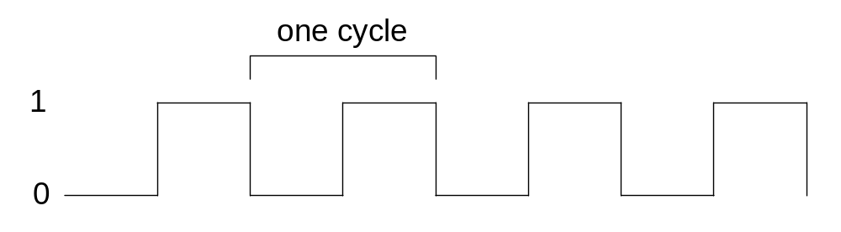
Clock
synchronizes all CPU and BUS operations
machine (clock) cycle measures time of a single operation
clock is used to trigger events
Irvine, Kip R. Assembly Language for x86 Processors 7/e, 2015.

Slide 21
What's Next
General Concepts
IA-32 Processor Architecture
IA-32 Memory Management
64-Bit Processors
Components of an IA-32 Microcomputer
Input-Output System
Irvine, Kip R. Assembly Language for x86 Processors 7/e, 2015.

Slide 22
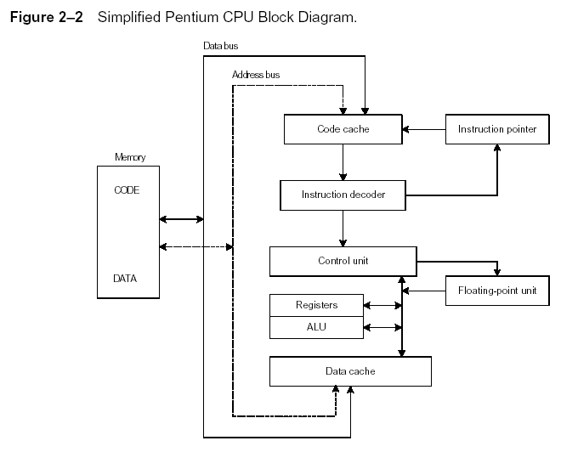
Instruction Execution Cycle
Instruction Execution Cycle
Fetch
Decode
Fetch operands
Execute
Store output
Irvine, Kip R. Assembly Language for x86 Processors 7/e, 2015.

Slide 23
Reading from Memory
Multiple machine cycles are required when reading from memory, because it responds much more slowly than the CPU. The steps are:
  Place the address of the value you want to read on the address bus.
  Assert (changing the value of) the processor’s RD (read) pin.
  Wait one clock cycle for the memory chips to respond.
  Copy the data from the data bus into the destination operand
Irvine, Kip R. Assembly Language for x86 Processors 7/e, 2015.

Slide 24
Cache Memory
High-speed expensive static RAM both inside and outside the CPU.
  Level-1 cache: inside the CPU
  Level-2 cache: outside the CPU
Cache hit: when data to be read is already in cache memory
Cache miss: when data to be read is not in cache memory.
Irvine, Kip R. Assembly Language for x86 Processors 7/e, 2015.

Slide 25
IA-32 Processor Architecture
Modes of operation
Basic execution environment
Floating-point unit
Intel Microprocessor history
Irvine, Kip R. Assembly Language for x86 Processors 7/e, 2015.

Slide 26
Modes of Operation
Protected mode
  native mode (Windows, Linux)
Real-address mode
  native MS-DOS
System management mode
  power management, system security, diagnostics
Virtual-8086 mode
  hybrid of Protected
  each program has its own 8086 computer
Not available in 64 bit Windows 7
Irvine, Kip R. Assembly Language for x86 Processors 7/e, 2015.

Slide 27
Basic Execution Environment
Addressable memory
General-purpose registers
Index and base registers
Specialized register uses
Status flags
Floating-point, MMX, XMM registers
Irvine, Kip R. Assembly Language for x86 Processors 7/e, 2015.

Slide 28
Addressable Memory
Protected mode
  4 GB
  32-bit address
Real-address and Virtual-8086 modes
  1 MB space
  20-bit address
  (not available in 64 bit Windows 7)
Irvine, Kip R. Assembly Language for x86 Processors 7/e, 2015.

Slide 29

General-Purpose Registers
Named storage locations inside the CPU, optimized for speed.
Irvine, Kip R. Assembly Language for x86 Processors 7/e, 2015.

Slide 30


Accessing Parts of Registers
Use 8-bit name, 16-bit name, or 32-bit name
Applies to EAX, EBX, ECX, and EDX
Irvine, Kip R. Assembly Language for x86 Processors 7/e, 2015.

Slide 31

Index and Base Registers
Some registers have only a 16-bit name for their lower half:
Irvine, Kip R. Assembly Language for x86 Processors 7/e, 2015.

Slide 32
Some Specialized Register Uses (1 of 2)
General-Purpose
  EAX – accumulator
  ECX – loop counter
  ESP – stack pointer
  ESI, EDI – index registers
  EBP – extended frame pointer (stack)
Segment
  CS – code segment
  DS – data segment
  SS – stack segment
  ES, FS, GS - additional segments
Irvine, Kip R. Assembly Language for x86 Processors 7/e, 2015.

Slide 33
Some Specialized Register Uses (2 of 2)
EIP – instruction pointer
EFLAGS
  status and control flags
  each flag is a single binary bit
Irvine, Kip R. Assembly Language for x86 Processors 7/e, 2015.

Slide 34
Status Flags
Carry
  unsigned arithmetic out of range
Overflow
  signed arithmetic out of range
Sign
  result is negative
Zero
  result is zero
Auxiliary Carry
  carry from bit 3 to bit 4
Parity
  sum of 1 bits is an even number
Irvine, Kip R. Assembly Language for x86 Processors 7/e, 2015.

Slide 35

Floating-Point, MMX, XMM Registers
Eight 80-bit floating-point data registers
  ST(0), ST(1), . . . , ST(7)
  arranged in a stack
  used for all floating-point arithmetic
Eight 64-bit MMX registers
Eight 128-bit XMM registers for single-instruction multiple-data (SIMD) operations
Irvine, Kip R. Assembly Language for x86 Processors 7/e, 2015.

Slide 36
What's Next
General Concepts
IA-32 Processor Architecture
IA-32 Memory Management
64-Bit Processors
Components of an IA-32 Microcomputer
Input-Output System
Irvine, Kip R. Assembly Language for x86 Processors 7/e, 2015.

Slide 37
IA-32 Memory Management
Real-address mode
Calculating linear addresses
Protected mode
Multi-segment model
Paging
Irvine, Kip R. Assembly Language for x86 Processors 7/e, 2015.

Slide 38
Protected Mode (1 of 2)
4 GB addressable RAM
  (00000000 to FFFFFFFFh)
Each program assigned a memory partition which is protected from other programs
Designed for multitasking
Supported by Linux & MS-Windows
Irvine, Kip R. Assembly Language for x86 Processors 7/e, 2015.

Slide 39
Protected Mode (2 of 2)
Segment descriptor tables
Program structure
  code, data, and stack areas
  CS, DS, SS segment descriptors
  global descriptor table (GDT)
MASM Programs use the Microsoft flat memory model
Irvine, Kip R. Assembly Language for x86 Processors 7/e, 2015.

Slide 40
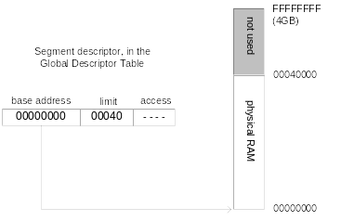
Flat Segment Model
Single global descriptor table (GDT).
All segments mapped to entire 32-bit address space
Irvine, Kip R. Assembly Language for x86 Processors 6/e, 2010.

Slide 41
Multi-Segment Model
Each program has a local descriptor table (LDT)
  holds descriptor for each segment used by the program
Irvine, Kip R. Assembly Language for x86 Processors 6/e, 2010.

Slide 42
Paging
Supported directly by the CPU
Divides each segment into 4096-byte blocks called pages
Sum of all programs can be larger than physical memory
Part of running program is in memory, part is on disk
Virtual memory manager (VMM) – OS utility that manages the loading and unloading of pages
Page fault – issued by CPU when a page must be loaded from disk
Irvine, Kip R. Assembly Language for x86 Processors 6/e, 2010.

Slide 43
Paging (from Stallings)
Split memory into equal sized, small chunks -page frames
Split programs (processes) into equal sized small chunks - pages
Allocate the required number page frames to a process
Operating System maintains list of free frames
A process does not require contiguous page frames
Use page table to keep track

Slide 44
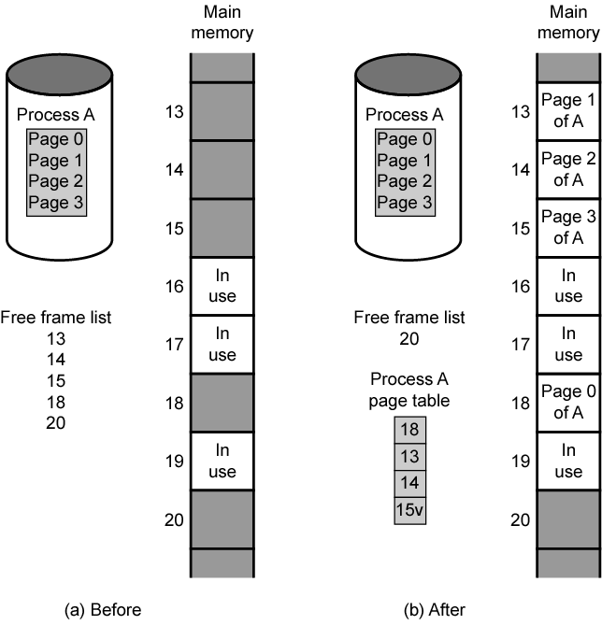
Allocation of Free Frames

Slide 45
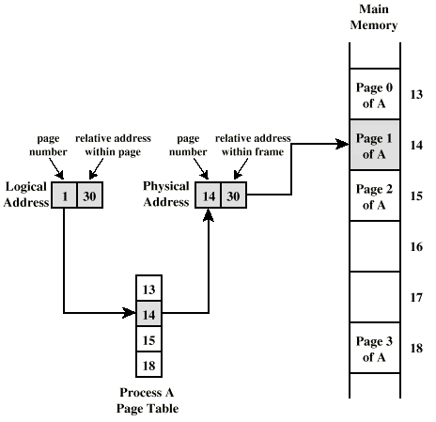
Logical and Physical Addresses - Paging

Slide 46
Virtual Memory
Demand paging
  Do not require all pages of a process in memory
  Bring in pages as required
Page fault
  Required page is not in memory
  Operating System must swap in required page
  May need to swap out a page to make space
  Select page to throw out based on recent history

Slide 47
Thrashing
Too many processes in too little memory
Operating System spends all its time swapping
Little or no real work is done
Disk light is on all the time
Solutions
  Good page replacement algorithms
  Reduce number of processes running
  Fit more memory

Slide 48
Bonus
We do not need all of a process in memory for it to run
We can swap in pages as required
So - we can now run processes that are bigger than total memory available!
Main memory is called real memory
User/programmer sees much bigger memory - virtual memory

Slide 49
What's Next
General Concepts
IA-32 Processor Architecture
IA-32 Memory Management
64-Bit Processors
Components of an IA-32 Microcomputer
Input-Output System
Irvine, Kip R. Assembly Language for x86 Processors 7/e, 2015.

Slide 50
64-Bit Processors
64-Bit Operation Modes
  Compatibility mode – can run existing 16-bit and 32-bit applications (Windows supports only 32-bit apps in this mode)
  64-bit mode – Windows 64 uses this
Basic Execution Environment
  addresses can be 64 bits (48 bits, in practice)
  16 64-bit general purpose registers
  64-bit instruction pointer named RIP
Irvine, Kip R. Assembly Language for x86 Processors 7/e, 2015.

Slide 51
64-Bit General Purpose Registers
32-bit general purpose registers:
  EAX, EBX, ECX, EDX, EDI, ESI, EBP, ESP, R8D, R9D, R10D, R11D, R12D, R13D, R14D, R15D
64-bit general purpose registers:
  RAX, RBX, RCX, RDX, RDI, RSI, RBP, RSP, R8, R9, R10, R11, R12, R13, R14, R15
Irvine, Kip R. Assembly Language for x86 Processors 7/e, 2015.

Slide 52
Max memory in 64 bit Systems
Max RAM limits for different editions of Windows 7:
  Starter: 8GB
  Home Basic: 8GB
  Home Premium: 16GB
  Professional: 192GB
  Enterprise: 192GB
  Ultimate: 192GB
Linux can support 64 TB (128 TB virtual address space)
Depends on system board manufacturer also
Irvine, Kip R. Assembly Language for x86 Processors 6/e, 2010.

Slide 53
What's Next
General Concepts
IA-32 Processor Architecture
IA-32 Memory Management
64-Bit Processors
Components of an IA-32 Microcomputer
Input-Output System
Irvine, Kip R. Assembly Language for x86 Processors 7/e, 2015.

Slide 54
Components of an IA-32 Microcomputer
Motherboard
Video output
Memory
Input-output ports
Irvine, Kip R. Assembly Language for x86 Processors 7/e, 2015.

Slide 55
Motherboard
CPU socket
External cache memory slots
Main memory slots
BIOS chips
Sound synthesizer chip (optional)
Video controller chip (optional)
IDE, parallel, serial, USB, video, keyboard, joystick, network, and mouse connectors
PCI bus connectors (expansion cards)
Irvine, Kip R. Assembly Language for x86 Processors 7/e, 2015.

Slide 56
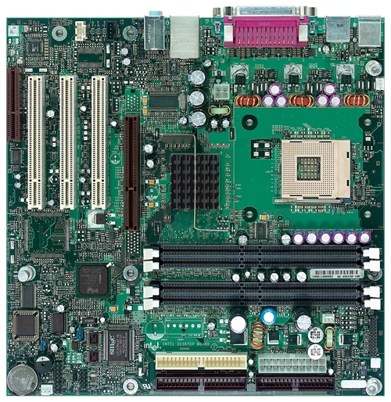
Intel D850MD Motherboard
mouse, keyboard, parallel, serial, and USB connectors
Video
Audio chip
PCI slots
memory controller hub
Pentium 4 socket
AGP slot
dynamic RAM
Firmware hub
I/O Controller
Speaker
Power connector
Battery
Diskette connector
Source: Intel® Desktop Board D850MD/D850MV Technical Product Specification
IDE drive connectors
Irvine, Kip R. Assembly Language for x86 Processors 7/e, 2015.

Slide 57
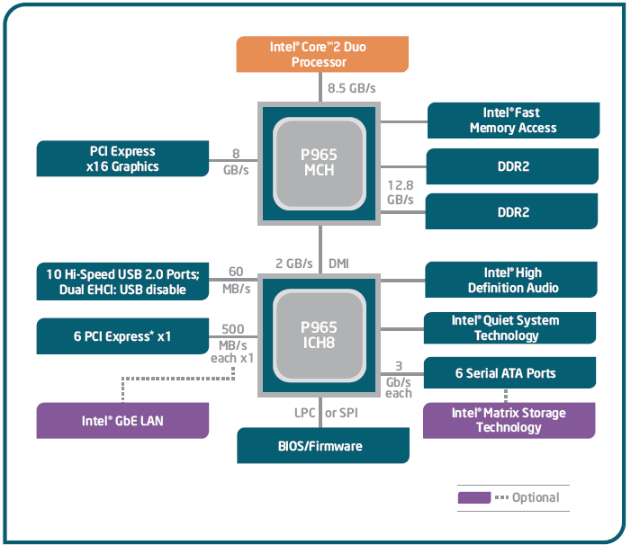
Intel 965 Express Chipset
Irvine, Kip R. Assembly Language for x86 Processors 7/e, 2015.

Slide 58
Video Output
Video controller
  on motherboard, or on expansion card
  AGP (accelerated graphics port technology)*
Video memory (VRAM)
Video CRT Display
  uses raster scanning
  horizontal retrace
  vertical retrace
Direct digital LCD monitors
  no raster scanning required
* This link may change over time.
Irvine, Kip R. Assembly Language for x86 Processors 7/e, 2015.

Slide 59
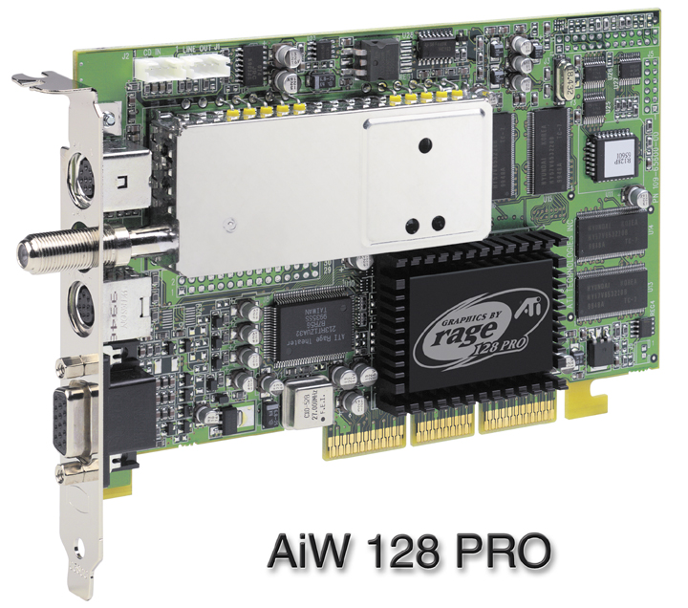
Sample Video Controller (ATI Corp.)
  128-bit 3D graphics performance powered by RAGE™ 128 PRO
  3D graphics performance
  Intelligent TV-Tuner with Digital VCR
  TV-ON-DEMAND™
  Interactive Program Guide
  Still image and MPEG-2 motion video capture
  Video editing
  Hardware DVD video playback
  Video output to TV or VCR
Irvine, Kip R. Assembly Language for x86 Processors 7/e, 2015.

Slide 60
Memory
ROM
  read-only memory
EPROM
  erasable programmable read-only memory
Dynamic RAM (DRAM)
  inexpensive; must be refreshed constantly
Static RAM (SRAM)
  expensive; used for cache memory; no refresh required
Video RAM (VRAM)
  dual ported; optimized for constant video refresh
CMOS RAM
  complimentary metal-oxide semiconductor
  system setup information
See: Intel platform memory (Intel technology brief: link address may change)
Irvine, Kip R. Assembly Language for x86 Processors 7/e, 2015.

Slide 61
Input-Output Ports
USB (universal serial bus)
  intelligent high-speed connection to devices
  up to 12 megabits/second
  USB hub connects multiple devices
  enumeration: computer queries devices
  supports hot connections
Parallel
  short cable, high speed
  common for printers
  bidirectional, parallel data transfer
  Intel 8255 controller chip
Irvine, Kip R. Assembly Language for x86 Processors 7/e, 2015.

Slide 62
Input-Output Ports (cont)
Serial
  RS-232 serial port
  one bit at a time
  uses long cables and modems
  16550 UART (universal asynchronous receiver transmitter)
  programmable in assembly language
Irvine, Kip R. Assembly Language for x86 Processors 7/e, 2015.

Slide 63
Device Interfaces
ATA host adapters
  intelligent drive electronics (hard drive, CDROM)
SATA (Serial ATA)
  inexpensive, fast, bidirectional
FireWire
  high speed (800 MB/sec), many devices at once
Bluetooth
  small amounts of data, short distances, low power usage
Wi-Fi (wireless Ethernet)
  IEEE 802.11 standard, faster than Bluetooth
Irvine, Kip R. Assembly Language for x86 Processors 7/e, 2015.

Slide 64
What's Next
General Concepts
IA-32 Processor Architecture
IA-32 Memory Management
Components of an IA-32 Microcomputer
Input-Output System
Irvine, Kip R. Assembly Language for x86 Processors 7/e, 2015.

Slide 65
Levels of Input-Output
Level 3: High-level language function
  examples: C++, Java
  portable, convenient, not always the fastest
Level 2: Operating system
  Application Programming Interface (API)
  extended capabilities, lots of details to master
Level 1: BIOS
  drivers that communicate directly with devices
  OS security may prevent application-level code from working at this level
Irvine, Kip R. Assembly Language for x86 Processors 7/e, 2015.

Slide 66
Displaying a String of Characters
When a HLL program displays a string of characters, the following steps take place:
Irvine, Kip R. Assembly Language for x86 Processors 7/e, 2015.

Slide 67
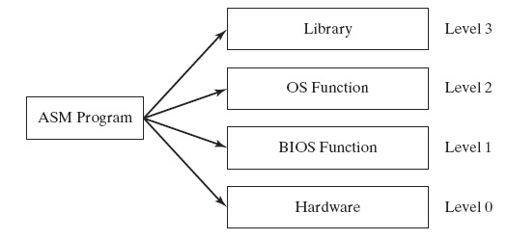
Programming levels
Assembly language programs can perform input-output at each of the following levels:
Irvine, Kip R. Assembly Language for x86 Processors 7/e, 2015.

Slide 68
Summary
Central Processing Unit (CPU)
Arithmetic Logic Unit (ALU)
Instruction execution cycle
Multitasking
Floating Point Unit (FPU)
Complex Instruction Set
Real mode and Protected mode
Motherboard components
Memory types
Input/Output and access levels
Irvine, Kip R. Assembly Language for x86 Processors 7/e, 2015.

Slide 69

42 69 6E 61 72 79
What does this say?
Irvine, Kip R. Assembly Language for x86 Processors 7/e, 2015.

