Slide 1
William Stallings Computer Organization and Architecture 9th Edition
Chapter 9
Computer Arithmetic

Slide 2
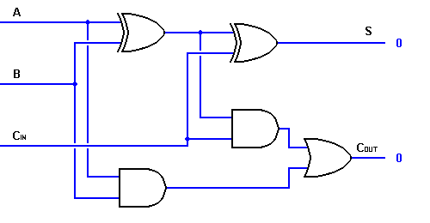
Arithmetic & Logic Unit
Does the arithmetic and logical calculations on data
Everything else in the computer is there to service this unit
Based on the use of simple digital logic devices that can store binary digits and perform simple Boolean logic operations
E.g.:

Slide 3
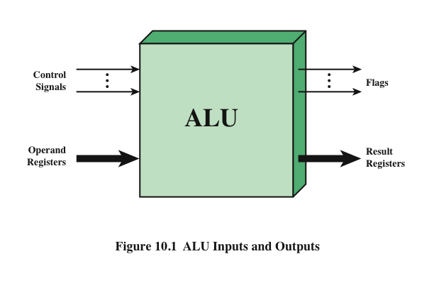
ALU Inputs and Outputs

Slide 4
Review of Number Systems
How are numbers written
Scratches on wall/rock
Knots on a string
Symbolically
Want to
Represent a useful set of numbers
Provide a unique way of representing a number
Most commonly used system
Arabic numerals
Positional representation
Decimal (base 10)

Slide 5

Decimal System (base 10)
Uses decimal digits (0, 1, …, 9)
Position of digit represents it’s magnitude
836 = 8 x 10² + 3 x 10 + 6
Fractions use negative powers of 10
0.313 = 3 x 10⁻¹ + 1 x 10⁻² + 3 x 10⁻³
The decimal number 472.256 would be

Slide 6
Binary Number System (base 2)
Uses digits 0 and 1
Also positional
1001.101 = 2³ + 2⁰ + 2⁻¹ + 2⁻³ = 9.625₁₀
You should be familiar with converting between binary and decimal
If not, see kipirvine.com/asm/workbook/binhex.htm

Slide 7
Hexadecimal Number System (base 16)
Uses digits 0, 1, 2, …, 9, A, B, C, D, E, F
Also positional
300E.A07 = 3x16³ + 14x16⁰ + 10x16⁻¹ +
7x16⁻³ = 12302.62708984375₁₀
You should also be familiar with converting between hex and decimal
If not, see kipirvine.com/asm/workbook/binhex.htm
Note that 4 binary digits can be represented by 1 hexadecimal digit

Slide 8
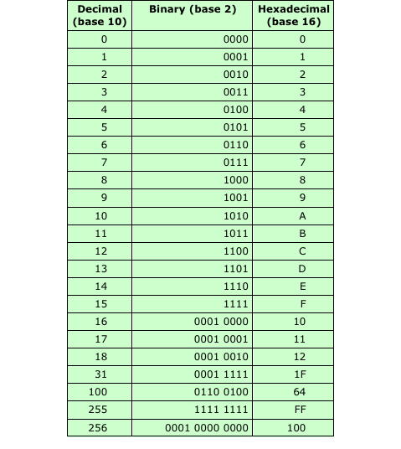
Decimal, Binary, and Hexadecimal

Slide 9
Integer Representation
Only have 0 & 1 to represent everything
Positive numbers stored in binary
e.g. 41=00101001
No minus sign
No period, or radix point
How are negative numbers represented?
Sign-Magnitude
Two’s complement
One’s complement (not discussed in following)
One of great debates in 50s was about which format to use.

Slide 10
Sign-Magnitude
Most significant bit is sign bit
0 means positive
1 means negative
+18 = 00010010
-18 = 10010010
Problems
Need to consider both sign and magnitude in arithmetic
Two representations of zero (+0 and -0)
Rarely used with integers today

Slide 11
Two’s Complement
Most significant bit is sign bit
Positive integers represented in usual binary form
Negative integers use the following
Take the Boolean complement of each bit of the corresponding positive integer
Add 1 to the result
NOTE!! This is ONLY for negative values!
Only one representation of zero
Range using n bits is -2^{n-1} to 2^{n-1}-1

Slide 12
Two’s Complement Examples
+3 = 00000011
+2 = 00000010
+1 = 00000001
+0 = 00000000
-1 = 11111111
-2 = 11111110
-3 = 11111101

Slide 13
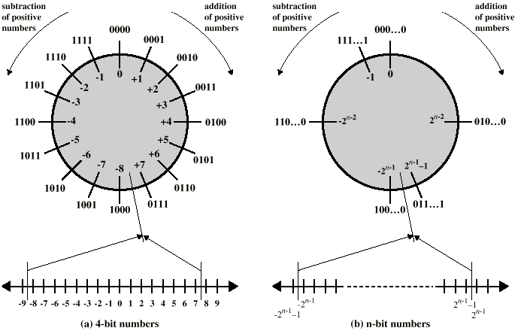
Geometric Depiction of Twos Complement Integers

Slide 14
Negation Special Case 1
0 = 00000000
Bitwise not 11111111
Add 1 to LSB +1
Result 1 00000000
Overflow is ignored, so:
- 0 = 0 √

Slide 15
Negation Special Case 2
-128 = 10000000
bitwise not 01111111
Add 1 to LSB +1
Result 10000000
So:
-(-128) = -128 Χ
Monitor MSB (sign bit)
It should change during negation

Slide 16
Range of Numbers
8 bit 2s complement
+127 = 01111111 = 2⁷ -1
-128 = 10000000 = -2⁷
16 bit 2s complement
+32767 = 011111111 11111111 = 2¹⁵ - 1
-32768 = 100000000 00000000 = -2¹⁵

Slide 17
Conversion Between Lengths
Positive number pack with leading zeros
+18 = 00010010
+18 = 00000000 00010010
Negative numbers pack with leading ones
-18 = 10010010
-18 = 11111111 10010010
i.e. pack with MSB (sign bit)

Slide 18
Addition and Subtraction
Normal binary addition
Monitor sign bit for overflow
Take twos complement of subtrahend and add to minuend
i.e. a - b = a + (-b)
So we only need addition and complement circuits

Slide 19
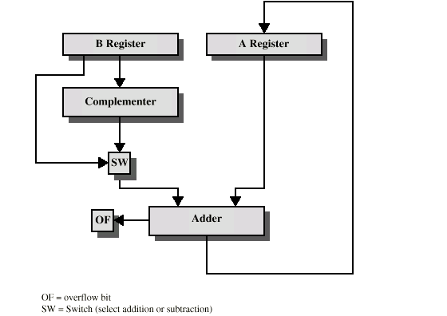
Hardware for Addition and Subtraction

Slide 20
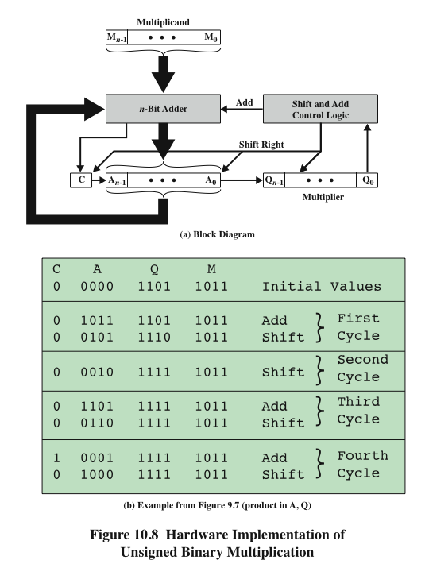
Hardware Implementation of Unsigned Binary Multiplication

Slide 21
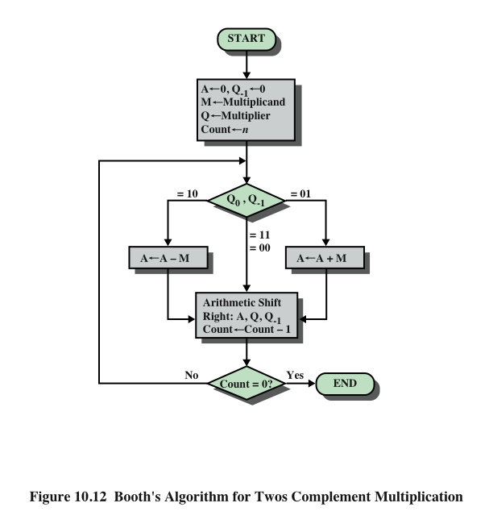
Booth’s Algorithm

Slide 22
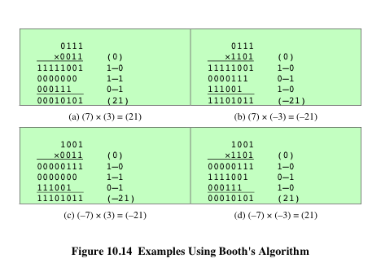
Examples Using Booth’s Algorithm

Slide 23
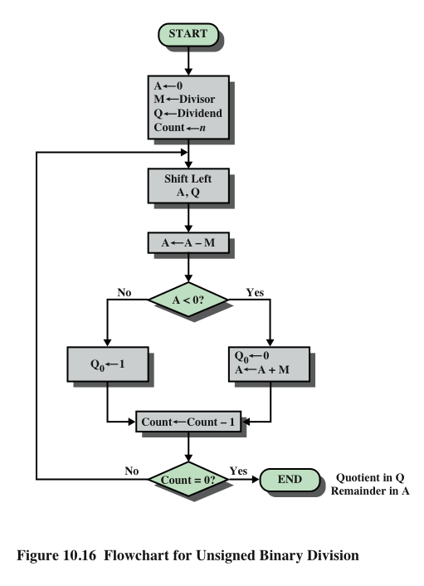
Flowchart for Unsigned Binary Division

Slide 24
Real Numbers
Numbers with fractions
Could be done in pure binary
1001.1010 = 2⁴ + 2⁰ +2⁻¹ + 2⁻³ =9.625
Where is the binary point?
Fixed?
Very limited
Has been used for decimal arithmetic
Moving?
How do you show where it is?
Use representation similar to scientific notation

Slide 25
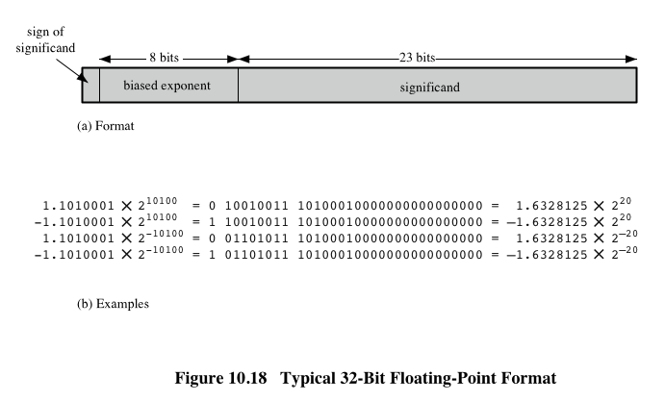
Typical 32-Bit Floating-Point Format

Slide 26
Floating Point representation
Exponent is in excess or biased notation
e.g. Excess (bias) 127 means
8 bit exponent field
Pure value range 0-255
Subtract 127 to get correct value
Range -127 to +128
Why is excess/bias needed?
Think of the representation of 0.0 and 1.0

Slide 27
Normalization
FP numbers are usually normalized
i.e., exponent is adjusted so that leading bit (MSB) of mantissa is 1
Since it is always 1 there is no need to store it
Referred to as the hidden bit
Compare this with scientific notation where numbers are normalized to give a single digit before the decimal point, e.g. 3.123 x 10³

Slide 28
FP Ranges
For a 32 bit number
8 bit exponent
+/- 2¹²⁸ ≈ 3.4 x 10³⁸
Accuracy
The effect of changing least significant bit (lsb) of mantissa
23 bit mantissa 2⁻²³ ≈ 1.2 x 10⁻⁷
About 7 decimal places

Slide 29
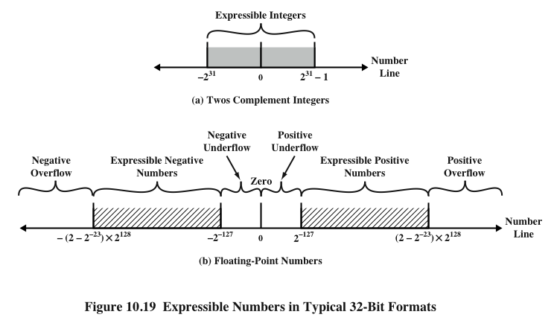
Expressible Numbers

Slide 30
IEEE 754
Standard for floating point storage
32 and 64 bit standards
8 and 11 bit exponent respectively
Extended formats (both mantissa and exponent) for intermediate results

Slide 31
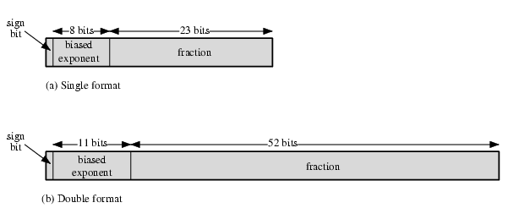
IEEE 754 Formats

Slide 32
FP Arithmetic +/-
Check for zeros
Align significands (adjusting exponents)
Add or subtract significands
Normalize result

Slide 33
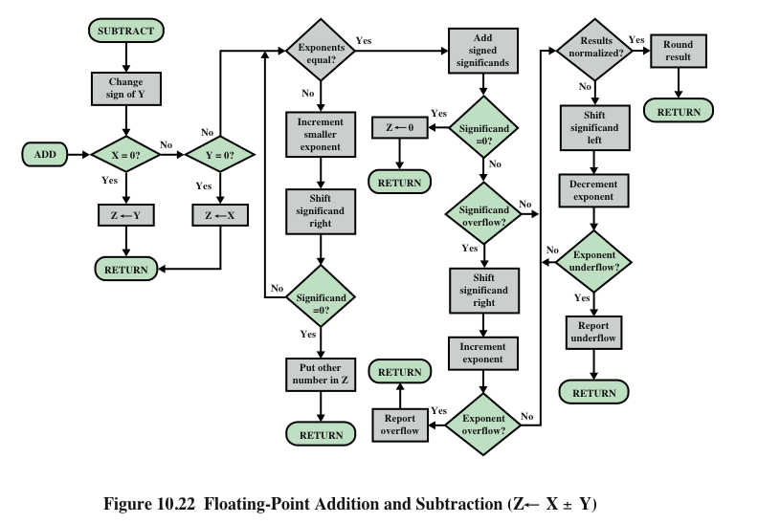
Floating-Point Addition and Subtraction

Slide 34
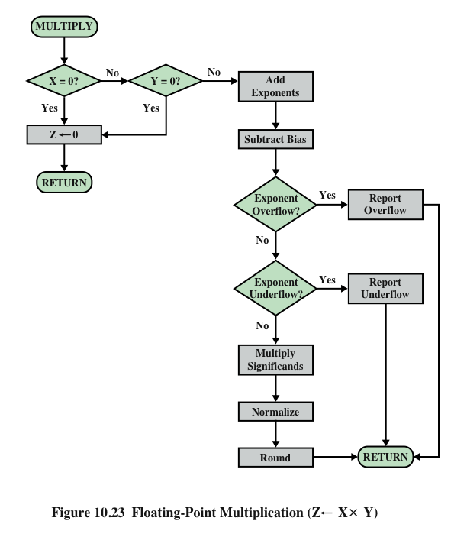
Floating-Point Multiplication

Slide 35
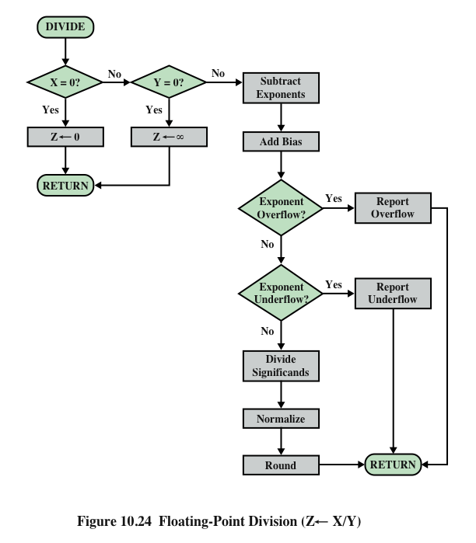
Floating-Point Division

