Slide 1
Citi Bike Analytics
Created by Cindy Pendarvis

Slide 2
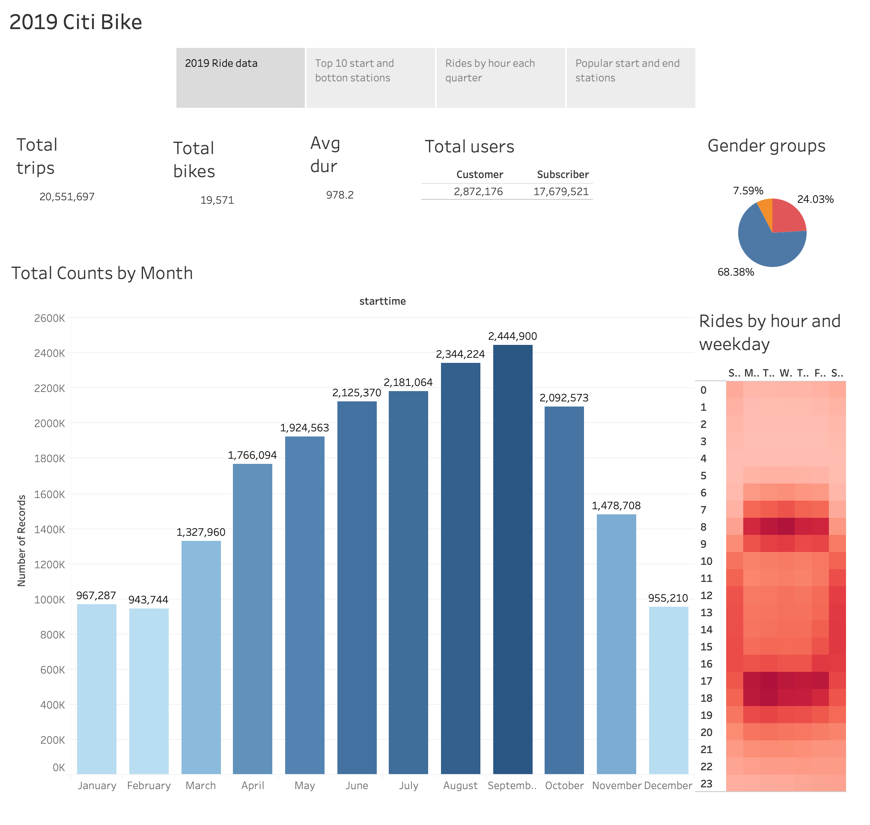

Slide 3
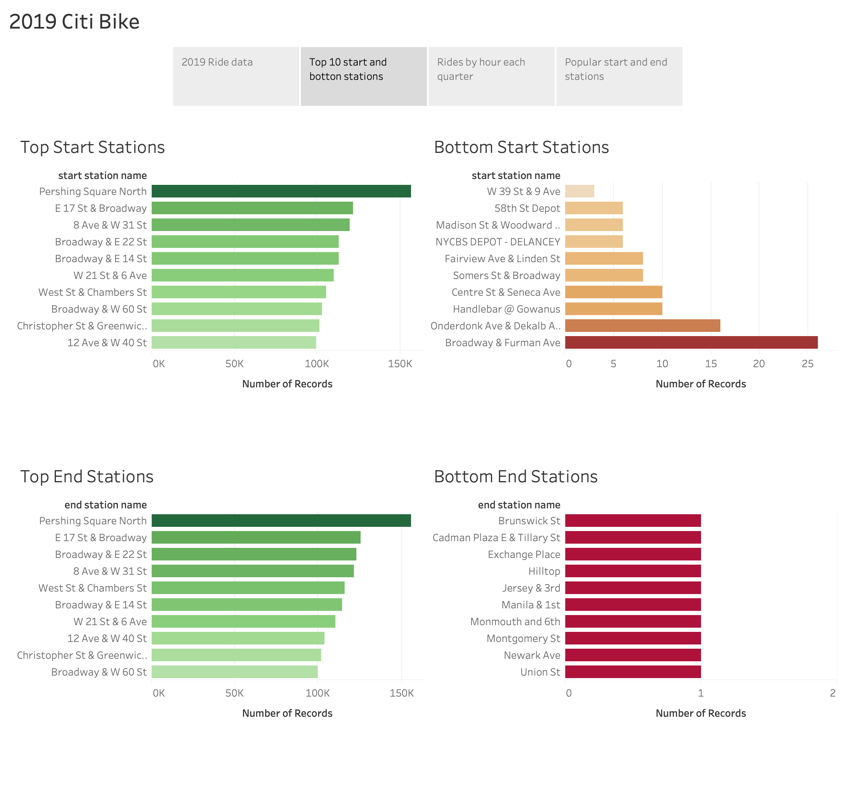

Slide 4
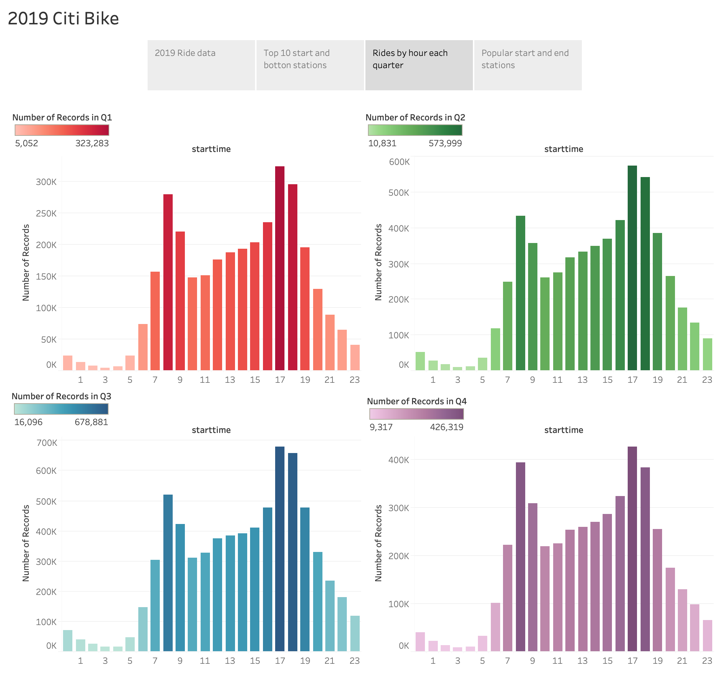

Slide 5
