Slide 1
Assignment 2 Writeup
Name: Peng, Chen
GT Email: c.peng@gatech.edu
GT ID: 903646937

Slide 2
Part-1 ConvNet

Slide 3
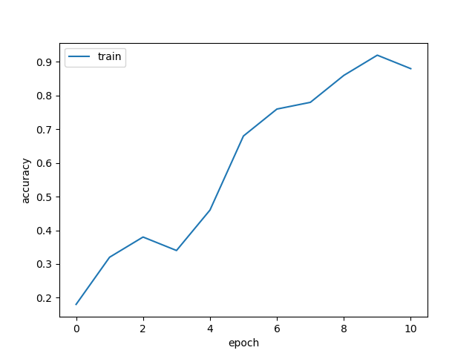
Put your learning curve here:

Slide 4
My CNN Model

Slide 5
Describe your model design in plain text here:
Architecture: The model constructed with 3 convolutional layer groups, each group includes 2 convolutional layers. Each convolutional layer follows with a ReLU layer and a batch normalization layer. Each convolutional group follows with a max pooling layer and a dropout layer. After the 3 groups of convolutional layers, the two fully connected layers was implemented to connect the conv layer and output layer. There are also a ReLU, a batch norm, and a dropout layer between the two fully connected layer.
All of the convolutional layers have 3*3 kernels with 1 replicate padding and 1 stride. The output channel number is from 32 to 128
All of the maxpooling layer have the 2*2 kernel with stride equals 2.
The dropout ratio is from 0.2 to 0.5

Slide 6
Describe your choice of hyper-parameters:
The model run with batch size 16
The learning rate is 0.01
The regularization factor is 0.001
The total training epoch is 35
The scheduler steps S[e1, e2, e3], where e1 = 20, e2 = 27 with learning rate decay [1, 0.1, 0.01]
The warmup epoch number is 5
The momentum for SGD is 0.9
The loss function is cross entropy loss.

Slide 7
What’s your final accuracy on validation set?
Best Prec @1 Acccuracy: 0.8220
Accuracy of Class 0: 0.8430
Accuracy of Class 1: 0.9000
Accuracy of Class 2: 0.7370
Accuracy of Class 3: 0.7140
Accuracy of Class 4: 0.8230
Accuracy of Class 5: 0.6790
Accuracy of Class 6: 0.8580
Accuracy of Class 7: 0.8590
Accuracy of Class 8: 0.9160
Accuracy of Class 9: 0.8910

Slide 8
Data Wrangling

Slide 9
What’s your result of training with regular CE loss on imbalanced CIFAR-10?
Fill in your per-class accuracy in the table
 | Class 0 | Class 1 | Class 2 | Class 3 | Class 4 | Class 5 | Class 6 | Class 7 | Class 8 | Class 9
CE Loss | 0.940 | 0.918 | 0.516 | 0.376 | 0.162 | 0.075 | 0.132 | 0.045 | 0.000 | 0.000

Slide 10
What’s your result of training with CB-Focal loss on imbalanced CIFAR-10?
Tune the hyper-parameter beta and fill in your per-class accuracy in the table
 | Class 0 | Class 1 | Class 2 | Class 3 | Class 4 | Class 5 | Class 6 | Class 7 | Class 8 | Class 9
beta=0.9999 | 0.594 | 0.646 | 0.262 | 0.309 | 0.232 | 0.306 | 0.518 | 0.452 | 0.515 | 0.442
beta=0.9 | 0.722 | 0.756 | 0.354 | 0.326 | 0.258 | 0.267 | 0.482 | 0.422 | 0.460 | 0.177

Slide 11
Put your results of CE loss and CB-Focal Loss(best) together:
 | Class 0 | Class 1 | Class 2 | Class 3 | Class 4 | Class 5 | Class 6 | Class 7 | Class 8 | Class 9
CE Loss | 0.940 | 0.918 | 0.516 | 0.376 | 0.162 | 0.075 | 0.132 | 0.045 | 0.000 | 0.000
CB-Focal | 0.594 | 0.646 | 0.262 | 0.309 | 0.232 | 0.306 | 0.518 | 0.452 | 0.515 | 0.442

Slide 12
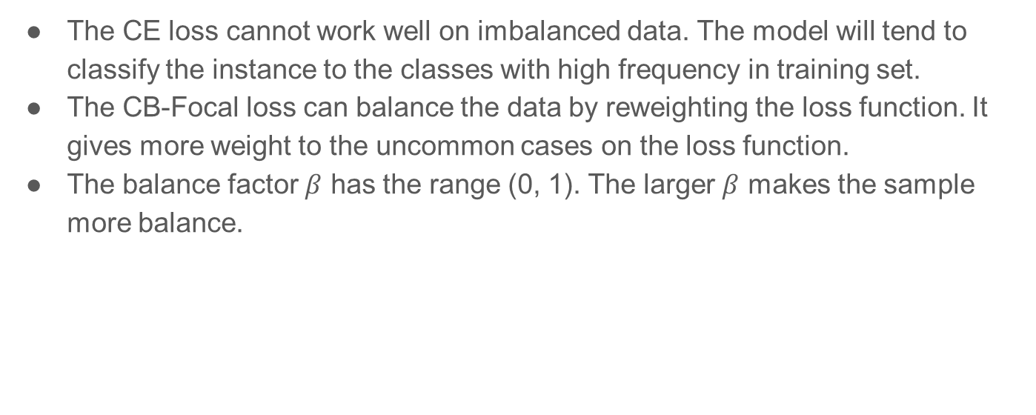
Describe and explain your observation on the result:
The CE loss cannot work well on imbalanced data. The model will tend to classify the instance to the classes with high frequency in training set.
The CB-Focal loss can balance the data by reweighting the loss function. It gives more weight to the uncommon cases on the loss function.
The balance factor $β$ has the range (0, 1). The larger $β$ makes the sample more balance.

