Slide 1
Plan for presentation
Context (10 min)
Intro to project
What’s the problem
Data (15 min)
How we dealt with the dirtiness of the data
Explain taxonomy
Explain classification model
Explain similarity model
Demo (10 min)
Future Directions (5 min)

Slide 2
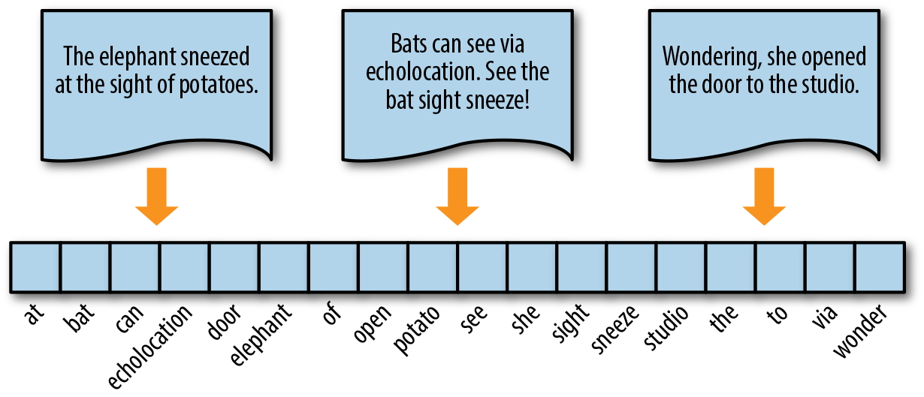
TFIDF Vectorization:
TF-IDF is short for term frequency–inverse document frequency.
TF-IDF is a way to measure how important a word is to a document.

Slide 3
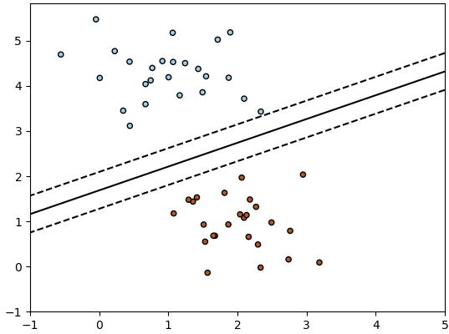
Classification Model
Stochastic Gradient Descent (SGD) is a simple yet very efficient approach to fitting linear classifiers and regressors under convex loss functions such as (linear) Support Vector Machines and Logistic Regression.

Slide 4
Technology
Artificial Intelligence
Displays
Industries
Collaboration
Computer Vision
Data
Developers
Engineering
Geospatial
Graphics
Input
IoT
Networks
Robotics
Security
Semiconductors
Sensors
Simulation
Smart Cities
Telecommunications
Video
Web Services
End Users and User Experience
Business
Standards
Use Cases
Inspection, Safety, and Quality
Maintenance
Navigation
Training
Device Energy Management
Display Technology
Optics
Wearables
Automotive
Aviation and aerospace
Chemical
Construction
Consumer Products
Cultural Heritage
Education
Emergency Response
Food, Agriculture, and Natural Sciences
Government
Industrial Equipment
Liberal Arts
Manufacturing
Marine
Medical
Metals and Mining
Oil and Gas
Power and Energy
Transportation
Utilities
Computer Human Interfaces
Human Factors
Human-Computer Interaction
Presence
Users
Business
Integration
Logistics
Policy
Standards
Audio

