Slide 1
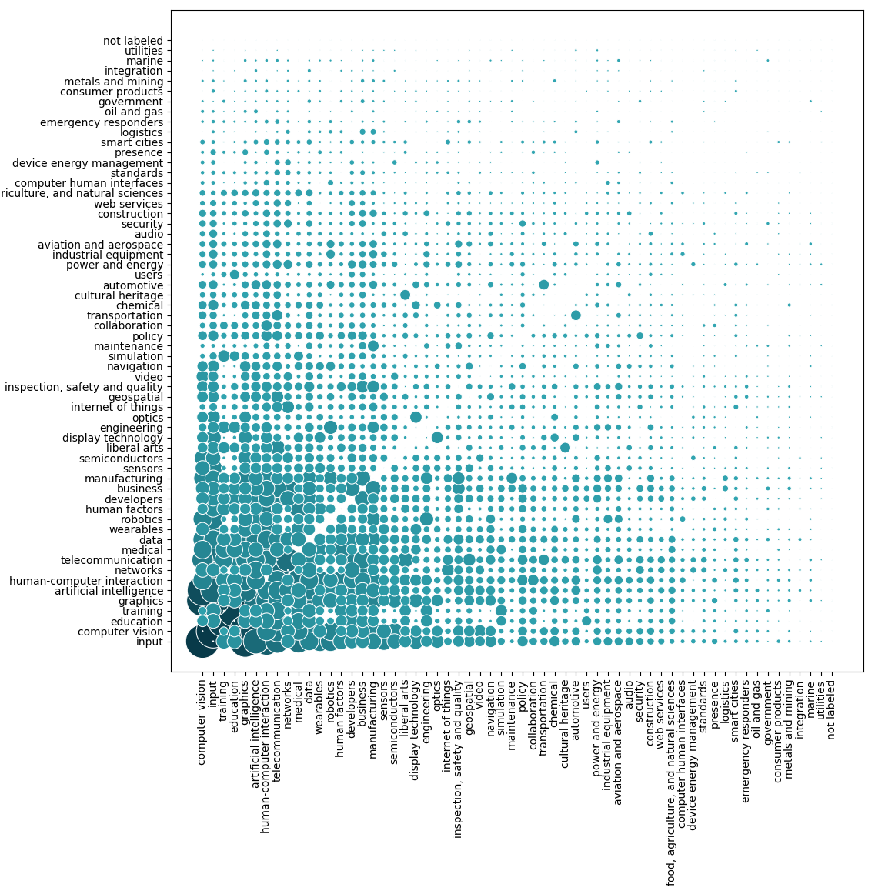
emergency responders + training
IoT + sensors
navigation + training
robotics + training
manufacturing + standards
wearables + human factors
training + inspection, safety and quality
geospatial + manufacturing
audio + input
wearables + networks

Slide 2
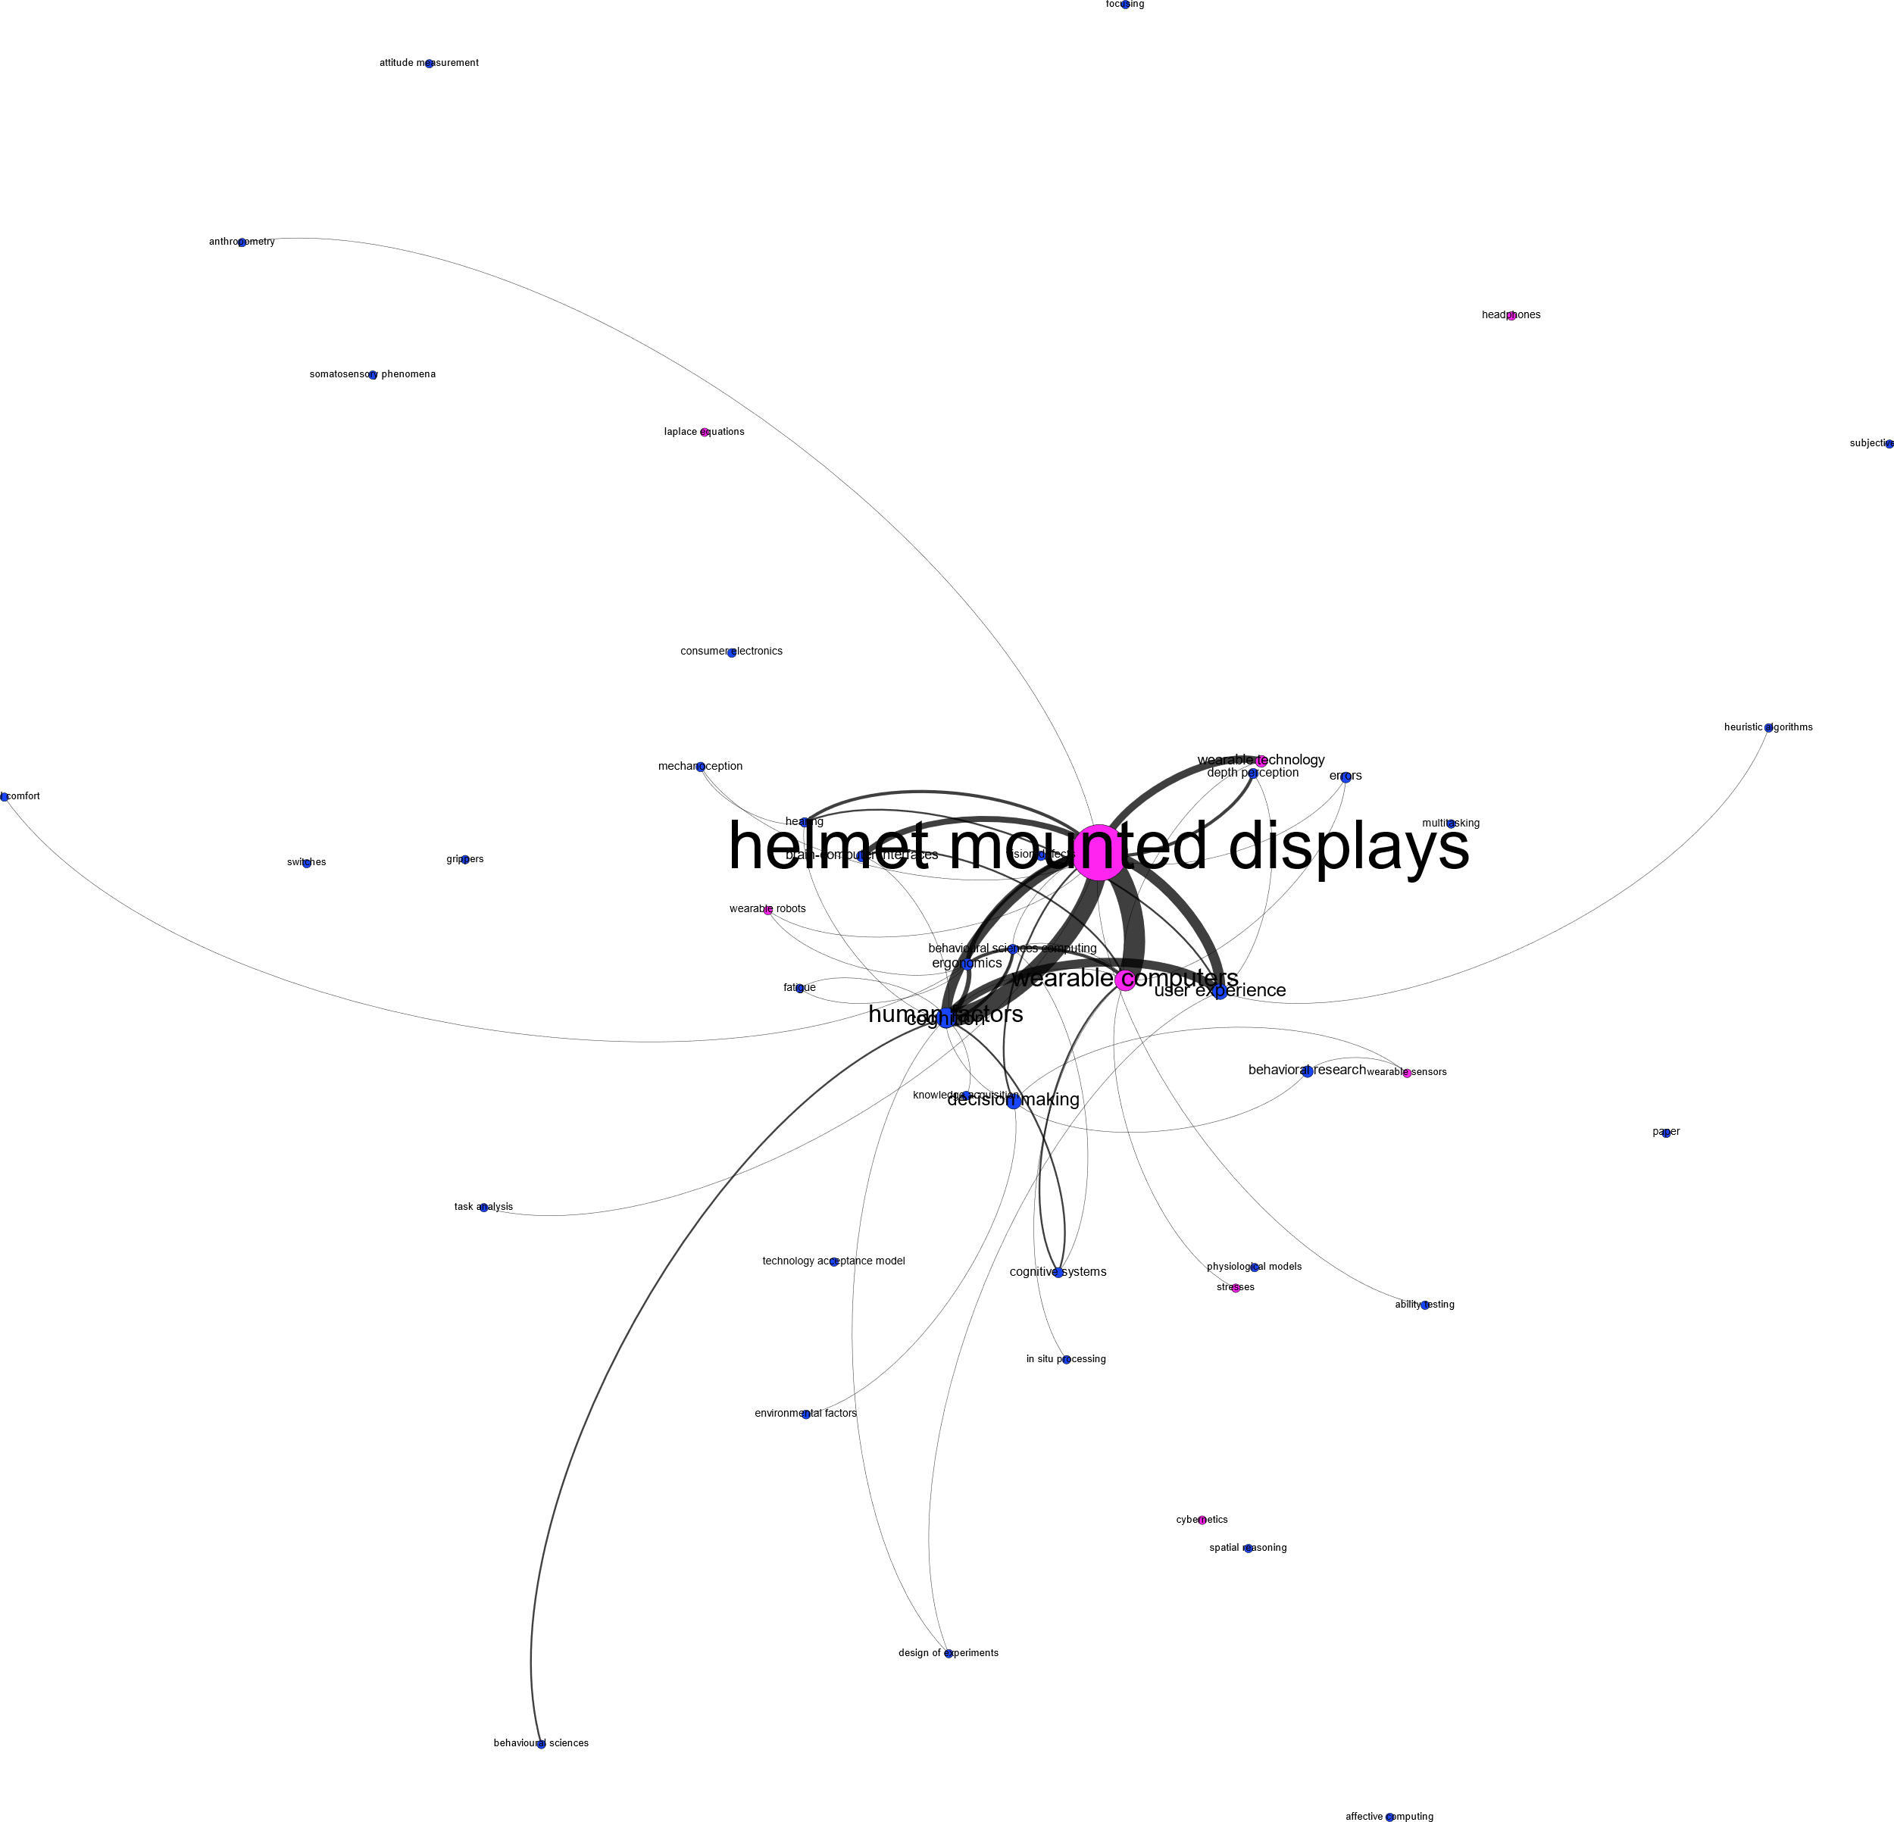
Wearables + Human Factors
Conclusion: Not a gap

Slide 3
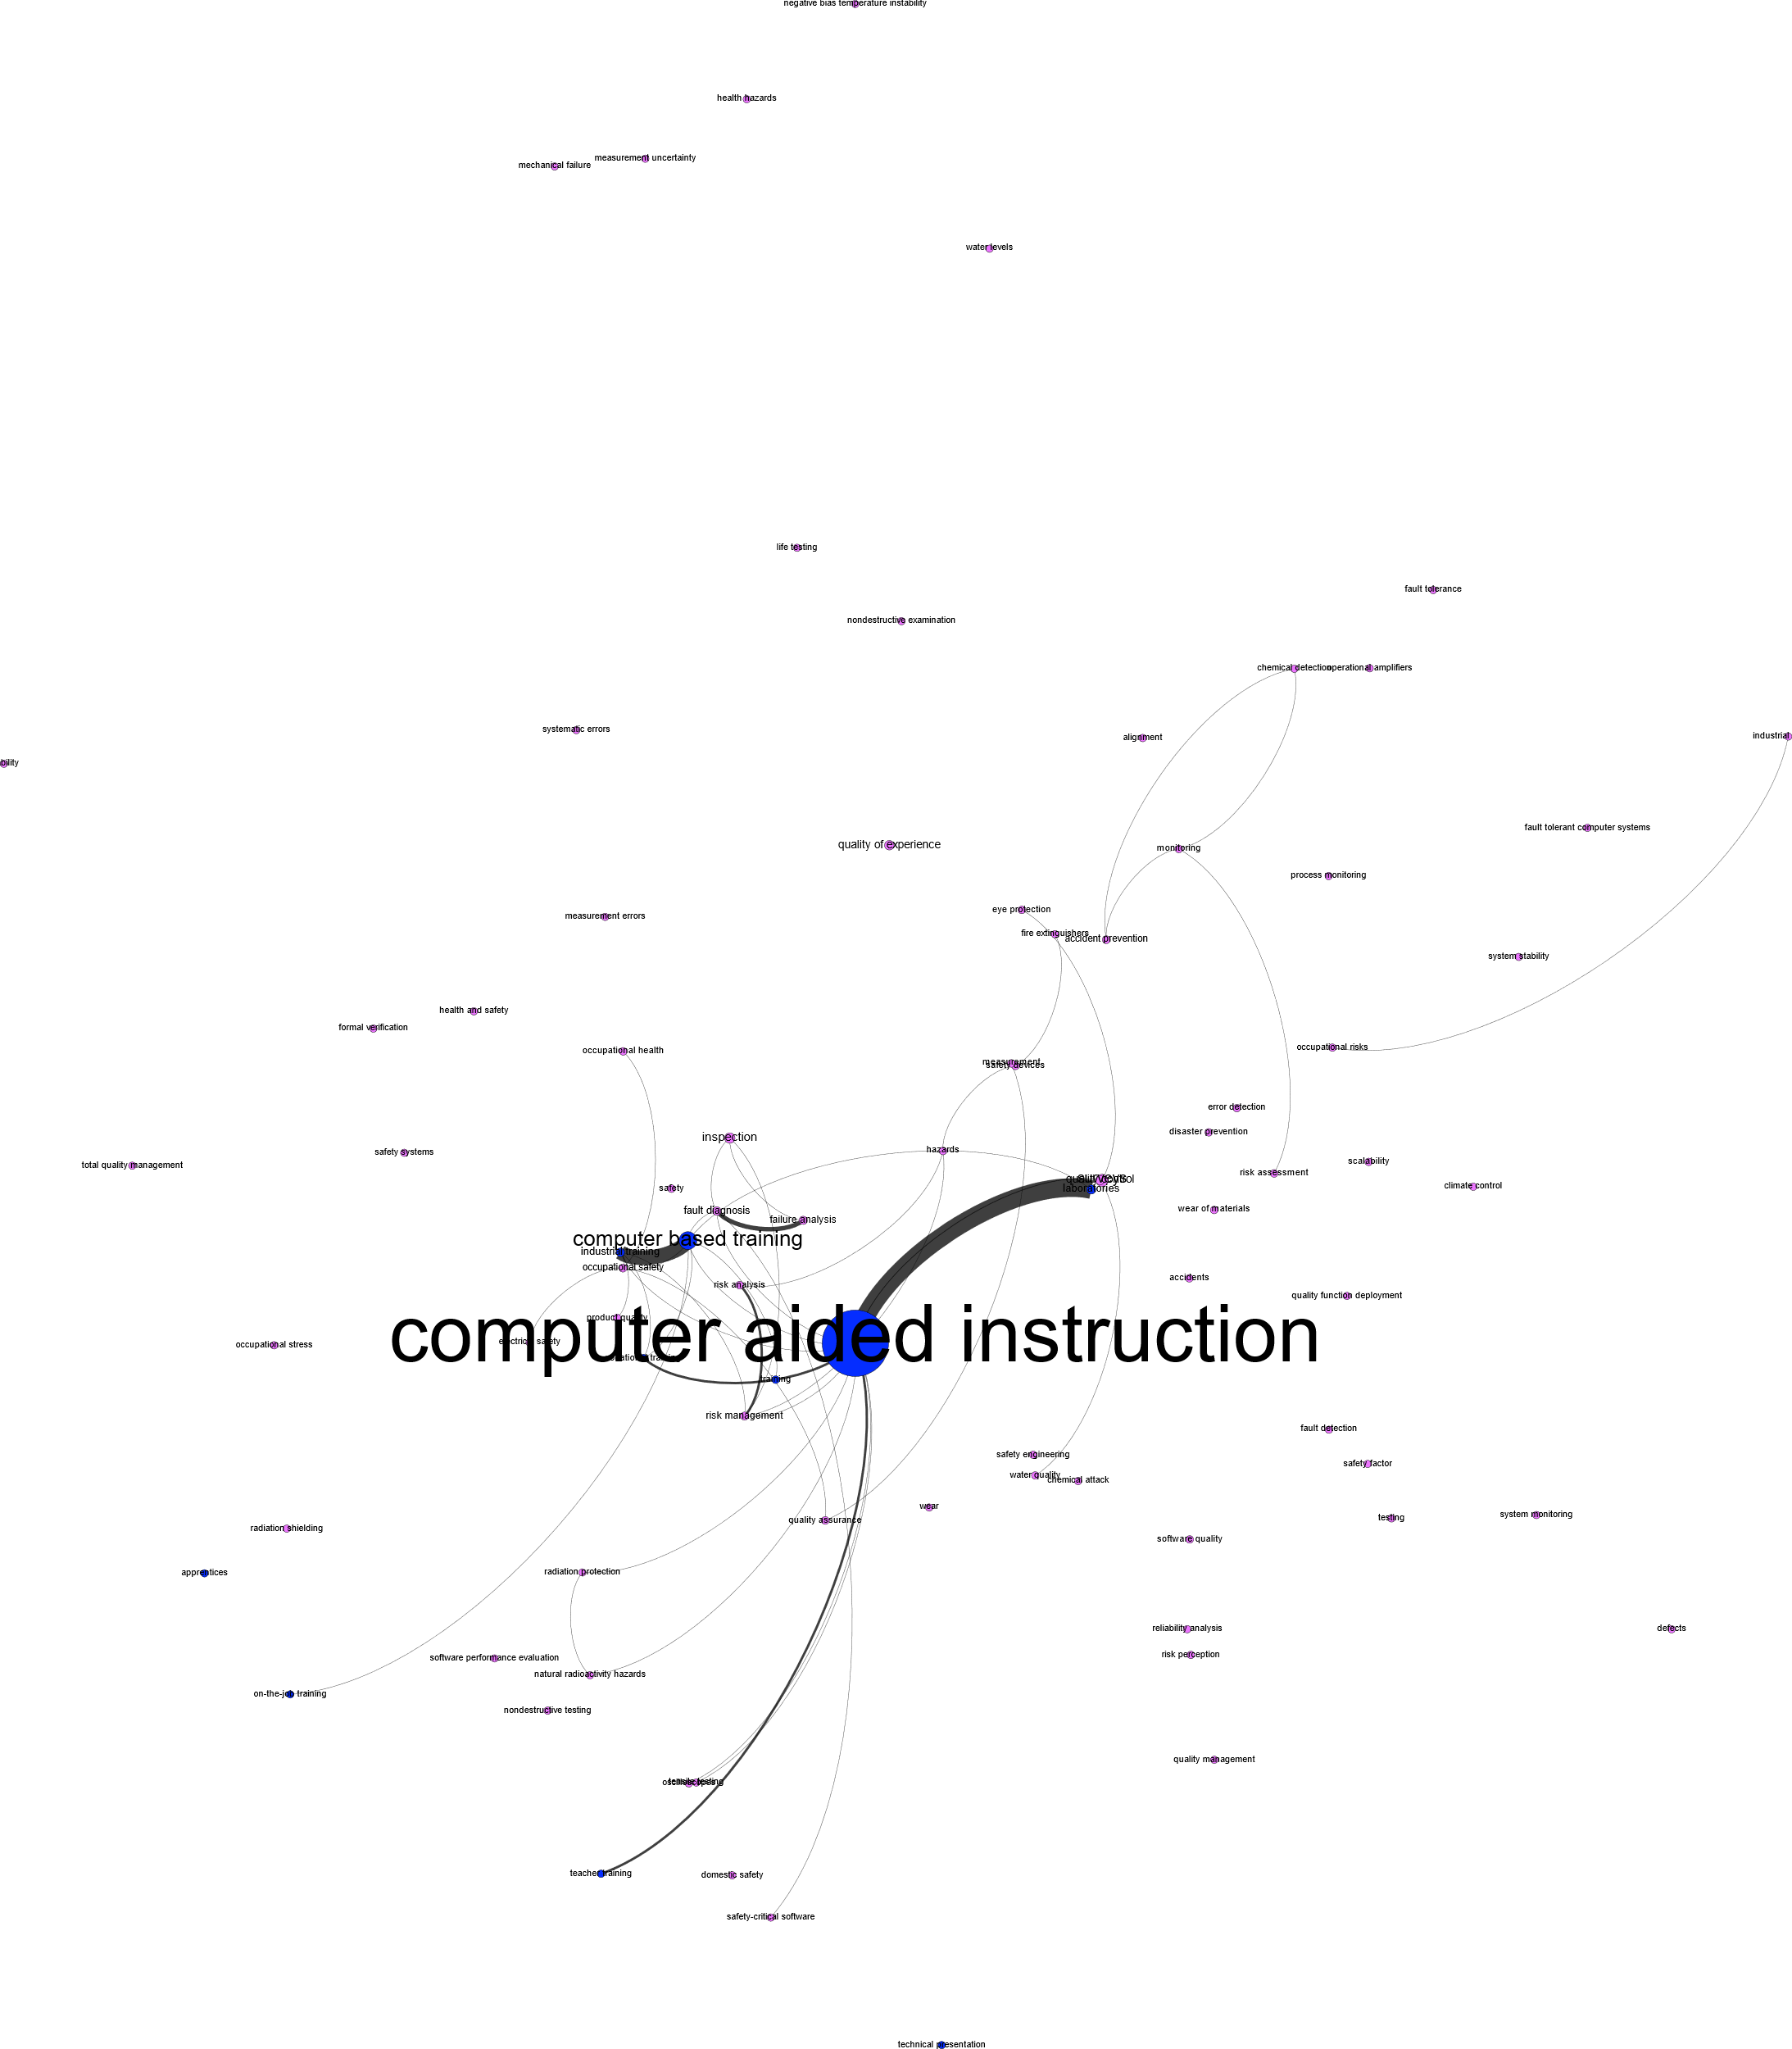
Training + Inspection, safety and quality
Conclusion: Gap. Not well connected and does not convey similar position/connectedness

Slide 4
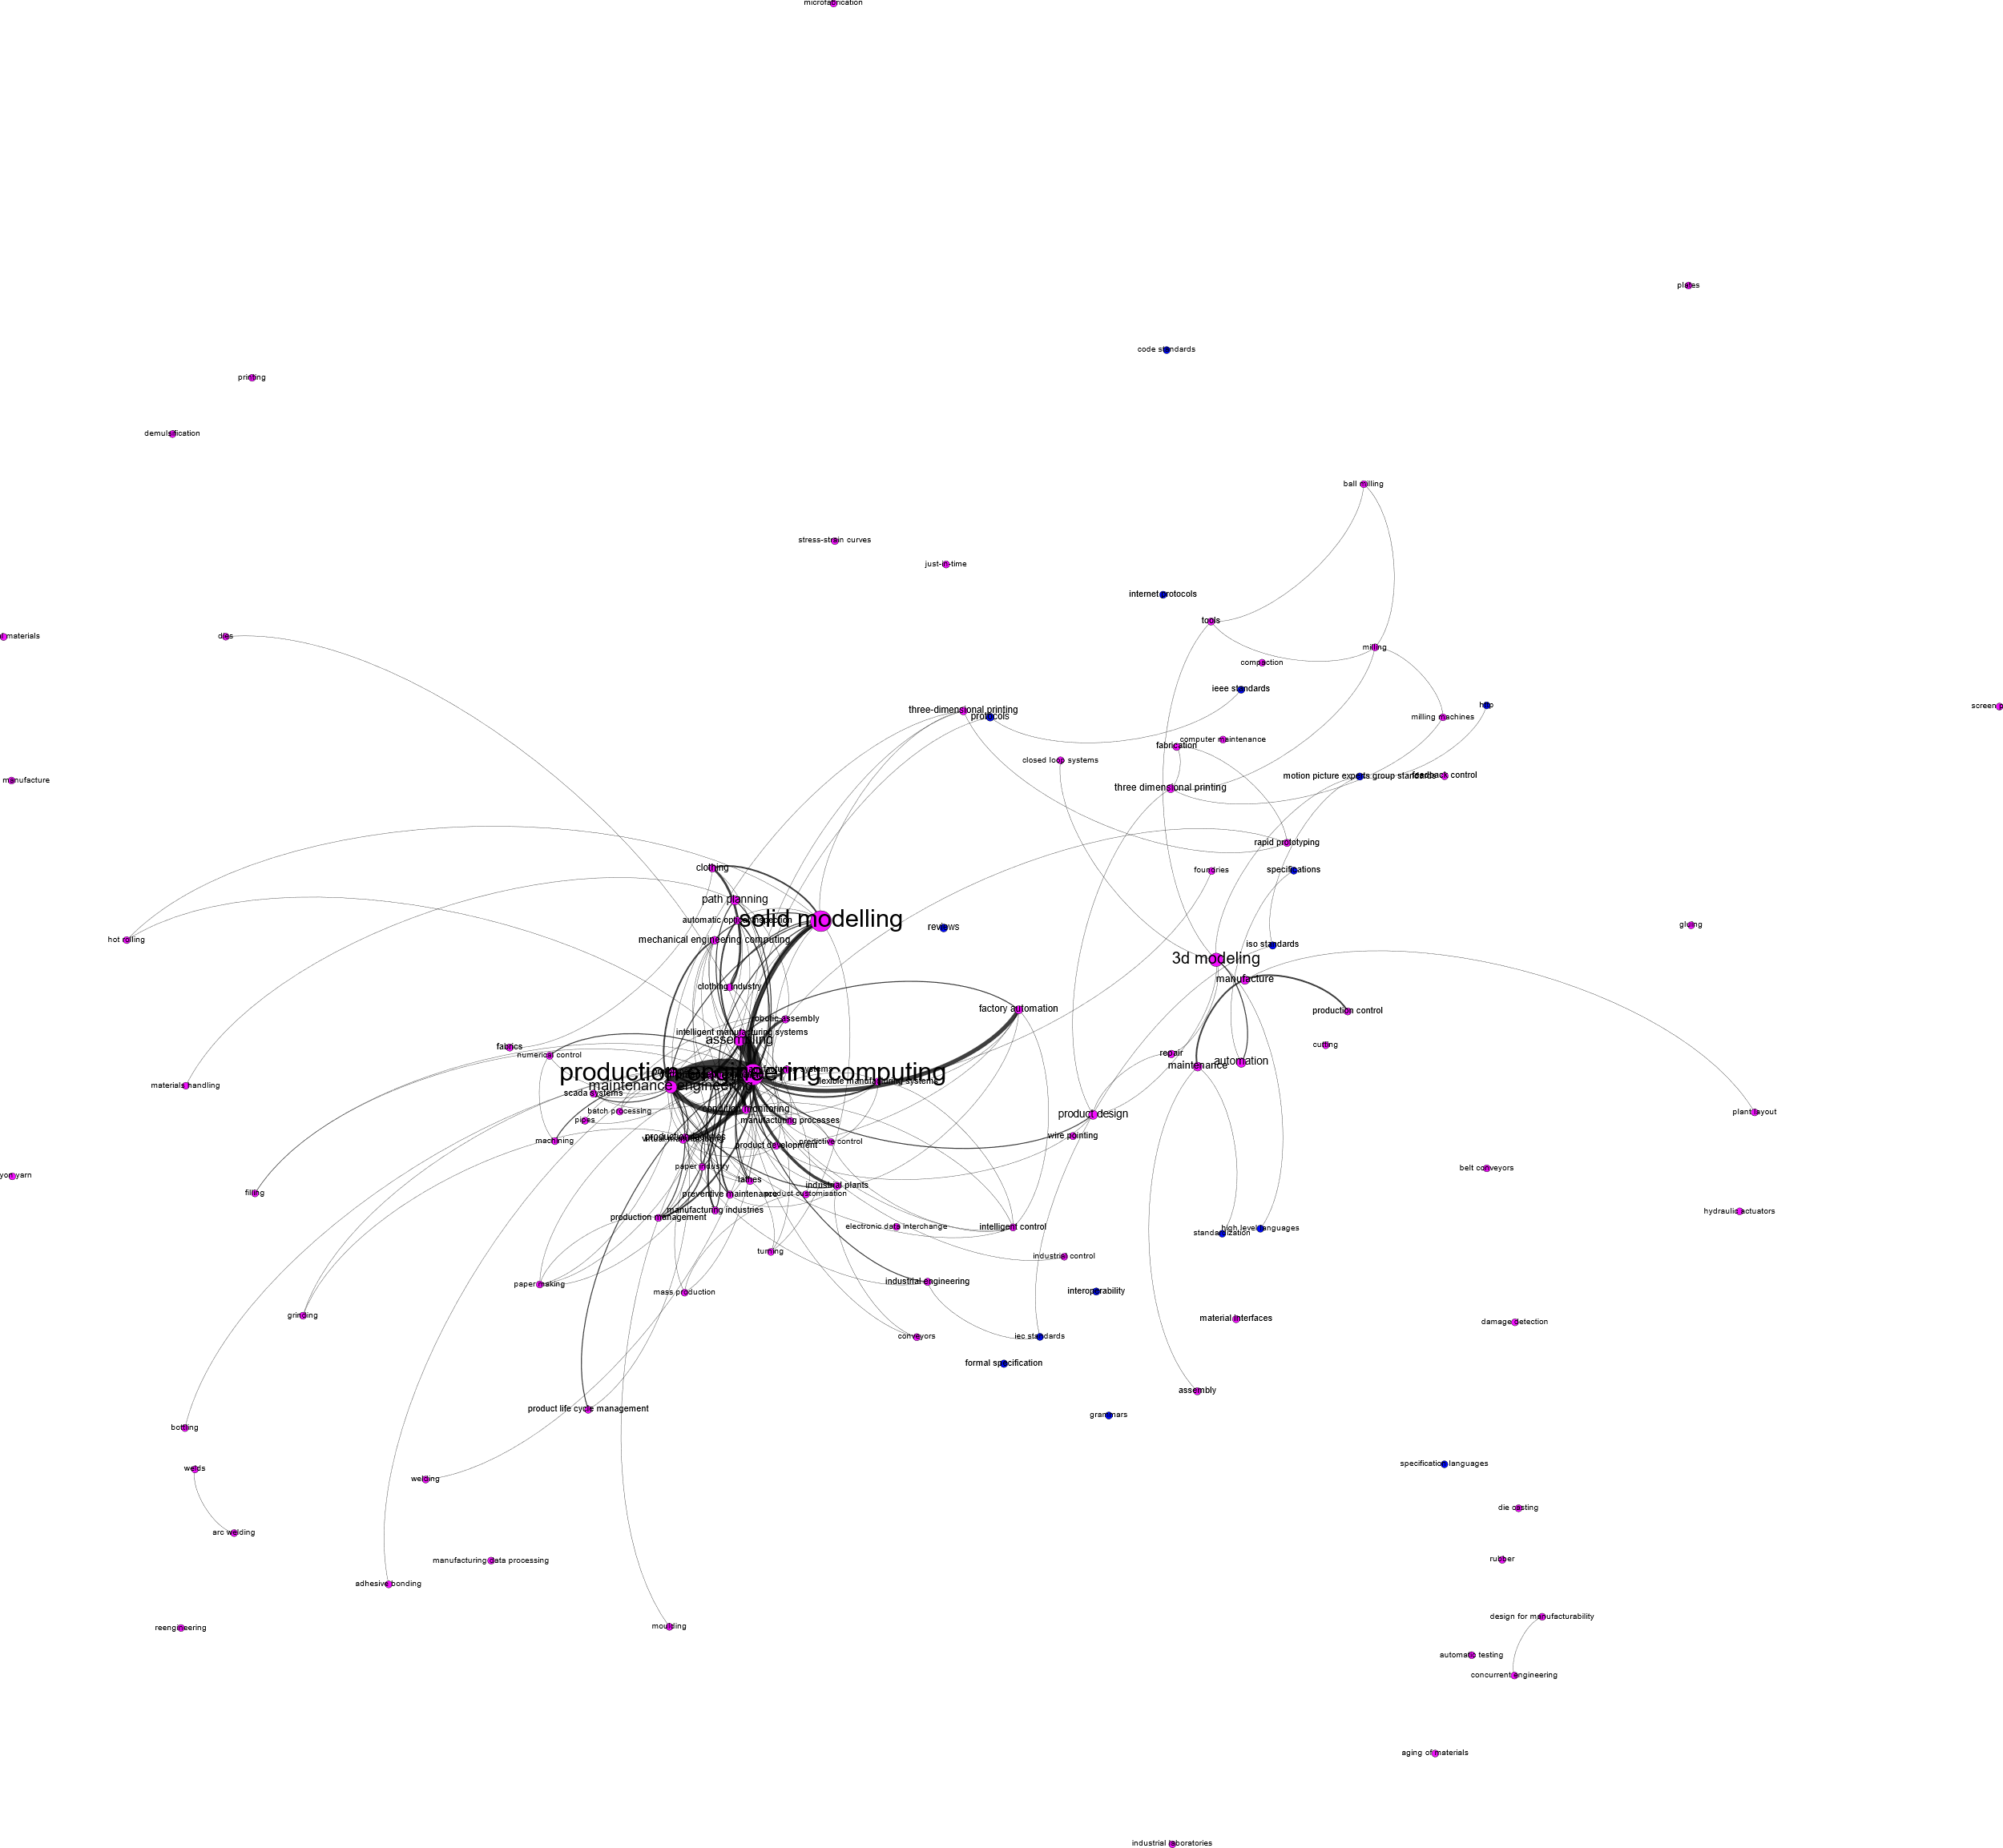
Manufacturing + Standards
Conclusion: Gap. Not well connected and does not convey similar position/connectedness

Slide 5
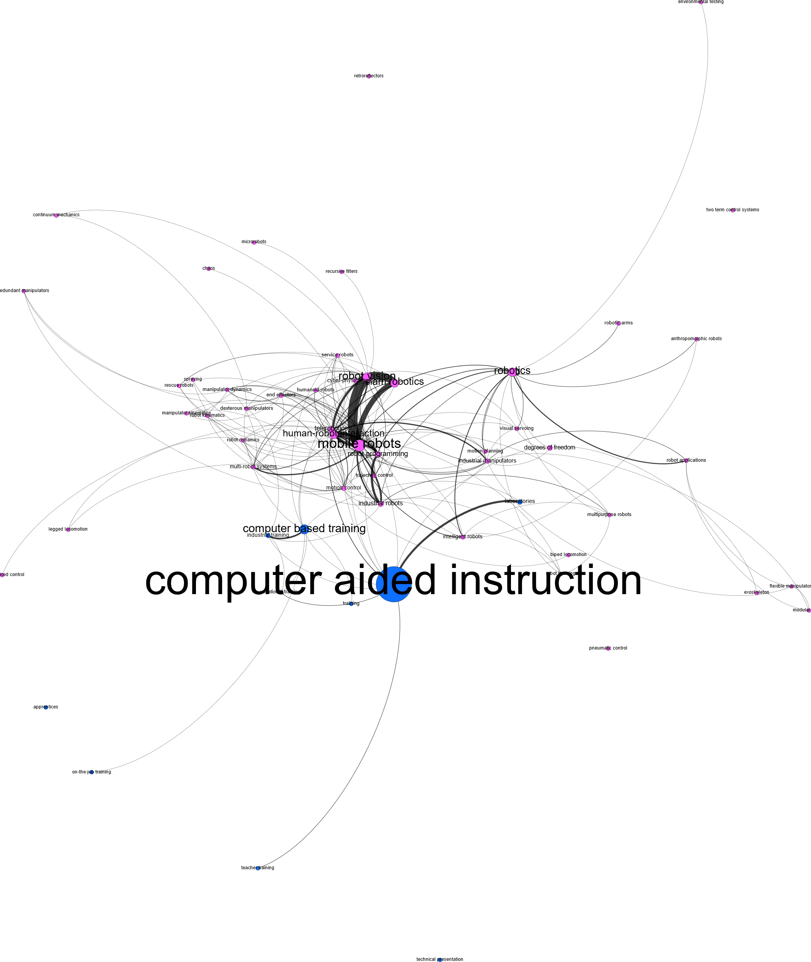
Robotics + Training
Conclusion: Mid Term Gap. Not well connected but does convey reasonably similar position/connectedness

Slide 6
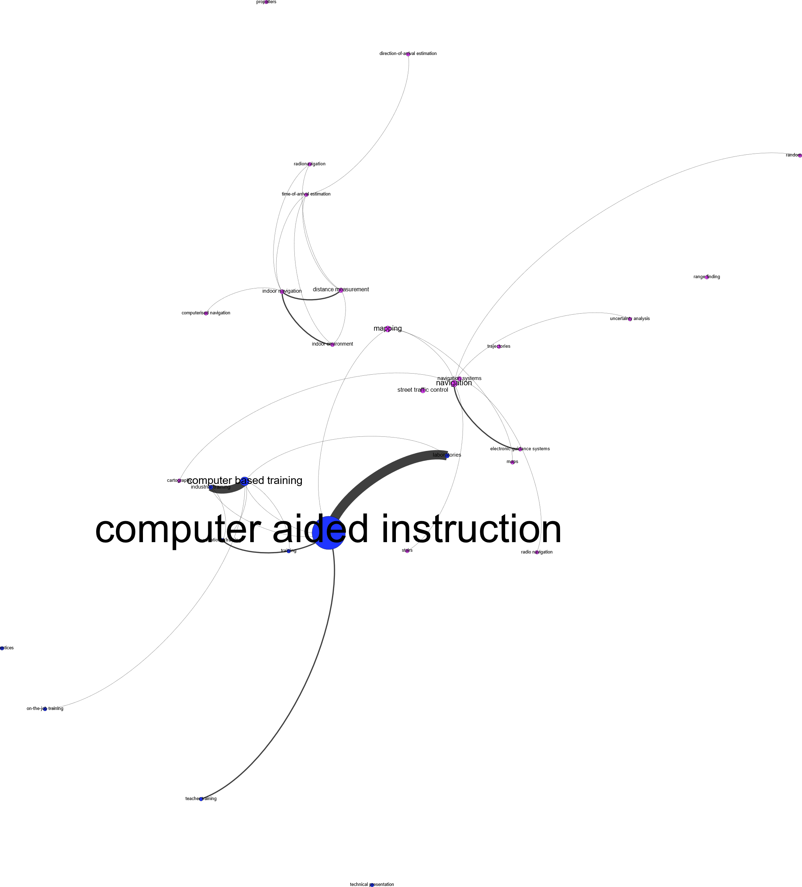
Navigation and Training
Conclusion: Gap. Not well connected and does not convey similar position/connectedness

Slide 7
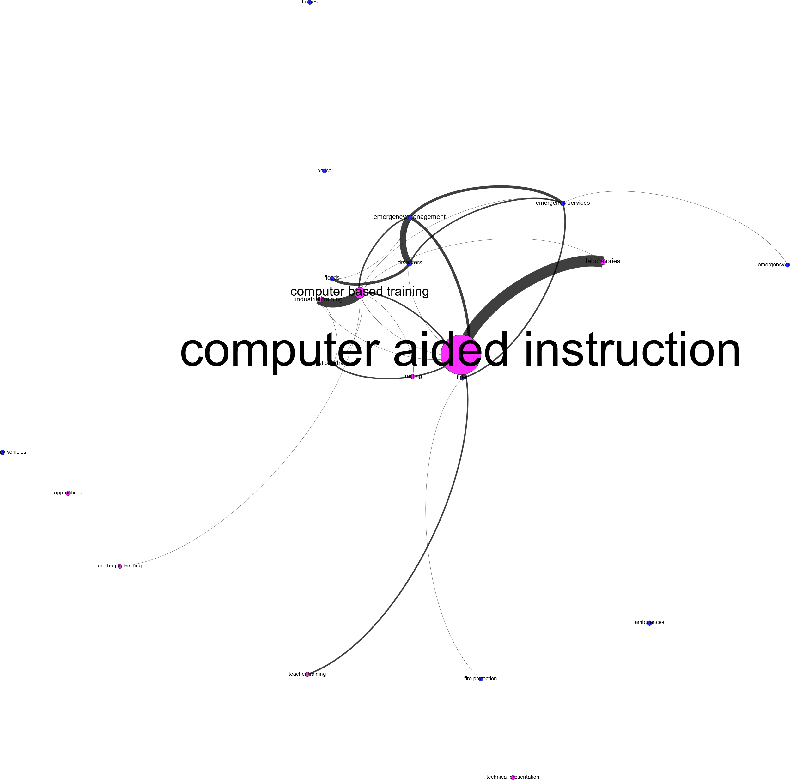
Emergency Responders and Training
Conclusion: Not a gap. Connected and “close”

Slide 8
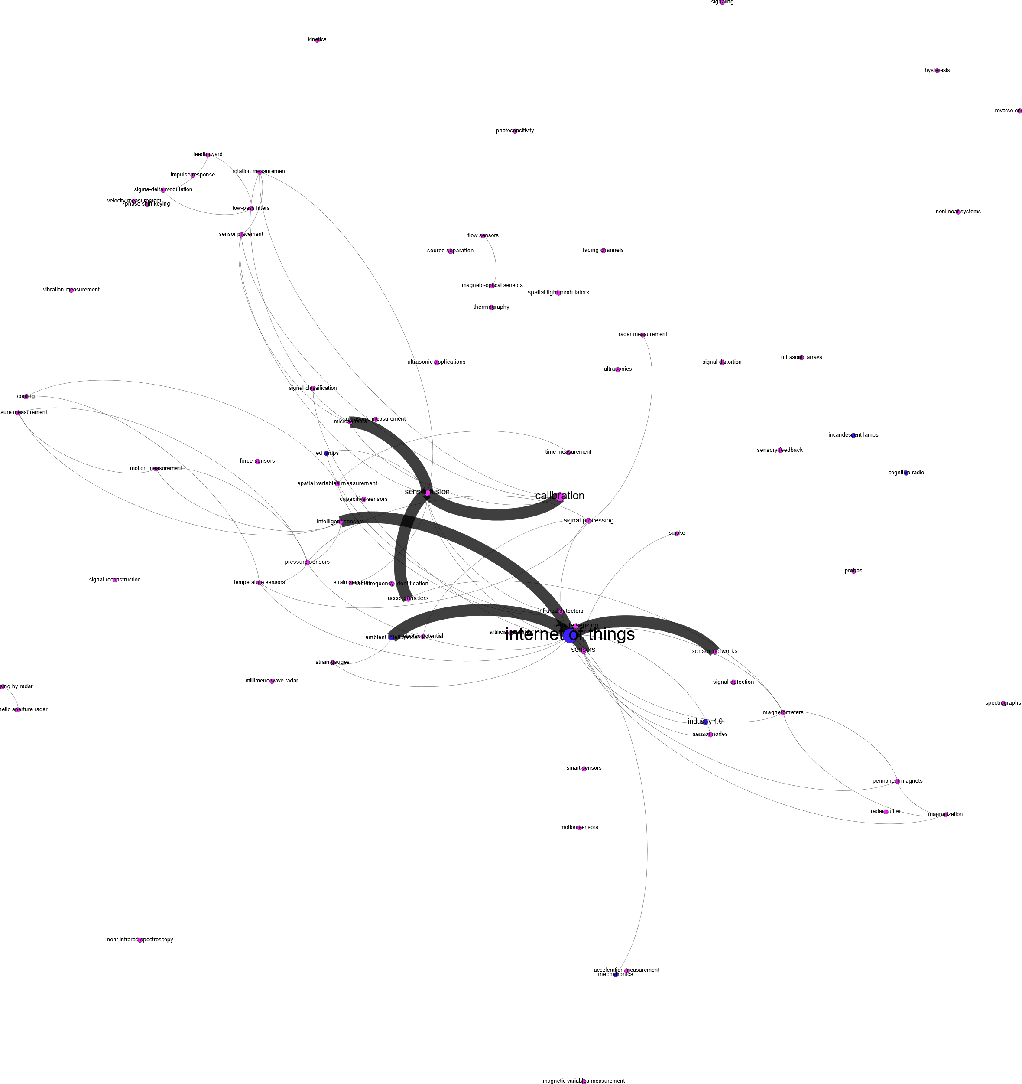
IoT + Sensors
Conclusion: Not a gap. Closely related…

Slide 9
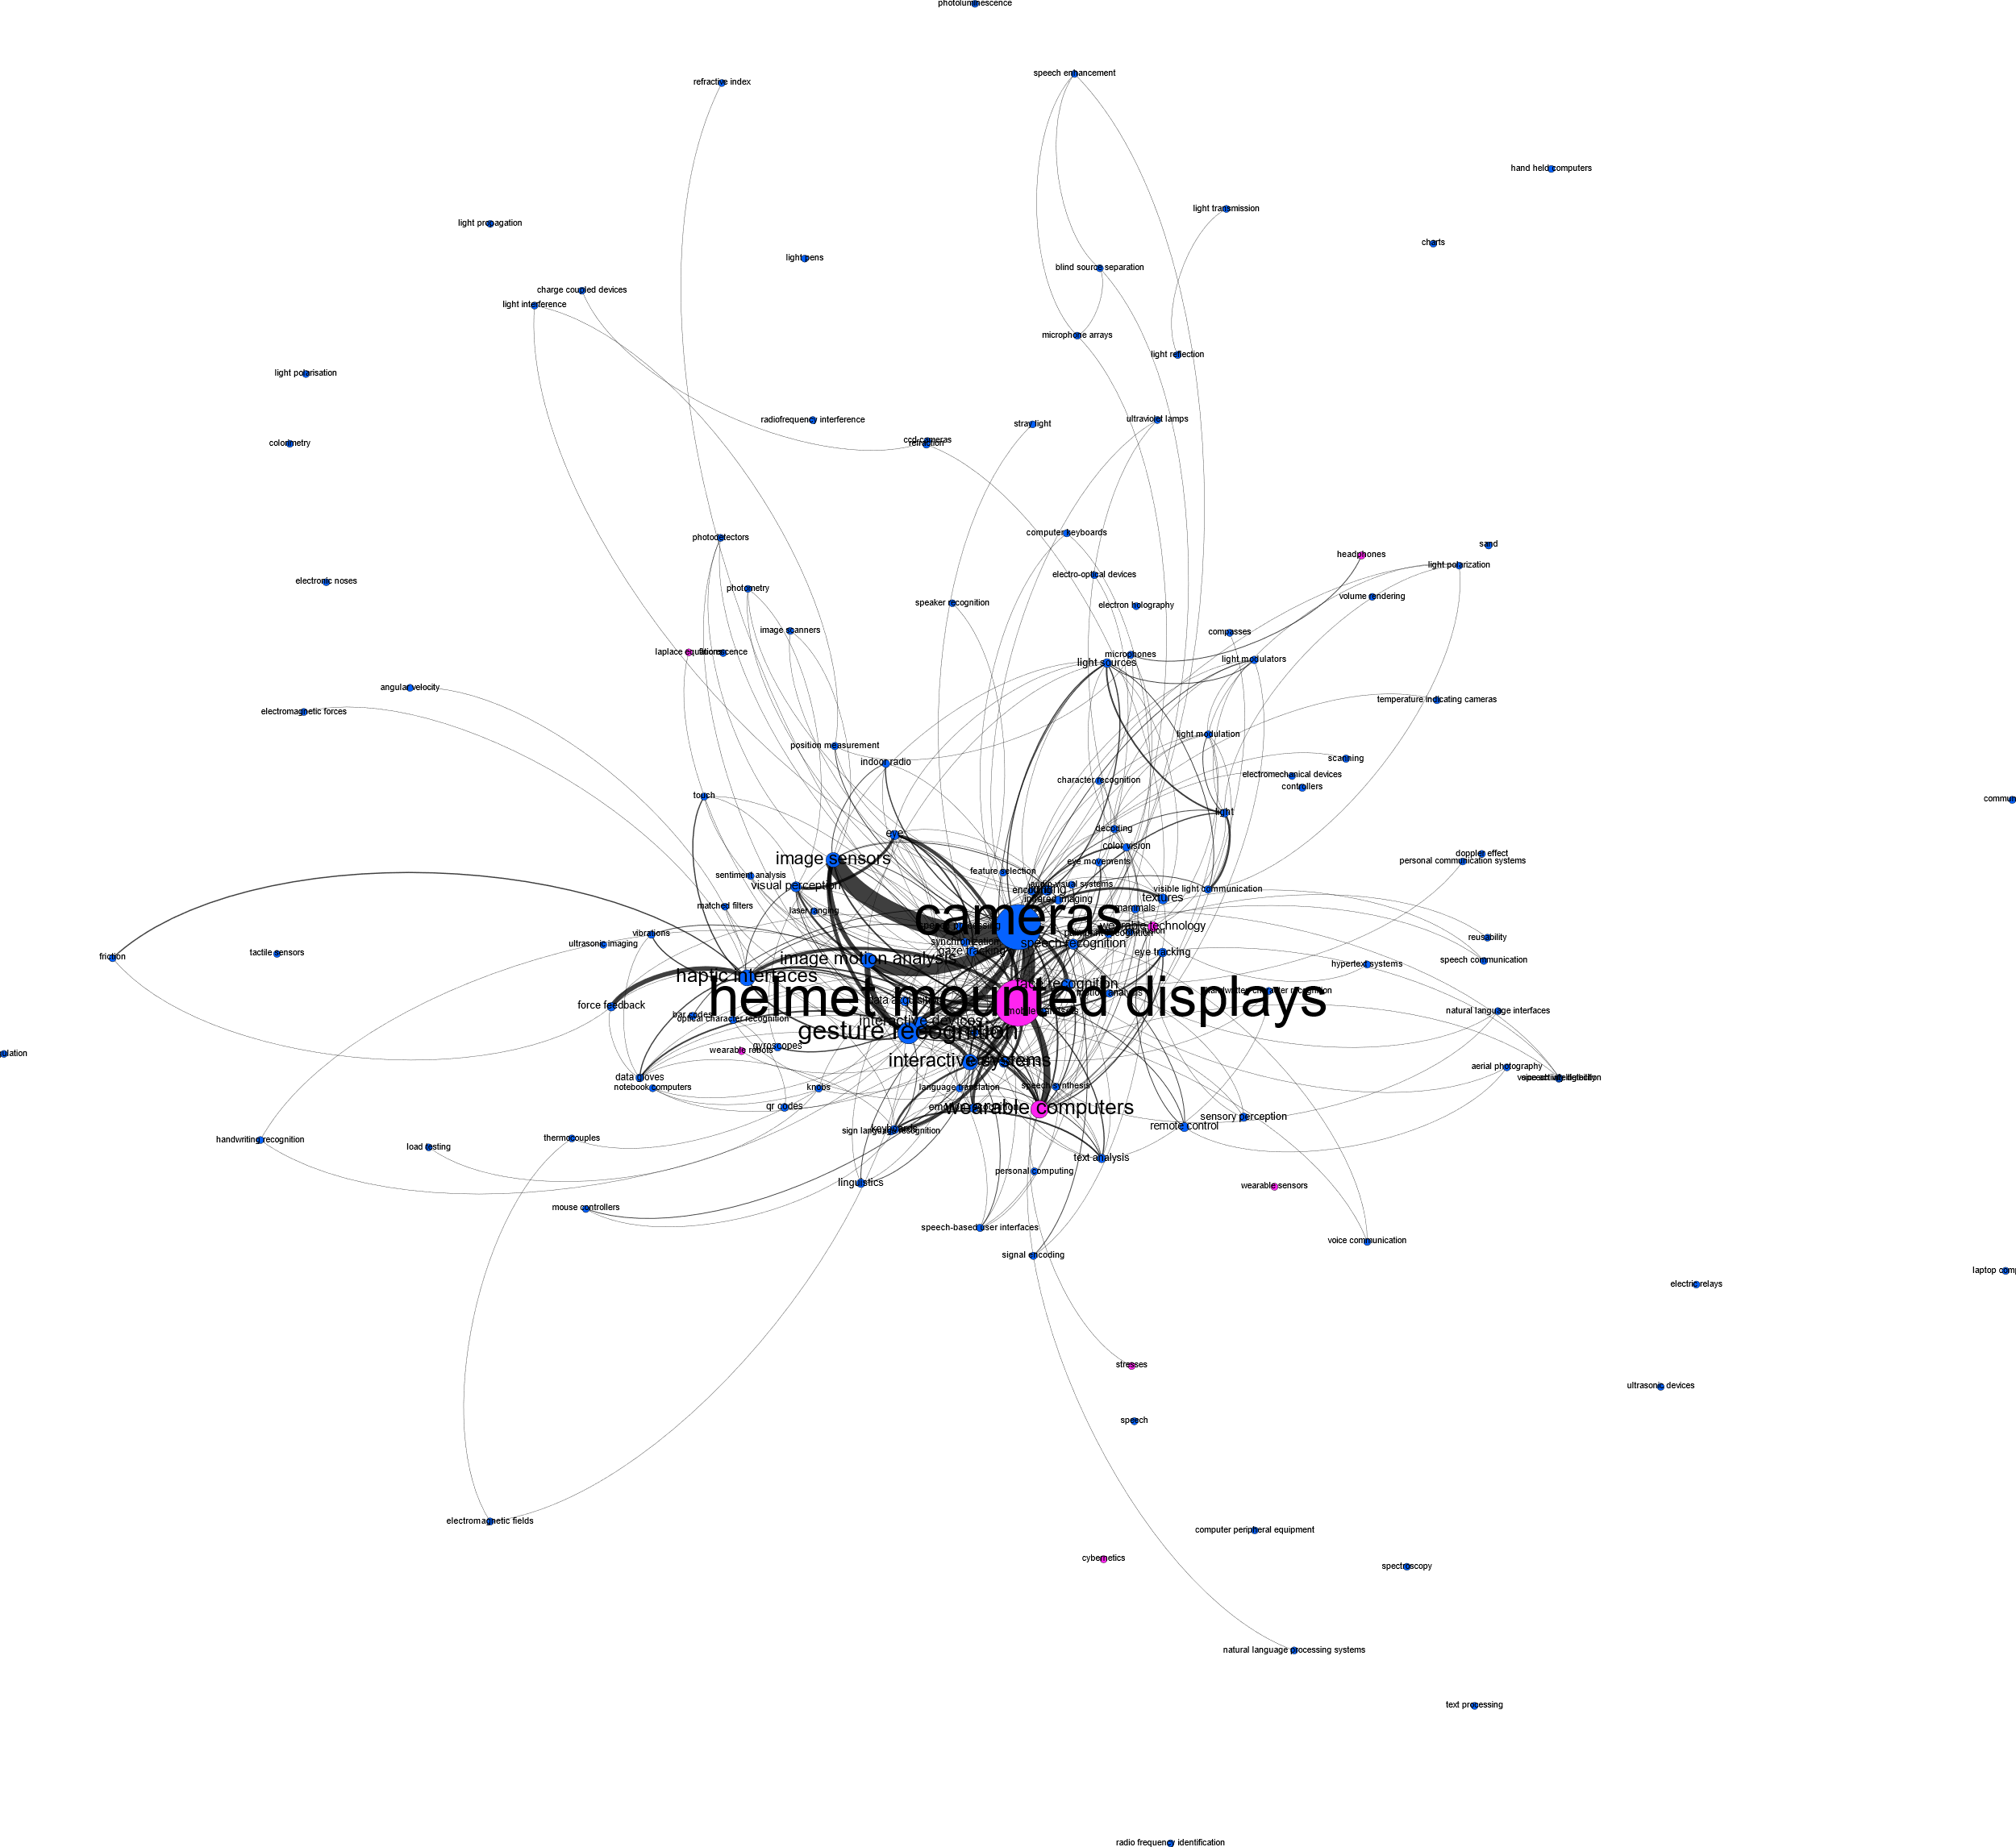
Input + Wearables
Conclusion: Not a gap. Closely related…

Slide 10
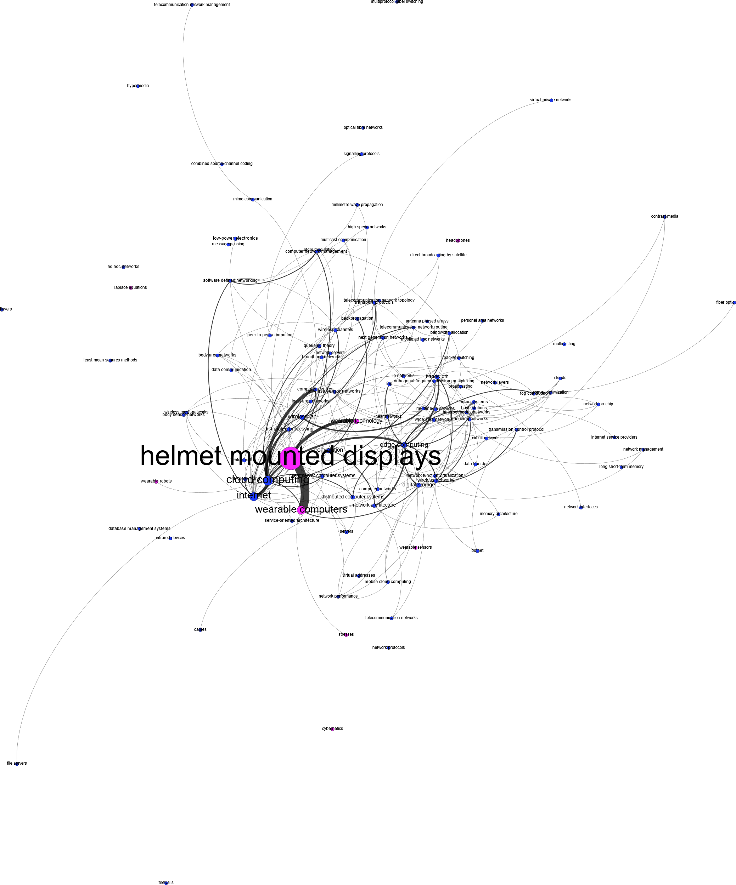
Networks + Wearables
Conclusion: Not a gap. Closely related…

Slide 11
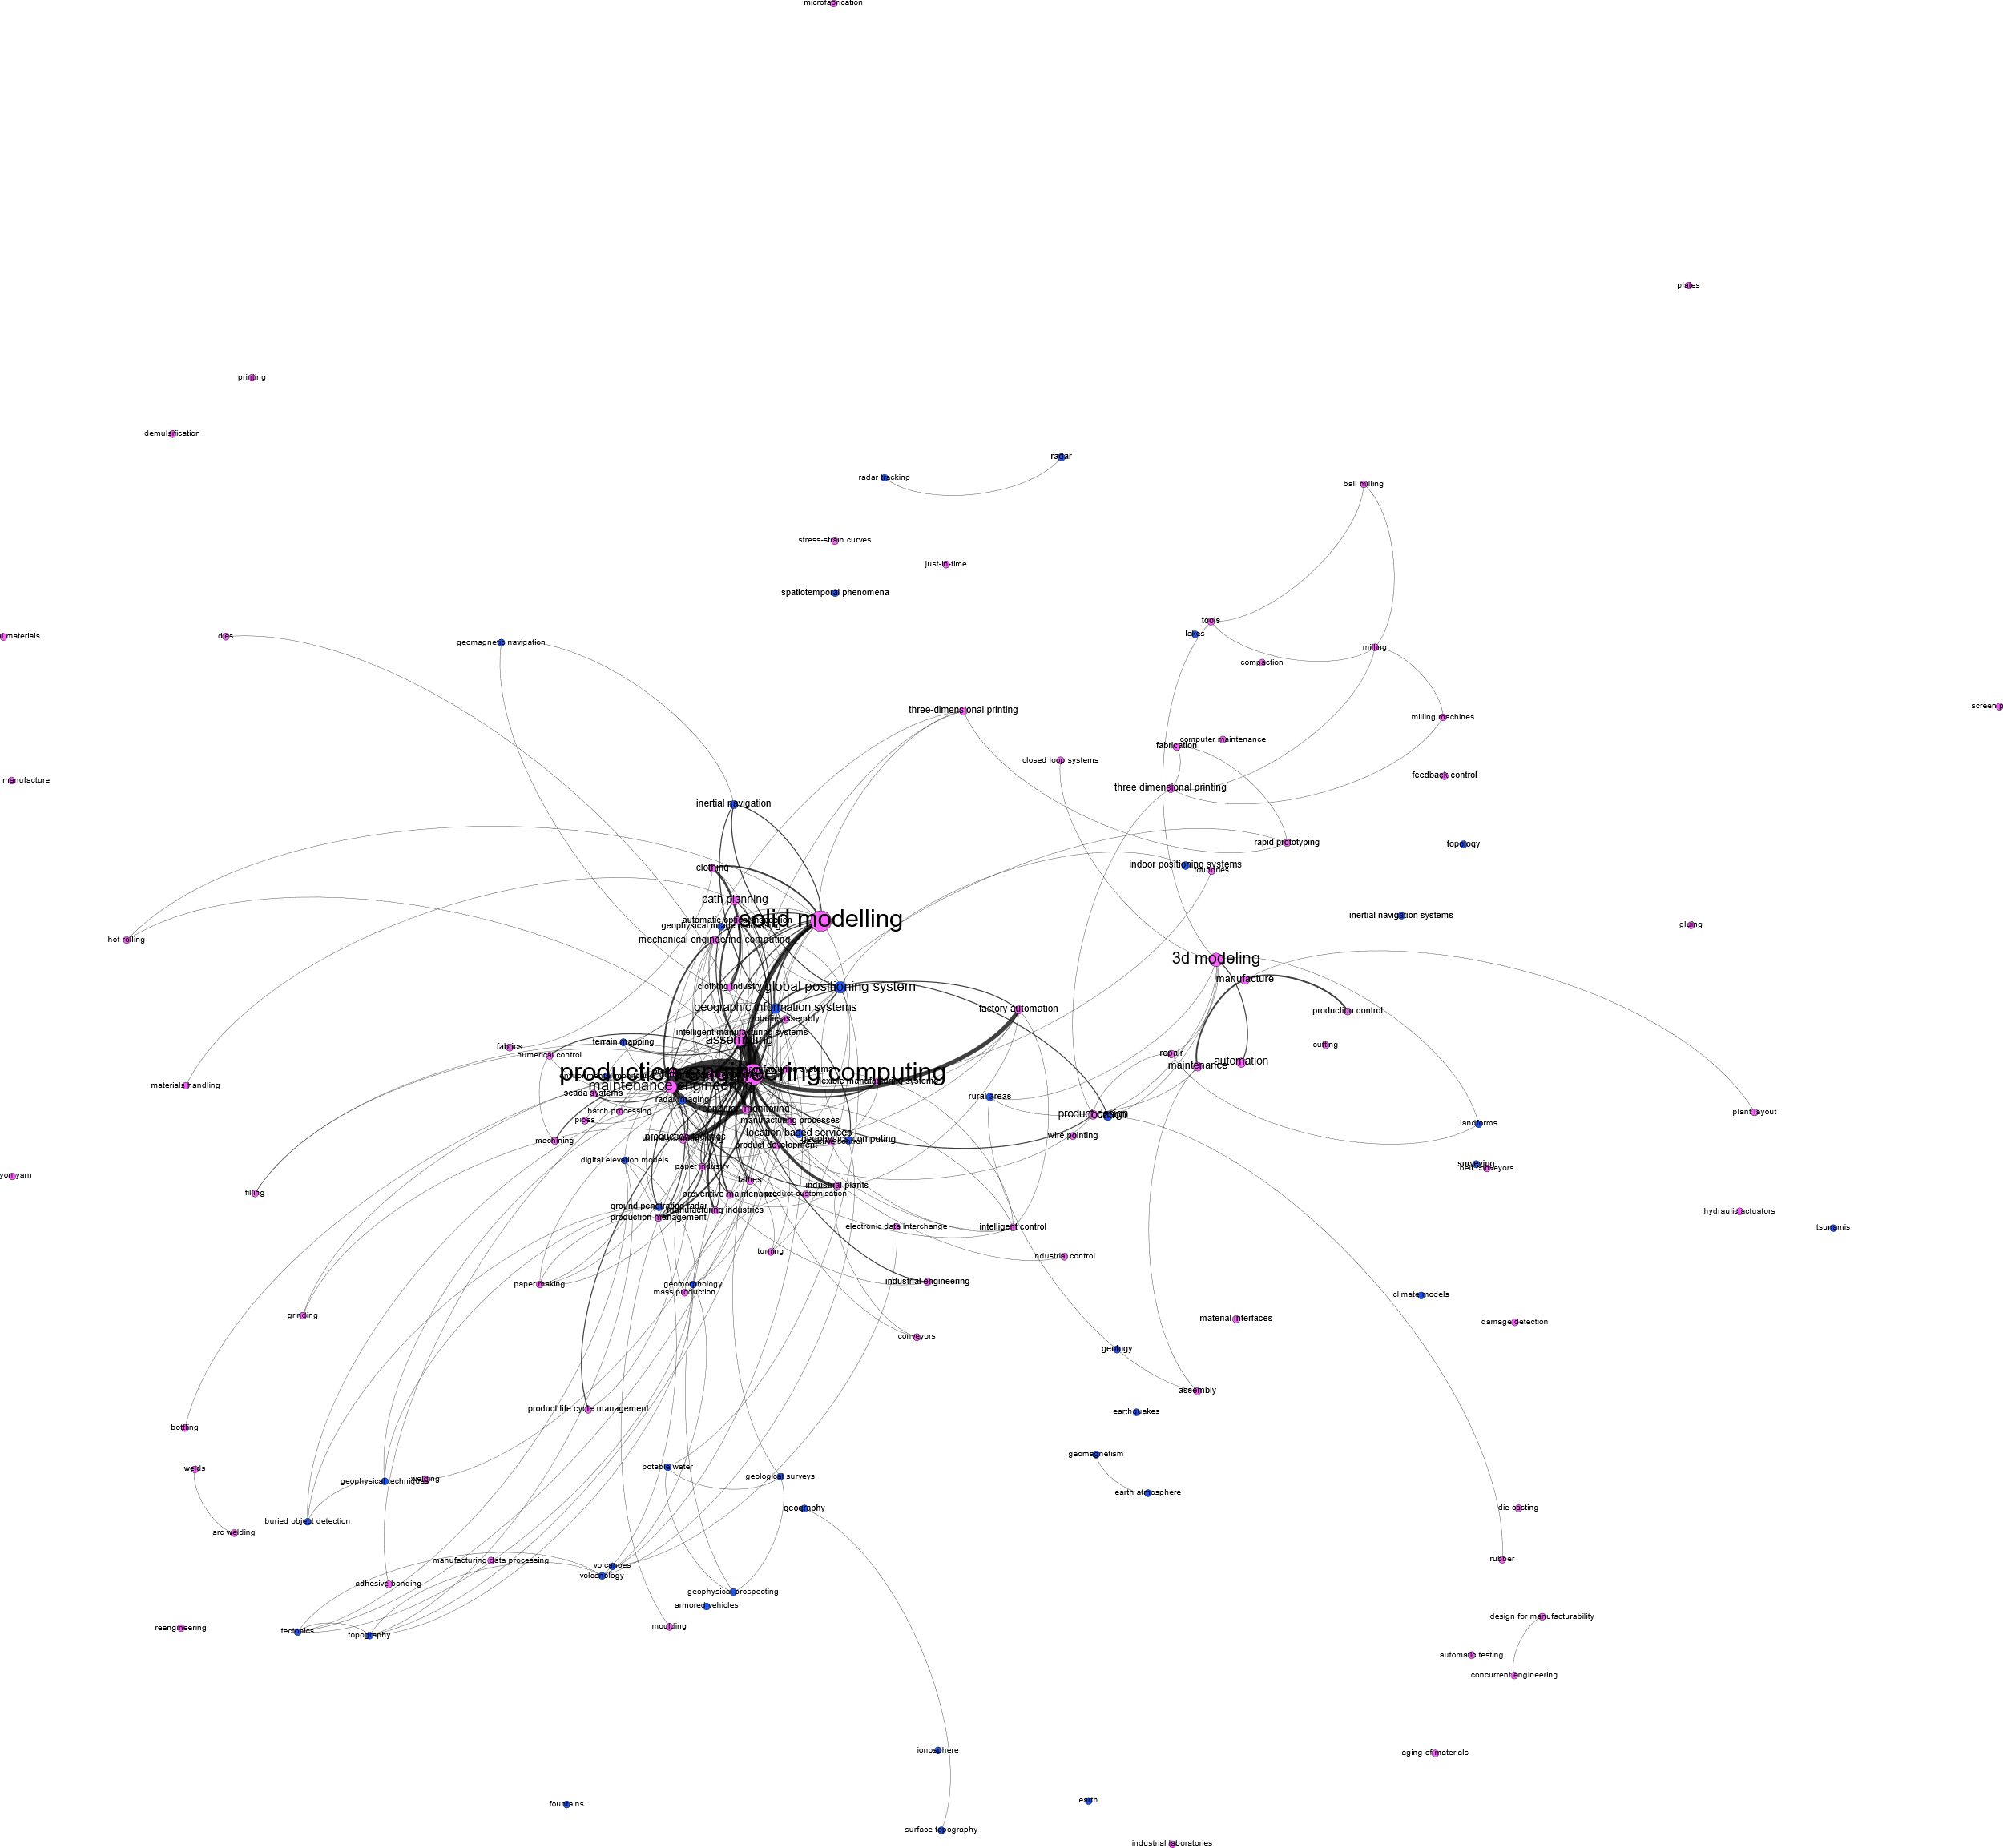
Geospatial + Manufacturing
Conclusion: Does not seem like a gap.

Slide 12
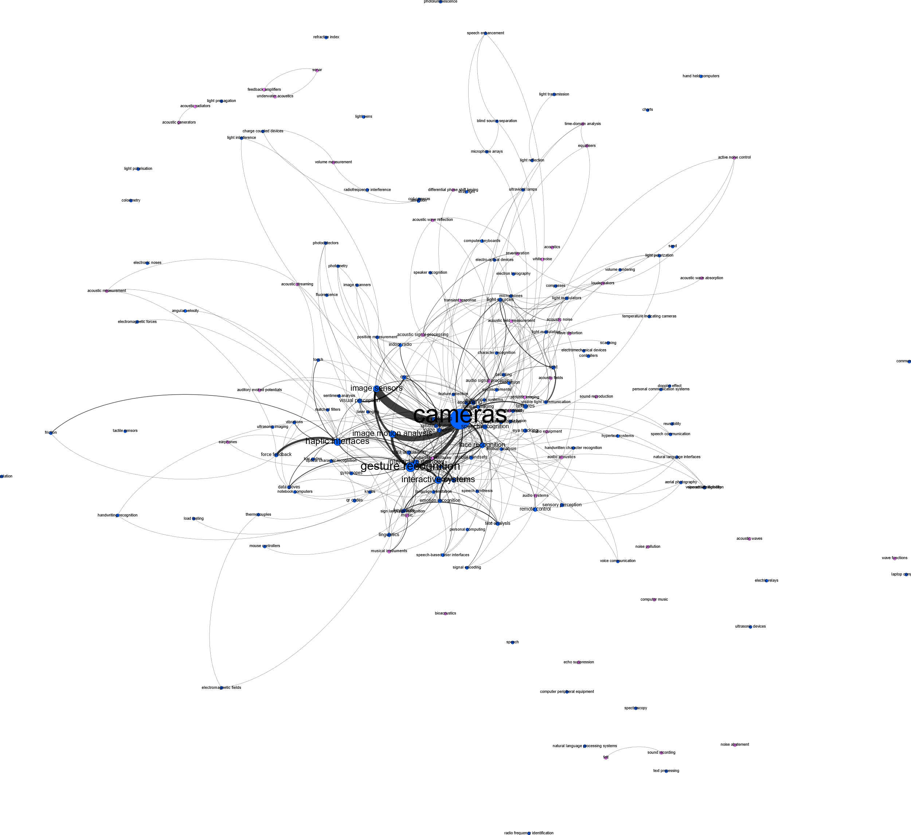
Audio + Input
Conclusion: Does not seem like a gap.

