Slide 1
Week 4
Behavioral theory of everything

Slide 2

Time machine to 1955
Herb Simon – Behavioral model of rational choice

Slide 3
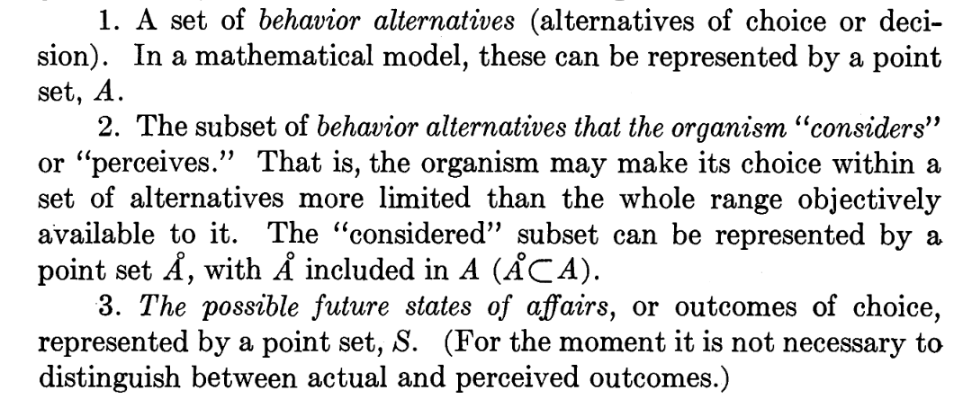

Slide 4
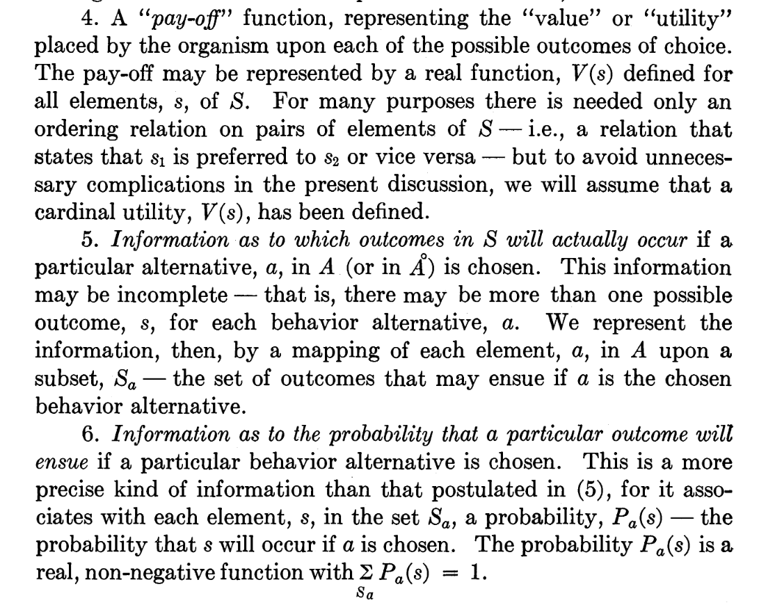

Slide 5
Does this look like something we know?
Represent the environment
Represent potential future states
(should be ~ similar to environment)
I perceive the future state in the same framework as I perceive the present
Represent the steps that can be taken
Represent the decision process between these steps
Represent utility or payoff function
Represent a mapping between steps and future states

Slide 6
In system dynamics
Current state = state of stocks and flows
Future state = desired state of stocks and flows
Steps are deterministic = driven by internal causal loops or external inputs
Utility / payoff is external – we evaluate if we get what we want

Slide 7
Why is system dynamics not enough
System boundaries
Interactions between parts
Non-deterministic system behaviors
Self-organization

Slide 8
Example – mass immunization
Follows S-I-R model – add “immunized” state
Increased immunization rates decrease number of susceptible and rate of infection
Disease rate falls, we get herd immunity because probability of infection ~ square of susceptible
Enter the anti-vax movement
Second S-I-R loop decreasing effectiveness of immunization?
But why do people decide to become anti-vax?

Slide 9
IMAGINE HOW HARD PHYSICS WOULD BE IF ELECTRONS COULD THINK

Slide 10
Model of rational choice
Transaction Cost Economics 101:
If sum(benefits) > sum(costs) – Immunize. Otherwise don’t
…except benefits and costs are probabilistic and in the future
EC (measles) = C(measles) * P(measles)
EC (autism) = C(autism) * P(autism)
C(measles) is a constant and P(measles) is high, EC(measles) = constant
C(autism) is infinite, P(autism) ~ 0 but > 0 ; EC(autism) = infinite

Slide 11
Except… we make these choices all the time
Given state transition S → S1…
If C(S-> S1) > C(S) – remain at S
Or do the same for multiple choices
This is simple as long as choices are discrete and independent
Which they are NOT.

