Slide 1
System Dynamics Model of Depression
Week 3

Slide 2
Goal
Taking system dynamics beyond toy models – toward a usable Level-1 model
Using system thinking to synthesize complex causal/feedback loops
Using empirical data to infer equations
Setting up an in-silico experiment
Analyzing results

Slide 3
References
D. Herrera and I. Bleijenbergh 2018, Cutting the Loops of Depression: a System Dynamics Representation of the Feedback Mechanisms Involved in Depression Development And Its Treatments https://www.systemdynamics.org/assets/conferences/2016/proceed/papers/P1240.pdf
Wittenborn AK, Rahmandad H, Rick J, Hosseinichimeh N. Depression as a systemic syndrome: mapping the feedback loops of major depressive disorder. Psychol Med. 2016;46(3):551–562. doi:10.1017/S0033291715002044
Niyousha Hosseinichimeh, Hazhir Rahmandad, Mohammad S. Jalalib and Andrea K. Wittenborn, Estimating the parameters of system dynamicsmodels using indirect inference https://jalali.mit.edu/sites/default/files/documents/Indirect%20inference%20for%20SD_2016_SDR.pdf

Slide 4
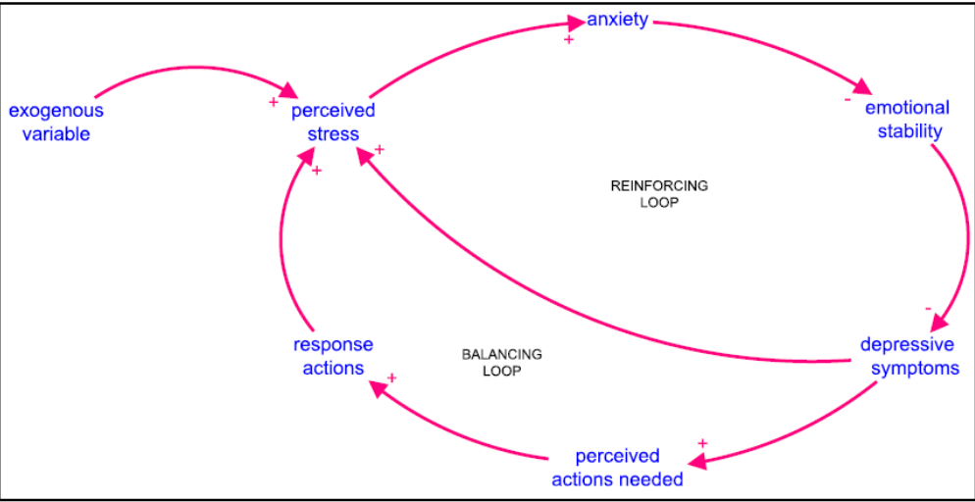
Building Complex Causal Loops

Slide 5
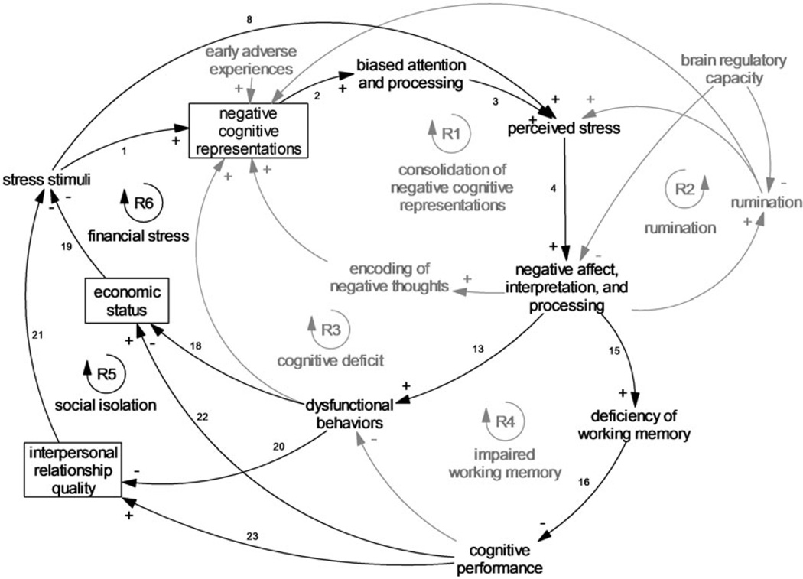

Slide 6
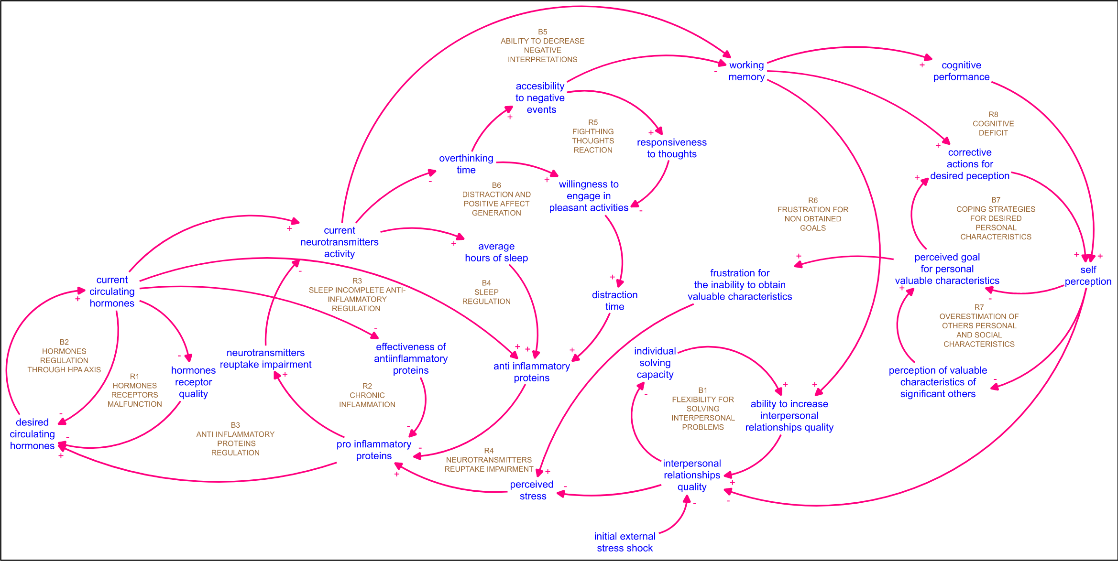

Slide 7
Tuning the model (a fragment)
Tuning a large complex model like this is pretty (goddamn) impossible
Why did we build it in the first place?
What does this mean?
How do we tune and validate this beast so it can become useful?

Slide 8
How do you eat an elephant? One bite at a time
But it’s easier if it’s a smaller elephant
Tune the model one causal loop at a time
Use empirical data

Slide 9
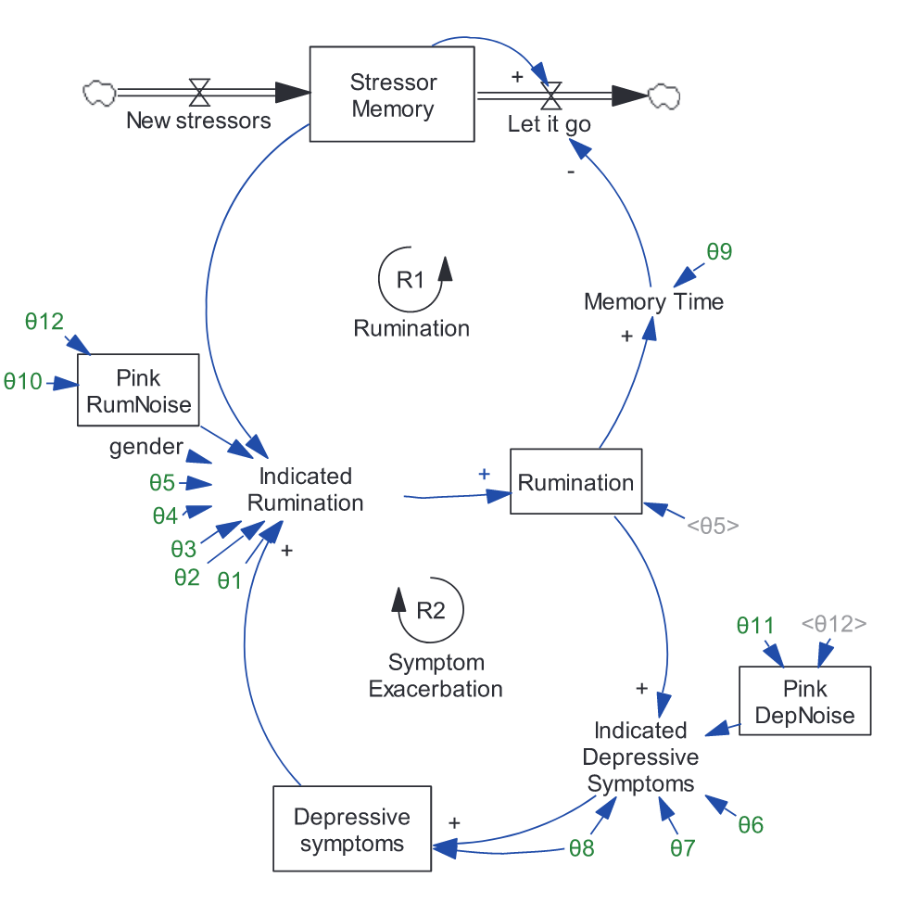
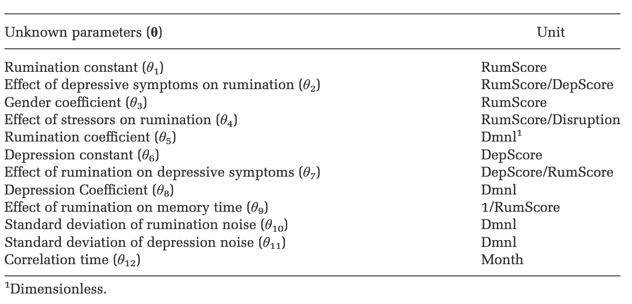
Noise sources are important –
put on the backlog for later discussion

Slide 10
Indirect Inference (duck) Method
Hypothesis: if it looks like a duck and quacks like a duck…
Imagine that there’s a magic function f(x) such that
F(x) has the same statistical properties as simulation subject
F(x) is directly derived from subject data (i.e. a stats model)
And…
Our simulation S(x) produces the same statistical properties as F(x)
We assume that S(x) is a faithful simulation

Slide 11
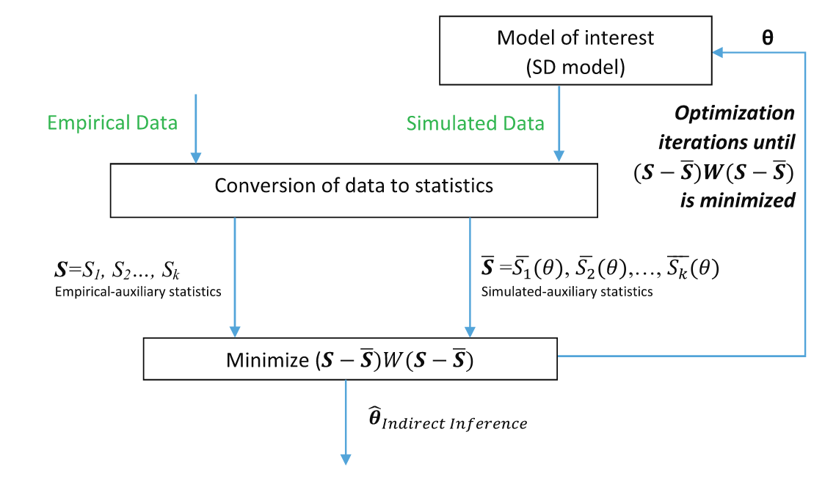

Slide 12
Standard optimization technique…
(more about optimization later)
Minimize difference between observed and simulated statistical parameters
Result of optimization:
Move the model from Level 0 (toy) to Level 1 (somewhat useful)
How?

Slide 13
Optimization in a nutshell
Represent subject and object of optimization (done)
Represent “energy function”, “cost function”, “objective function” or “utility function” (depending on which field you’re from)
Represent initial conditions
Do we know initial conditions in the model? Are they random? Is there a “cold start problem”?
Are there attractors?
At this point, we don’t know. Random is good enough.
Represent “STEP” – what does it mean to make a change?
What does “good enough” mean if we don’t know what is “good”?

Slide 14
… and I quote…
Note that auxiliary models do not need to be accurate (i.e. the density function may not accurately describe the conditional distribution of x for the element of being estimated (Durlauf and Blume, 2008)). It is an approximate model, which, unlike the model of interest, can be easily estimated with limited computational costs (e.g. using a simple linear regression). If the data-generating process (the model of interest, i.e. the SD model) is identical to the real-world data-generating process, we would then expect the replication of simulated auxiliary statistics to be close to the empirical ones.
On the next page
… While many different auxiliary models could be beneficial, the estimation would be more efficient if the auxiliary models were defined as precisely aspossible;

Slide 15
My brain exploded from contradictions ;-)
(runs around and tears remaining hair out)

Slide 16
OK, what model statistics do we use?
It should be relatively stable; i.e. its value should not be very sensitive to the process and measurement noise streams
If it is not, it’ll be thrown off by model noise sources
Good statistics are sensitive to change in at least one of the model parameters
If it does not, we can’t use it
Empirical statistics should be inexpensive to calculate
Less relevant in 2019
Number of statistics should be equal to or greater than the number of parameters that need to be estimated
This is how we distinguish what affects what in model tuning

Slide 17
Algorithm
Fit empirical model on real data and capture empirical statistics
Generate the simulated data using the SD model
Multiple runs with randomized parameters ~~ number of empirical observations
Estimate the simulated-empirical statistics using the empirical model and simulated data
Energy function / cost function
Minimize the difference between the empirical-empirical statistics and the simulated-empirical statistics.
Make a meaningful change in SD model parameters
Repeat steps 2-3
Until good enough ;) (what is good enough?????)
Beware of overfitting – too good is not good

Slide 18
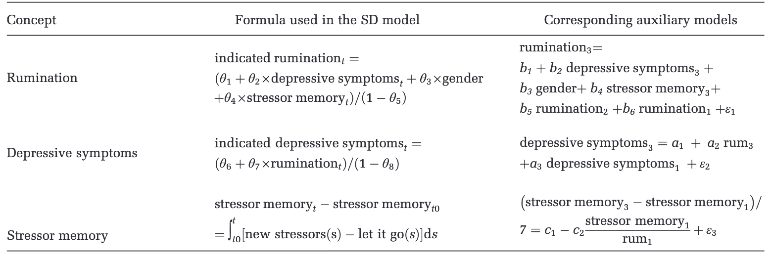
Back to example
Simple linear regressions with coefficients from the literature

Slide 19
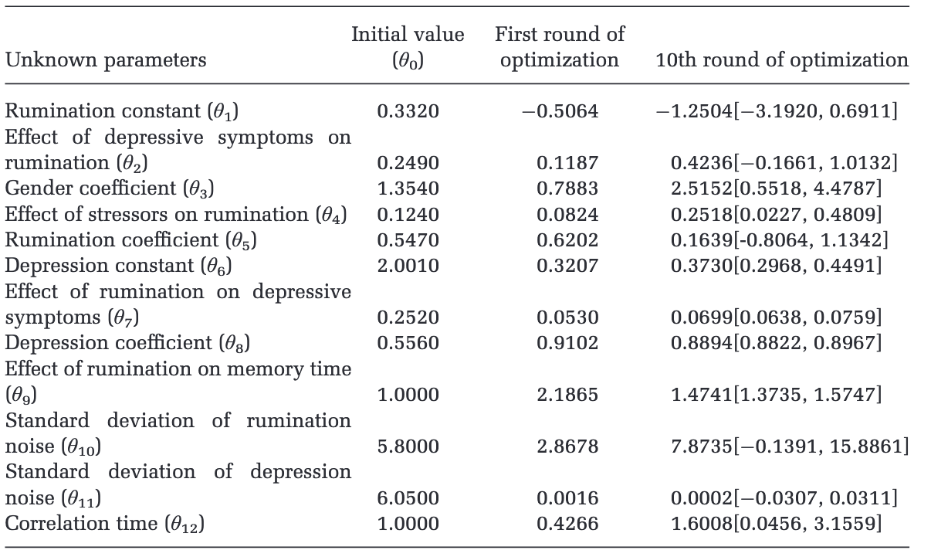
Running optimizations
Initial value == mean of empirically estimated value
Step == standard deviation
Other parameters use Newton method
and/or Monte Carlo

Slide 20
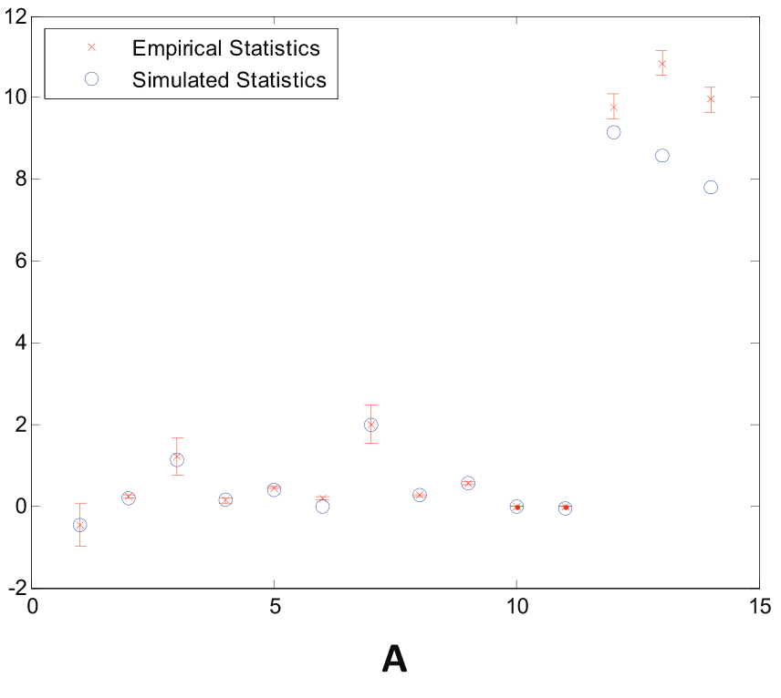
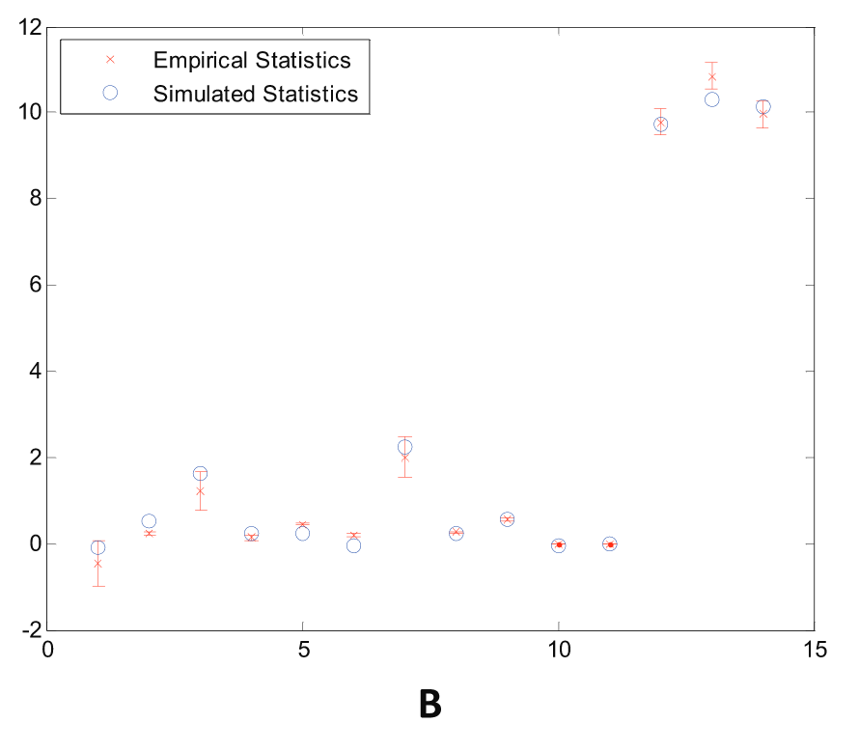
Before and after optimization

Slide 21
OK, now what?
We have just worked through 2 causal loops out of 10-15
We researched and built an empirical model from raw data
We have tuned and adapted parameters for a small number of variables in SD model
We can… hire 5 grad students and grind for another year
Or...
Think about it ;-)

Slide 22

What’s wrong with DUCK method?
Overfitting
You forgot a bias
Combinatorial explosion
What if it’s not a duck?

Slide 23
Dimensionality Curse / Combinatorial Explosion
((( BACKLOG to n-k model )))
Two things to consider:
N = number of variables / causal loops
K = how interconnected are the variables?
STATS assume independence of variables. System thinkers know better

Slide 25
N = 25 variables
Each variable has 3-5 interconnections
Not quite chaotic, but will give you a headache
Quantify the headache:
Potential connections = 25*24 = 600 (~ n^2)
Existing connections = e = 42 (I counted)
Connection density = e /(n*(n-1)) = 0.07
If density = 1/(n) variables are not interconnected, linear models will work
If density ~ 1, variables are ALL connected, full-on chaos
Most real systems are at the edge of chaos
((( THIS IS BACKLOG – TO BE EXPLORED LATER )))

Slide 26
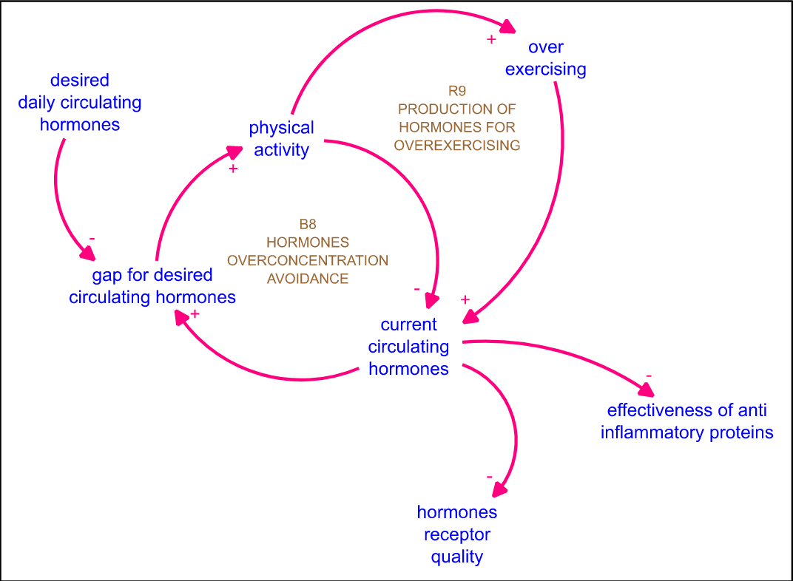
Experimenting with models
Does exercise help?

Slide 27
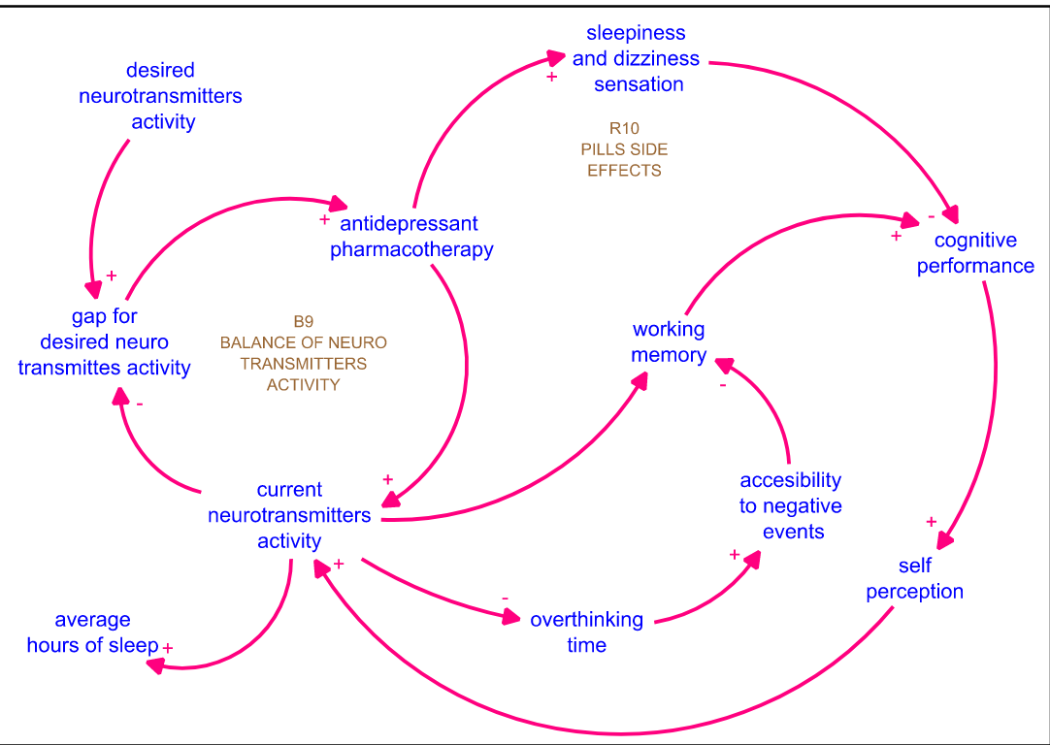
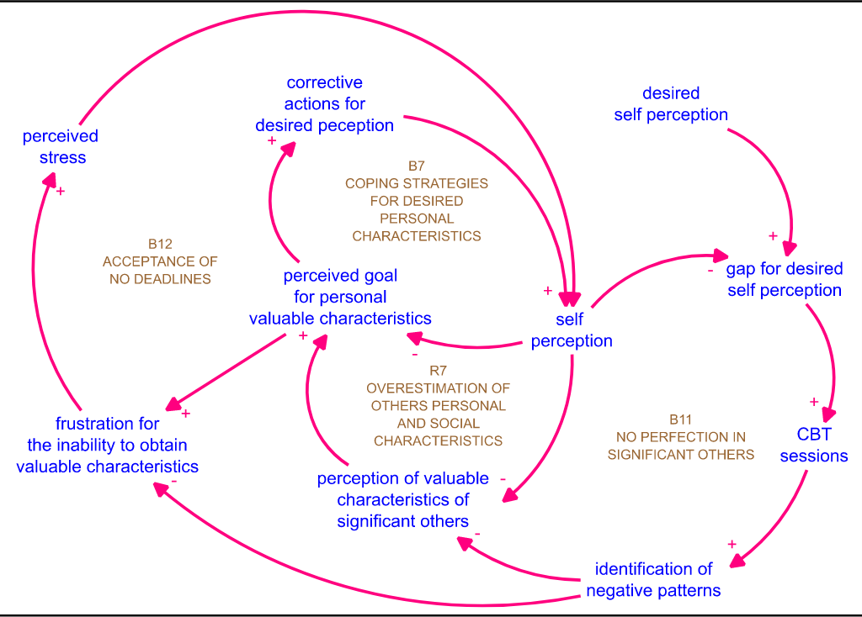
Antidepressants and Therapy

Slide 28
Experimental Design -- simple
 | Control | Arm 1 | Arm 2 | Arm 3
Observation 1
Observation 2
Observation 3

Slide 29
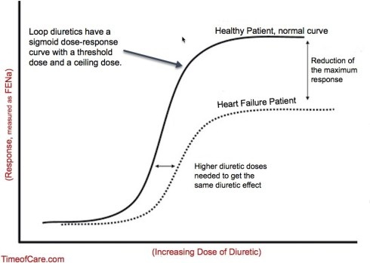
Dose response surface
What a clinician wants to see
MDs are overworked plumbers, not precise scientists
They have 15 min with a patient and need to write a prescription
They hate this too

Slide 30
Experimental Design for Systems -- MATRIX
 | Control | V1-1 | V1-2 | V1-3
Control
V2-1
V2-2
V3-3
Statistically significant number of observations per cell
Run the model X times – 30 minimum
Compute the relevant statistics per cell
Build response surface

Slide 31
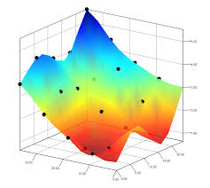
Response Surface
Allows for better understanding of multivariate and interdependent phenomena
This is for 2 endogenous variables / 1 exogenous
WE HAVE 25 (without treatments)

Slide 32
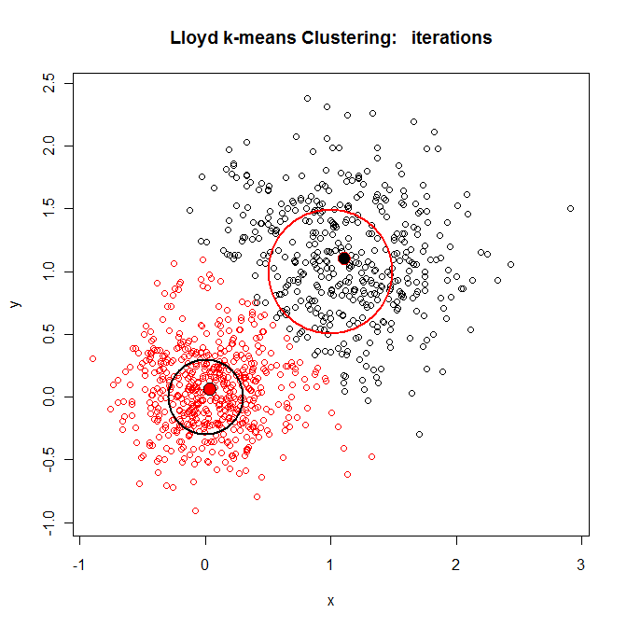
So experimenting with models is awesome but also sucks
We suck in massively multivariate datasets and produce massively multivariate output.

Slide 33
Now go interpret your clusters ;-)
… easier said than done – subjective AF.

