Slide 1
System Dynamics Model
Week 2

Slide 2
System Dynamics Model
System dynamics is an approach to understanding the behavior of complex systems over time. It deals with internal feedback loops and time delays that affect the behavior of the entire system.
What makes using system dynamics different from other approaches to studying complex systems is the use of feedback loops and stocks and flows.
The basis of the method is the recognition that the structure of any system — the many circular, interlocking, sometimes time-delayed relationships among its components — is often just as important in determining its behavior as the individual components themselves.
http://en.wikipedia.org/wiki/System_dynamics

Slide 3
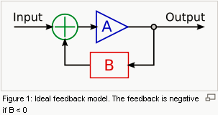
Feedback
Feedback is a phenomenon whereby some proportion of the output signal of a system is passed (fed back) to the input. This is often used to control the dynamic behavior of the system.
An example of a feedback system is an automobile steered by a driver.
http://en.wikipedia.org/wiki/Feedback

Slide 4
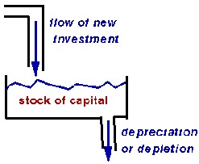
Stocks and flows
Economics, business, accounting, and related fields often distinguish between quantities which are stocks and those which are flows.
A stock variable is measured at one specific time. It represents a quantity existing at a given point in time, which may have been accumulated in the past.
A flow variable is measured over an interval of time. Therefore a flow would be measured per unit of time.
http://en.wikipedia.org/wiki/Stock_and_flow

Slide 5
An example
The elements of system dynamics diagrams are feedback, accumulation of flows into stocks and time delays.
To illustrate the use of system dynamics, imagine an organization that plans to introduce an innovative new durable consumer product. The organization needs to understand the possible market dynamics, in order to design marketing plans and production plans.
What are the basic components? What are the relations between the components?
http://en.wikipedia.org/wiki/System_dynamics

Slide 6
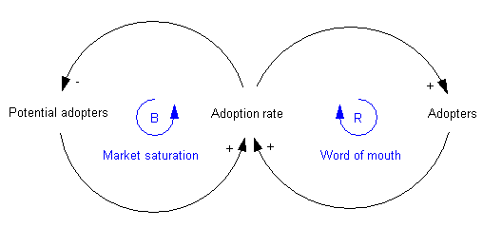
Step 1: casual loop diagrams
Causal loop diagram: a simple map of a system with all its constituent components and their interactions, revealing the structure of a system.
The positive reinforcement (labeled R) loop indicates that the more people have already adopted the new product, the stronger the word-of-mouth impact.
The second feedback loop is negative reinforcement (or "balancing" and hence labeled B). Clearly, growth cannot continue forever, because as more and more people adopt, there remain fewer and fewer potential adopters.
http://en.wikipedia.org/wiki/System_dynamics

Slide 7
Step 1: dynamic casual loop diagrams
Both feedback loops act simultaneously, but at different times they may have different strengths. Thus one would expect growing sales in the initial years, and then declining sales in the later years.
-step1 : (+) green arrows show that Adoption rate is function of Potential Adopters and Adopters
-step2 : (-) red arrow shows that Potential adopters decreases by Adoption rate
-step3 : (+) blue arrow shows that Adopters increases by Adoption rate
https://ipfs.io/ipfs/QmXoypizjW3WknFiJnKLwHCnL72vedxjQkDDP1mXWo6uco/I/m/Adoption_SFD_ANI_s.gif

Slide 8

Step 2: stock and flow diagrams
The next step is to create what is termed a stock and flow diagram. A stock is the term for any entity that accumulates or depletes over time. A flow is the rate of change in a stock.
In this example, there are two stocks: Potential adopters and Adopters. There is one flow: New adopters. For every new adopter, the stock of potential adopters declines by one, and the stock of adopters increases by one.
http://en.wikipedia.org/wiki/System_dynamics

Slide 9
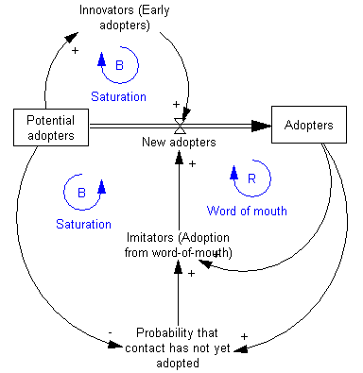
Step 2: stock and flow diagrams
http://en.wikipedia.org/wiki/System_dynamics

Slide 10
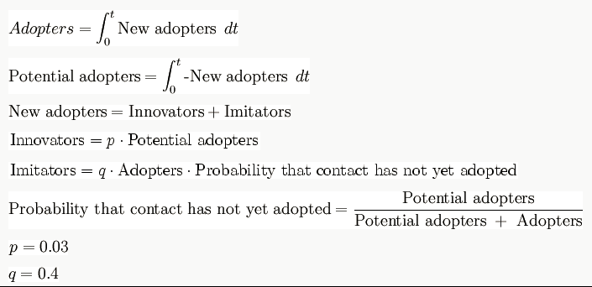
Step 3: write equations
http://en.wikipedia.org/wiki/System_dynamics

Slide 11
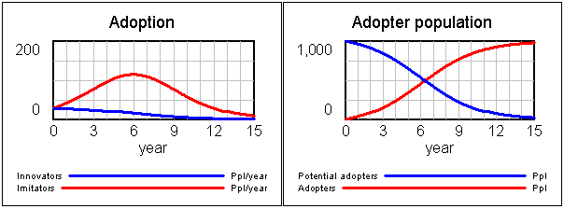
Step 4: run simulations
Estimate the parameters and initial conditions. These can be estimated using statistical methods, expert opinion, market research data or other relevant sources of information.
Simulate the model and analyze results
http://en.wikipedia.org/wiki/System_dynamics

Slide 12
Step 4: run simulations

Slide 13
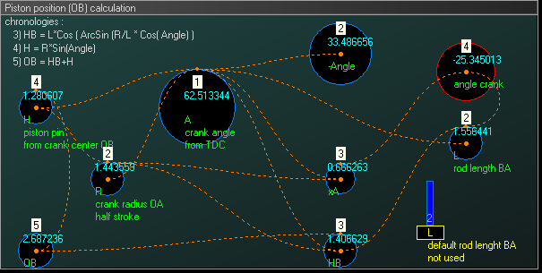
Example of piston motion
Objective : study of a crank-connecting rod system. Model a crank-connecting rod system through a system dynamic model. The crank, with variable radius and angular frequency, will drive a piston with a variable connecting rod length.
System dynamic modeling:

Slide 14
Example of piston motion
Simulation : the behavior of the crank-connecting rod dynamic system can then be simulated.

Slide 15
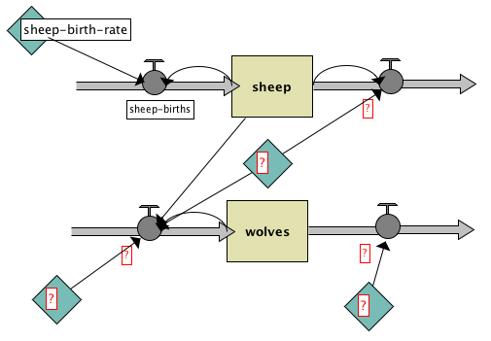
Live-code
Move back to the System Dynamics window
Add a stock of wolves
Add Flows, Variables and Links to make your diagram look like this:

Slide 16
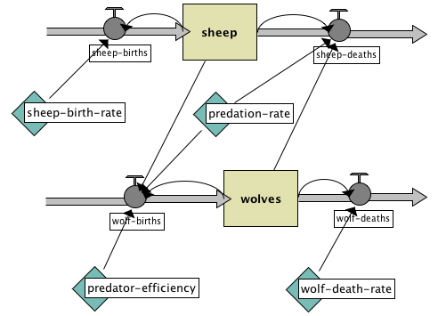
Live-Code
Add one more Flow from the wolves Stock to the Flow that goes out of the Sheep stock.
Fill in the names of the diagram elements so it looks like this:
where
initial-value of wolves is 30,
wolf-deaths is wolves * wolf-death-rate ,
wolf-death-rate is 0.15,
predator-efficiency is .8,
wolf-births is wolves * predator-efficiency * predation-rate * sheep,
predation-rate is 3.0E-4,
and sheep-deaths is sheep * predation-rate * wolves.

Slide 17
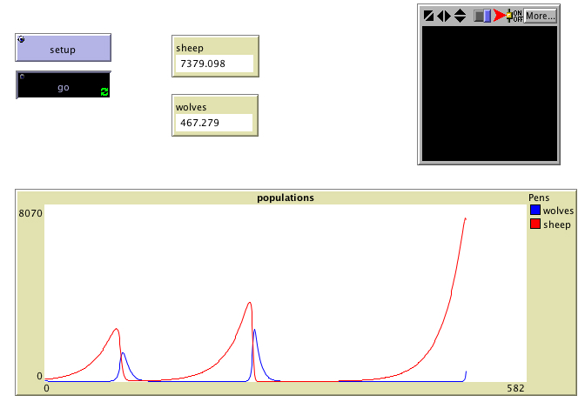
Tutorial
Go to the main window, add a plot pen "wolves" to the population plot, press setup and see your System Dynamics Modeler diagram in action.

Slide 18
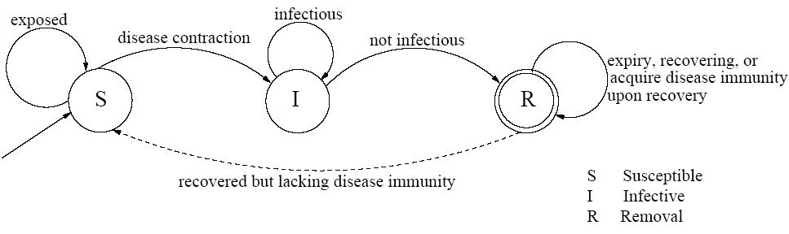
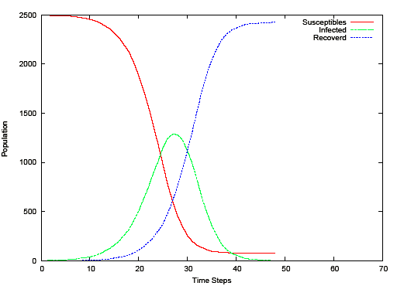
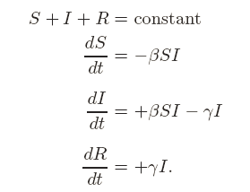
Example: mathematical epidemiology
Susceptibles Infectives Removals (SIR) model

Slide 19
Applications
System dynamics has found application in a wide range of areas, for example population, ecological and economic systems, which usually interact strongly with each other.
System dynamics have various "back of the envelope" management applications. They are a potent tool to:
-Teach system thinking reflexes to persons being coached
-Analyze and compare assumptions and mental models about the way things work
-Gain qualitative insight into the workings of a system or the consequences of a decision
-Recognize archetypes of dysfunctional systems in everyday practice
System dynamics has been used to investigate resource dependencies, and resulting problems, in product development.
http://en.wikipedia.org/wiki/System_dynamics

Slide 20
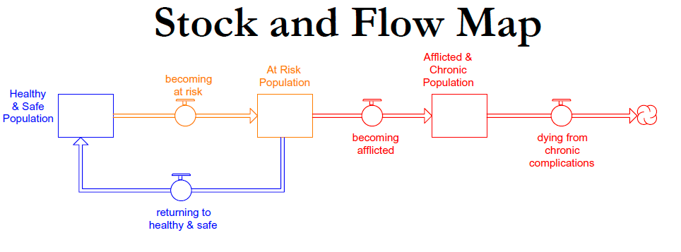
Using a Systems Dynamics Framework to Improve State Policy-making
Karen J. Minyard, Rachel Ferencik, Chris Soderquist, Heather Devlin, Mary Ann Phillips, Ken Powell
Academy Health
State Health Research and Policy Interest Group
June 27, 2009

Slide 21
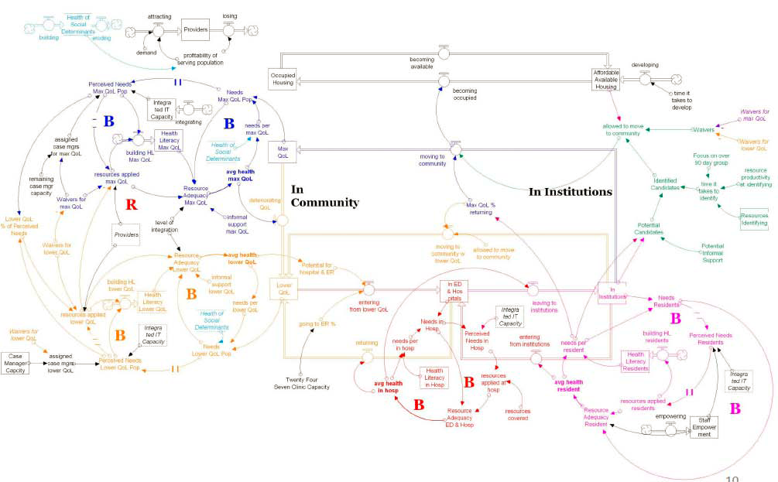
Dynamics in the Dual Eligible Population: A Systems Map Georgia Health Policy Center Communities Joined in Action

Slide 22
DE SIR model
Susceptibles Infectives Removals (SIR) model

Slide 23
Experiment setup
We run the AB model under five different network structures, including fully connected, random, Watts-Strogatz small world, scale-free, and lattice.
The fully connected network is closest to the perfect mixing assumption of the DE; the lattice, with connections solely to neighbors, is most different; the small world and scale free networks are widely used and characterize many real situations (Watts and Strogatz 1998; Barabasi and Albert 1999; Barabasi 2002).
We test each network structure with homogeneous and heterogeneous agent attributes such as the rate at which each agent contacts others.
We compare the DE and AB epidemics on a variety of key metrics relevant to public health, including the fraction of the population ultimately infected (the total burden of disease), the maximum prevalence of infectious cases (a measure of the peak load on public health infrastructure), and the time to the peak of the epidemic (indicating how much time health officials have to respond).

Slide 24
Results
Experiment results see paper on P. 29, 30
Surprisingly, however, the differences between the DE and AB models are not statistically significant for key metrics such as peak time, peak prevalence, and disease burden in any but the lattice network. Though the small-world and scale-free networks are highly clustered, their dynamics are close to the DE model: even a few long-range contacts and highly connected hubs seed the epidemic at multiple points in the network, enabling it to spread rapidly.
We also examine the ability of the DE model to capture the dynamics of each network structure in the realistic situation where data on underlying parameters are not available. Surprisingly, the fitted DE model matches the mean behavior of the AB model under all network structures and heterogeneity conditions tested.

