Slide 1
SpaceX: Predicting Falcon 9 Stage 1 Success
Catherine Petrozzino
June 20
Let’s meet over launch!
Company Confidential

Slide 2
Executive Summary
With modest amount of modeling:
Predict successful stage 1 landing for Falcon 9 Stage 1 Launch with 83% - 85% accuracy
Key features for success predictors
Launch Date – early launches failed more frequently
SpaceX has improved over time
Concurrently, SpaceX’s transitioned to more optimal orbit types and Payload Mass weights have results in more success

Slide 3
Table of Contents
Introduction
Methodology
Results: Data Organization
SQL Results
Folium Results
Plotly Results
Deeper Dive into 2018

Slide 4
Introduction
Business objective: can SpaceX achieve a competitive advantage by bidding on those projects for which there is a high likelihood of a successful Falcon9 stage 1 landing?
Data science objective: Can SpaceX use a ‘quick-and-dirty’ modeling exercise to predict if a Booster 9 launch will be successful?
Can features be isolated that are key contributors to the success or failure of Stage 1 landing?
Are there further recommendations to improve the performance of the modeling?

Slide 5
Methodology
Data Sources
SpaceX past launch history data which was converted to a .json file
187 rows with 43 columns
SpaceX DataSet
101 rows with 10 columns
Wikipedia’s List of Falcon 9 and Falcon’s heavy launches updated June 9, 2021
Converted to a dataframe with 121 rows and 11 columns
Classification Models evaluated on 90 Falcon 9 trials
Ridge regression was used to fine tune the results
Logistic Regression
Support Vector Machine
Decision tree
K-Nearest Neighbors

Slide 6
Results: Data Organization
Data analysis focused on the following features and target with an emphasis on the bolded features
Date (captured as calendar and/or flight number
Time
Booster_Version
Launch Site
Payload
PAYLOAD_MASS_KG
Orbit
Customer
Mission_Outcome
Landing Outcome (target)

Slide 7
SQL Results (1 of 2)
Dec 12, 2015: Date of first successful stage 1 landing with F9 Rocket
Booster version
FT associated with the first successful launch
Prior to that date, V1.0 and V1.1 were exclusively used
After that date, FT, B4, B5 used with majority success
Maximum payload masses
B5 booster version was exclusively used

Slide 8
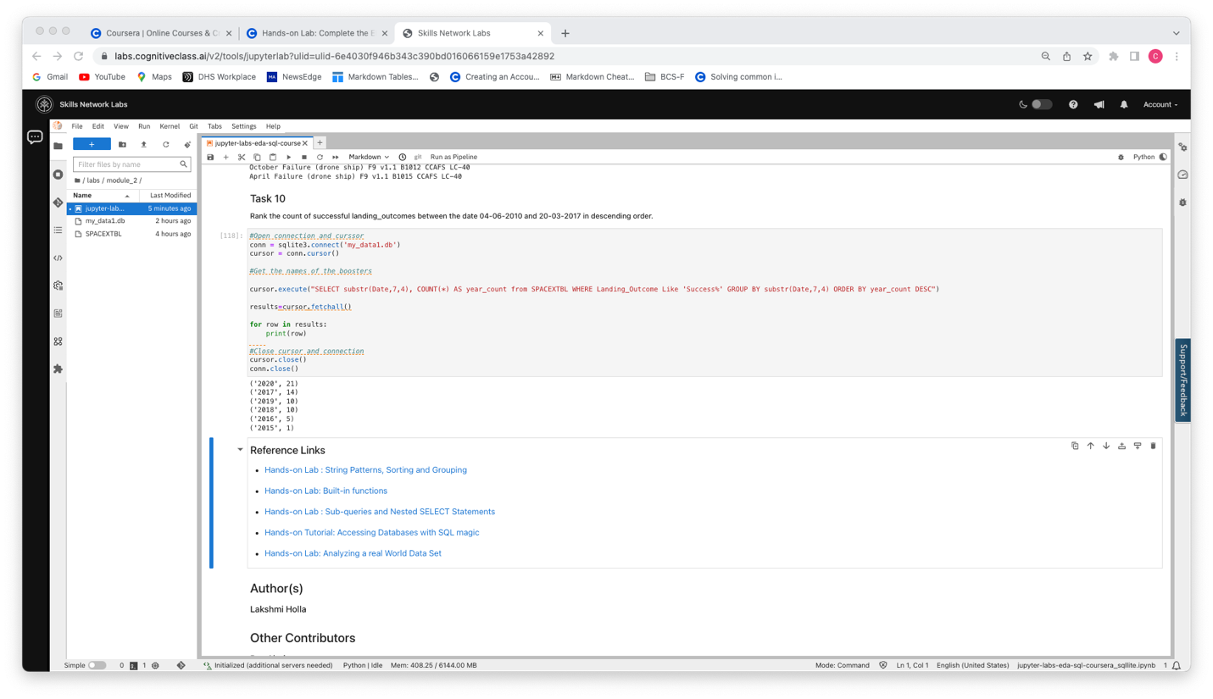
SQL Results (2 of 2)
Mission outcomes – per SQL table, there was only 1 mission failure versus 35 landing failures
No significant correlation between
Date appears strongly correlated with successful launches

Slide 9
Folium Results
Comparing most successful launch site (KSC) to least successful launch site (both Cape Canaveral sites (CC)) showed:
Very little difference geographically between KSC and CC
All launch sites including Vanderburg are similarly close to the coastline, inhabited areas and railroads
Vanderburg has a difference of ~40 degrees longitude
Examining the cluster variables showed that it has the 2nd most successful launches
Neither significantly better or worse than all other launch sites
Conclusion: geography of launch site appears to be insignificant

Slide 10
Plotly results
KSC had most successful launches
Earlier Booster Version Categories (v1.0 and 1.1) resulted in substantial failures
The next series of boosters FT, B4, B5 had more successes but still resulted in a majority of failures
Payloads over 5.5K resulted in primarily failures

Slide 11
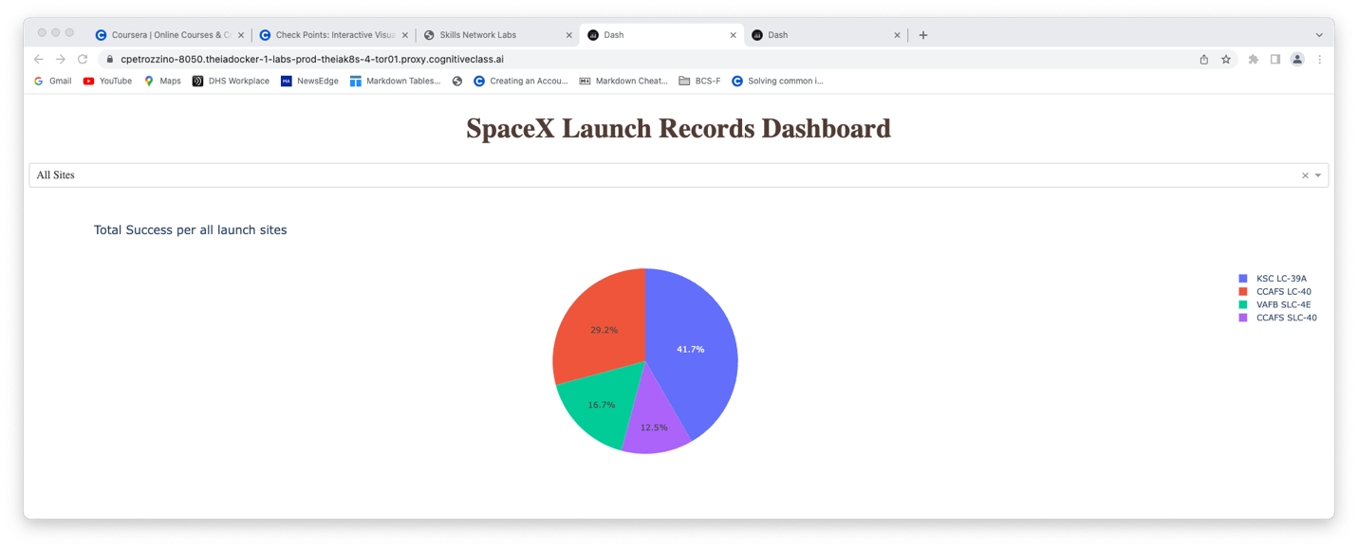
Success Rate per Launch site
Successful launches per site
CCAFS SLC-40
KSC
Vanderburg
CCAFS LC-40

Slide 12
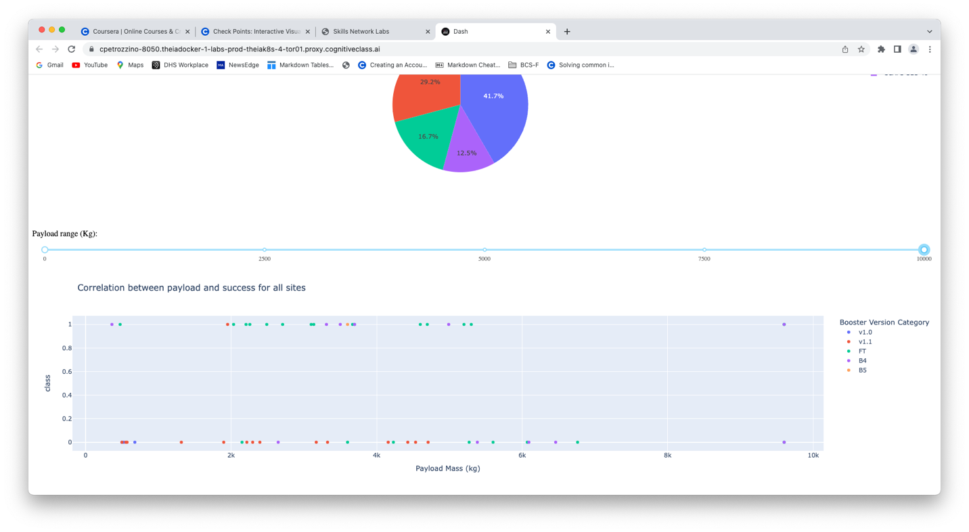
Correlation between payload mass and specific booster versions with successful launches
Payload Mass (kg)

Slide 13
Deeper Dive into the year 2018

Slide 14
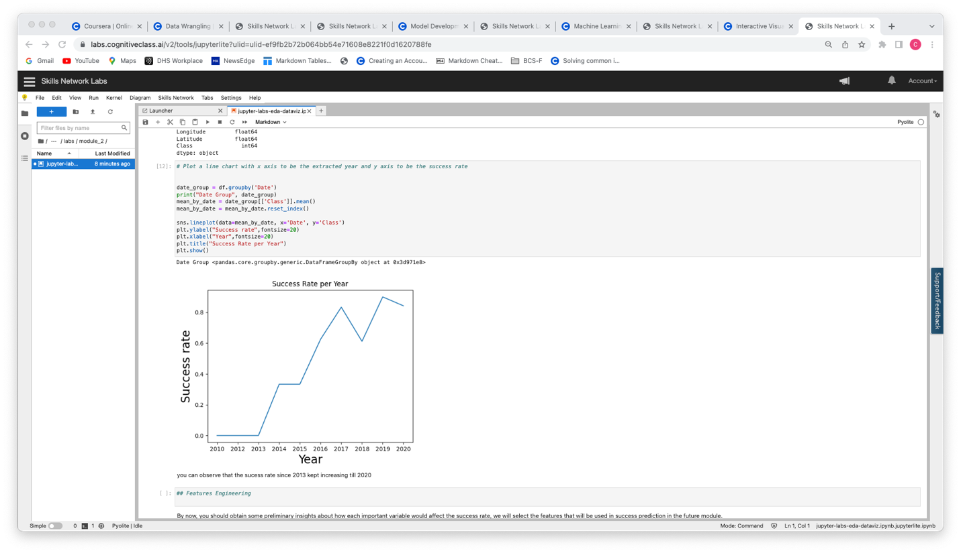
Success with Time
NOTE: Dip in success rate for 2018 (flight numbers 48 – 67)

Slide 15
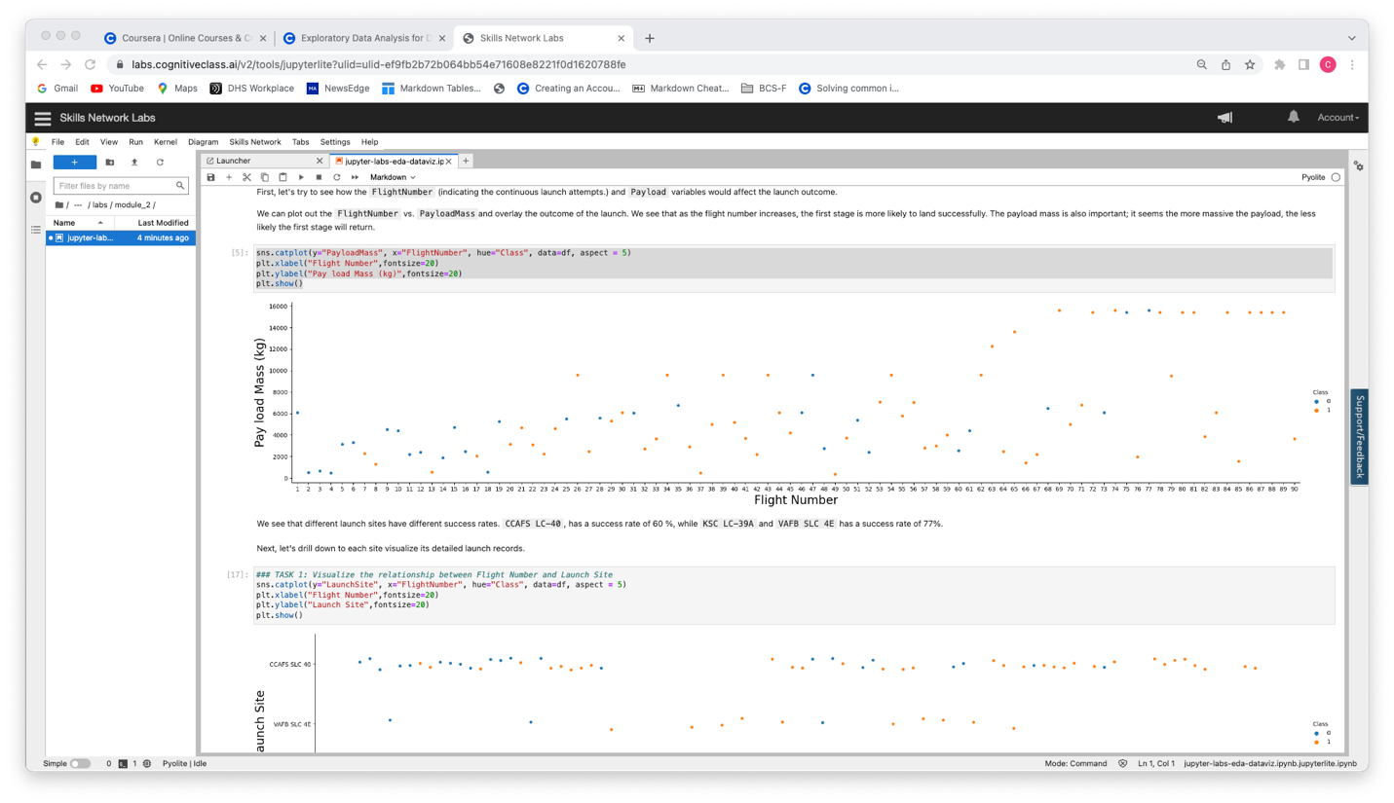
Payload Mass (Kg) in 2018
2018
6000Kg
2000 Kg
Class
Blue = failure
Orange = success
In 2018, all failed Payload Masses were between 20 and 60 Kg. SpaceX moved away from this mass range after 2018 with higher rate of success.

Slide 16
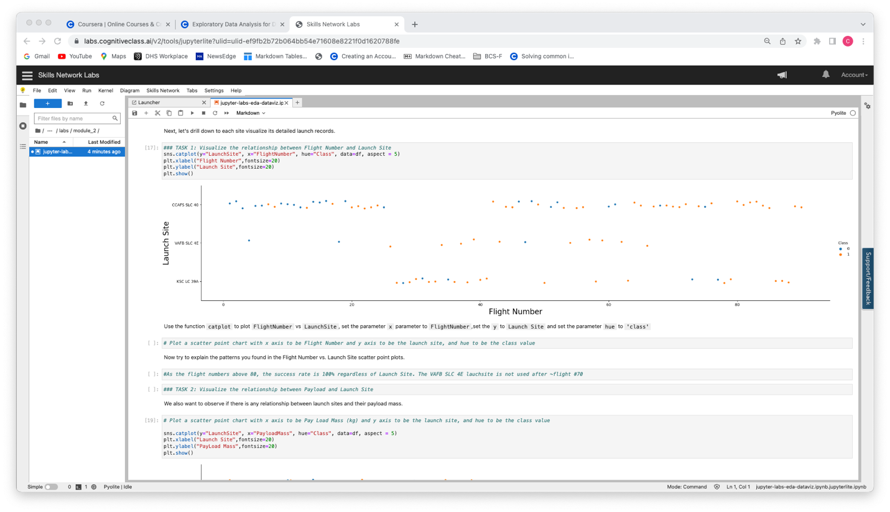
2018 Launch Site
2018
(in increments of 20)
Class
Blue = failure
Orange = success
All failed launches in 2018 were from CCAFS SLC 40.
However, CCAFS SLC 40 continued to be used with great success after 2018

Slide 17
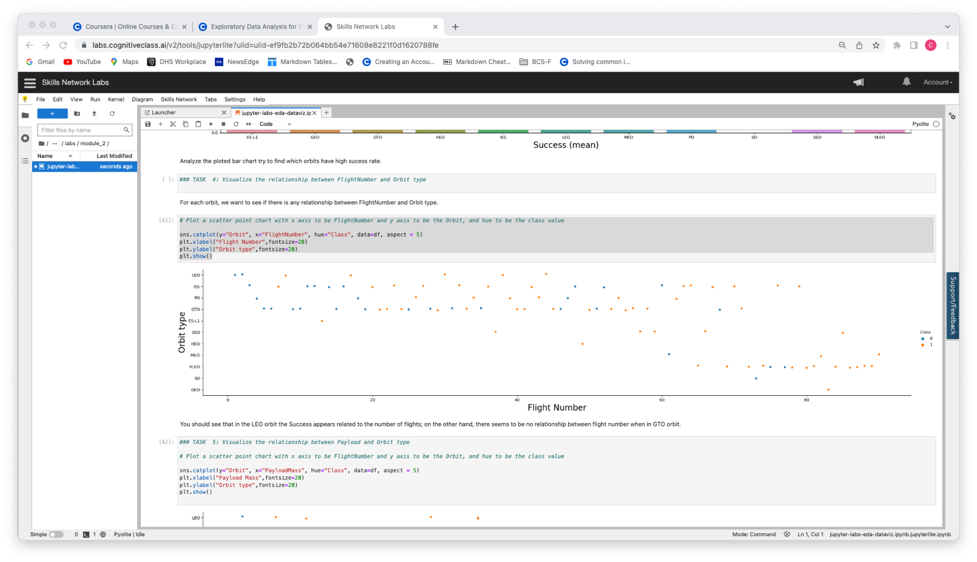
Orbit Types
2018
(in increments of 20)
GTO & ISS orbits were problematic from the beginning of the program to 2018. After 2018, SpaceX transitioned to more successful orbits.

Slide 18
Modeling

Slide 19
Modeling Details
Final data
90 Falcon 9 launches with 18 features
Empty Payload Mass values were replaced by the the mean
One-hot encoding was used on categorical variables
Data was split:
Training set = 20% (72 training entries, 18 test entries)
Models
Sklearn classification models: Logistic regression (logreg), Support Vector Machine (SVC), Decision Tree (tree) and K-Nearest Neighbor (KNN)
Fine tuning: GridSearchCV using ridge regression and cv = 10
Evaluation: accuracy, score and confusion matrix
In some cases: logloss function

Slide 20
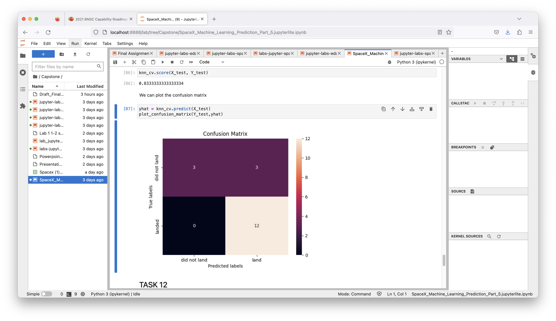
Modeling Results
Logreg, SVC and KNN performed nearly identically
Accuracy (training data): ~85%
Score (test data): 83%
Identical confusion matrices

Slide 21
Recommended Model: Logistic Regression
SVM and KNN are known to have potential problems if:
Number of features are larger than number of samples AND/OR
There is a small number of samples
Logreg model log loss function = ~.48
Tree model had higher accuracy but a lower test score suggesting over-fitting (see back-up for more details).

Slide 22
Conclusion
With modest amount of modeling:
Predict successful Falcon 9 Stage 1 Launch with 83% - 85% accuracy
Logistic regression algorithm processing ~18 features
Based on Exploratory data Analysis: key independent features are: Date, Orbit Type and Payload Mass
Recommend further analysis
Identify key features through modeling algorithms
Further analysis (e.g., analyze prediction success with later years vs. earlier years, etc.)

Slide 23
Back-up Slides

Slide 24
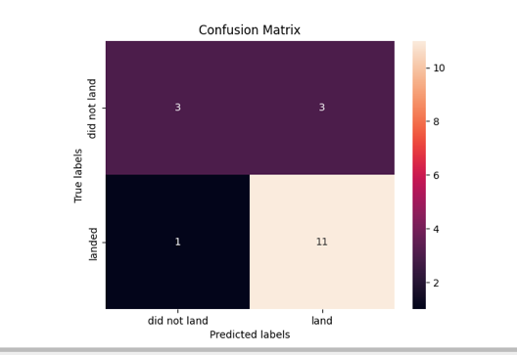
Decision tree Modeling
Accuracy (training data) = .875
Score (test data) = .778
Log loss sore = 2.26
Higher accuracy may be a sign of over-fitting
Given lower score accuracy and higher incidence of false negative.

