Slide 1
Lights/Lighting

Slide 2
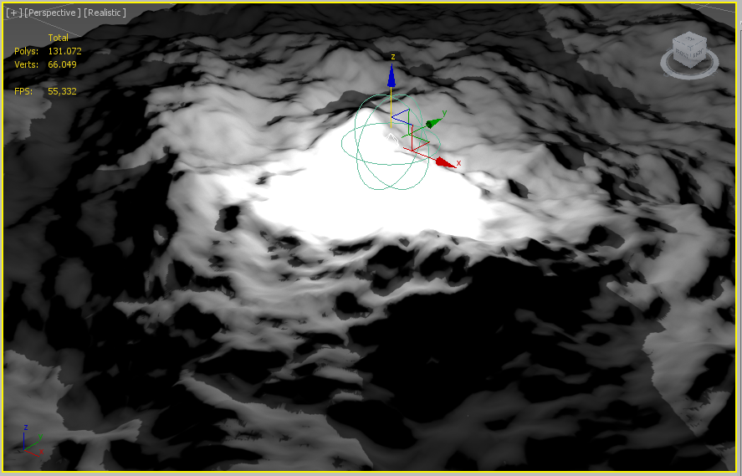
Lights/Lighting

Slide 3
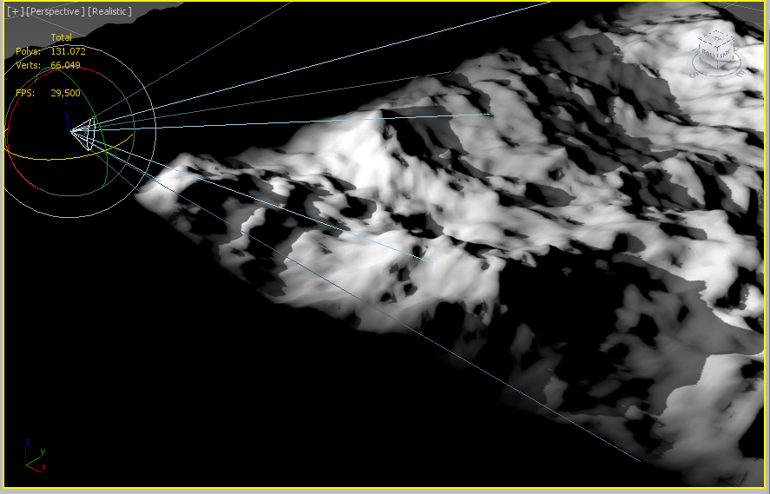
Lights/Lighting

Slide 4
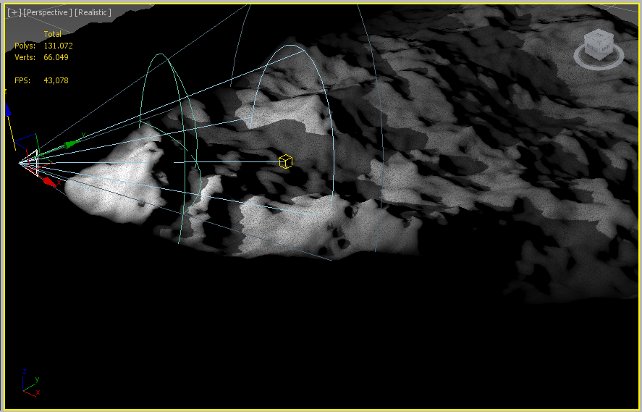
Lights/Lighting

Slide 5
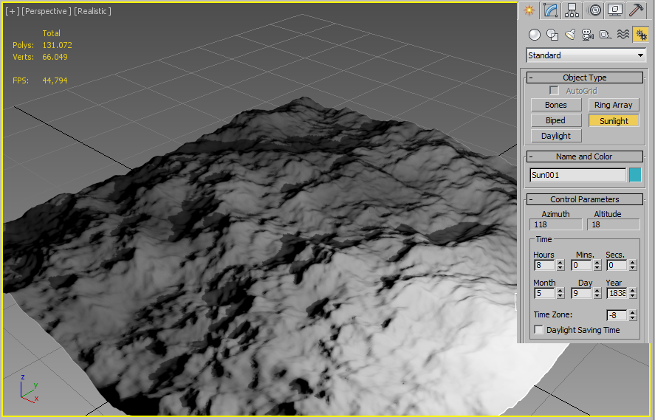
Lights/Lighting

Slide 6
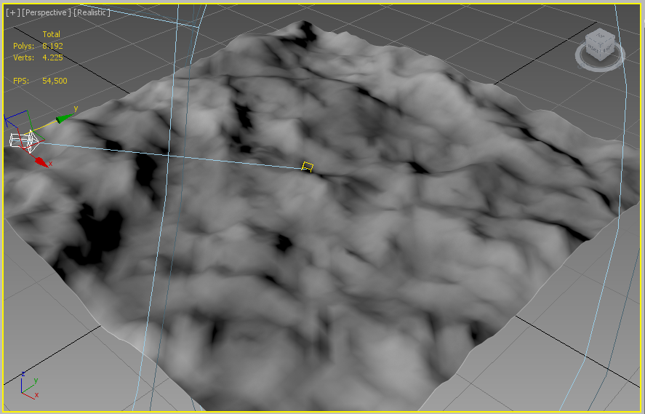
Lights/Lighting

Slide 7
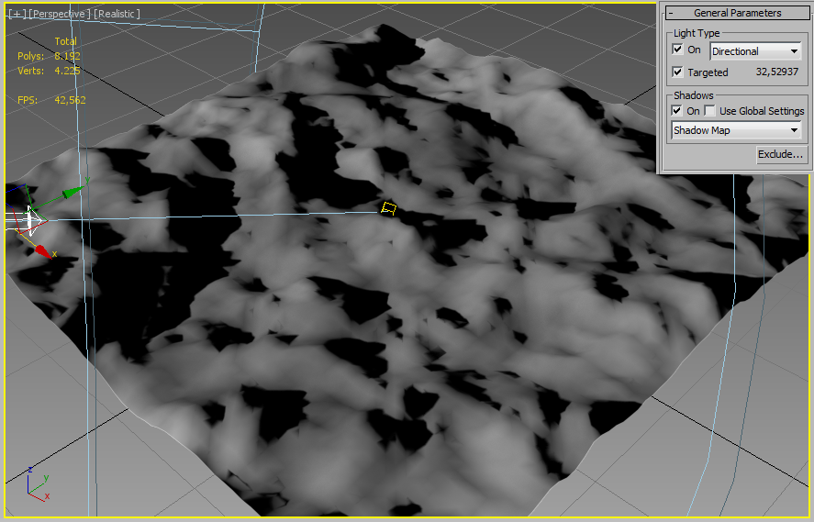
Lights/Lighting

Slide 8
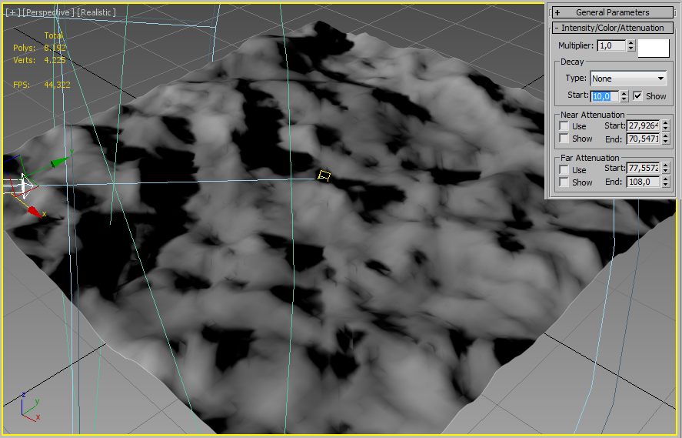
Lights/Lighting

Slide 9
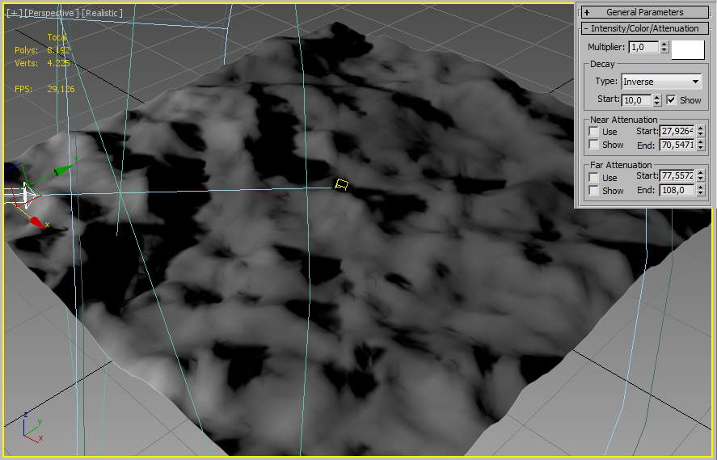
Lights/Lighting

Slide 10
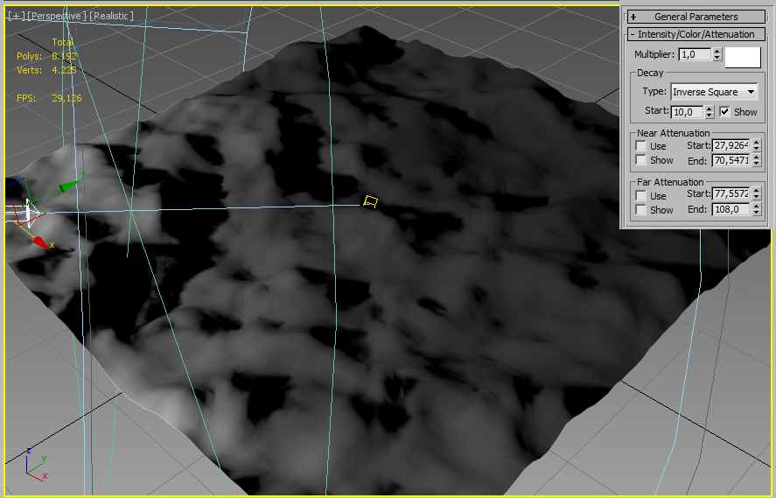
Lights/Lighting

Slide 11
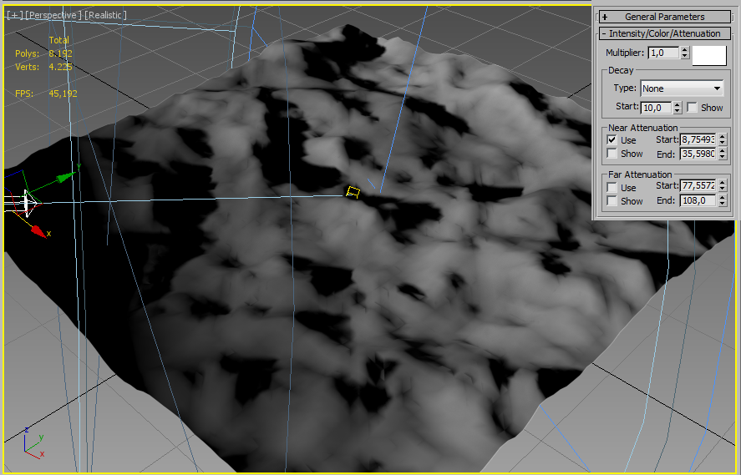
Lights/Lighting

Slide 12
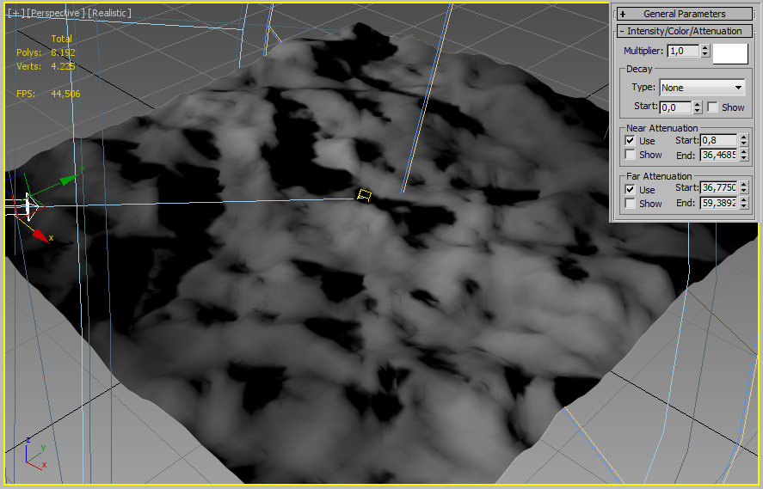
Lights/Lighting

Slide 13
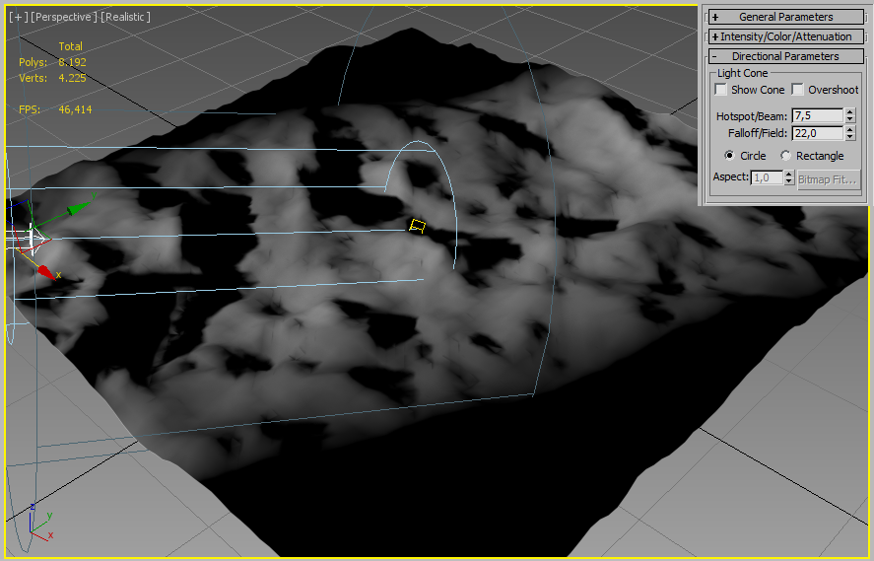
Lights/Lighting

Slide 14
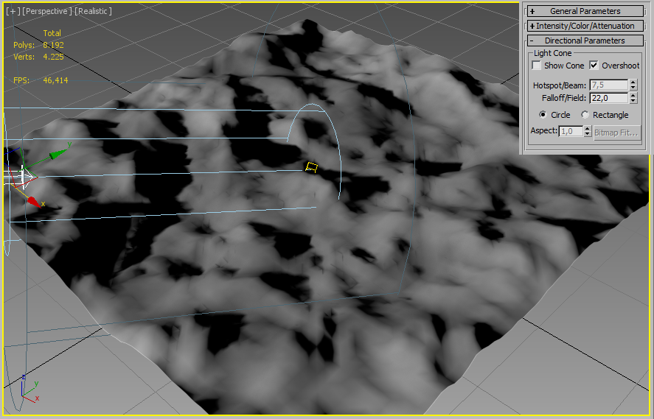
Lights/Lighting

Slide 15
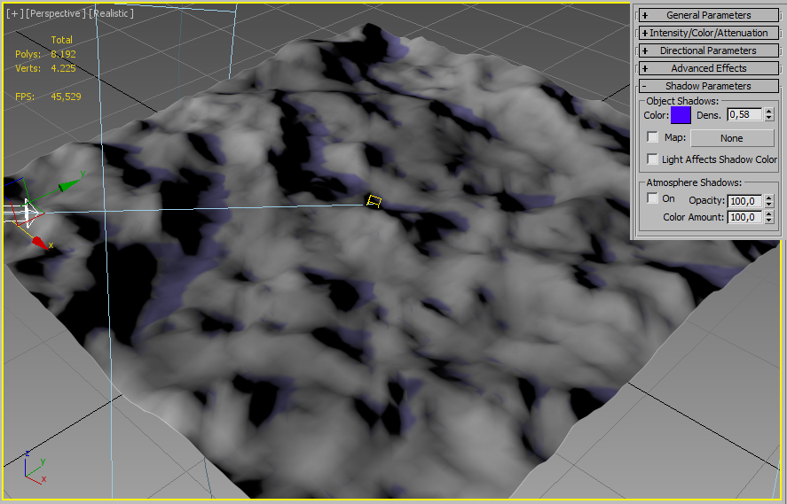
Lights/Lighting

Slide 16
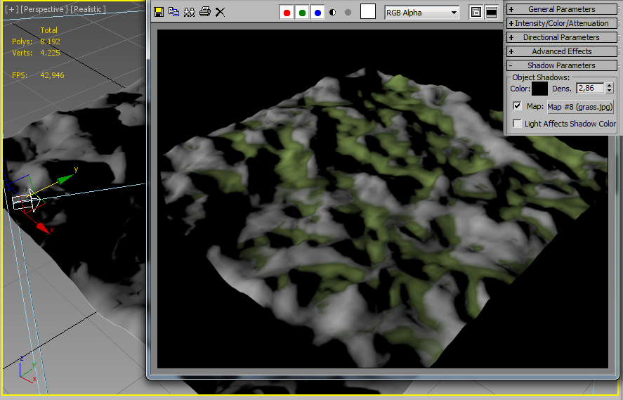
Lights/Lighting

Slide 17
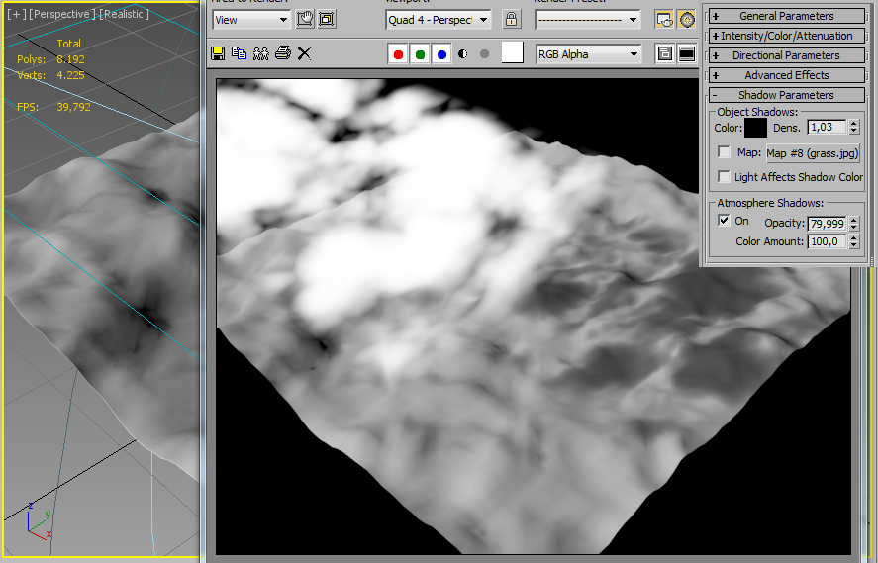
Lights/Lighting

