Slide 1
Market Structure and Corporate Payout Policy
Xiongshi Li
Guangxi University
Mao Ye
University of Illinois at Urbana-Champaign and NBER
Miles Zheng
University of Illinois at Urbana-Champaign
The Microstructure Exchange
June 23, 2020

Slide 2
Two Famous Puzzles in the Payout Literature
Two forms of corporate payouts: dividends and share repurchases
Miller and Modigliani (1961): paying out through dividends or share repurchases does not matter
Tax disadvantages of dividends
Dividend tax was higher than capital gain tax
Capital gain tax can be deferred
Two most salient puzzles (Farre-Mensa, Michaely, and Schmalz 2014)
Dividend puzzle (Black 1976)
Why do firms pay dividend at all?
Secular increase of share repurchases relative to dividends over the past three decades
This paper: the costs of repurchases can address these two puzzles simultaneously
Market structure frictions can explain why repurchases cannot completely drive out dividends
The reduction in market structure frictions over time explains the secular increase in share repurchases

Slide 3
Costs under Old vs. New Market Structures
Liquidity cost
Firms and their investors pay transaction costs
Compliance cost: SEC rule 10b-18
Repurchase price should not exceed the highest bid or previous trade price
Prevent firms from inflating their stock price by demanding liquidity at the ask price
Dealer market modeled by Ho and Stoll (1981) and Glosten and Milgrom (1985)
Firms cannot buy at the bid price, because buy orders are executed at the ask price
Firms cannot buy at a price less or equal to the previous price
The move towards electronic limit order books and dark pools reduces these frictions
Limit order books: firms can submit limit orders at the bid price
Dark pools: firms can match their orders passively at the bid price

Slide 4
Event Studies and a Controlled Experiment
The 1994 Manning Rule: Increase execution priority for issuers
Prior to 1994, NASDAQ dealers can trade ahead of issuers at the same price
Example: a dealer quotes $100 bid and $102 ask, and an issuer quotes $100 bid
The issuer’s quote only entitled to an execution when the market ask price drop to $100
Higher execution costs for issuers
Violates SEC 10b-18 because the execution is at the ask
The Manning Rule prohibits dealers from executing ahead of their customers at the same price
Share repurchases of NASDAQ firms increase by 69% relative to non-NASDAQ firms
Tick size reduction from $1/8 to $1/16 in 1997 and then to 1 cent in 2001
Reduce the depth, or the queue to provide liquidity at the same price
Share repurchase increased by 68% and 32% (stocks with larger vs smaller change in bid-ask spread)
NYSE installed autoquotes in 2003
Computer algorithms reduce both execution and compliance costs
NYSE firms increased their share repurchase by 24% relative to non-NYSE firms

Slide 5
Event Studies and a Controlled Experiment
In 2016, SEC randomly selected 1200 stocks and increases their tick size to 5 cents
Tick size for 1199 control stocks remains at 1 cent
Repurchase payouts for treatment firms decrease by 21%
The reduction is as high as 45% if the stocks’ bid-ask spreads are less than 5 cents before treatment
Tick-constrained treatment firms
400 stocks in test group 3 suffer from additional treatment: trade-at requirement
Dark pools need to execute a trades at a price 2.5 cents higher than the highest displayed bid price
At the same price, trade-at rule grants execution priority to displayed orders in exchanges
SEC 10b-18: repurchase price should be less than or equal to the highest displayed bid price
Unintended contradictions between two rules implicitly ban share repurchases in dark pools
Tick-constrained firms in test group 3 reduce share repurchases by 55%
Tick-constrained firms in test groups 1 & 2 reduce share repurchases by 36%

Slide 6
Questions?

Slide 7
Roadmap
The controlled experiment: tick size pilot
Tick size: constrained firms in test groups reduce their repurchase payouts by 45%
Time priority: constrained firms with larger increase in bid-depth reduce repurchases more
Dark pool: constrained firms in test group 3 reduce repurchases by 55%
Event studies
1994 Manning Rule
Higher execution priority for NASDAQ issuers increases share repurchases by 69%
Two tick size reductions
Reduction in queue length at the same price increases share repurchases by 68% after 1997 and 32% after 2001
Installation of autoquotes for NYSE
The move from manual to automatic trading increases share repurchases by 24%

Slide 8
Roadmap
The controlled experiment: tick size pilot
Tick size: constrained firms in test groups reduce their repurchase payouts by 45%
Time priority: constrained firms with larger increase in bid-depth reduce repurchases more
Dark pool: constrained firms in test group 3 reduce repurchases by 55%
Event studies
1994 Manning Rule
Higher execution priority for NASDAQ issuers increases share repurchases by 69%
Two tick size reductions
Reduction in queue length at the same price increases share repurchases by 68% after 1997 and 32% after 2001
Installation of autoquotes for NYSE
The move from manual to automatic trading increases share repurchases by 24%

Slide 9
Sample Stocks
Start in the universe of Reg NMS securities in April 4, 2016
Market cap < $3 billion, price higher than $2 on the last day of the measurement period
Price > $1.5 every day, average daily volume < 1 million shares during the measurement period
Result: 2,399 stocks
Stratified random sampling of 27 buckets (3-by-3-by-3 independent sorting)
Share price, market cap, and trading volume
Low, medium, and high: each has one-third of the population
Final list: 1200 treatment stocks and 1199 control stocks

Slide 10
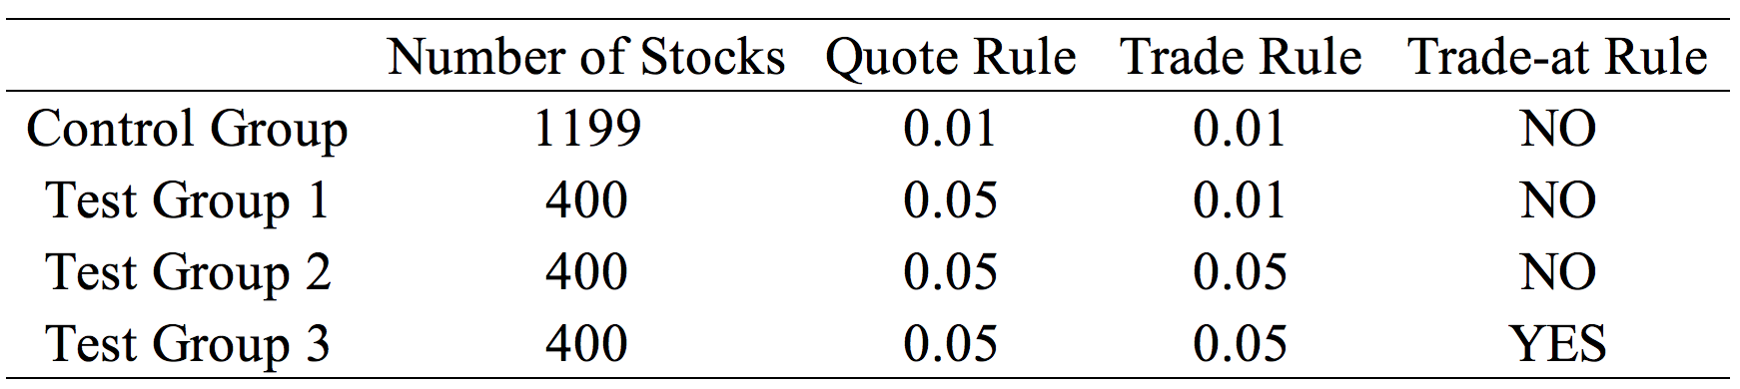
Four Groups
Compare three test groups with control group to evaluate the overall impact
Compare test group 3 and test groups 1&2 to evaluate the impact of dark trading

Slide 11
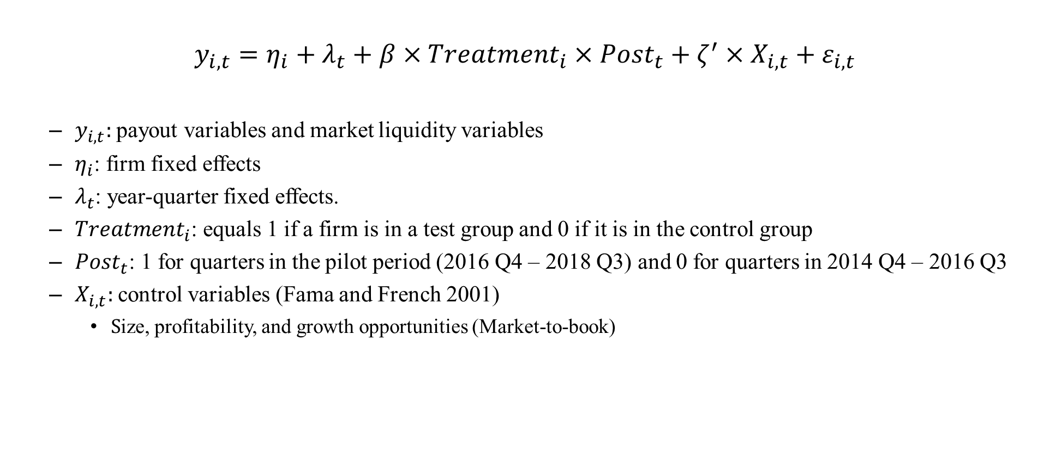
Methodology: Difference-in-Differences Tests
$$y_{i,t}=η_{i}+λ_{t}+β×{Treatment}_{i}×{Post}_{t}+ζ^{′}×X_{i,t}+ε_{i,t}$$
$y_{i,t}:$payout variables and market liquidity variables
$η_{i}$: firm fixed effects
$λ_{t}$: year-quarter fixed effects.
${Treatment}_{i}$: equals 1 if a firm is in a test group and 0 if it is in the control group
${Post}_{t}$: 1 for quarters in the pilot period (2016 Q4 – 2018 Q3) and 0 for quarters in 2014 Q4 – 2016 Q3
$X_{i,t}:$control variables (Fama and French 2001)
$S$ize, profitability, and growth opportunities (Market-to-book)

Slide 12
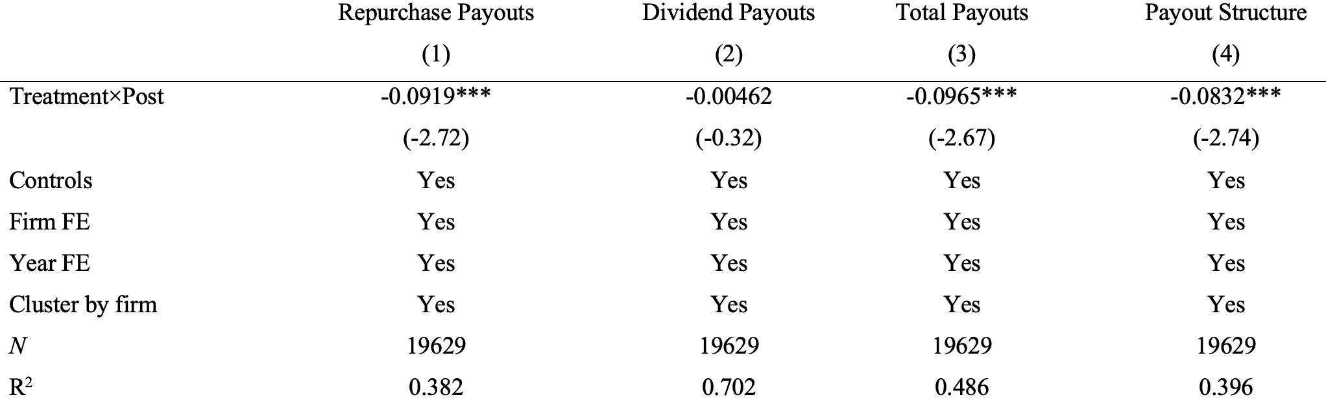
Firms Reduce Repurchase Payouts by 21%
The reduction in repurchase payouts is 0.09% over total assets per quarter
Average repurchase payout before the pilot was 0.43%
Notes:
reduce payout

Slide 13
No Significant Changes in Dividend Payouts
Notes:
reduce payout

Slide 14
Total Payouts and Structure of Payouts
Total payouts decrease by 14% (average repurchase payout before the pilot was 0.67%)
Payout structure (repurchase payouts +1)/(dividend payouts +1) decreases by 0.08
Notes:
reduce payout

Slide 15
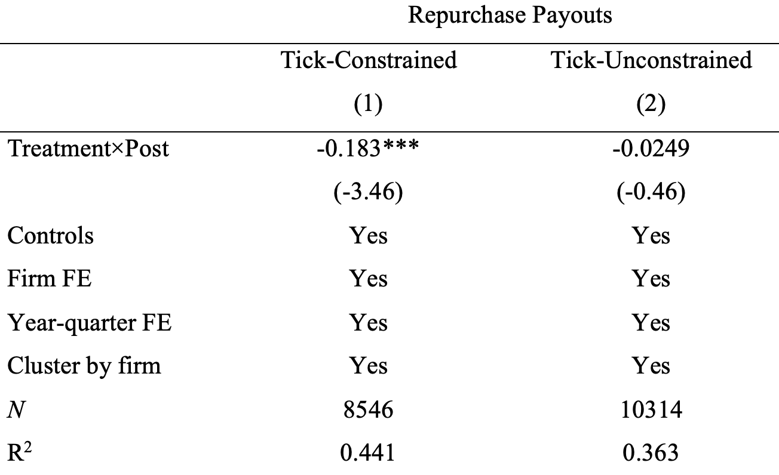
Tick-Constrained vs. Unconstrained Samples
Constrained firms in the treatment group reduce repurchase payouts by 0.18%
Average repurchase payout before the pilot was 0.41%
A decline of 45% compared with the pre-shock level

Slide 16
Puzzle
Why is the effect so large?
Firms can still finish repurchase by paying a few more cents per share if they can use market orders
The compliance channel: SEC Rule 10b-18
Purpose: prevents corporations from manipulating prices
Four safe-harbor conditions
Price: repurchase price should not exceed the highest bid or previous trade price
Encourage firms to provide liquidity when repurchasing shares
Volume: The issuer cannot purchase over 25 percent of the average daily volume in the preceding four weeks
Timing: The issuer cannot trade at the opening or during the last 30 minutes of trading
Manner: The issuer must purchase all shares from a single broker or deal during a single day

Slide 17






Price Conditions Under Modern Market Structure
Issuers repurchasing at a price exceeding the highest bid are subject to manipulation suspicion
HFT:
$5.03
Repurchase broker:
$5.02
Best Ask
$5.01
If I use a market order, it will be executed immediately.
$5.00
Best Bid
$4.99
Repurchase brokers are generally slower than HFTs
If a firm hires an HFT as its broker, the HFT becomes slower than other HFTs because it must comply with 10b-18
$4.98
$4.97

Slide 18

Increase in Tick Size: Queuing On Bid-Side
Tick Size Pilot Program
HFT:
$5.00
Repurchase brokers:
$4.99
Wait for execution
I will use a limit order
$4.98
$4.97
$4.96
$4.95
Queuing (lower and lower priority)

Slide 19
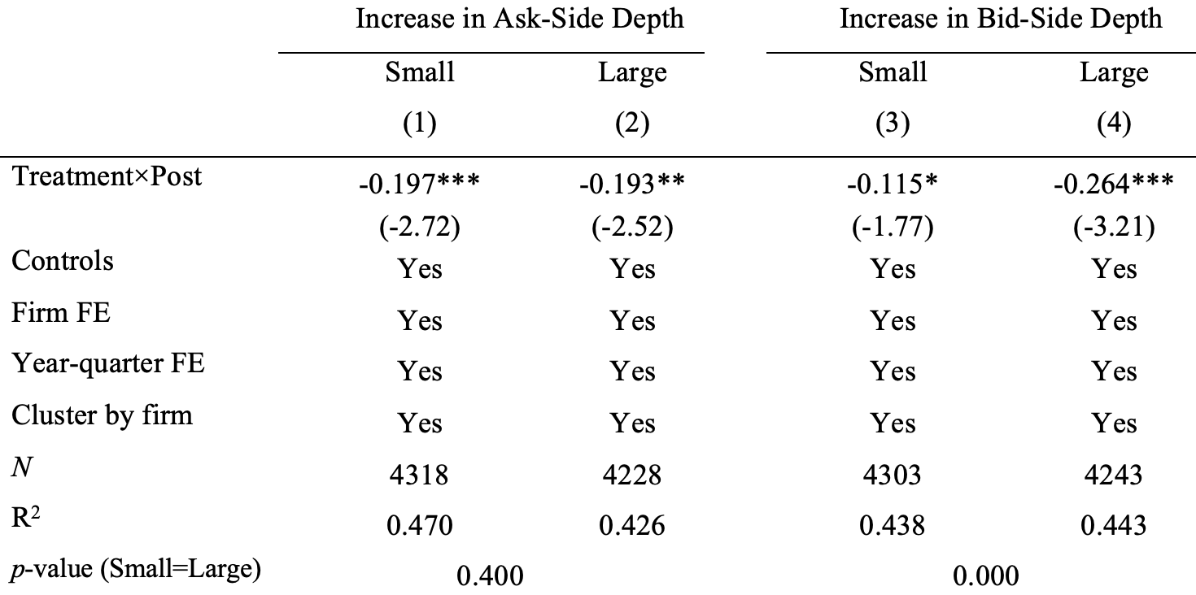
A Large Increase in Bid-Side Depth Reduces Repurchases
Cutoff: the median value

Slide 20
Summary
Greater depth is generally considered more liquid (Goldstein and Kavajecz 2000)
However, a market with large depth on the bid side may imply an illiquid market for issuers

Slide 21
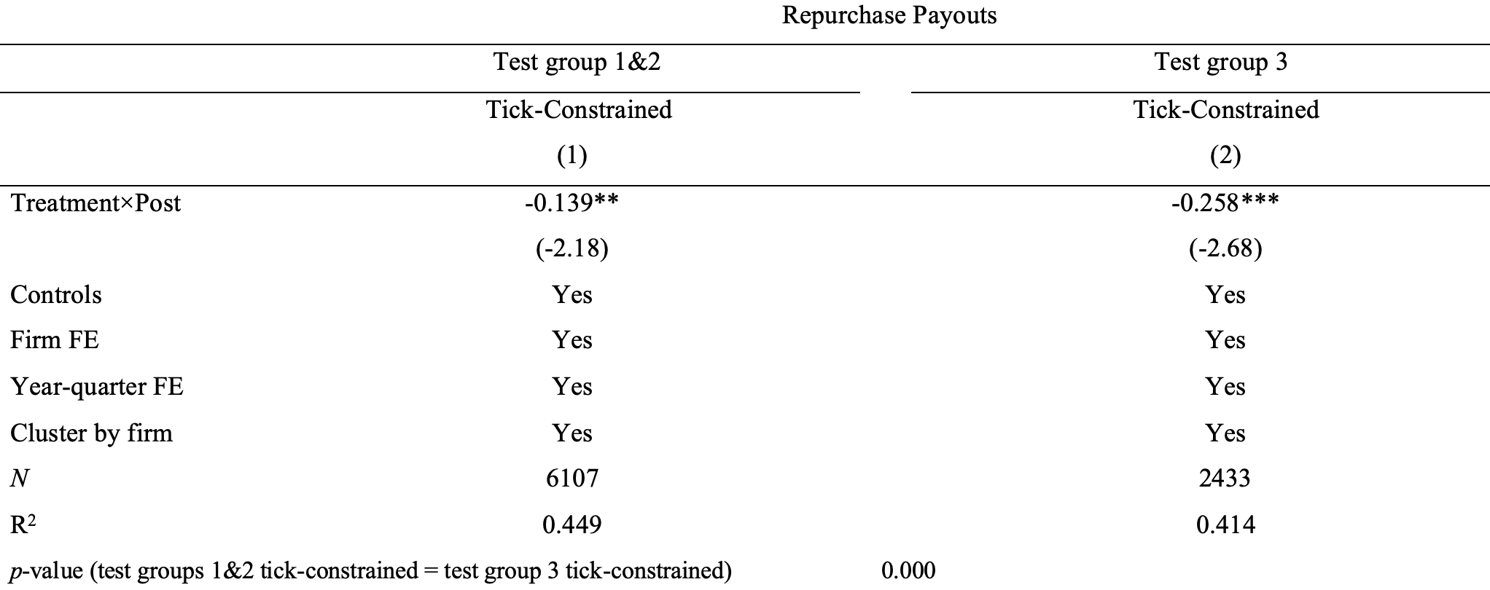
Dark Pool Matters for Share Repurchases
Tick-constrained firms in test group 3 reduce share repurchases by 55%
Tick-constrained firms in test groups 1 & 2 reduce repurchases by only 36%
Modest difference in change in liquidity (Rindi and Werner 2019)

Slide 22


Test Group 1&2 Issuers: Queue-Jumping Using Dark Pools
Tick Size Pilot Program
HFT:
$5.00
Repurchase brokers:
Send orders to dark pools to jump ahead of the long queue
$4.95
Queuing (lower and lower priority)

Slide 23
Test Group 3 Issuers: Conflict Between New and Old Rules
Tick Size Pilot Program
HFT:
Old rule 10b-18 price condition (purpose: prevent price manipulation): Repurchasing price should not be higher than the bid price in the stock exchange
$5.00
Repurchase brokers:
New trade-at rule for test group 3 (purpose: improve trading transparency): Orders in dark pools have to improve the price in the stock exchange by more than 2.5 cents
Face double constraints in both exchanges and dark pools: fail to execute
Not available for repurchasing orders
$4.95
Queuing (lower and lower priority)

Slide 24
Intuition
Non-price competition under price controls
Kornai (1980) and Shleifer and Vishny (1992a and 1992b)
Queuing: arrive at the market earlier to beat rivals
High-frequency trading is an application
Dark market or side payments
The dark pool is an application
Firms pay dark pool to find trading counterparties
Dark pool then can pay for order flow to the counterparties

Slide 25
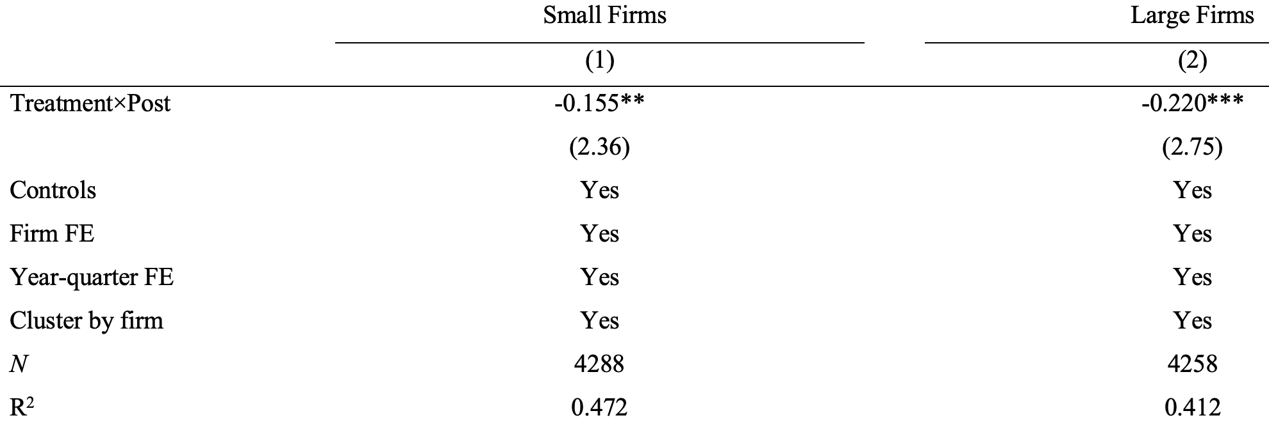
Similar Results Among Large and Small firms
Partition based on total assets
For small firms, tick-constrained firms reduce share repurchases by 46% (0.155%/0.335%)
For large firms, tick-constrained firms reduce share repurchases by 45% (0.220%/0.490%)

Slide 26
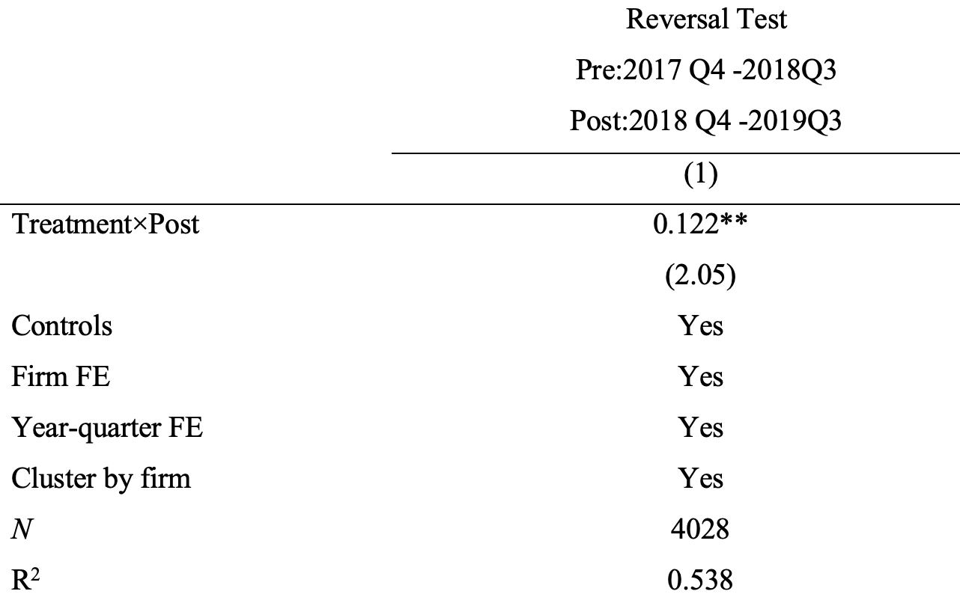
Reversal Test
Tick size pilot ends on Oct. 1, 2018
Tick-constrained firms increase their repurchases after pilot ends
45% increase (0.122/0.304)

Slide 27
Questions?

Slide 28
Roadmap
The controlled experiment: tick size pilot
Tick size: constrained firms in test groups reduce their repurchase payouts by 45%
Time priority: constrained firms with larger increase in bid-depth reduce repurchases more
Dark pool: constrained firms in test group 3 reduce repurchases by 55%
Event studies
1994 Manning Rule
Higher execution priority for NASDAQ issuers increases share repurchases by 69%
Two tick size reductions
Reduction in queue length at the same price increases share repurchases by 68% after 1997 and 32% after 2001
Installation of autoquotes for NYSE
The move from manual to automatic trading increases share repurchases by 24%

Slide 29
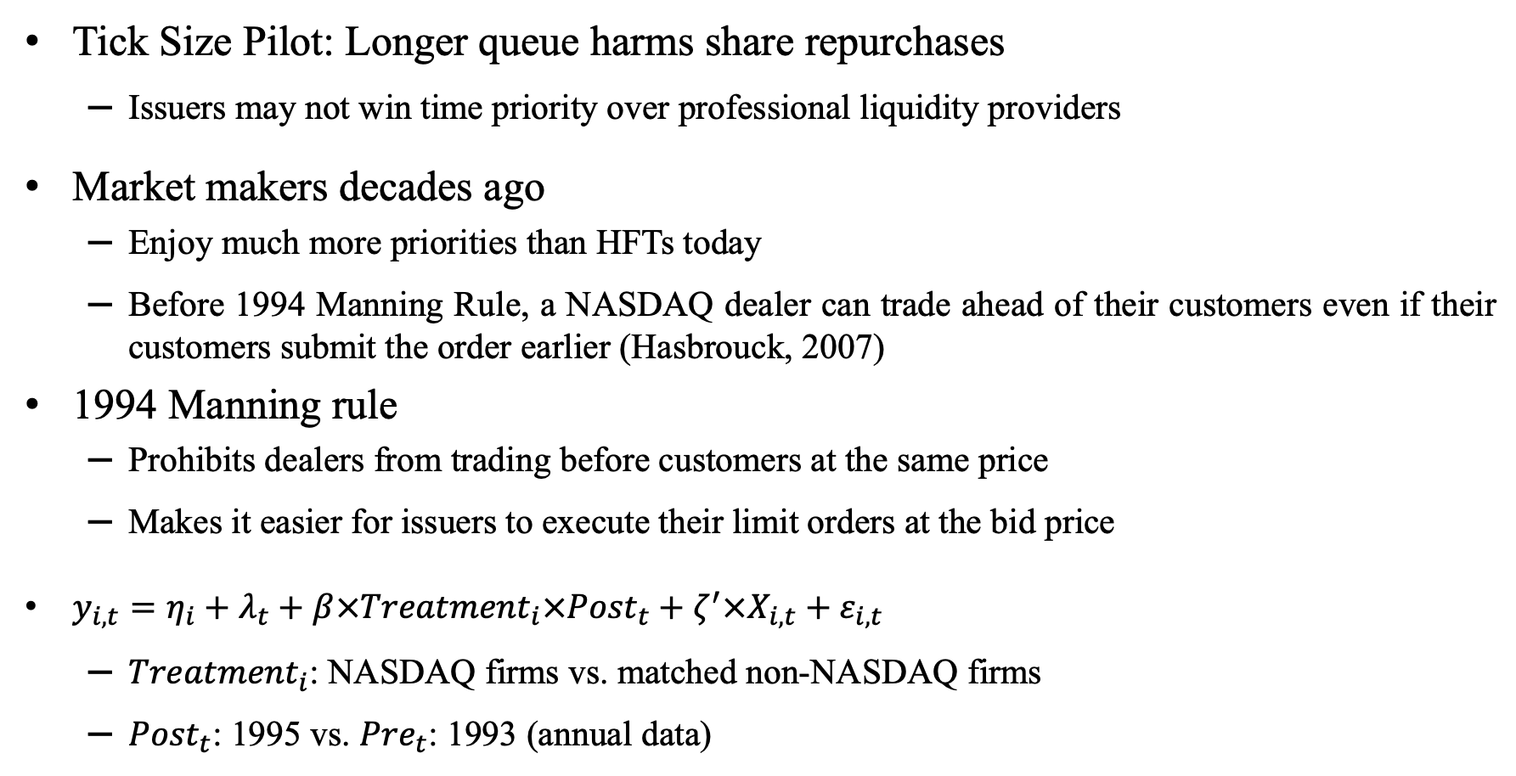
1994 NASDAQ Manning Rule
Tick Size Pilot: Longer queue harms share repurchases
Issuers may not win time priority over professional liquidity providers
Market makers decades ago
Enjoy much more priorities than HFTs today
Before 1994 Manning Rule, a NASDAQ dealer can trade ahead of their customers even if their customers submit the order earlier (Hasbrouck, 2007)
1994 Manning rule
Prohibits dealers from trading before customers at the same price
Makes it easier for issuers to execute their limit orders at the bid price
$y_{i,t}=η_{i}+λ_{t}+β×{Treatment}_{i}×{Post}_{t}+ζ^{′}×X_{i,t}+ε_{i,t}$
${Treatment}_{i}$: NASDAQ firms vs. matched non-NASDAQ firms
${Post}_{t}$: 1995 vs. ${Pre}_{t}$: 1993 (annual data)

Slide 30
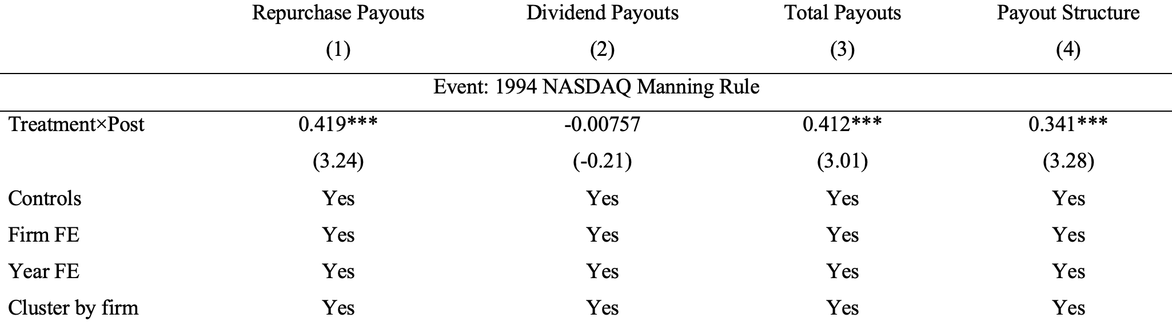
1994 NASDAQ Manning Rule
NASDAQ firms relative to other firms
Repurchase payouts increases by 69% (0.42%/0.61%)

Slide 31
Roadmap
The controlled experiment: tick size pilot
Tick size: constrained firms in test groups reduce their repurchase payouts by 45%
Time priority: constrained firms with larger increase in bid-depth reduce repurchases more
Dark pool: constrained firms in test group 3 reduce repurchases by 55%
Event studies
1994 Manning Rule
Higher execution priority for NASDAQ issuers increases share repurchases by 69%
Two tick size reductions
Reduction in queue length at the same price increases share repurchases by 68% after 1997 and 32% after 2001
Installation of autoquotes for NYSE
The move from manual to automatic trading increases share repurchases by 24%

Slide 32
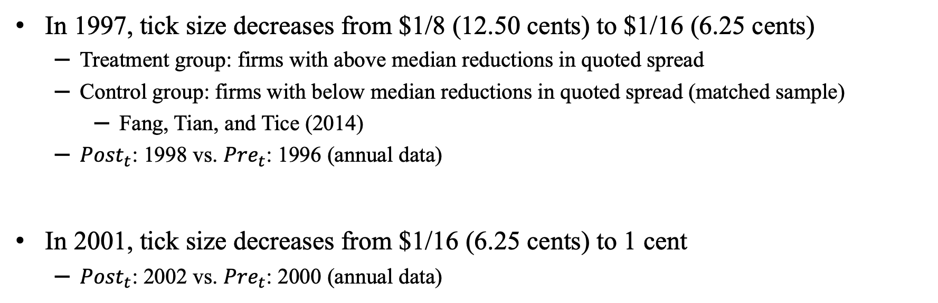
1997 Tick Size Reduction and 2001 Decimalization
In 1997, tick size decreases from $1/8 (12.50 cents) to $1/16 (6.25 cents)
Treatment group: firms with above median reductions in quoted spread
Control group: firms with below median reductions in quoted spread (matched sample)
Fang, Tian, and Tice (2014)
${Post}_{t}$: 1998 vs. ${Pre}_{t}$: 1996 (annual data)
In 2001, tick size decreases from $1/16 (6.25 cents) to 1 cent
${Post}_{t}$: 2002 vs. ${Pre}_{t}$: 2000 (annual data)

Slide 33
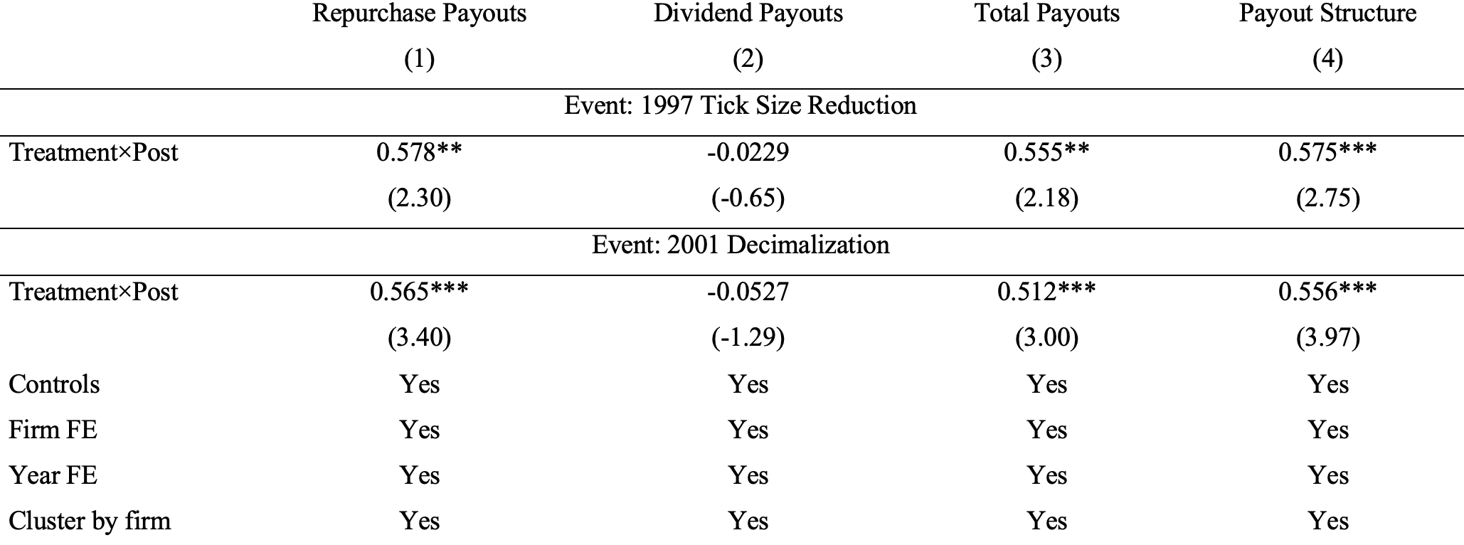
Tick Size Reduction Leads to More Share Repurchases
Treatment firms relative to control firms
1997 tick size reduction: repurchase payouts increases by 68% (0.58%/0.85%)
2001 decimalization: repurchase payouts increases by 32% (0.57%/1.75%)

Slide 34
Roadmap
The controlled experiment: tick size pilot
Tick size: constrained firms in test groups reduce their repurchase payouts by 45%
Time priority: constrained firms with larger increase in bid-depth reduce repurchases more
Dark pool: constrained firms in test group 3 reduce repurchases by 55%
Event studies
1994 Manning Rule
Higher execution priority for NASDAQ issuers increases share repurchases by 69%
Two tick size reductions
Reduction in queue length at the same price increases share repurchases by 68% after 1997 and 32% after 2001
Installation of autoquotes for NYSE
The move from manual to automatic trading increases share repurchases by 24%

Slide 35
Dividend Tax Cut & Reduced Frictions of Share Repurchase in 2003
Relative taxation advantage: 2003 dividend tax cut increases dividend payouts
Puzzle: repurchase payouts increases even more (Chetty and Saez, 2005; 2006)
A reduction in dividend tax should increase dividend relative to share repurchase
Understanding the microeconomic foundations of the cost of share repurchases is of great importance for future work (Chetty and Saez, 2010)
Our interpretation: computer algorithms reduce the cost of share repurchase
Before 2003, specialists in NYSE manually disseminate the quotes.
Manual execution of share repurchases (high touch)
Costly
Hard to comply with 10b-18
Auto quotes allow computer algorithms to execute share repurchases (low touch)
Real-time feedback on market information
Automatically submit orders

Slide 36
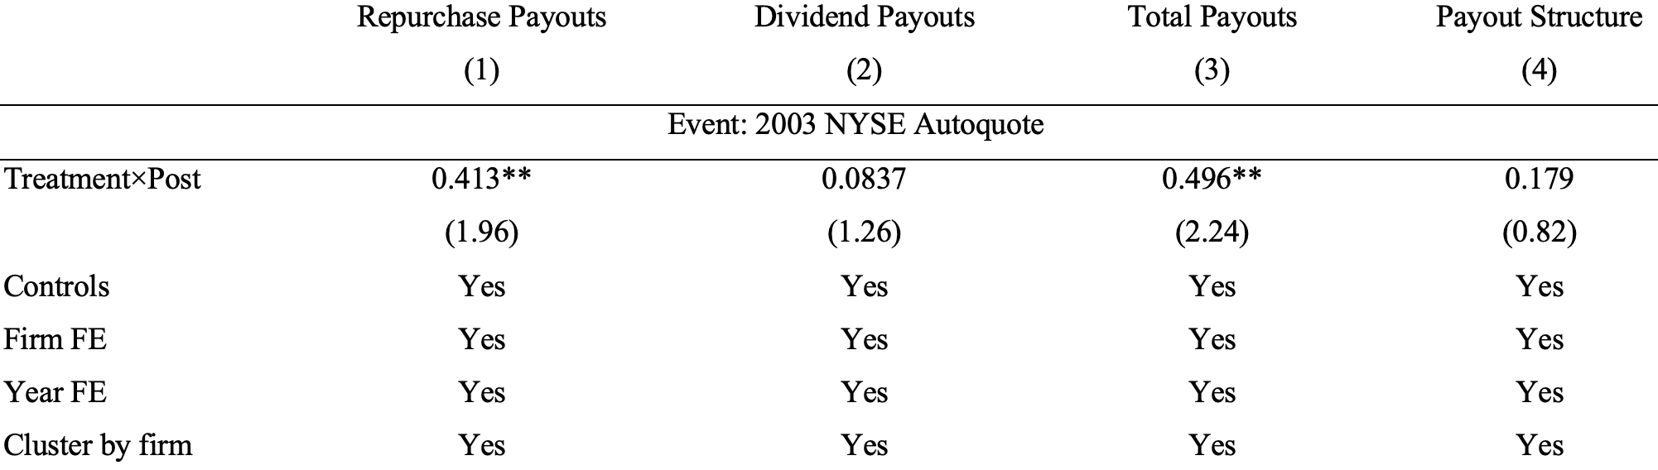

NYSE Autoquotes
${Treatment}_{i}$: NYSE firms vs. matched non-NYSE firms
${Post}_{t}$: 2004 vs. ${Pre}_{t}$: 2002 (annual data)
Repurchase payouts of NYSE firms increase by 24% (0.41%/1.72%)

Slide 37
Conclusion
Stock market structure has first-order effects on share repurchases
The cost to comply with SEC 10b-18 is prohibitively high in a pure dealer market
Market microstructure reforms since the 1990s reduce the privilege of professional market makers
This trend of disintermediation reduces the frictions for issuers to buy back shares
The cost of repurchases provides a unified explanation for two puzzles
The reduction in these costs over time can explain why share repurchases increase more than dividends
However, the liquidity and compliance costs always exist
Provide an explanation on why share repurchases cannot completely drive out dividends

Slide 38
Two New Dimensions for Research on Liquidity
Liquidity for whom
Regulations change the definition of liquidity for distinct groups of traders
A market with greater depth is generally considered a liquid market, but may be illiquid for repurchasing firms who face regulatory constraints
Liquidity where
Distribution of liquidity across distinct types of platforms is important
Dark-pool liquidity matters for share repurchases
Dark pools match orders based on the price set by the exchanges
Their passive price determination dovetails nicely with the philosophy of SEC 10b-18
SEC (2010) even discussed the possibility to exempt dark pools from 10b-18 when dark pools match orders at the midpoint of bid and ask.

Slide 39
Policy Implications
Market microstructure
Conflicts between the old and new rules
Rule 10b-18: repurchase price cannot exceed highest bid or previous trade prices
Trade-at rule: prices in dark pool should be higher than the highest bid
Regulators should examine whether proposed new regulations contradict with existing regulations
More regulation vs. deregulation
High-frequency trading and dark pools can be a response to existing regulations
Share repurchases
Heated debate on the secular increase of share buybacks and plans to ban share buybacks
Limited economic analysis on why share repurchases increase over time
Our paper provides one explanation

Slide 40
Thank you!

Slide 41
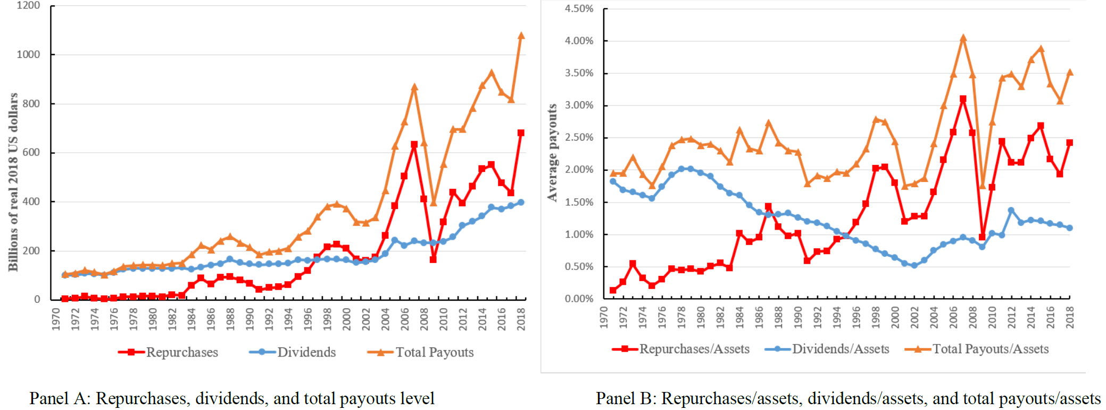
Secular Increase of Share Repurchases Relative to Dividends
Click here to go back

