Slide 1

Chapter 1
Equations and
Inequalities
1.2 Linear Equations and
Rational Equations
Copyright © 2014, 2010, 2007 Pearson Education, Inc.

Slide 2
Objectives:
Solve linear equations in one variable.
Solve linear equations containing fractions.
Solve rational equations with variables in the denominators.
Recognize identities, conditional equations, and inconsistent equations.
Solve applied problems using mathematical models.

Slide 3


Definition of a Linear Equation
A linear equation in one variable x is an equation that can be written in the form
where a and b are real numbers, and

Slide 4
Generating Equivalent Equations
An equation can be transformed into an equivalent equation by one or more of the following operations:
1. Simplify an expression by removing grouping symbols and combining like terms.
2. Add (or subtract) the same real number or variable expression on both sides of the equation.
3. Multiply (or divide) by the same nonzero quantity on both sides of the equation.
4. Interchange the two sides of the equation.

Slide 5
Solving a Linear Equation
1. Simplify the algebraic expression on each side by removing grouping symbols and combining like terms.
2. Collect all the variable terms on one side and all the numbers, or constant terms, on the other side.
3. Isolate the variable and solve.
4. Check the proposed solution in the original equation.

Slide 6




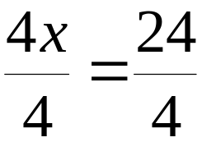



Example: Solving a Linear Equation
Solve and check the linear equation:
Check:

Slide 7
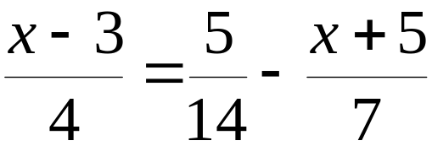
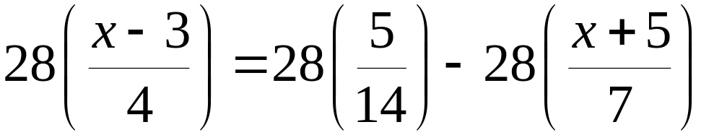






Example: Solving a Linear Equation Involving Fractions
Solve and check:
The LCD is 28, we will multiply both sides of the
equation by 28.

Slide 8
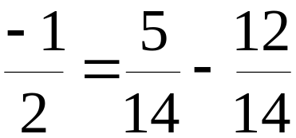
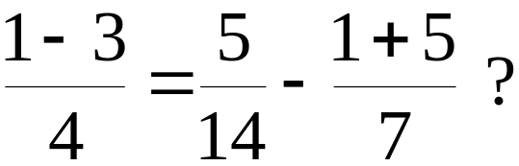
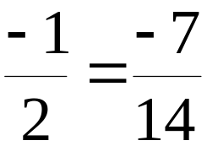
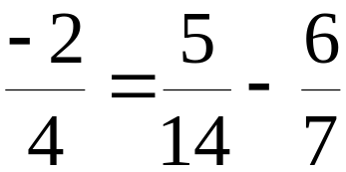
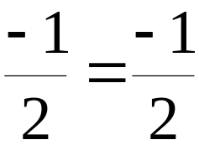
Example: Solving a Linear Equation Involving Fractions (continued)
Check:

Slide 9
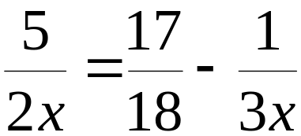
Solving Rational Equations
When we solved the equation
we were solving a linear equation with constants in the denominators. A rational equation includes at least one variable in the denominator. For our next example, we will solve the rational equation

Slide 10
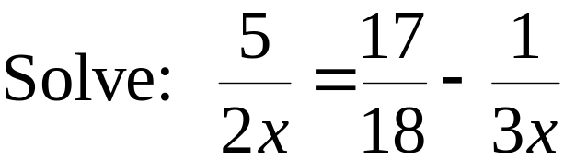



Example: Solving a Rational Equation
We check for restrictions on the variable
by setting each denominator equal to zero.

Slide 11
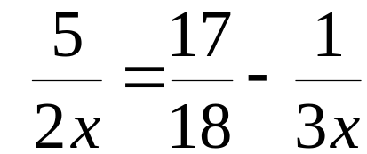
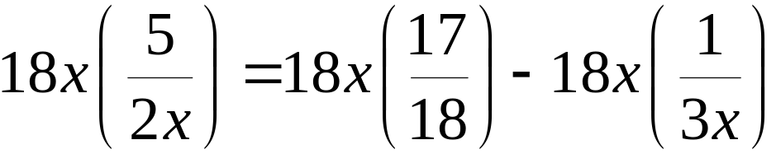




Example: Solving a Rational Equation
(continued)
The LCD is 18x, we will multiply both sides of the
equation by 18x.

Slide 12
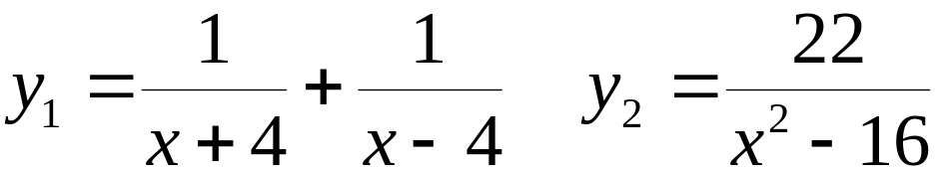
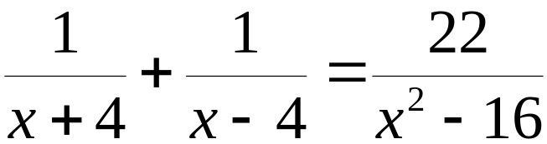



Example: Solving a Rational Equation to Determine When Two Equations are Equal
Find all values of x for which y₁ = y₂
We begin by finding the restricted values.
The restricted values are x = – 4 and x = 4

Slide 13
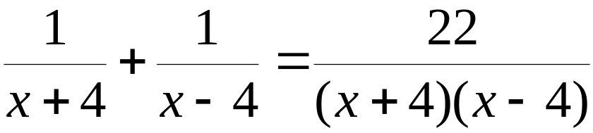
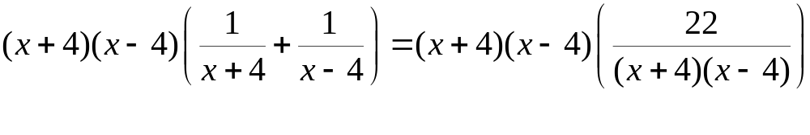

Example: Solving a Rational Equation to Determine When Two Equations are Equal (continued)
We multiply both sides of the equation by the LCD

Slide 14


Example: Solving a Rational Equation to Determine When Two Equations are Equal (continued)
11 is not a restricted value. Therefore, x = 11.

Slide 15
Types of Equations: Identity, Conditional, Inconsistent
An equation that is true for at least one real number is called a conditional equation. The examples that we have worked so far have been conditional equations.
An equation that is true for all real numbers is called an identity.
An equation that is not true for any real number is called an inconsistent equation.

Slide 16




Example: Categorizing an Equation
This is a false statement. This equation is
an example of an inconsistent equation.
There is no solution.

Slide 17




Example: Categorizing an Equation
This is a true statement. The solution set
for this equation is the set of all real numbers.
This equation is an identity.

Slide 18
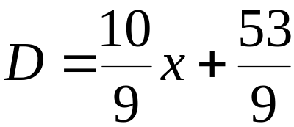
Example: Solving Applied Problems Using Mathematical Models
Persons with a low sense of humor have higher levels of
depression in response to negative life events than those
with a high sense of humor. This can be modeled by the
formula In this formula, x represents
the intensity of a negative life event and D is the average level of depression in response to that event. If the low humor group averages a level of depression of 10 in response to a negative life event, what is the intensity of that event?

Slide 19

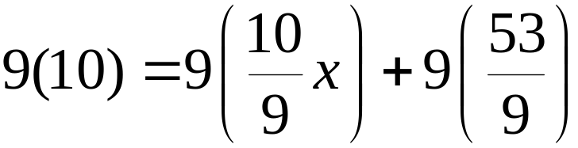



Example: Solving Applied Problems Using Mathematical Models (continued)
The intensity of the event is 3.7

