Slide 1

Chapter 1
Equations and
Inequalities
1.4 Complex Numbers
Copyright © 2014, 2010, 2007 Pearson Education, Inc.

Slide 2
Objectives:
Add and subtract complex numbers.
Multiply complex numbers.
Divide complex numbers.
Perform operations with square roots of negative
numbers.

Slide 3

Complex Numbers and Imaginary Numbers
The imaginary unit i is defined as
The set of all numbers in the form
a + bi
with real numbers a and b, and i, the imaginary unit,
is called the set of complex numbers.
The standard form of a complex number is
a + bi.

Slide 4
Operations on Complex Numbers
The form of a complex number a + bi is like the binomial
a + bx. To add, subtract, and multiply complex numbers,
we use the same methods that we use for binomials.

Slide 5







Example: Adding and Subtracting Complex Numbers
Perform the indicated operations, writing the result
in standard form:

Slide 6










Example: Multiplying Complex Numbers
Find the product:

Slide 7




Conjugate of a Complex Number
For the complex number a + bi, we define its complex
conjugate to be a – bi.
The product of a complex number and its conjugate
is a real number.

Slide 8
Complex Number Division
The goal of complex number division is to obtain a real
number in the denominator. We multiply the numerator
and denominator of a complex number quotient by the
conjugate of the denominator to obtain this real number.

Slide 9
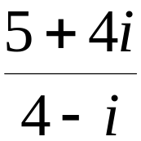
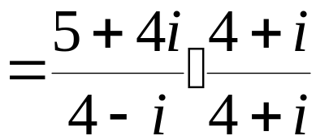
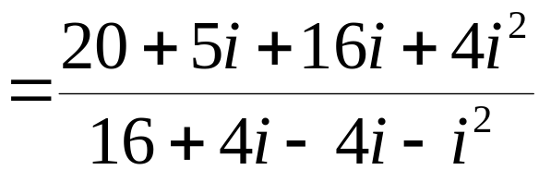
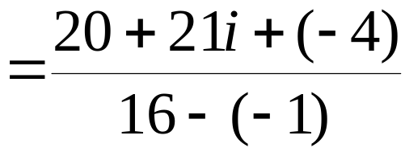
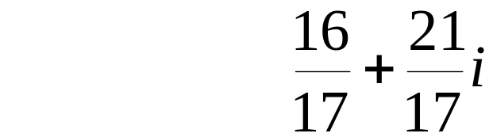
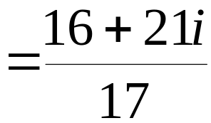
Example: Using Complex Conjugates to Divide Complex Numbers
Divide and express the result in standard form:
In standard form, the result is

Slide 10

Principal Square Root of a Negative Number
For any positive real number b, the principal square root of
the negative number – b is defined by

Slide 11

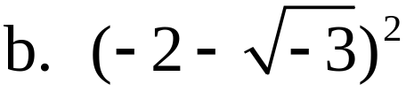
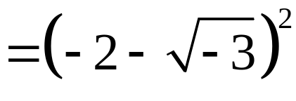

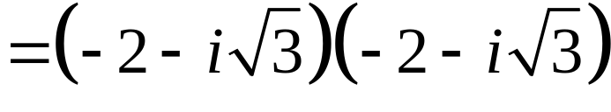


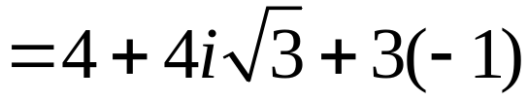

Example: Operations Involving Square Roots of Negative Numbers
Perform the indicated operations and write the result in
standard form:

