Slide 1

Chapter 1
Equations and
Inequalities
1.5 Quadratic Equations
Copyright © 2014, 2010, 2007 Pearson Education, Inc.

Slide 2
Objectives:
Solve quadratic equations by factoring.
Solve quadratic equations by the square root property.
Solve quadratic equations by completing the square.
Solve quadratic equations using the quadratic formula.
Use the discriminant to determine the number and type of solutions.
Determine the most efficient method to use when solving a quadratic equation.
Solve problems modeled by quadratic equations.

Slide 3


Definition of a Quadratic Equation
A quadratic equation in x is an equation that can be written
in the general form
where a, b, and c are real numbers, with
A quadratic equation in x is also called a second-degree
polynomial equation in x.

Slide 4
The Zero-Product Principle
To solve a quadratic equation by factoring, we apply the zero-product principle which states that:
If the product of two algebraic expressions is zero, then at least one of the factors is equal to zero.
If AB = 0, then A = 0 or B = 0.

Slide 5
Solving a Quadratic Equation by Factoring
1. If necessary, rewrite the equation in the general form
, moving all nonzero terms to one side, thereby obtaining zero on the other side.
2. Factor completely.
3. Apply the zero-product principle, setting each factor containing a variable equal to zero.
4. Solve the equations in step 3.
5. Check the solutions in the original equation.

Slide 6



Example: Solving Quadratic Equations by Factoring
Solve by factoring:
Step 1 Move all nonzero terms to one side and obtain zero on the other side.
Step 2 Factor

Slide 7




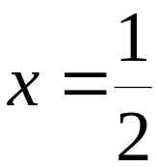
Example: Solving Quadratic Equations by Factoring
(continued)
Steps 3 and 4 Set each factor equal to zero and solve the resulting equations.

Slide 8

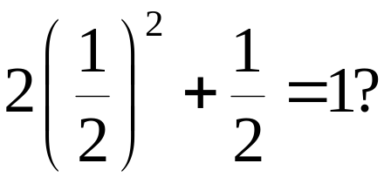

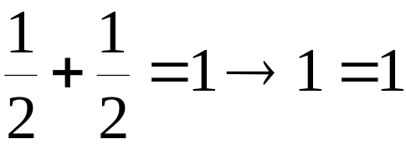
Example: Solving Quadratic Equations by Factoring
(continued)
Step 5 Check the solutions in the original equation.
Check

Slide 9



Solving Quadratic Equations by the Square Root Property
Quadratic equations of the form u² = d, where u is an algebraic expression and d is a nonzero real number, can be solved by the Square Root Property:
If u is an algebraic expression and d is a nonzero real number, then u² = d has exactly two solutions:
or
Equivalently,
If u² = d, then

Slide 10





Example: Solving Quadratic Equations by the Square Root Property
Solve by the square root property:

Slide 11
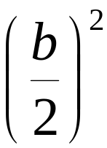
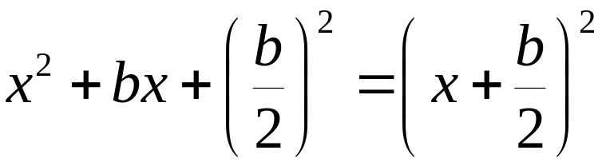
Completing the Square
If x² + bx is a binomial, then by adding , which is
the square of half the coefficient of x, a perfect square trinomial will result. That is,

Slide 12


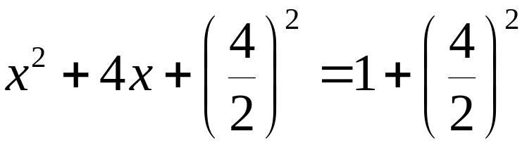



Example: Solving a Quadratic Equation by Completing the Square
Solve by completing the square:

Slide 13
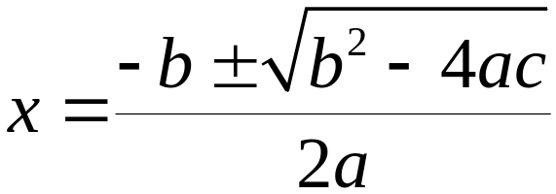
The Quadratic Formula
The solutions of a quadratic equation in general form
with , are given by the quadratic formula:

Slide 14

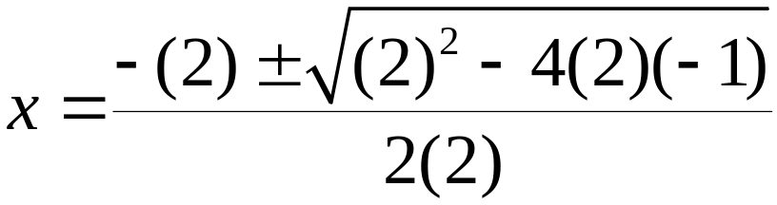
Example: Solving a Quadratic Equation Using the Quadratic Formula
Solve using the quadratic formula:
a = 2, b = 2, c = – 1

Slide 15
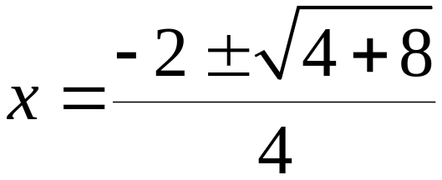
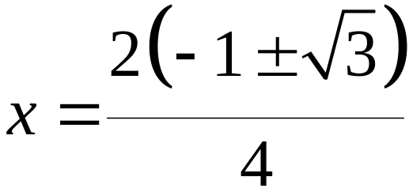
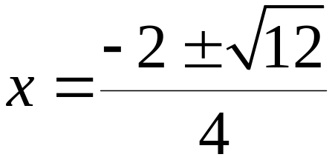
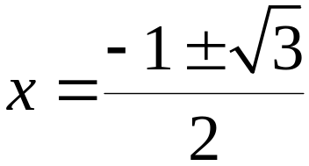
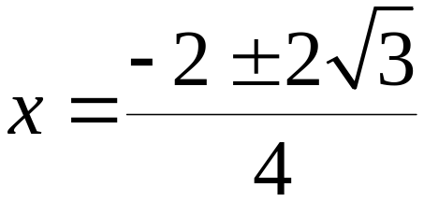
Example: Solving a Quadratic Equation Using the Quadratic Formula (continued)

Slide 16

The Discriminant
We can find the solution for a quadratic equation of the form using the quadratic formula:
The discriminant is the quantity
which appears under the radical sign in the quadratic formula. The discriminant of the quadratic equation determines the number and type of solutions.

Slide 17
The Discriminant and the Kinds of Solutions to
If the discriminant is positive, there will be two unequal real solutions.
If the discriminant is zero, there is one real (repeated) solution.
If the discriminant is negative, there are two imaginary solutions.

Slide 18

Example: Using the Discriminant
Compute the discriminant, then determine the number and type of solutions:
The discriminant, 81, is a positive number. There are two real solutions.

Slide 19

Example: Application
The formula
models a woman’s normal systolic blood pressure, P, at age A. Use this formula to find the age, to the nearest year, of a woman whose normal systolic blood pressure is 115 mm Hg.
Solution: We will solve the equation

Slide 20

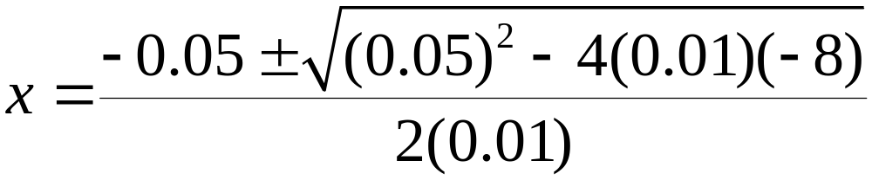
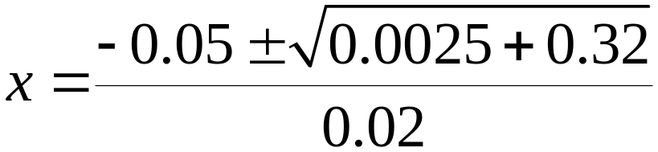
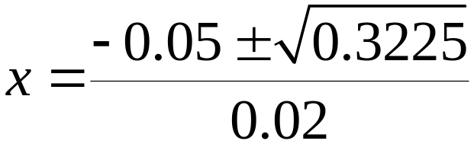
Example: Application (continued)

Slide 21

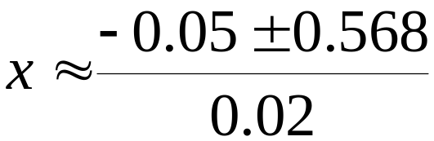
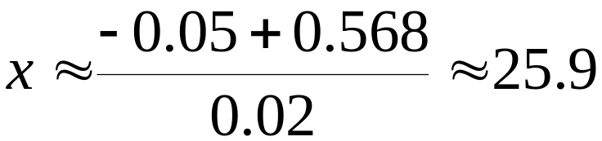
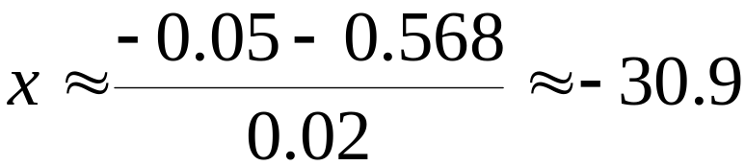
Example: Application (continued)
The positive solution,
indicates that 26 is the
approximate age of a woman
whose normal systolic blood
pressure is 115 mm Hg.

